Slide 1
HEBT requirements to reach intermediate objective
F. Hagenbuck
4th joint BINP-FAIR Collaboration Coordination Workshop

Slide 2
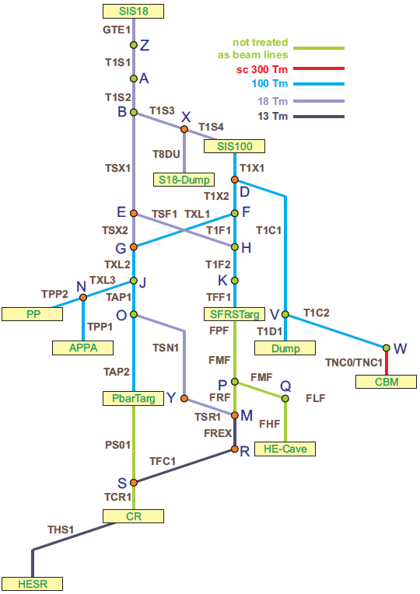
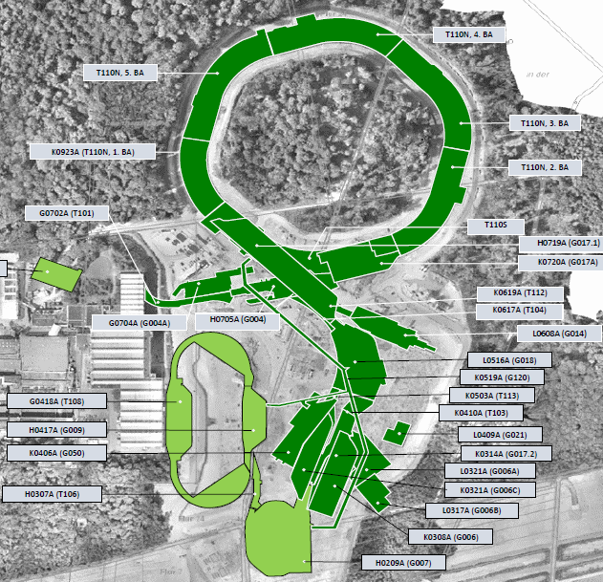
Intermediate Objective for HEBT
SIS100
SIS18
CBM
Super-FRS
HESR
APPA
CR

Slide 3
Machine installation windows (PdR/LCM 2019)
start installation 06/2021
opening G17.1
SIS100
SIS18
opening G004A
CBM
Super-FRS
start installation 05/2022 (LCM, 20.05/01.07 2019)
APPA
HESR
opening G050
p-bar
start installation 09/2022 (LCM 30.07.2019)
CR
opening G007

Slide 4
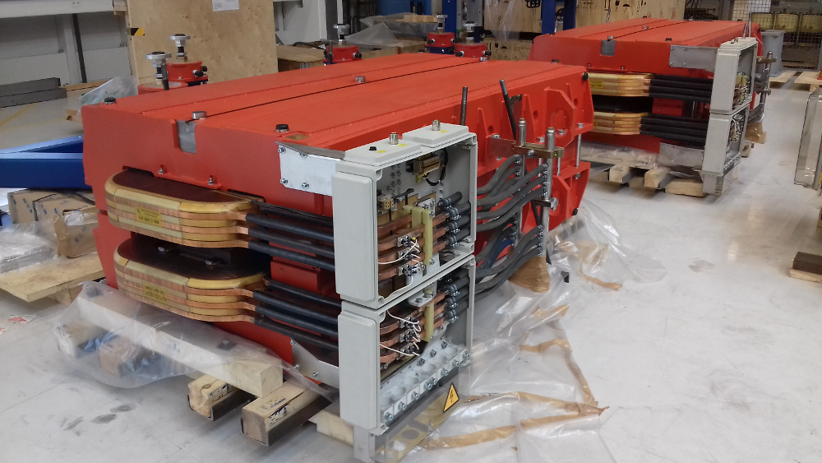
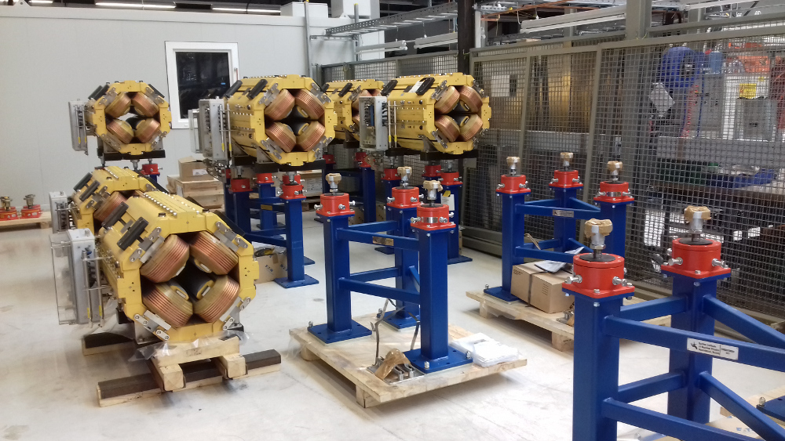
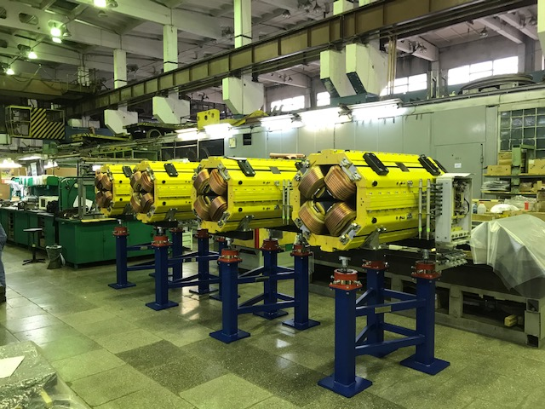
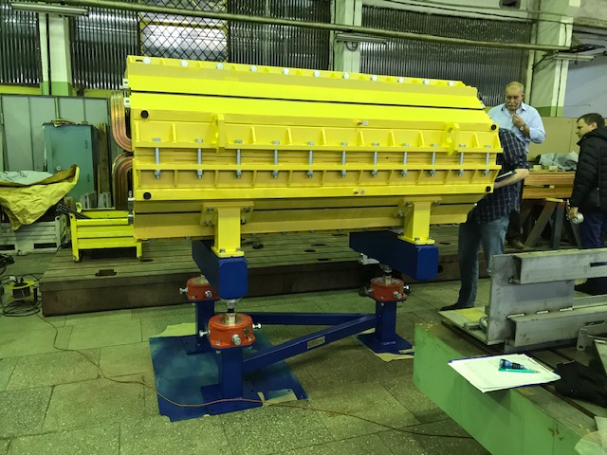
BINP–FAIR Collaboration Status@HEBT
Magnets Batch2&3 (incl. FBL&HED)
in total 303 magnets
Design phase almost completed (80%)
Series production running
42 magnets delivered to FAIR/GSI (+34 pending, delivery after closing open FAT points )
dip15_0 at GSI
quad2 at GSI
quad11 at BINP
quad10 at BINP
ü
Vacuum chambers Batch1 completed
Vacuum chambers Batch2&3
Vacuum chambers for magnets of Batch2&3 – in total 272 pieces
Design phase ongoing (approved 3D models ~40%, approved 2D drawings ~10%)
3 chambers manufactured (type known from Batch1), FAT pending
Vacuum chambers Batch4
Pumping chambers, straight tubes, bellows etc. – in total ~1440 pieces
Design phase started
Specification drawings only for one beamline section (T1S1) provided by GSI up to now

Slide 5
HEBT requirements to reach Intermediate Objective – HEBTA
Magnets & Vacuum Chambers Batch2&3
32 magnets (4 dipoles, 22 quadrupoles, 6 steerer) delivered for SIS18 – SFRS
6 magnets (6 steerer) delivered for SIS100 – CBM
SIS18 - SFRS
SIS18 – SIS100 SIS100 – CBM

Slide 6
HEBT requirements to reach Intermediate Objective – HEBTA
Pre-Assembly Magnets & Vacuum Chambers Batch2&3
80 drawings for pre-assembly have to be prepared
129 assemblies have to be pre-assembled
Start installation 06/2021
all magnets and related vacuum chambers should be at FAIR/GSI in 01/2021 for SAT and pre-assembly
all drawings for pre-assembly have to be prepared in time before pre-assembly
support needed for pre-assembly at FAIR/GSI
all vacuum chambers Batch4 should be at FAIR/GSI in 01/2021 for SAT and pre-assembly
support needed for transport and installation in the tunnel

Slide 7
HEBT requirements to reach Intermediate Objective – HEBTB/C
Magnets & Vacuum Chambers Batch2&3
4 magnets (6 steerer) delivered for SIS18/SIS100 – APPA
SIS100 – SFRS SIS18/SIS100 – APPA
SIS100 – pbar to CR (FBL)

Slide 8
HEBT requirements to reach Intermediate Objective – HEBTB/C
Pre-Assembly Magnets & Vacuum Chambers Batch2&3
56 drawings for pre-assembly have to be prepared
102 assemblies have to be pre-assembled
Start installation 05/2022
all magnets and related vacuum chambers should be at FAIR/GSI in 12/2021 for SAT and pre-assembly
all drawings for pre-assembly have to be prepared in time before pre-assembly
support needed for pre-assembly at FAIR/GSI
all vacuum chambers Batch4 should be at GSI in 12/2021 for SAT and pre-assembly
support needed for transport and installation in the tunnel

Slide 9
HEBT requirements to complete HEBTC
Magnets & Vacuum Chambers Batch2&3
SFRS – CR CR – HESR
Pre-Assembly Magnets & Vacuum Chambers Batch2&3
8 drawings for pre-assembly have to be prepared
34 assemblies have to be pre-assembled

Slide 10
HEBT requirements to complete HEBTC
Start installation 09/2022
all magnets and related vacuum chambers should be at FAIR/GSI in 05/2022 for SAT and pre-assembly
all drawings for pre-assembly have to be prepared in time before pre-assembly
support needed for pre-assembly at FAIR/GSI
all vacuum chambers Batch4 should be at FAIR/GSI in 05/2022 for SAT and pre-assembly
support needed for transport and installation in the tunnel
Further needed – no contract yet
2 CR „like“ dipoles (discussion on Wednesday, Session 7)
4 CR wide type Quadrupoles
Related vacuum chambers
400mm Beam Diagnostics (discussion on Friday, Session 13)

Slide 11
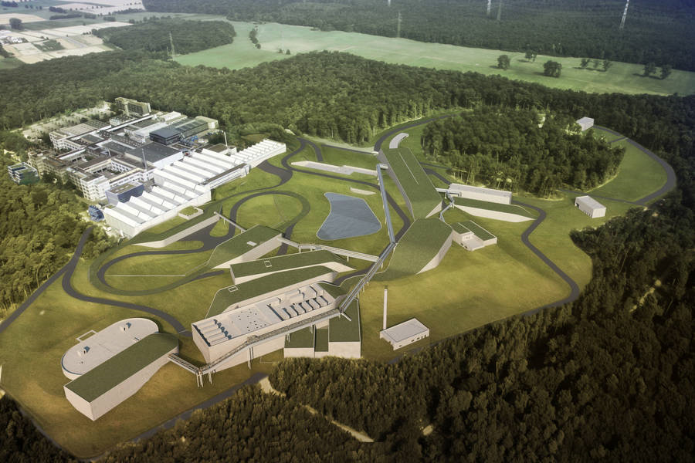
Thank you for your attention!

