Slide 1
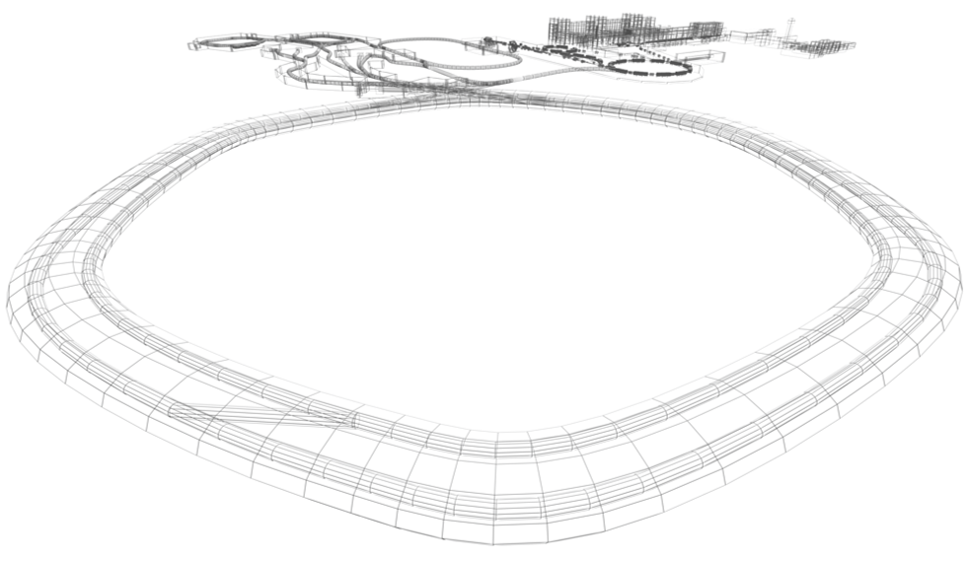
Status of BINP collaboration with FAIR
Eugene Levichev
Budker INP, Novosibirsk
4th FAIR-BINP Meeting 25-29 May, 2020, Novosibirsk

Slide 2
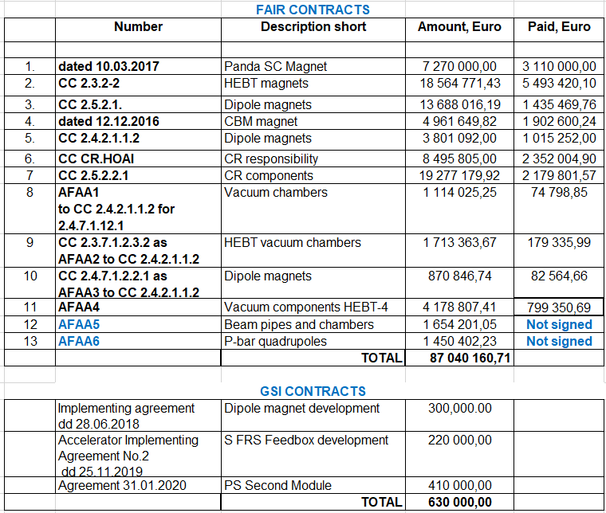

Slide 3
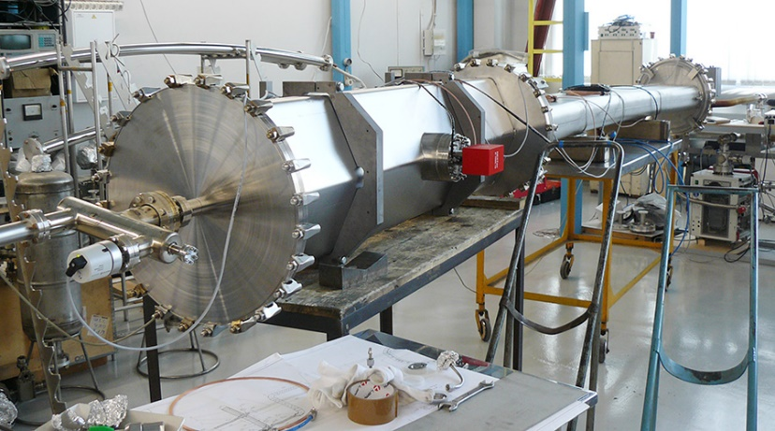
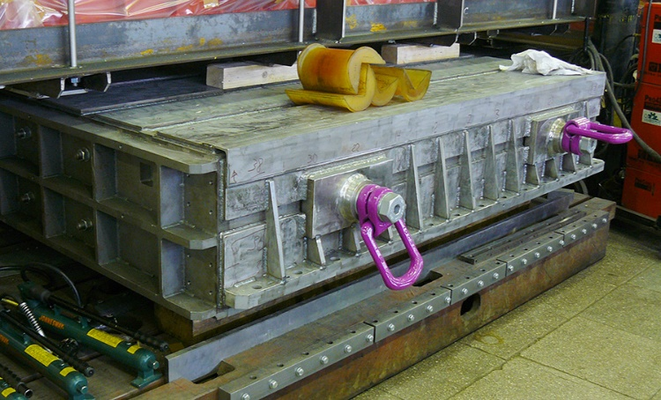
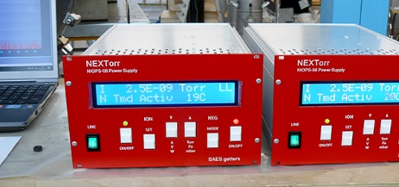
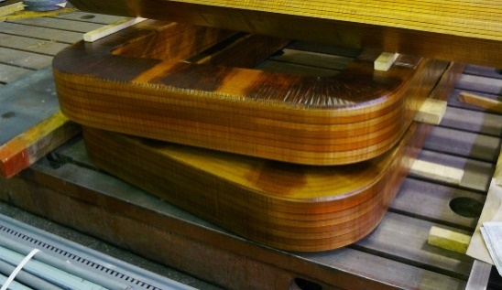
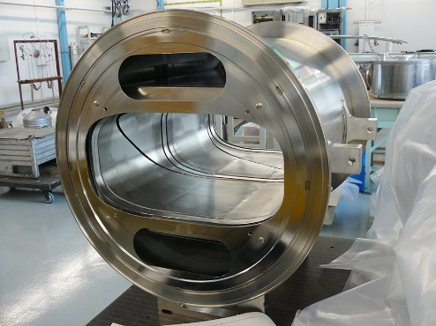
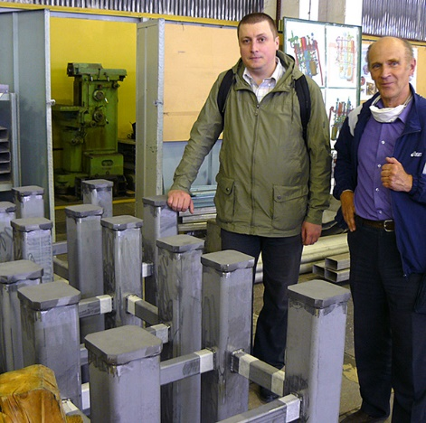
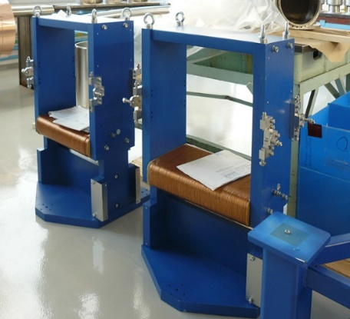
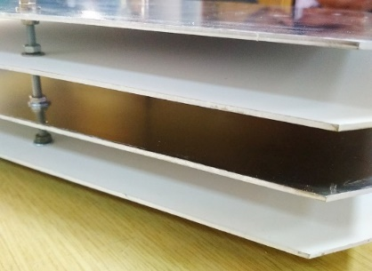
Contracts | Matter | Value | Absorbed | Signed
CC CR.HOAI | Technical coordination | 8,495,805.00 | 2,352,004.90 | 19.08.2014
CC 2.5.2.2.1 | CR WPs: magnets; PCs; vacuum; kickers; septa; diagnostics, TCR1 beamline | 19,277,179.92 | 2,179,799.29 | 26.06.2018
CC 2.5.2.1 | CR dipoles | 13,688,016.19 | n/d | 12.10.2015
Collector Ring
Assembly of dipole and quad chambers
prototypes test:
vacuum achieved!
FoS dipole production: yoke parts and coils
Scrapers supports
Scintillating screen plates
FoS wide steering magnets
Wide pickup prototype

Slide 4
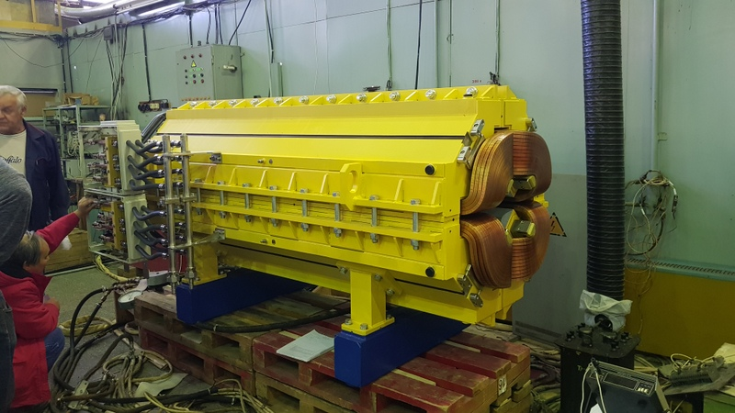
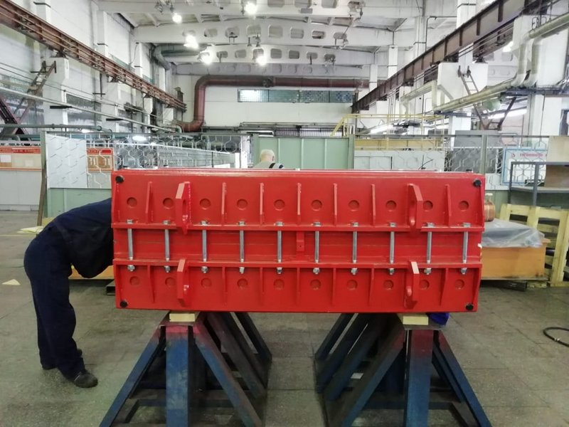
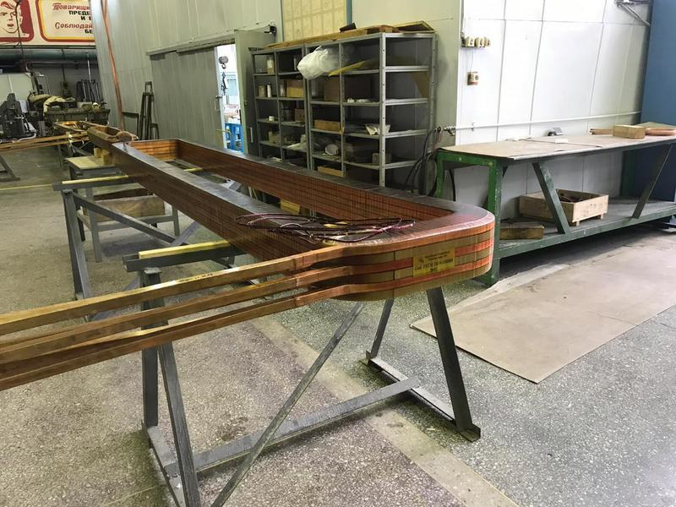
HEBT magnets batch 2-4 (CC2.3.2-2)
Dipole 4_0 | 2
Dipole 10_0 | 6
Dipole 13_0 | 2
Dipole 13_3 | 3
Dipole 19_0 | 4
Dipole 15_0 | 4
Dipole 15_1 | 1
Dipole 16_0 | 1
Dipole 17_0 | 1
Quadrupole 2 | 90
Quadrupole 2 long | 4
Quadrupole 10 | 4
Quadrupole 11 | 70
Quadrupole 12 | 12
Steering 13 | 5
Steering 18 | 48
Steering 100 | 45
Total magnets | 303
Total ≈ 18 000 000 euro
Final delivery until October 2021
Delivered 49 magnets
Ready for delivery 27 magnets
Ready for FAT 23 magnets

Slide 5
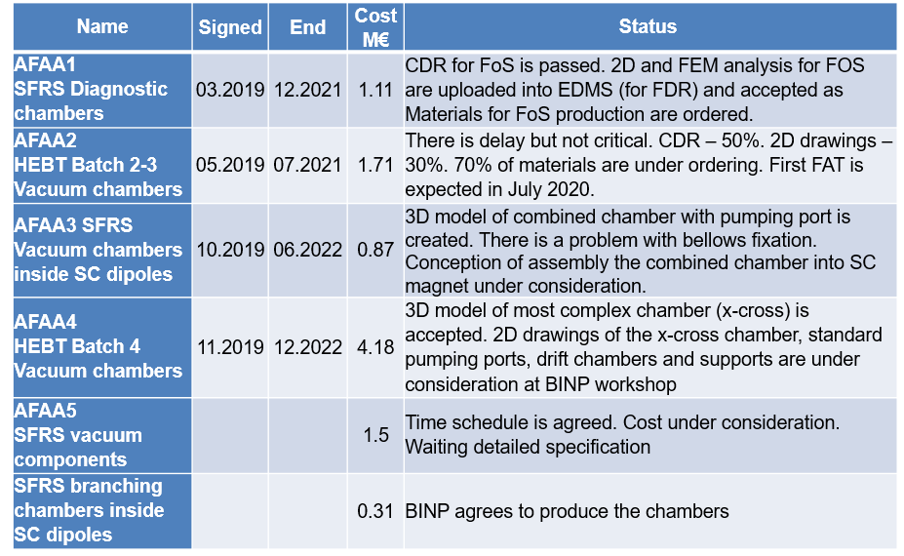
Vacuum component contracts

Slide 6
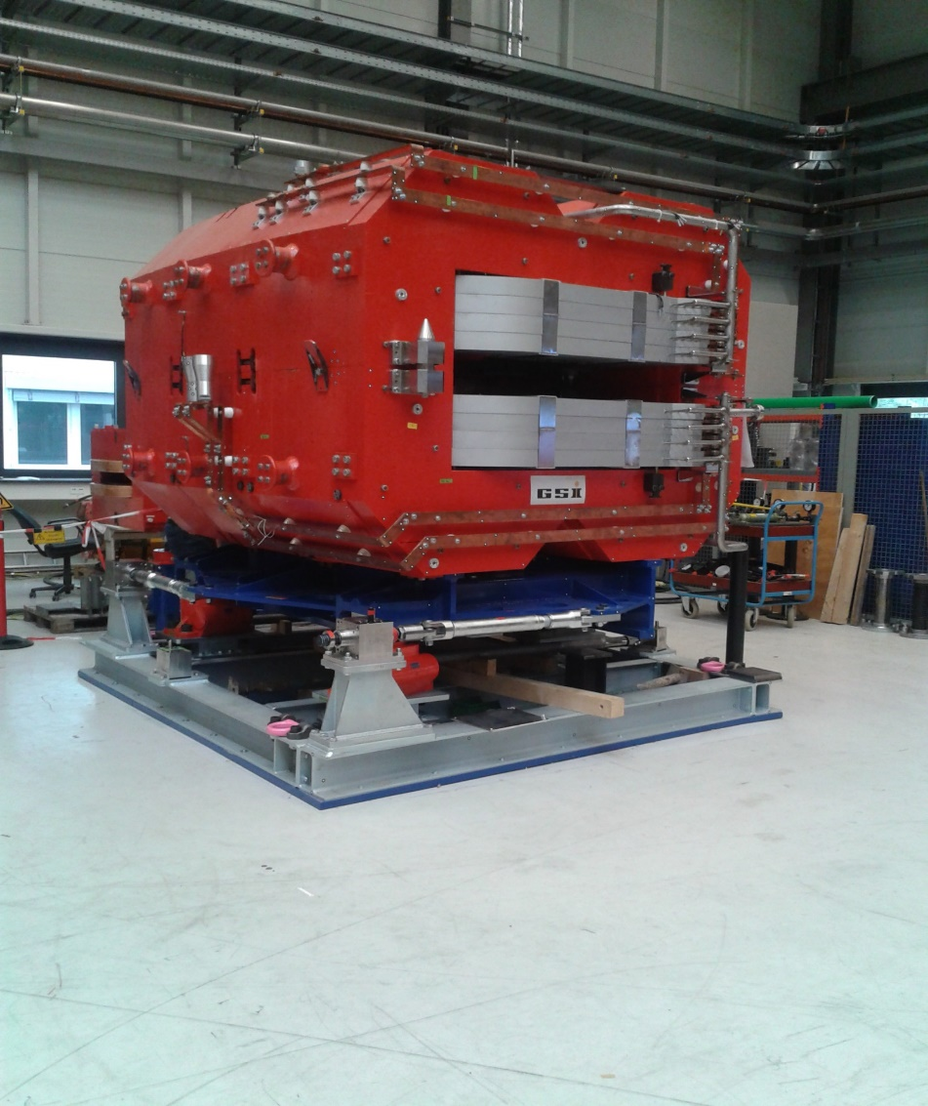
CC 2.4.2.1.1.2 (03.2019 – 10.22)
PROTOTYPE, 2010
New CAD model, 2020
TOTAL: 3801092.00 EUR
FAIR supplies cable to BINP
TOTAL – Cable Cost = 2900720.00 EUR
Two radiation resistance magnets based on a design of the 2010 prototype.

Slide 7
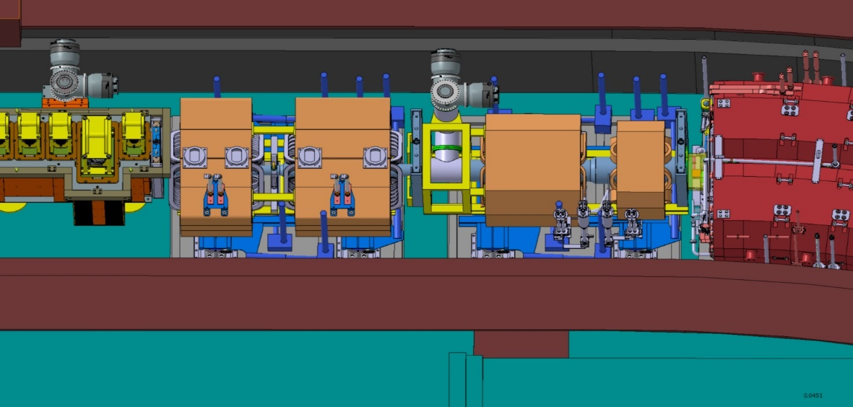
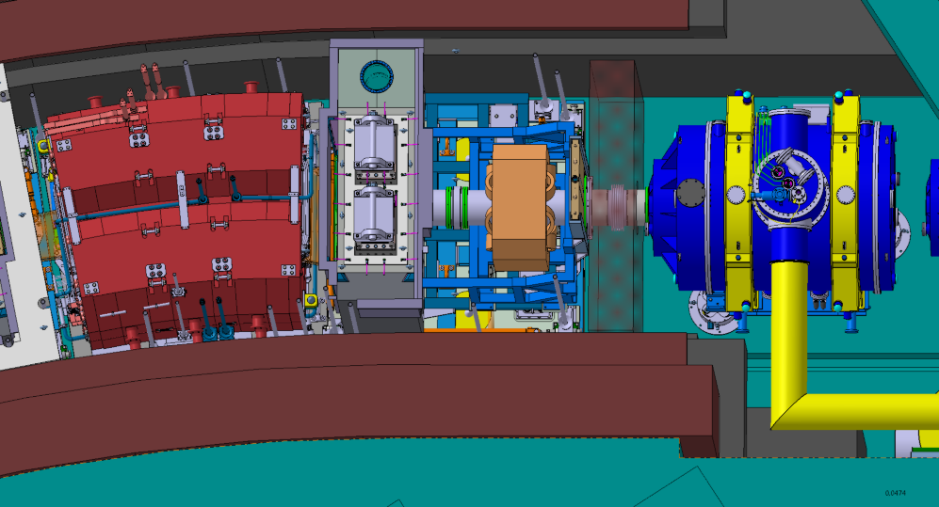
2.2.05.0121 Accelerator Implementing Agreement No. 1, GSI (end date is of May 2020)
Total: 75000.00 EUR
Development of 3 quadrupole and sextupole SFRS magnets.
3D magnetic field simulation has been done. 3D design is under completion.
Quad-Quad
Assembly
Quad-Sext
Assembly
Single sextupole

Slide 8
Summary
FAIR is (one of the) greatest and important BINP collaborator in the history.
Friendly and productive communications were established between two teams.
In spite of many problems and particularly difficult present period, BINP does it best to fulfill all responsibilities.
I propose to establish a FAIR-BINP coordination group (small enough, 5+5 or even less), which will have a zoom meeting every month (or once per two weeks) to discuss and solve current issues and problems.

