Slide 1
Absolute gas gain measurement in straw drift tubes at 2 bar

Slide 2
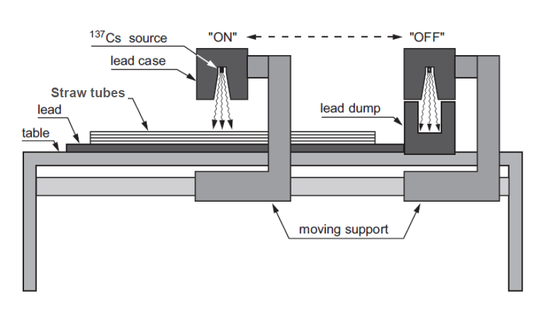
Experimental setup for absolute gas gain measurements at LNF
¹³⁷Cs 1.395 GBq
Straw tubes ‘a la COSY’ filled with Ar/CO2(90/10) gas mixture
at overpressure 1000 mbar

Slide 3
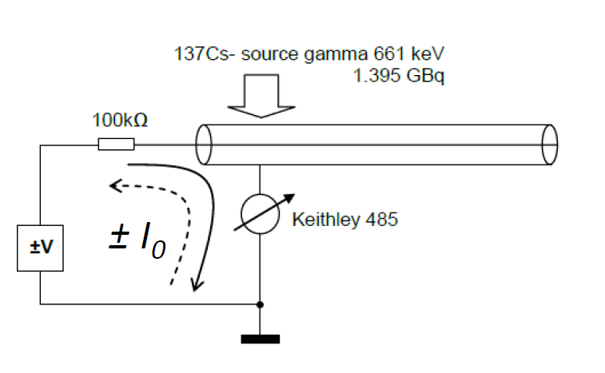
Ionization current I₀ changes polarity if voltage ±V changes polarity
ON

Slide 4
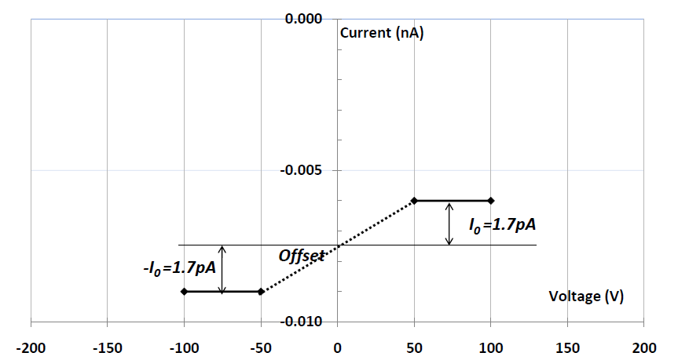
Where zero at ±V at source ON?
6/14/10

Slide 5
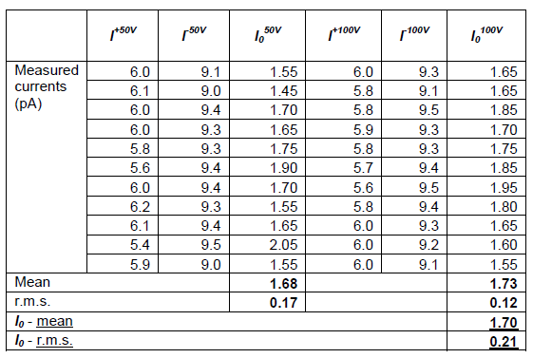
I0 finding from raw data

Slide 6
Spread of currents in various straws within 20%
4 straws connected in parallel
Variations around middle within 20%
Middle with error bar 20%

Slide 7
Gas gain increment finding ArCO2(90/10) at room temperature and 1000 mbar over-pressure

Slide 8
Gas gain presented in Torino – wrong Reason: P measured on input at open output resulting lower pressure inside tube
Presented
in Torino
New measurements

Slide 9
Pedagogical reminds
Gas Gain (GG) in a cylindrical proportional counter is a function
of the applied voltage V
Diethorn parametrization
b and a are the radii of the anode wire and of the cathode, respectively.
Therefore ln(GG)/V vs V is a straight line with slope ΔV and intercept E_{min}.
ln(GG)/V
E_{min}
HV

Slide 10
Absolute gas gain and Diethorn’s parameterization G(V,ρ)
Emin – is the minimal field needed for multiplication;
ΔV - is the potential variation required to produce one more electron in the avalanche;

Slide 11
Gas gain as current-ratio vs. Diethorn’s equation G(V,ρ) helps to see space charge effect
Emin=28.5kV/cm; ΔV=30V
Diethorn’s model validity (α_{Town}=kE)
Current becomes sensitive
to space charge
Very high rate
and large signals
(to be better with MIP)
HV_{op}=1800V
☺
1700V
1800V
1900V
6/14/10
A.Kashchuk INFN-Ferrara and PNPI-St.Petersburg
11

Slide 12
Gas gain vs. V and over-pressure

Slide 13
Conclusion
Results of gas gain measurements obtained with 2 methods:
Cs-137 (presented here)
and Fe-55 (presented by J.S. in Torino)
are in agreement
Gas gain 10⁵, if needed for high space resolution, can be reached at reduced over-pressure, e.g. from 1000 to 700 mbar in vicinity of HV=1800V
Gas gain stabilization can be made by an automatic regulation of HV or over-pressure

