Slide 1
Final results from Juelich prototype measurements
Susanna Costanza
Pavia Group
PANDA Collaboration Meeting
Stockholm – June 15, 2010

Slide 2
Outline
Description of the experimental setup
Aim of this work
TDC spectra analysis
Tracking method steps
Autocalibration
Single tube resolution
Summary & Outlook

Slide 3
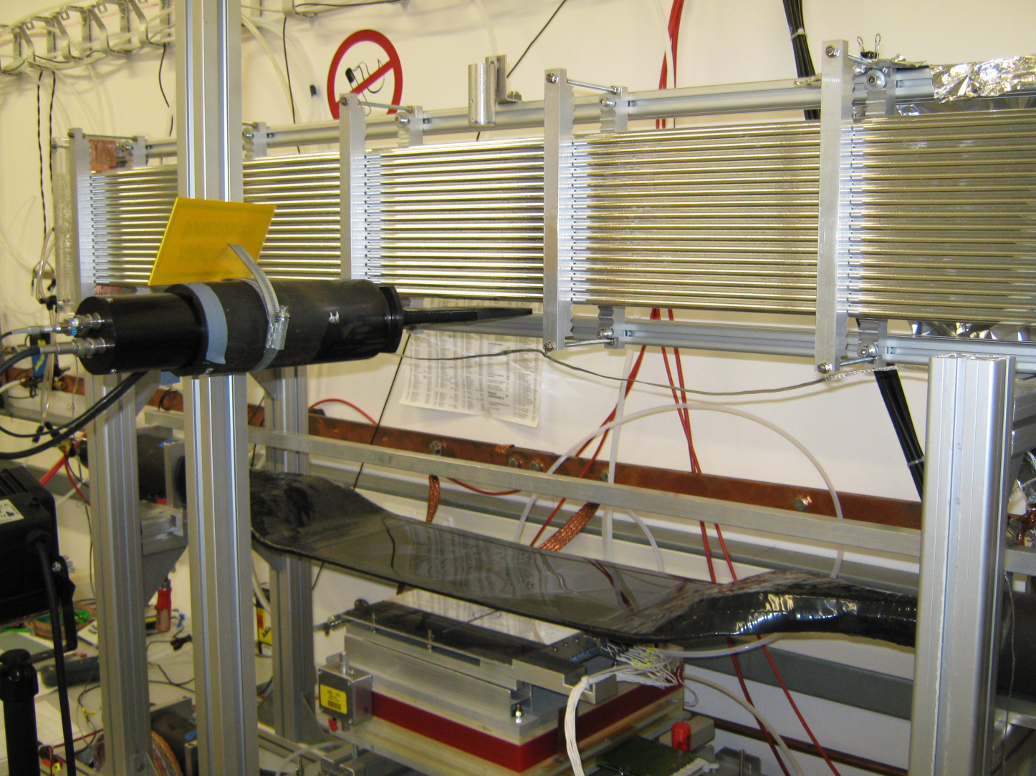
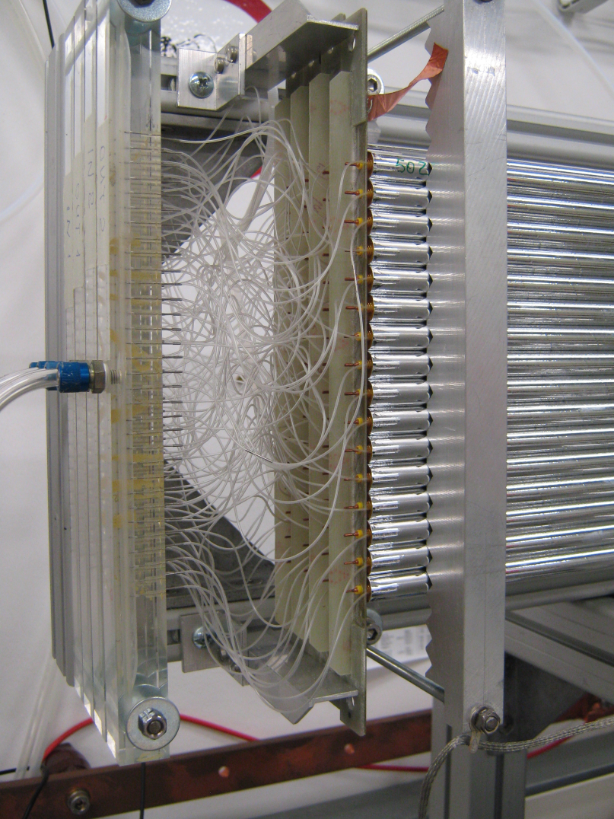
STT prototype @ FZJ
Designed for COSY-TOF and PANDA (P. Wintz)
ELECTRONICS:
Standard existing electronics
64 channels with CMP16 + F1-TDC
64 channels with Fast QDC (160 MHz, 240 MHz in prep)
from WASA @ COSY
DESIGN
4 x (16 x 2) = 128 straws
(4 self-supporting double-layers, 32 tubes each)
1.5 m long
30 μm wall thickness (aluminised mylar)
20 μm anode wire
Different gas mixtures (ArCO₂ (90/10) - ArC₂H₆ (80/20))
Operating at overpressure

Slide 4
Aim of the present work:
First results for dE/dx are already promising (see K.PYSZ’s talk – March C.M.)
Deeper investigation of these data
2 different readout information: TDC and QDC
Work packages:
calibration of the straw (position and isochrone parametrization)
reconstruction of cosmic tracks
dE/dx analysis using full QDC information (time signal, signal amplitude and integrated charge)
track length information in the gas
Data sets:
ArCO₂ (90/10)
ArC₂H₆ (80/20)
Comparison between TDC and QDC information
i.e. isochrone parametrization
Notes:
Sr90 radioattivo, decade beta con decay energy = 0.546 MeV

Slide 5
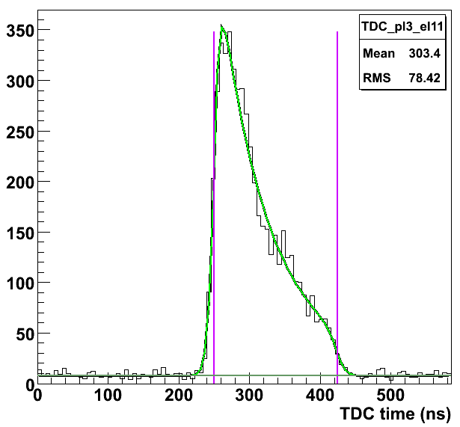
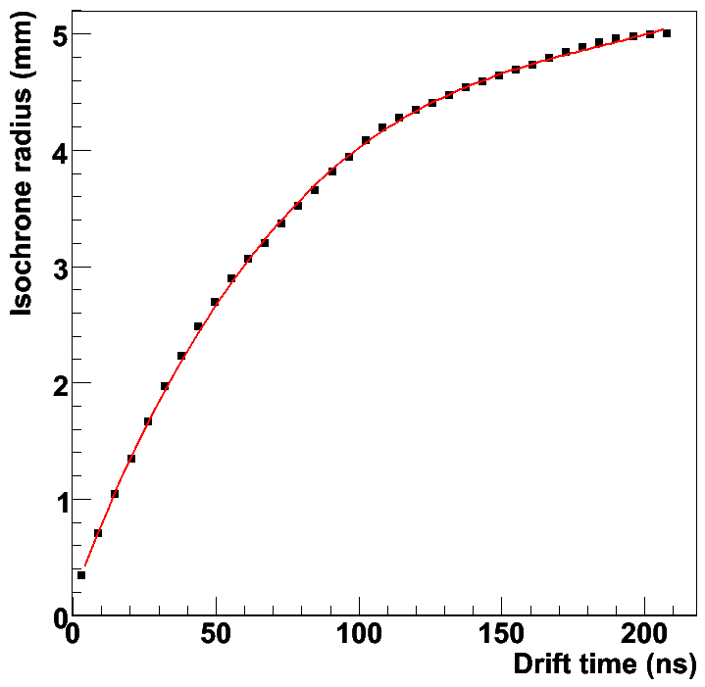
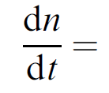
TDC spectra analysis
Fitting of the single TDC spectra
Offset correction for single spectra
Sum of all the spectra
r-t relation obtained in the hypotesis of uniform illumination over the tube volume:
ATLAS Coll., NIM A 523 (2004)
3rd order polynomium
p₀ 1.824190 e-01
p₁ 6.377422 e-02
p₂ -3.092456 e-04
p₃ 5.535298 e-07
fit
t₀, t_{max}
Noise level

Slide 6
Tracking method
PRE-PREFIT:
minimization of the perpendicular distances of a set of N points (x_{i}, y_{i}) from the best-fit line
FILTERING after the prefit:
Filter for bad events (number of hits, mean distance of the centres of the firing tubes to the prefit line)
Filter for spurious hits: cut on the distance from the prefit
PREFIT (MINUIT):
Fit of the following χ²:
where:
are the residuals
are the drift radii obtained from the r-t relation
are the wire coordinates

Slide 7
Tracking method (II)
REMARKS:
The χ² minimised in the PREFIT:
is not the sum of standard gaussian variables
contains the parameter b in the denominator → non linear minimization
= track points
Non linear minimization but closer to a standard χ²
Find the track points!!!
INTERSECTION FINDER:
Dotted line: orthogonal to the prefit through the wire coordinates
2 intersection points with the isochrone: the closest to the prefit line is the track point
REFIT (MINUIT) with the new χ² and the track points
FILTERING

Slide 8
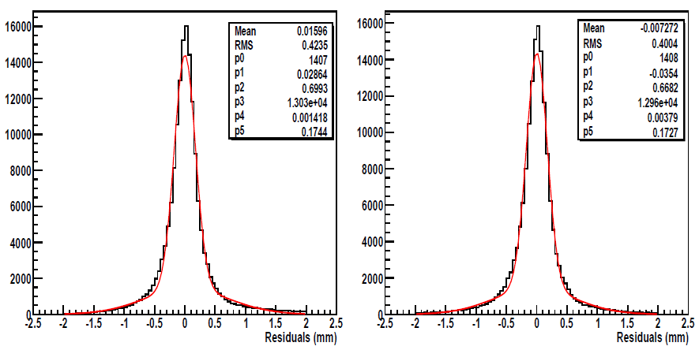
Tracking method (III)
Is the refit useful?
MEAN RESIDUALS DISTRIBUTIONS
PREFIT
PREFIT + REFIT

Slide 9
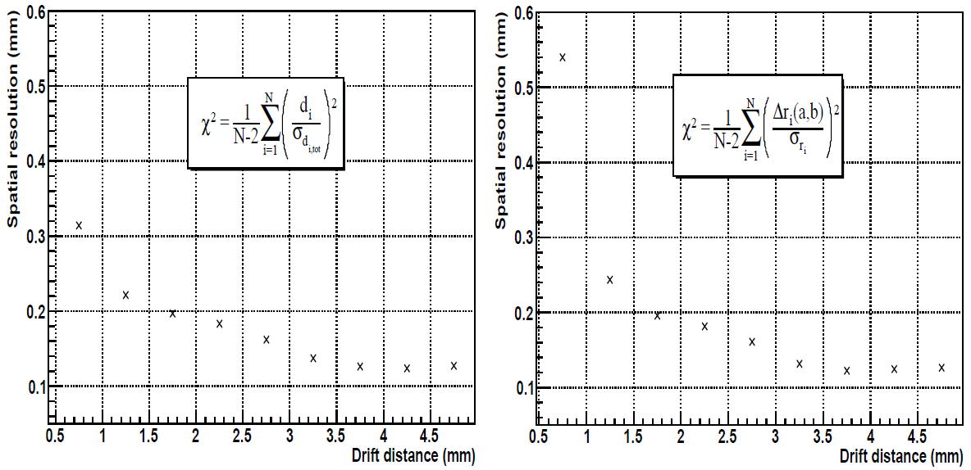
Tracking method (IV)
Is the refit useful?
SPATIAL RESOLUTION CURVES
PREFIT + REFIT
PREFIT

Slide 10
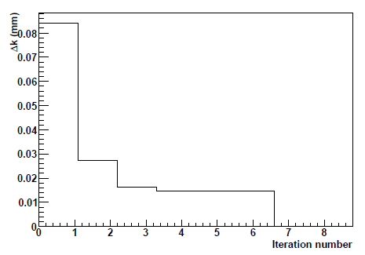
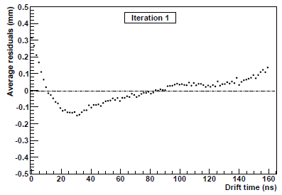
Autocalibration
AIM:
Have a high precision knowledge of the r(t) relation to perform a good track fitting
r(t) relation:
Drift time → drift radius
Tracking:
Parameters of the best fit line
Residuals calculations
Correction of the r(t) relation with the residuals themselves
… Best r(t) relation
Check of the mean square correction
Deviations = MISCALIBRATION!!

Slide 11
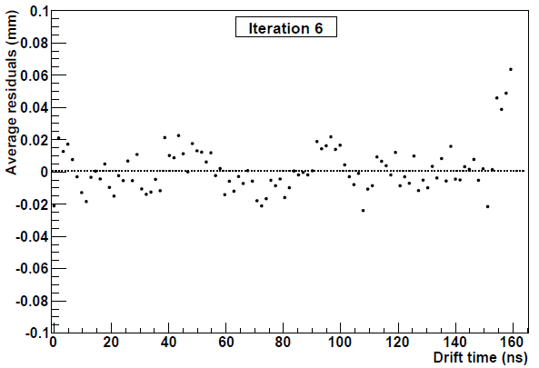
Autocalibration (II)

Slide 12
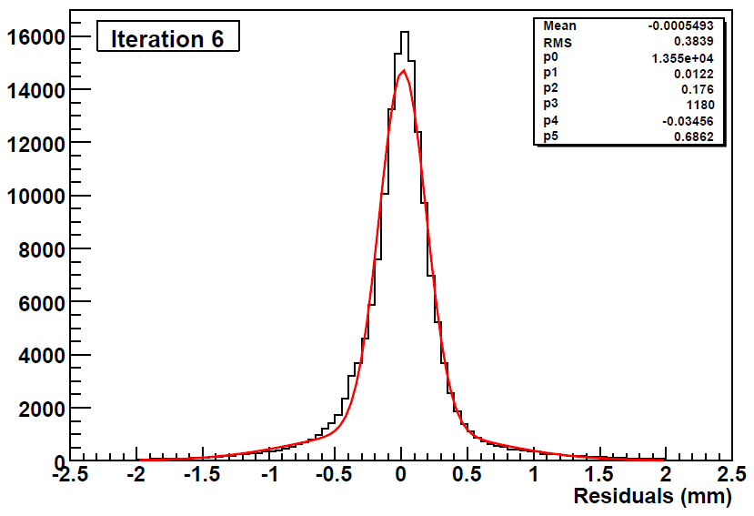
Mean residuals distribution
μ = 12.2 μm
σ = 176 μm

Slide 13
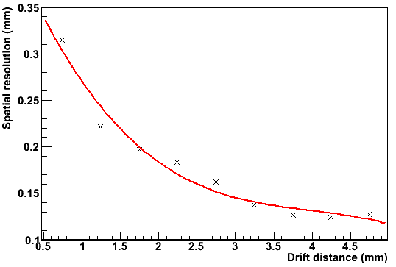
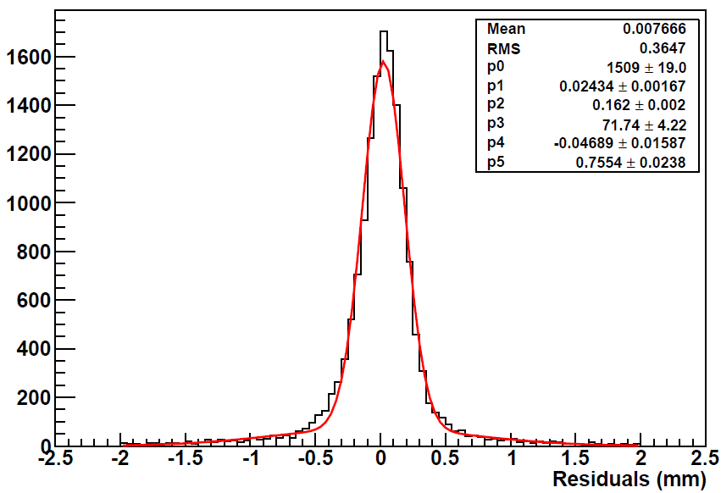
Mean spatial resolution
The mean value of the residuals is in agreement with the resolution curve of a single tube
“BIASED”

Slide 14
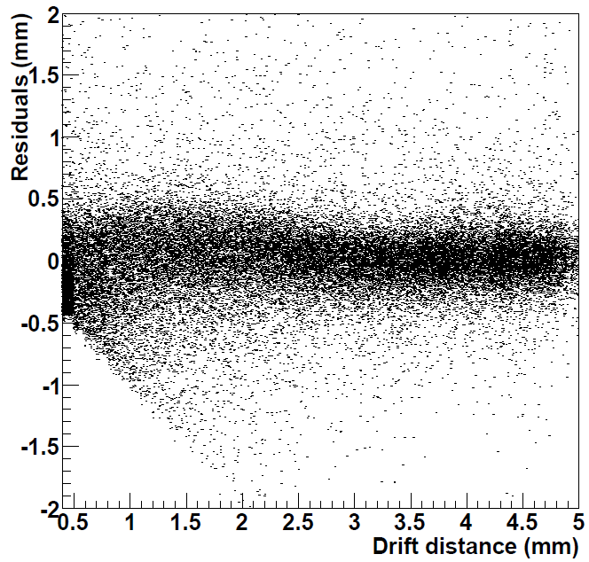
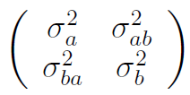
Single tube resolution
Tracks with N > 16 hits selected and fitted with N-1 space points
Residuals of the excluded tube vs drift distance
→ convolution of the tube resolution & track extrapolation errors due to the fit
Residuals distribution sliced in 10 intervals and fitted with 2 Gauss functions → σ_{G}
Computed the error on the distance of each track point to the best fit line, due to the fit
covariance matrix given by Minuit in the refit
correlation a – b
σ²_{resol} = σ²_{G} – σ²_{d}

Slide 15
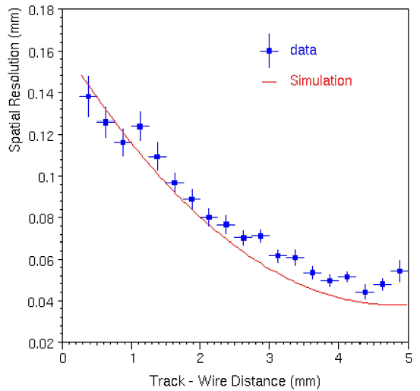
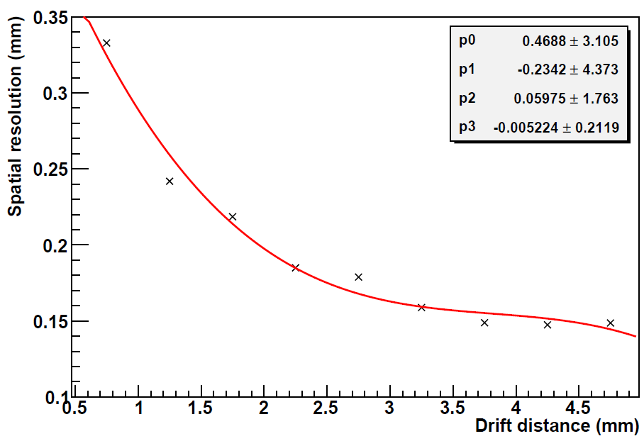
Single tube resolution (II)

Slide 16
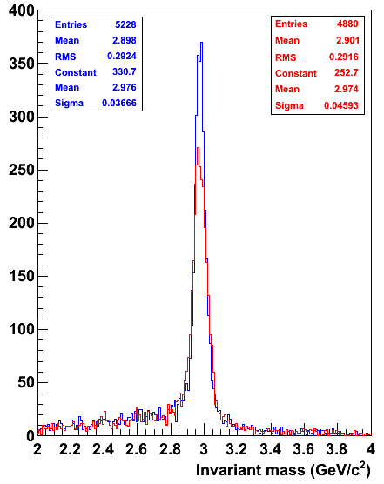
η_{c} Invariant Mass - comparison
Resolution (COSY-TOF):
1.2%
Resolution (Prototype):
1.57%
For details:
See talk in Computing Session

Slide 17
Summary & Outlook
Isochrone calibration from TDC spectra
Track reconstruction implemented
Autocalibration implemented
Single tube mean resolution of ~ 175 μm
With non-dedicated time resolution readout (CMP16)
Track length correction to be used in dE/dx analyses
Set up the QDC analyses
Determine the dE/dx resolution
Compare different data sets
Comparison of experimental results with simulations
Thank you!

