Slide 1
Beam parameter measurement at the FRS

Slide 2
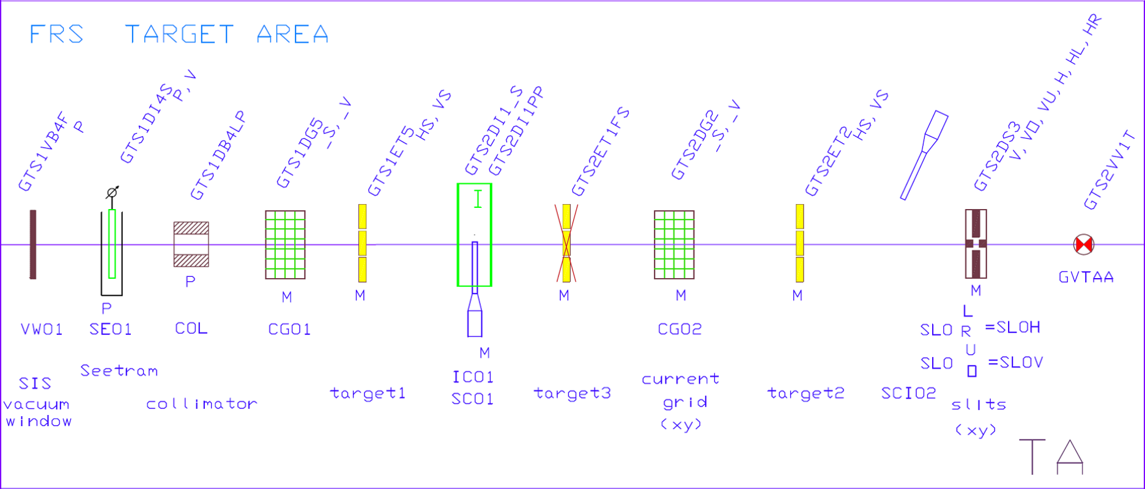
Diagnosis target area

Slide 3
Program step 1
Slow extraction
Calibrate Seetram
Optimize transmission
Measure x- and y-profiles, beam intensity in and transmission to the target area for different intensities 10³,10⁶, 10⁹
Repeat step 2) and 3) for all 5 optics
3 for Target station 1 (maximum rigidity 13.7 - 18.6 Tm)
2 for Target station 2 (maximum rigidity 15.8 - 18.7 Tm)
Repeat for fast extraction
Time estimate: 2-3 shifts?

Slide 4
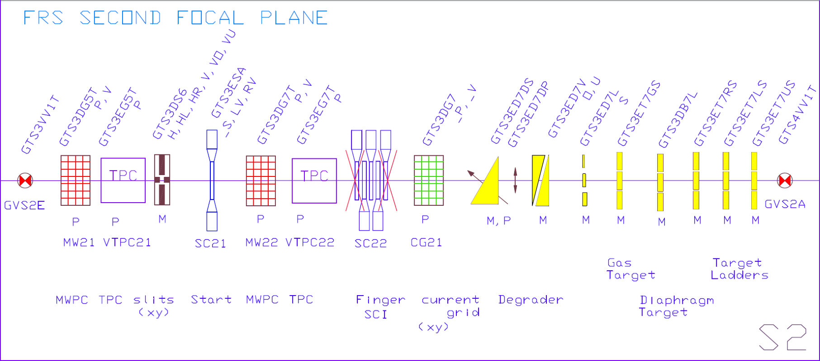
Diagnosis S2 area

Slide 5
Program step 2
Particle by particle analysis at S2, select suitable charge dependent on intensity
S2 is dispersive with (x,d)=6.5 m (or in high resolution mode ~16 m at S4 )
Longitudinal momentum analysis of the beam (vs. time in spill)
Transversal emittance for different inensities 10³,10⁶, 10⁹
Record time difference between particles – a measure of the spill micro structure
Time estimate: 2 shifts?

