Slide 1
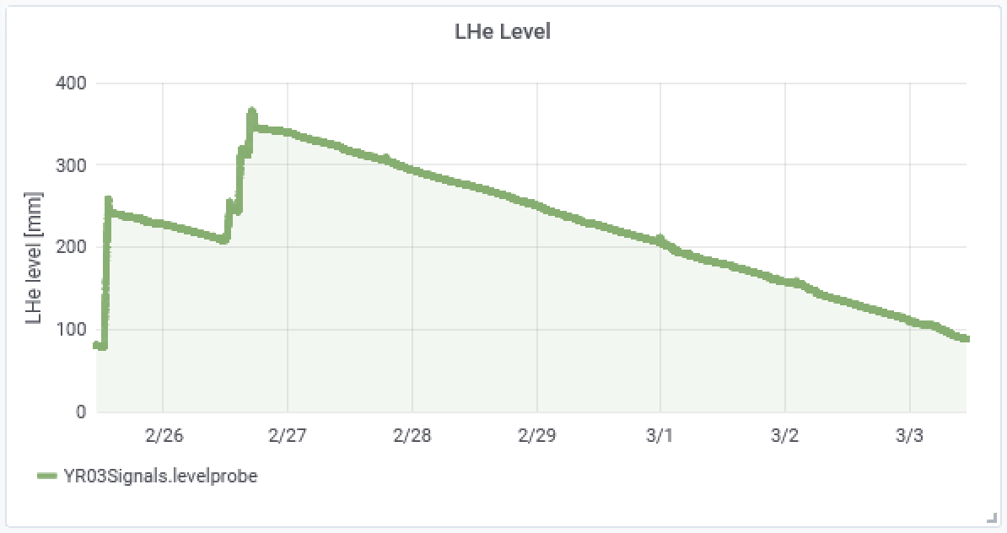
and HITRAP
CRYRING@ESR
CRYRING@ESR
ECooler
Last fill lasted 5+ days, first try to refill successful last week, another refill ongoing
Major vacuum incident on Nov-23: still tests with the cryopumps, compressor change ongoing
Ring Operation/Test
YR06QD1 water leak – repair incl. bake out - done
Giessen ECR running very stable for D+, ion source application and FESA layer still to be finished (CSCO)
Experiment installation ongoing
Commissioning with beam starts today in YRT1
HITRAP
Electron/Ion transmission test at the cooling Penning trap ongoing
discussion on Shutdown activities for HITRAP linac needed, however, added to planning
PAC Experiments in April/May expect:
136Xe50+, 238U88+ and 238U91+ @ about 10 MeV/u, 107 (/ minute)
cooled!
Frank Herfurth
March-03, 2020

