Slide 1
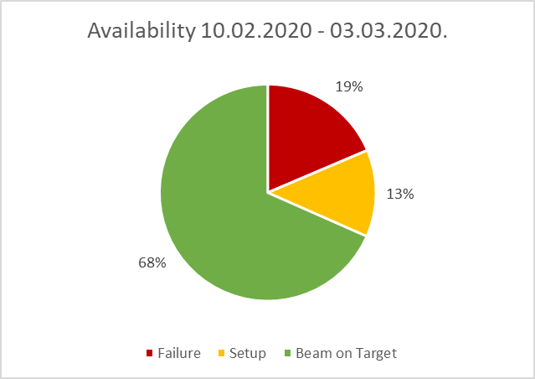
Operations – 03.03.2020
Status Physics Run
general
beam time is running smoothly – all experiments are provided with the requested beams
UNILAC
Ca- and Xe-beam time on all scheduled targets
Au- beam is already prepared for tomorrow
HSI-RFQ has to be switched off/on several times per shift
SIS18:
stable operation
beam losses at ramp that start limit beam intensities to ca. 2-3E9 are not yet understood
water ingress into kicker room increased again due to the rainfall of last days, T. Brühne reports water at the switching cabinet, “towels” must be changed 2x per day, the actions taken so far by CAM show no major improvement of the situation
HEST
stable operation
FRS
stable operation
GHFSMU1: A technical defect caused by an unusual ramping scheme led to several longer interruptions during weekend → solved
ESR
stable operation
Cryring
bake out finished, preparation for beam time ongoing
FAIR Commissioning
First conversation with H.R. Sprenger about the coordination of HW installation and interface to Commissioning took place last week → the approach of the installation concept could be the basis also for commissioning concept
2 more meetings are scheduled with H. Simon (SuperFRS) and S. Menke (Commons)
https://www.gsi.de/work/beschleunigerbetrieb/betrieb/betriebsstatistik.htm

