Slide 1
Movement of the TS Platform
Inti Lehmann

Slide 2
Objectives
Movement over 20m
reliable, (semi) automatic?
relatively fast (~1h?)
well defined path in x (1cm?)
minimise vibrations
(avoid early definition of path)
Alignment at in-beam position
in x, y and z
precise <1mm?
no shaking
(semi) automatic?

Slide 3
Input from Jost
25 May 2010

Slide 4
Input from Jost
25 May 2010

Slide 5
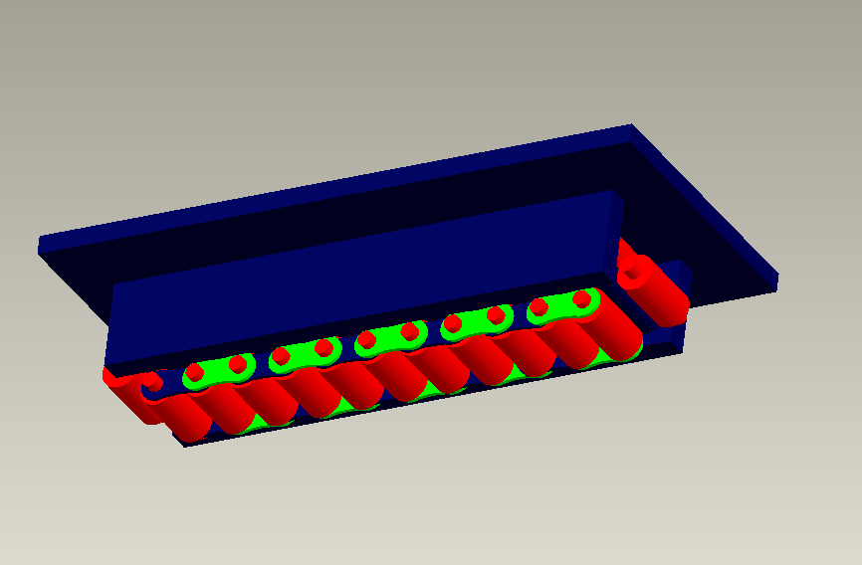
My Preference/Dream
Easy and fast semi automatic roll in
Hillman rollers
Air cushions
Problem shaking

Slide 6
My Preference/Dream
Precise semi automatic positioning
Plastic sliders above rollers
staying in place for ever
Force by jacks
driven remotely
in x, y relative to rollers/cushions?
in z lifting plate with rollers
Alignment feedback from all crucial places
relative to beam pipe

