Slide 1
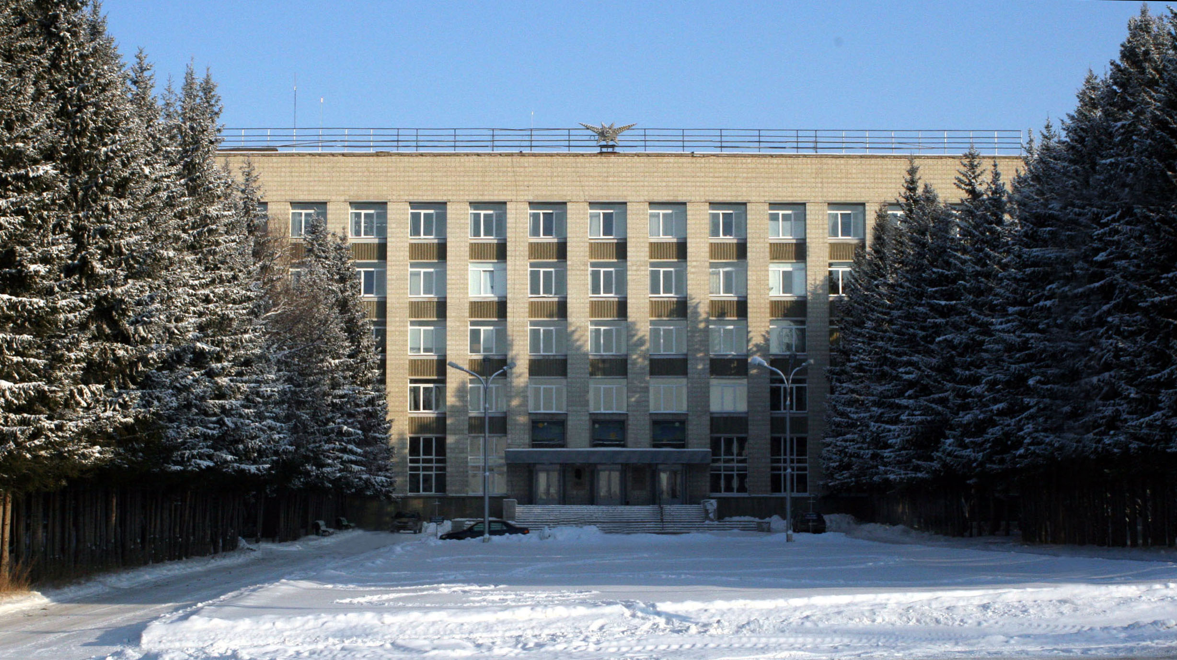
Budker Institute of Nuclear Physics

Slide 2
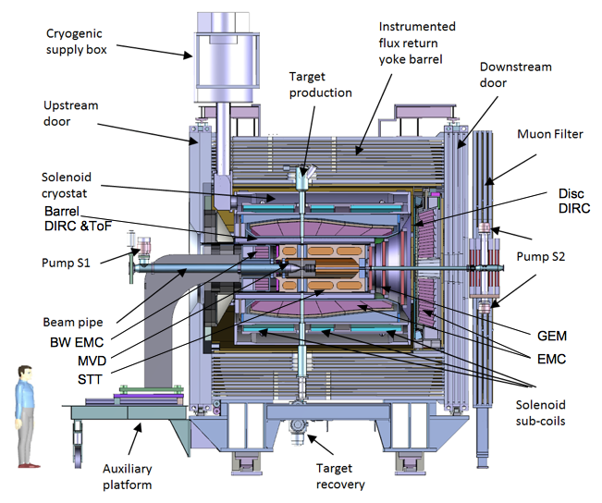
PANDA solenoid magnet
The PANDA solenoid is designed to provide a magnetic field of 2 T with a uniformity of ± 2% and radial magnetic field integral in the range 0 to 2 mm over the central tracking region. The magnet is characterized by a warm bore of 1.9 m diameter, a free length of 4 m and 22.4 MJ of stored energy.
Since PANDA is a fixed target experiment, the main technical challenge is the insertion of a warm target pipe vertically to the solenoid axis in correspondence with the interaction point located at 1/3 of the length of the solenoid. In order to meet the above requirement while satisfying the magnetic field homogeneity constraints, the magnet is split in 3 interconnected coil modules.
Artistic view of the solenoid magnet including detector systems

Slide 3
The main milestones of production of the PANDA solenoid magnet
The scope of delivery includes:
Magnetic and engineering design of the magnet including tools and support;
Production and delivery of the magnet (consisting of yoke, cold mass and cryostat, alignment components, proximity cryogenics, support frame and platform beams) and all tools;
Power converter and quench protection and instrumentation.
Item | Date
Start contract | 03/2017
Control assembling of the Yoke of solenoid at the BINP site | 09/2020
Magnetic tests of the PANDA solenoid including safety system and electrical components at BINP (additional contract) | 07/2021 - 05/2022
Assembling and tests at the FAIR site
Assembling of the magnet at Darmstadt | 06/2022
Acceptant tests at FAIR | 08/2022
Installation of the PANDA solenoid magnet at worked position and final acceptance tests | 01-05/2023

Slide 4
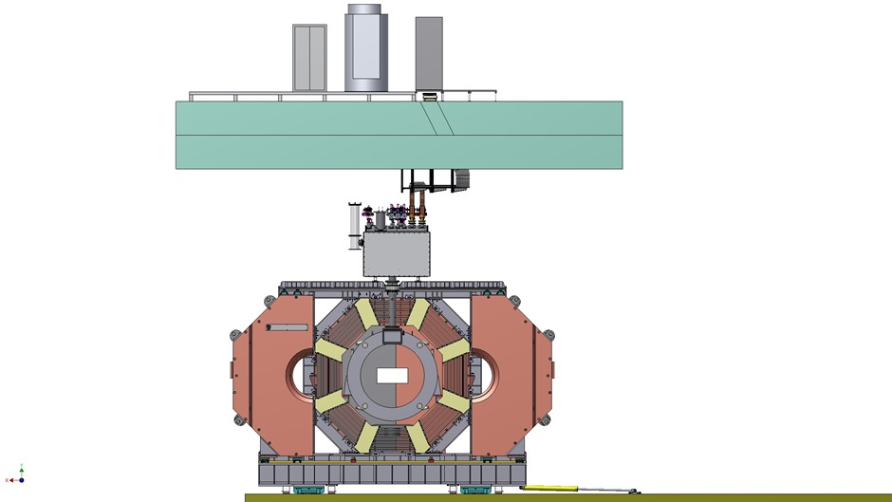
The views of the PANDA Solenoid
Power supply and EES racks
Concrete ceiling
Cable layout
Control Dewar with current leads
Yoke with solenoid
The PANDA Solenoid parts.

Slide 5
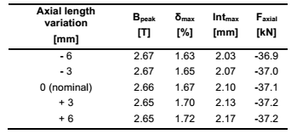
Cryostat and cold mass of the PANDA solenoid magnet
Parameter | Unit | Value
Outside diameter | мм | 2680
Inner diameter | мм | 1900
Length | мм | 3090
Magnetic field in coil | T | 3
Current | kA | 5
Stored Energy | MJ | 22,4
Weight | t | 14.5
Outer diameter of coils is 2200 mm,
length: two coils - 887 mm, one – 400 mm.
3D model PANDA solenoid.

Slide 6
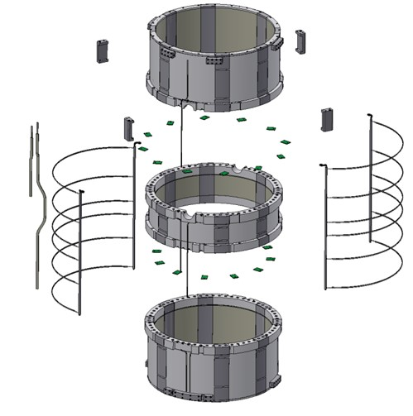
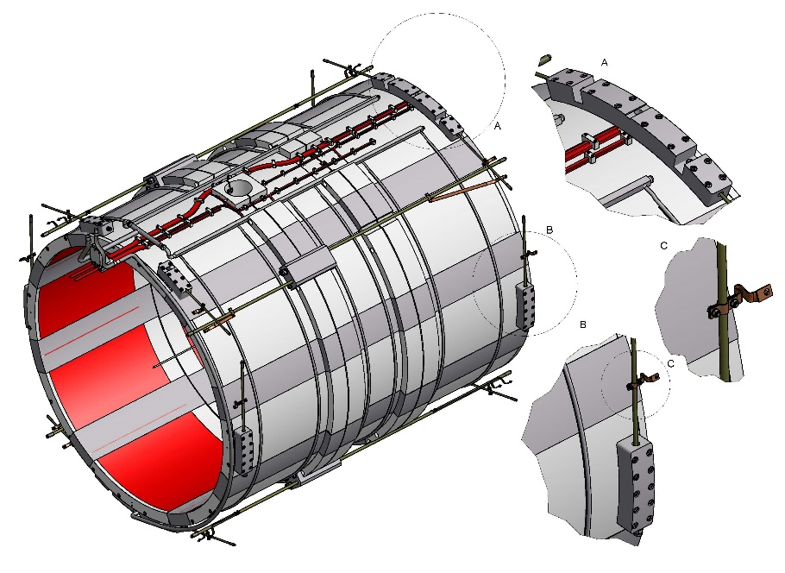
Cold mass parts
Target hole
Support blocks
3 Coils
Tie rods
Thermal bridges
Pure aluminum strips
Cooling circuit
3D model of the PANDA cold mass.

Slide 7
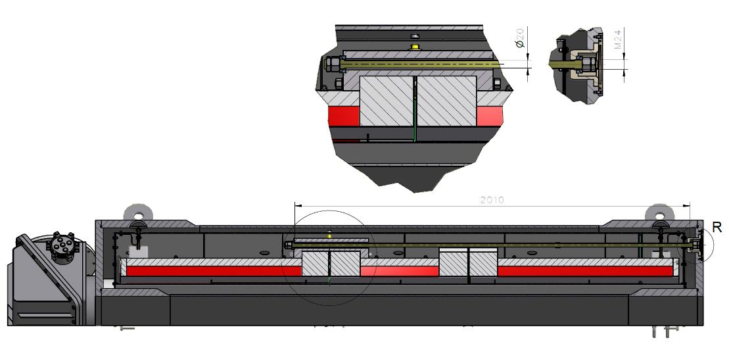
Scheme of fixation of the cold mass.
The diameter of suspension is 16 mm, the length is 840 mm.
In the radial direction the Cold mass fixed with help radial rods. The diameter of radial rods is 12 mm, the length is 720 mm.
Cold mass is based into Cryostat with help suspensions and axis rods. Material of rods is Ti-5Al-2.5Sn
In the axial direction the Cold mass is fixed with help longitudinal rods. The diameter of longitudinal rods is 20 mm, the length is 2010 mm downstream side and 1120mm upstream side.

Slide 8
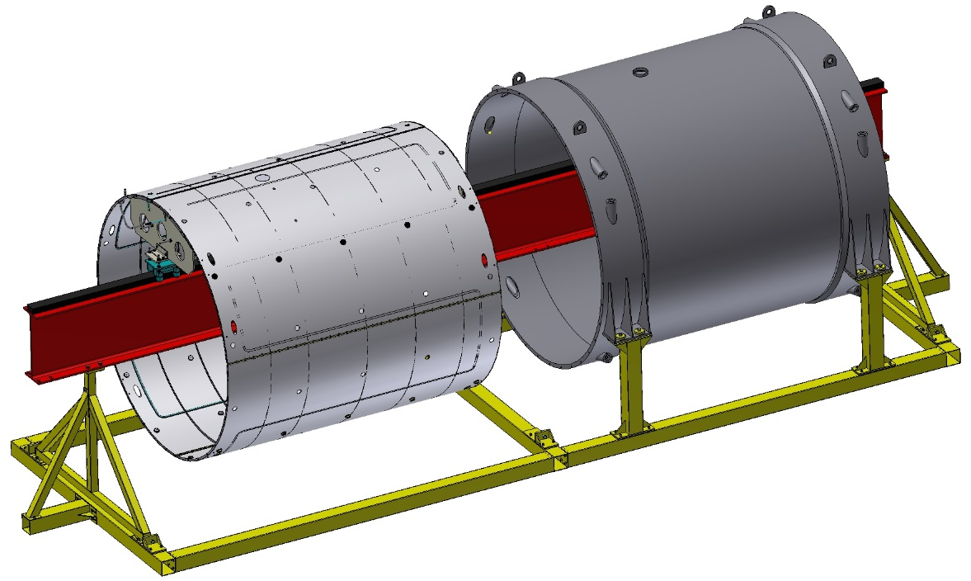
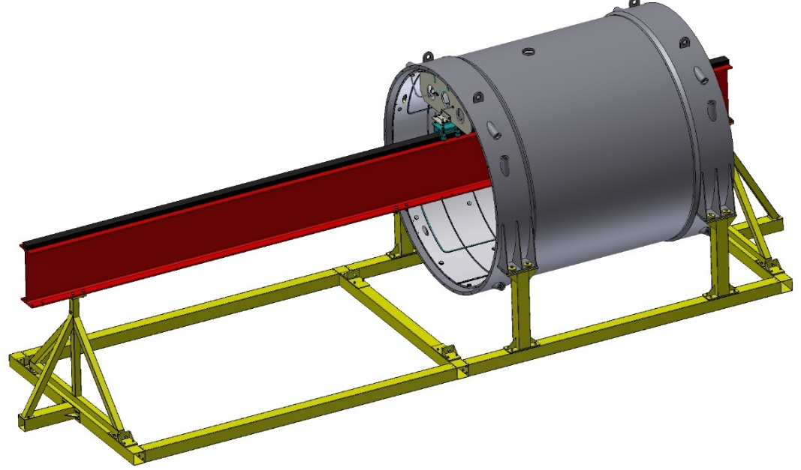
Production of the cold mass and cryostat.

Slide 9
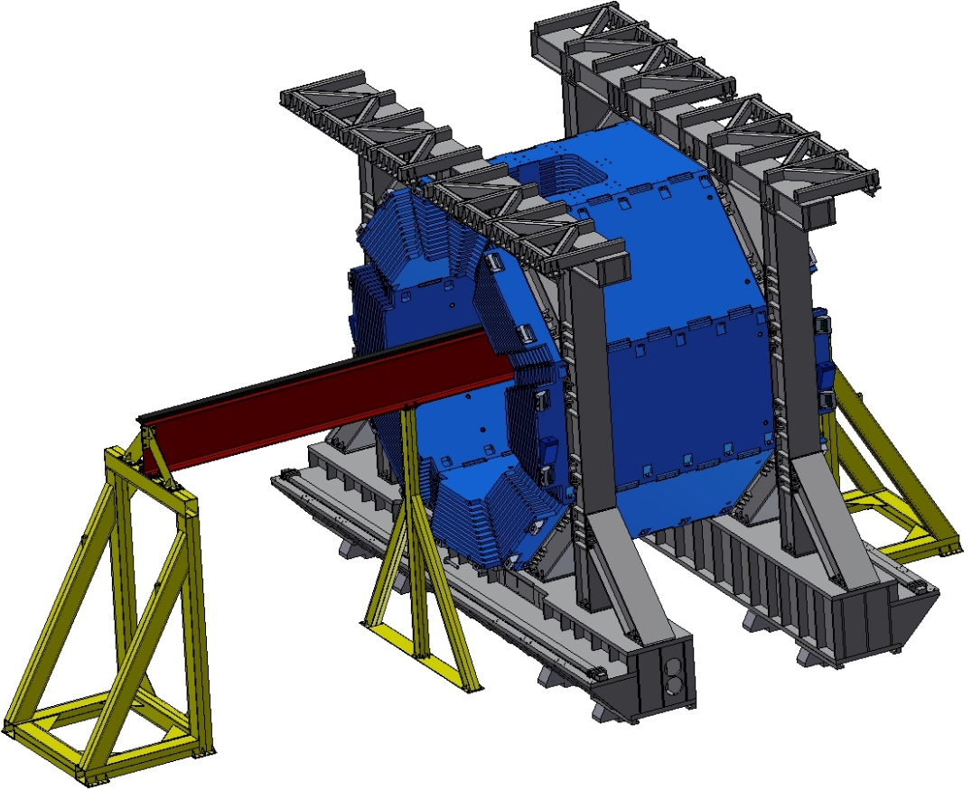
Production of the cold mass and cryostat.

Slide 10
Production of the cold mass and cryostat.
Item | Date
Start contract with subcontractor | 05/2020
Preparation production of the Cryostat, cold mass, thermos shields and stands for assembling of the cryostat and solenoid | 09/2020
Assembling cryostat on the Plant site | 11/2020
Delivery to BINP and SAT | 01/2021
Installation of the coils to the cold mass shells according to production of the coils | 06 – 12 /2021

Slide 11
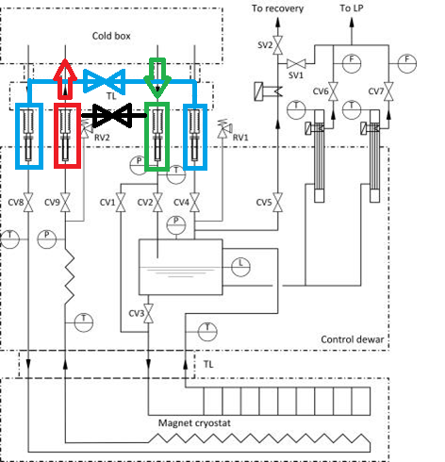
Cryogenic system
The cryogenic system of the PANDA magnet consists of a Control Dewar with helium vessel, transfer line and thermosyphon circulation loop. It is a self-regulating thermosyphon circulation flow system. A natural circulation loop is operated on the principle that a heat load on the channels of the heat exchanger produces a two-phase flow that is on average of lower density than the liquid phase. Homogenous model is used for the preliminary study for CMS detector solenoid, CERN.
The scheme has a cooling circuit that will work with liquid nitrogen when the solenoid magnet is moved to the assembly area.
PANDA solenoid cryogenic Process Flow Diagram.

Slide 12
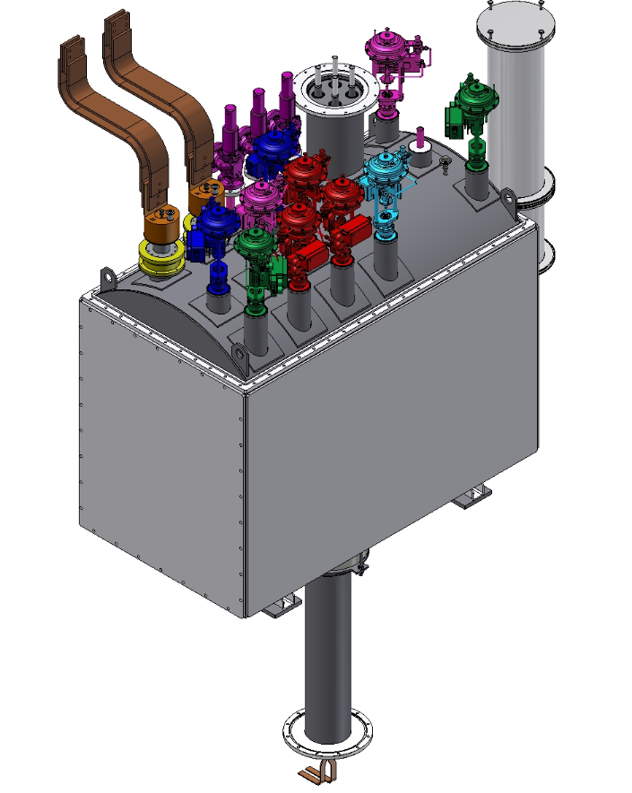
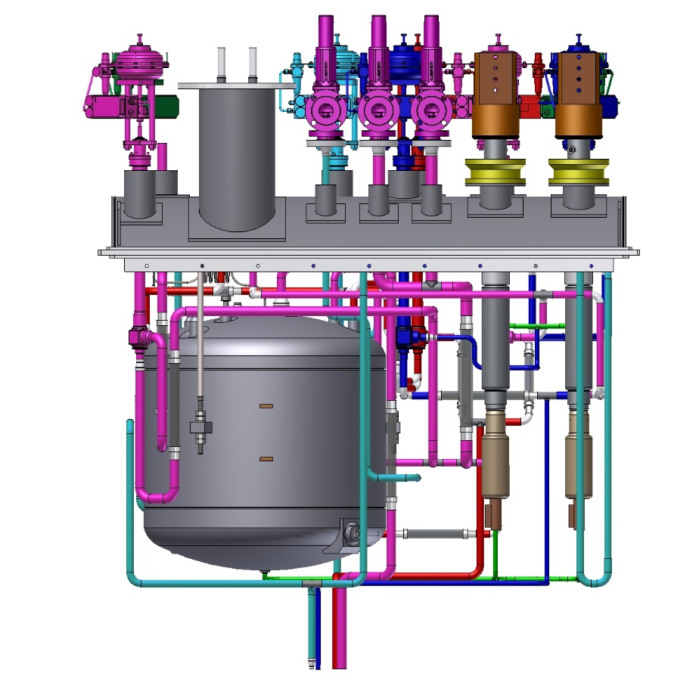
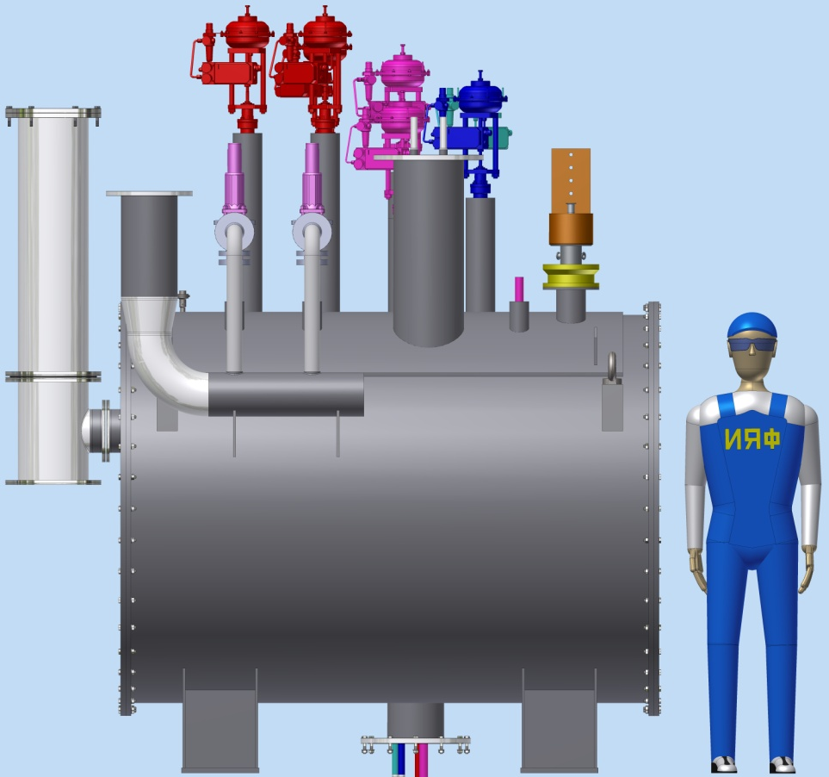
Distribution box – Control Dewar.
Control Dewar includes:
Vessel for liquid helium (~480L);
Current leads;
Thermal shields;
Valves, instrumentation;
Vacuum shell;
Transfer line (Chimney) connecting the vacuum vessels of cryostat and control Dewar.

Slide 13
Distribution box – Control Dewar.
Details drawings – started 02/2020
Calculation loads of piping – until 05/2020
Calculation current leads – until 05/2020
Approval of the drawings by third party – 07-08/ 2020
FDR – 08-09/2020
Purchasing valves and instrumentation – 06/2020-06/2021
Place production – BINP
FAT in BINP, vessel IV category – 10/2021

Slide 14
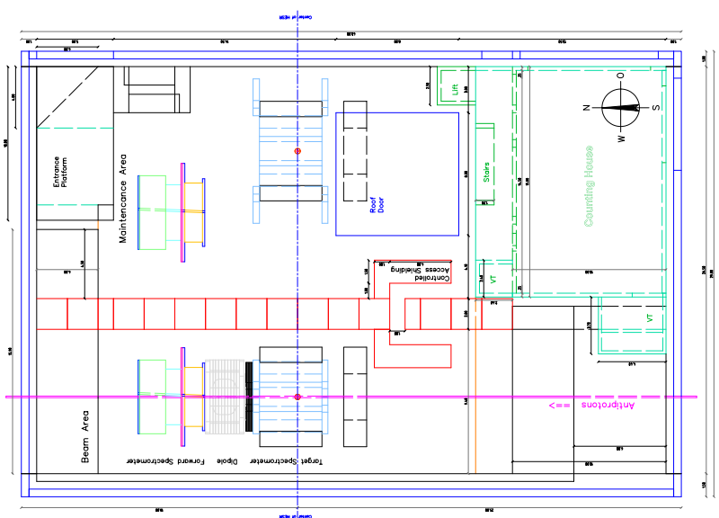
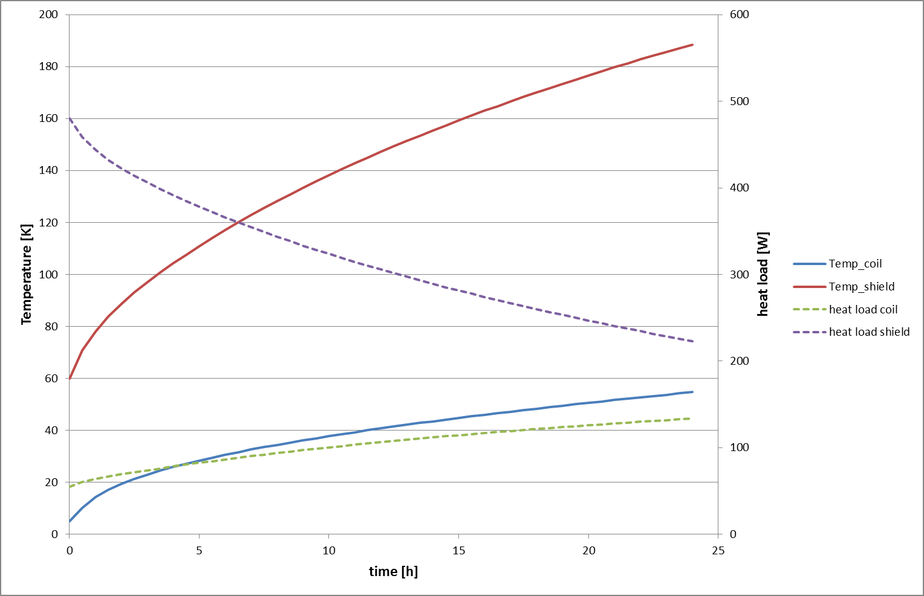
Scheme of location of the PANDA magnet in beam position and in assembling area
The magnet will be approximately 6 month in parking position of the assembling area for maintenance. In this position a forced helium circuit (83-100K) cooled by liquid nitrogen is foreseen.
The travel between the parking and the beam position will take less than a day, and the expected temperature should stay in an acceptable range for the cold mass.
PANDA magnet areas.
The maximal temperature of the thermal shield is estimated about 130K after 8 hours and the maximal temperature of the cold mass ≈ 35 K.
Dependence of temperature and thermal loads of the cold mass and thermal shield.

Slide 15
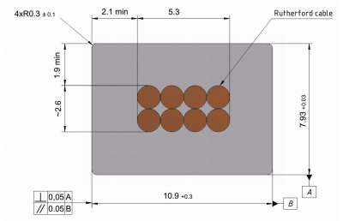
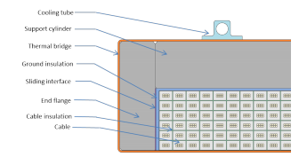
Main risks. Conductor.
Thickness (after cold work) at 300 K | mm | 7.93 | ± 0.03
Width (after cold work) at 300 K | mm | 10.95 | ± 0.03
Critical current (at 4.2 K, 5 T) | A | > 14690
Critical current (at 4.5 K, 3 T) | A | > 16750
Overall Al/Cu/sc ratio |  | 10.5/1.0/1.0
Aluminum RRR (at 4.2 K, 0 T) |  | > 600
Al 0.2% yield strength at 300 K | MPa | > 30
Conductor mechanical and electrical parameters.
Rutherford cable, 8 strands, extruded in Al matrix

Slide 16
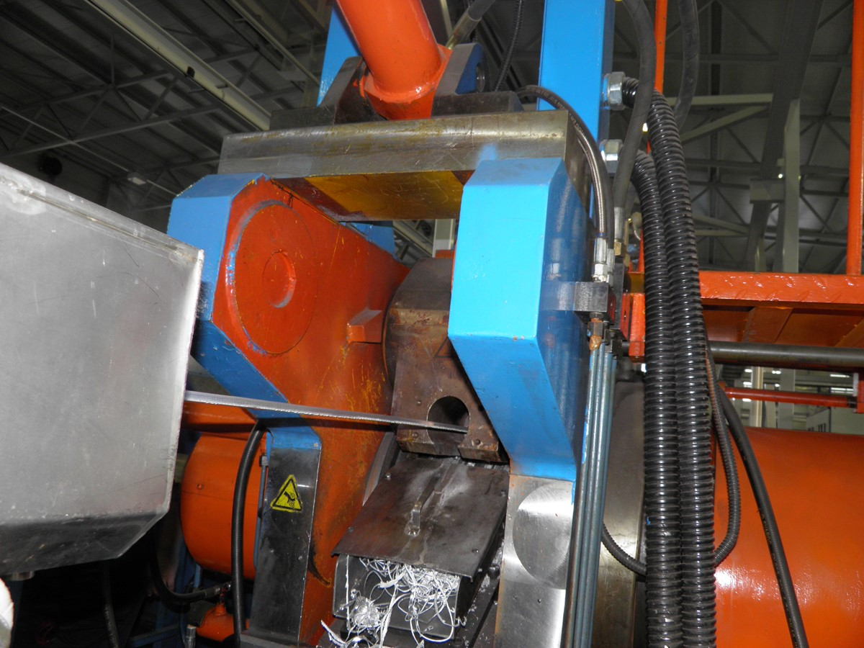
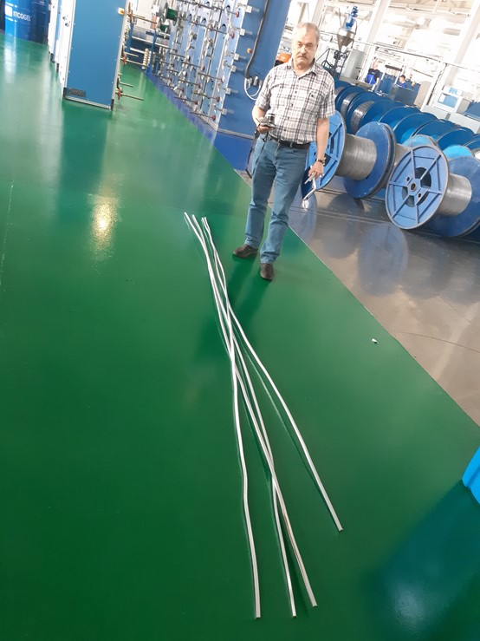
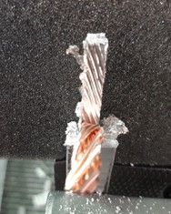
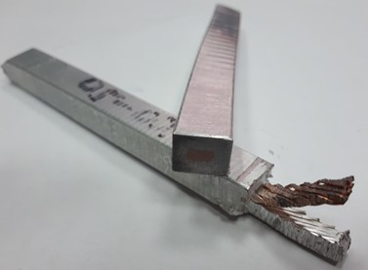
Development of the conductor.
Sarko.
Produced about 20 meters a conductor from A95 and NbTi cable;
4 pieces the conductor 3,5m prepared for following tests;
Mechanical tests should be in BINP;
Cryogenic tests for RRR and critical currents should be carried out in Bochvar institute and CERN.

Slide 17
Main risks. Conductor.
Status of the PANDA conductor development/ procurement
VNIINM Bochvar
VNIIKP
Saransk cable optic (SarKO)
Purchasing superconductive conductor - lack of a manufacturers
Rutherford cable co-extrusion/ conklad in a pure Al
Production1000m Cu Rutherford cable for tests in SARKO - 03-04/ 2020
Tests in SARKO, 1000m Cu Rutherford cable - 04-05/ 2020
Preparation contracts for PANDA NbTi strands production, VNIINM - 03/ 2020
Production strands VNIINM for central coil - 02/2021
Production strands VNIINM for up/downstream coils - 09/2021
PANDA Rutherford cables production, VNIIKP - 03-10/ 2021
Production PANDA conductor with SARKO - 03 - 11/ 2021

Slide 18
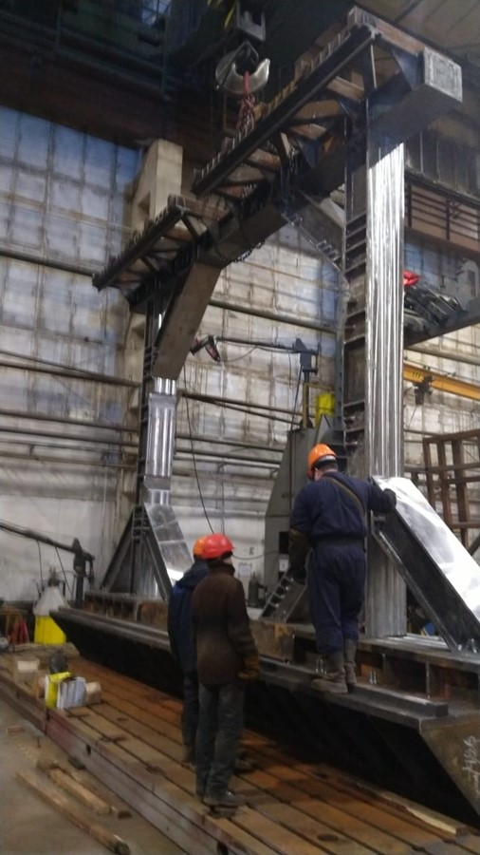
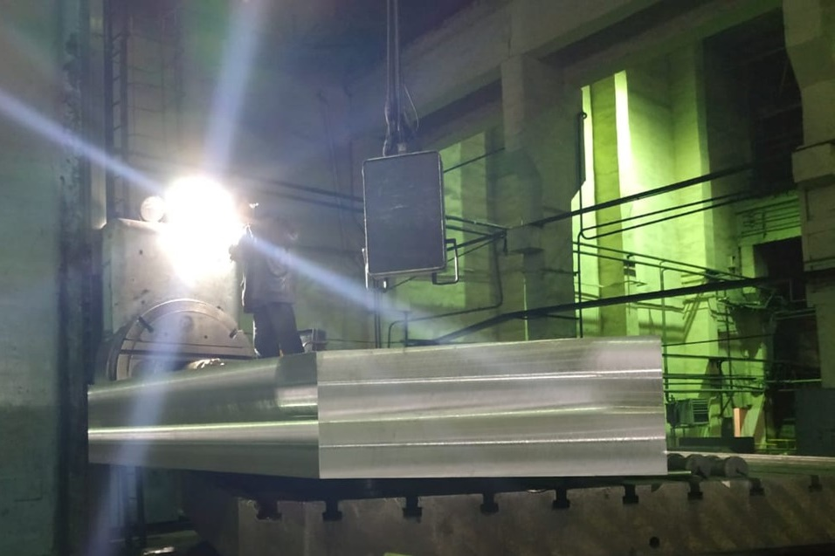
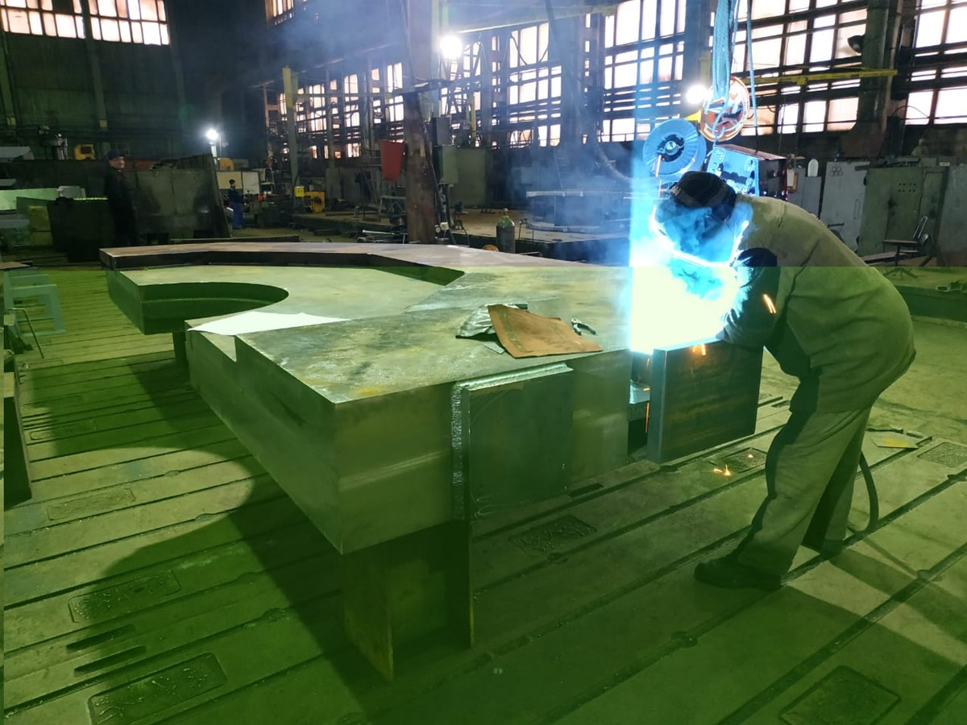
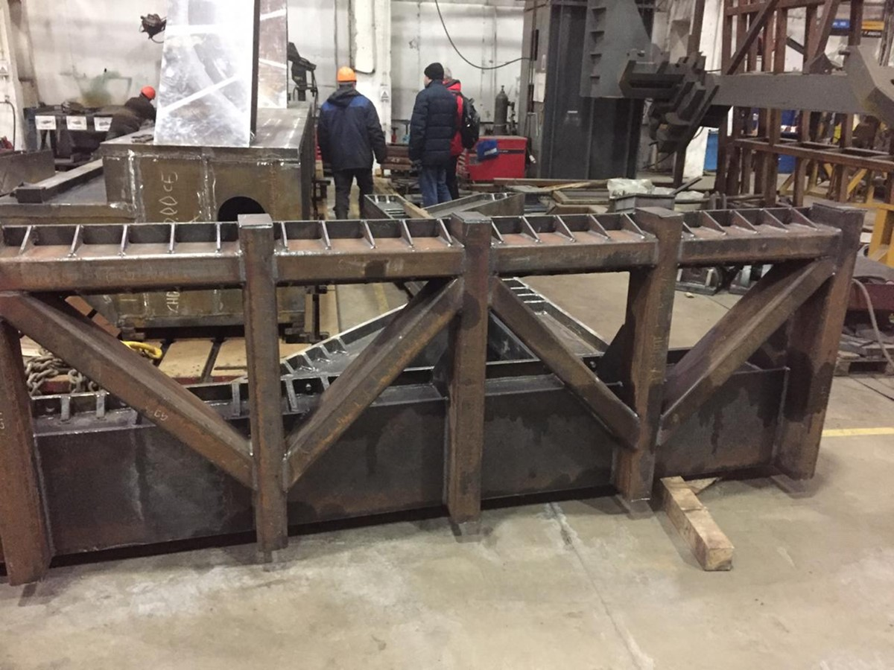
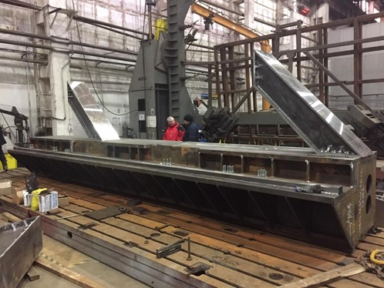
Yoke production and assembling

Slide 19
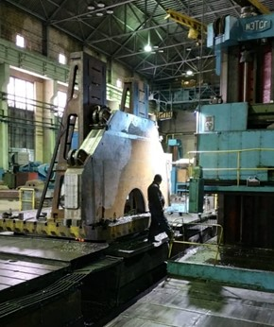
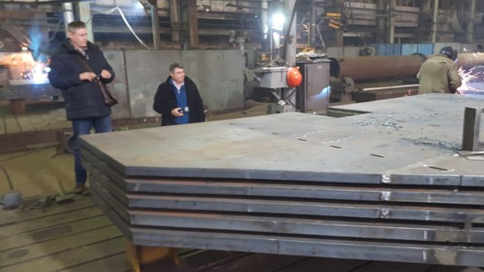
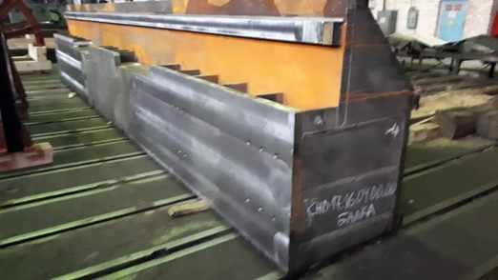
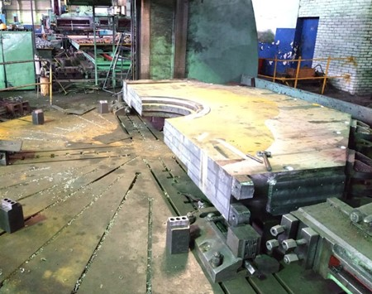
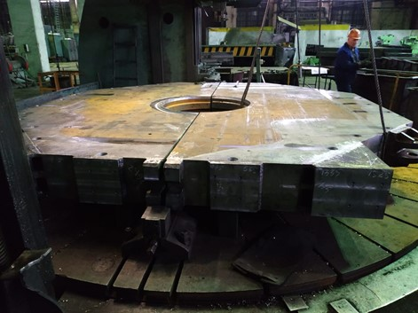
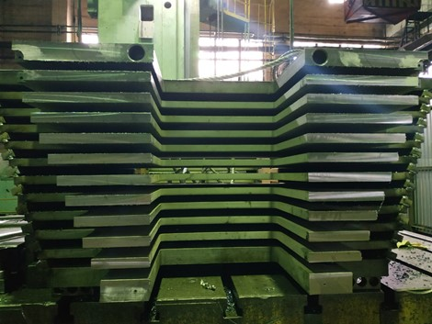
Yoke production and assembling

Slide 20
Yoke production and assembling
Item | Date
Production all parts of the yoke | 04/2020
Control assembling | 05-06/2020
Additional machining | 06-07/2020
Paint all parts | 7/2020
FAT and assembling of the yoke | 07 – 08 /2020
Control dimension of the yoke | 09-10/2020
Delivery to BINP and SAT | 09-10/2020

Slide 21
Conclusion
Name of item | Status of work
Yoke and frame | In production
Cryostat of solenoid | Design is ready, technological development, purchasing raw material, preparation drawings of tooling. Call for tender
Cold mass | Design is ready, technological development, purchasing raw material, preparation drawings of tooling. Call for tender
Conductor purchasing | Development work, Call for tender for production of the Rutherford cable
Control Dewar box | Preliminary design April 2020
PANDA solenoid power cabling | Design is ready, production
Power supply and energy extraction system | Detail design is ready Purchasing power supply and electrical components, production
Magnet safety system | in process
FAT | Preparation place for PANDA solenoid installation, procedures installation, development a flow scheme of connection KEDR-PANDA solenoid cryogenics

Slide 22
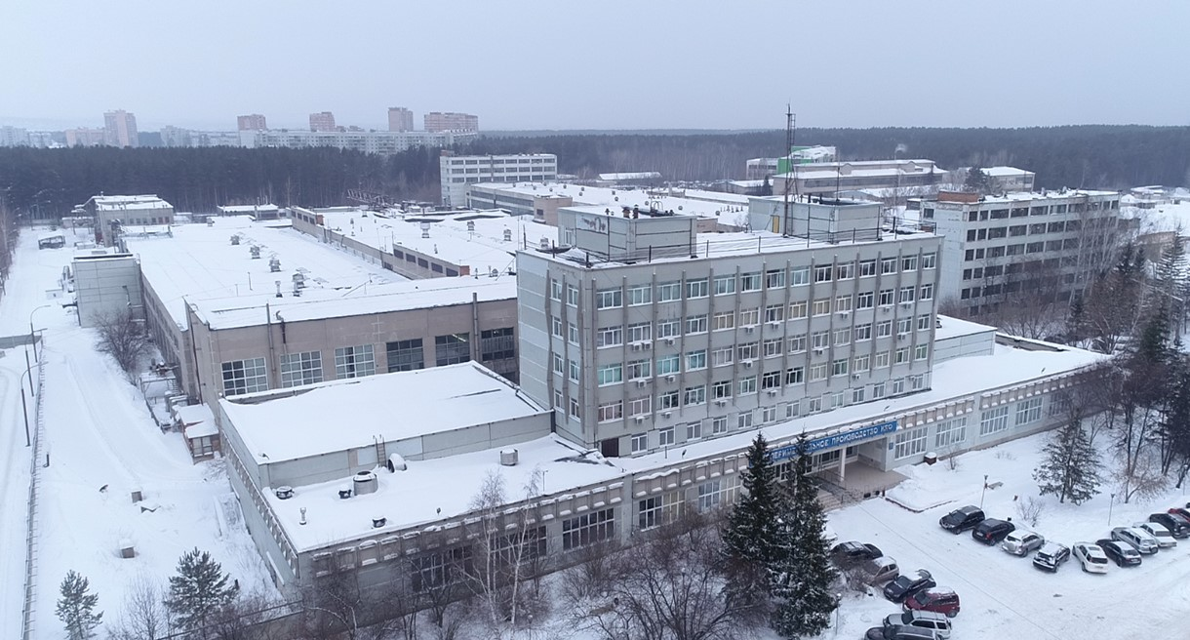
Thank you for your attention

