Slide 1
Analysis of the channels Ψ(3770) → D⁺D⁻ →K⁻π⁺π⁺ K⁺π⁻π⁻ and η_{c} →K⁰_{S}K⁺π⁻ → π⁺π⁻K⁺π⁻ with pandaroot
Susanna Costanza - Pavia Group
PANDA C.M., Stockholm – June 14, 2010

Slide 2
Outline
Ψ → D⁺D⁻ → K⁻π⁺π⁺ K⁺π⁻π⁻
Events generation and simulation
Events reconstruction
Analysis
MC test of the 4C fitter
Invariant masses with/without kinematic fit
Resolution & efficiency
η_{c} → K⁰_{S}K⁺p⁻ → π⁺π⁻K⁺π⁻
Events generation and simulation
Events reconstruction & analysis
Invariant masses
Resolution & efficiency
Comparison

Slide 3
Ψ(3770) → D⁺D⁻ →K⁻π⁺π⁺ K⁺π⁻π⁻

Slide 4
events generation and simulation

Slide 5
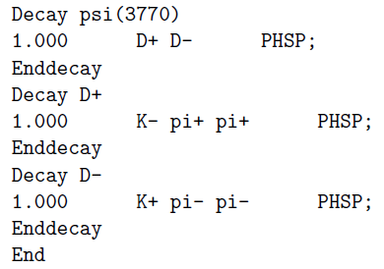
Events generation
Decay file:
No background
simpleEvtGen:
100k events
E_{cm} = m(Ψ) = 3.7699 GeV → p(Ψ) = (0., 0., 6.57, 7.57) GeV

Slide 6
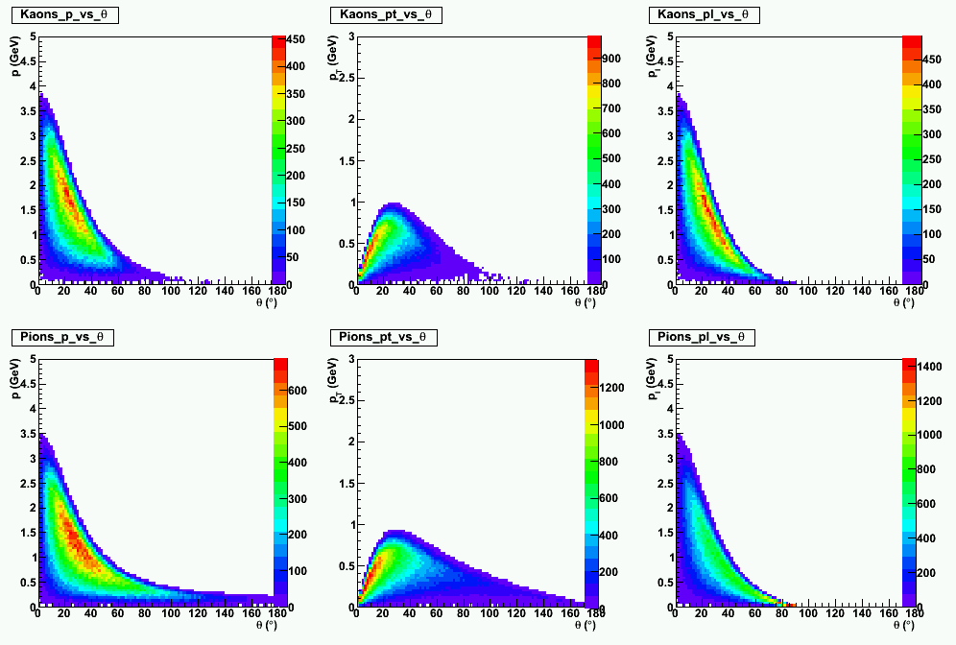
MC momentum distributions vs θ

Slide 7
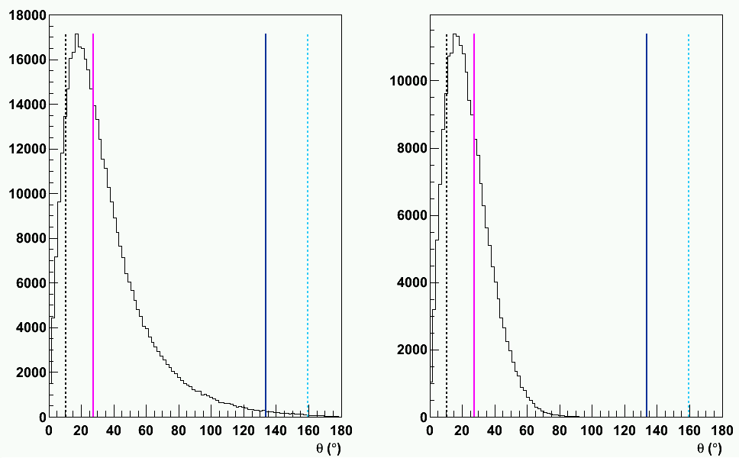
MC angular distributions
α
α’
β’
β
α
α’
β’
β
PIONS
KAONS

Slide 8
Geometrical remarks
α = 10.6°
α’ = 27.7°
β’ = 133.6°
β = 159.5°
α’ < θ < β’ :
Hits in ALL layers
β’ < θ < β:
Hits NOT in ALL layers
r (cm)
42
α < θ < α’:
Hits NOT in ALL layers
15
β’
α’
β < θ < π:
STT “blind”
β
0 < θ < α:
STT “blind”
α
-40
I.P.
80
z (cm)
STT
GEM
FT
Angular distribution of the tracks peaked in the forward direction, where the Straw Tracker is totally or partially “blind”
Importance of the GEM chambers and of the Forward Tracker!!!

Slide 9
events reconstruction & ANALYSIS

Slide 10
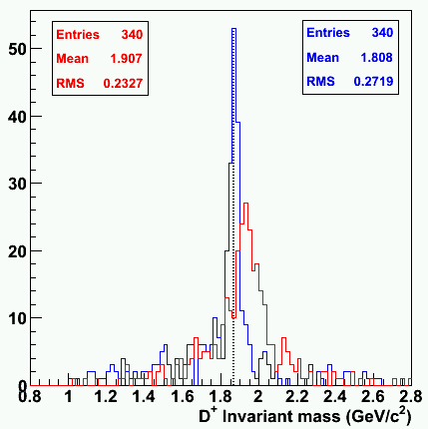
Reconstruction steps
Reconstruction with LHEtrack
(trunk/macro/pid/run_reco_sttcombi.C):
Ideal pattern recognition
Fit with:
MVD (real),
STT (helix hits from MC points),
GEM … ?
LHETrack
KALMAN
Systematic shift of the mean
The helix fit is not the suitable in a region where the magnetic field is not constant

Slide 11
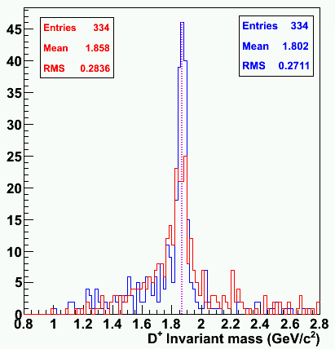
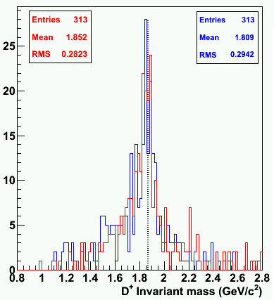
GEM chambers – remarks
LHETrack
KALMAN
LHETrack
KALMAN
LHETrack
KALMAN
LHETrack
KALMAN
Kalman = prefit
NECESSARY to include GEM chambers in the Kalman

Slide 12
Reconstruction steps (II)
Reconstruction with LHEtrack:
Ideal pattern recognition
Fit with:
MVD (real points),
STT (helix hits from MC points),
no GEM
Kalman filter (trunk/macro/pid/run_reco_sttcombi.C):
MVD + STT + GEM
STT
z information excluded
σ_{r} for the reco hits:
Constant = 100 μm
Juelich experimental curve from COSY-TOF
Juelich experimental curve from the prototype (factor 2 larger)
Back propagation of primary tracks to their vertex (MC info)

Slide 13
Particles Identification
TCandLists (tutorials/charmonium/run_pid_sttcombi.C):
Reconstructed charge
Mass and PDG information from MC truth
PndPidIdealAssociatorTask
Wrong 7x7 covariance matrix
the track parameters are:
Geane (6):
Kinematic fit (7):
Cov (7x7) computed with parameters in the wrong order
CORRECTED LOCALLY

Slide 14
Events analysis
Ad hoc analysis macro… on the basis of the ones in trunk/tutorials/charmonium
Charged (plus and minus) and Neutral TCandLists from PID
Cuts:
Reject secondary tracks (from MC index) →identify daughter particles from D⁺ and D⁻
Reject tracks with Kalman flag < 0
D candidates:
D.Combine(K, π, π)
D.Select(D_Mass_Selector) → (1.8696 ± 0.3) GeV/c²
Ψ candidates:
Ψ.Combine(D⁺, D⁻)

Slide 15
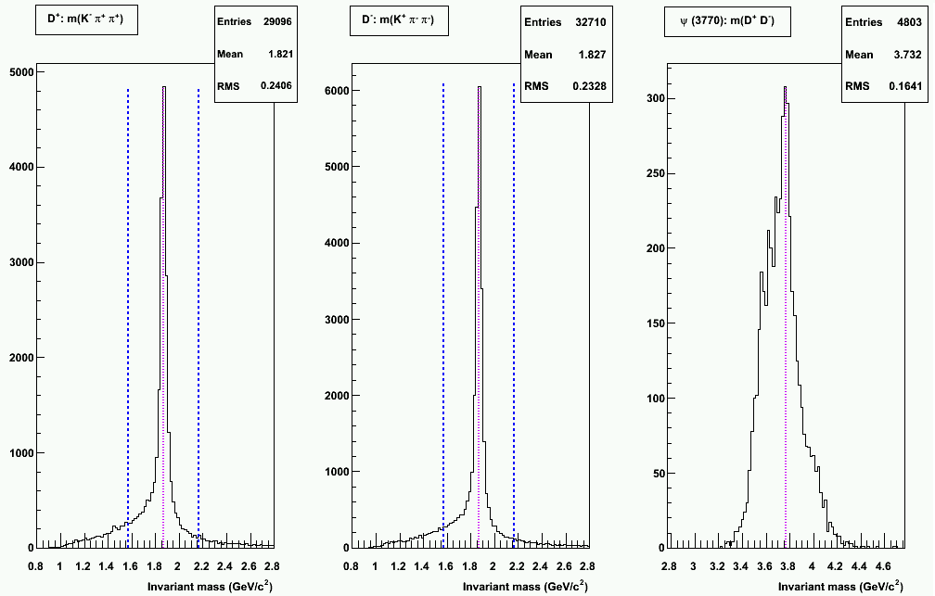
Invariant masses

Slide 16
… next step … KINEMATIC FIT!!!
MC test of the 4C FITTER

Slide 17
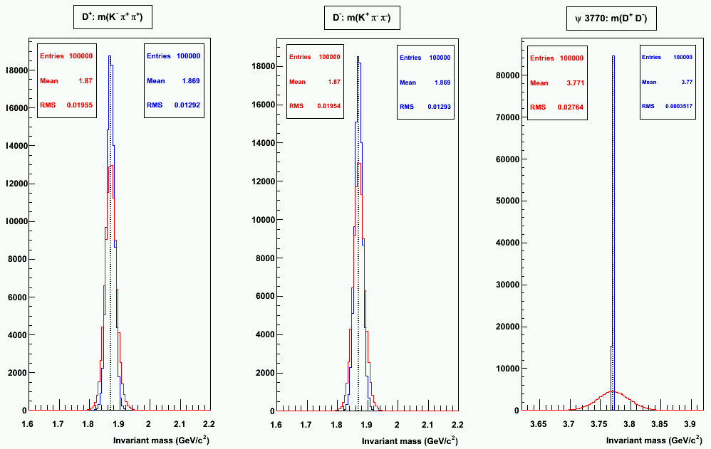
MC Invariant Masses
KALMAN
KINEMATIC FIT

Slide 18
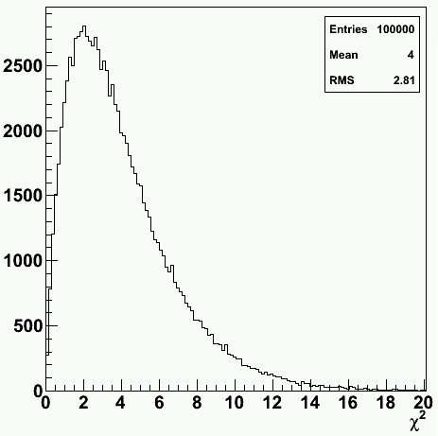
χ² distribution
ν = 4 (NDF)
<χ²> = ν = 4
Var(χ²) = 2ν = 8
σ(χ²) = 2.83

Slide 19
… ready to apply the 4C fitter to the Ψ(3770) events!

Slide 20
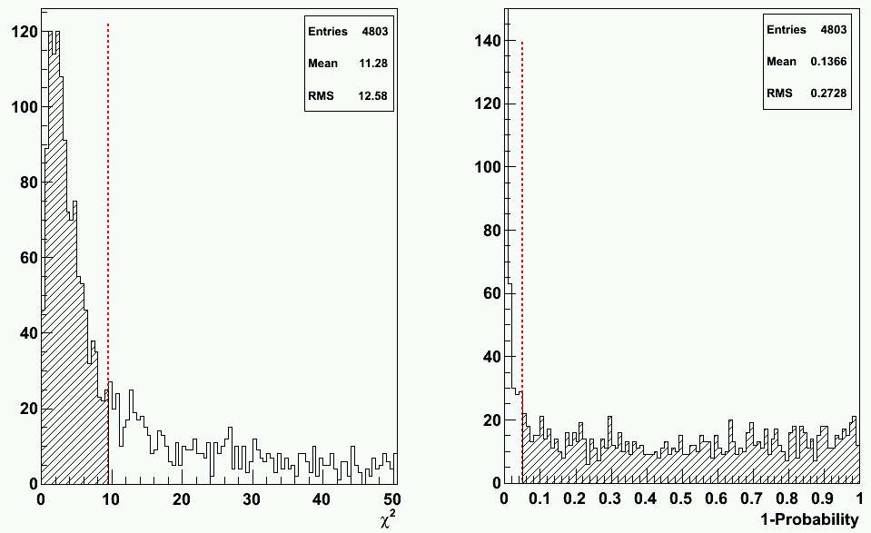
χ² distribution
χ² > 9.5
P < 0.05%
χ² > 9.5
events rejected

Slide 21
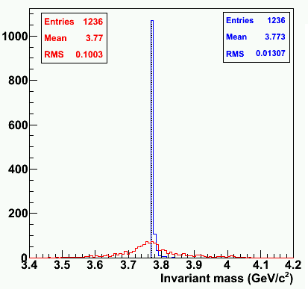
Ψ(3770) Invariant Mass
Forced to the exact value by the 4C fit constraint
KALMAN
KINEMATIC FIT

Slide 22
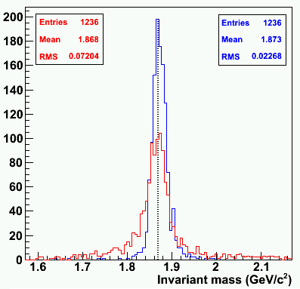
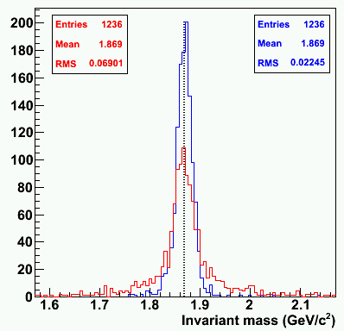
D⁺/D⁻ Invariant Masses
D⁺
D⁻
KALMAN
KINEMATIC FIT

Slide 23
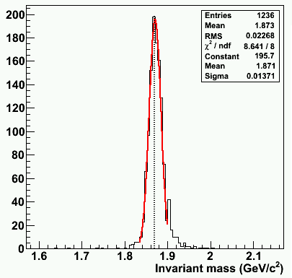
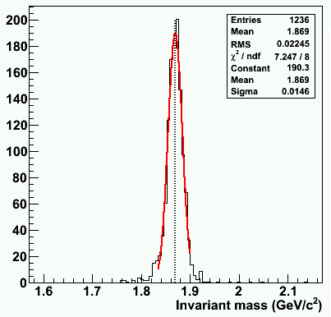
D⁺/D⁻ Resolution
D⁺
D⁻
Resolution: 0.73%
Resolution: 0.78%

Slide 24
Efficiencies
Simulated tracks: 600000
Output trks from LHEtrack: 503293 (83.88% of the sim trks)
Good trks from Kalman (flag>0): 418186 (83.09% of the LHE trks)
Good trks from back prop (flag, q): 407428 (80.95% of the LHE trks)
GOOD EVT = ALL the 6 primary tracks have to be “good” (cuts passed)
Simulated events: 100000
Output evts from LHEtrack: 34010 (34.01% of the sim evts)
Good evts from Kalman (flag>0): 10858 (31.93% of the LHE evts)
Good evts from back prop (flag, q): 8889 (26.14% of the LHE evts)
Analysis:
D⁺ found: 29096
D⁻ found: 32710
Ψ found: 4803 (14.1% of the LHE evts)
Kinematic fit (χ² cut): 1236 (3.6% of the LHE evts)

Slide 25
Efficiencies (II)
Reasons for the low efficiency?
Detector errors not tuned?
Low single track efficiency for low momenta particles?
Geane back propagation failures → why?
Kalman failures → why?
LHEtrack failures (wrong reconstructed charge, bad results from prefit, …) → why?
… to be investigated!!!

Slide 26
η_{c} →K⁰_{S}K⁺π⁻ → π⁺π⁻K⁺π⁻

Slide 27
events generation and simulation

Slide 28
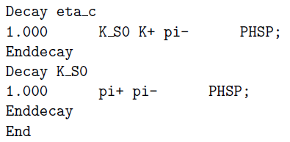
Events generation
Decay file:
No background
simpleEvtGen:
100k events
E_{cm} = m(η_{c}) = 2.9798 GeV → p(η) = (0., 0., 3.68, 4.73) GeV

Slide 29
MC momentum distributions vs θ

Slide 30
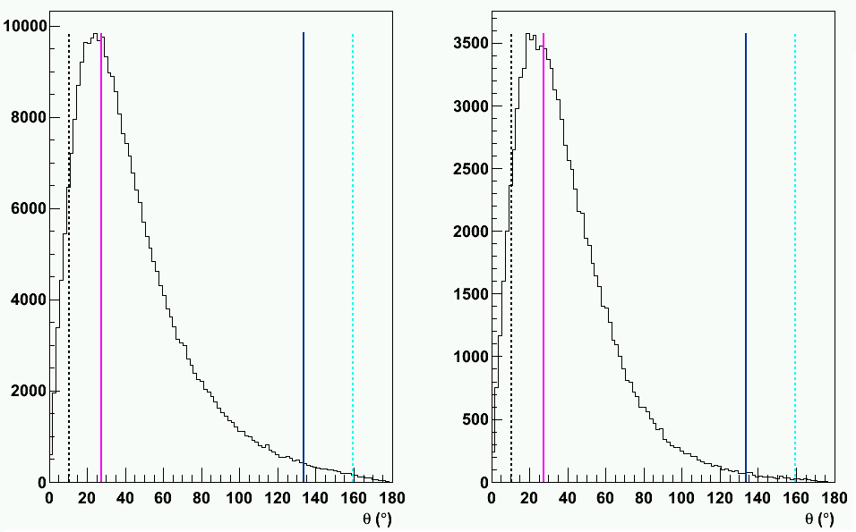
MC angular distributions
α
α’
β’
β
α
α’
β’
β
PIONS
KAONS

Slide 31
events reconstruction & ANALYSIS

Slide 32
Events reconstruction and analysis
Reconstruction with LHEtrack
Ideal pattern recognition
Fit: MVD → real, STT→ MC, no GEM
Kalman filter
MVD + STT + GEM
Back propagation to the primary vertex
Particles Identification (ideal)
Charged (plus and minus) and Neutral TCandLists
Analysis for the invariant mass
Cuts:
Reject secondary tracks (from MC index) →identify K⁰_{S} decay products
Reject tracks with Kalman flag < 0
K⁰_{S} candidates:
Mass Selection: (497.67 ± 30) MeV/c²
η_{c} candidates:

Slide 33
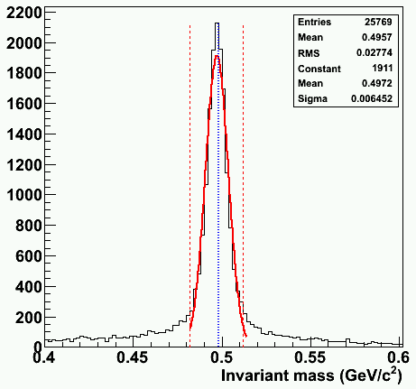
K⁰_{S} Invariant Mass
K⁰_{S}
Mass window
Resolution:
1.29%

Slide 34
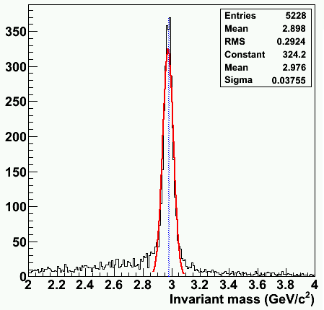
η_{c} Invariant Mass
η_{c}
Juelich resolution curve
from COSY-TOF
Resolution: 1.2%

Slide 35
Efficiencies
Simulated tracks: 400000
Output trks from LHEtrack: 343989 (85.99% of the sim trks)
Good trks from Kalman (flag>0): 255511 (74.28% of the LHE trks)
Good trks from back prop (flag, q): 235528 (68.47% of the LHE trks)
GOOD EVT = ALL the 4 primary tracks have to be “good” (cuts passed)
Simulated events: 100000
Output evts from LHEtrack: 56086 (56.09% of the sim evts)
Good evts from Kalman (flag>0): 14882 (26.53% of the LHE evts)
Good evts from back prop (flag, q): 10126 (18.05% of the LHE evts)
Analysis:
K⁰_{S} found: 25769
K⁰_{S} found in the mass window: 15530
η_{c} found: 5228 (9.32% of the LHE evts)

Slide 36
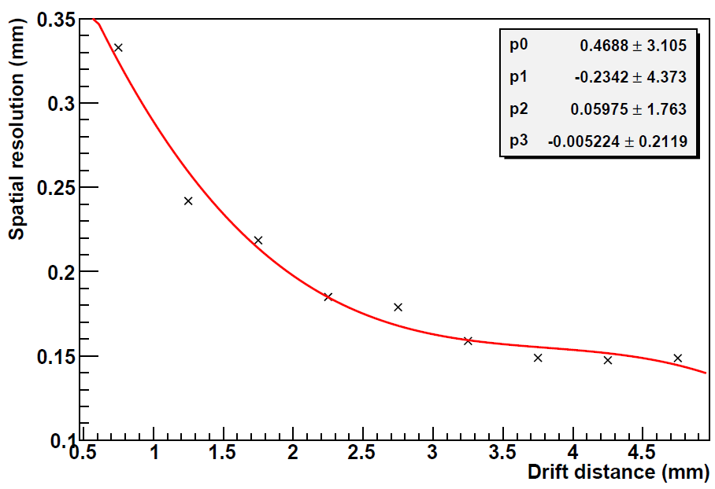
… with the resolution curve from the Juelich prototype data in the digitization step…

Slide 37
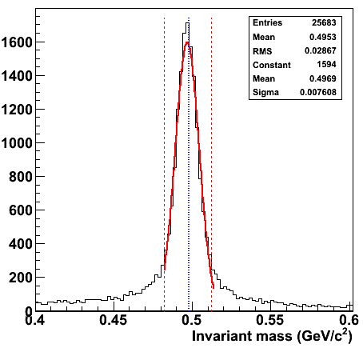
K⁰_{S} Invariant Mass
K⁰_{S}
Mass window
Resolution (COSY-TOF):
1.29%
Resolution:
1.53%

Slide 38
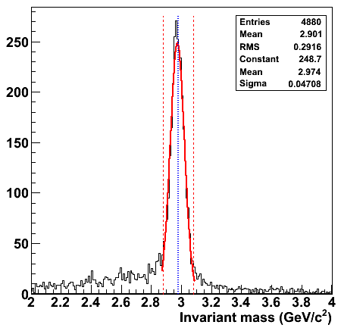
η_{c} Invariant Mass
η_{c}
Resolution: 1.57%
Resolution (COSY-TOF): 1.25%

Slide 39
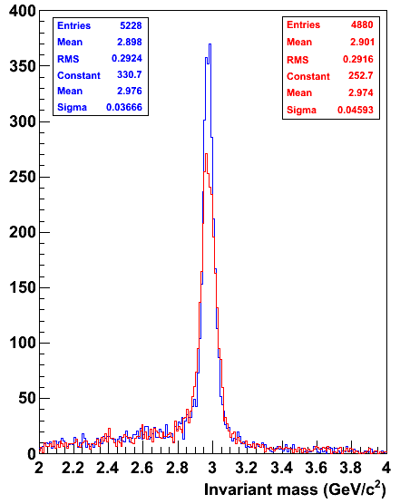
η_{c} Invariant Mass - comparison
Resolution:
1.25%
Resolution:
1.61%

Slide 40
Conclusions
Two decay channels have been studied, from simulation to reconstruction and analysis
Preliminary results have been obtained for the invariant mass of the Ψ(3770) and η_{c} resonances
Resonable mass resolutions obtained
Problems of low event reconstruction efficiency → to be investigated
The analysis of decay channels is feasible in PANDAroot, even though results can still be improved!
Thank you!

