Slide 1
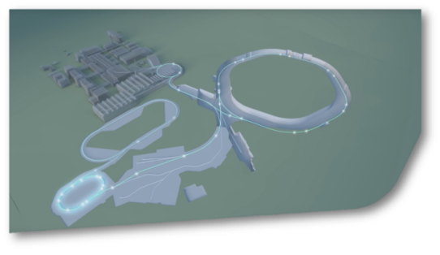
SIS18 Status Report KW06
SIS18
There is an increasing risk for operation by rain water penetrating through openings and through the wall in front of the kicker-room and entering into electronic components. The issue has been addessed to the GA.
The third revision of the new TS1MU1 has been
successfully completed by DANFYSIK. The magnet
is now ready for installation. As next step the chamber
will be integrated for cooling tests.
Three quadrupole magnets identified which can be used for the new HHD beam line.

