Slide 1
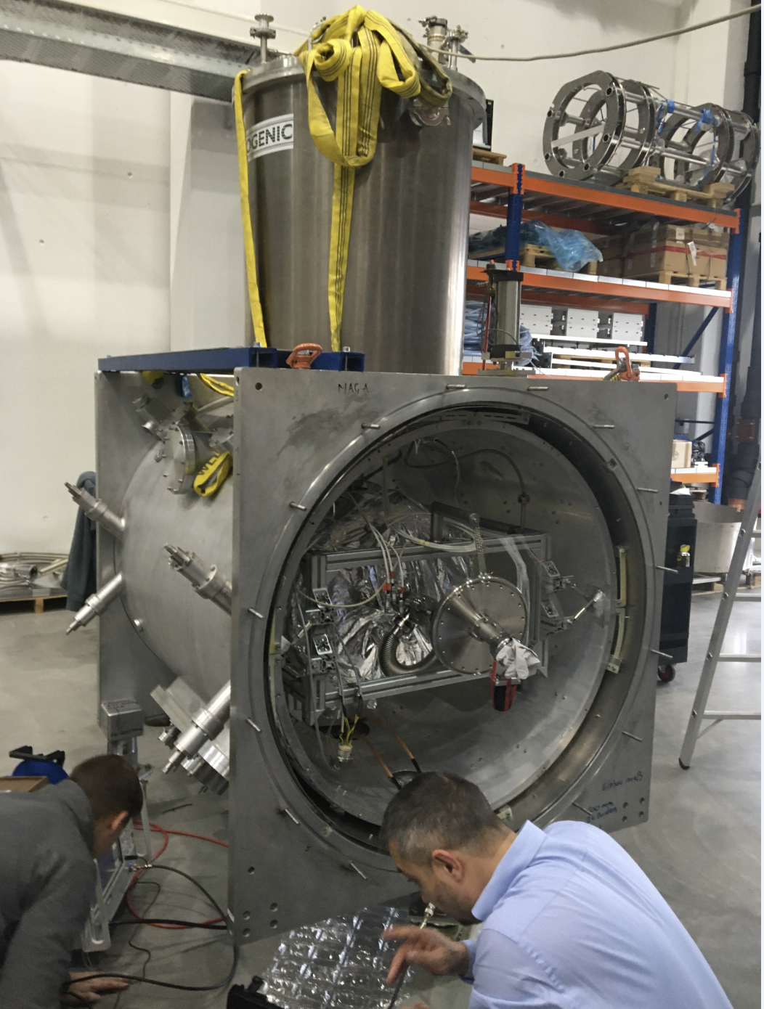
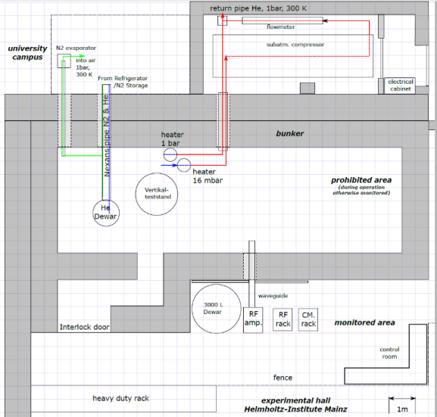
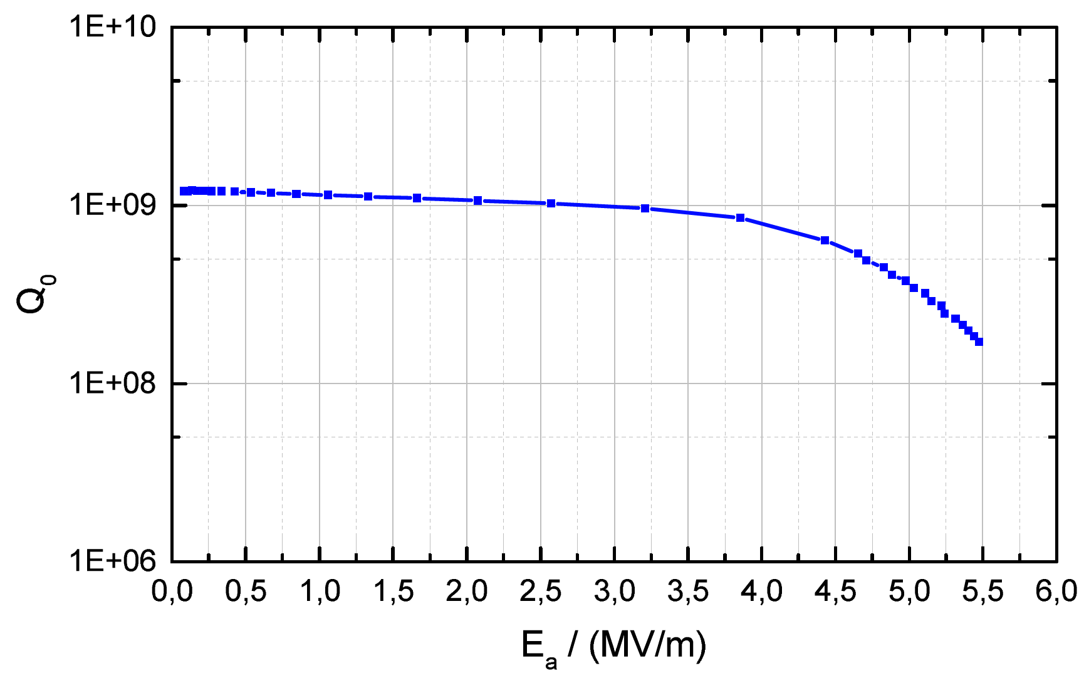
cw-LINAC (14.12.2020)
Advanced Demonstrator (HI-Mainz activities)
CH-cavities (CH1&2) at RI for final preparation
CH1 delivered to Mainz, first RF-test @HI-Mainz in the horizontal test cryostat asap
CH2 delivered to Frankfurt, Rf-testing @ GUF in a vertical cryostat asap
Further testing not possible due to missing Oxygen sensor!
HI-Mainz Lab-activities
preparation of test cryostat o.k.
set up of cryo, rf, controls-infratsructure o.k.
preparation of test cave o.k.
CH1-Test
HIM/Lab.
First cavity test at horizontal cryostat
(Mainz, December 19)

Slide 2
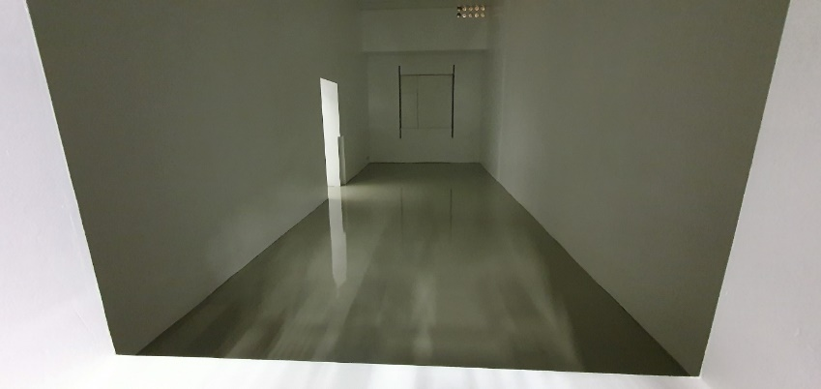
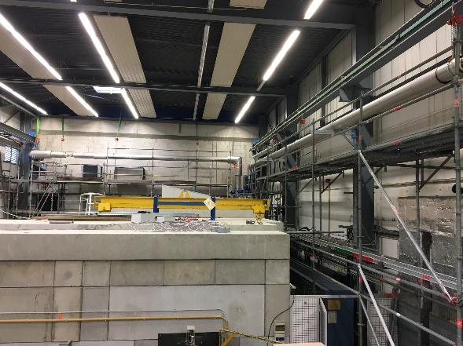
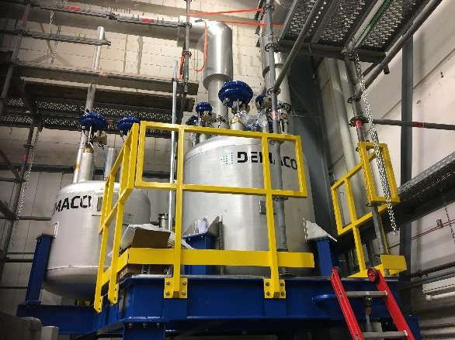
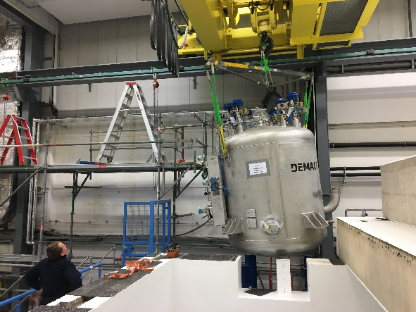
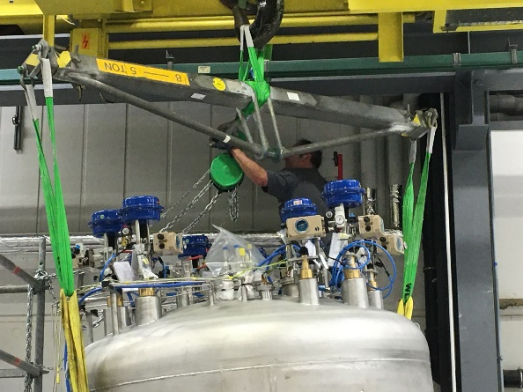
Preparation of Advanced Demonstrator cave and its infrastructure
setup of bunker accomplished => setup of infrastructure => setup of beamline
dismantling of the scaffolding => cleaning SH1 (G. Gruber)
set up of cryo transfer line, incl. all distr. boxes and controls – Restart of activities – weld inspection (X-Ray) accomplished
Ordering
4 RF-amplifiers (o.k.)
2 sc solenoids (delivery: Q2/2020)
cryostat I (delivery: Q2/2020)
cryostat II (o.k.)
(ultrapure) Niobium delivered (SAT, qualification at DESY this week)
2 sc rebunchers (o.k.)
2 sc CH cavities (CH1 FAT, SAT o.k.)
cryo supply controls (o.k.)
2 Feschenko Monitors (cw-Linac + p-Linac) (delivery: autumn 2020, SAT at cw-Linac-transfer line)

