Slide 1
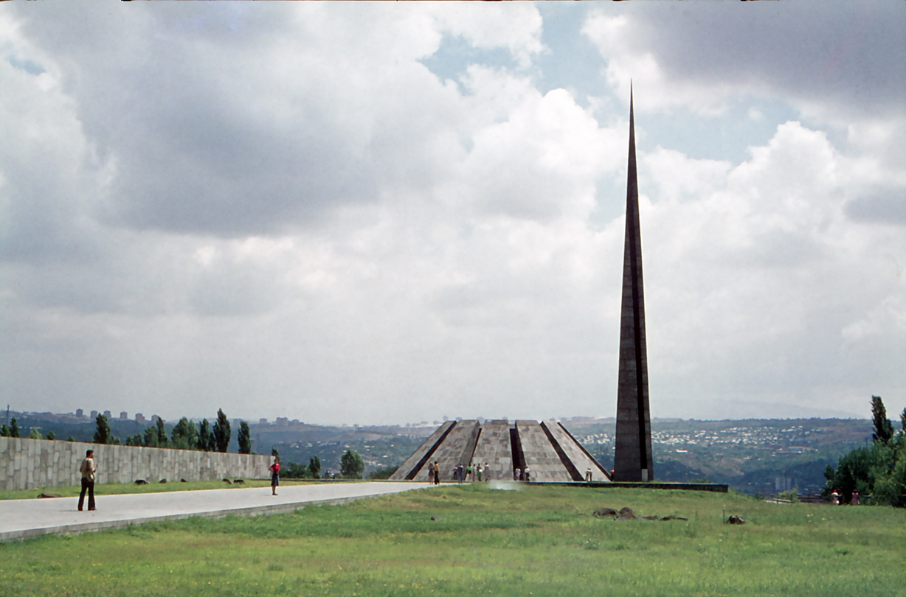
Yerevan 1976

Slide 2
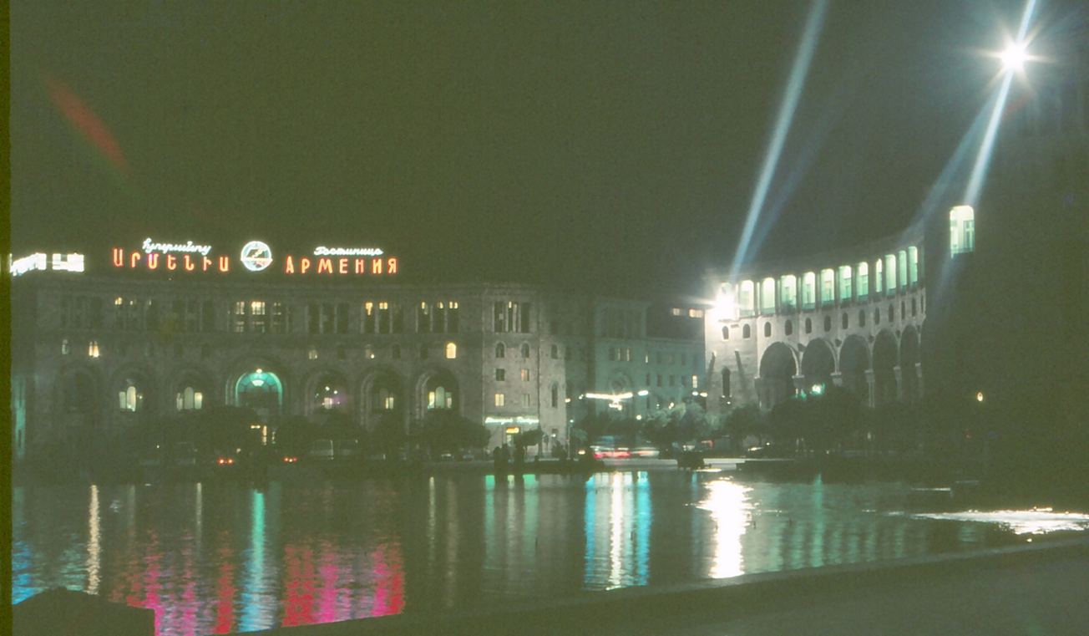

Slide 3
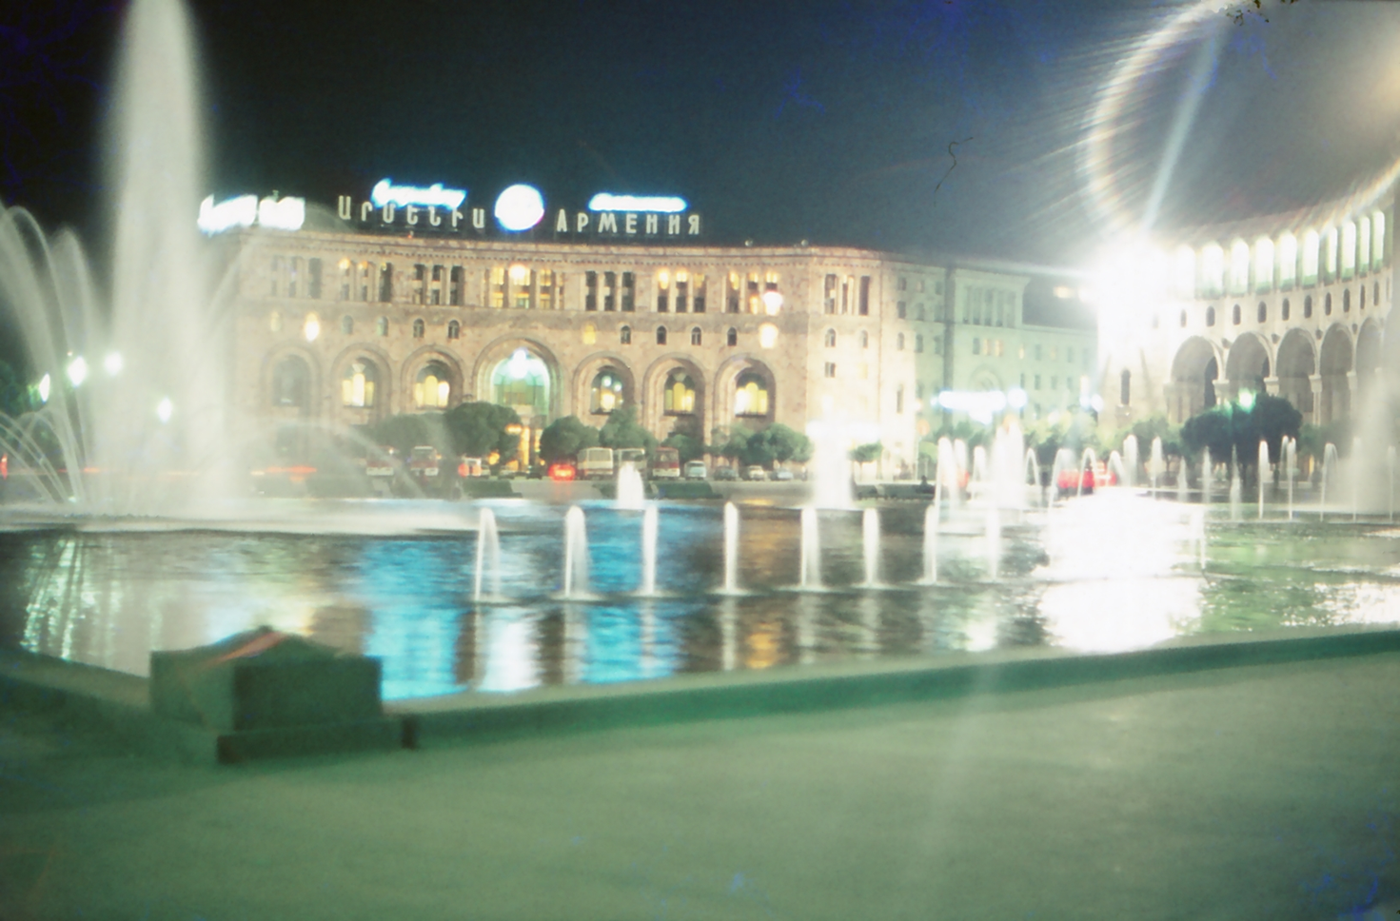

Slide 4
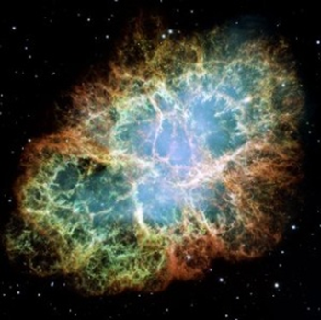
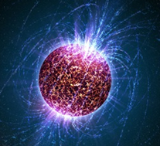
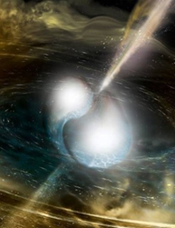
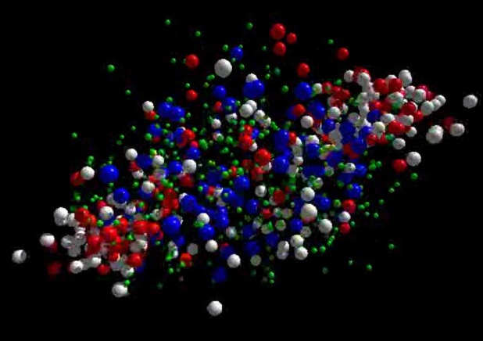





neutron
matter
Cosmic matter in the laboratory -
The CBM experiment at FAIR
Outline:
Peter Senger
The Facility for Antiproton and Ion Research
Exploring cosmic matter in the laboratory
- the high-density nuclear matter equation-of-state
- the QCD phase diagram
➢ The Compressed Baryonic Matter (CBM) experiment
The Modern Physics of Compact Stars and Relativistic Gravity (MPCS ) 2019
17-21 September 2019, Yerevan, Armenia

Slide 5
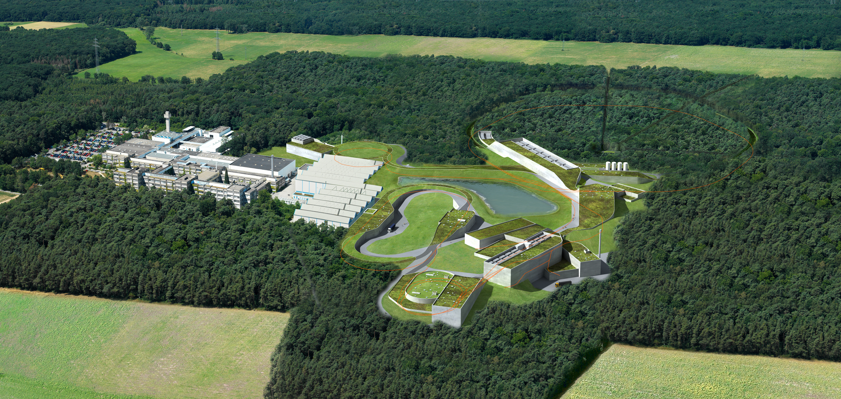
FAIR – Facility for Antiproton and Ion Research
Facility for Antiproton and Ion Research
FAIR is worldwide the largest project in fundamental science.
Forefront research in nuclear, hadron, atom, plasma, antimatter, and applied physics.
Member states: Germany, Russia, India, Poland, Romania, France, Finland, Sweden, Slovenia,
Great Britain.
2500 – 3000 users per year.
Construction in progress, full completion in 2025.
Financing: Fed. Rep. Germany 60%, Hesse 10%,
partner countries 30%

Slide 6











Facility for Antiproton & Ion Research
SIS100/300
p-Linac
SIS18
Compressed Baryonic Matter
Primary Beams
10¹²/s; 1.5 GeV/u; ²³⁸U²⁸⁺
10¹⁰/s ²³⁸U⁹²⁺ up to 11 (35) GeV/u
3x10¹³/s 30 (90) GeV protons
Anti-Proton Physics
HESR
Super Fragment-Separator:
Nuclear Structure and Astrophysics
Secondary Beams
radioactive beams up to
1.5 - 2 GeV/u;
10¹¹ antiprotons 1.5 - 15 GeV/c
Technical Challenges
FAIR phase 1
FAIR phase 2
CR
rapid cycling superconducting magnets
dynamical vacuum
6
100 m

Slide 7
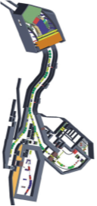
Facility for Antiproton & Ion Research
Experimental programs
SIS18
SIS100/300
p-Linac
Compressed Baryonic Matter
HESR
Anti-Proton Physics
Super Fragment-Separator:
Nuclear Structure and Astrophysics
NUSTAR: Rare Isotope beams
Nuclear structure
Nuclear astrophysics:
Origin of elements in universe?
CR
FAIR phase 1
FAIR phase 2
100 m
7

Slide 8
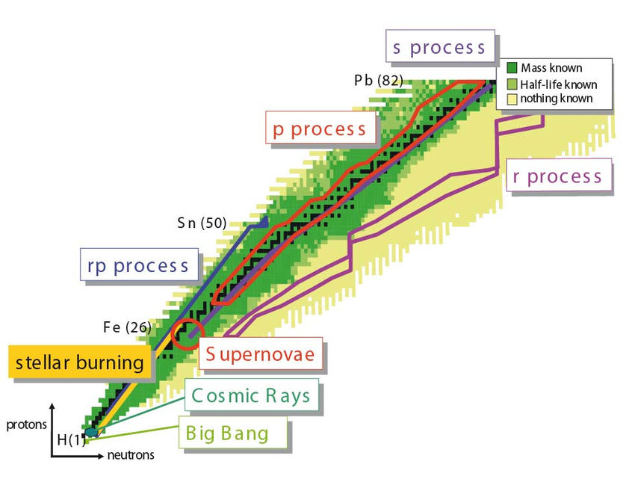

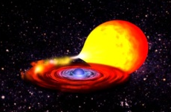

Nuclear astrophysics: The origin of elements
Measurements in the laboratory: Mass, lifetime, decay channels, structure of very rare instable (neutron or proton rich) nuclei
rp-, p- process:
Synthesis of nuclei with masses close to and beyond the proton dripline in binary systems of a sun and a neutron star
X-ray binary
s- (slow) process:
Synthesis of heavy nuclei via slow neutron capture in very massive stars
r- (rapid) process:
Synthesis of very neutron-rich instable nuclei via rapid capture of neutrons in neutron star mergers
8

Slide 9
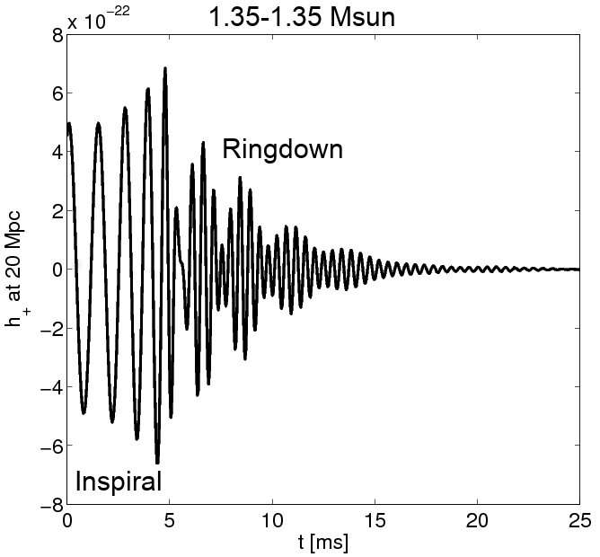
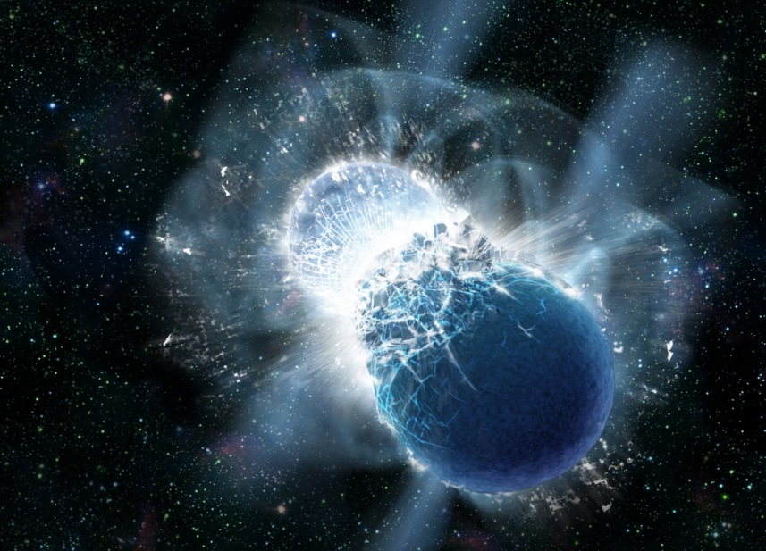
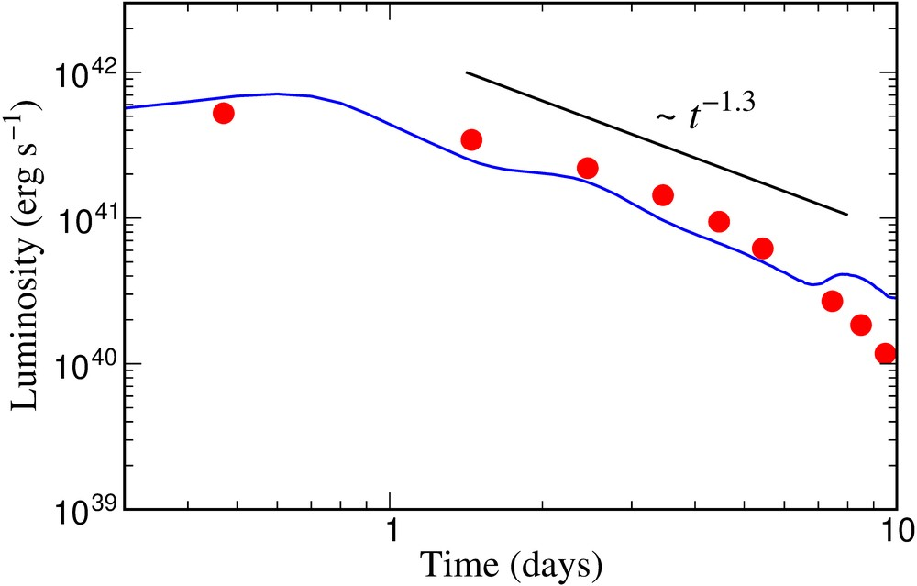
Astrophysical site of heavy element production
(r process) in the universe: Neutron star merger !
A. Bauswein
Neutron star merger
Metzer, Martinez-Pinedo, Arcones et al. (2010)
Astrophys. J. 848, L12 (2017)
Gravitational
Wave Signal
Electromagnetic “Kilonova” Signal
Copyright: Dana Berry, SkyWorks Digital, Inc
Electromagnetic “Kilonova” signal due to “r process” in neutron star merger theoretically predicted by GSI scientists in 2010.
Confirmation by recent astronomical observations after gravitational wave detection from GW170817 (August 2017).
Source of heavy elements including gold, platinum and uranium.
Sun

Slide 10
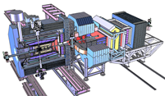
Facility for Antiproton & Ion Research
Experimental programs
SIS18
SIS100/300
p-Linac
Compressed Baryonic Matter
HESR
Anti-Proton Physics
Super Fragment-Separator:
Nuclear Structure and Astrophysics
PANDA:
Antiproton-proton collisions
CR
FAIR phase 1
FAIR phase 2
100 m
10

Slide 11
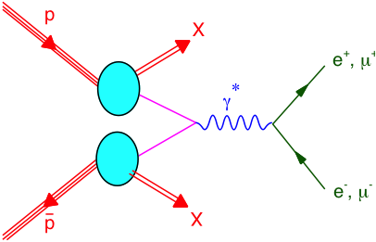
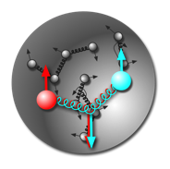
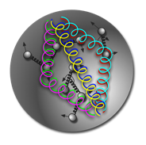
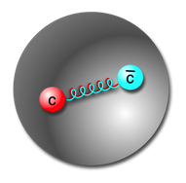
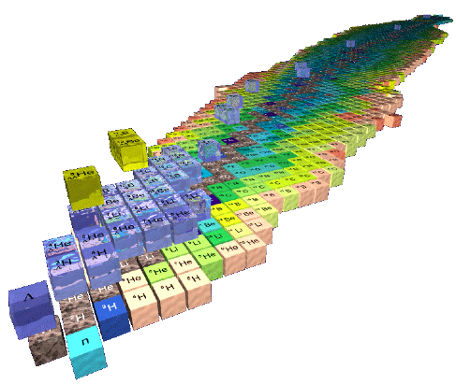
Hadron Physics with antiprotons at FAIR
Gluonic excitations:
Hybrids, glueballs
Charmonium states:
Precision
spectroscopy
Time-like form factors,
nucleon structure
In medium mass modifications:
Extension to the charm sector
Extension of nuclear chart:
Double hypernuclei
π⁻
25 MeV
π
π⁺
K⁺
K
100 MeV
K⁻
D
D⁻
50 MeV
D⁺

Slide 12
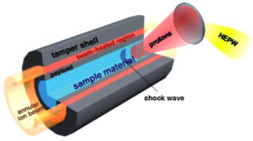
Facility for Antiproton & Ion Research
Experimental programs
SIS18
SIS100/300
p-Linac
HESR
Anti-Proton Physics
Super Fragment-Separator:
Nuclear Structure and Astrophysics
Atomic
Physics
Plasma &
Applied Sciences
CR
FAIR phase 1
FAIR phase 2
100 m
12

Slide 13
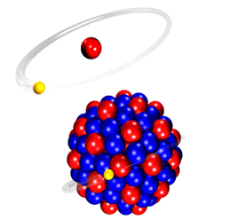
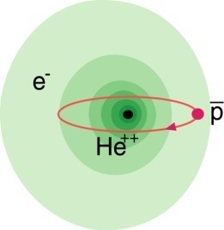
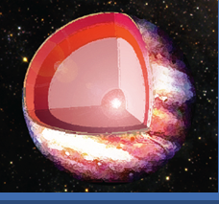
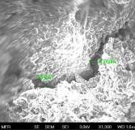
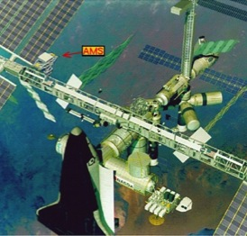
Atomic Physics, Plasma and Applied Sciences
Atomic Physics
Plasma
Materials
Bio
SPARC
FLAIR
HEDgeHOB/WDM
MAT/BIOMAT
BIO/BIOMAT
strong field research
... probing of fundamental laws of physics
anti-matter
... matter / anti-matter asymmetry
planetary interiors
... states of matter common in astrophysical objects
extreme conditions
... radiation hardness and modification of materials
aerospace engineering
... radiation shielding of cosmic radiation
Highest Charge States: Extreme Static Fields
Relativistic Energies: Extreme Dynamical Fields and Ultrashort Pulses
High Intensities: Very High Energy Densities and Pressures
High Charge at Low Velocity: Large Energy Deposition
Low-Energy Anti-Protons: Antimatter Research

Slide 14
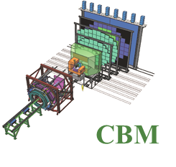
Facility for Antiproton & Ion Research
Experimental programs
SIS18
SIS100/300
p-Linac
Compressed Baryonic Matter
HESR
Anti-Proton Physics
Super Fragment-Separator:
Nuclear Structure and Astrophysics
Compressed Baryonic Matter:
Equation-of-state
Phase transitions
Hypernuclei
CR
FAIR phase 1
FAIR phase 2
100 m
14

Slide 15

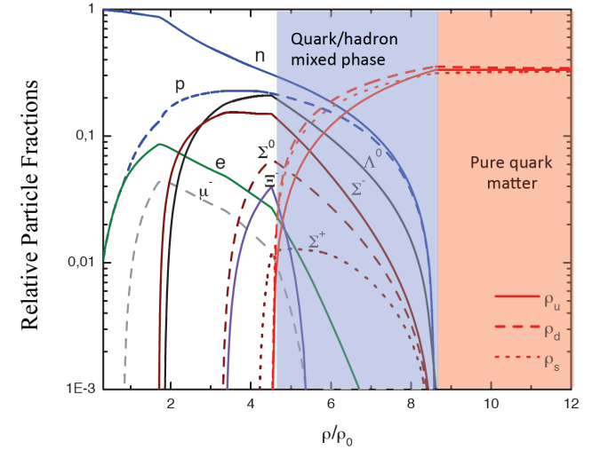

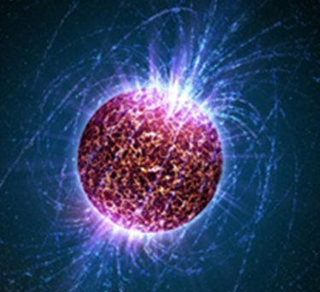
High-density QCD matter in lab and space
EOS
DOF
phase
diagram
15

Slide 16
Neutron star mergers and heavy-ion collisions
density
temperature
M. Hanauske et al.,
J. Phys.: Conf. Ser.
878 012031
n-star merger
EOS
Au +Au
1.5A GeV

Slide 17
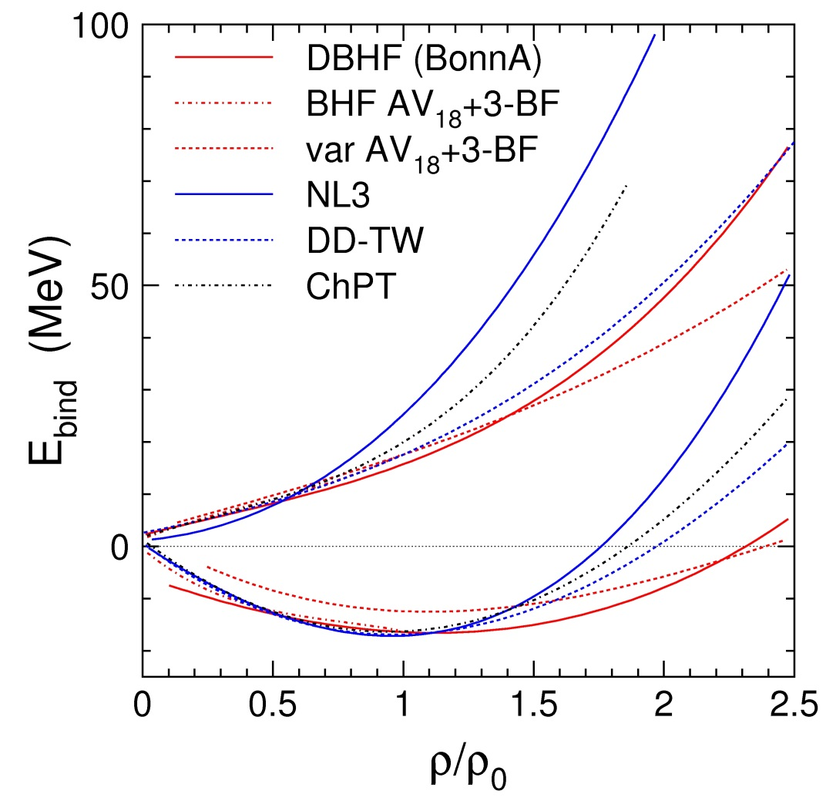
The nuclear matter equation-of-state
The nuclear matter equation of state (EOS) describes the relation between density, pressure, temperature, energy, and isospin asymmetry
P = δE/δV⏐_{T=const}
V = A/ρ
δV/ δρ = - A/ρ²
P = ρ² δ(E/A)/δρ⏐_{T=const}
Ch. Fuchs and H.H. Wolter, EPJA 30 (2006) 5
Neutron matter
E/A
E_{A}(ρ,δ) = E_{A}(ρ,0)+E_{sym}(ρ)·δ²
with δ= (ρ_{n}–ρ_{p})/ρ
E_{sym}
Symmetric matter

Slide 18
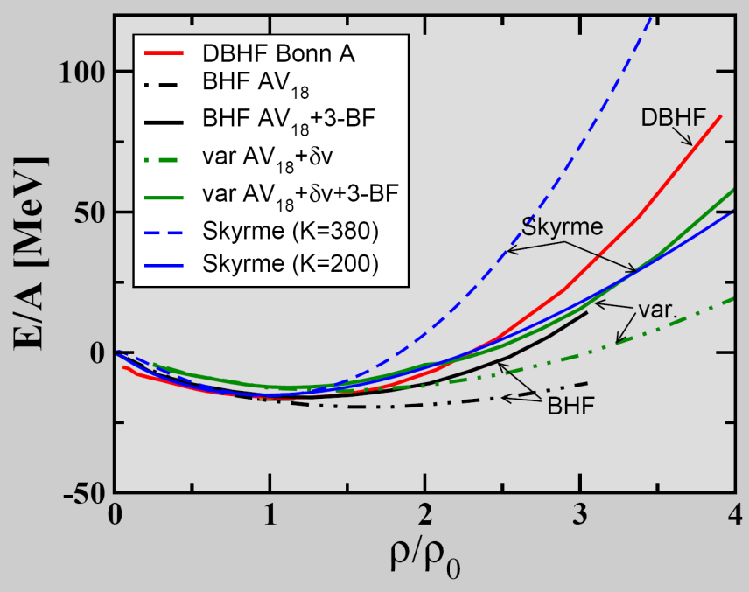
The EOS of (symmetric) nuclear matter
E_{A}(ρ,δ) = E_{A}(ρ,0) + E_{sym}(ρ)·δ² + O(δ⁴)
C. Fuchs, Prog. Part. Nucl. Phys. 56 (2006) 1
T=0: E/A = 1/ρ ∫ U (ρ)dρ
Effective NN-potential:
U(ρ)=αρ+βρ^{γ}
E/A(ρ_{o}) = -16 MeV
slope δ(E/A)(ρ_{o})/δρ = 0
curvature K_{nm} = 9ρ² δ²(E/A)/δρ²
(nuclear incompressibility)
Measurements at GSI SIS18:
elliptic flow of light fragments
subthreshold kaon production
K_{nm} = 200 MeV: "soft" EOS
K_{nm} = 220 ± 40 MeV: "soft" EOS
A. Le Fevre et al., Nucl. Phys. A945 (2016) 112
C. Sturm et al., (KaoS Collaboration) Phys. Rev. Lett. 86 (2001) 39
Ch. Fuchs et al., Phys. Rev. Lett. 86 (2001) 1974
K_{nm} = 380 MeV: "stiff" EOS

Slide 19
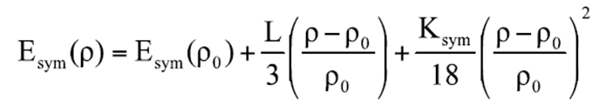
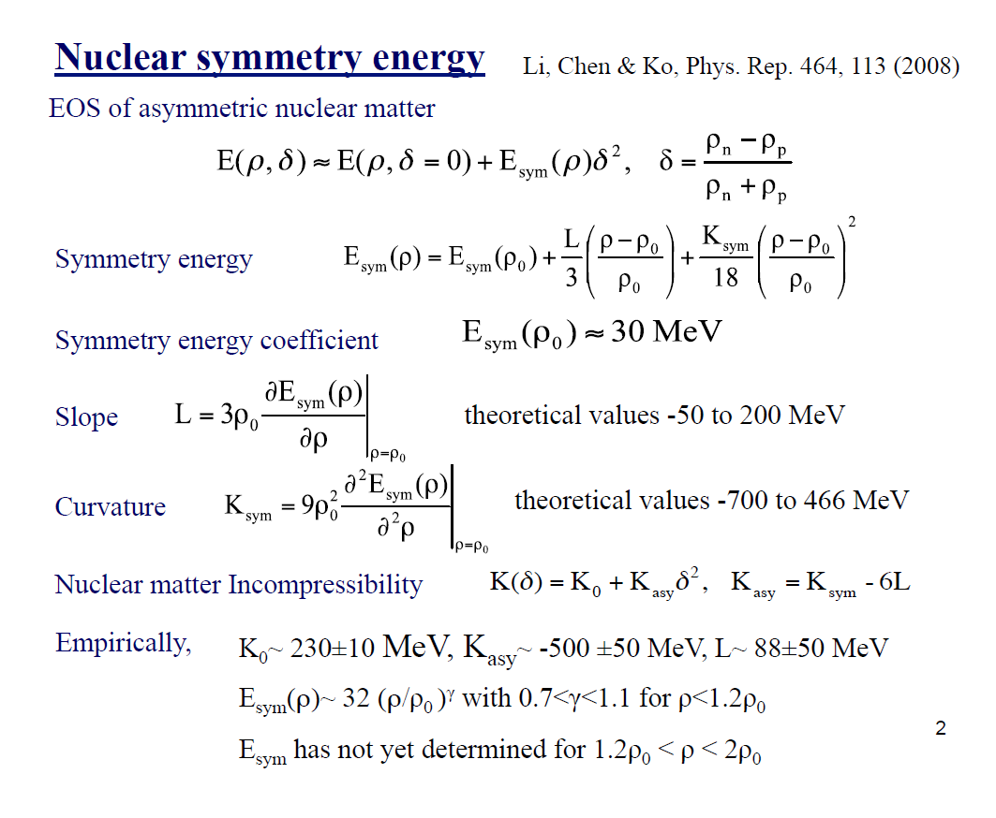
The nuclear symmetry energy
E_{A}(ρ,δ) = E_{A}(ρ,0)+E_{sym}(ρ)·δ²
Ch. Fuchs and H.H. Wolter, EPJA30 (2006) 5
Empirical value E_{sym}(ρ₀) ≈ 30 MeV
slope
theoretical value L(ρ₀) ≈ 60 MeV
E_{sym} (MeV)
B.A. Li and X. Han, Phys. Lett. B 727 (2013) 276
curvature
elliptic flow n/ch
Au+Au 400A MeV
theoretical value K_{sym} = -700 to 470 MeV
P. Russotto et al., Phys. Rev. C 94, 034608 (2016)

Slide 20
Mass-density relation of neutron stars
for different EOS
PSR J0740+6620
M = 2.17±0.11 M_{sun}
H. Cromartie et al.,
arXiv:1904.06759 (2019)
PSR J1614-2230
M = 1.97±0.04 M_{sun}
P. Demorest et al.,
Nature 467, 1081 (2010)
PSR J0348+0432
M = 2.01±0.04 M_{sun}
J. Antoniadis et al.,
Science 340, 6131 (2013)
3 ρ₀
5 ρ₀
T. Klaehn et al., Phys. Rev. C74: 035802, 2006

Slide 21
Mass-density relation of neutron stars
for different EOS
J. M. Lattimer and M. Prakash, From Nuclei to Stars, ed. S. Lee, p.275, WorldScientific. (2011) arXiv:1012.3208v1

Slide 22


Baryon densities in central Au+Au collisions
I.C. Arsene et al., Phys. Rev. C 75, 24902 (2007)
5 A GeV
10 A GeV
8 ρ₀
5 ρ₀
∼ 2 ρ₀
∼ 5 ρ₀
22
courtesy Toru Kojo (CCNU)

Slide 23
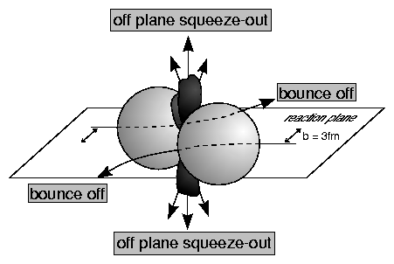
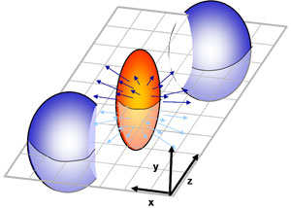
First attempts to study the high-density EOS
EOS of symmetric matter extracted from collective proton flow
→ driven by the pressure gradient in the early fireball
Au+Au collisions measured at AGS for beam energies from 2 to 11A GeV:
„The heavy-ion constraint“
hard EoS
soft EoS
K⁺ prod.
fragment flow
Azimuthal angle distribution:
dN/dφ = C (1 + v₁ cos(φ) + v₂ cos(2φ) + ...)
P. Danielewicz, R. Lacey, W.G. Lynch, Science 298 (2002) 1592

Slide 24
Future attempts to study the high-density EOS
Systematic studies of collective flow of baryons
Threshold production of multi-strange hyperons
Idea:
Ξ and Ω yield at subthreshold energies ∼ multi-step collisions ∼ density → EOS
Hyperon production via multiple collisions
Strangeness production:
pp → K⁺Λ⁰p (E_{thr} = 1.6 GeV)
pp → K⁺K⁻pp (E_{thr} = 2.5 GeV)
pp → K⁺pΛ⁰
pp → K⁺pΛ⁰
pp → K⁺pΛ⁰
Λ⁰Λ⁰→ Ξ⁻ p
Λ⁰ Ξ⁻ → Ω⁻ n
pp → K⁺pΛ⁰
pp → K⁺pΛ⁰
pp → ppK⁺K⁻
Λ⁰Λ⁰→ Ξ⁻ p
Direct multi-strange hyperon production:
pp → Ξ⁻ K⁺K⁺p (E_{thr} = 3.7 GeV)
pp → Ω⁻ K⁺K⁺K⁰p (E_{thr} = 7.0 GeV)
pp → Λ⁰Λ⁰ pp (E_{thr} = 7.1 GeV)
pp → Ξ⁺ Ξ⁻ pp (E_{thr} = 9.0 GeV)
pp → Ω⁺ Ω⁻ pp (E_{thr} = 12.7 GeV
K⁻ Ξ⁻ → Ω⁻ π⁻
pp → K⁺pΛ⁰
p
pp → K⁺pΛ⁰
Λ⁰p→ K⁺ Ξ⁻ p
Λ⁰ Ξ⁻ → Ω⁻ n

Slide 25
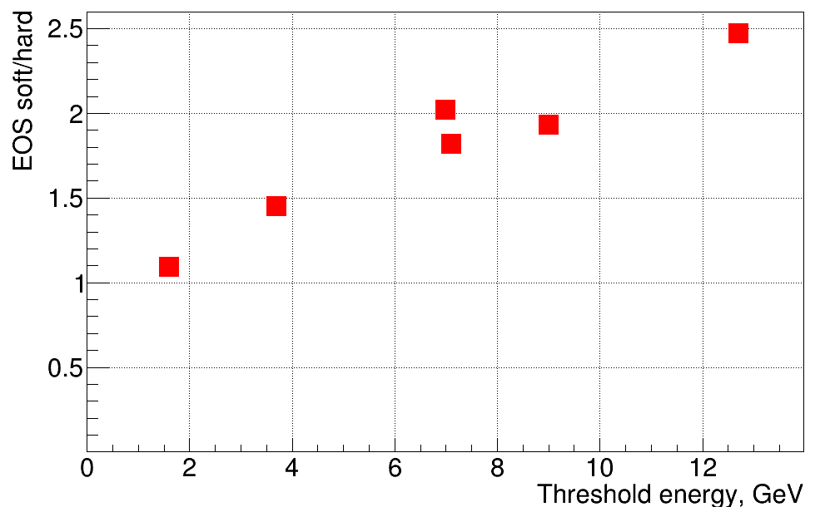
Multi-strange hyperons: promising observables for the EOS of symmetric matter
Hyperon yield in 4A GeV Au+Au:
soft EOS (K=240 MeV) / hard EOS (K=350) MeV
Ω⁻
Ω⁺
Ξ⁺
Λ
Ξ⁻
preliminary !
Λ
PHQMD calculations , J. Aichelin, E. Bratkovskaya, V. Kireyeu et al., priv. comm.

Slide 26
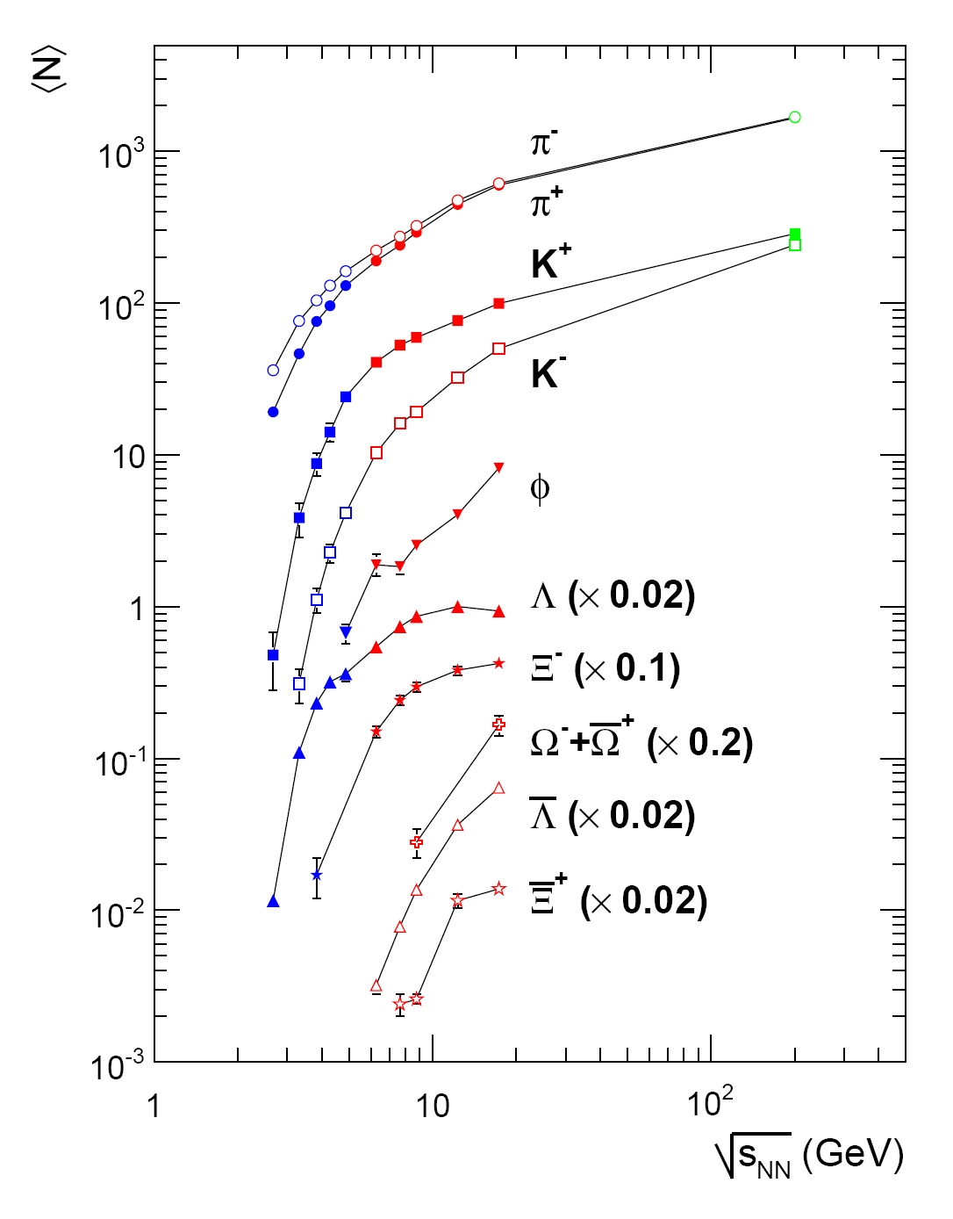
Multi-strange hyperons:
data situation and CBM performance
Simulations using the UrQMD event generator
for central Au+Au collisions 10A GeV based
on realistic detector responses
FAIR

Slide 27
The symmetry energy E_{sym} at high density
Elliptic flow neutrons/protons (upgrade option for CBM)
Particles with opposite isospin ?
π⁻/π⁺
I₃ | particle | production | E_{thr} GeV | decay
+1 | Σ⁺(uus) | pp → Σ⁺K⁺n pp → Σ⁺K⁰p pn → Σ⁺K⁰n | 1.8 | Σ⁺ → pπ⁰ Σ⁺→ nπ⁺
-1 | Σ⁻(dds) | pn → Σ⁻K⁺p nn → Σ⁻K⁺n | 1.8 | Σ⁻ → nπ⁻
Au+Au 400A MeV
n/p flow
n/p flow
Missing mass method
π⁻/π⁺
π⁻/π⁺
W.-M. Guo et al., Phys. Lett. B738 (2014) 397

Slide 28
Exploring the QCD phase diagram
NUPECC Long Range Plan 2017

Slide 29
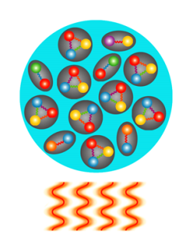
Exploring the QCD phase diagram
At very high temperature:
➢ N of baryons ≈ N of antibaryons, situation similar to early universe
➢ L-QCD finds crossover transition between hadronic matter and Quark-Gluon Plasma
➢ Experiments: ALICE, ATLAS, CMS at LHC, STAR, PHENIX at RHIC

Slide 30
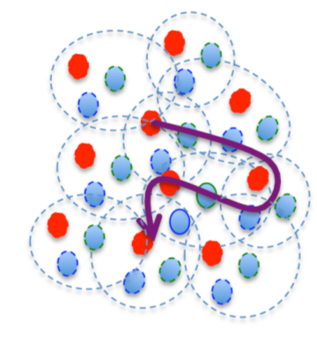
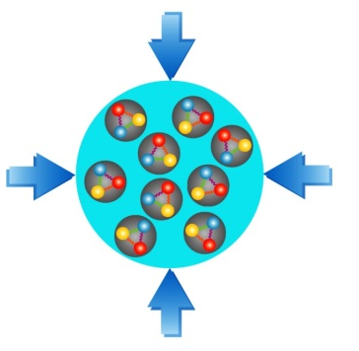
Exploring the QCD phase diagram
At high baryon density:
➢ N of baryons >> N of antibaryons , densities like in neutron star cores
L-QCD not (yet) applicable, models predict phase transitions and exotic phases
Experiments:
BES at RHIC, NA61 at CERN SPS, CBM at FAIR, MPD/BM@N at NICA, CEE at HIAF

Slide 31
Quark-hadron phase transitions in general-relativistic neutron-star mergers ?
E. Most et al., (… M Hanauske, L. Rezzola), Phys. Rev. Lett. 122, 061101 (2019)
Transition from hadronic matter to quark matter
at ρ > 4 ρ₀ and T > 50 MeV ?

Slide 32
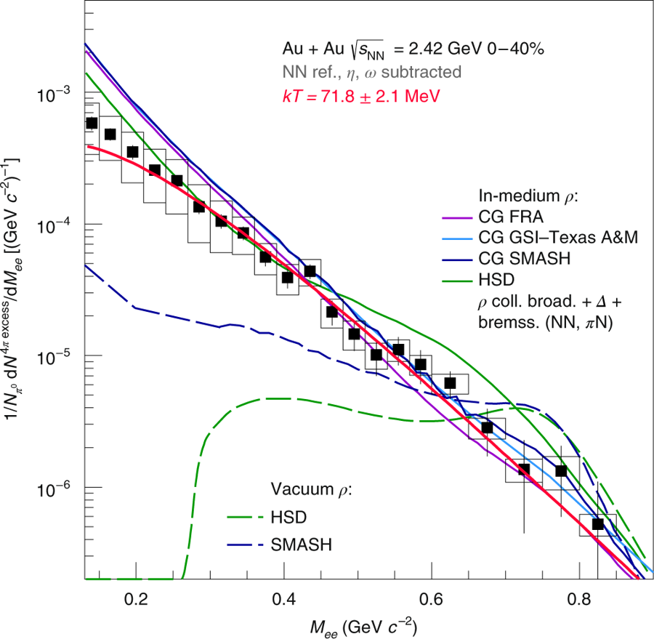
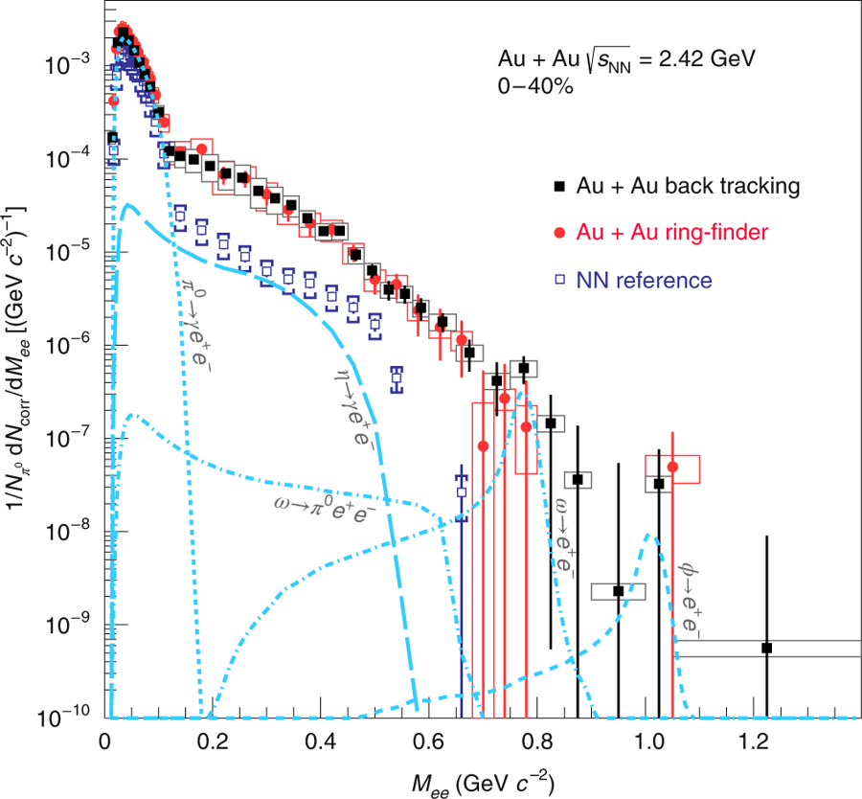
Thermal radiation from dense QCD matter
Au+Au collisions at 1.25 A GeV: ρ ≤ 2.5 ρ₀, T ≈ 72 MeV
Di-electron excess yield
after subtraction of vector mesons
Di-electron yield
J. Adamczewski-Musch et al., The HADES Collaboration, Nature Physics 2019,
https://doi.org/10.1038/s41567-019-0583-8

Slide 33
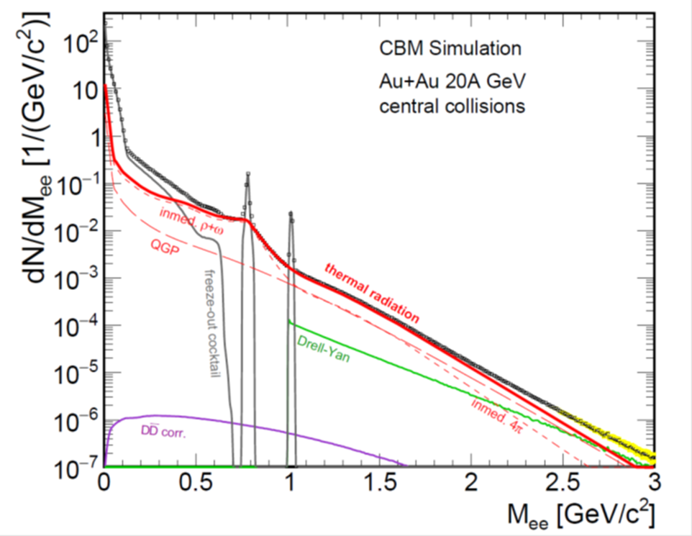
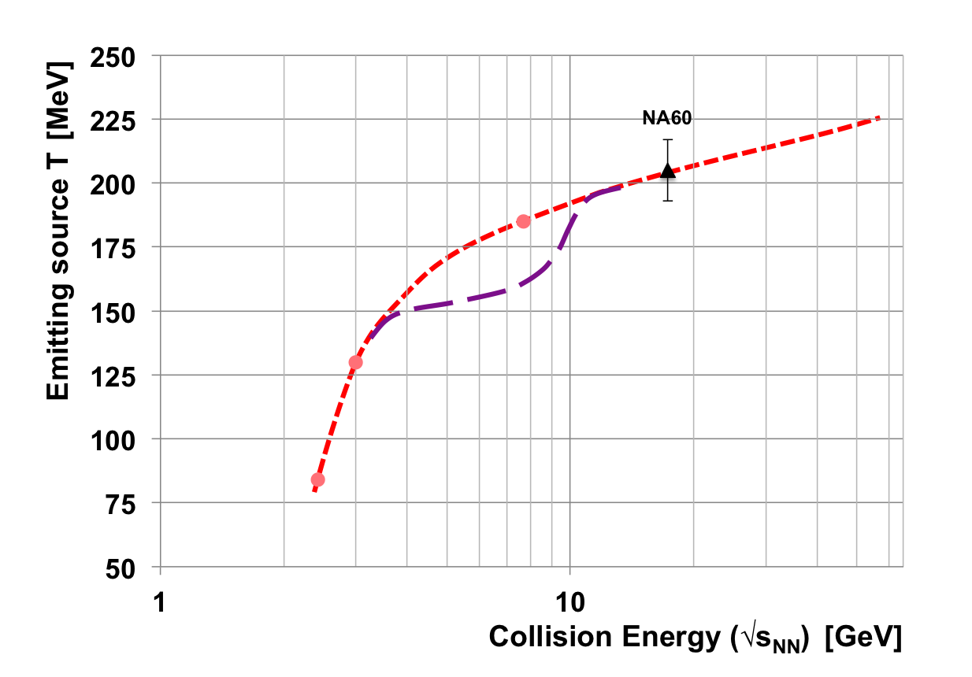
Experimental indication for a phase transition at large μ_{B}?
Invariant mass (M_{inv} > 1 GeV/c² ) of lepton pairs as function of beam energy → thermal radiation from fireball → caloric curve → phase coexistence (1st order transition)
Invariant mass distribution of lepton pairs
Slope of dilepton invariant mass spectrum
1 GeV/c² < M_{inv} < 2.5 GeV/c²
HADES
T. Ablyasimov et al., (CBM Collaboration)
Eur. Phys. J. A 53 (2017) 60

Slide 34
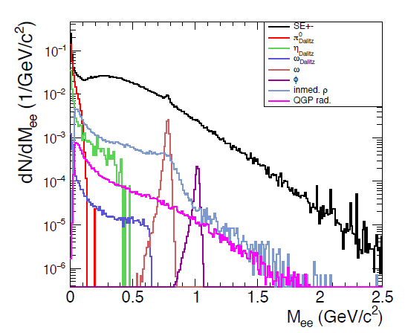
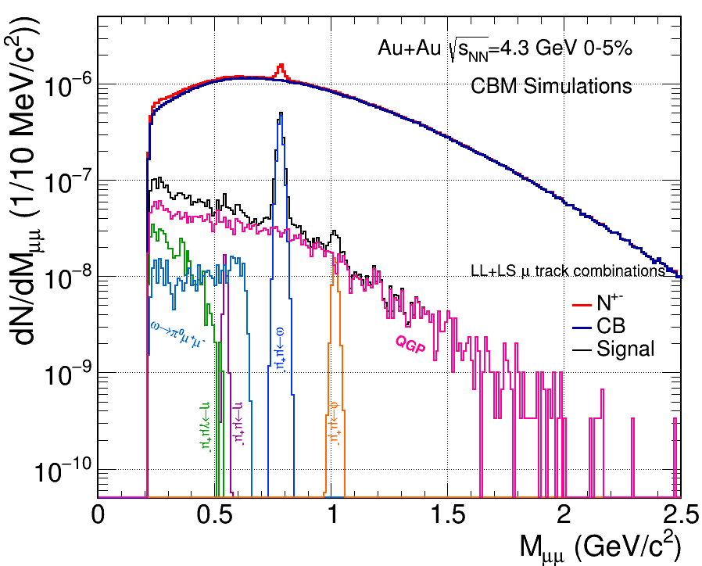
Dilepton invariant mass spectra
central Au+Au collisions at a beam energy of 8A GeV
Simulations: CBM experiment
Electron-positron pairs
Muon pairs
QGP +
inmed. 4π

Slide 35
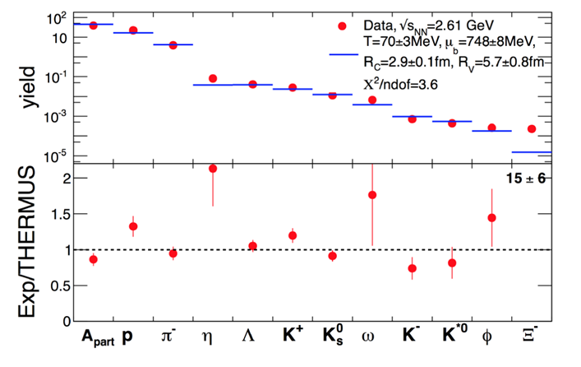
Scouting the location of the phase transition
by multistrange hyperons
Excitation function of strangeness: Ξ⁻(dss),Ξ⁺(dss),Ω⁻(sss),Ω⁺(sss)
→ chemical equilibration at the phase boundary ?
Particle yields and thermal model fits
A. Andronic et al., Jour. Phys. G38 (2011)
HADES: Ar + KCl 1.76 A GeV
G. Agakishiev et al., Eur. Phys. J. A 47 (2011) 21

Slide 36
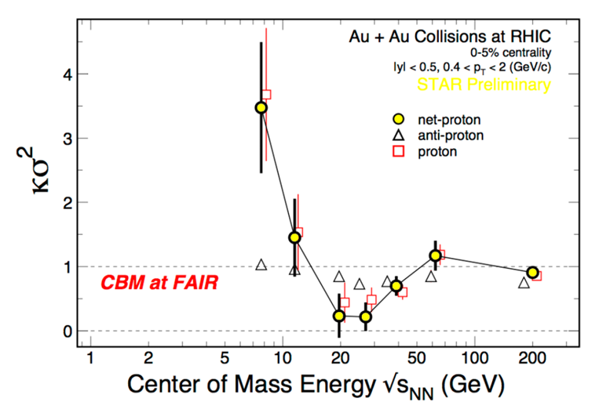
Searching for the critical endpoint of the
1st order phase transition at SIS100 energies ?
Event-by-event fluctuations of conserved quantities (B,S,Q)
“critical opalescence”
4th moment of net-proton multiplicity distribution
Data:
STAR at RHIC
beam energy scan

Slide 37

Hyperons in massive neutron stars?
M. Orsaria, H. Rodrigues, F. Weber, G.A. Contrera, arXiv:1308.1657
Phys. Rev. C 89, 015806, 2014 (SU(3)-NJL model calculations)

Slide 38
Hyperons in massive neutron stars?
J. Rikovska-Stone, P.A.M. Guichon, H.H. Matevosyan, A.W. Thomas
Nucl. Phys. A792 (2007) 341 (QMC model calculations)
3 ρ₀

Slide 39
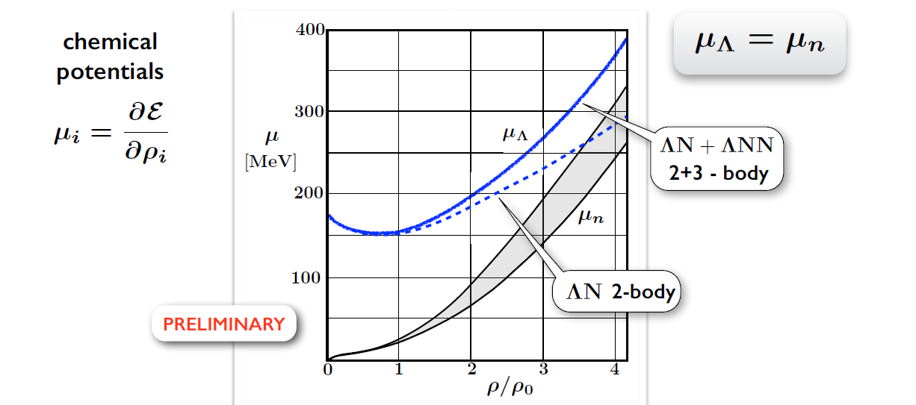
Hyperons in massive neutron stars?
W. Weise, arXiv:1905.03955v1, to appear in JPS Conf. Proc
(Lambda single particle potential in neutron star matter from Chiral SU(3) EFT interactions)

Slide 40

Production of light hypernuclei in
heavy-ion collisions
Study of ΛN, ΛNN, and ΛΛN interactions
Central Au+Au collisions at 10 A GeV:
 | Multiplicity | Yield in 1 week
_{ΛΛ}⁵H | 5 ⋅ 10⁻⁶ | 3000
_{ΛΛ}⁶He | 1 ⋅ 10⁻⁷ | 60
Reaction Rate 1 MHz, BR 10%, efficiency 1%
Hyperon observables:
yield
lifetime
collective flow
SIS100
A. Andronic et al., Phys. Lett. B697 (2011) 203

Slide 41
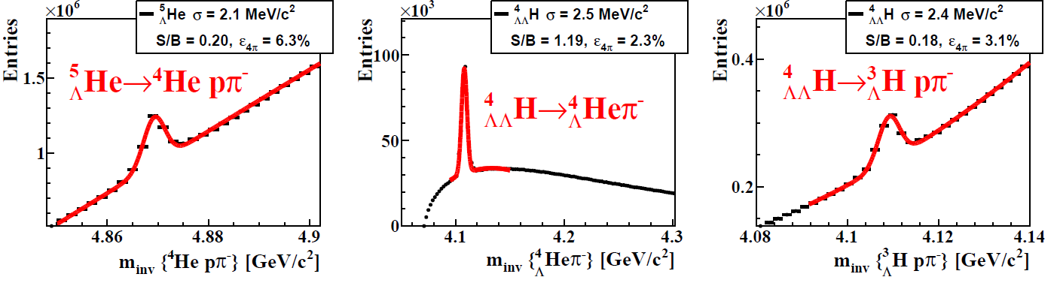




Hypernuclei reconstruction in CBM
5 M min. bias Au+Au collisions 10A GeV/c
_{ΛΛ}⁶He yield 60/week
(reaction rate 1 MHz, BR 10%, efficiency 1%)
Example:
_{ΛΛ}⁶He
p
p
π
⁶_{ΛΛ}He
⁵_{Λ}He
t
Nagara event

Slide 42

The Compressed Baryonic Matter Experiment
Ring
Imaging
Cherenkov
Transition
Radiation
Detector
SC Dipol
Magnet
Silicon
Tracking
System
Time of Flight
Detector
HADES
p+p, p+A
A+A (low mult.)
Micro
Vertex
Detector
Muon
Detector
Projectile
Spectator
Detector
DAQ/FLES HPC cluster

Slide 43


The CBM Collaboration: 58 institutions, > 460 members
China:
CCNU Wuhan
Tsinghua Univ.
USTC Hefei
CTGU Yichang
Chongqing Univ.
Czech Republic:
CAS, Rez
Techn. Univ. Prague
France:
IPHC Strasbourg
Hungary:
KFKI Budapest
Eötvös Univ.
Germany:
Darmstadt TU
FAIR
Frankfurt Univ. IKF
Frankfurt Univ. FIAS Frankfurt Univ. ICS
GSI Darmstadt
Giessen Univ.
Heidelberg Univ. P.I.
Heidelberg Univ. ZITI
HZ Dresden-Rossendorf
KIT Karlsruhe
Münster Univ.
München TU
Tübingen Univ.
Wuppertal Univ.
ZIB Berlin
Russia:
IHEP Protvino
INR Troitzk
ITEP Moscow
Kurchatov Inst., Moscow
VBLHEP, JINR Dubna
LIT, JINR Dubna
MEPHI Moscow
PNPI Gatchina
SINP MSU, Moscow
Ukraine:
T. Shevchenko Univ. Kiev
Kiev Inst. Nucl. Research
India:
Aligarh Muslim Univ.
Bose Inst. Kolkata
Panjab Univ.
Rajasthan Univ.
Univ. of Jammu
Univ. of Kashmir
Univ. of Calcutta
B.H. Univ. Varanasi
VECC Kolkata
IOP Bhubaneswar
IIT Kharagpur
IIT Indore
Gauhati Univ.
Japan:
KEK Tsukuba
Korea:
Pusan Nat. Univ.
Poland:
AGH Krakow
Jag. Univ. Krakow
Warsaw Univ.
Warsaw Univ. Tech.
Romania:
NIPNE Bucharest
Univ. Bucharest
CBM Scientists
43

Slide 44




Future experimental facilities
SIS100: c = 1100 m
Collider: c = 503 m

Slide 45

Experiments exploring dense QCD matter
high net-baryon densities
Complementary approaches towards the study of dense baryonic matter, but joint technical developments:
CBM photon detector
used in HADES
CBM TOF detector and reconstruction software used in STAR
Foreward calorimeters for CBM and NA61/SHINE
Silicon detector and software developements for CBM-BM@N-NICA
Supported by EU CREMLIN+ (5.8 M€ over 4 years)
T. Ablyasimov et al., (CBM Collaboration) Eur. Phys. J. A 53 (2017) 60

Slide 46





FAIR phase 0 experiments on dense QCD matter
1. CBM RICH photon detector: 430 out of 1100
multi-anode photo-multipliers (MAPMT) installed
in HADES experiment and used for physics runs
2. CBM TOF detector: 10% of the CBM TOF
modules including read-out chain installed and
used at STAR/RHIC (BES II 2019/2020)
3. Four Silicon Tracking Stations and a
Projectile Spectator Detector will be installed
in the BM@N experiment at the Nuclotron in
JINR/Dubna (start 2019 with Au-beams
up to 4.5A GeV )
4. miniCBM experiment installed at GSI/SIS18
and commissioned with beam for a full system
test with high-rate nucleus-nucleus collisions
from 2018 - 2021
46

Slide 47


FAIR Project Status 2018
Comprehensive civil construction plan: completion of all buildings by 2022
Full integrated planning for construction and commissioning of the entire project: Completion of the full FAIR facility by 2025.
2014: 1350 pillars 60 m deep
Ground breaking - 4 July 2017

Slide 48


Slide 49


Slide 50


Slide 51


Slide 52

CBM Cave + Building
52

Slide 53

FAIR Collaboration Members by Country

Slide 54

  Instead of a summary:
  NuPECC recommendation
  Key Summary Recommendation of the NuPECC Long Range Plan 2017 presented in Brussels on Nov 27th :
  Complete urgently the construction of the ESFRI* flagship FAIR and develop and bring into operation the experimental program of its four scientific pillars APPA, CBM, NUSTAR and PANDA.
FAIR is a European flagship facility for the coming decades. Worldwide unique it will allow for a large variety of unprecedented fore-front research in physics and applied science. It focuses on the structure and evolution of matter. Its multi- faceted research opens a new era in our understanding of the fundamental building blocks of matter and the forces as well as of the evolution of our Universe: the new possibilities for research in Darmstadt are unique and are expected to produce ground breaking new insights for nuclear research.
*European Strategy Forum on Research Infrastructures

Slide 55
Backup

Slide 56
EOS with phase transition
T. Fischer, N. Bastian, M. Wu, S. Typel, T. Klähn, D. Blaschke,
Nature Astronomy (2018), DOI: 10.1038/s41550-018-0583-0, arXiv:1712.08788v2

Slide 57
Deep-subthreshold production
of multi-strange hyperons
Isospin-dependent strangeness-exchange cross sections in UrQMD
F. Li, L. W. Chen, C. M. Ko and S. H. Lee,
Phys. Rev. C 85, 064902 (2012)
G. Graef, J. Steinheimer, F. Li, M. Bleicher,
Phys. Rev. C 90, 064909 (2014)

Slide 59



BM@N upgrade for Au+Au collisions
central collision Au+Au 4A GeV
Joint GSI-JINR development of Silicon Tracking Stations for CBM and BM@N

