Slide 1
Commissioning the LHC Injector Complex
V. Kain, CERN
LINAC2 1978-2018
switched off on 12th of November at 3pm

Slide 2
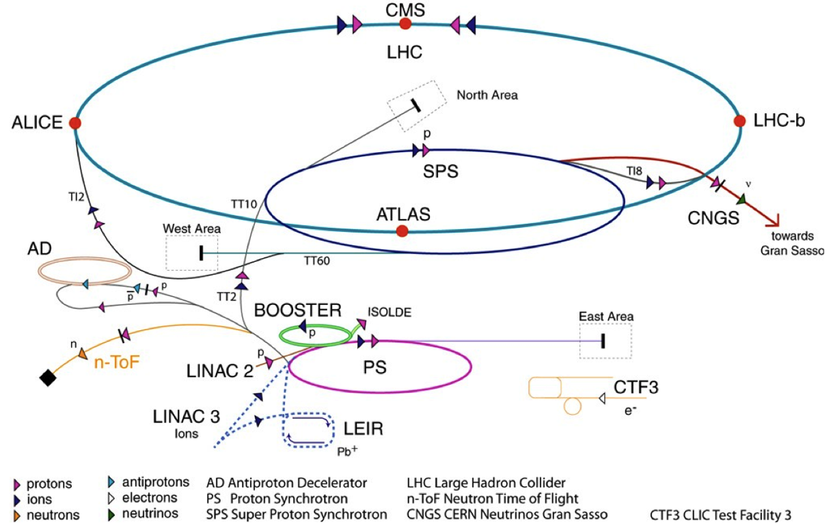
The pre-LS2 LHC chain
 | Max. P (GeV/c) | Length / Circ. (m)
LINAC2* | 0.050 | 30
Booster* | 1.4 | 157
PS | 26 | 628
SPS | 450 | 6’911
LHC | 6’500 | 26’657
LHC proton path
Beam 1
Beam 2
*: kinetic energy
Injector contributions:
The Booster defines the brightness Ν/ε,
The PS defines the bunch spacing & train structure,
The SPS assembles trains.

Slide 3
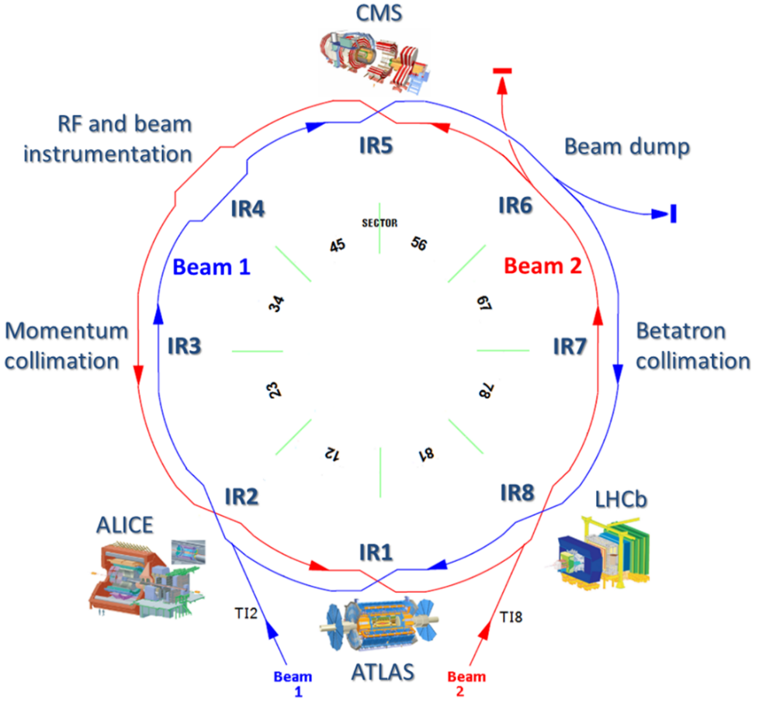






The LHC experiments
ATLAS and CMS are the two high luminosity experiments, L ~ 10³⁴ cm⁻²s⁻¹.
  Most performance figures and parameters refer to those experiments (luminosity, β*).
LHCb is a medium luminosity experiment, L ~ 4×10³² cm⁻²s⁻¹.
ALICE is a low luminosity / ion experiment, L ~ 10³¹ cm⁻²s⁻¹.
LHCb and ALICE are luminosity levelled by beam separation.
  At β* of 10 m (ALICE) and 3 m (LHCb).
TOTEM, ALFA and AFP are forward physics experiments.

Slide 4
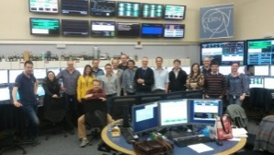
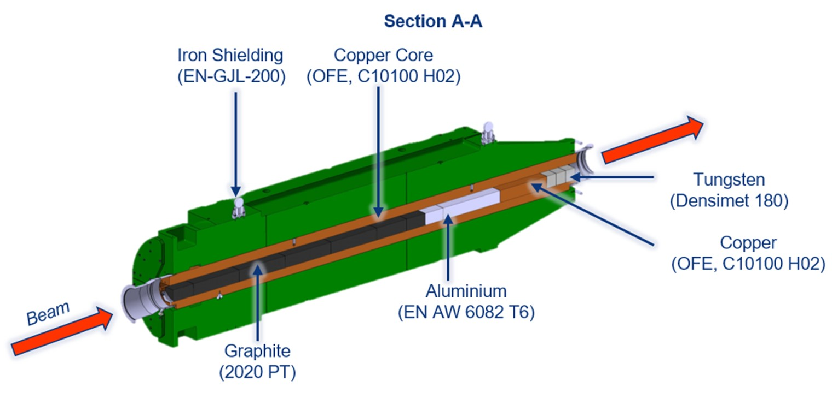
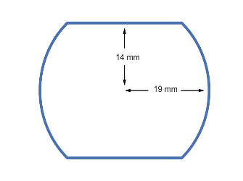
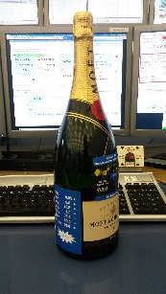
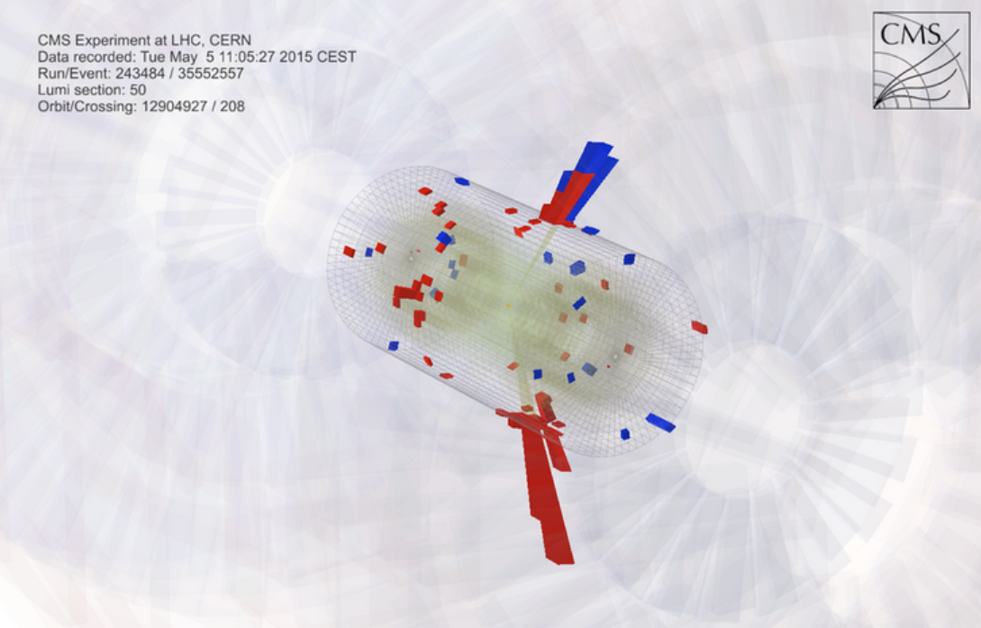
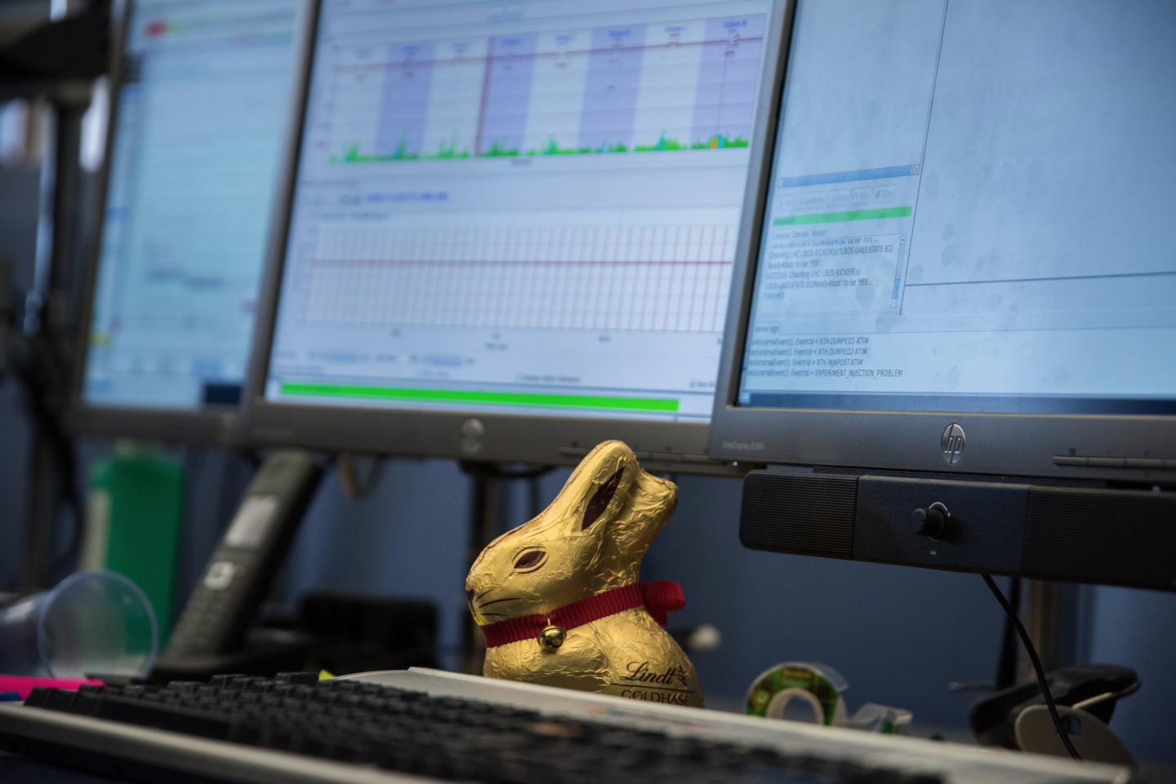
LHC Run 2
After a recovery year in 2015, the LHC moved into production in 2016, pushing the performance step by step from one year to the next despite intensity limitations.
April 25,
SPS beam dump vacuum leak, limited bunch train length
L > 2 x 10³⁴cm⁻²s⁻¹
October,
2 x design luminosity
April 10
First beam at
April,
16L2 beam loss events are back !
Intensity limitation
2015
2016
2017
2018
June 3,
Start of physics operation for run 2
July,
Design luminosity
June,
First signs of 16L2 beam loss events
Intensity limitation
July,
150 fb⁻¹ !
Easter,
First beam circulating
L >10³⁴cm⁻²s⁻¹

Slide 5
LHC parameters
Between the 2015 and 2018, β* was lowered from 80 cm to 30 cm (25 cm at lower intensity).
  Reflects the improved understanding of machine (aperture).
Performance in 2018 compared to design and Run 3 estimate.
  Loss spikes and beam instabilities in one cell, most likely due to residual condensed gas (‘16L2’) limited the intensity
Parameter` | Design | 2018 | Run 3
Bunch population N_{b} (10¹¹ p) | 1.15 | ~1.1 | ~1.7
No. bunches k | 2780 | 2556 | ~2700
Emittance ε (mm mrad) | 3.5 | ~1.8 | 1.5-2
β* (cm) | 55 | 30 / 25 | 100-25
Full crossing angle (μrad) | 285 | 320 - 260 | 340-260
Peak luminosity (10³⁴ cm⁻²s⁻¹) | 1.0 | ~2.1 | ~3-4

Slide 6
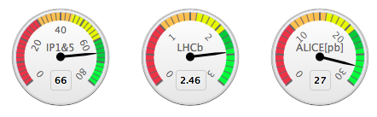
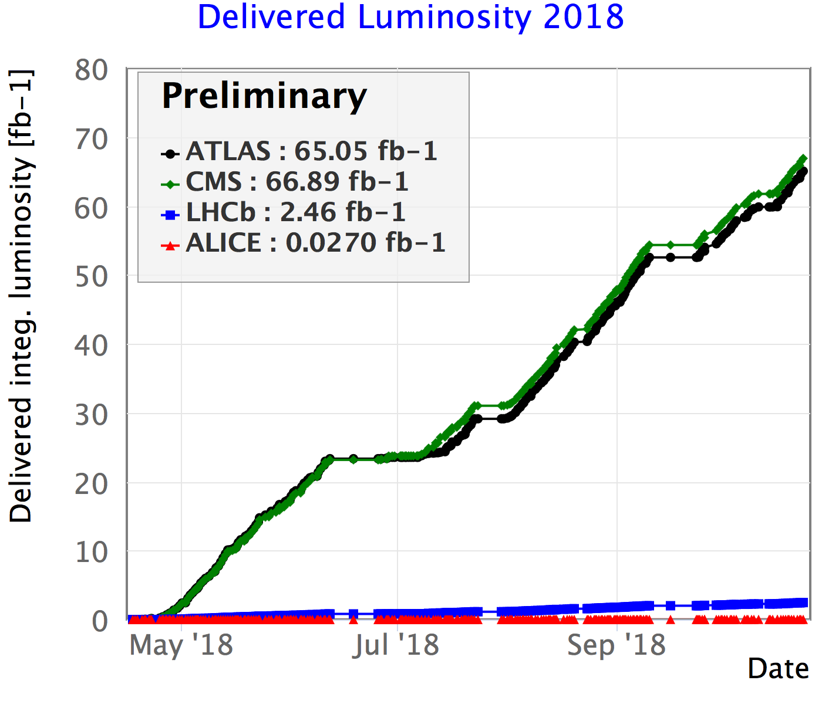
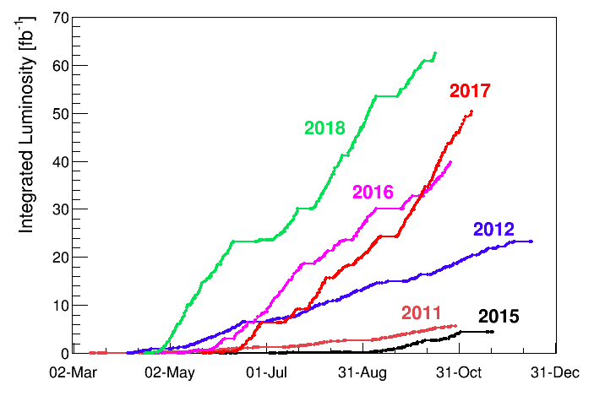
Luminosity production
Run2 pp physics ended on 24 October morning at 6:01am with (manual) dump of fill 7334 after 13.4 hours of Stable Beams

Slide 7
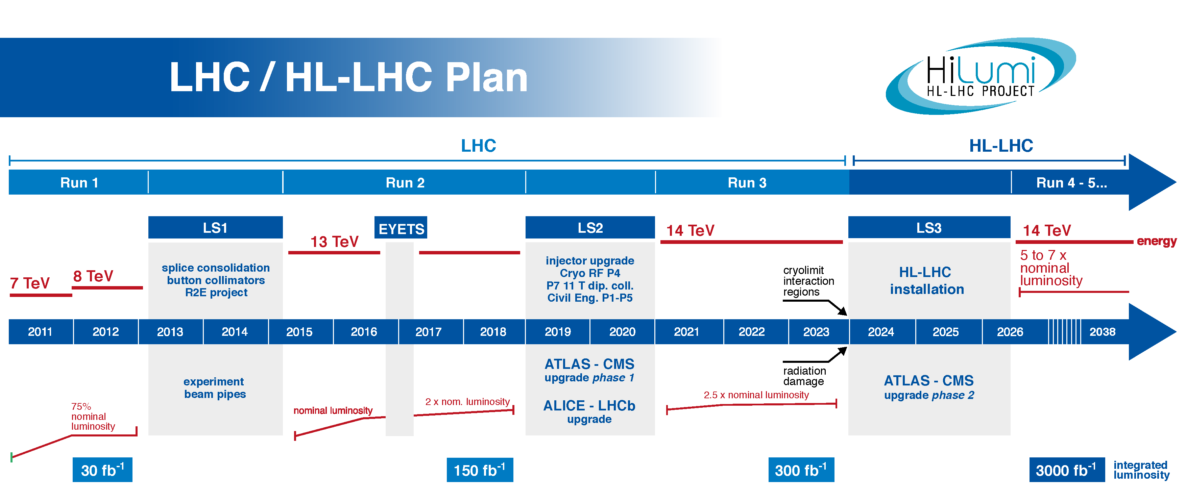
What’s next?
Run 3 = 7 TeV, first step towards HL-LHC: LHC Injector Upgrade (LIU)
HL-LHC = increase luminosity by a factor 5 and integrated luminosity by a factor 10 to 3000 fb⁻¹.
  250 fb⁻¹ per year

Slide 8
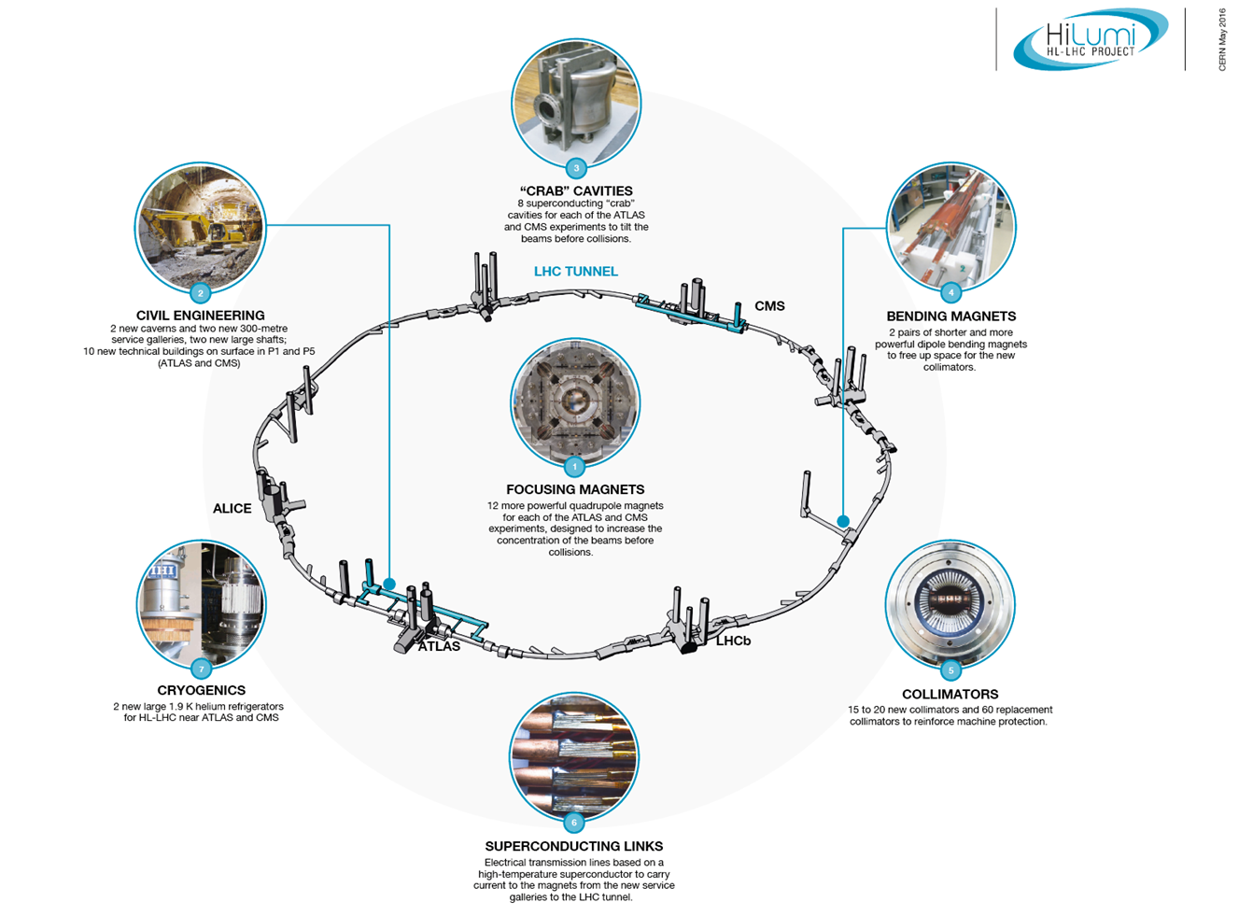
HL-LHC ingredients
LIU beams
Availability, reduce effect of crossing angle, β*
LHC Injector Upgrade
Notes:
What is the reason for the superconducting link?
100 m long high power superconducting links.
Pile limit: HL-LHC 140

Slide 9
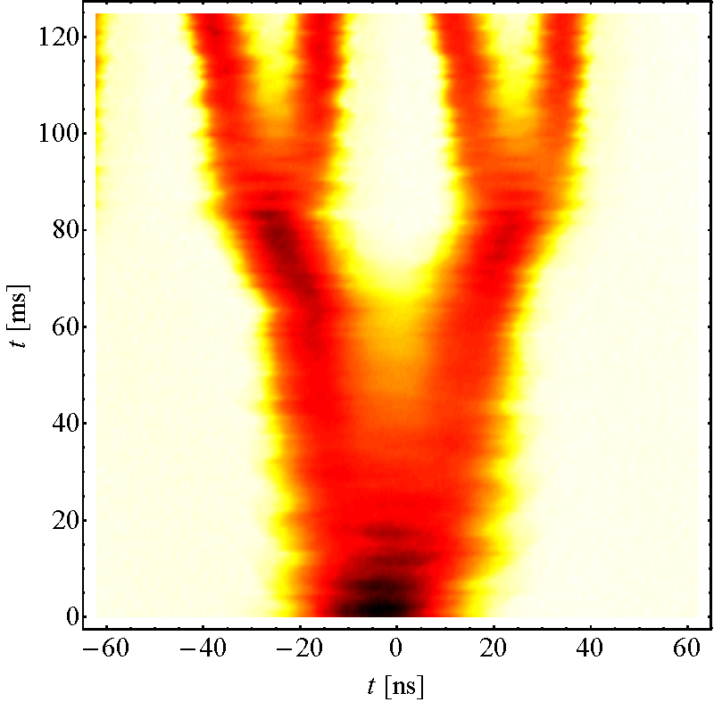
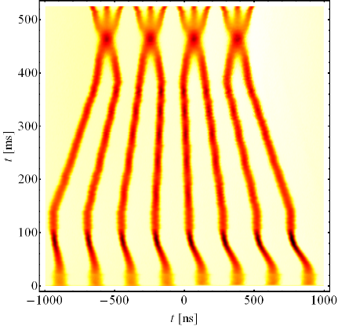
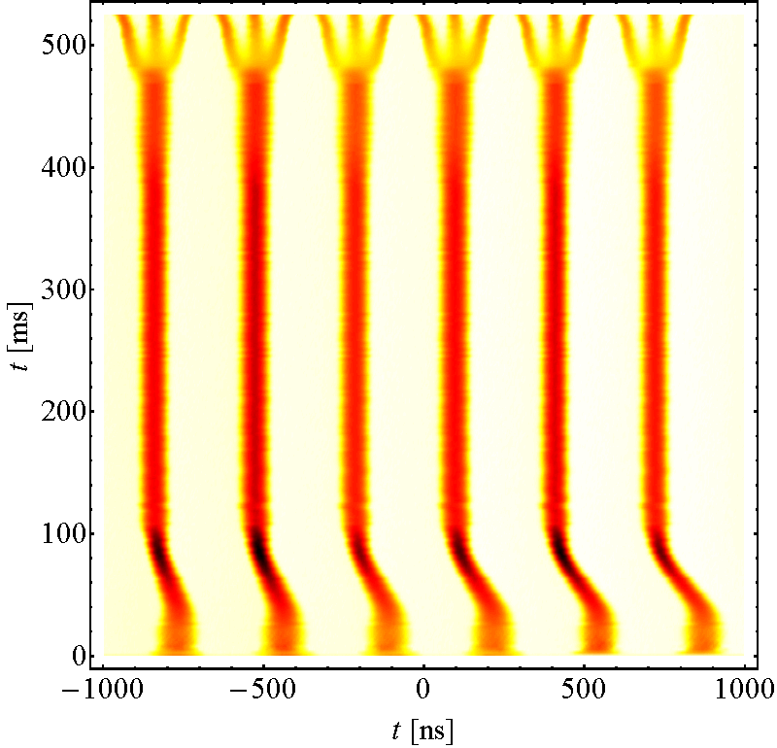
LHC beams in the injectors…
The standard LHC beam with 25 ns bunch spacing is obtained in the Proton Synchrotron by splitting of 6 booster bunches into 72 bunches at extraction.
  Triple splitting at low energy, 2x double splitting at high energy.
  Emittance at injection into LHC ~ 2.8 μm.
A lower emittance variant is obtained from 8 booster bunches that are first compressed and merged longitudinally into 4 bunches (Batch Compression Merging and Splitting, BCMS), followed by splitting into 48 bunches at extraction.
  Emittance at injection into LHC ~ 1.5 μm.
  Shorter train length implies more ‘holes’ in the beam at the LHC, loose ~150 bunches.
BCMS (8 PSB b.)
Standard (6 PSB b.)

Slide 10
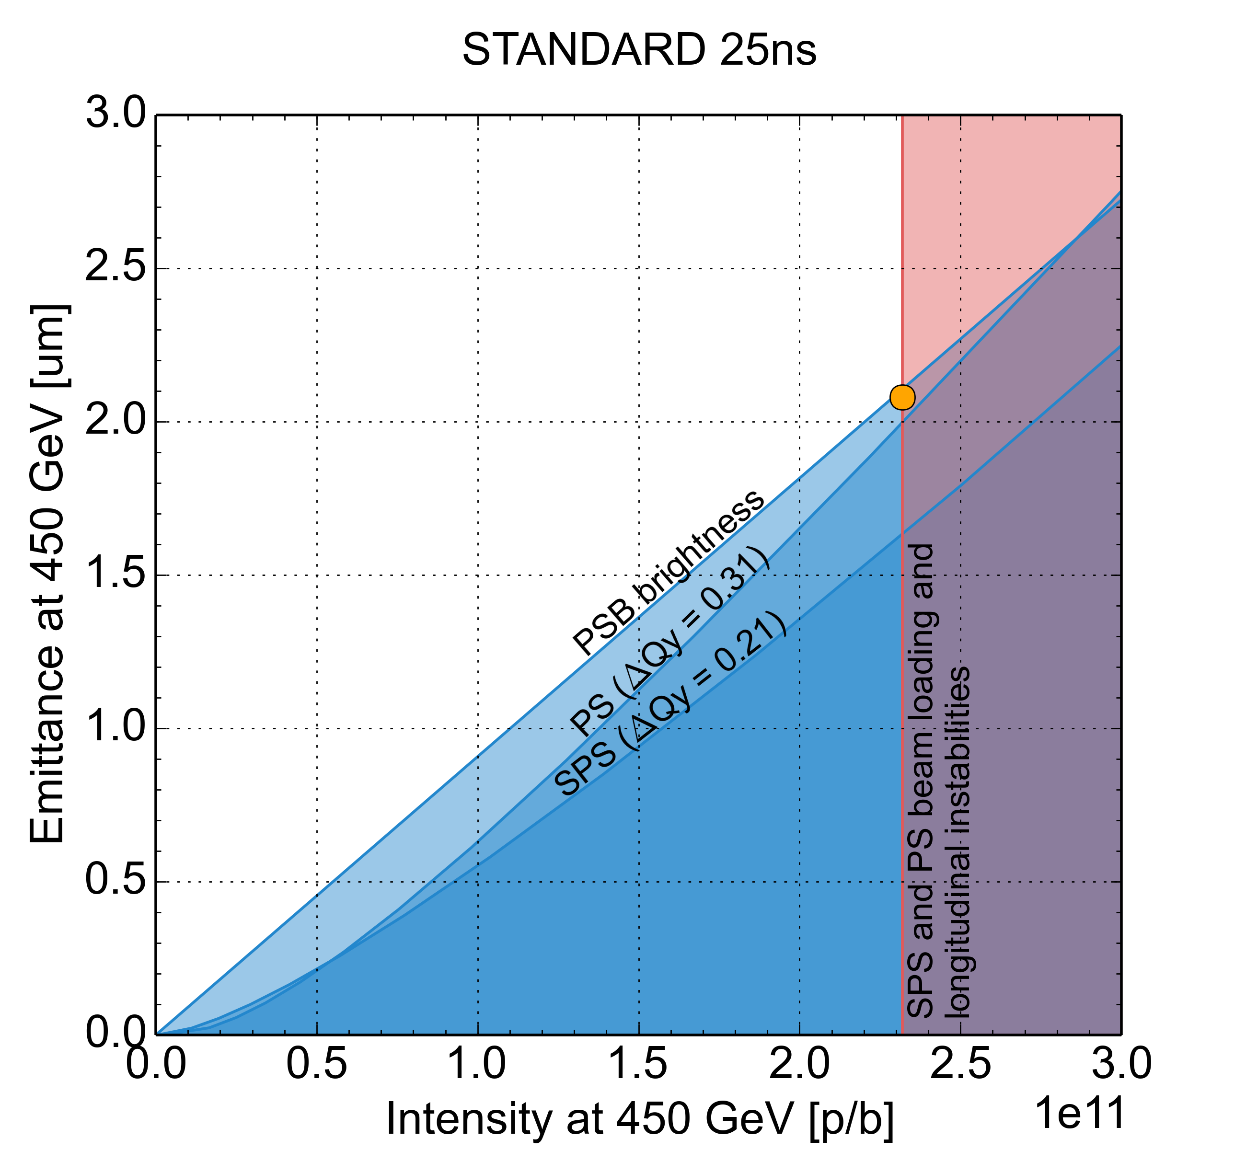
LHC beams in the injectors…
2018 operational beam
HL-LHC base line beam
48 bunches per injection from PS
72 bunches per injection from PS

Slide 11
Injector upgrade during LS2 (1)
PSB
  Connection to Linac4 → New H⁻ charge exchange injection at 160 MeV from Linac4 to double brightness of LHC beams
  Acceleration to 2 GeV
    New main power supply POPS-B
    Replacement of C02-C04-C16 RF systems by Finemet based RF system
Linac3 + LEIR
  Source and Low Energy Beam Transport improvements to increase current from Linac3 and improve reproducibility
  Intensive studies on Linac3-LEIR modeling and monitoring to increase reliability and transmission

Slide 12
Injector upgrade during LS2 (2)
PS
  New injection at 2 GeV for protons to mitigate space charge
  RF improvements to improve beam quality and increase longitudinal coupled bunch instability threshold
    Impedance reduction of the RF systems
    Installation of new Finemet RF system as longitudinal feedback
  Operational deployment of transverse feedback system
SPS
  200 MHz RF system upgrade
    Rearrangement of cavities and power upgrade
    New LLRF including slip stacking capability
  Electron cloud mitigation and impedance reduction to increase intensity reach
    a-C coating of QFs + one full arc
    QF-type flange shielding and HOM damping in 200 MHz cavities
  New beam dump system in LSS5 and new design of protection devices to comply with the target HL-LHC beam parameter values

Slide 13
LIU parameter goals
Proton beam properties @LHC injection
 | N_{b} (x 10¹¹ p/b) | ε_{x,y} (μm) | Bunch/batch spacing | Bunches
HL-LHC target | 2.3 | 2.1 | 25 / 200 ns | 4x72b/ inj
Pb ion beam properties @LHC injection
 | N_{b} (x 10⁸ ions/b) | ε_{x,y} (μm) | Bunch/batch spacing | Bunches
HL-LHC target | 1.9 | 1.5 | 50 / 100 ns | 7x8b/ inj

Slide 14
Towards LIU…
2e+11 p+/bunch injected in 2018 and accelerated. BCMS

Slide 15
Bunch intensities from injectors post LS2
The beam intensity will be ramped up in the LHC injectors during Run 3.
Year | Initial Intensity [ppb] | Target Intensity [ppb]
2021 | 1.15×10¹¹ | 1.3×10¹¹
2022 | 1.3×10¹¹ | 1.8×10¹¹
2023 | 1.8×10¹¹ | 2.1×10¹¹
The maximum bunch intensity in the LHC is estimated around 1.7×10¹¹ ppb due to limitations from RF system, beam dump system, heating of equipment, beam stability.
  There are uncertainties on the scaling of power… the final answer by the beam !
With such bunch intensities the LHC can virtually achieve luminosities well beyond the cryogenic limit of ≈2×10³⁴ cm⁻²s⁻¹.
  Opens the door for long luminosity levelled fills at the limiting luminosity.
Run 2
Run 3

Slide 16
HL-LHC Parameters
asdf

Slide 17
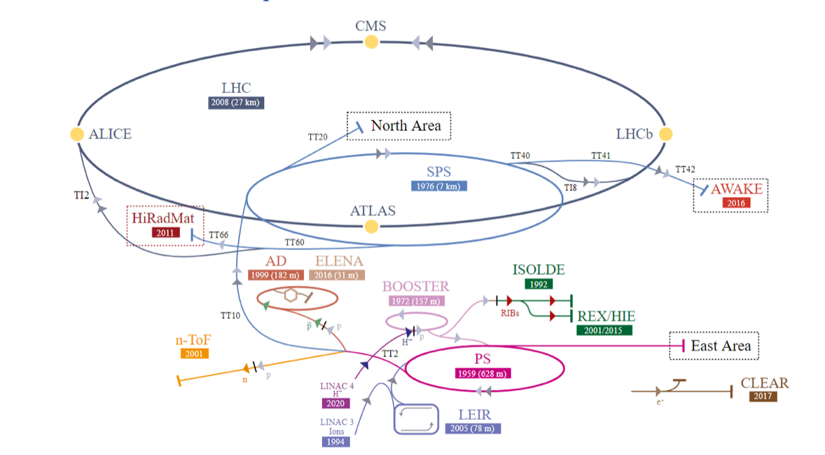
The Injector Chain
Non-LHC beams
ISOLDE: the radioactive ion beam facility
East Area: secondary beam lines fed by PS protons on 2 targets
nTOF: pulsed neutron source
AD/ELENA: low energy antiprotons
AWAKE: proton driven plasma wake field acceleration
HiRadMat: high intensity /brightness to material test facility
North Area: secondary beam lines fed by SPS protons/ions on 3 targets. Multiturn extraction (MTE) beam.

Slide 18
The Non-LHC beams
p⁺ beam/facility | machine | comment
ISOLDE | PSB | I > 3.2e+13 in 4 rings; critical: losses and steering in extraction region and to ISOLDE targets
MTE for North Area | PSB, PS, SPS | I_{SPS}<=4e+13; h=2 in PSB; critical: ε_{V}, Low intensity MTE required for alignment in PS and SPS and aperture measurements
LHC | PSB, PS, SPS | ~ 15 variants; critical: ε, tails, losses; extractable to LHC, SPS COAST,… Probe beam not commissioning beam in injectors
nTOF | PSB, PS | I_{PSB} 8e+12 from 1 PSB ring; or 3e+12 in parasitic operation
East | PSB, PS | 6e+11 from 1 PSB ring
AD | PSB, PS | 4.5e+12 per PSB ring, 4 rings
HiRadMat | SPS | Operation of facility with high intensity LHC beam. critical: ε, High precision experiments
AWAKE | PSB, PS, SPS | I_{SPS} ~ 3e+11; 4 σ_{l} < 1 ns, synchronised to AWAKE laser

Slide 19
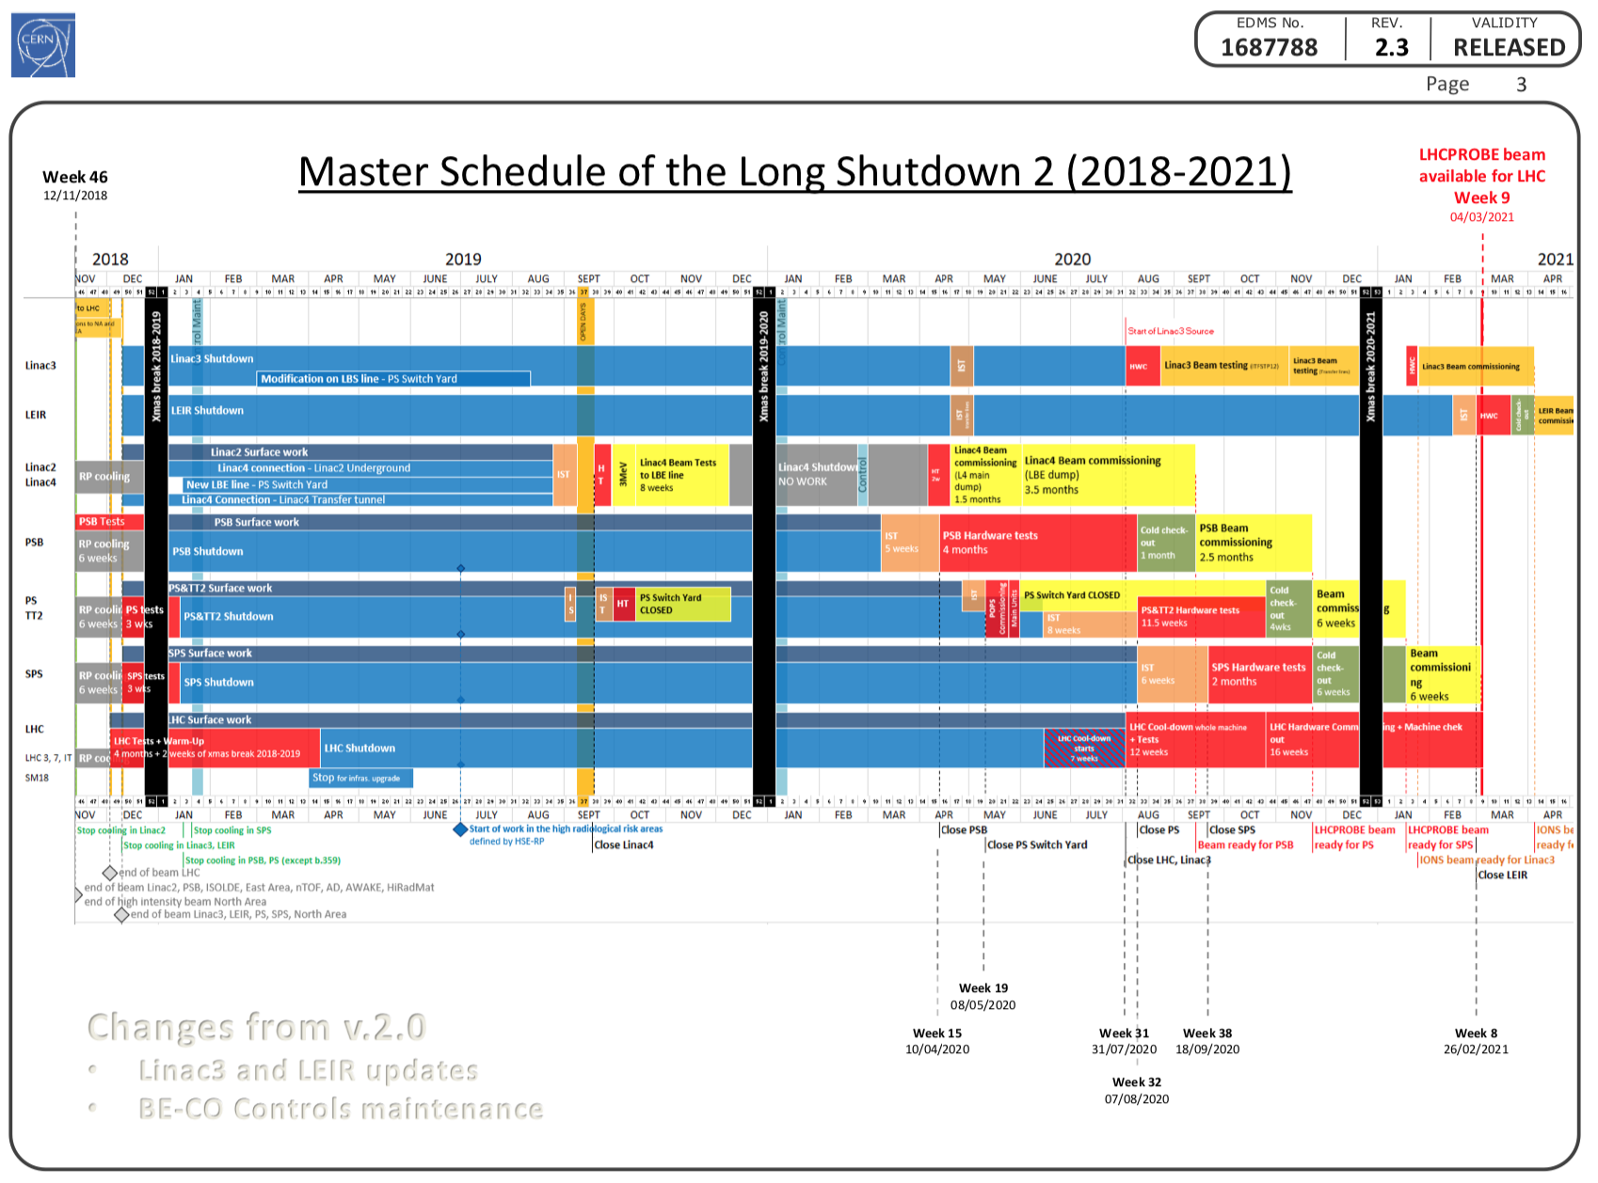
Commissioning the Injector Complex - the task

Slide 20
Commissioning the Injector Complex - the task
→ Goal 1: extract LHCPROBE beam towards the LHC at 450 GeV from a “new” injector complex consisting of 4 machines on the 4th of March 2021
  after only 6 weeks of commissioning in the last machine
  Commissioning beams != LHCPROBE beam
  LHCPROBE (=LHCPILOT) beam: single bunch, 5 x 10⁹ p+/bunch
    Pre-LS2: nominal bunch: ~ 1.2 x 10¹¹ p+/bunch
    LIU: nominal bunch: 2.3 x 10¹¹ p+/bunch
→ Goal 2: reach pre-LS2 proton performance by end of 2021 for all beams
→ Goal 3: reach HL-LHC performance for ions for the 2021 ion run

Slide 21
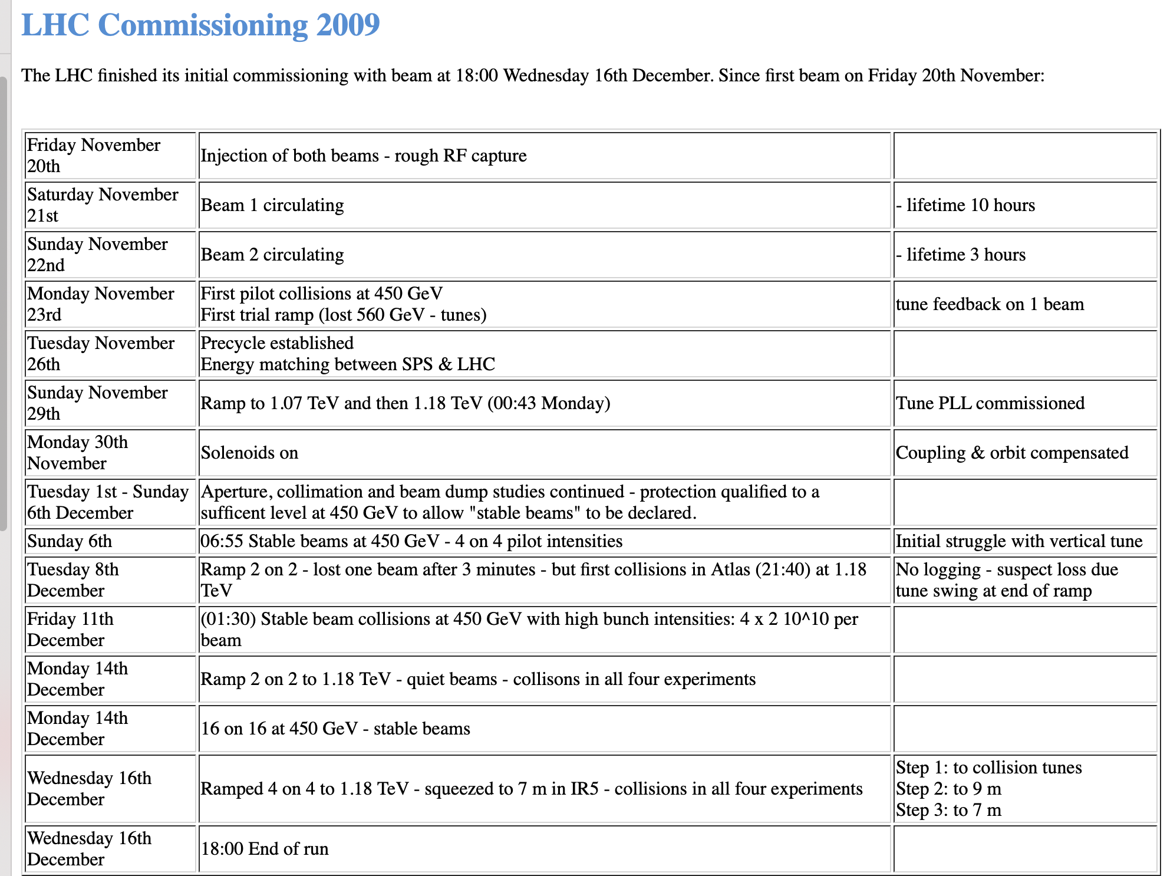
Don’t reinvent the wheel → LHC commissioning
http://lhc-commissioning.web.cern.ch/lhc-commissioning/news-2009/LHC-2009.htm
26 days

Slide 22
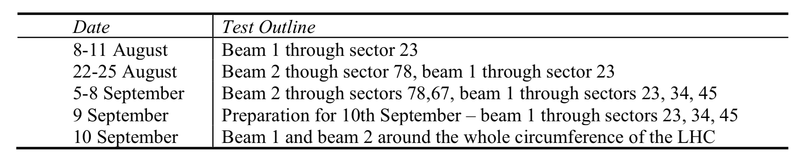
LHC injection tests
Key messages:
Staged deployment
  No long continuous commissioning phases → but intense, short, very well prepared commissioning periods
Intense preparation phase
  Prepare scenarios, not equipment
  E.g. how to inject a single bunch into LHC bucket 1 from the SPS
    and not how to operate the injection equipment

Slide 23
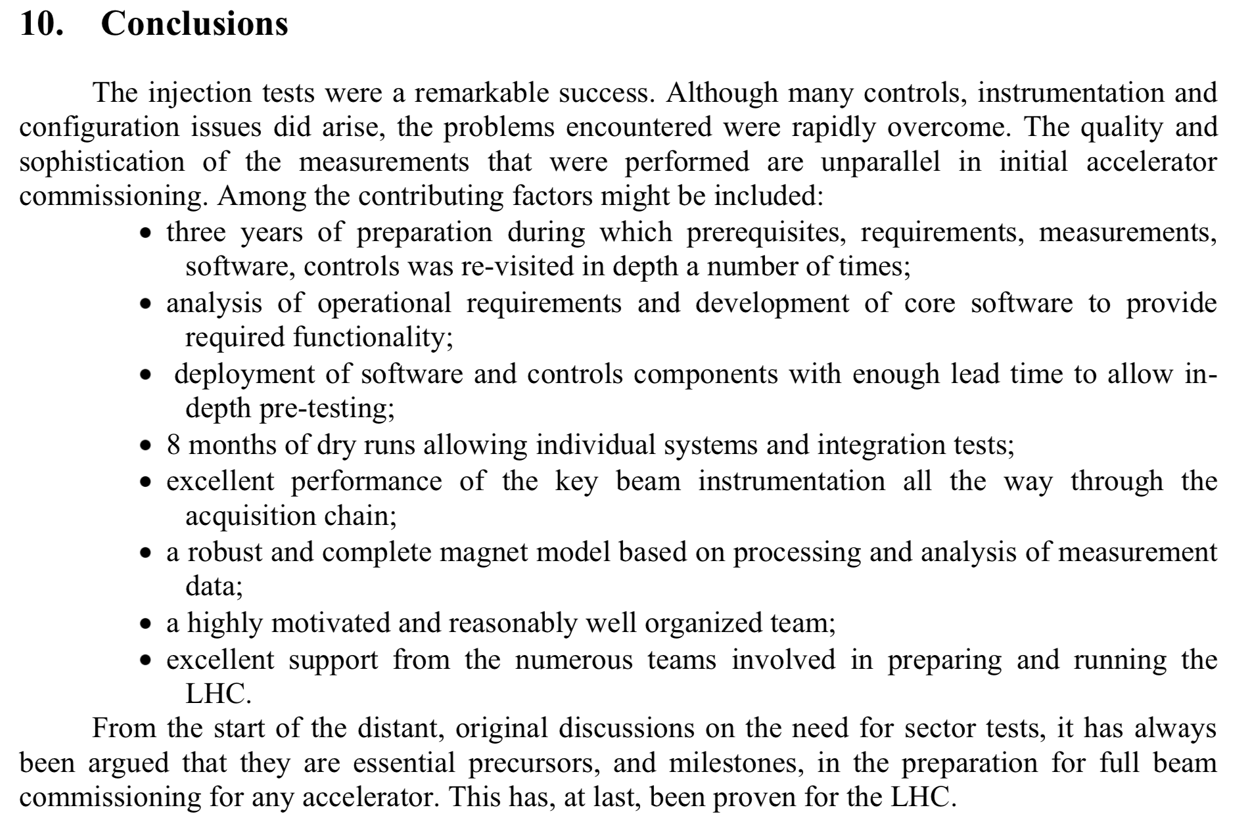
LHC Injection tests
The LHC Injection Tests, LHC Performance Note 1, 2008-10-21

Slide 24
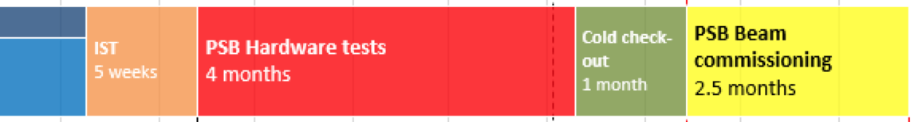
Preparation is key
LIU Project ensured that installed upgrades fulfill specifications
Challenge 1: integrate them in controls environment and exploit them in most efficient way
Challenge 2: make all systems work together according to tight schedule
→ Integration working groups
→ Test, test, test: Individual system tests (ISTs), dry runs, Hardware commissioning (HWC)
Dry runs not visible in planning – punctual…
  Will be part of IST planning at later stage
Machine closed!
Responsibility:
Shutdown coordination → Operations
…this is what we are preparing now
Standalone commissioning

Slide 25
Testing phase: What is done when?
IST → equipment groups carry out tests to assert optimal functioning of equipment
  During shutdown or HWC period
Dry run → vertical slice test in collaboration between equipment groups, CO, OP from equipment to control room application/algorithm/setting
  During shutdown or HWC period
HWC/check out → OP runs equipment with control room tools with all interfaces and within operational scenarios. Machine is run as with beam
  During HWC period

Slide 26

Equipment integration?
Given the length of the shutdown, the last installation dates and how long it takes to prepare more sophisticated tools, cannot afford to integrate sequentially
  I.e. hardware installed, FESA interface ready, control room tools and settings management ready.
Start with top level settings management and algorithms/ tools without hardware and FESA ready (or only mock interfaces)
  Define interface – continuous collaboration
  Build physics driven value generators, parameter hierarchies, makerules,…

Slide 27
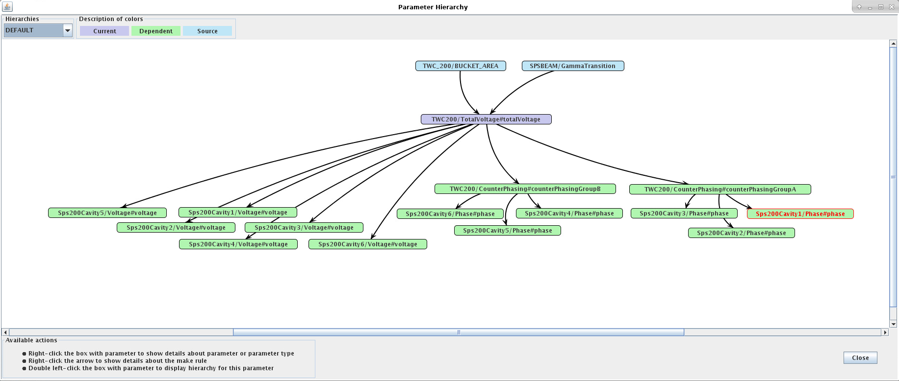
Examples: new SPS LLRF

Slide 28
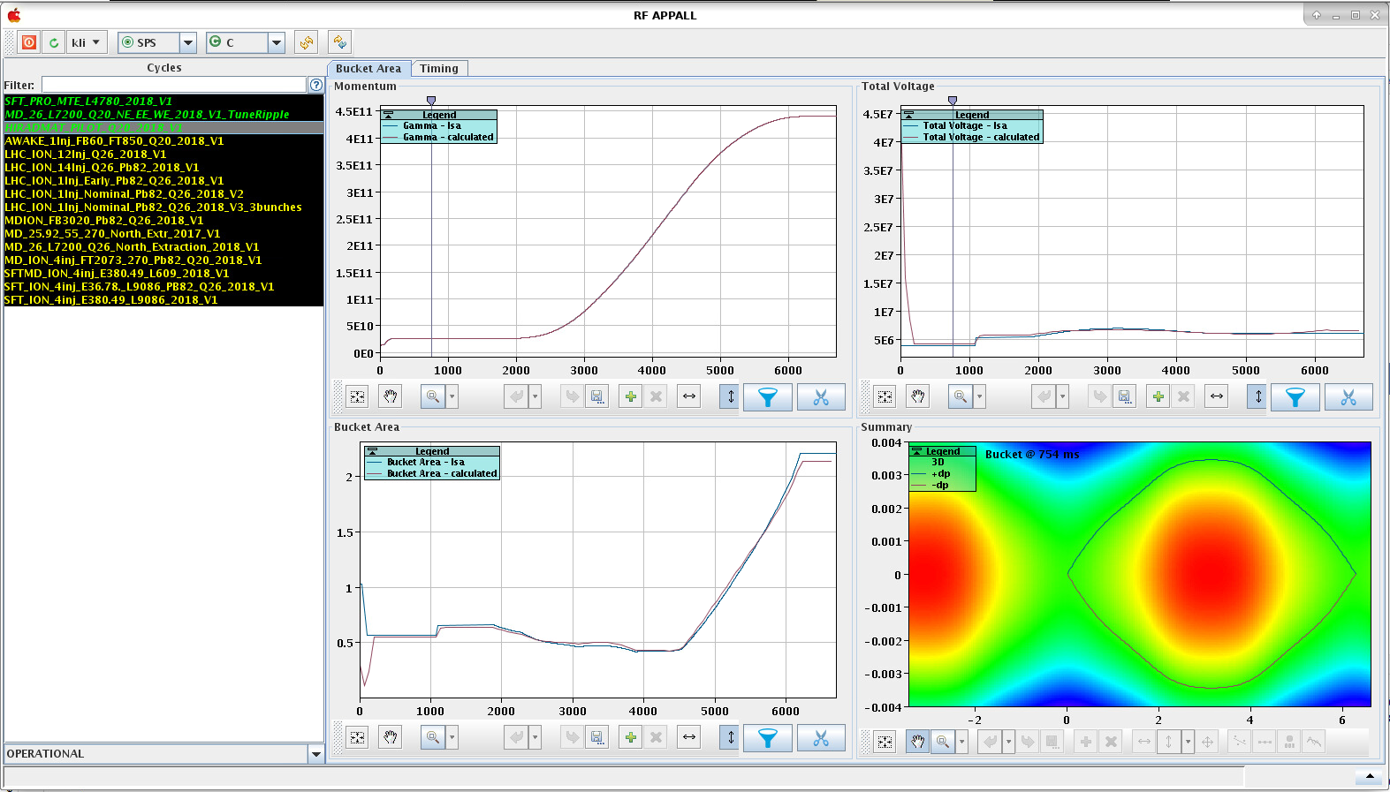
Examples: new SPS LLRF

Slide 29
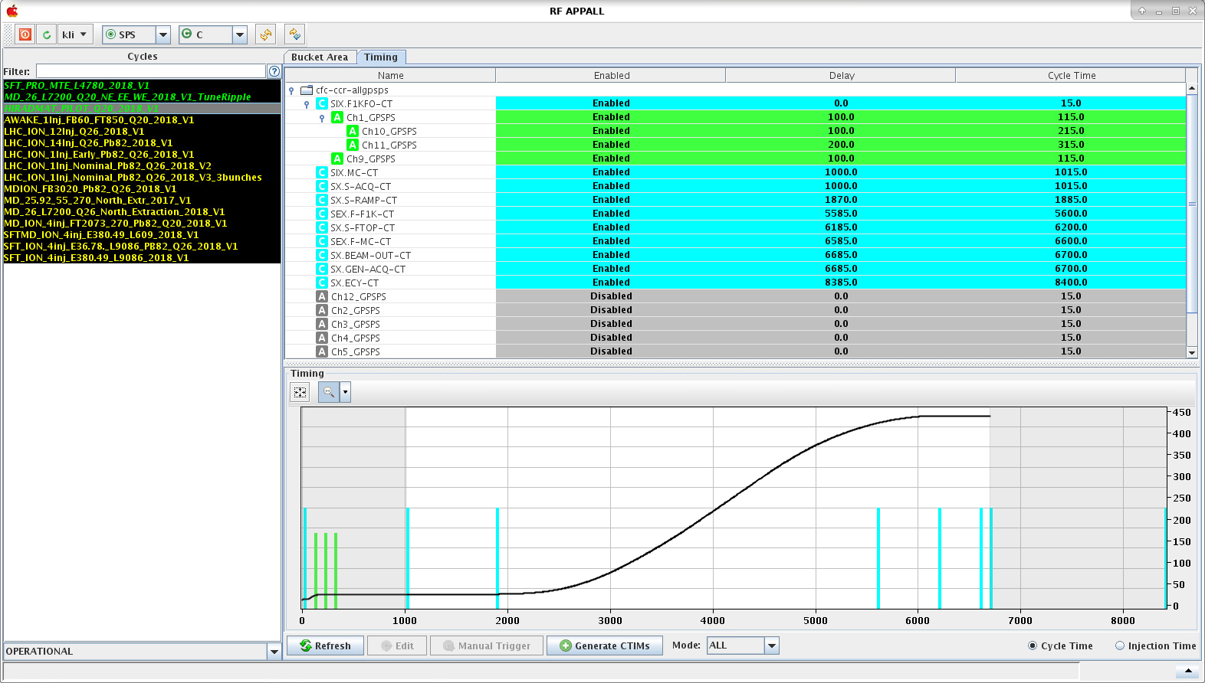
Examples: new SPS LLRF

Slide 30
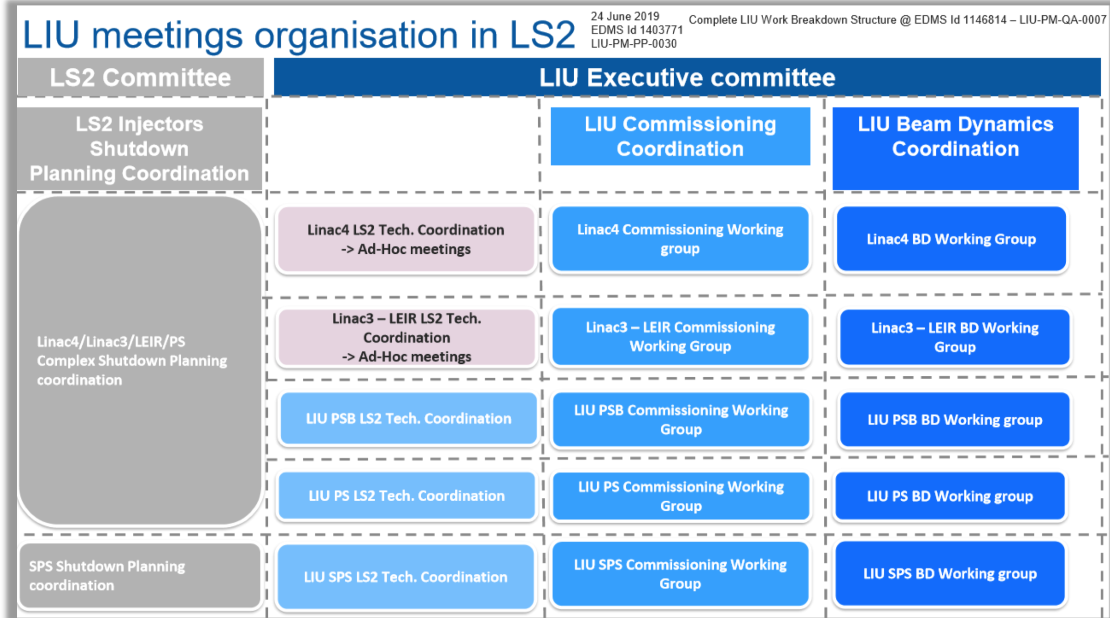
LIU commissioning structure
asd

Slide 31
Aspects to cover
Integrate new hardware
  New operational scenarios, higher level parameters
  Define/prepare software, cover all interfaces (interlocks, timing, settings generation,...)
  Define test procedures
Tools
  Next generation settings management in injectors: model based settings generation and correction
  New timing system approach
Ensure readiness of plans and procedures for commissioning
Establish teams and responsibilities
Organize, execute, analyze dry runs/reliability runs/hardware commissioning, beam commissioning to deliver beam parameters according to predefined time line

Slide 32
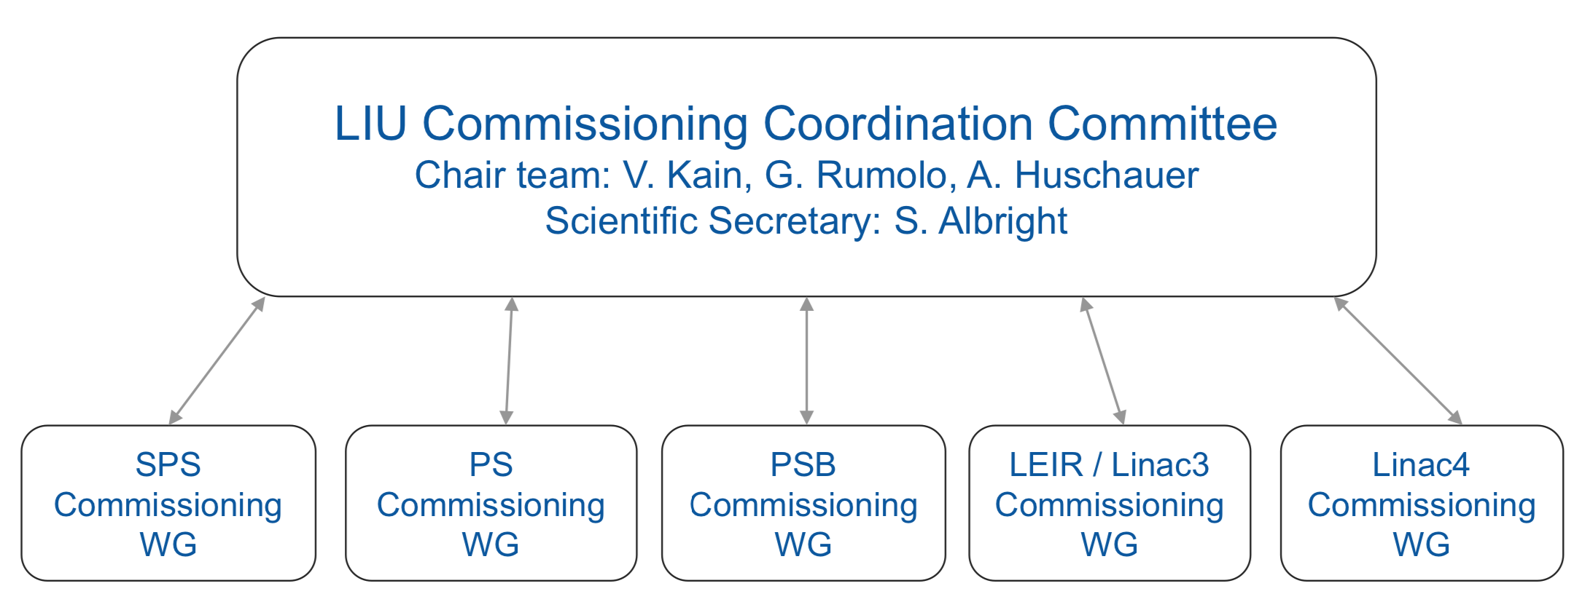
Current structure - responsibilities

Slide 33
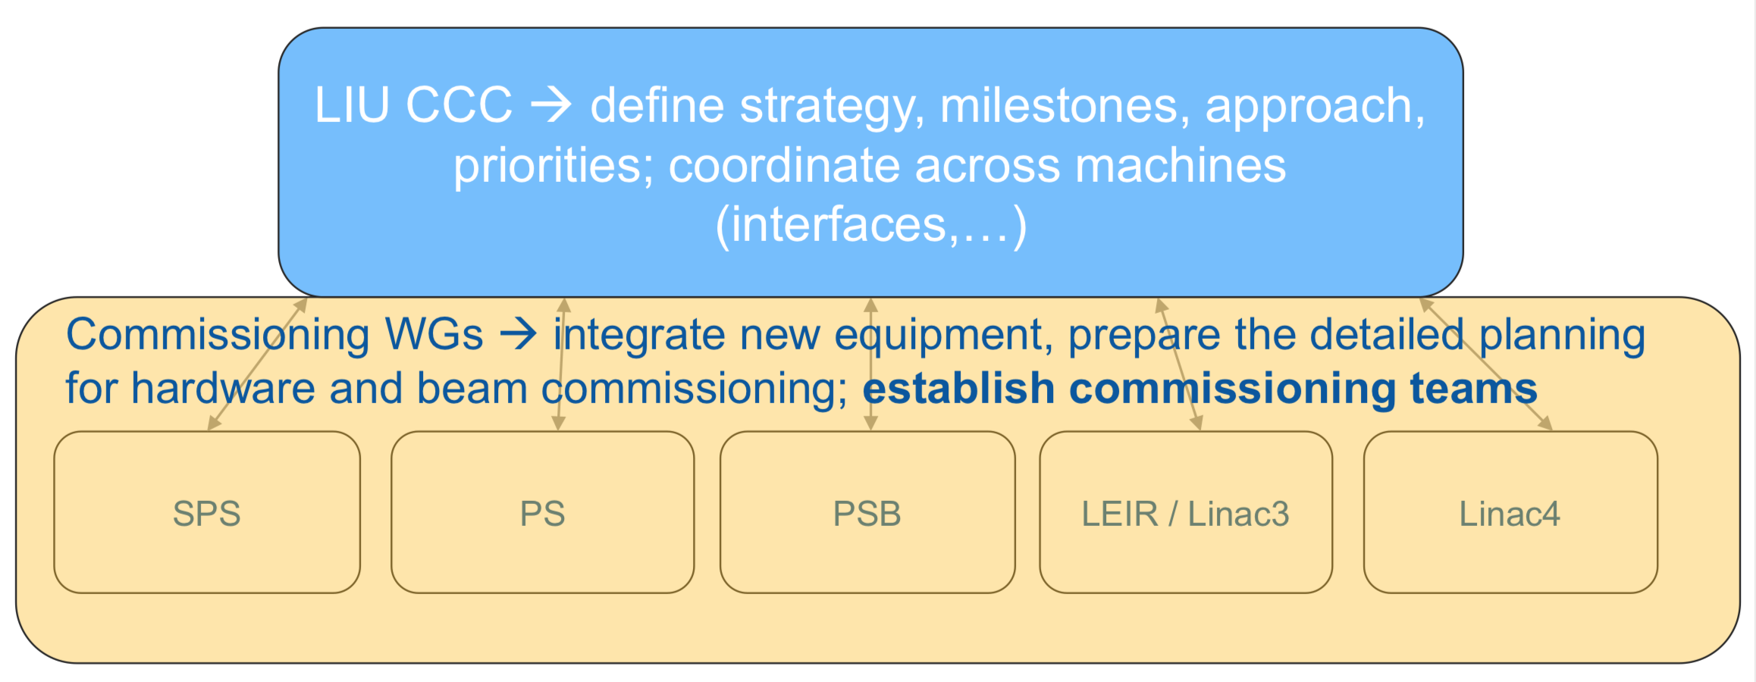
Current structure - responsibilities

Slide 34
Formalize existing commissioning experience
2018 Objectives | Formalize beam commissioning with 2018 start-up Add beam commissioning to re-commissioning check lists Establish planning and time allocation of tests Review approach and procedures afterwards Take reference measurements LEIR will already have all LIU upgrades This will serve as template for after LS2
 | Tools: Launch injector settings management working group Establish prioritized list of tools to be prepared/upgraded for after LS2 per machine; define resources and deadlines Develop further online beam parameter (and performance) analysis and tracking Prepare list of methods/algorithms to test during 2018 run
 | How to commission main new LIU systems in the different machines? Which beams, which entry conditions, which infrastructure, which steps, which procedures, which tools? Include in beam commissioning check lists

Slide 35
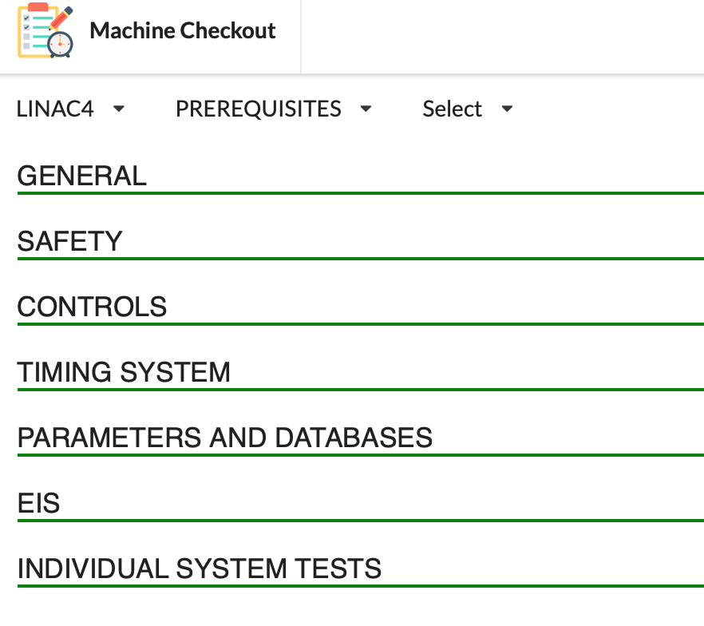
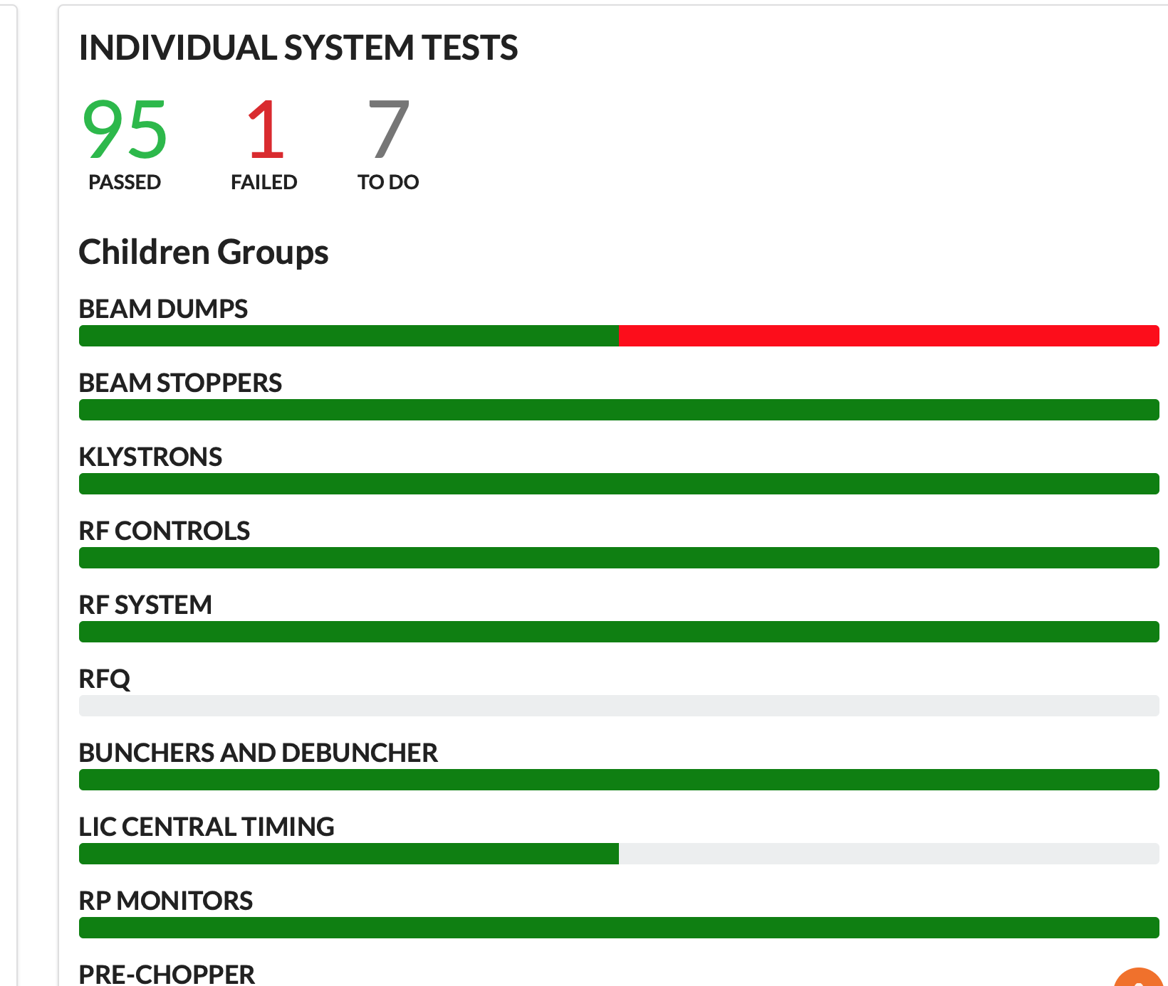
Tools for preparation and coordination
Planning IST & HWC: MS project; collaboration between EN/ACE – BE/OP
  Allows resource loaded planning
  Logical as ISTs partially in shutdown and HWC
  Responsibility: shutdown period planning → EN-ACE; HWC period planning → BE-OP
Planning beam commissioning: Accelerator Schedule Management (ASM)
Tracking: check list tool

Slide 36
Check lists
Example 2017 check lists
ž

Slide 37
Check lists
Example 2017 check lists

Slide 38
Check lists

Slide 39
How to define what needs to be tested when?
HWC and beam commissioning: BE-OP recommissioning coordinators and coordinators have experience from the past
  Responsibility and safety well defined: machine is closed
  Building on check lists of previous start-ups
  LIU specificities and other special tests are being incorporated.
Individual System Test: first time formalized
  Workflow to establish list of ISTs with adequate detail and first planning was established and fine tuned
    Beam and HW commissioning WG established list with equipment groups
      Safety details included
    Second iteration with equipment groups to prepare planning organized by facility coordinators
    Test procedures are being written for safety critical ISTs during shutdown

Slide 40
Testing during shutdown?
Individual System Tests and Co-activity
Baseline strategy: all safety critical IST during HWC period.
BUT…
cross-machine interdependence
  Switch yard that needs to be closed very early → LINAC4 LBE run
    HWC with POPS testing does not (might not) allow co-activity: magnet patrol → issue for kicker, septa testing.
big machines, big numbers, limited number of available teams
  E.g. COD converter renovation in the SPS
new equipment:
  LIU system extended testing

Slide 41
Testing during shutdown?
Individual System Tests and Co-activity
  Safety critical ISTs during shutdown period need mitigation measures.
  Systems typically concerned: kickers, septa, other magnets, RF, cryogenics
  What work is possible in vicinity of IST? → input to establish planning.
  Test procedure with details on hazard created and mitigation being prepared.
List of ISTs that need test procedure established by commissioning WG.
https://edms.cern.ch/document/2248909/1
Funken (LIU Project Safety Officer ),
A.-P. Bernardes (Safety Support Officer)

Slide 42
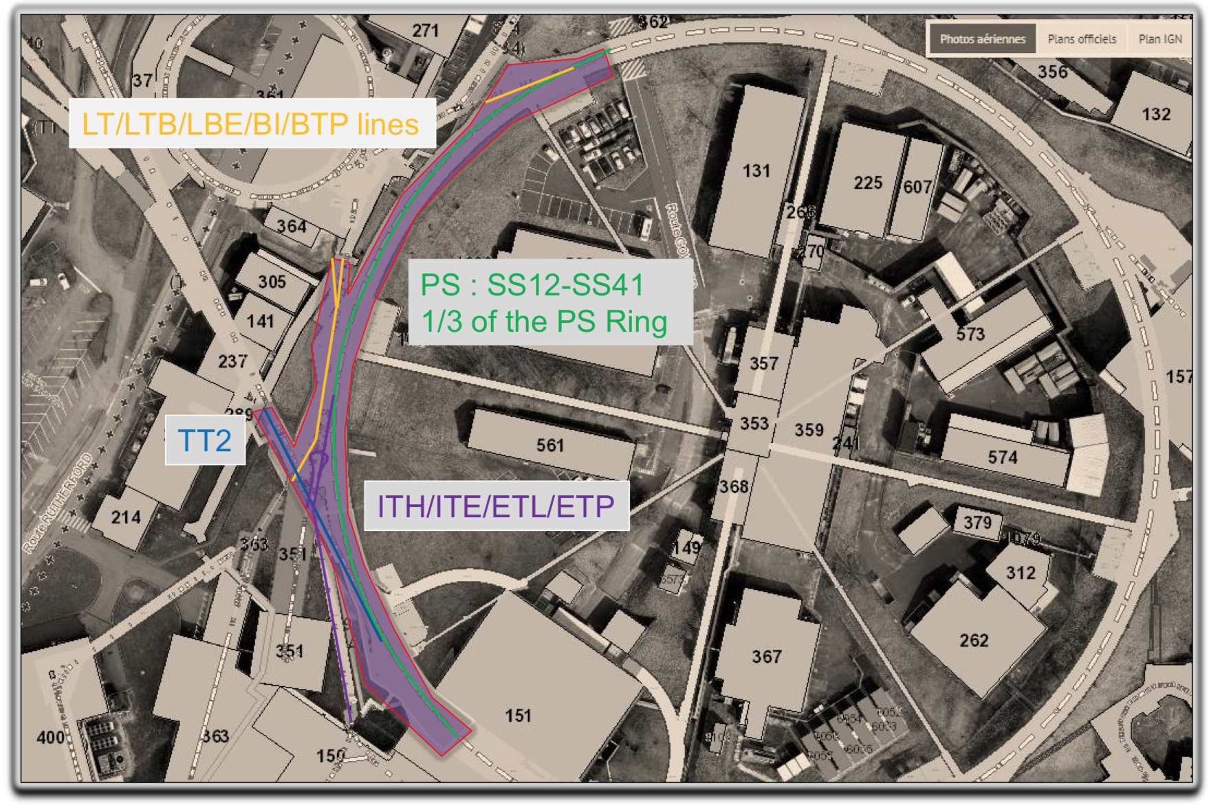
PS switch yard overview

Slide 43
2020
LINAC4: standard (i.e. post YETS-type) re-commissioning
LINAC3 test run with beam: commissioning of TL BPMs, LINAC3 LLRF, source tests
PSB: testing from March, beam September
PS: testing from April, beam November
SPS: testing from February

Slide 44
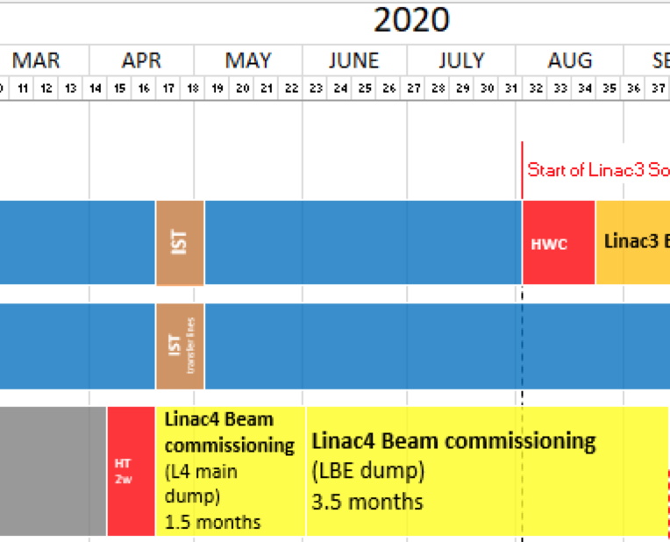
LINAC4
From the current master schedule:
LINAC4 in 2020: different commissioning state compared to rest of complex
Test of “typical post-YETS” start-up. Re-use planning and check lists
→ Switch yard closed from week 20. Beam week 23

Slide 45
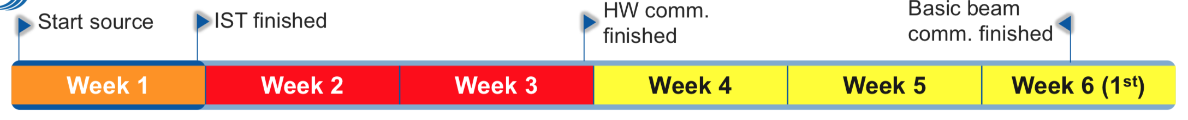
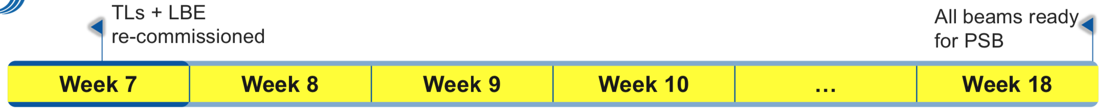
LINAC4 2020 – 2 Phases
Phase 1: to LINAC4 dump → commissioning 2.5 weeks
Phase 2: to LBE dump: 12 weeks
  Running in; concentrated MDs for beam quality, automation, reproducibility. Detailed plan available at link
  Stripper foil test
  Final beam preparation for injection into PSB
  Co-activity to be managed → switch yard; PSB HWC

Slide 46
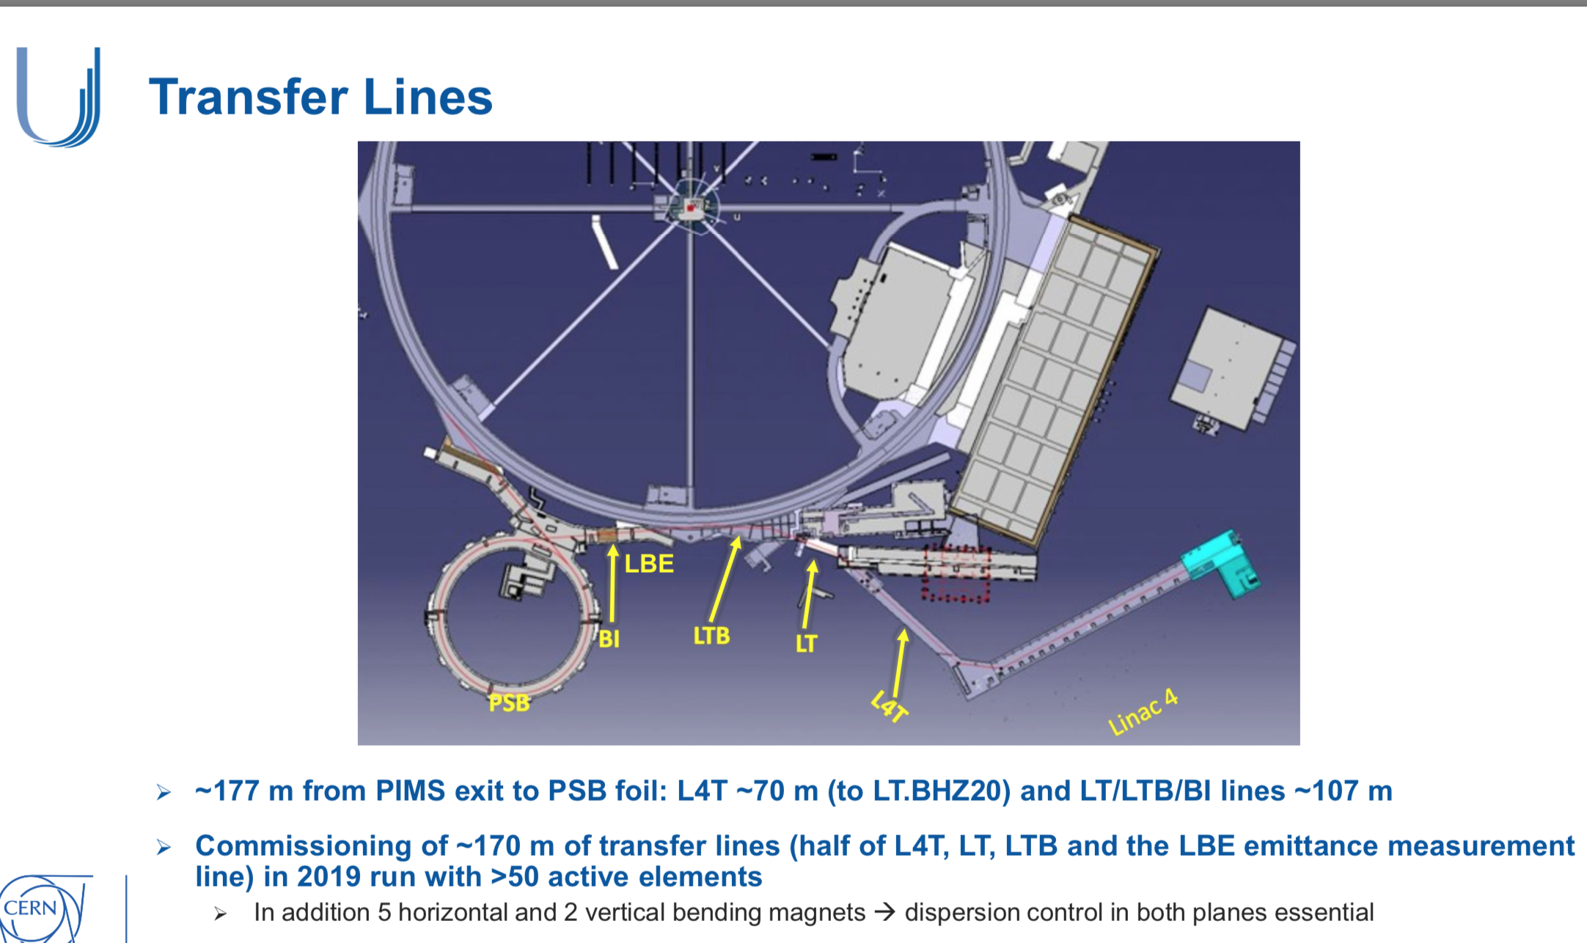
LINAC4 – transfer line commissioning ongoing
LBE run until mid Dec 2019
Montreux workshop
Feb’ 2019

Slide 47
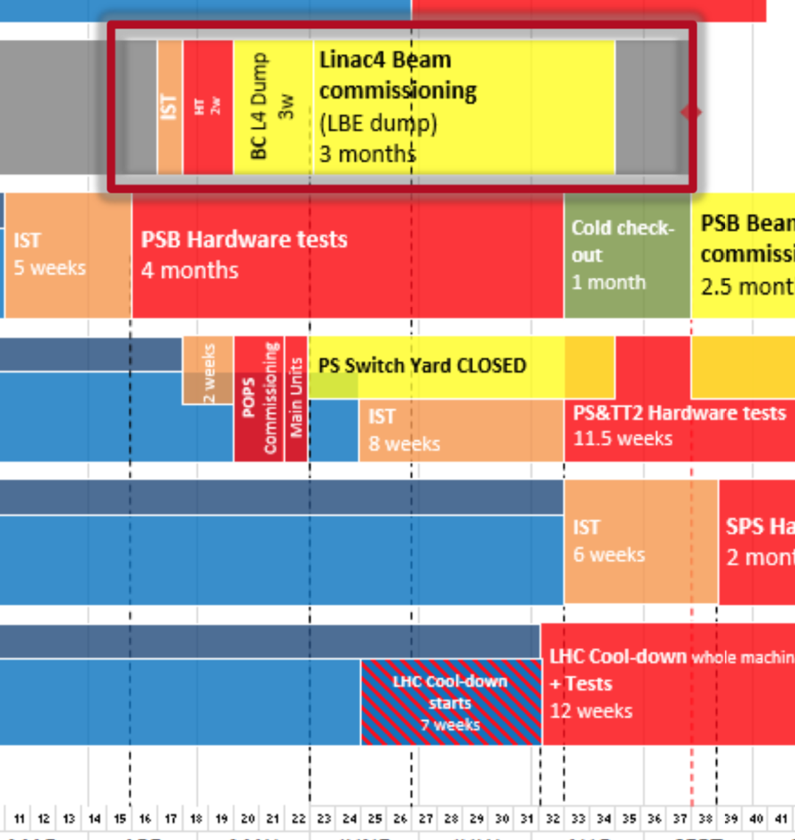
LINAC4 in 2020
January 2020: outcome of LBE run in 2019 will define what needs to be done during run in 2020
Proposal:
Includes IST period
Allows to reopen switch yard → ease PS commissioning

Slide 48
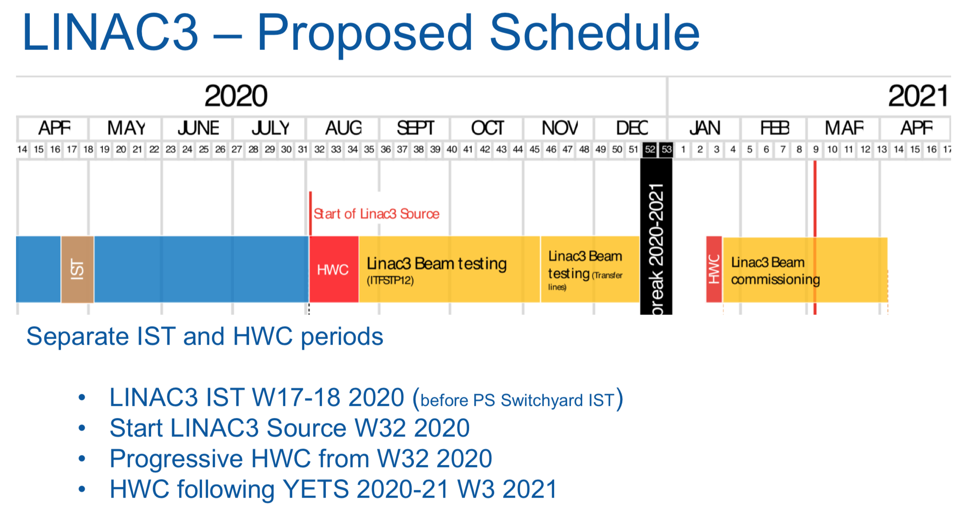
LINAC3
Early switch yard closure taken into account in planning
Partial DSO test of LEIR required for TL test w46-51: requirements defined
IST/HWC planning online. Extending HWC check lists for new LLRF

Slide 49
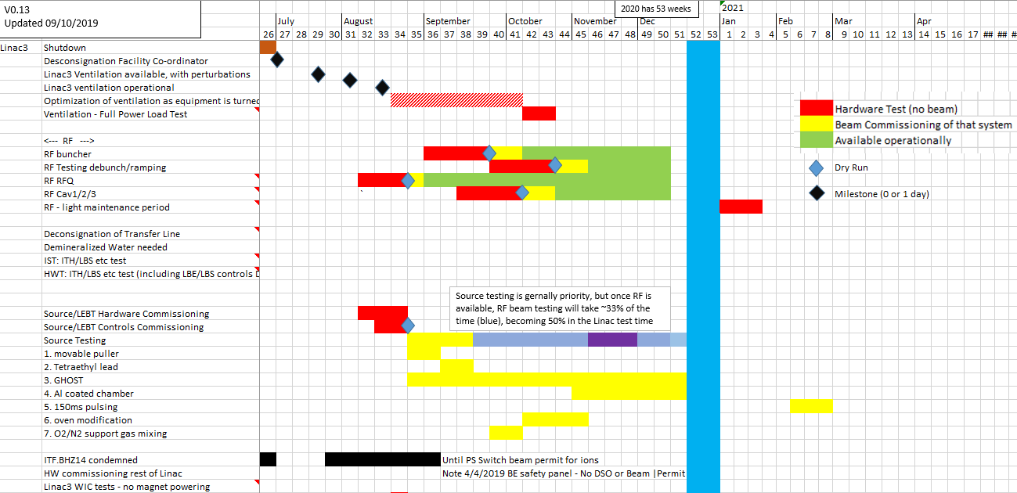
LINAC3 + LEIR Transfer Line – beam commissioning planning 2020
Linac3 source long term development has tests for new ideas, and consolidation of Low Level RF system
Transfer line BPM commissioning
Details under this link

Slide 50
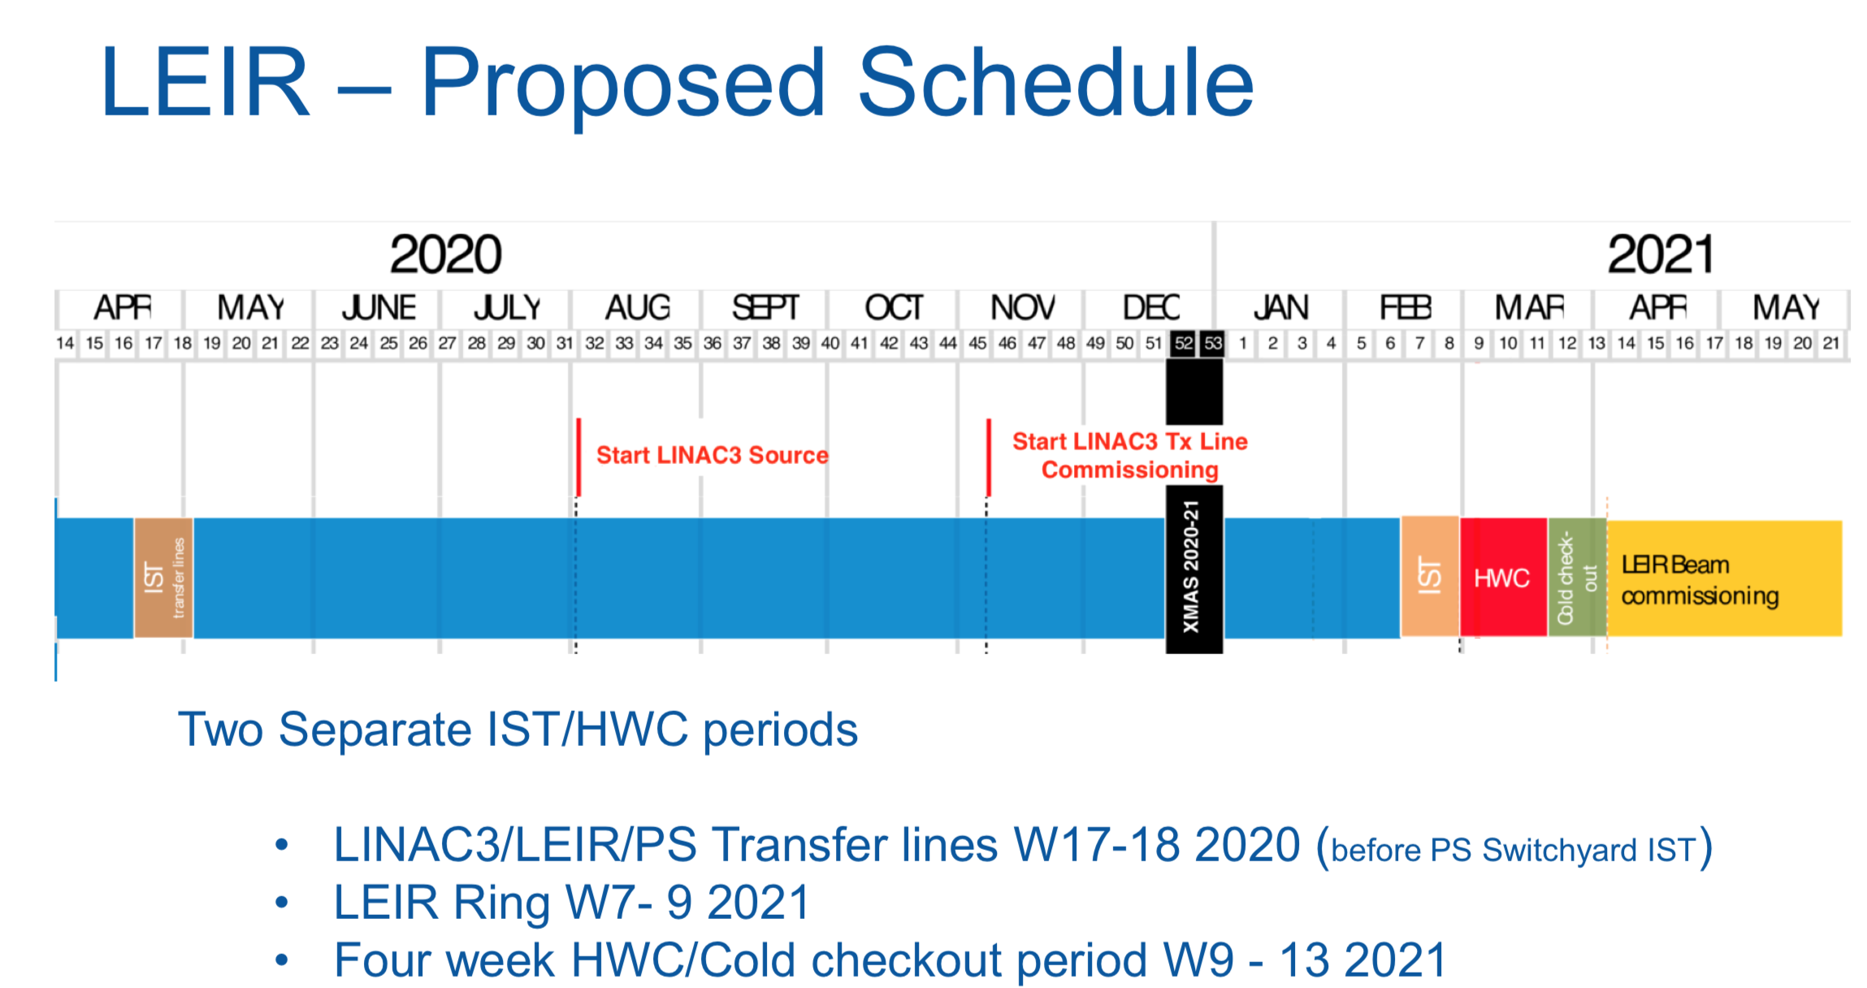
LEIR
Early switch yard closure taken into account in planning
RF power system IST before IST period due to manpower situation
  Safety impact being verified
IST planning online; HWC check lists being re-worked, first version of planning available. HWC checks partially automated.

Slide 51
LEIR – beam commissioning planning
Details under this link

Slide 52
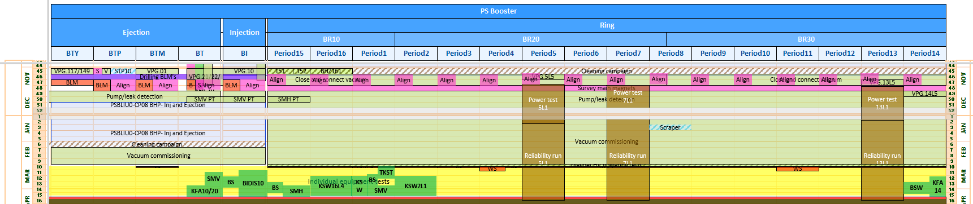
PSB
DSO tests defined (switch yard, PSB)
Safety critical IST of FINEMET cavities, Beam transfer equipment and power converters during shutdown → test procedures prepared;
  Converter connection to magnets and consequent tests moved to the HW comm.
IST planning online, dates being fixed for BI tests
Check lists for HWC exist from past, no online planning yet: new systems to be integrated
  More details required for RF, new LIU BI
Interlock tests for BIS/WIC/SIS/external conditions are already scheduled during HWC period

Slide 53
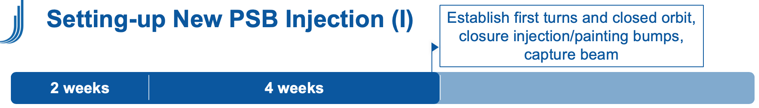
PSB – beam commissioning plan
As presented here
P

Slide 54
PSB – beam preparation schedule
Date | Beams Milestone | Comment
End Nov. 2020 (Week 48) | LHCPROBE/INDIV, at least one ring TOF @ 200-400E10 ppb, MTE @ 1E12 ppp (1.25E11 ppb). | TOF intensity increasing with time. MTE in H2 (H1 as a backup).
Beg. Dec. 2020 (Week 50) | MTE @ 1E13 ppp (1.25E12 ppb). | MTE in H2 (H1 as a backup)
Mid. Dec. 2020 (Week 51) | LHC multi-bunch
End Jan. 2021 (Week 5) | AD
Mid. Feb. 2021 (Week 7) | MTE @ 2E13 ppp (2.5E12 ppb).
End Mar. 2021 (Week 13) | ISOLDE

Slide 55
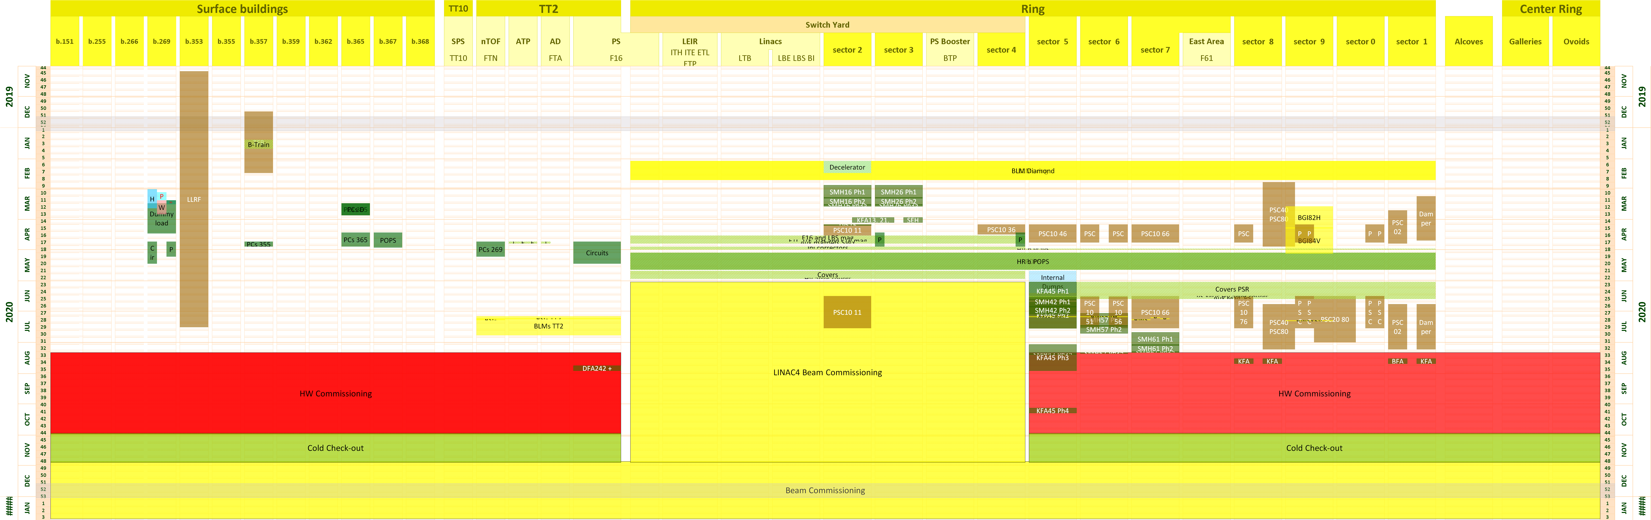
PS
Early closing of switch yard big challenge: → POPS testing early, too short IST in switch yard.
Baseline: provide planning to allow for current planning LINAC4/LBE
Input for ISTs from all systems available
Draft planning available – details for power converter test to be finalized
List of safety critical ISTs during shutdown being prepared
HWC planning only started

Slide 56
PS – beam commissioning planning
6 weeks stand alone commissioning, Christmas stop after week 4
Details of commissioning plan here

Slide 57
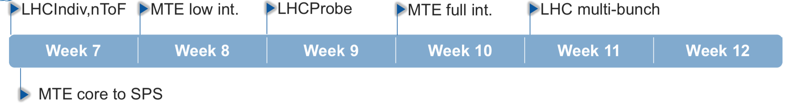
PS – beam preparation schedule
Schedule in accordance with required commissioning steps of PS and SPS downstream

Slide 58
SPS
IST: solid planning online. Several iterations with equipment groups incorporated.
  Transfer line power converter testing negotiated with LHC.
Outstanding:
  Access system tests during IST period compatible with fire safety testing?
  Testing BHZ magnet (PS equipment) with SPS beam dump and injection interlock.
  IST test procedure to be prepared and approved for:
    Power converters
    Beam transfer equipment
HWC planning: first version online in MS project
  DSO tests “defined”
  Assumes earlier SPS closure date: 15/9 instead of 18/9
    Approval of advancement March 2020
  To be finalized: RF testing, testing of scenarios (COAST, FFA,…) and dry runs

Slide 59
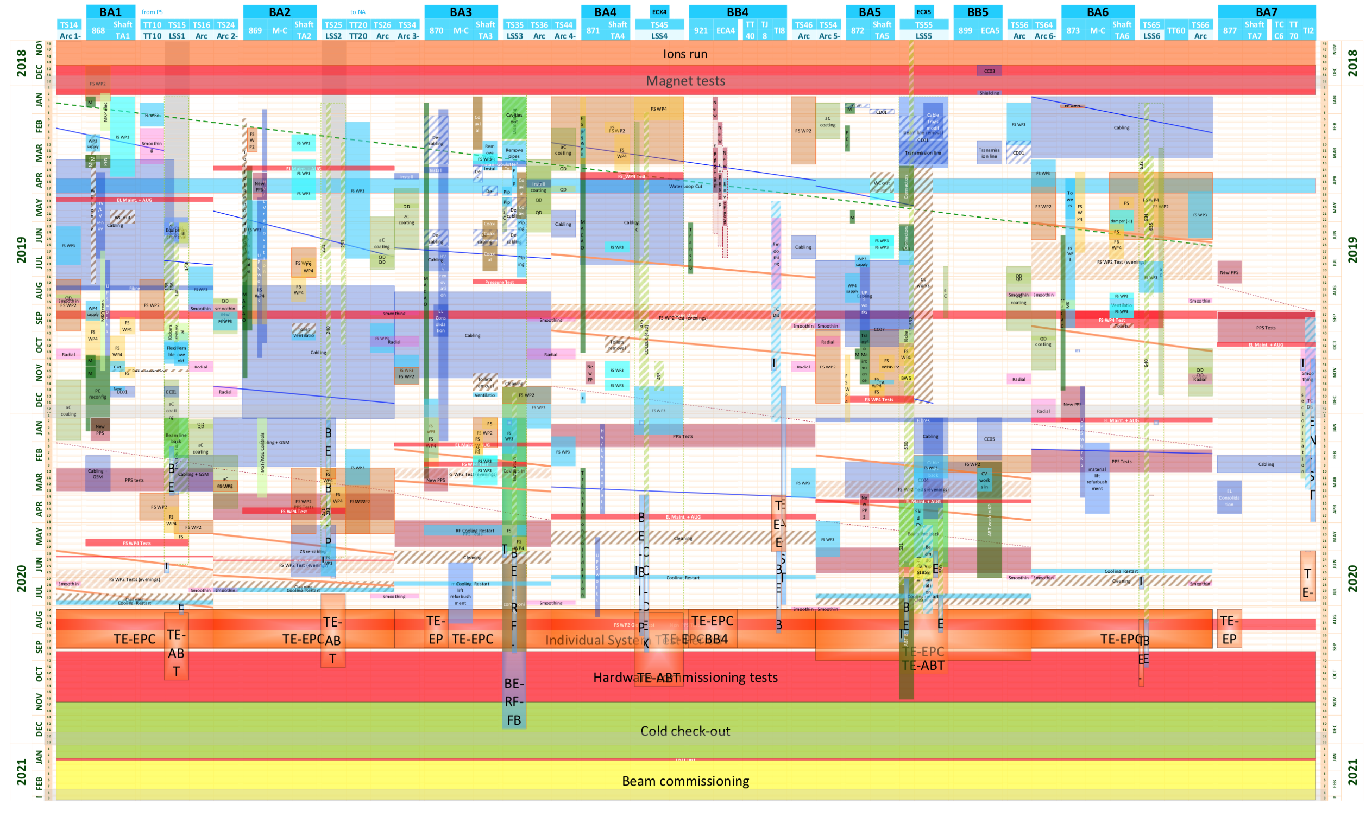
SPS

Slide 60
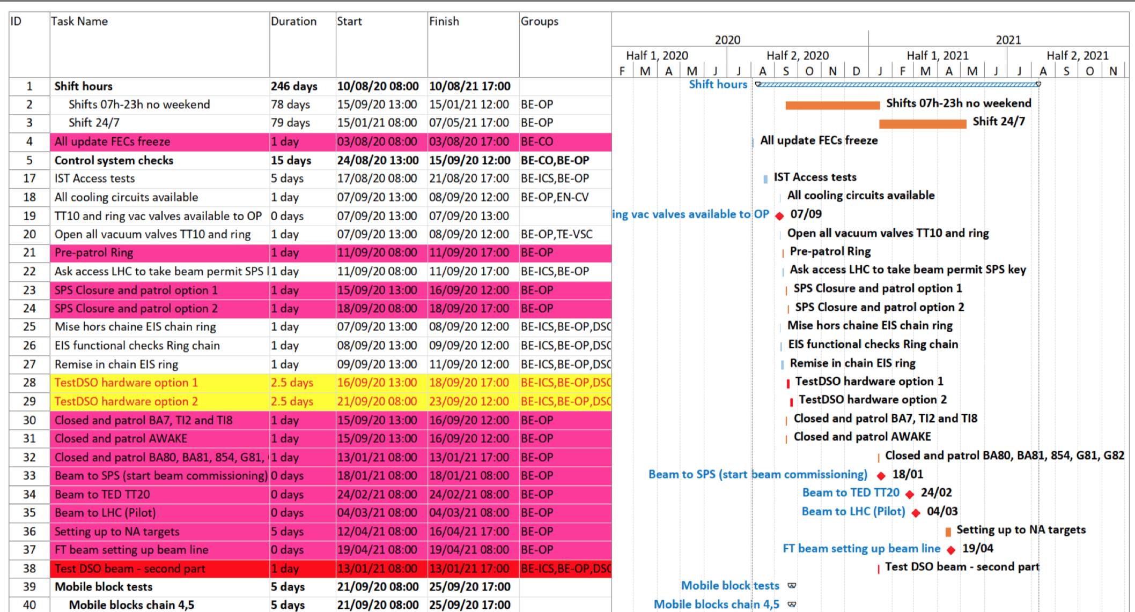
SPS
Extract of part of the planning at beginning of HWC period

Slide 61
SPS – beam commissioning plan
6 weeks of standalone commissioning
  See details under this link

Slide 62
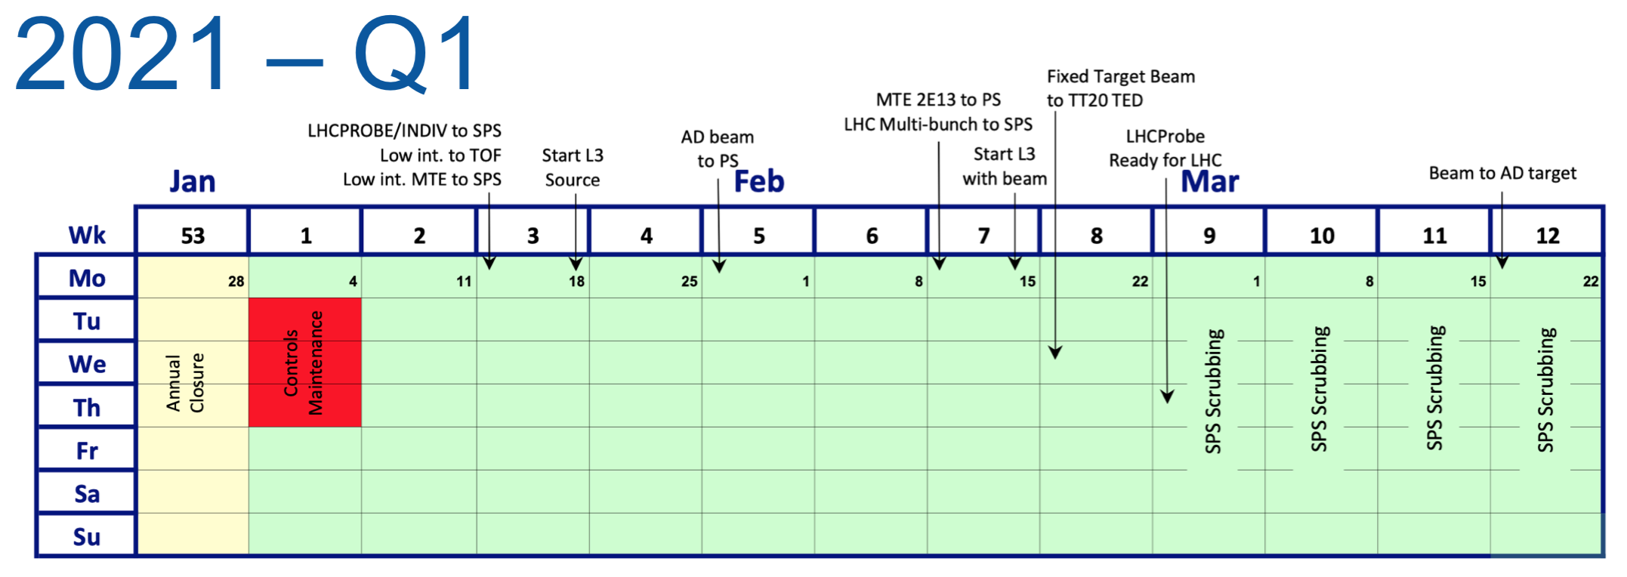
Post standalone commissioning (1)
After delivering LHC beams → beams to other facilities
Facility start-up dates defined in collaboration between machines experimental areas and facilities
→ First version for discussion of injector schedule 2021
2021 Q1

Slide 63
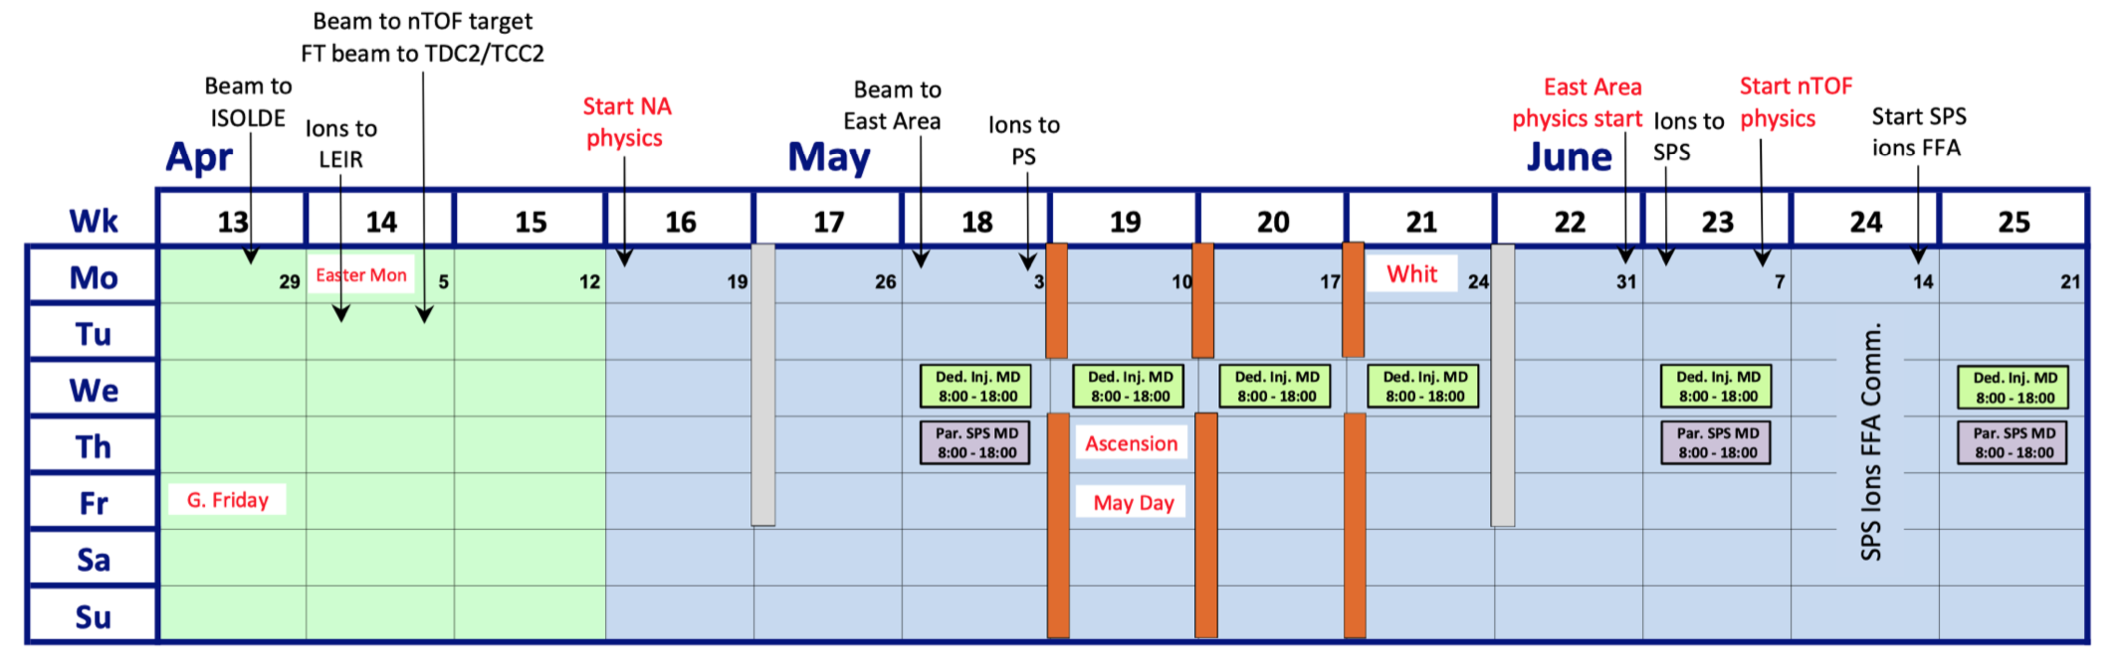
Post standalone commissioning (2)
2021 Q2
Foresee slots for AWAKE and HiRadMat
  Runs to be confirmed
MDs proposed to start in May 2021
  Currently also foresee parallel long MDs
Schedule will be updated after Christmas council meeting

Slide 64
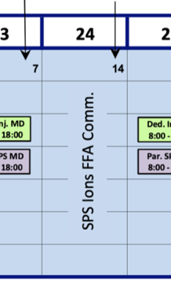
Commissioning of ions in the SPS
Post-LS2 ion commissioning in the SPS: in blocks
  Foresee week dedicated to standard ion commissioning: week 24.
    Most certainly only LHC ion beams need to be commissioned, probably no FT ion program in 2021
  Spare commissioning week: week 30
Details to be established for slip stacking commissioning
  Same principle for initial commissioning: in dedicated blocks
  Tentative first block week 35
  Commissioning with all injections → dedicated MD slots
  First details to be presented at LIU workshop in January 2020
    Including commissioning strategy, tools, estimate of required time

Slide 65
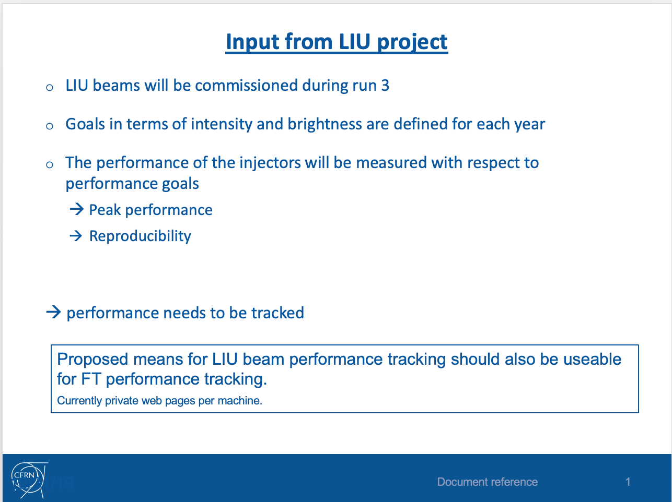
Tools for commissioning towards LIU performance
Generic performance tracking tool required
Established plan with controls group

Slide 66


Performance tracking
Feedback by CO →
Request will be fulfilled
Work ongoing
Exists in SPS already
No commitment yet
for rest of complex.
Feedback mid 2020.

Slide 67
Moving to the next phase
Adequate structure for beam commissioning?
From study/installation/preparation configuration to global commissioning and performance optimization
Discussions only started: proposal to be clear for next LIU workshop (January 2020)
IST coordination with LS2 coordination
HWC through re-commissioning coordinators, informal control room meetings
As is…

Slide 68
Moving to the next phase
Will be addressed at the January 2020 LIU workshop
Proposal for beam commissioning and operation:
Per machine: upgraded Machine Coordination meeting to combine
  Machine and technical coordination
  Beam dynamics WG
  Beam and hardware commission WG
  Weekly
Across complex: Accelerator/Injector Performance Meeting
  Guide and lead overall commissioning and operation according to performance
    − Peak and reproducibility
    − Efficiency (e.g. LHC beam preparation, injector impact on LHC turn-around- time)
  Target beam dynamics, operational aspects, software, algorithms, hardware
  All beams
  Bi-weekly
Already in practice @ LEIR

Slide 69
THe end

Slide 70
Rough timeline of post-LS2 beam commissioning
The first year of Run 3 (2021) will have to be fully devoted to
  The recovery of the pre-LS2 beams (protons) with LIU equipment, both for LHC and FT physics
  The production of the Pb ion beams to the full LIU performance with slip stacking in SPS for the 2021 ion run
2022 should be devoted to accelerating 2e11 p/b injected in the SPS
  Already injected in 2017 with 70% of the target bunch intensity, brightness and train length
  Still marginally stable in the PS and affected by instabilities in the SPS
Further intensity steps (additional 15% and 10%) to be made in 2023 and 2024
  These steps are unprecedented and will require dedicated scrubbing runs in the SPS and fine transverse and longitudinal optimisations
  While high intensity is being commissioned, corrective actions compatible with YETS could be applied, if needed.
2020-21
2022
Commissioning of pre-LS2 beams with Linac4 and installed LIU equipment + commissioning of the LIU performance Pb ion beams with slip stacking in SPS
Commissioning of 1.8 10¹¹ p/b with the desired brightness and loss budgets out of SPS
2023
2024
Commissioning of 2.1 10¹¹ p/b up to SPS extraction and tests of higher intensity at least up to the SPS injection
Commissioning of 2.3 10¹¹ p/b up to SPS extraction with the desired brightness and loss budgets

