Slide 1
CBM. Design of cryogenic system
11.2019, BINP, M.Kholopov, A.Bragin

Slide 2
FAIR

Slide 3
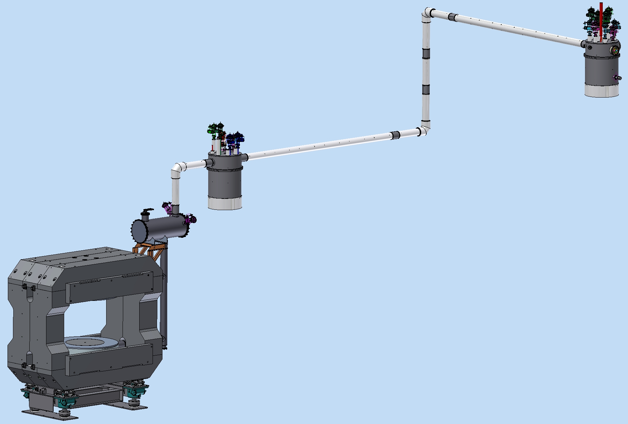
3D Model of CBM Magnet and cryosystem
Feed Box (m=960kg, D=1100mm, H=2600mm)
Cryostat (m=430kg, D=700mm,
L=1650mm)
Branch Box (m=1150kg, D=1100mm, H=2600mm)
He transfer
Line (30kg*m)
Coil (m=1479kg, D=2160mm, d=1160mm, h=482mm)
Iron Yoke & supports (m= 149712 kg)

Slide 4
3D Model of CBM Branch box
Pneumatic valves
Hads detectors iterface
Feed Box iterface
Input interface
He Pipelines
Cu Thermal shield
Vacuum shell

Slide 5
Flowscheme of CBM Branch box

Slide 6
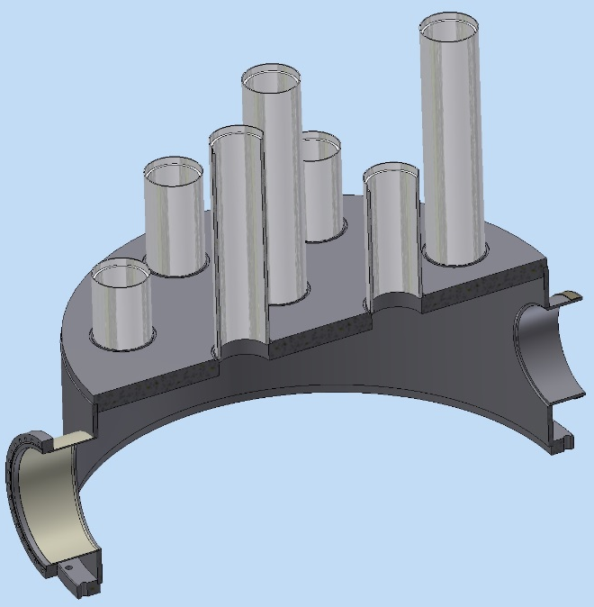
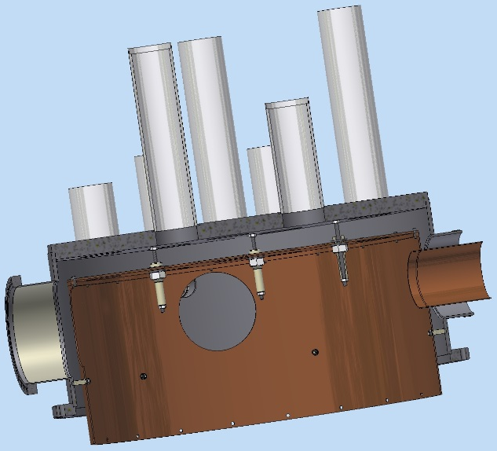
Stages of Assembly of the CBM Branch box
Vacuum shell. Top.
Thermal shield. Top.
Thermal shields suspension
Thermal shields spacer
CDR CBM cryogenic system

Slide 7
Stages of Assembly of the CBM Branch box
Installation of pipelines 50K F
Installation of pipelines 4.6K F
Installation of pipelines 4.5K R
metal hoses are used to remove the load from the valve

Slide 8
Stages of Assembly of the CBM Branch box
Installation of pipelines 80K R
Installation of Middle Thermal shield
Fastening of thermal bridges and connection of Thermal shield
Threaded rivet M6
Thermal bridges

Slide 9
Stages of Assembly of the CBM Branch box
Installation of the bottom of Thermal shield
Installation of the bottom of Vacuum shell
At all stages of Assembly, the rules of vacuum hygiene are fulfilled. During Assembly of the Helium lines is checked for the vacuum and pressure.

Slide 10
3D Model of CBM Feed box
Magnets cryoctat iterface
Pneumatic valves
He Pipelines
Branch Box interface
Cu Thermal shield
Vacuum shell

Slide 11
Flowscheme of CBM Feed box

Slide 12
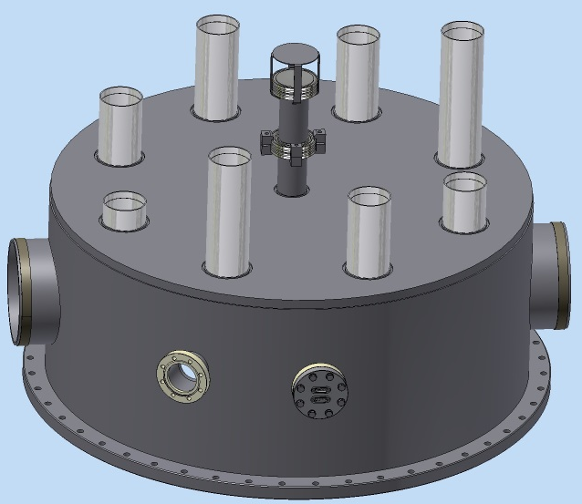
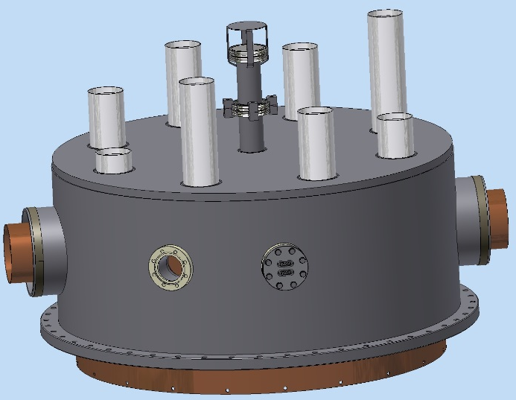
Stages of Assembly of the CBM Feed box
Vacuum shell. Top.
Thermal shield. Top.
Thermal shields suspension
Thermal shields spacer
CDR CBM cryogenic system

Slide 13
Stages of Assembly of the CBM Feed box
Installation of pipelines 4.5K R
Installation of discharge pipelines
Installation of pipelines 50K F
metal hoses are used to remove the load from the valve

Slide 14
Stages of Assembly of the CBM Feed box
Installation of pipelines 4.6K F
Installation of pipelines 80K R
Installation of Middle Thermal shield
Thermal bridges
Threaded rivet M6

Slide 15
Stages of Assembly of the CBM Feed box
Installation of the bottom of Thermal shield
Installation of the bottom of Vacuum shell
At all stages of Assembly, the rules of vacuum hygiene are fulfilled. During Assembly of the Helium lines is checked for the vacuum and pressure.

Slide 16
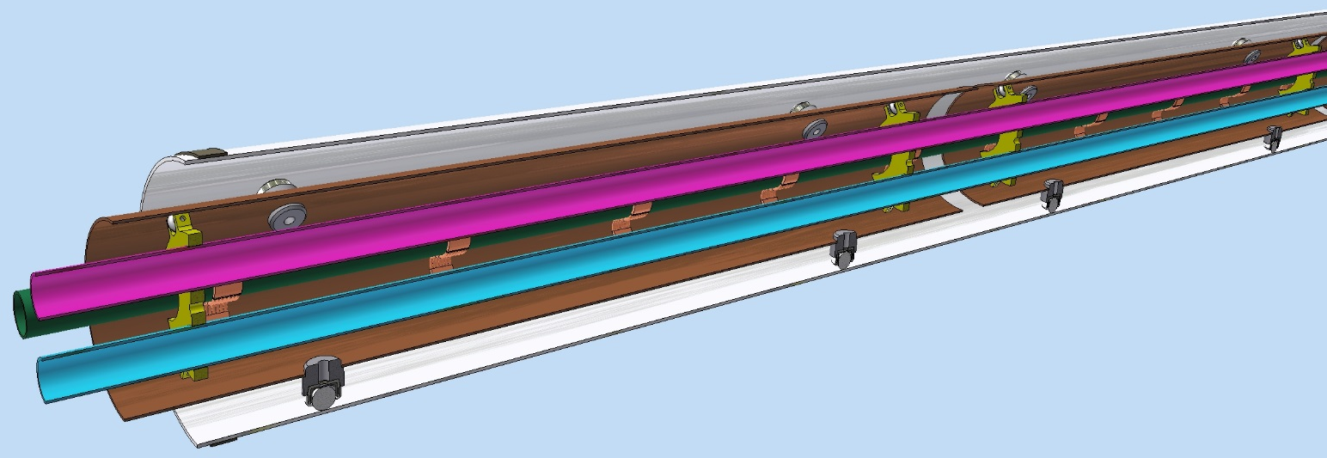
3D Model of CBM Transfer line
Line part of TL
G10 spacer
Ball joint
He Pipes
Cu Thermal shield
Vacuum shell DN200

Slide 17
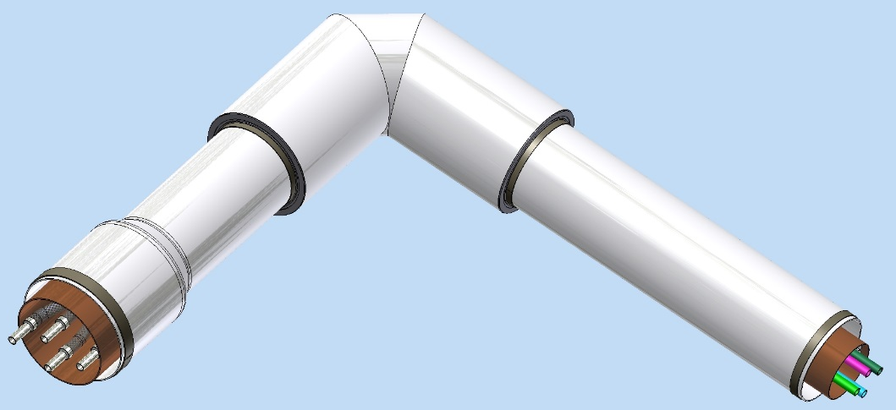
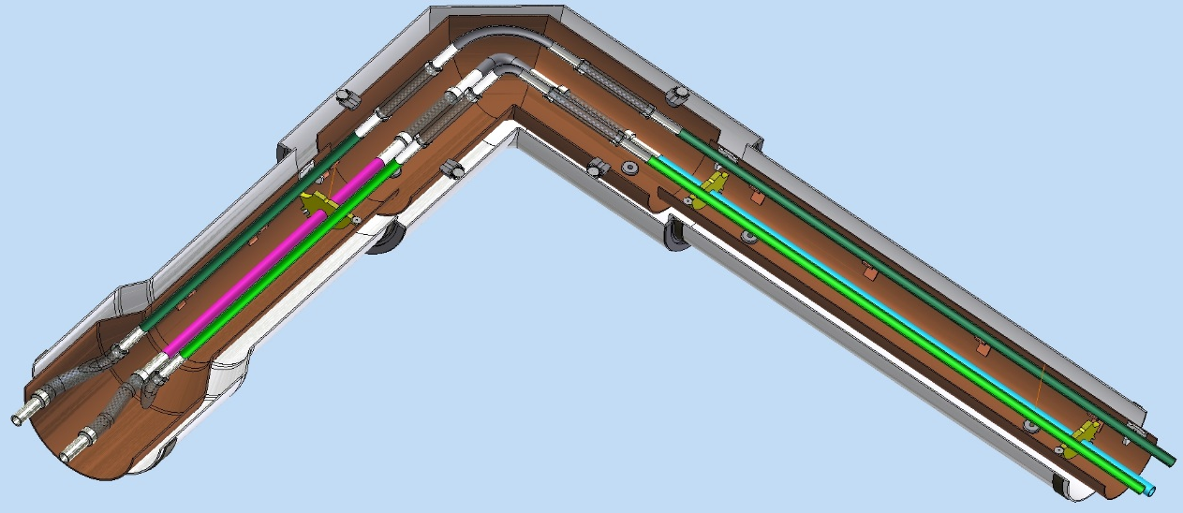
3D Model of CBM Transfer line
Angle part of TL
Angle vacuum shell DN250
Magnets cryoctat iterface
Ball joint
Vacuum shell DN200
He Pipes
Cu Thermal shield
G10 spacer

Slide 18
Thank you for your attention!

