Slide 1
MVD Small Silicon Strip Disks
15.2.2018 Tobias Stockmanns

Slide 2
Assumptions
No new sensor design:
Wedge Sensor
34.59/19.94 x 55.67 mm^2 // 36.87/21.69 x 57.67 mm^2
Barrel Sensors
S1: 58.275 x 33.315 mm^2 // 60.275 x 35.315 mm^2
S2: 33.315 x 33.315 mm^2 // 35.315 x 35.315 mm^2
Within the boundaries of the existing disks
Inner radius 22 mm
Outer radius 267 mm

Slide 3
Wedge Sensors
Does not work:
Large holes
Electronic has to be tilted
Support
Sensor

Slide 4
Barrel Sensors
Where to put the electronics?
Front Side Electronics
MCC
35 mm
Sensor
Support
Back Side Electronics
Sensor
60 mm
Sensor
Support
35 mm
20 mm
Sensor
Support
Sensor
Sensor
Support

Slide 5
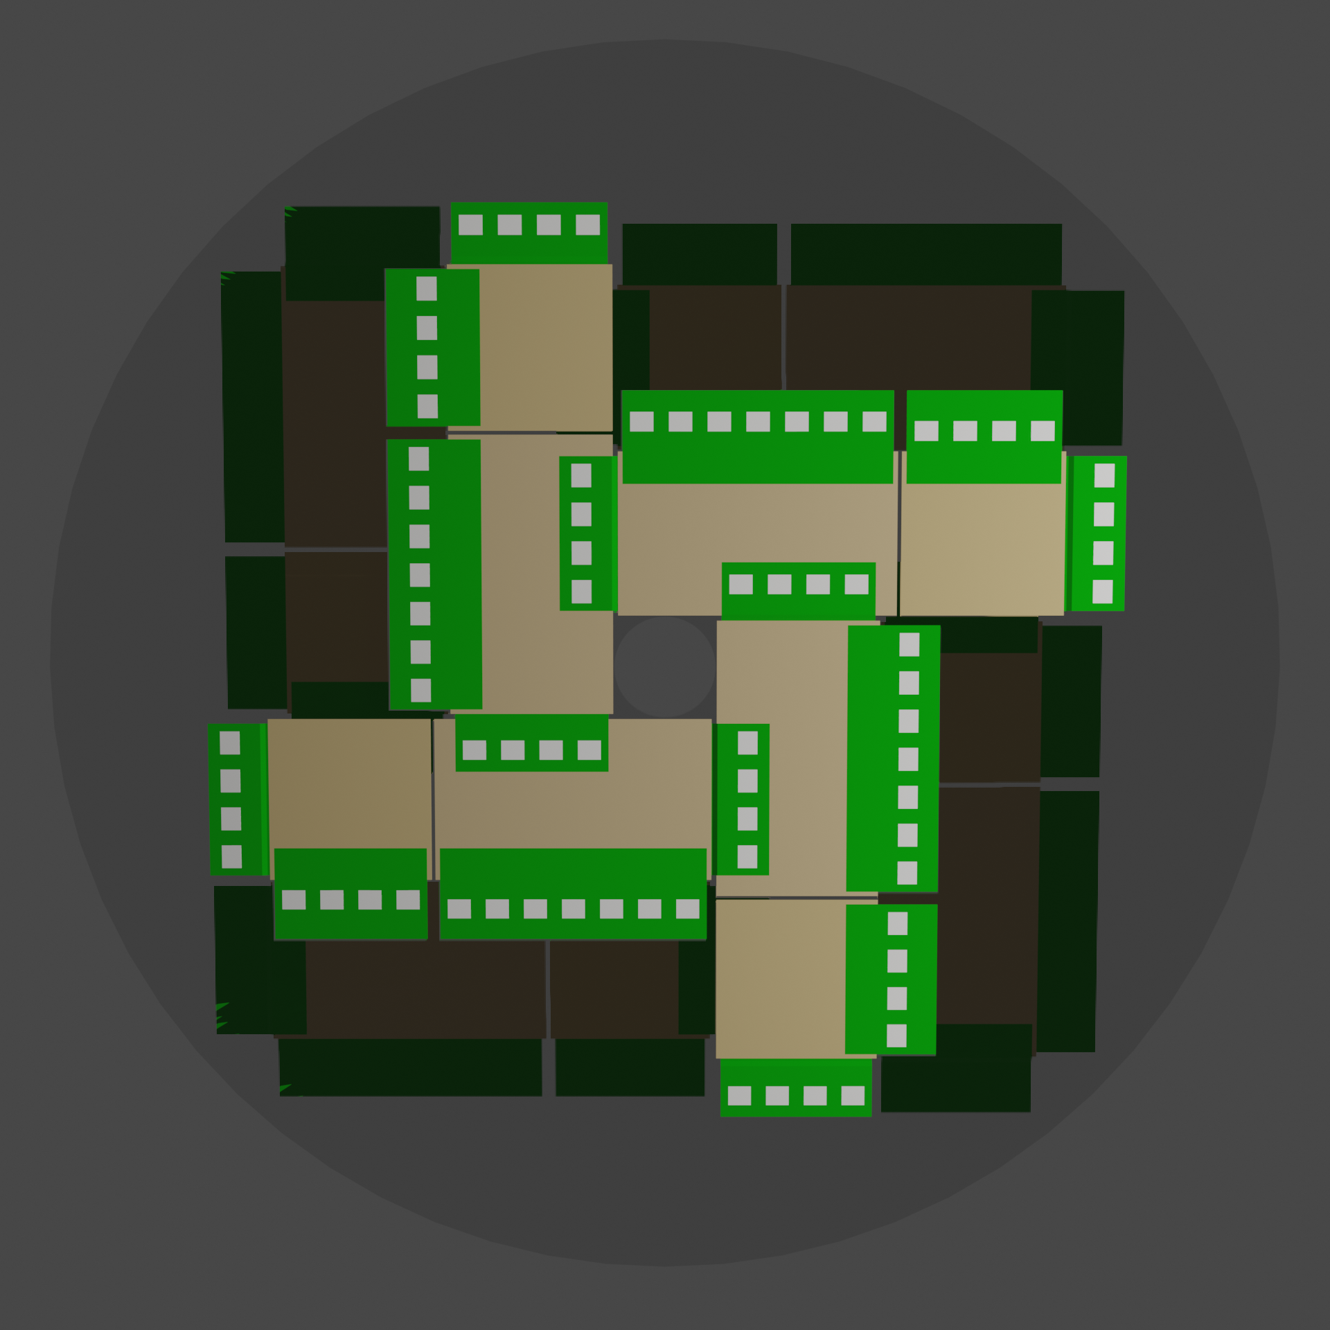
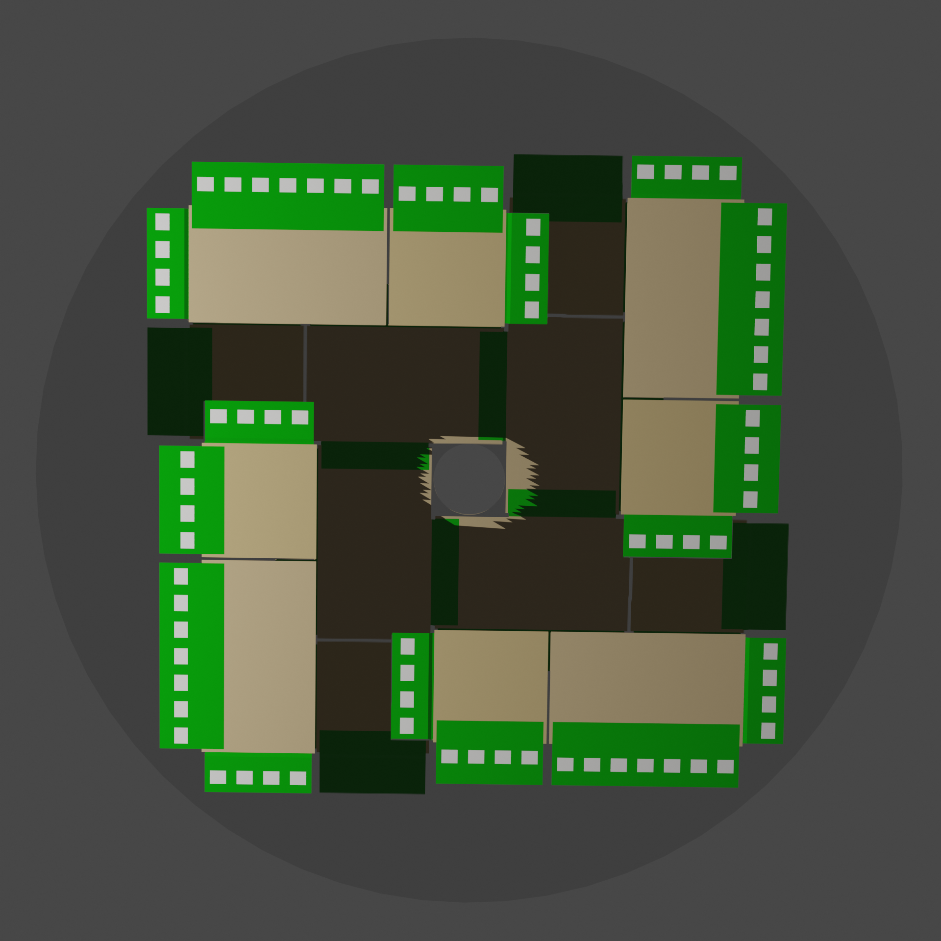
Disk Layout

Slide 6
Disk Layout

Slide 7
Disk Layout

Slide 8
Disk Layout
Sensor
Support
Sensor

Slide 9
Requirements
2 Disks with:
8 large modules:
1 sensor 60 x 35 mm^2
11 TOAST
1-2 module controller
8 square modules:
1 sensor 35 x 35 mm^2
8 TOAST
1-2 module controller
Support structures with cooling
Holding structures
Total:
16 large sensors
16 small sensors
304 TOAST
32-64 module controller

Slide 10
Summary
Building the forward disks based on barrel sensors seems possible
Advantage:
Same sensor technology than barrel
No big holes in the inner part of the disks
No bending of electronics necessary
Disadvantage:
Holes at larger radii
Overlapping of electronics and sensors (problem for cooling?)

