Slide 1
Neutral Hadron Detection with PANDA
Nov 5, 2019 | Albrecht Gillitzer
PANDA Collaboration Meeting 19/3, GSI Darmstadt

Slide 2
Introduction
PANDA is optimized to detect charged particles and photons
‚stable‘ charged particles: $p, \overline{p}, π^{±}, K^{±}, e^{±}, μ^{±}$
neutral mesons: $π^{0}, η, η′, ω$ / $φ, J/{ψ, K_{S}}$
longlived hyperons: $Λ, Σ^{0}, Ξ^{−}, Ω^{−}$
physics arguments to detect ‚stable‘ neutral hadrons $K_{L}, n, \overline{n}$
example: $\overline{p}p→φφ→K^{+}K^{−}K_{S}K_{L}$
stable neutral hadron detection in PANDA?

Slide 3
15 GeV/c $\overline{p}p→K_{L}K_{L}ν$
K_{L} detection efficiency

Slide 4
$K_{L}$ Detection in PANDA-relevant Phase Space
Box Generator well suited for specific regions of phase space
most simple & efficient way to cover the full PANDA-relevant phase space: use EvtGen with Neutrino(s) at p = p_{max}
EvtGen doesn‘t care about lepton flavor violation
here: $15 {GeV}/{c \overline{ p}p→K_{L}K_{L}ν}$

Slide 5
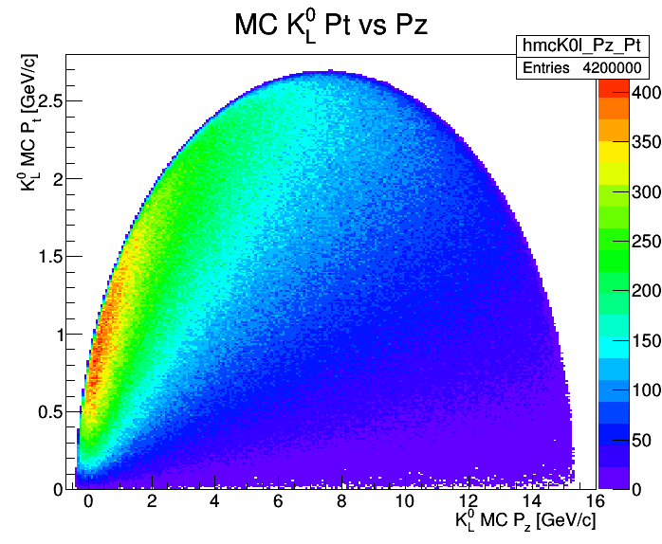
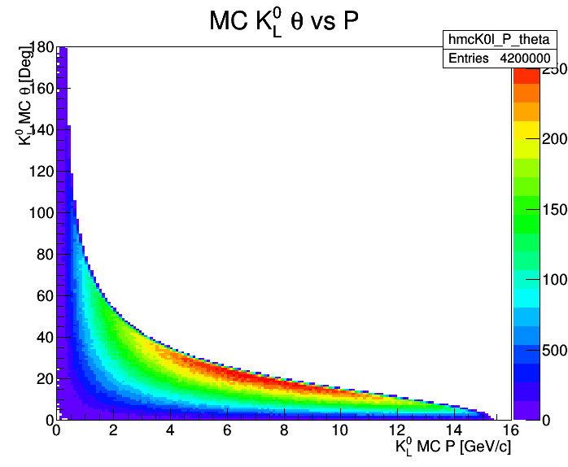
$K_{L}$ MC Generated Distributions
2.1 M events → 4.2 M $K_{L}$

Slide 6
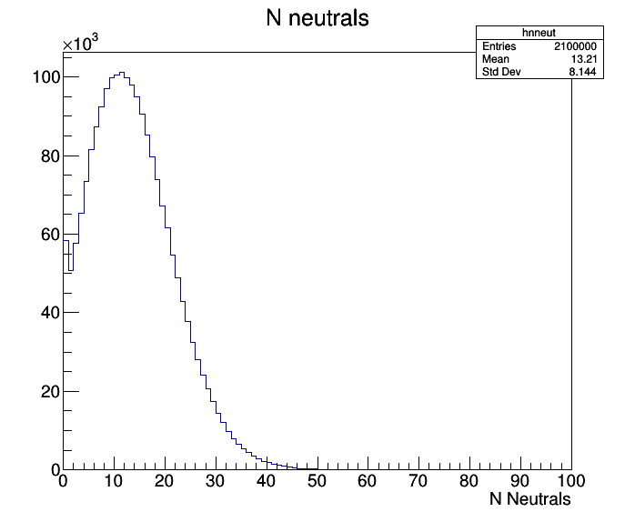
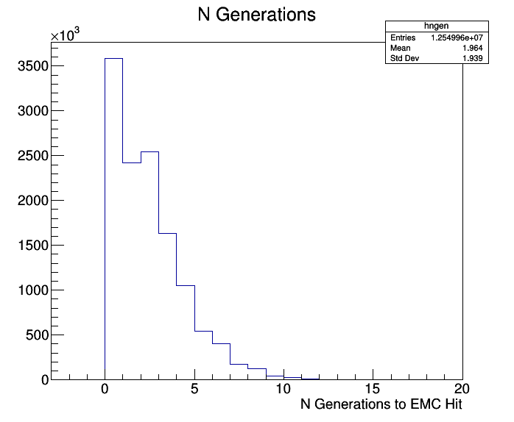
Neutral Candidate Multiplicity
Up to ~40 neutral candidates, average: ~13 neutral candidates
~3% no candidate, 2.5% one candidate

Slide 7
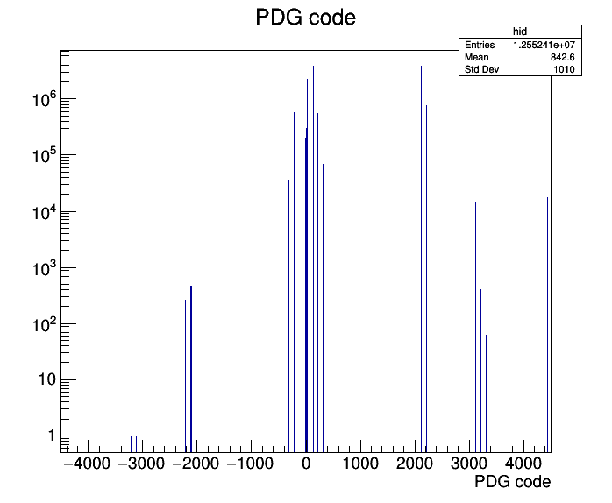
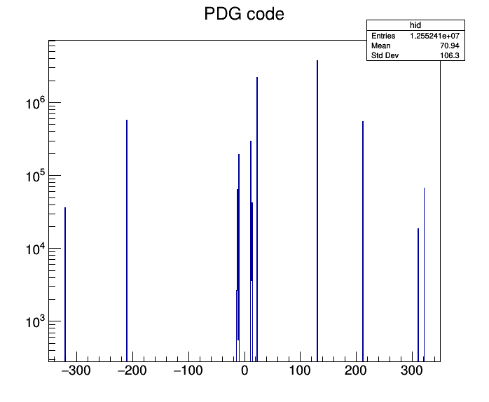
Neutral Candidates: MC Truth Particles
K_{L}
n
p
γ
π
π
Dominant: K_{L}, neutrons and photons

Slide 8
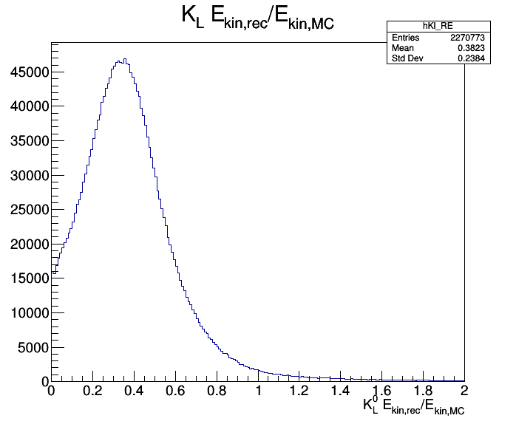
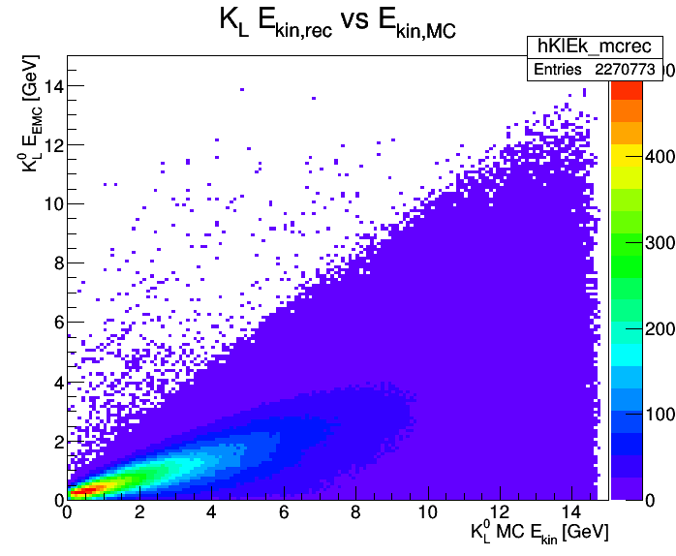
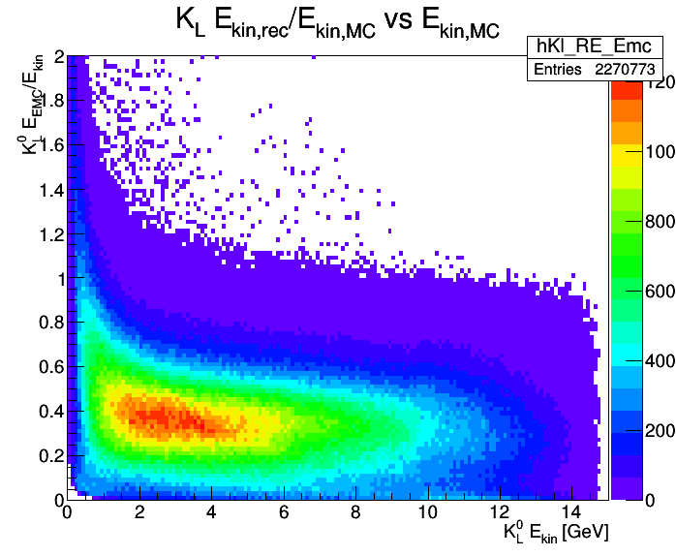
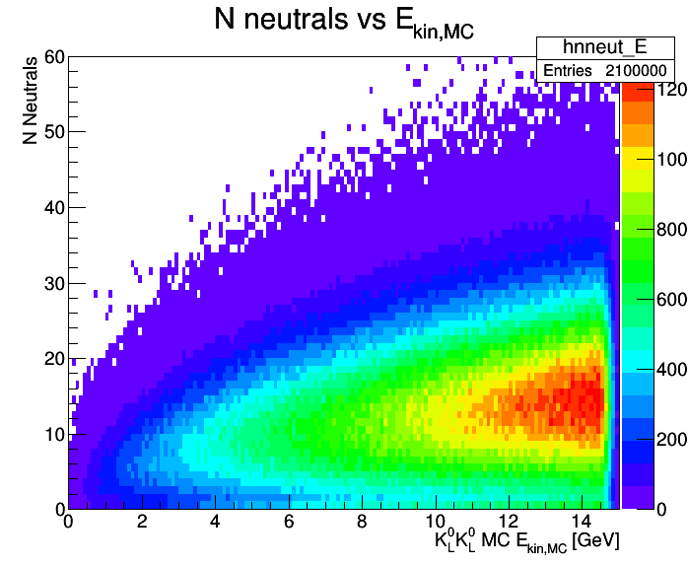
K_{L} E_{EMC} / E_{kin,MC}
K_{L} E_{EMC} vs E_{kin,MC}
K_{L} E_{EMC} / E_{kin,MC} vs E_{kin,MC}

Slide 9
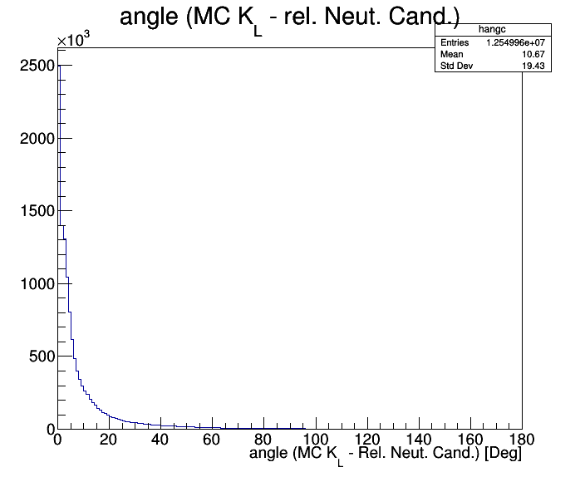
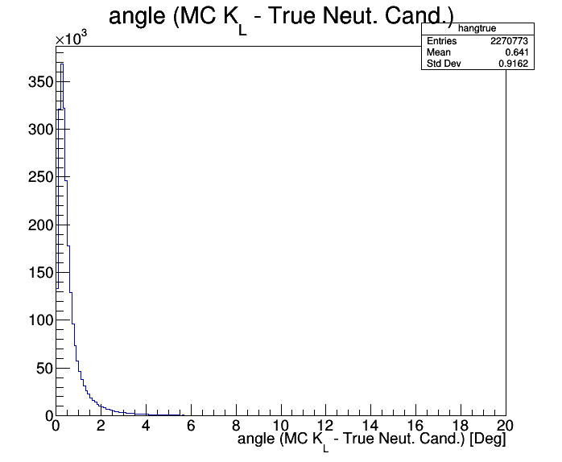
EMC Cluster: Angular Correlation with MC Truth
Angular deviation $δψ≅{0.9}^{o}$

Slide 10
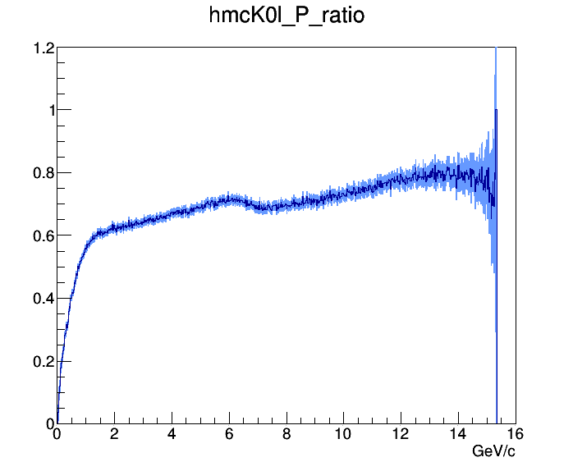
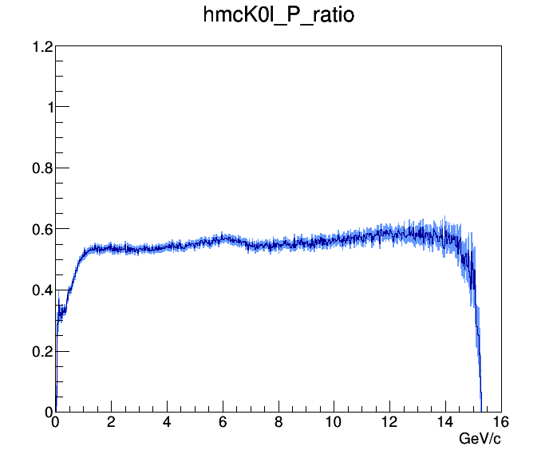
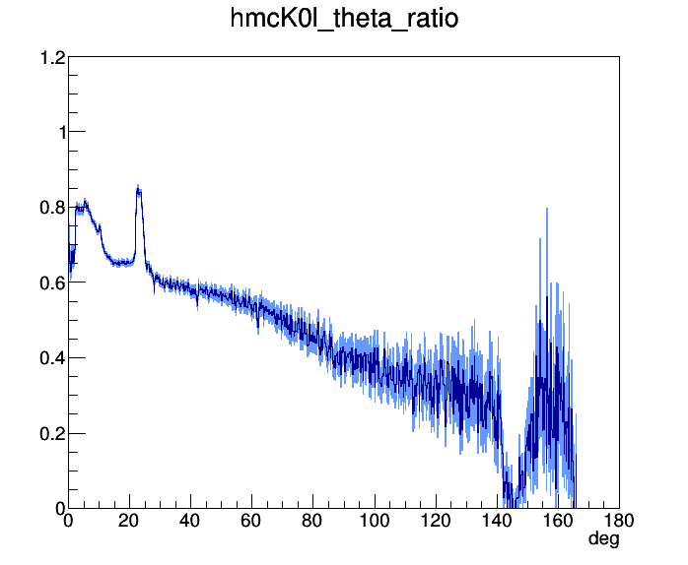
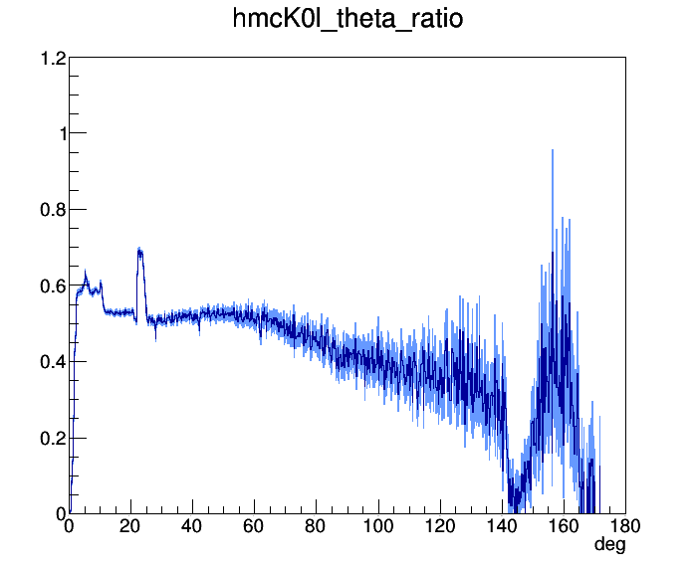
${N_{EMC}}/{N_{gen}}$, $ψ<5^{o}$
$${N_{EMC,True}}/{N_{gen}}$$
${N_{EMC}}/{N_{gen}}$, $ψ<5^{o}$
$${N_{EMC,True}}/{N_{gen}}$$

Slide 11
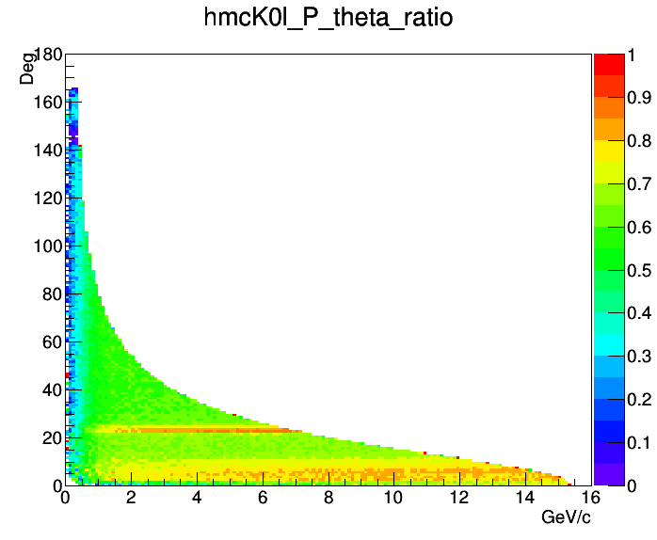
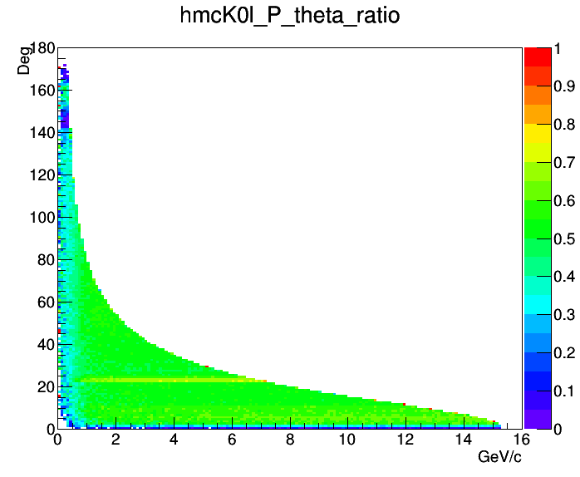
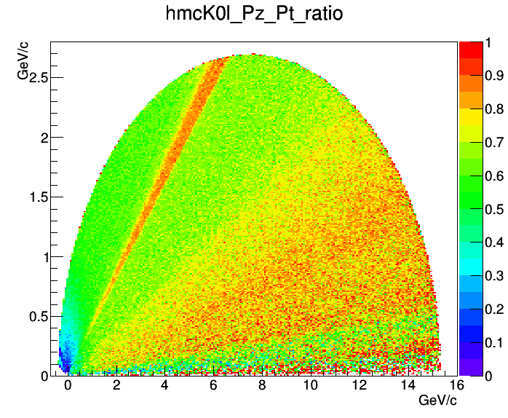
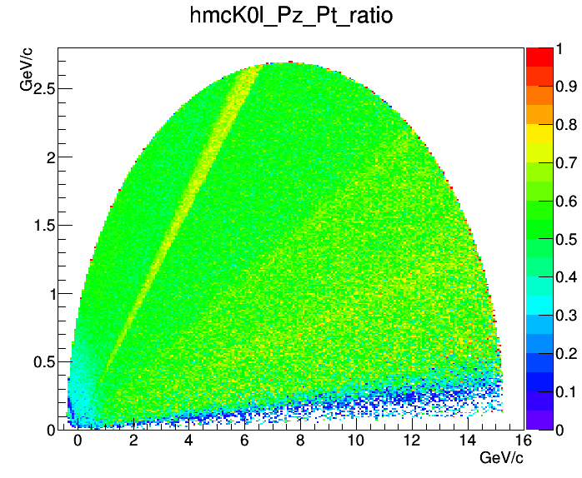
${N_{EMC}}/{N_{gen}}$, $ψ<5^{o}$
$${N_{EMC,True}}/{N_{gen}}$$

Slide 12
1.5 GeV/c $\overline{p}p→φφ→K^{+}K^{−}K_{S}K_{L}$
Analysis

Slide 13
$\overline{p}p→φφ$: Important Channel in Meson Spectroscopy
One of the benchmark channels in the design of PANDA
Sensitivity to tensor glueball state predicted by lattice QCD around 2.4 GeV/c²
$\overline{p}p→φφ$ cross section much above OZI rule estimate
See talk at PANDA CM June 2019 by Iman Keshk:
very low reconstruction efficiencies for kaons at small angles
no proper PWA possible
Further investigations, e.g. independent simulation studies, needed

Slide 14
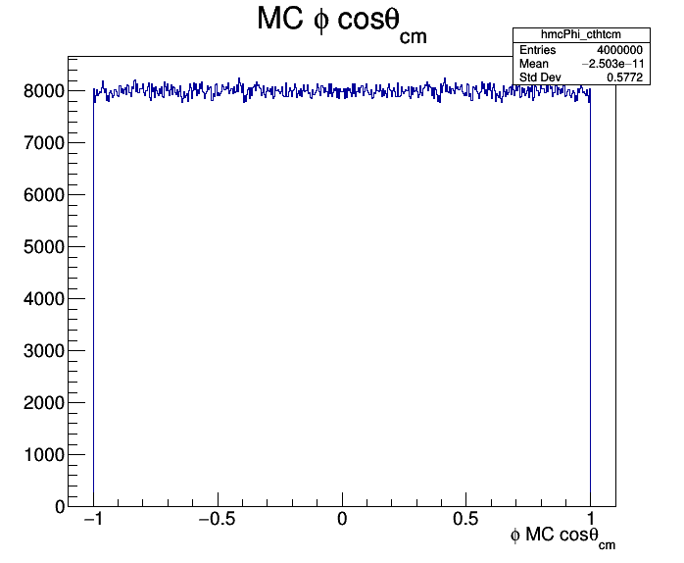
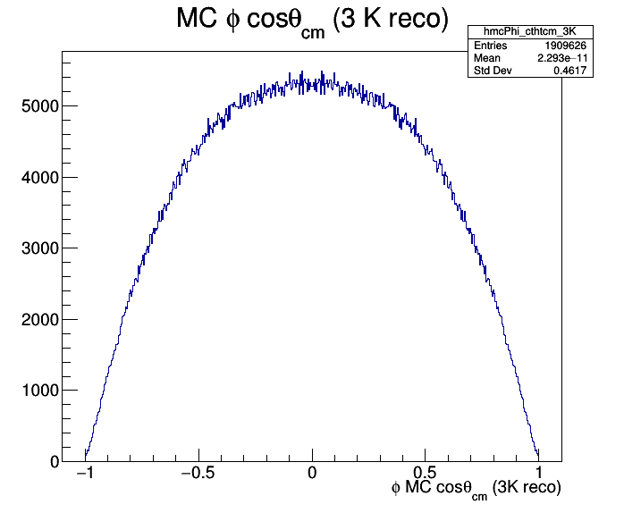
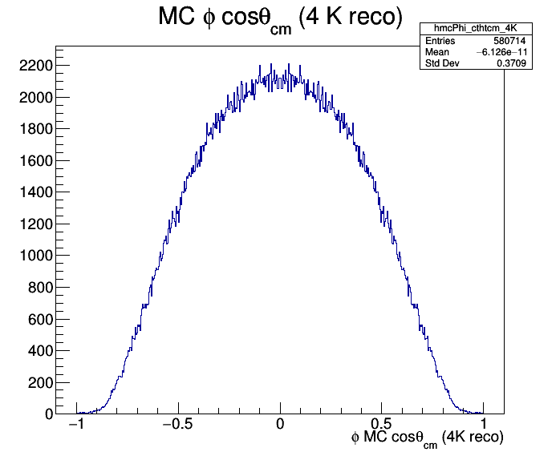
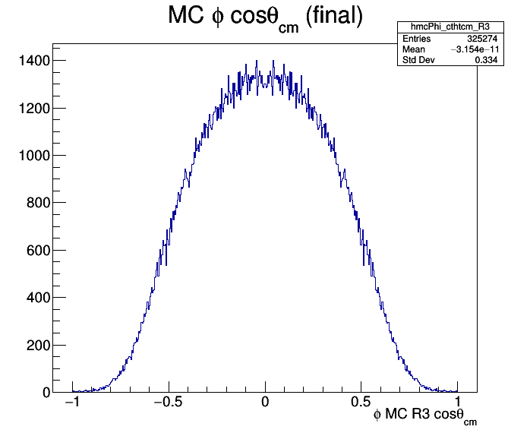
MC
$$1.5 {GeV}/c$$
$$\overline{p}p→φφ→K^{+}K^{−} K^{+}K^{−}$$
MC
MC
MC

Slide 15
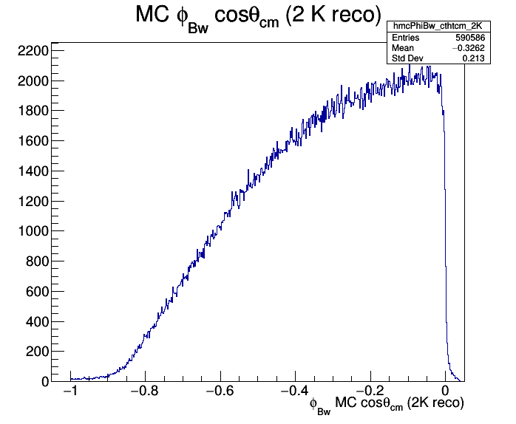
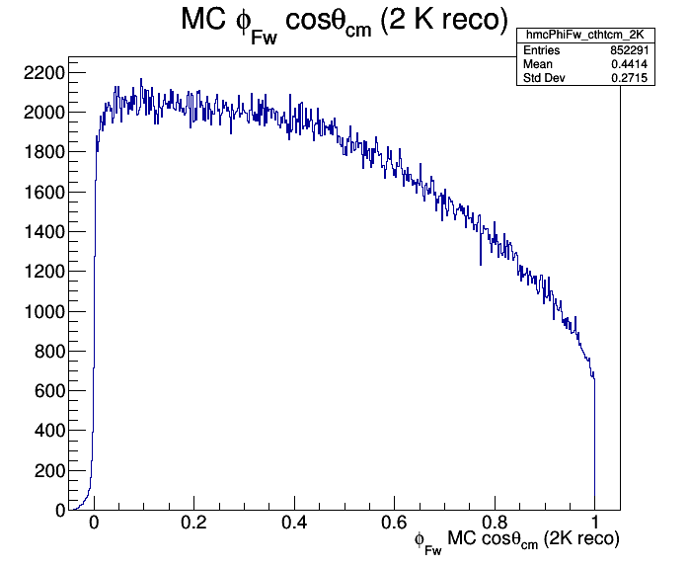
Efficiency Reduction for Forward & Backward $φ→K^{+}K^{−}$
MC
MC
Zero efficiency for backward $φ$, still finite for forward $φ$

Slide 16
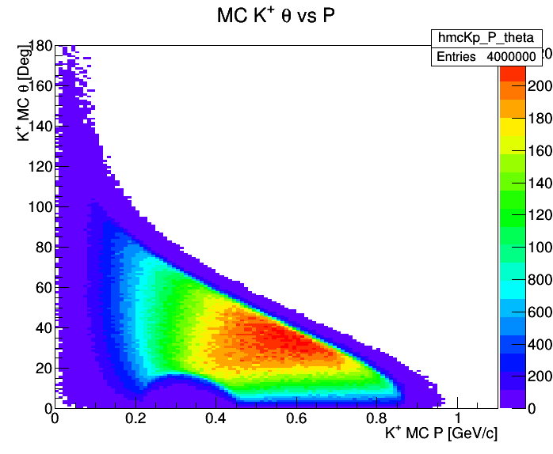
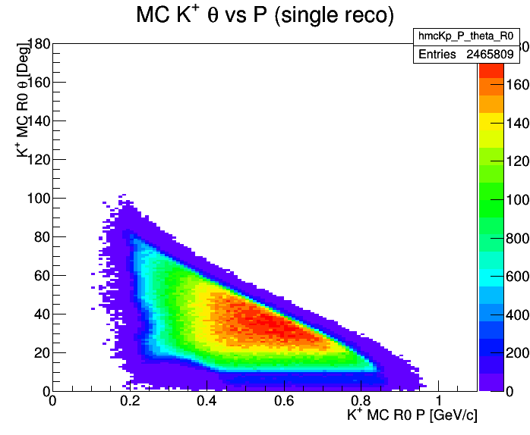
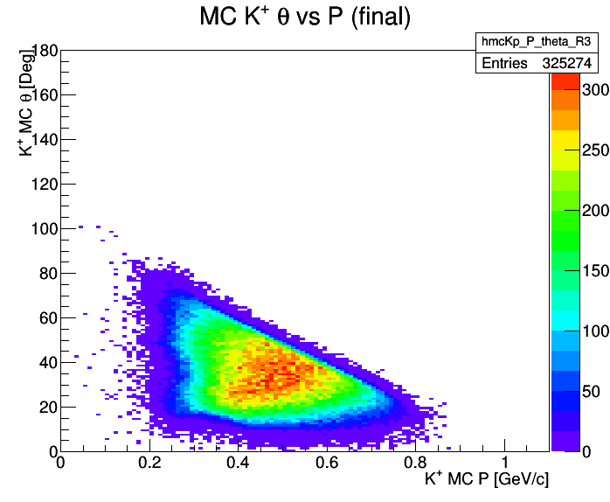
MC
MC
MC
No kaons reconstructed for p < 0.2 GeV/c

Slide 17
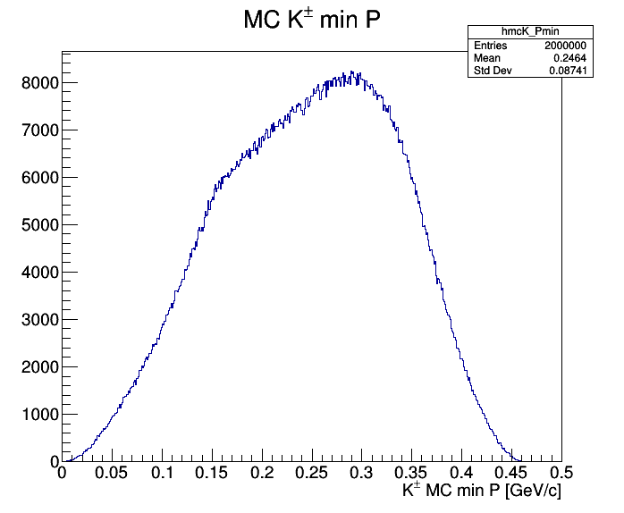
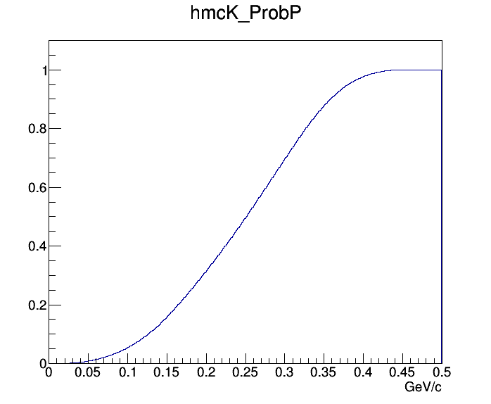
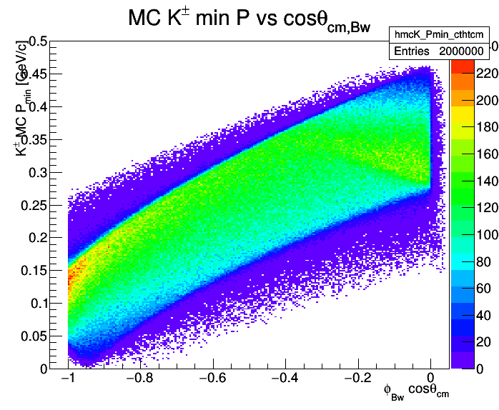
MC
MC
MC
$K^{±}$ with lowest momentum $p_{min}$ per event
Probability for having a kaon with $p_{min}<0.2 GeV/c$ is 31.3%
For $\cos{θ_{cm}≅−1}$: $p_{min}<0.15 GeV/c$

Slide 18
1.5 GeV/c $\overline{p}p→φφ→K^{+}K^{−}K_{S}K_{L}$
Expect better efficiency for backward $φ→K_{S}K_{L}$
1st step: EMC response to K_{L} in full PANDA phase space:
efficiency ~30 - 50%
good directional information
fair time information
poor - no energy information
Simulated 8 M events (4 M with backward $φ→K_{S}K_{L}$)
Reconstruct $φ_{+−}K_{S}→K^{+}K^{−}{ π}^{+}π^{−}$ system with DecayTreeFitter
Reconstruct $φ_{00}$ and $K_{L}$ as missing particles
Use EMC directional information for $K_{L}$ if found in search window

Slide 19
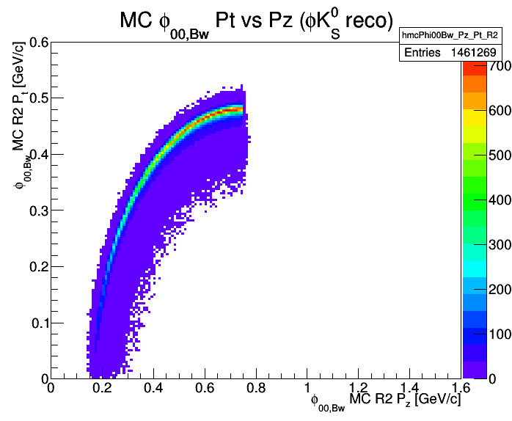
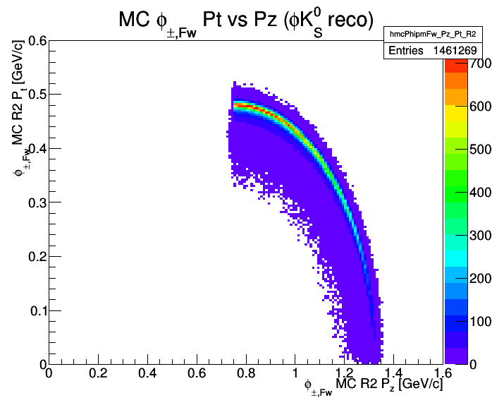
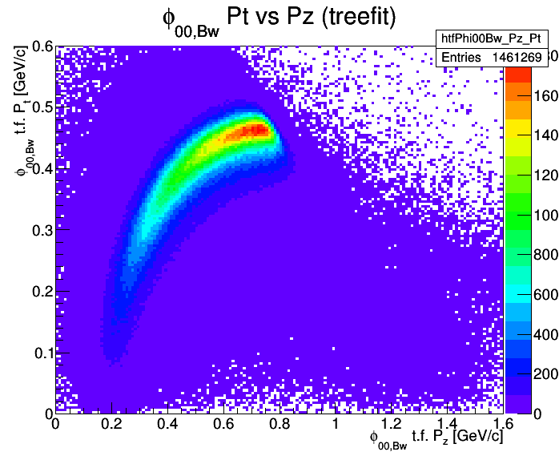
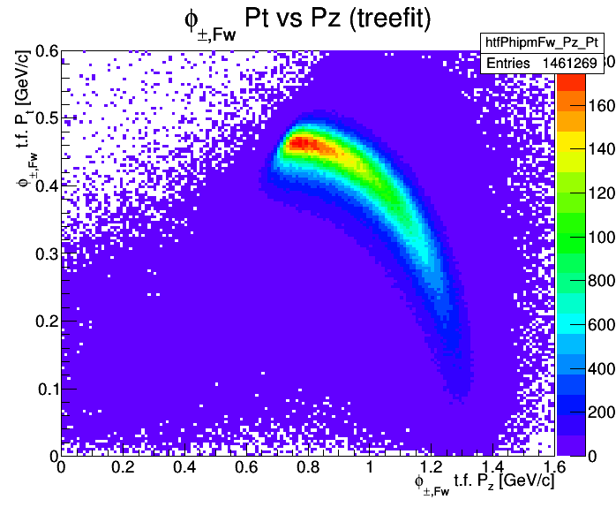
MC
MC
reco
reco

Slide 20
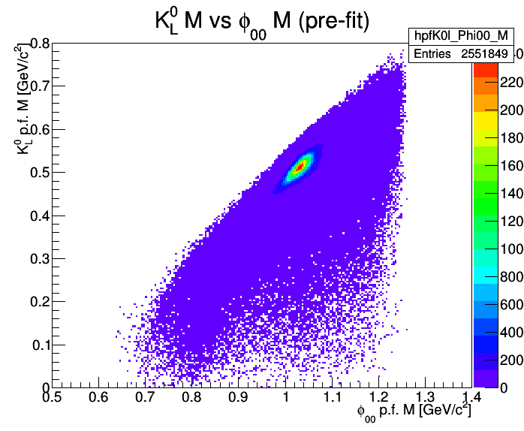
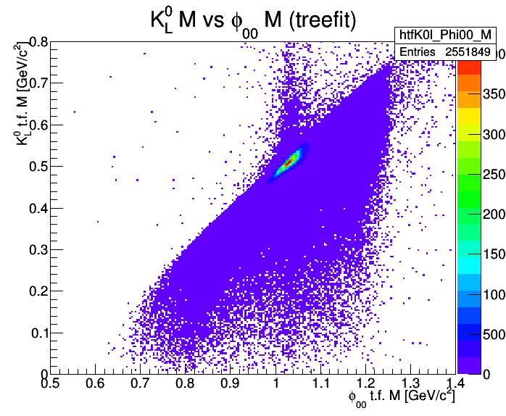
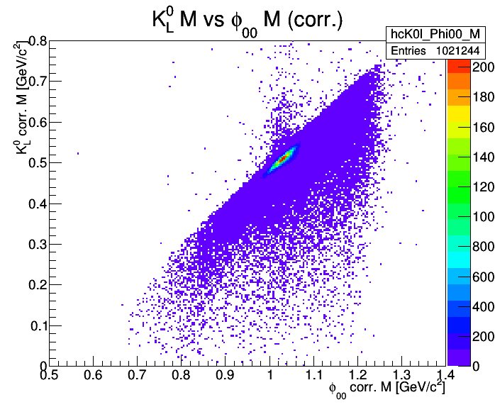
reco
reco
reco
tree fit on $φ_{±}K_{S}→K^{+}K^{−}π^{+}π^{−}$ system
„corr“: EMC cluster directional information used for $K_{L}$

Slide 21
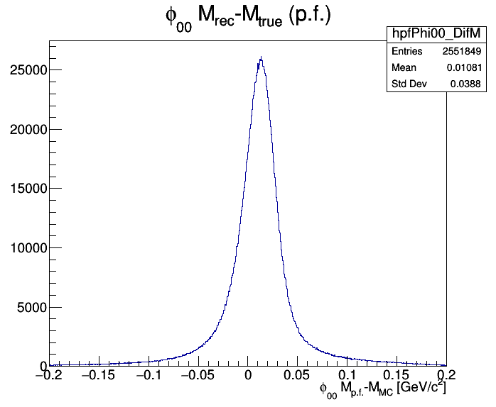
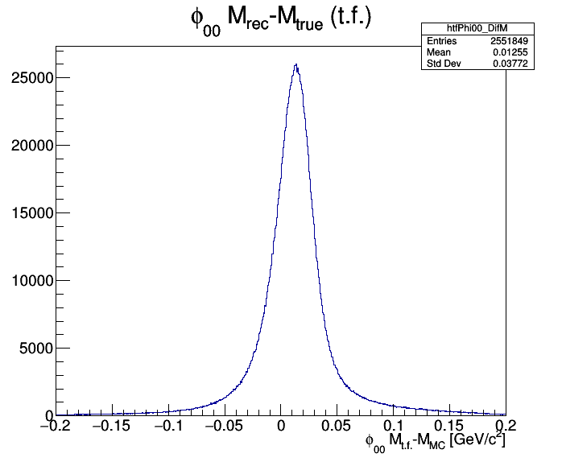
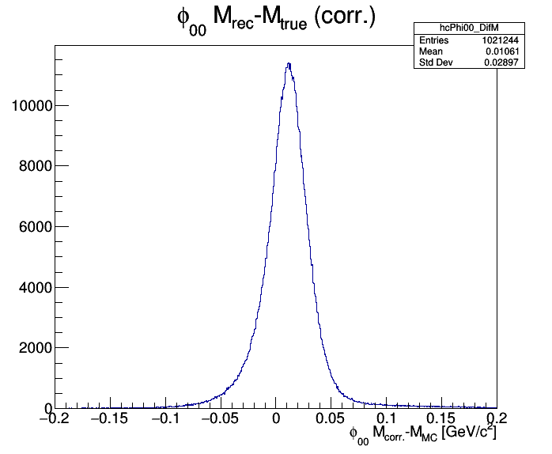
pre-fit → tree fit: little improvement
tree fit → corr. with K_{L} EMC info: significant improvement

Slide 22
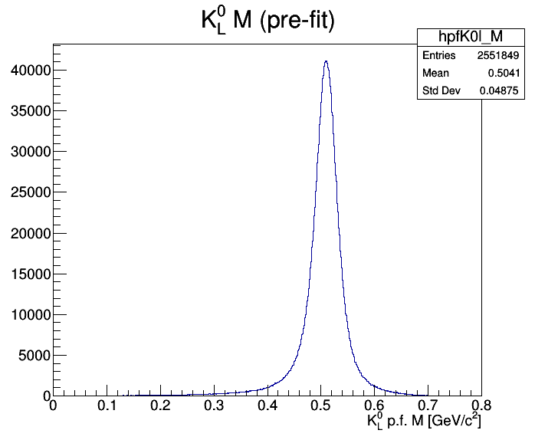
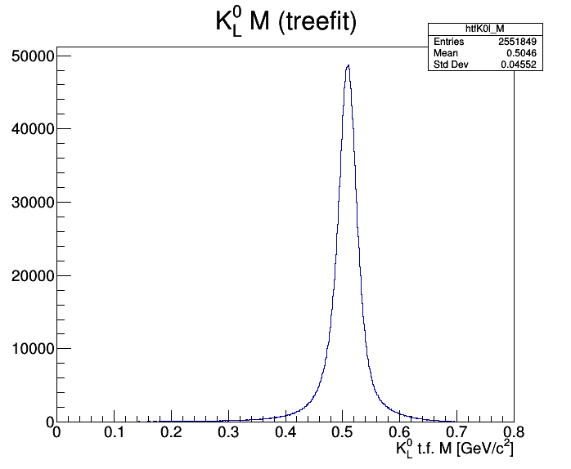
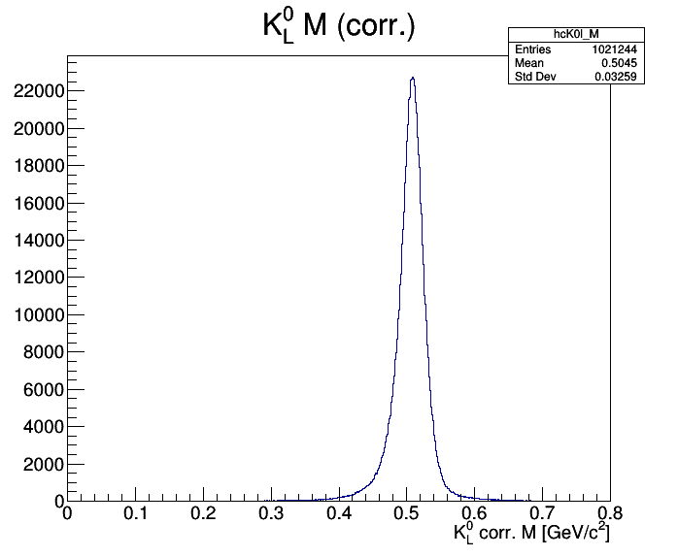
reco
reco
reco
pre-fit → tree fit: little improvement
tree fit → corr. with K_{L} EMC info: significant improvement

Slide 23
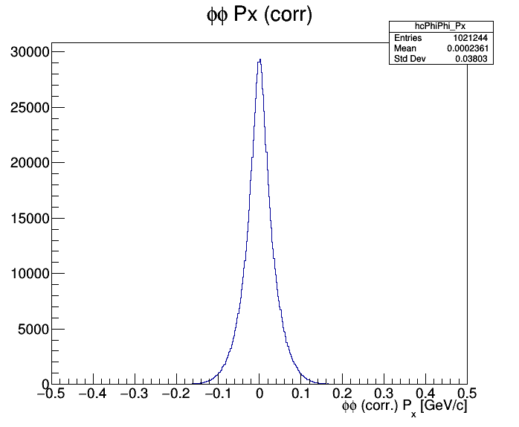
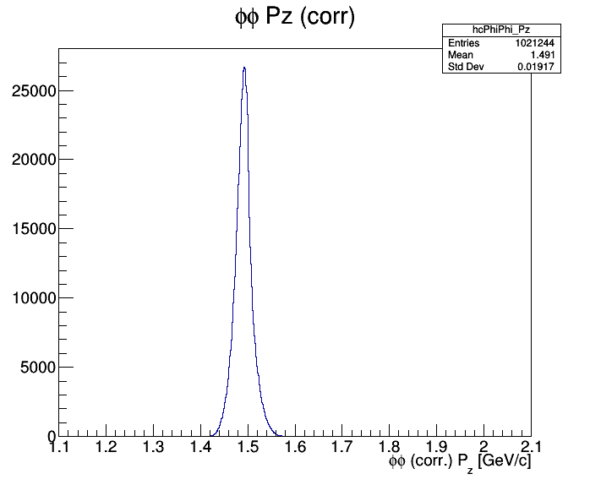
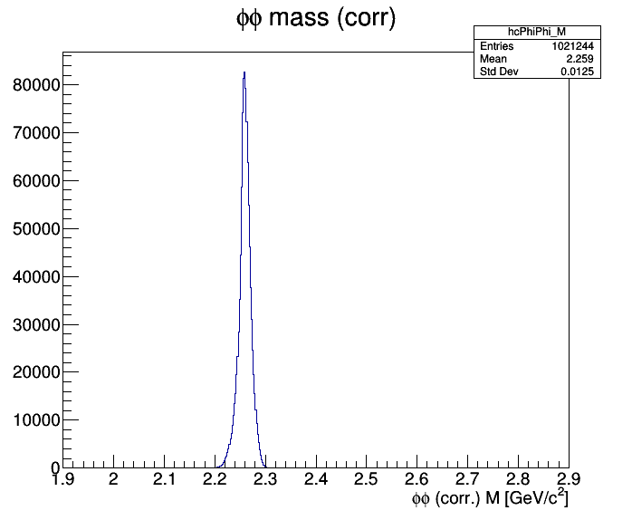
reco
reco
reco
reco

Slide 24
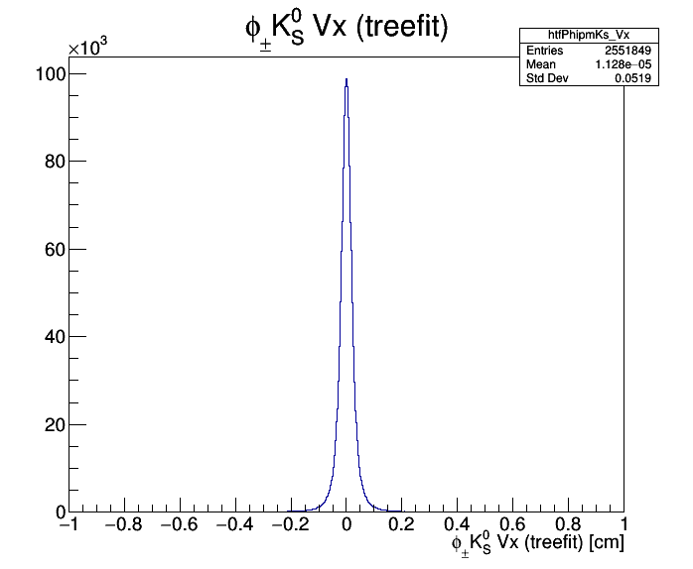
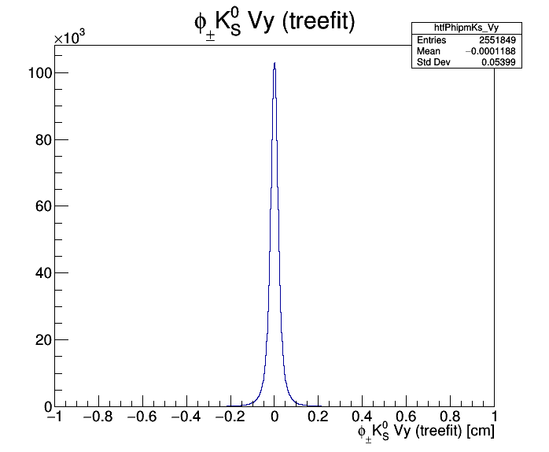
reco
reco
reco
primary vertex reconstructed well within 1 mm

Slide 25
directional precision

Slide 26
EMC time info
MC truth fraction

Slide 27
MC
MC
MC
MC

Slide 28
Summary
$K_{L}$ detection efficiency in the EMC above 50% for $p>1 GeV/c$ or for $θ<{60}^{o}$, decreases towards low momenta.
$\overline{p}p→φφ→K^{+}K^{−}K_{S}K_{L}$ can be reconstructed in PANDA.
Finite reconstruction efficiency in the full ${φ θ}_{cm}$ range
$φK_{S}$ reco efficiency 36.5% (bwd $φ_{00}$) / 31.9% (tot.)
6.4% non MC matched
$K_{L}$ detection efficiency 33.7% (bwd) / 40.0% (tot.)
Full final state detection 12.3% (bwd) / 12.8% (tot.)
DecayTreeFitter for missing particles / information to be implemented

