Slide 1
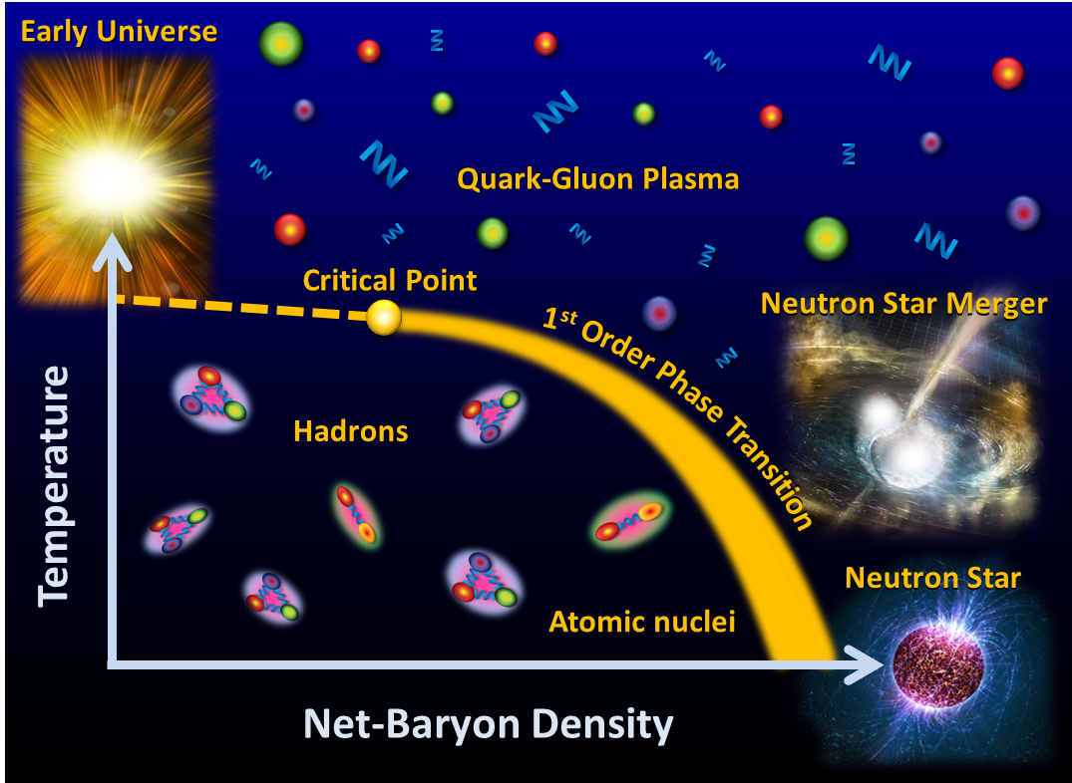





Status of the CBM experiment at FAIR
Peter Senger
8th International Conference on New Frontiers in Physics (ICNFP 2019)
Workshop on Physics at FAIR-NICA-SPS-BES/RHIC
21-29 August 2019, Kolymbari, Crete, Greece
1

Slide 2
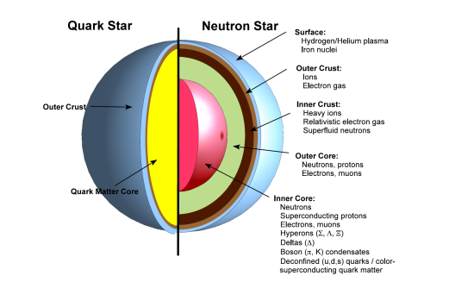
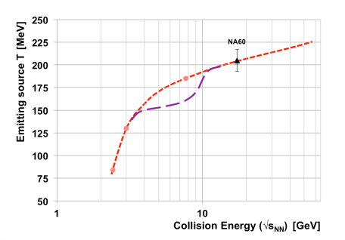
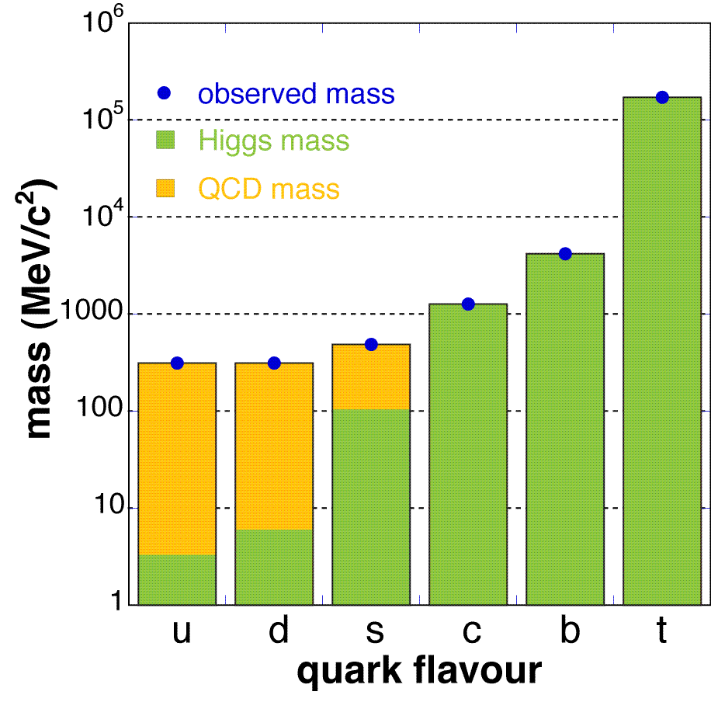
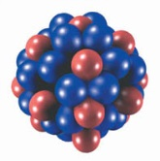
CBM physics case and observables
The QCD matter equation-of-state at neutron star core densities
➢ collective flow of identified particles (π,K,p,Λ,Ξ,Ω,...)
driven by the pressure gradient in the early fireball
➢ particle production at (sub)threshold energies via
multi-step processes (multi-strange hyperons, charm)
Phase transitions from partonic to hadronic matter
➢ excitation function of strangeness: Ξ⁻(dss),Ξ⁺(dss),Ω⁻(sss),Ω⁺(sss)
→ chemical equilibration at the phase boundary
Phase coexistence
➢ excitation function (invariant mass) of lepton pairs:
thermal radiation from QGP, caloric curve
anisotropic azimuthal angle distributions: “spinodal decomposition”
Critical point
event-by-event fluctuations of conserved quantities (B,S,Q)
“critical opalescence”
Onset of chiral symmetry restoration at high ρ_{B}
➢ in-medium modifications of hadrons: ρ,ω,φ →e⁺e⁻(μ⁺μ⁻)
➢ dileptons at intermediate invariant masses: 4 π → ρ-a₁ chiral mixing
N-Λ, Λ-Λ interaction, strange matter?
➢ (double-) lambda hypernuclei
Λ
Λ

Slide 3
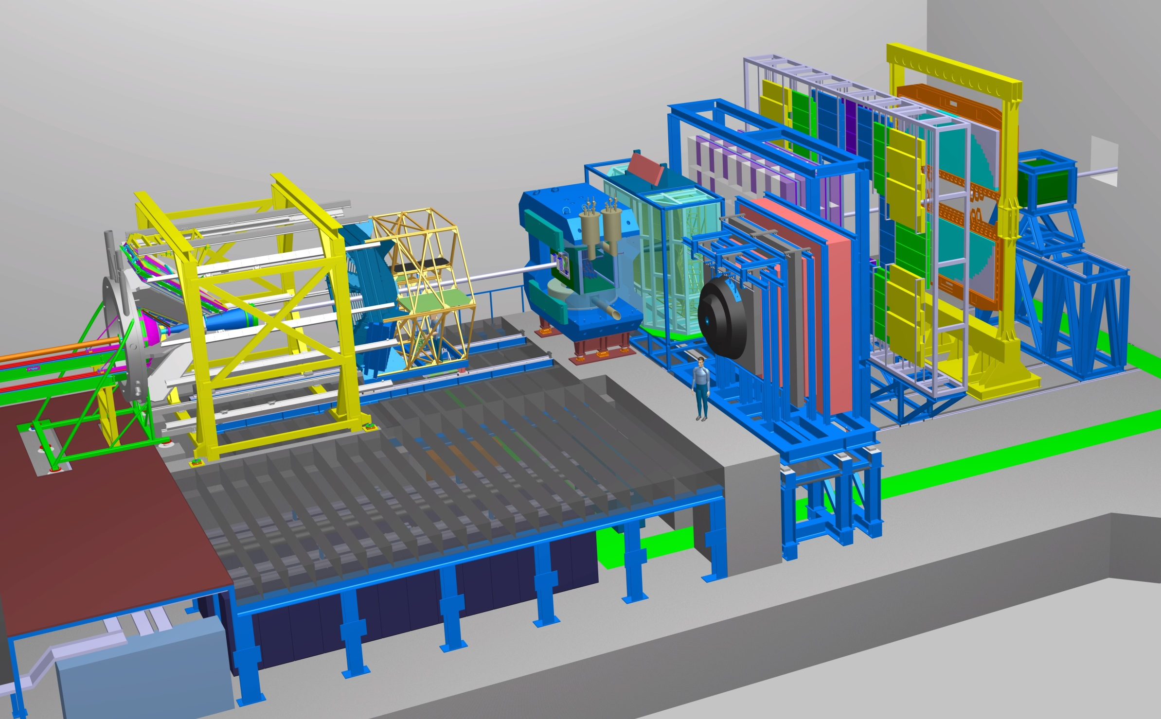
The Compressed Baryonic Matter Experiment
Ring
Imaging
Cherenkov
Transition
Radiation
Detector
SC Dipol
Magnet
Silicon
Tracking
System
Time of Flight
Detector
HADES
p+p, p+A
A+A (low mult.)
Micro
Vertex
Detector
Muon
Detector
Projectile
Spectator
Detector
DAQ/FLES HPC cluster

Slide 4
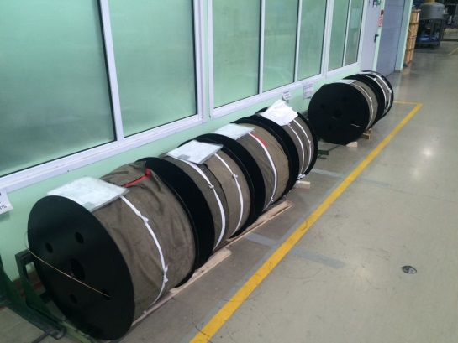
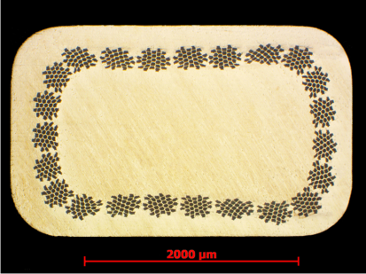
CBM SC magnet
In-kind contribution by Russia, built by BINP Novosibirsk
Production status:
- The bare SC cable is manufactured
Cross section (photo)
Cable for 3 coils
- Contract for SC cable insulation
signed with VNIIKP
- Machining of the magnet yoke
will start in October 2019
Next steps:
Preliminary Design Review in Nov. 2019
Agreement on the cooling circuit, cryostat, coil support struts, control system
Final Design Review in May 2020
All technical drawings finished
Construction in 2020 - 2021

Slide 5
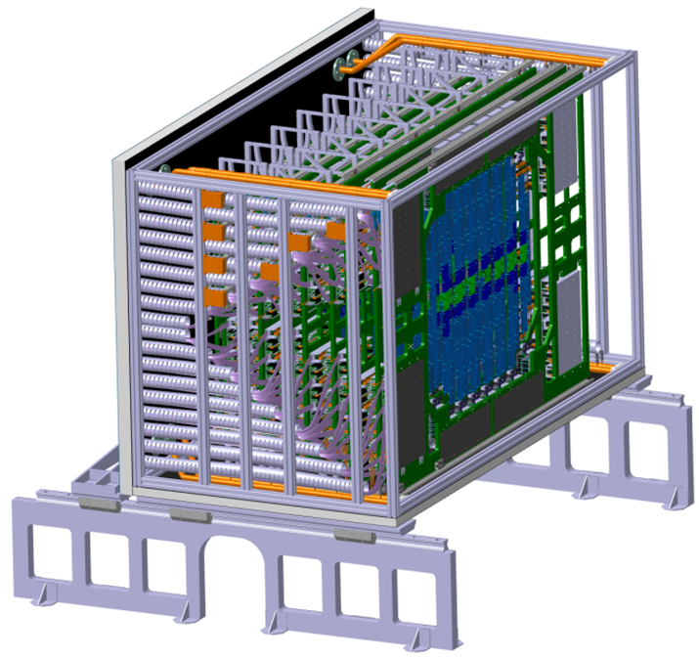
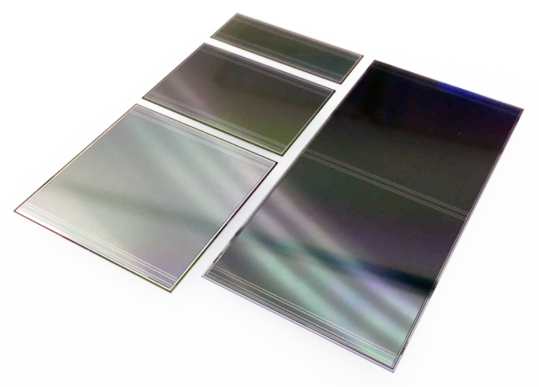
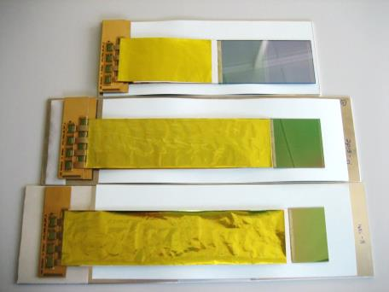
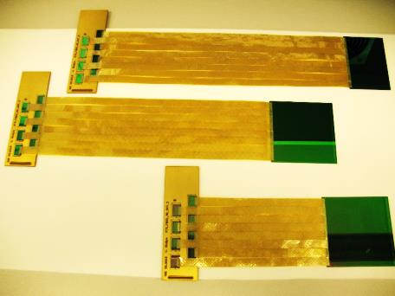
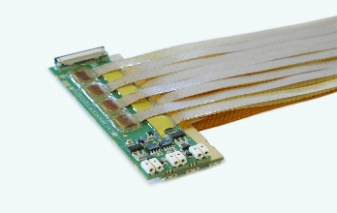
Silicon Tracking System
➢ Charged particle track reconstruction, momentum determination
In-kind contributions by Germany, Russia, Poland:
GSI, JINR, KIT Karlsruhe, JU + AGH Krakow, KINR Kiev, Univ. Tübingen, Warsaw UT
STS
Silicon microstrip sensors
Status:
TDR approved by FAIR in July, 2013
Radiation tolerance of silicon sensors tested up to n_{eq} (1 MeV) = 2 × 10¹⁴ /cm².
1100 silicon microstrip sensors ordered from vendor Hamamatsu Photonics,
delivery scheduled in batches from 11/2019 to 10/2020.
Second design iteration of the STS-XYTER ASIC made, applied to prototype modules.
Carbon fiber ladders ordered in company, delivery until 10/2019.
Module and ladder assembly procedures established, working towards declaring production readiness. Start of series production in 2020.
System engineering and system integration progressing.
Demonstrator detector mSTS operated in mCBM experiment.
Module assembly at GSI and JINR
5

Slide 6
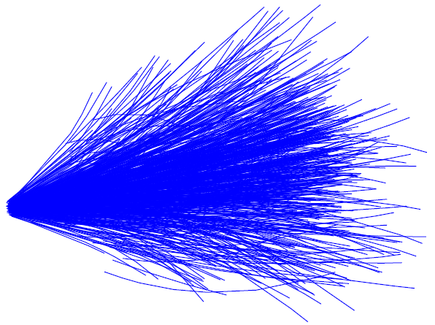
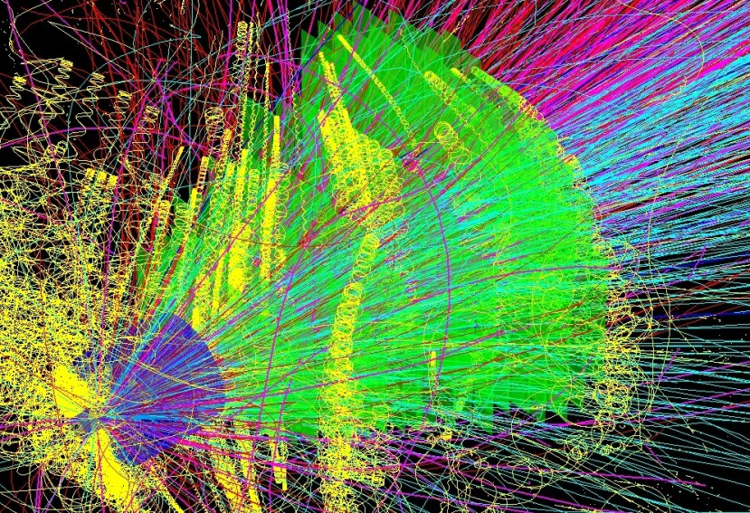
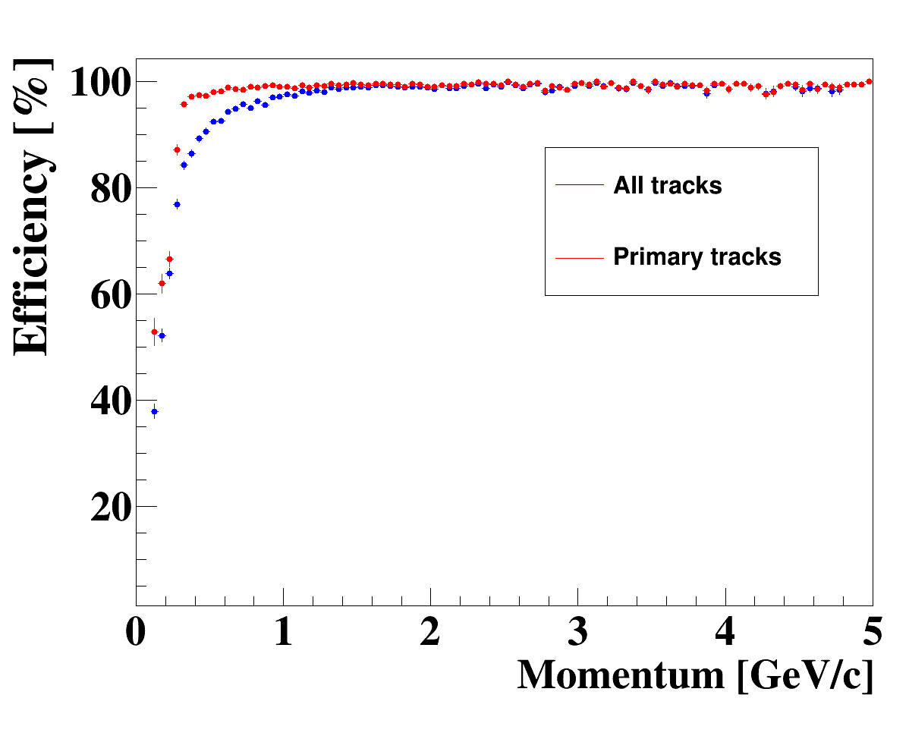
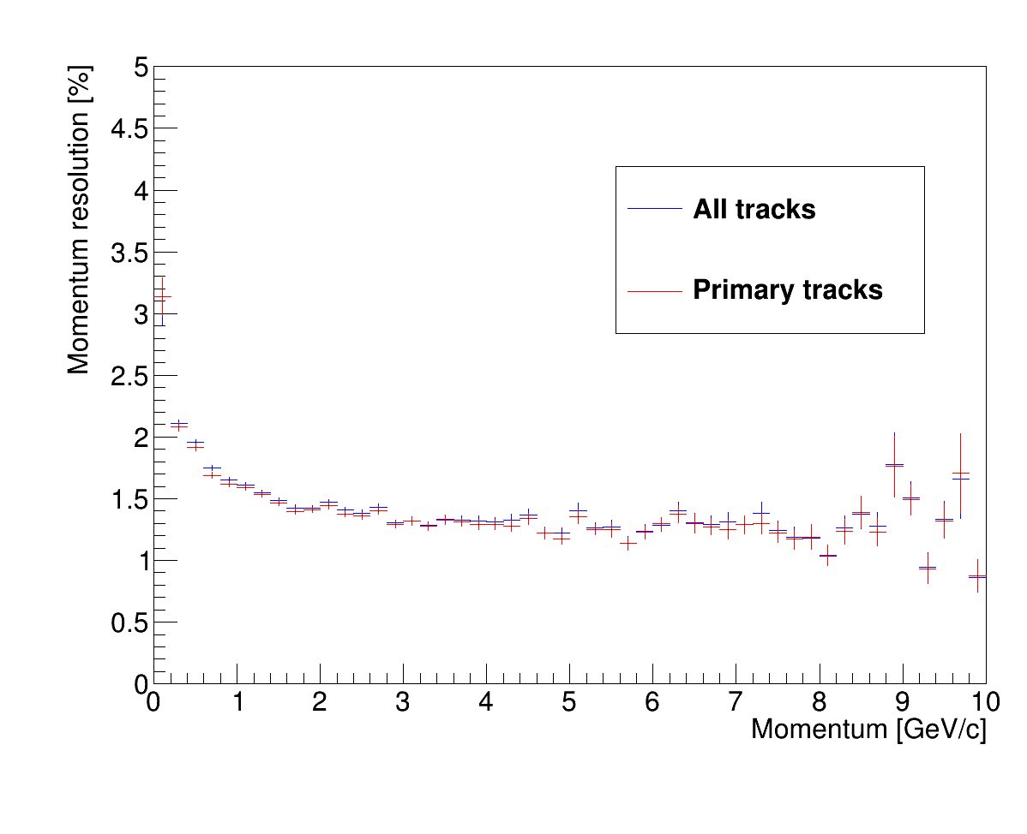
Charged particle track reconstruction
Event generators UrQMD 3.3, PHSD
Transport code GEANT3, FLUKA
Realistic detector geometries, material budget and detector response
reconstruction
Au+Au 10 A GeV
momentum
resolution
track reconstruction efficiency
Notes:
6
6
6

Slide 7
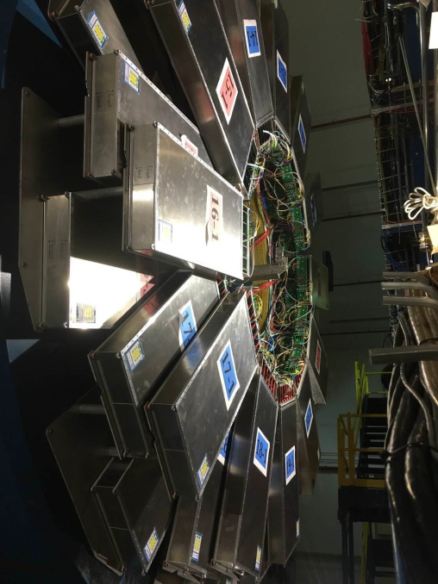
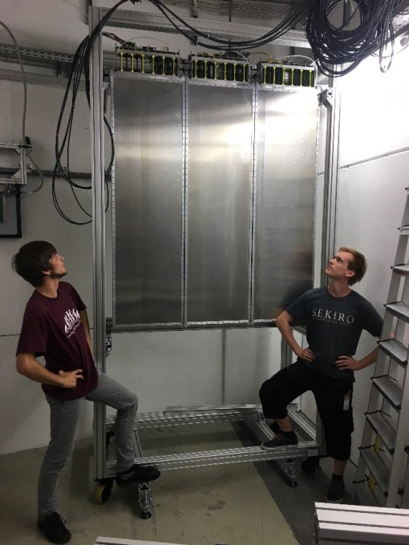
The high-rate MRPC TOF wall
➢ Particle identification
Challenge: Time resolution 50 ps up to 25 kHz/cm². Total area 100 m²
In-kind contributions by Germany, China, Romania:
THU Beijing, NIPNE Bucharest, GSI Darmstadt, TU Darmstadt, IfI Frankfurt, USTC Hefei,
Univ. Heidelberg, ITEP Moscow, HZDR Rossendorf, CCNU Wuhan.
Status:
TDR approved Feb. 2015
Full size prototype TOF MRPC detectors installed and operated at mCBM (GSI) and STAR (RHIC)
PID capability at STAR demonstrated
TOF at STAR
TOF at mCBM
7

Slide 8
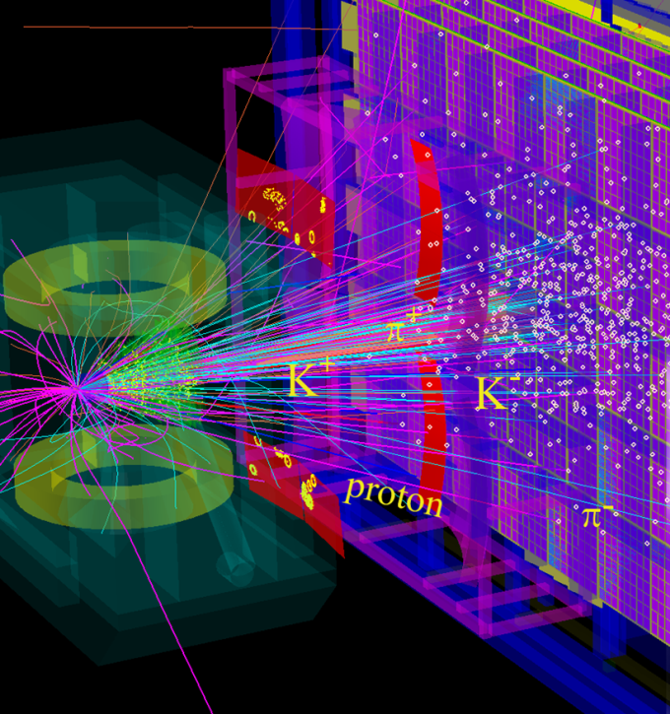
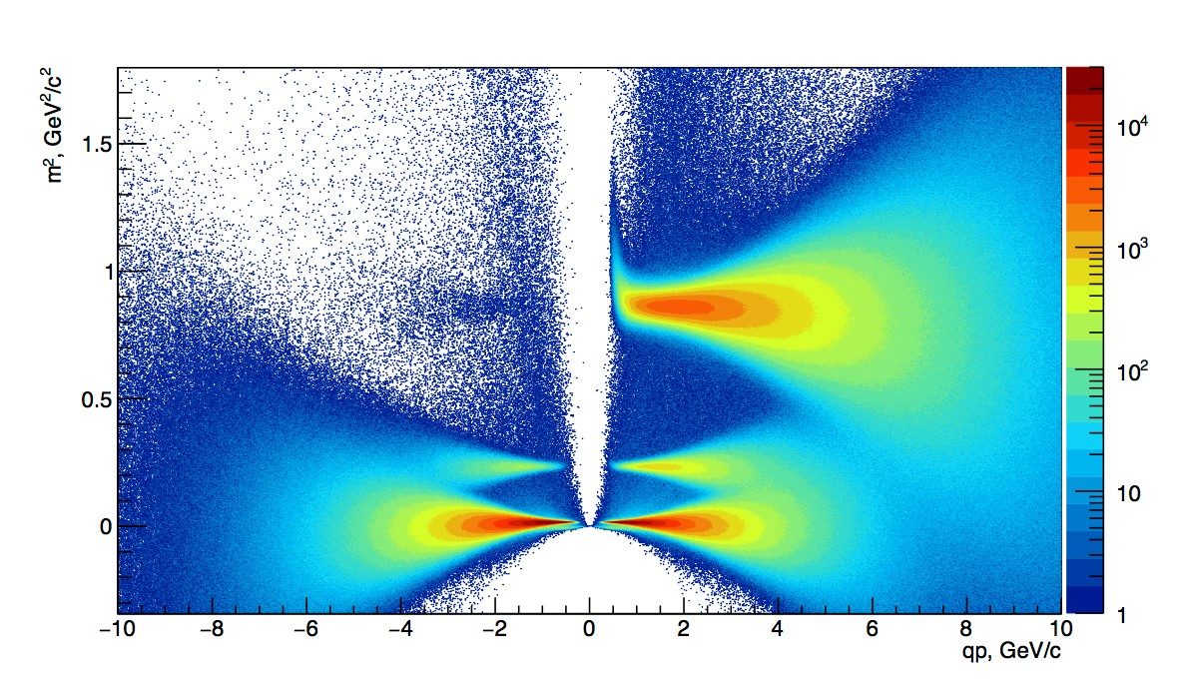
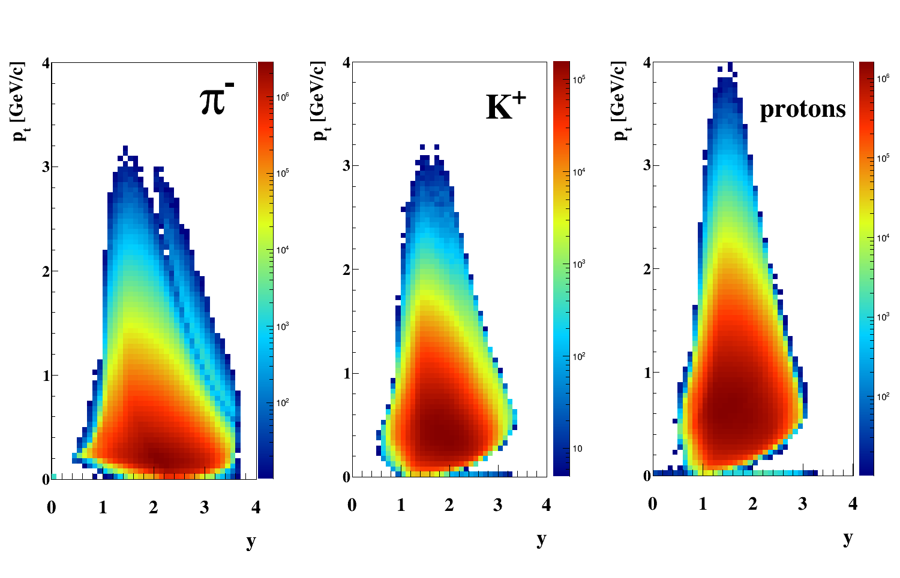
Hadron identification by STS + TOF
p̅
p
_{K}-
_{K}+
(µ⁻,e⁻) π⁻
π⁺ (µ⁺,e⁺)
Au+Au collisions
10 A GeV

Slide 9
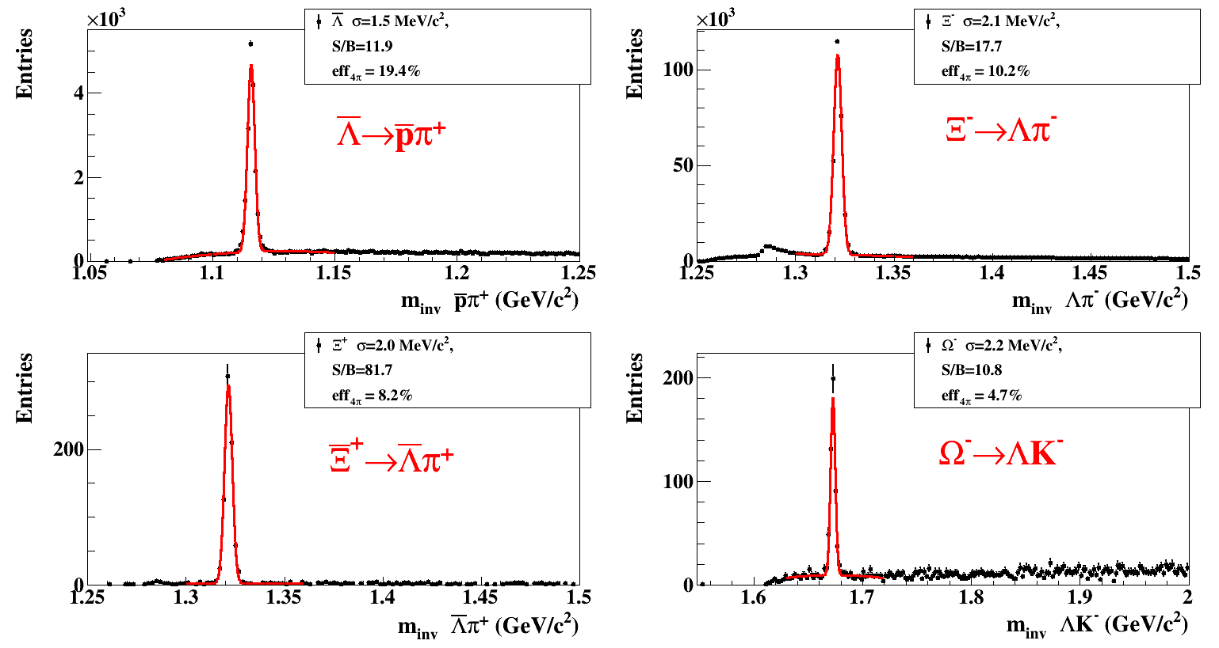
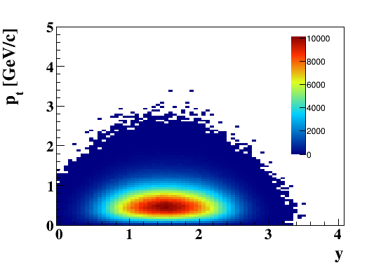
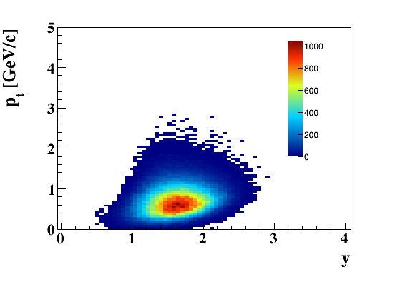
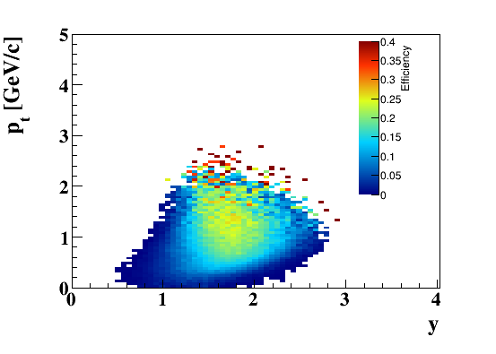
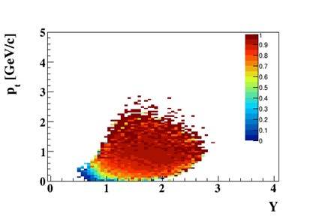
Hyperon reconstruction (STS+TOF)
5 M central Au+Au collisions 10A GeV/c
MC Ξ⁻
Reco Ξ⁻
Efficiency Ξ⁻
Purity Ξ⁻

Slide 10
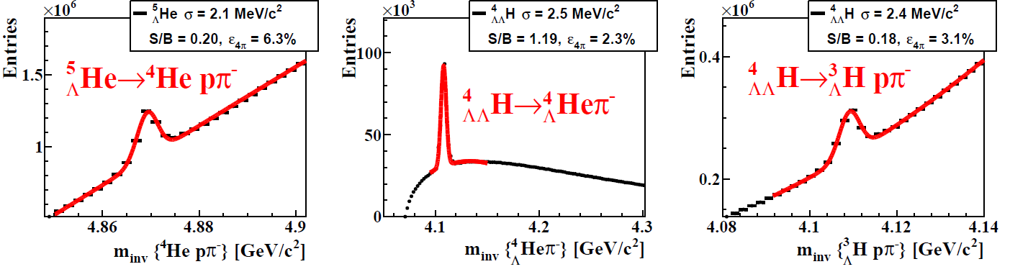
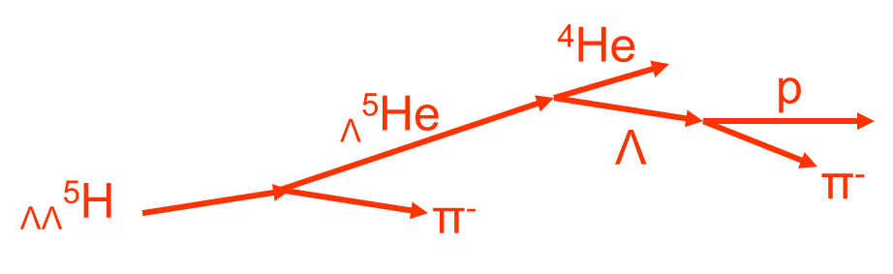
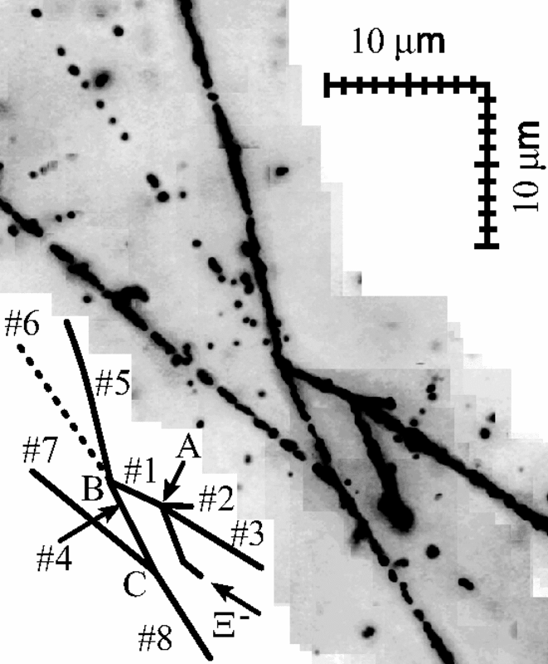
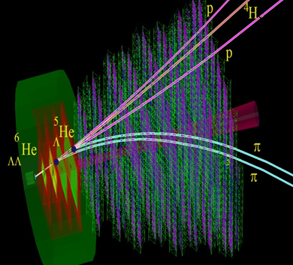
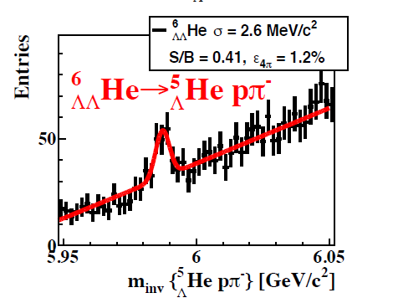
Hypernuclei reconstruction (STS+TOF)
5 M min. bias Au+Au collisions 10A GeV/c
_{ΛΛ}⁶He yield 60/week
(reaction rate 1 MHz, BR 10%, efficiency 1%)
Example:
_{ΛΛ}⁶He
p
p
π
⁶_{ΛΛ}He
⁵_{Λ}He
t
Nagara event

Slide 11
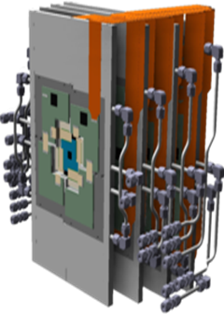
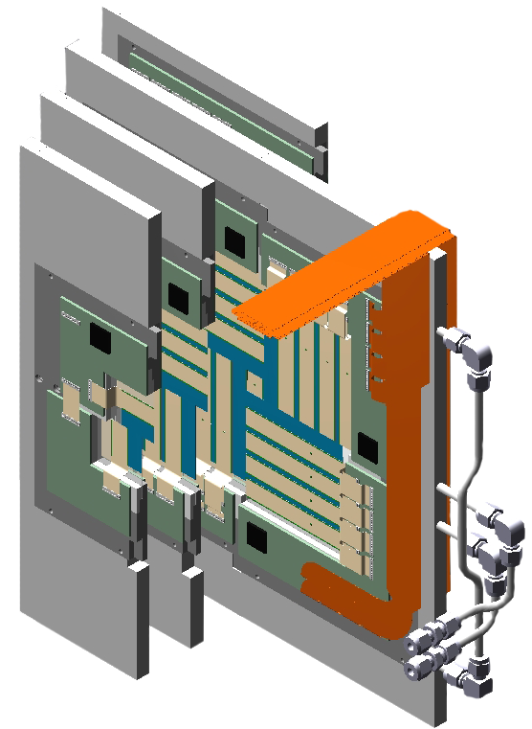
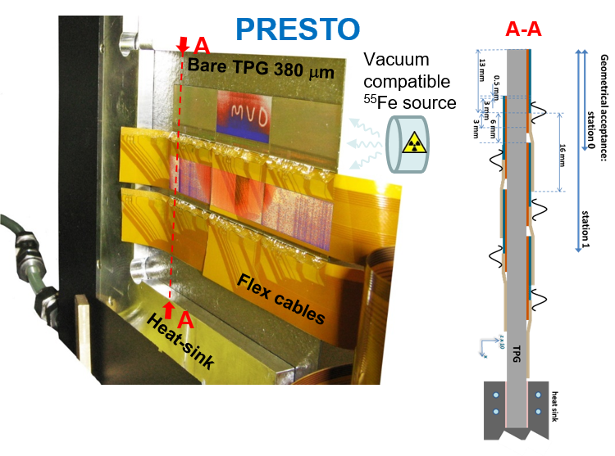
Micro Vertex Detector (MVD)
In-kind contributions by Germany, France: Univ. Frankfurt, IPHC Strasbourg
➢ Background suppression for di-electron measurements
Determination of secondary vertices of open charm decays (τ = 10⁻¹²-10⁻¹³ s)
Improved tracking for hyperon-ID
Status:
Prototyping well advanced with PRESTO module: integration concept (vacuum operation / material budget) demonstrated
Dedicated CBM sensor in synergy with ALICE-ITS upgrade: improved in-pixel logic and data throughput, R/O time ~ 5 μs.
Dedicated CBM MVD pixels sensor prototype MIMOSIS-0 in house and being characterized.
First full size sensor MIMOSIS-1 design reviewed, submission in Sept. 19.
11

Slide 12
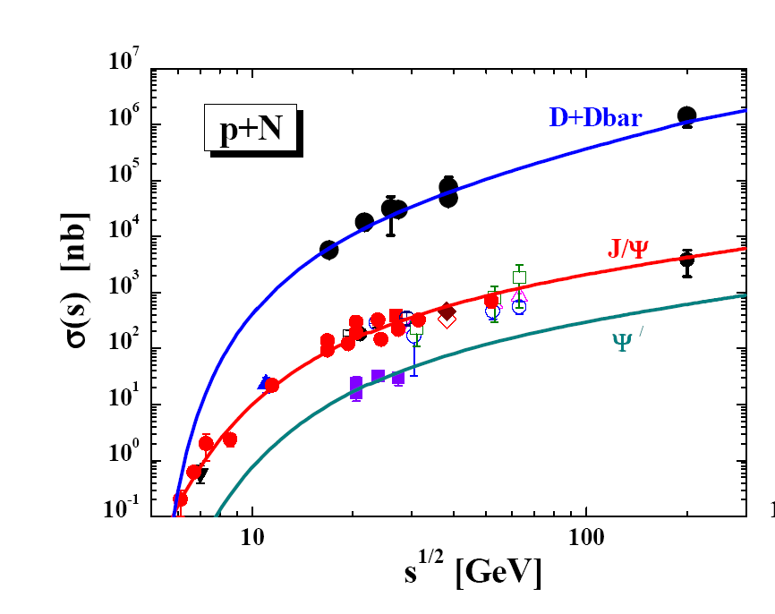
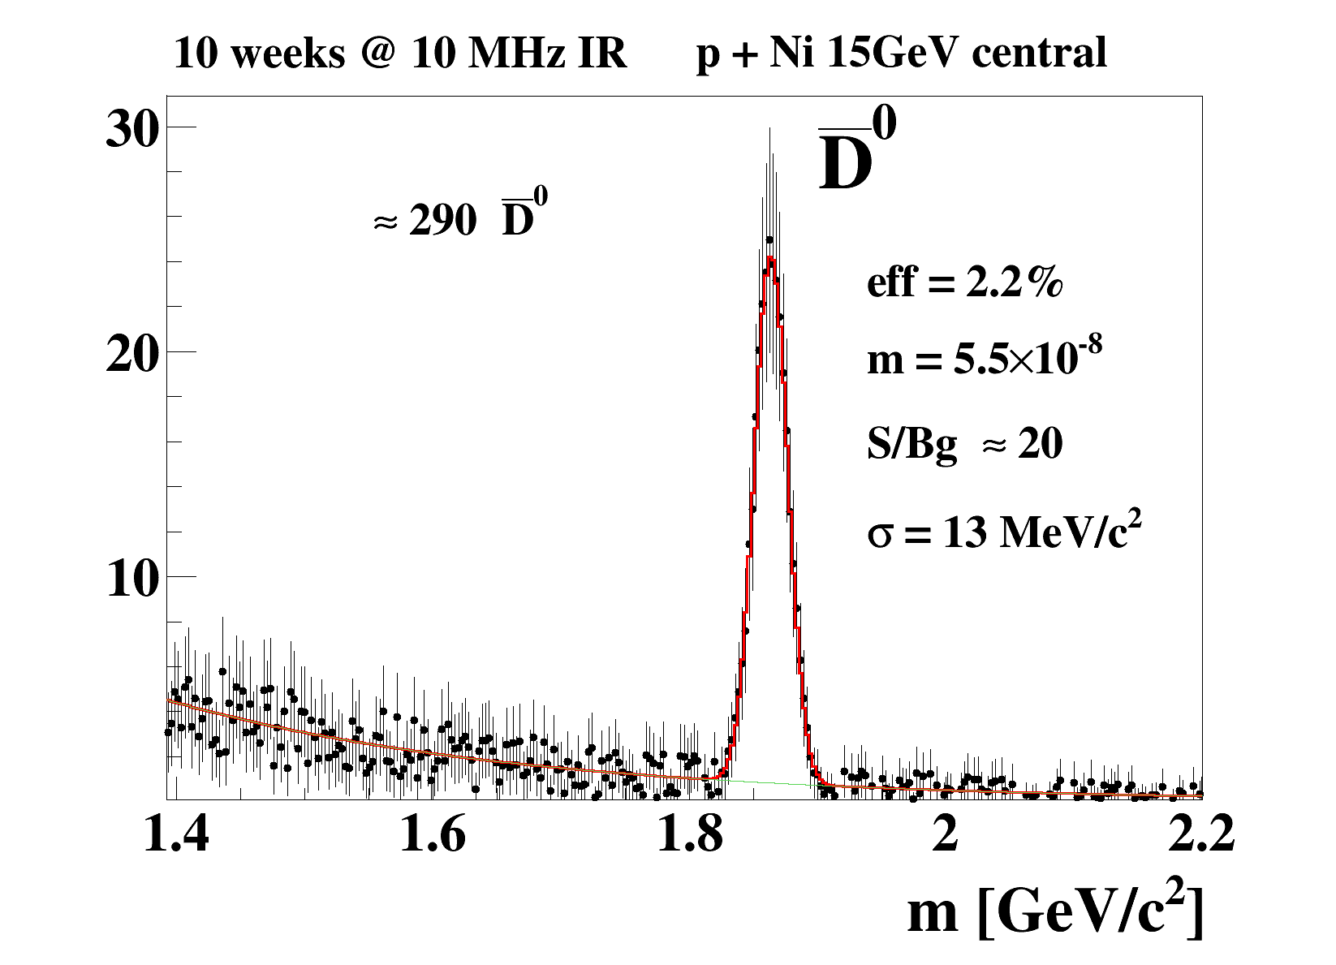
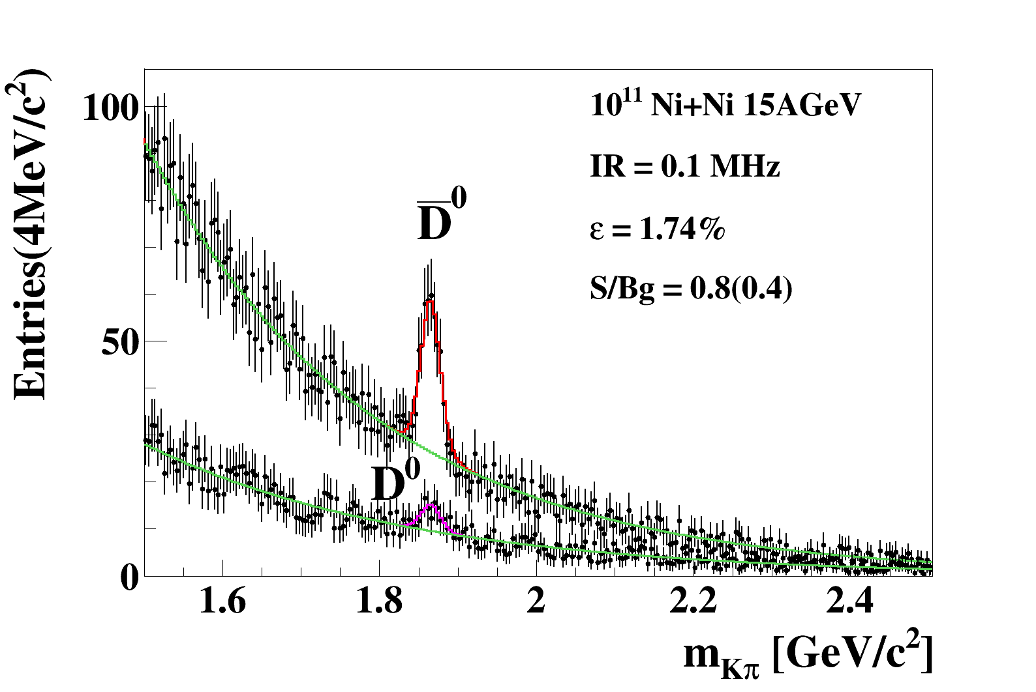
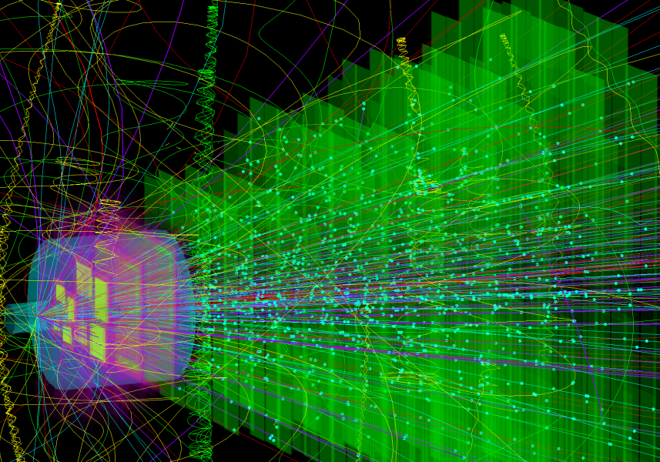
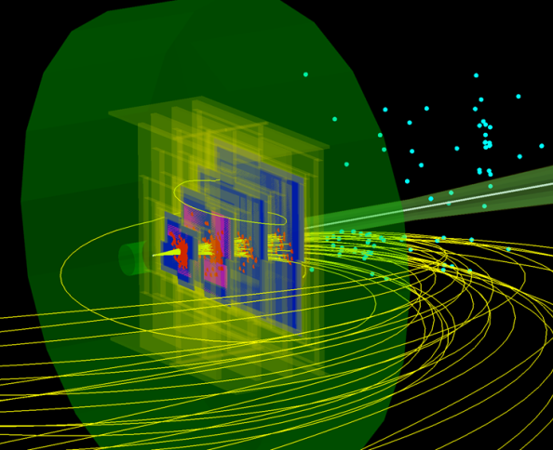
Open charm (MVD + STS + TOF)
cτ = 60…312 μm
O. Lynnik et al., Nucl. Phys. A 786 (2007) 183
D⁺
K⁻
π⁺
π⁺
Simulation p + N 15 GeV
Ni + Ni central collisions at 15 A GeV
260 D⁰ and 45 D⁰ in 2 weeks at IR = 0.1 MHz
UrQMD
δ electrons

Slide 13
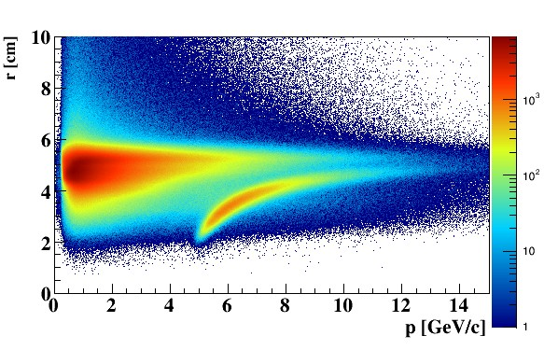
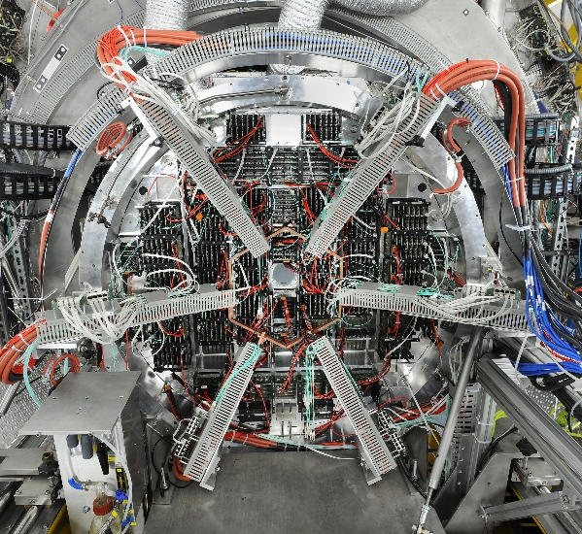
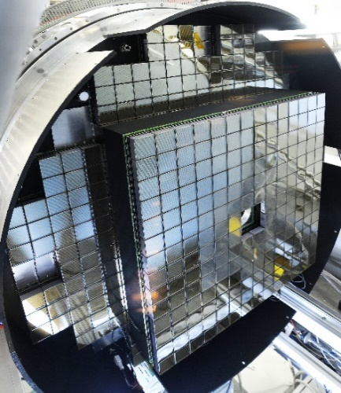
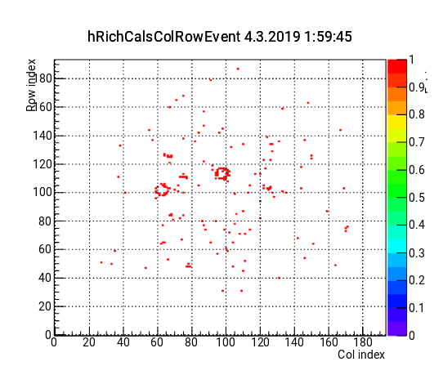
Ring-Imaging Cherenkov (RICH) Detector
➢ Electron identification
In-kind contributions by Germany, Russia:
Univ. Gießen, Univ. Wuppertal, PNPI Gatchina, GSI
e
π
Status:
All 1100 H12700 MAPMTs delivered and tested, 428 MAPMTs including readout chain integrated in HADES RICH detector; successful participation in HADES beam time 2019
Concept for new structure of mirror wall with substantially reduced material budget, first prototype under stress test
First hardware/ software implementation for the measurement of mirror misalignments and software correction cycle ready
HADES beam time:
ω-meson candidate
13

Slide 14
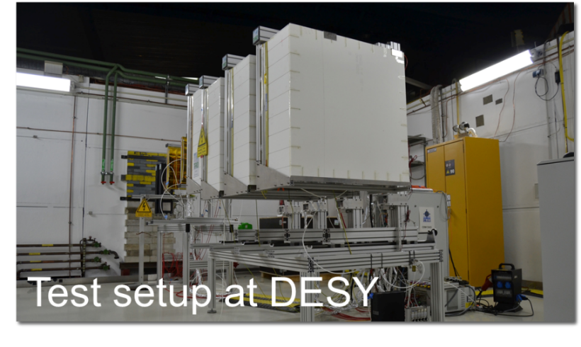
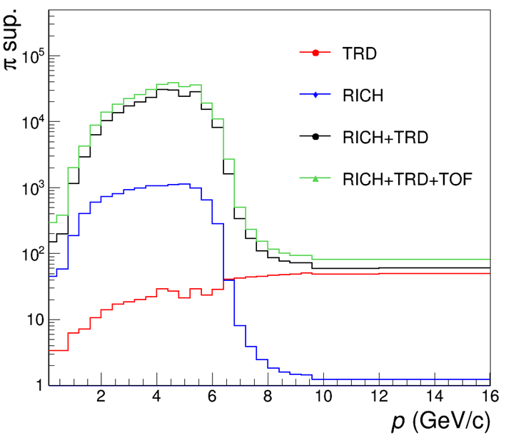
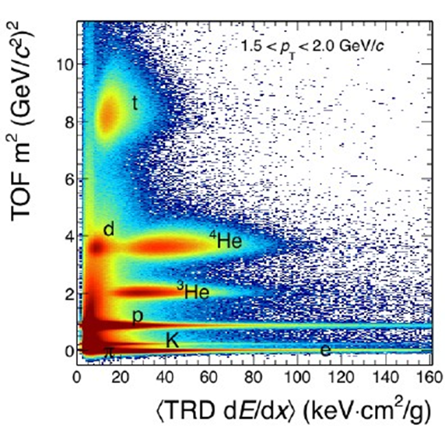
Transition Radiation Detector (TRD)
➢ Electron identification, energy-loss measurements
In-kind contributions by Germany, Romania:
NIPNE Bucharest, Univ. Frankfurt, Univ. Heidelberg, Univ. Münster
pion suppression
Challenge:
ε(e±)= 90%
ε(π) = 5%
at 100 kHz/cm²
Status:
Beam and laboratory tests
First results from GIF++: Stable chamber and readout
operation at high γ-irradiation
X-ray test setup in Bucharest: 2-D position reconstruction of irradiated area
Infrastructure
First design suggestions for support structure (Münster)
Integration of type-1 modules in progress (Bucharest)
Front-end electronics
15000 SPADIC2.2 chips (final version) produced in engineering run
➢ Chips are packaged (BGA) and being mounted on FEBs
14

Slide 15
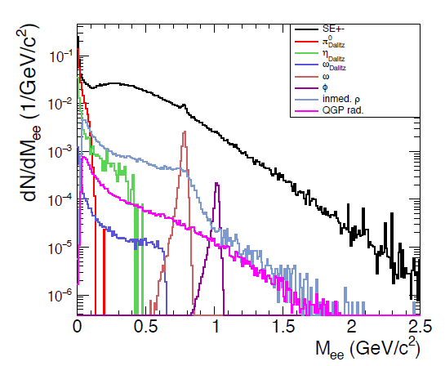
Dilepton invariant mass spectra
for central Au+Au collisions at 8A GeV
Di-electrons: MVD+STS+RICH+TRD+TOF

Slide 16
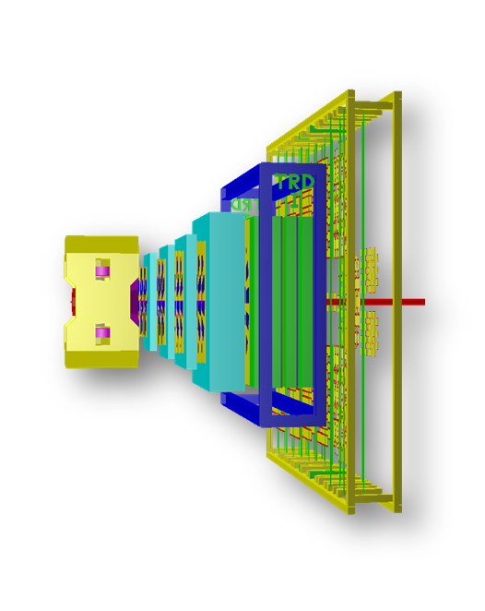
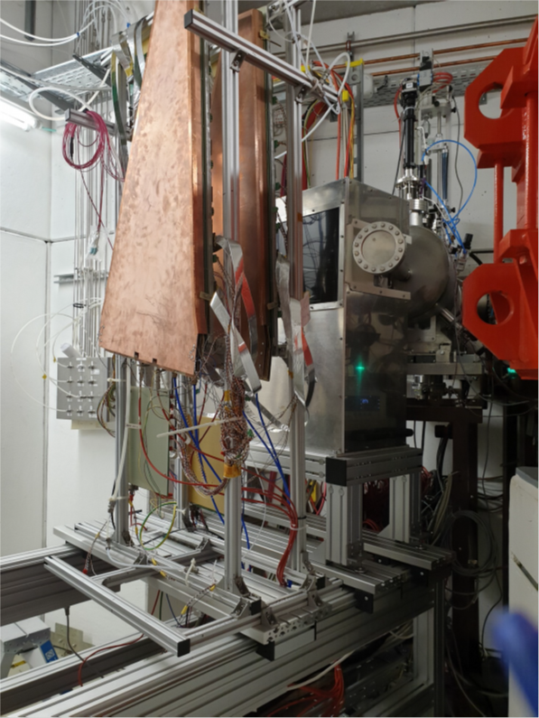
Muon Chamber (MuCh) System
➢ Muon identification
In-kind contributions by india, Russia:
VECC Kolkata +12 Indian Inst.,
PNPI Gatchina,
PSD
MuCh at SIS100:
2 GEM triplets, 2 tracking detector tripletts,TRD
Bakelite RPCs under investigation for stations 3 and 4.
High rate (kHz) operationrequires low resistivity Bakelite
Status:
TDR approved in Feb. 2015
Full size prototype GEM detectors build at VECC and under test in mCBM
The GBTx emulator was implemented and tested.
mainframe and absorbers and under construction at PNPI
Full size GEM detectors tested with free-streaming read-out electronics in the mCBM setup at GSI 2019
16

Slide 17

Dilepton invariant mass spectra
for central Au+Au collisions at 8A GeV
STS+MUCH+TRD+TOF
Di-muons

Slide 18

Charmonium
for central Au+Au collisions at 10A GeV
STS+MUCH+TRD+TOF
Sub-threshold charm production in nuclear collisions J. Steinheimer, A. Botvina, M. Bleicher arXiv:1605.03439
6480 J/ψ in 2 weeks at IR = 10 MHz
ε_{J/ψ} = 0.9 %
S/B ratio = 1.0

Slide 19




Projectile Spectator Detector
➢ determination of collision centrality and orientation of the reaction plane
In-kind contributions by Russia, Czech Rep.: INR Moscow, TU Darmstadt, Rez Prague
PSD at
BM@N JINR
20 modules.
June 2019
PSD at
NA61 CERN SPS.
13 modules.
April 2019
PSD at
mCBM GSI.
1 module.
April 2019
Status:
TDR approved Feb. 2015;
At present, all 44 PSD CBM modules have been fully assembled at INR, Moscow;
Prototype of the PSD readout electronics based on PANDA ECAL sampling ADC is tested and integrated for mPSD readout at mCBM;
PSD modules tested with cosmic rays at INR Moscow and withhadron beams at CERN
Most of the PSD CBM modules have been already integrated in the BM@N, NA61 and mCBM experiments and will be used during FAIR-Phase-0;
Reconstruction algorithms for the reaction plane and centrality determination were developed
19

Slide 20
Projectile Spectator Detector
Reconstructed directed flow of π⁻ in Au+Au collisions at 10 A GeV

Slide 21


Successful Multi Project Chip Prototyping for CBM
In-kind contributions by Germany, Poland: GSI Darmstadt, Univ. Heidelberg, AGH Krakow
5 final prototype chips for CBM:
STS-XYTER and Much-XYTER
Get4 in two versions for TOF
PADI production for CBM@STAR
SPADIC for CBM-TRD
Produced Chips:
Several thousand STS-XYTER and MUCH-XYTER Chips for detector prototyping
Full number of PADI Chips needed for CBM-Tof at STAR
Full number of Get4 TDC chips needed for CBM-Tof at STAR
Full number of SPADIC Chips for CBM-TRD

Slide 22


CBM online systems
In-kind contributions by Germany, Poland, India:
Univ. Frankfurt, FIAS, GSI Darmstadt, KIT Karlsruhe, IIT Kharagpur, Warsaw UT
First-level Event Selector
GSI Green IT Cube
Novel readout system: no hardware trigger on events, detector hits with time stamps, full online 4-D track and event reconstruction.
Status:
FLES input interface designed
FLESnet software successfully applied in beam tests with detectors
TDRs on DAQ, FLES
22

Slide 23





mCBM DAQ
2019: The mCBM DAQ link to the GC
Green Cube: online timeslice building
and event selection
mCBM DAQ container:
data pre-processing
green
cube
μ-slices
green cube
FLIM
Green Cube
flow
300m
data
50m
GBT
mini CBM: high-rate heavy-ion experiment at GSI

Slide 24



4D track and event reconstruction
Au beam 8 A GeV
one single ion
passing the target
FairIon + GEANT3
Au+Au 8 A GeV
central collision
UrQMD + GEANT3
Au+Au 8 A GeV
peripheral collision
UrQMD + GEANT3

Slide 25
4D track and event reconstruction
Hit and track time distribution for
Au+Au 10 AGeV mbias events at 10 MHz (UrQMD)

Slide 26

4D reconstruction
10 MHz Au+Au, 10 AGeV,
300k mbias UrQMD events, ideal PID
 |  | K⁰s | Λ | Λ̅ | Ξ⁻
 | ε_{method}, % | 68.6 | 61.2 | 67 | 46.7
 | ε_{4π}, % | 20.7 | 19.4 | 28 | 10.5
 | S/B | 10.6 | 23.7 | 12.7 | 21.8
 | ε_{method}, % | 68.5 | 62.0 | 62 | 45.2
 | ε_{4π}, % | 21.1 | 20.6 | 32 | 11.7
 | S/B | 9.8 | 12.9 | 10 | 14.2
 | ε_{method}, % | 67.5 | 60.9 | 59 | 46.0
 | ε_{4π}, % | 19.4 | 18.7 | 26 | 10.6
 | S/B | 9.3 | 12.5 | 10 | 12.3
 | ε_{method}, % | 66.8 | 60.0 | 64 | 41.8
 | ε_{4π}, % | 17.6 | 16.7 | 28 | 8.2
 | S/B | 9.2 | 12.2 | 8 | 11.7
3 D
0.1 MHz
1 MHz
10 MHz
all mother particles emitted from one primary vertex

Slide 27

Online particle identification in CBM:
The KF Particle Finder
successfully used online in the STAR experiment

Slide 28

Real data analyzed with CBM KF Particle Finder
STAR 4.4 M mbias AuAu collisions, √s_{NN}=7.7 GeV

Slide 29

Cave + Building
Infrastructure
Rail systems
Support structures
Cryo supply
Gas supply
Electronic racks
Cooling (racks, detectors)
Beam pipe +vacuum system
Cables, fibres, racks
Safety systems
Alignement system
Cranes, lifting tools
29

Slide 30


Slide 31





FAIR phase 0 experiments on dense QCD matter
1. CBM RICH photon detector: 430 out of 1100
multi-anode photo-multipliers (MAPMT) installed
in HADES experiment and used for physics runs
2. CBM TOF detector: 10% of the CBM TOF
modules including read-out chain installed and
used at STAR/RHIC (BES II 2019/2020)
3. Four Silicon Tracking Stations and a
Projectile Spectator Detector will be installed
in the BM@N experiment at the Nuclotron in
JINR/Dubna (start 2019 with Au-beams
up to 4.5A GeV )
4. miniCBM experiment installed at GSI/SIS18
and commissioned with beam for a full system
test with high-rate nucleus-nucleus collisions
from 2018 - 2021
31

Slide 32
CBM installation schedule
2021
2022
2023
2024
2025
shell
construction
services installation
building
certifi-
cation
construction site rules
construction site services
normal operation rules
rail system
upstream
platform
1st installation window
support structures,
service lines, ….
no access
2nd installation window
services (HV,LV, gas)
detectors
commissioning
crane1
(Nov’20)
crane2
(Jun’21)
basic
services
HBO
(09’22)
Cryo
(01’23)
first
SIS100
beams
M11: 04‘25
M10
infra
M10
supports
M10 services
M10
detectors
W.F.J. Müller, CBM Technical coordinator

Slide 33

Summary
The CBM research program adresses fundamental properties of QCD matter, including its the equation-of-state and its the phase structure at high densities, which is relevant for our understanding of the dynamics of supernova explosions and the structure of neutron stars.
The relevant experimental observables include multi-strange particles, lepton pairs, collective flow and fluctuations, charmed particles and hypernuclei.
The key feature of the CBM experiment is high rate capabilty based on fast and radiation-hard detectors, free-streaming data readout, and high-speed online event reconstruction and selection on a high-performance computing farm.
The development and construction of the CBM detector systems, readout electronics and analysis software is progressing. The CBM start version will be ready to take the first beams from SIS100 in 2025
33

