Slide 1
The Few Body Higgs

Slide 2
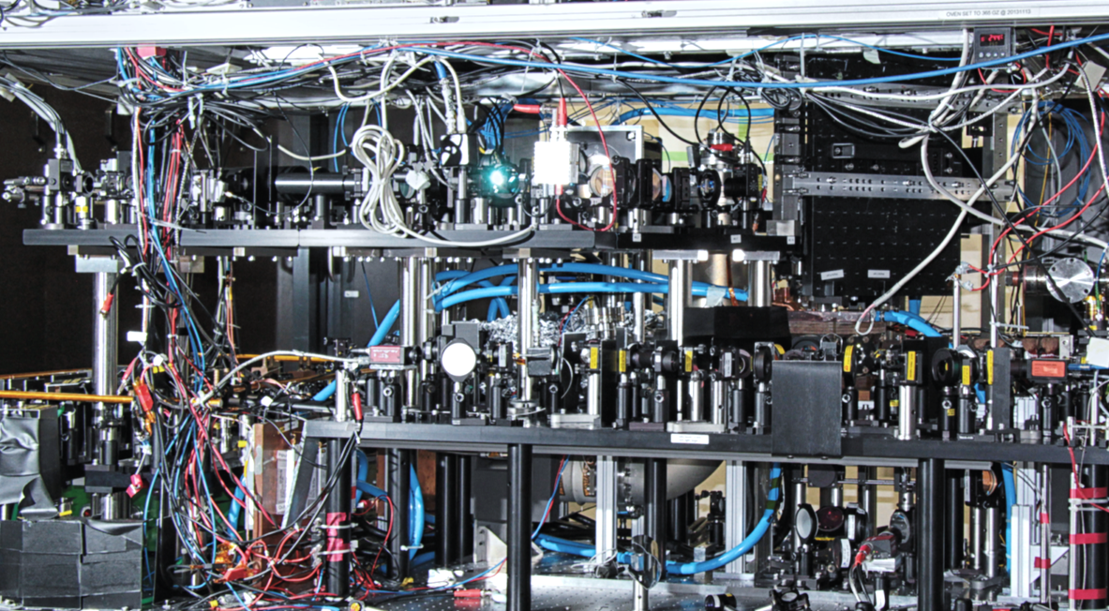
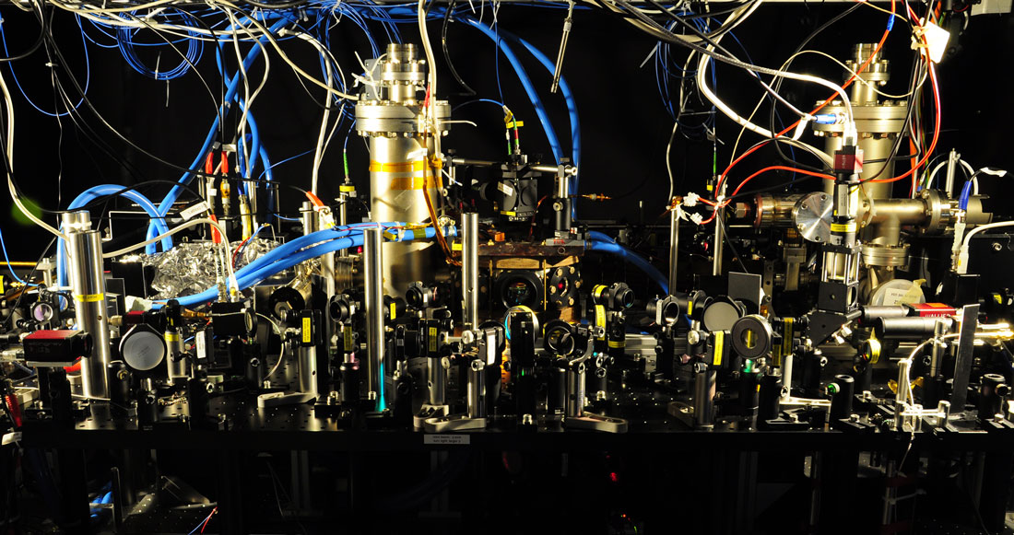
Experimental Apparatus

Slide 3
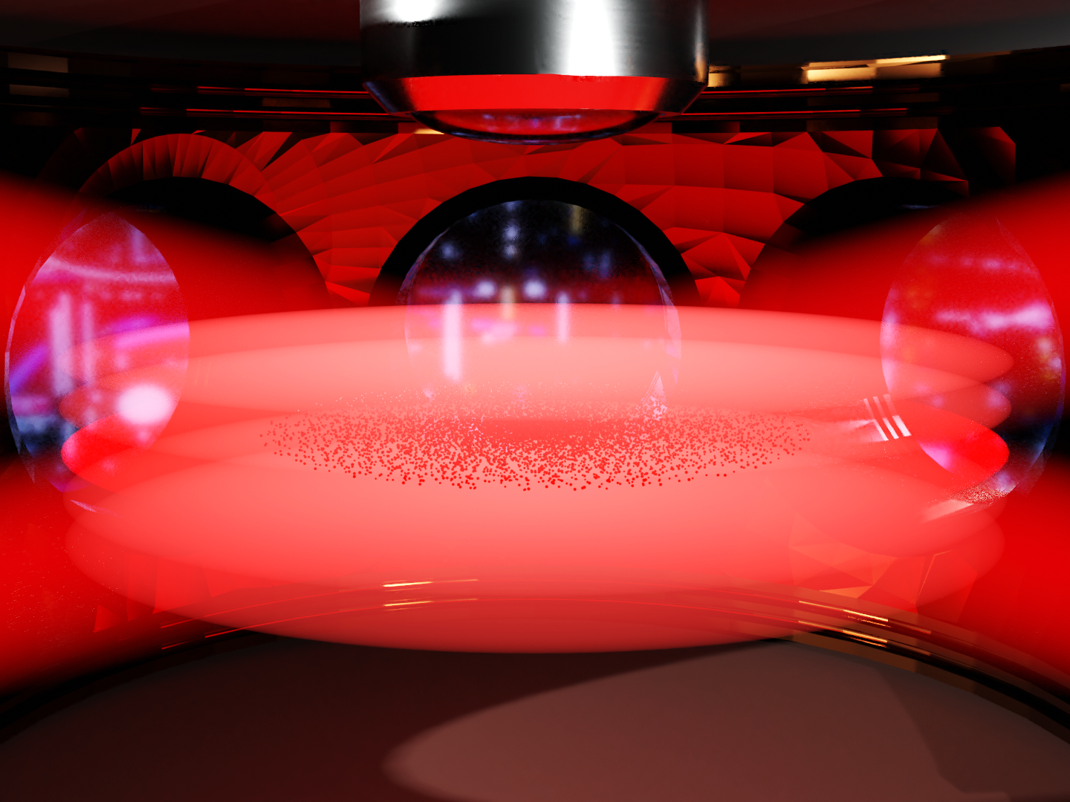
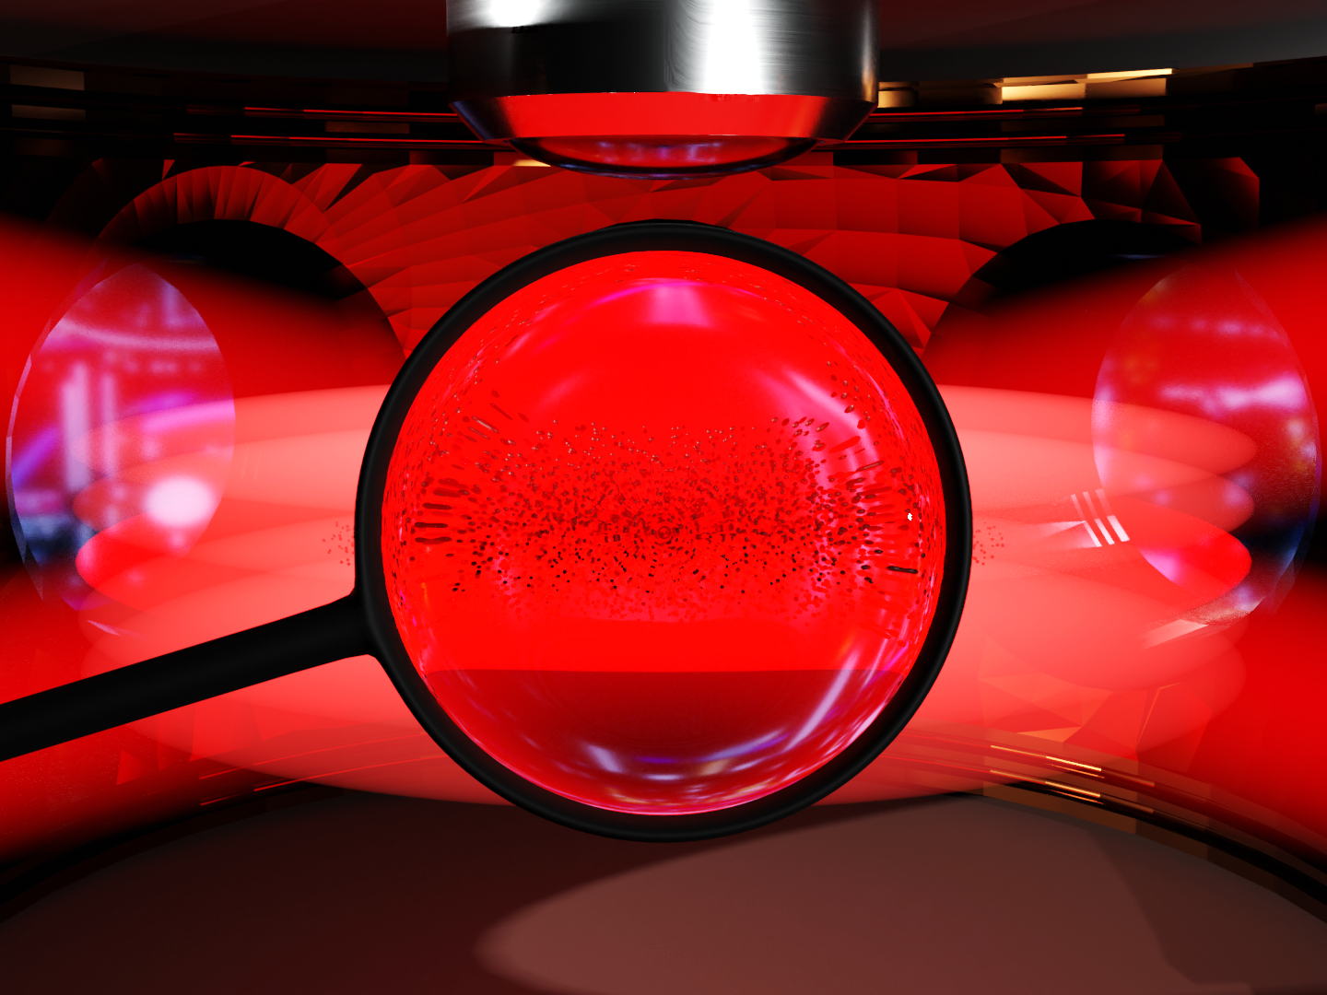
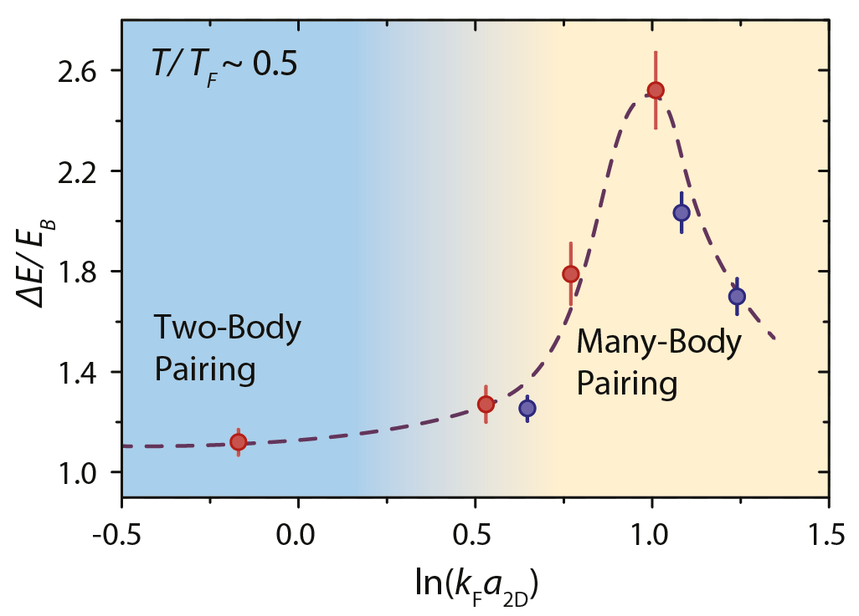
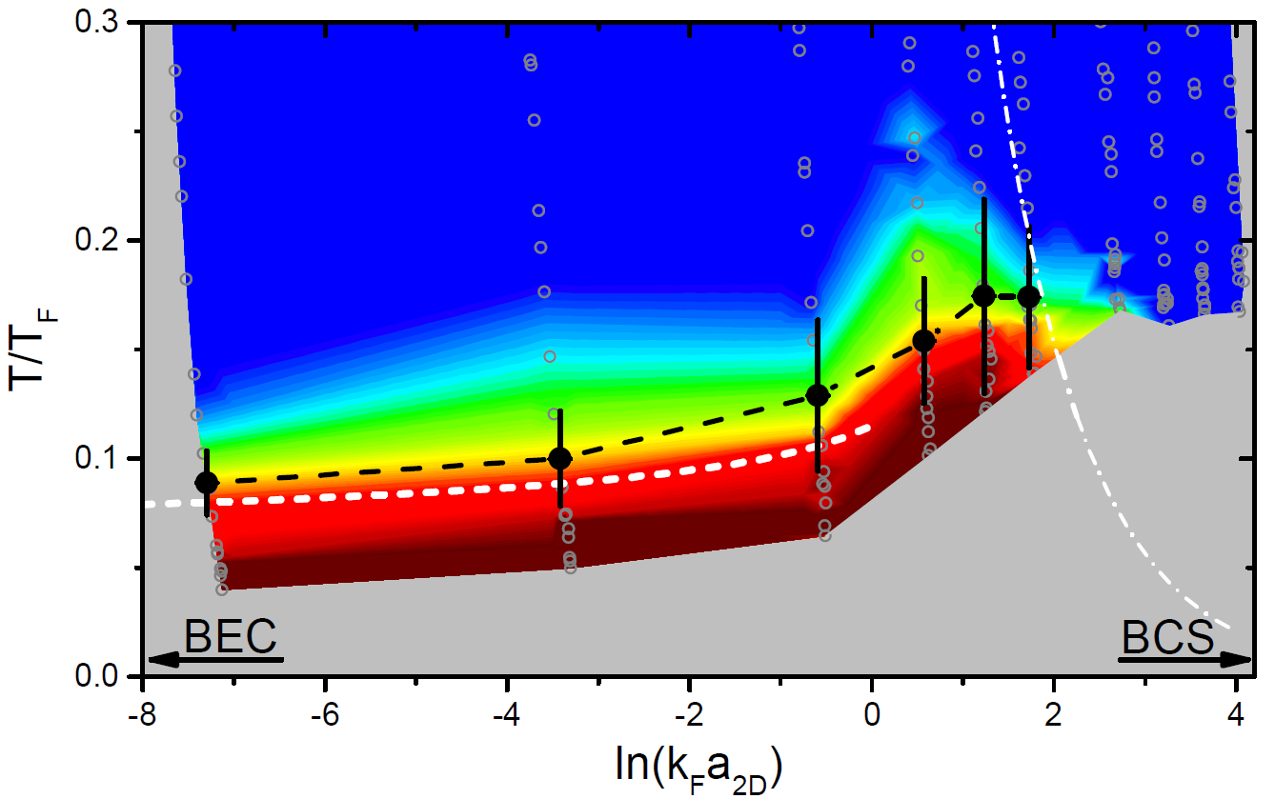
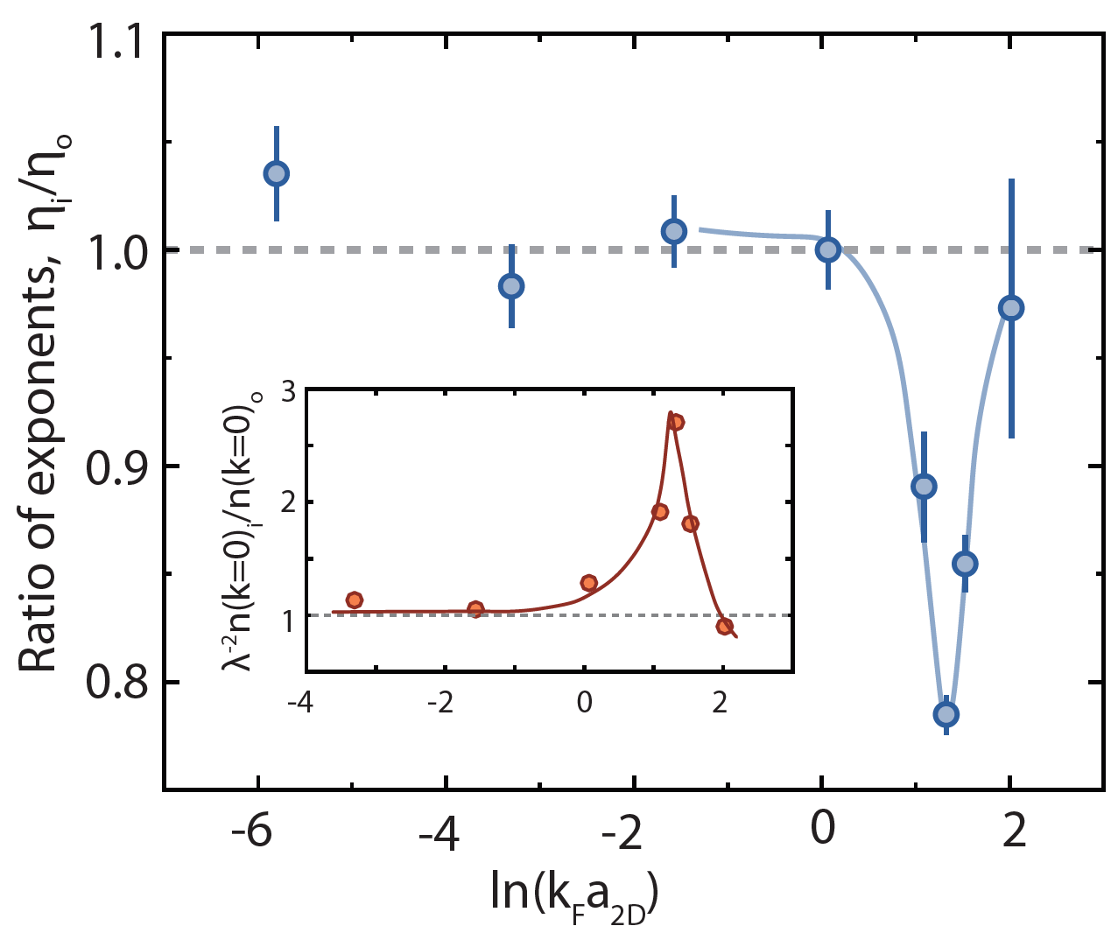
Fermions in Two Dimensions
M.G. Ries et al., PRL 114, 230401 (2015)
P.A. Murthy et al., Science 359, 6374 (2018)
MH et al., PRL 121, 120401 (2018)
P.A. Murthy et al., Science 365, 6450 (2019)

Slide 4
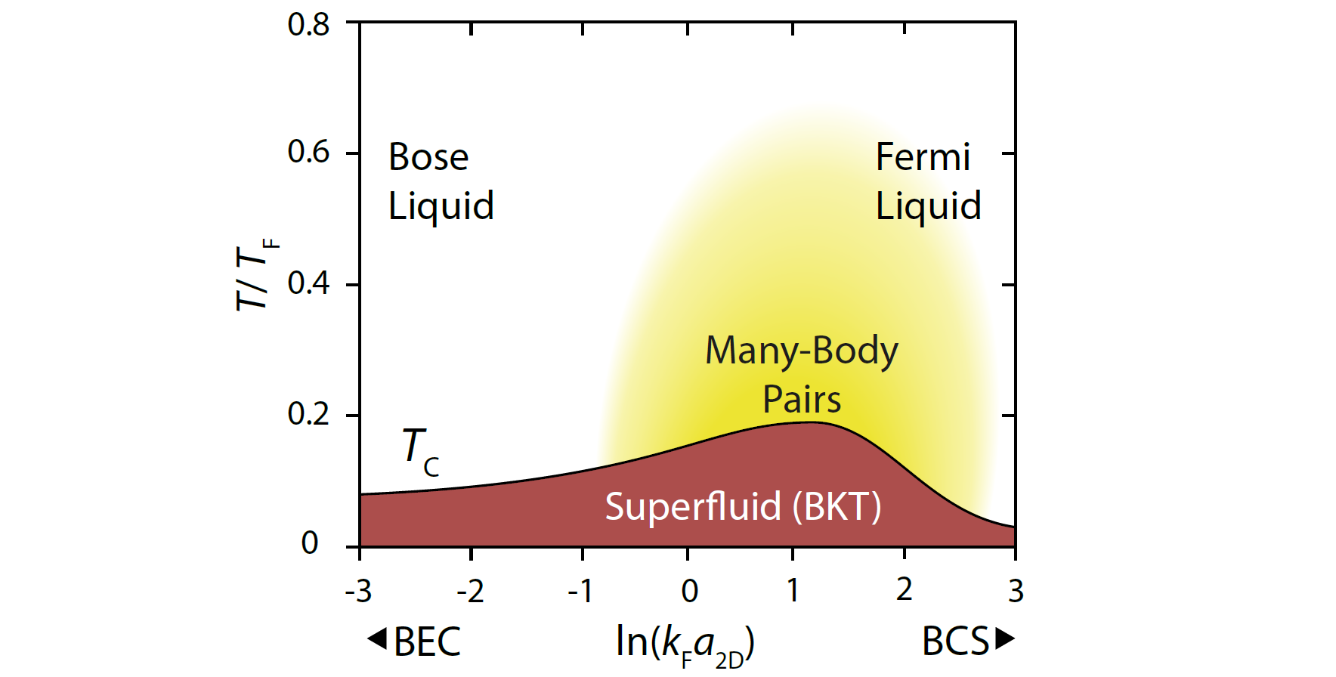
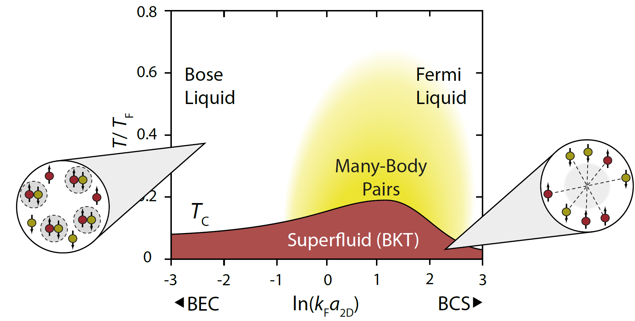
2D BEC-BCS Crossover
$$ℋ_{0}=−\sum_{σ=↑,↓,i}{\frac{ℏ^{2}}{2m}∇_{i}^{2}+{\sum_{i<j}{\frac{ℏ^{2}}{2m}}g}_{0}δ^{2}\left(r_{i}−r_{j}\right)}$$

Slide 5
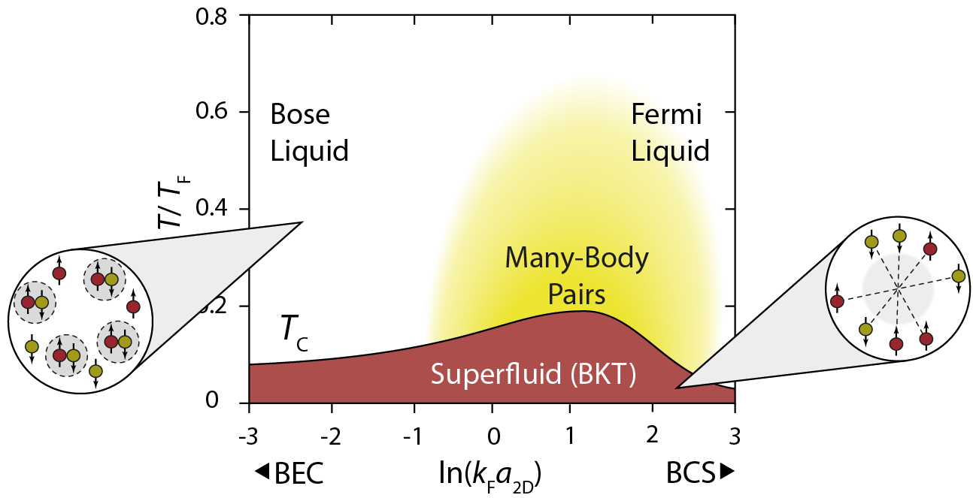
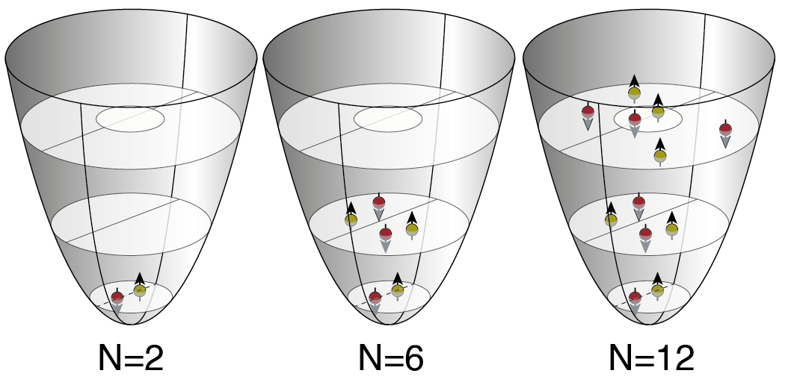
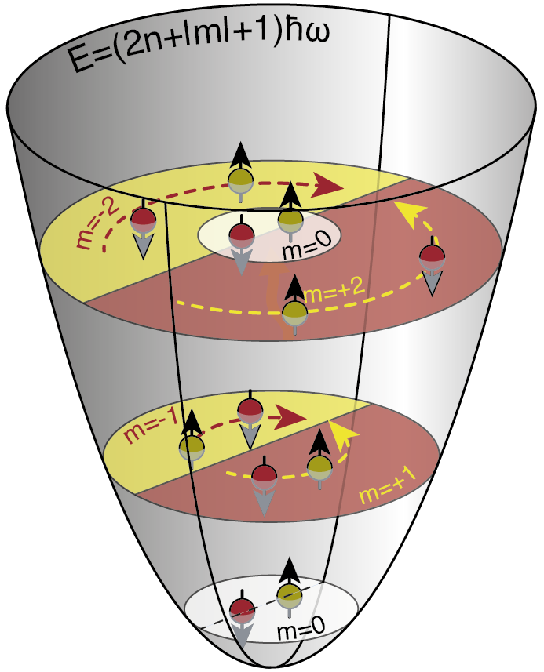
Mesoscopic Systems
$$ℋ_{0}=−\sum_{σ=↑,↓,i}{\frac{ℏ^{2}}{2m}∇_{i}^{2}+{\sum_{i<j}{\frac{ℏ^{2}}{2m}}g}_{0}δ^{2}\left(r_{i}−r_{j}\right)}$$
$$+ V_{ext}$$
Pairing is essential ingredient to fermionic superfluidity
In the trap: Competition between pairing energy and trap level spacing.
Normal $↔$ Superfluid quantum phase transition at critical pair binding energy
Formation of a Shell structure
What are the few-body precursors of the phase transition?

Slide 6
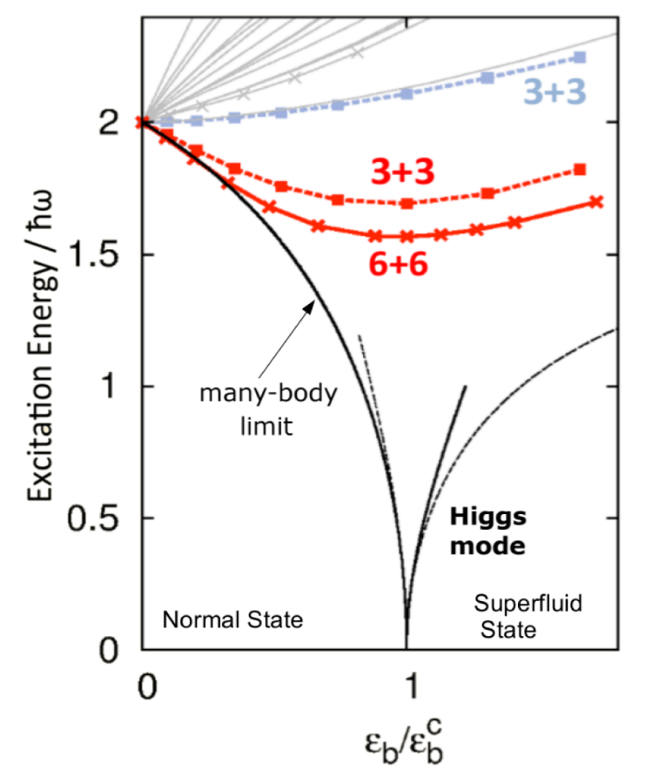
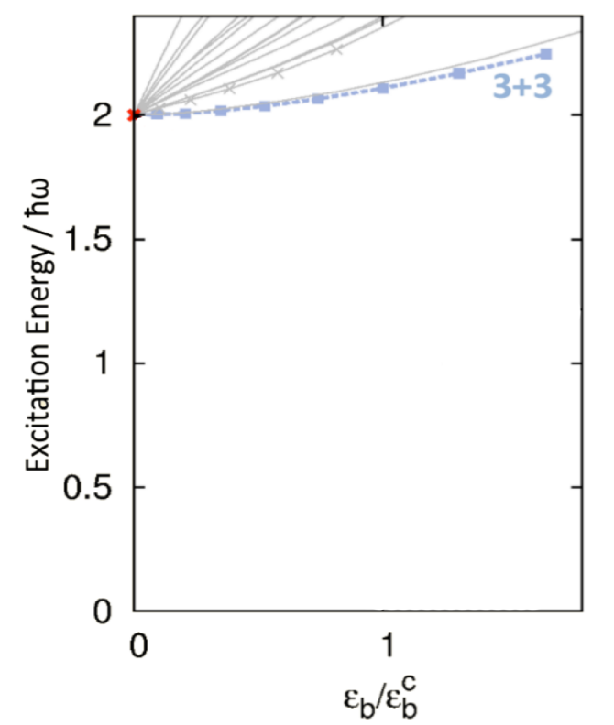
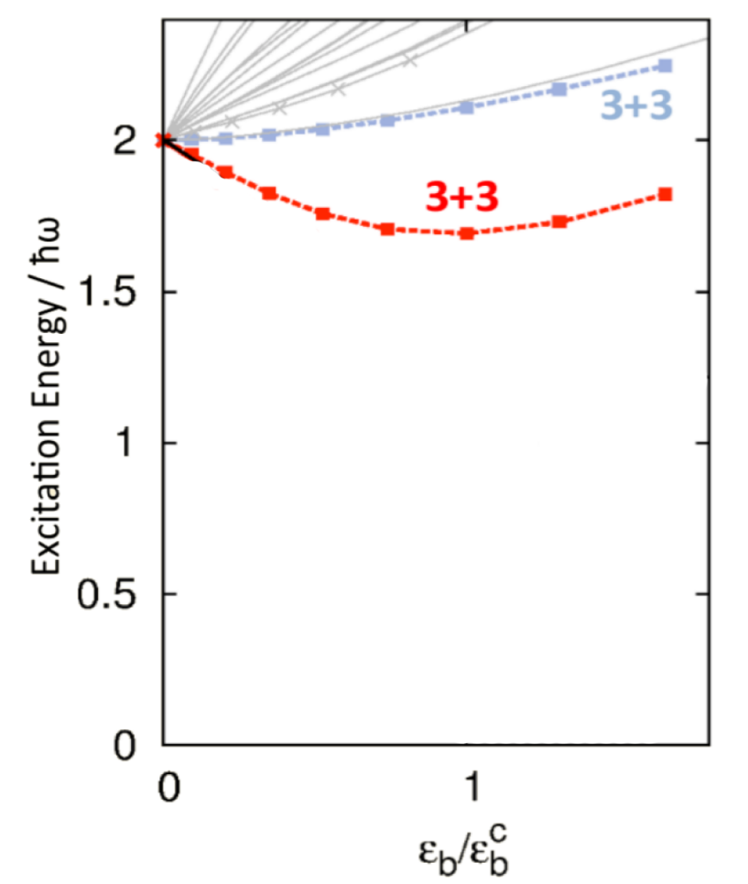
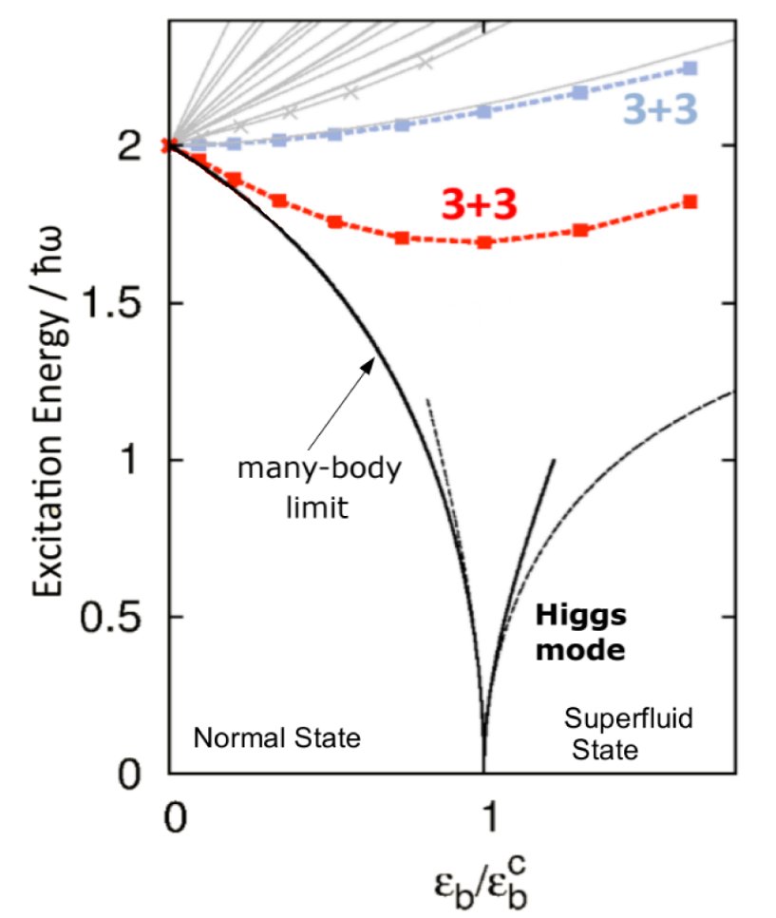
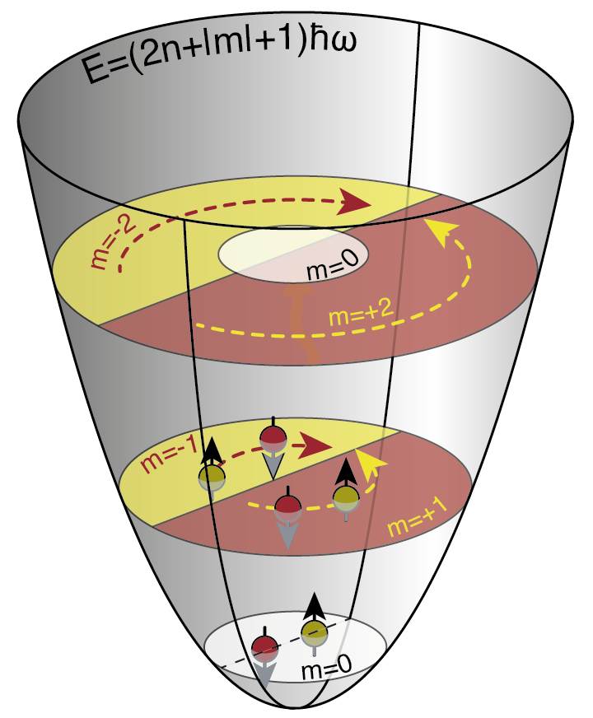
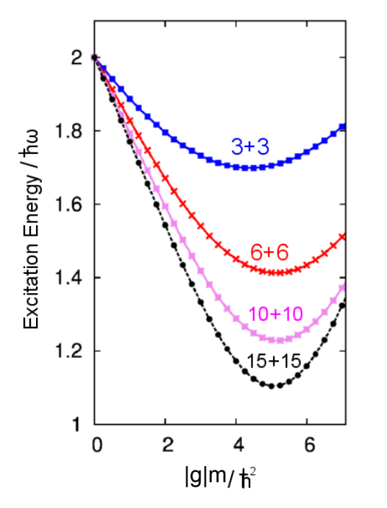
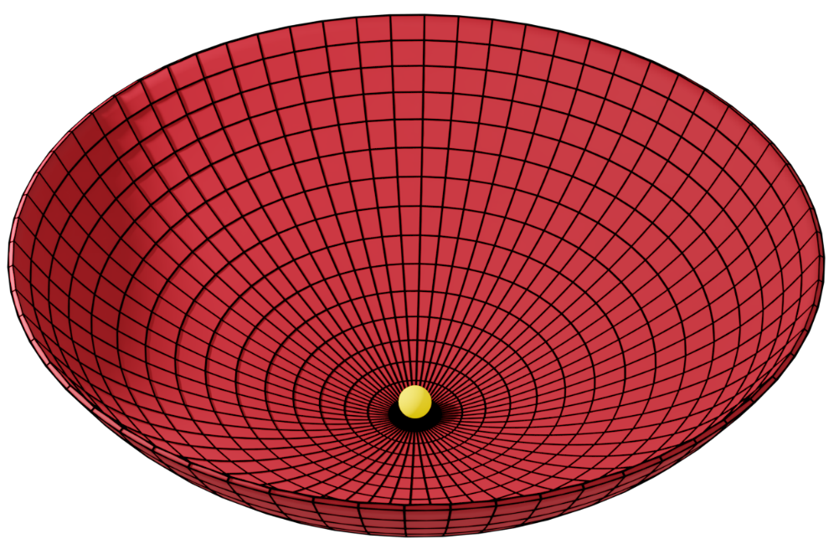
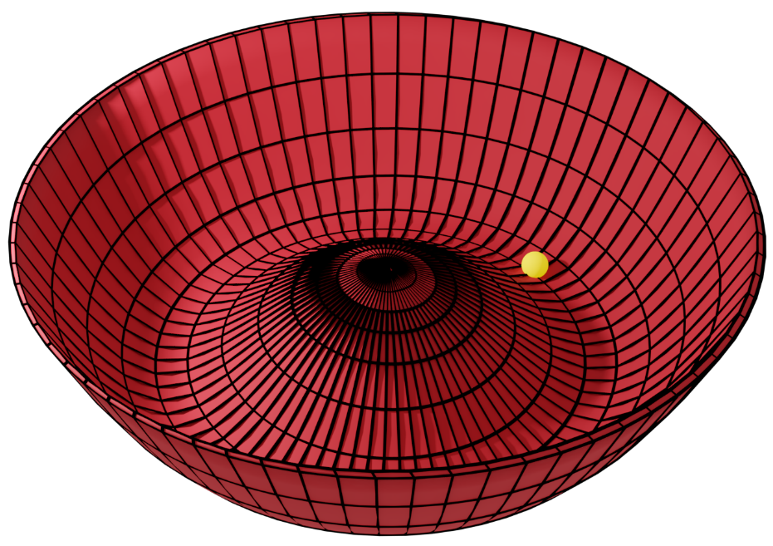
Higgs Mode Precursor
Phase transition is characterized by order parameter (pair density):
$$Δ=\left\langle Ψ_{↑}\left(r\right)Ψ_{↓}(r)\right\rangle$$
Higgs mode is the oscillation of order parameter.
J. Bjerlin et al., PRL 116, 155302 (2016):
Normal Fluid $(Δ=0$)
Superfluid $(Δ≠0$)

Slide 7
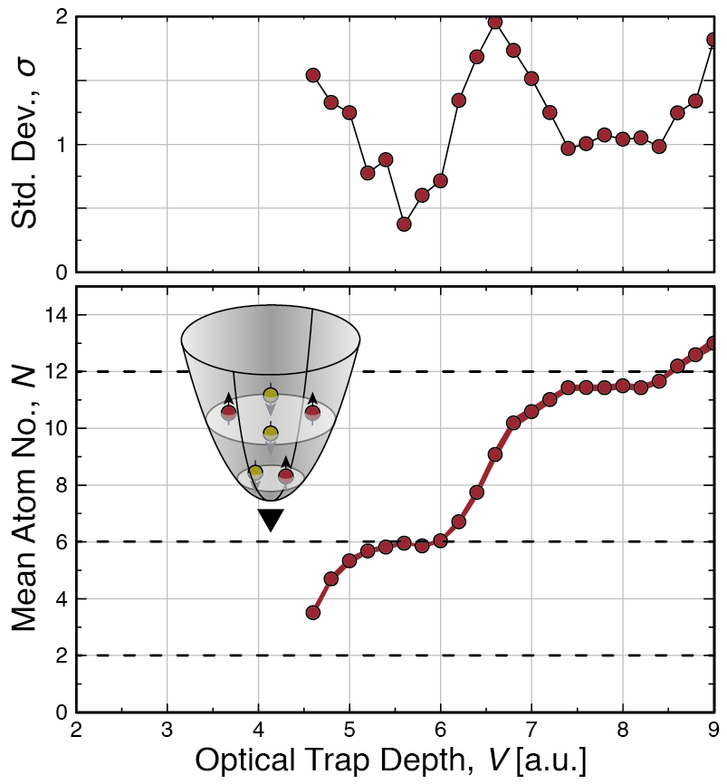
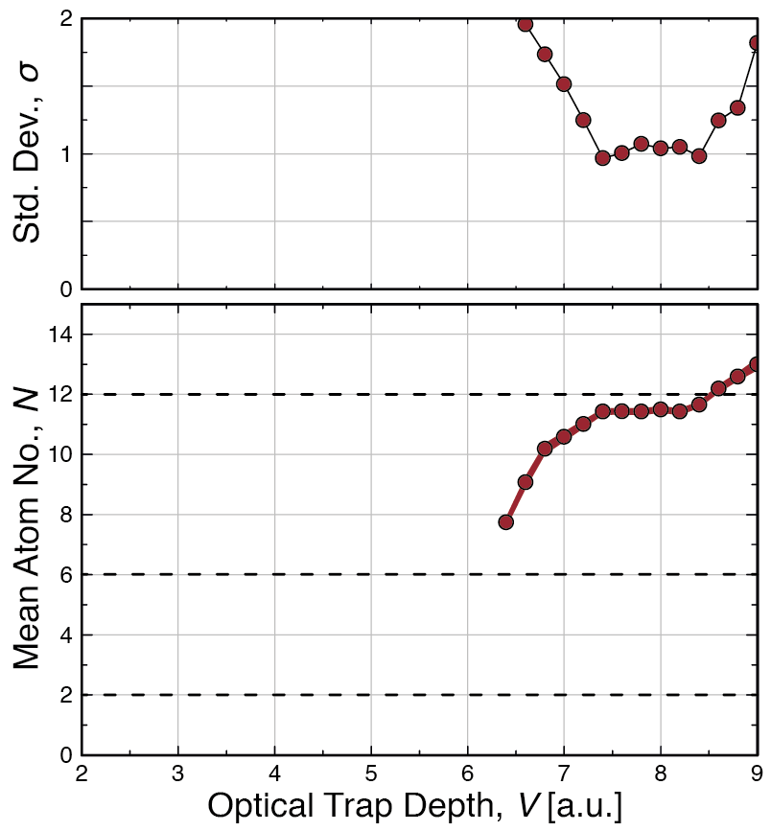
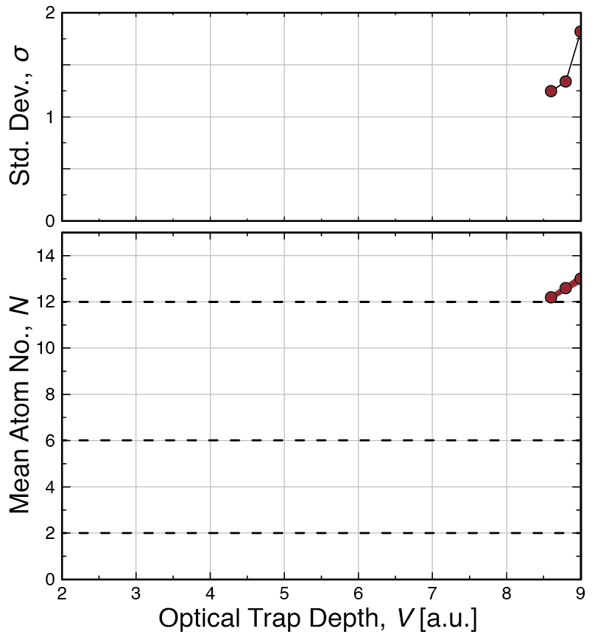
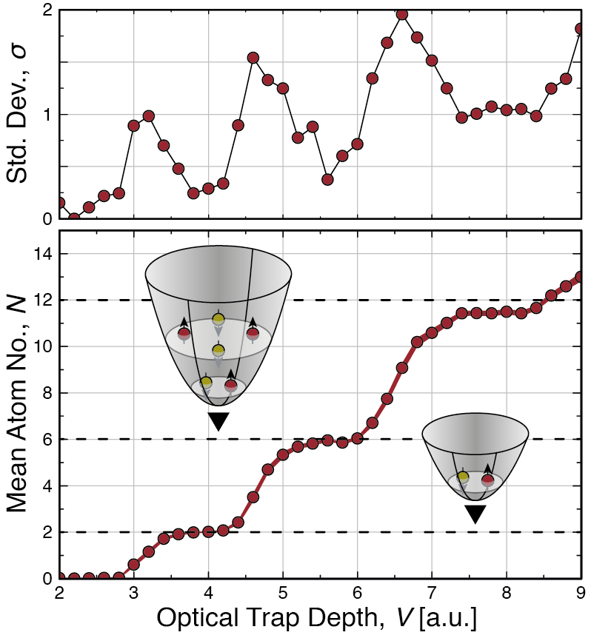
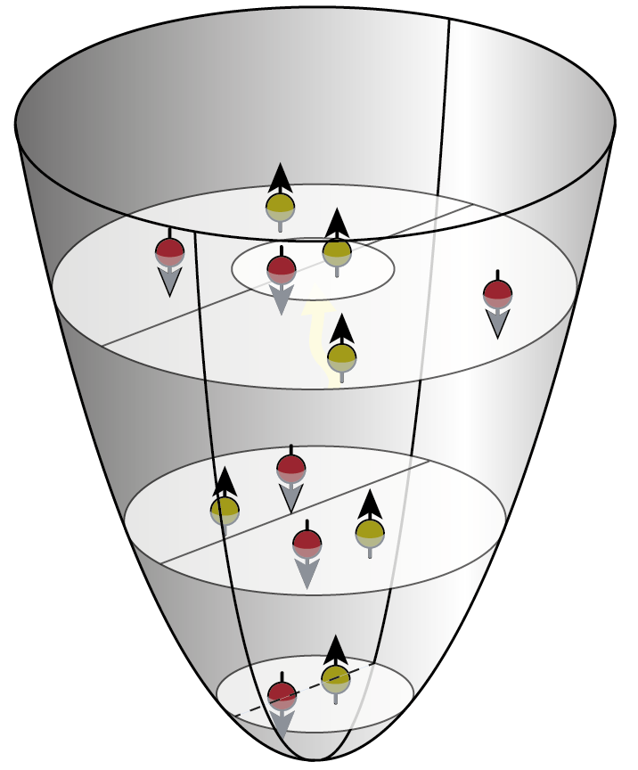
Combined Potential
J. Bjerlin et al., PRL 116, 155302 (2016):
?
F. Serwane et al. Science 15, 6027 (2011)

Slide 8
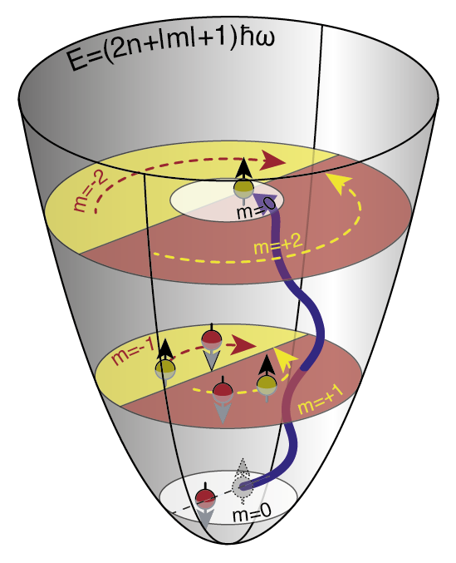
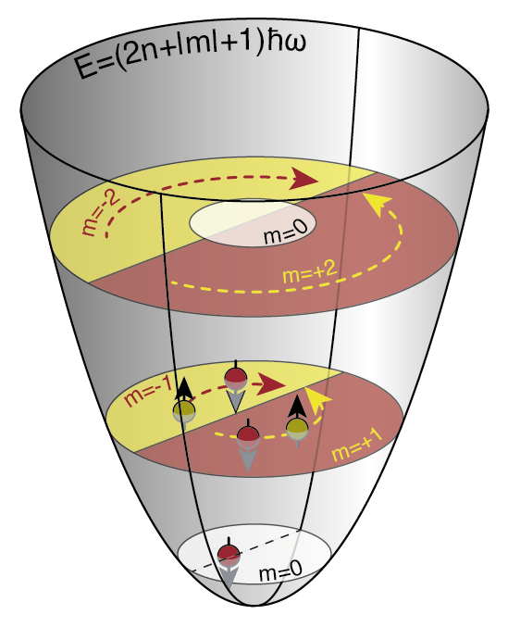
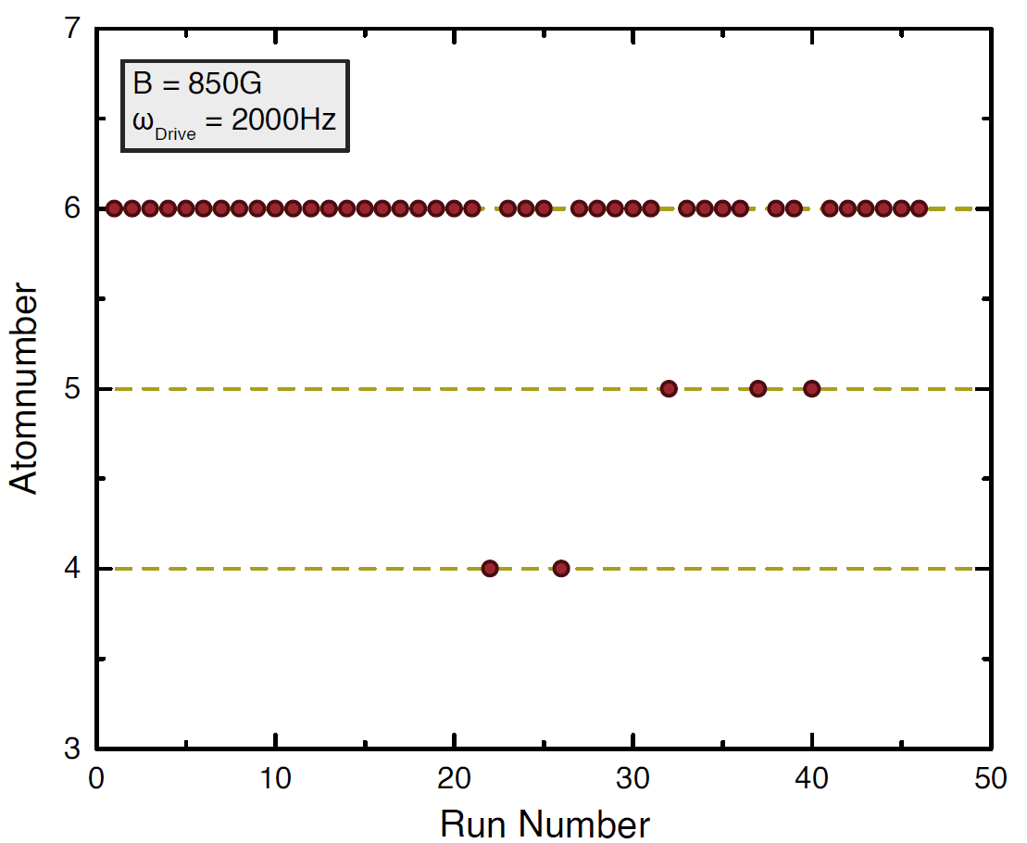
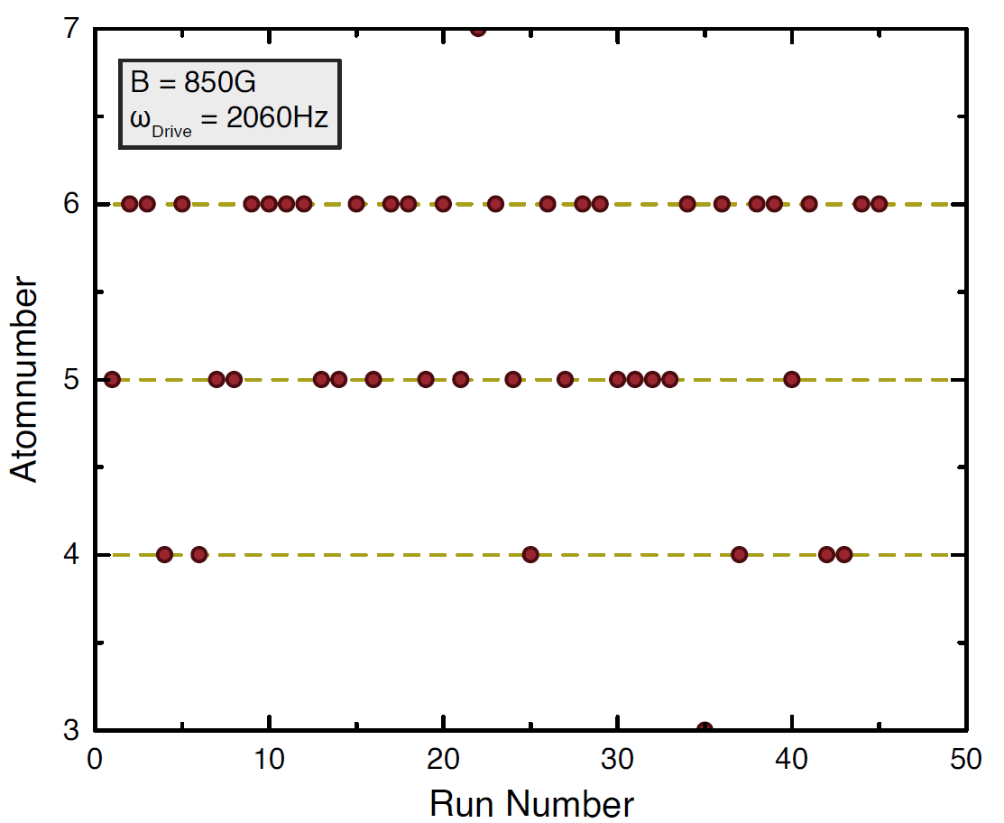
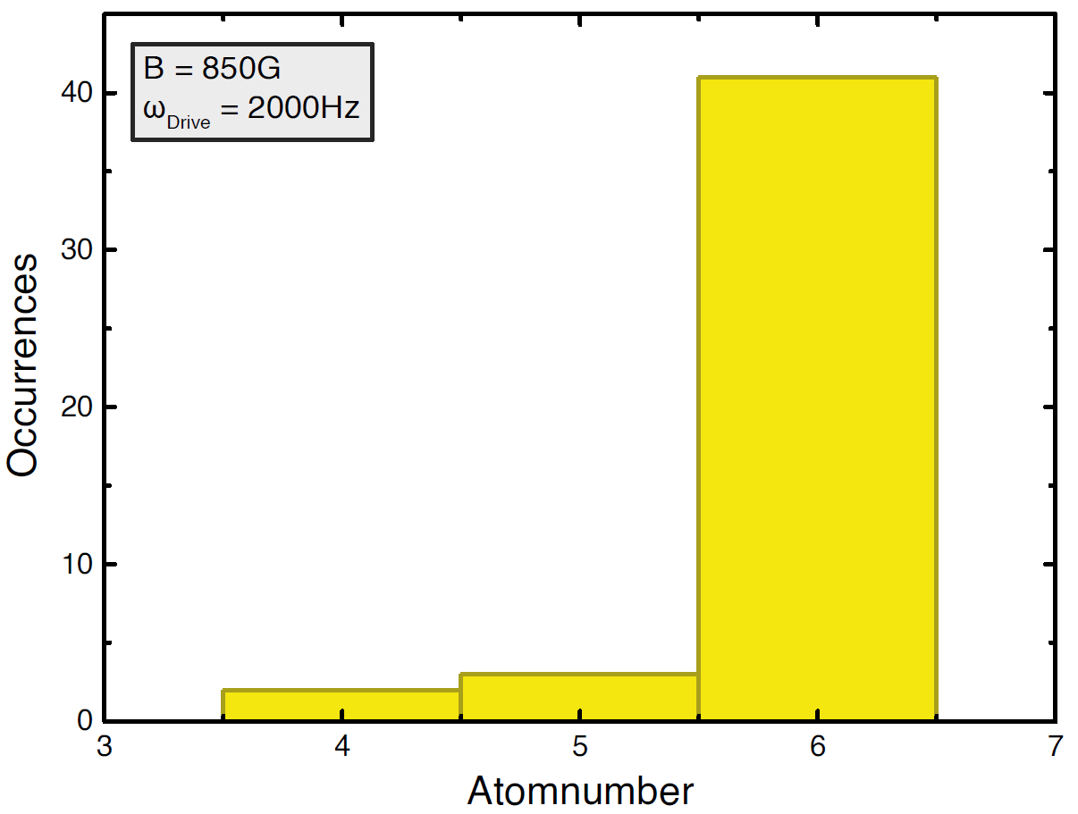
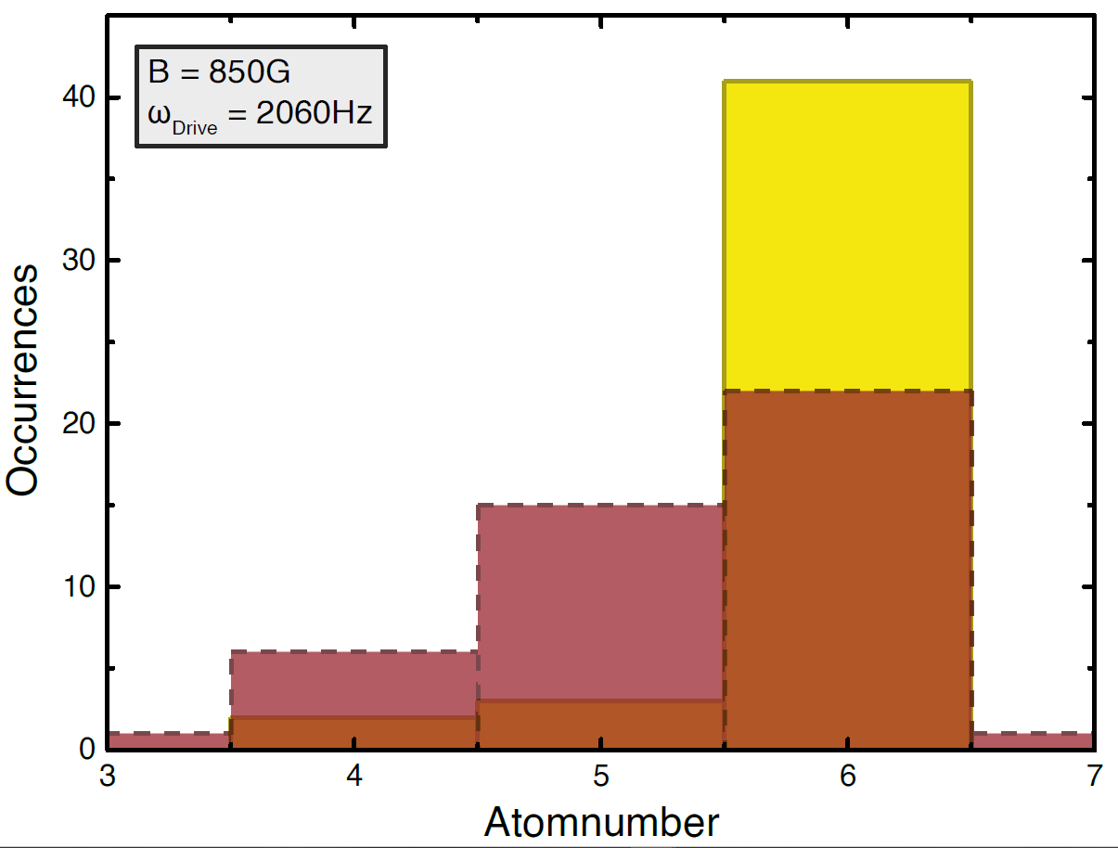
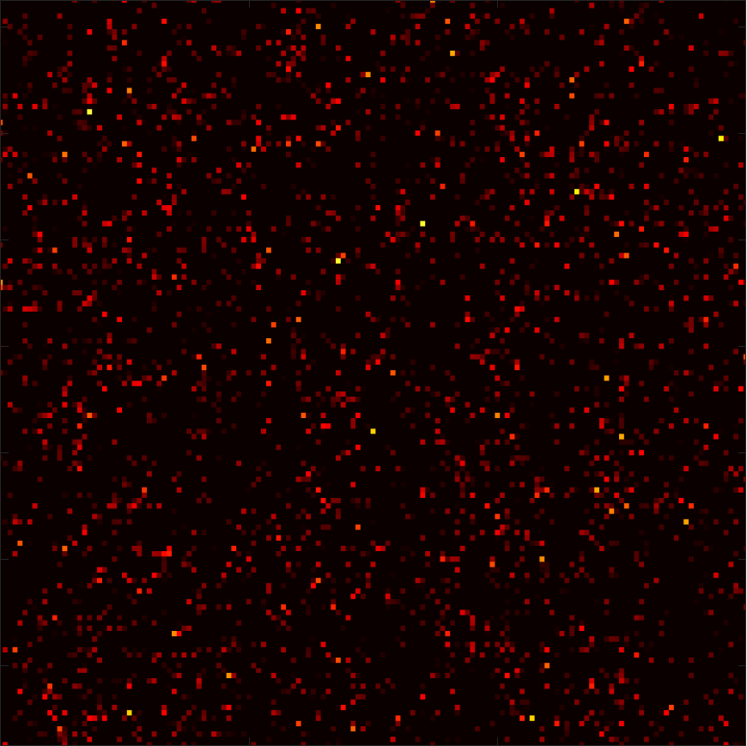
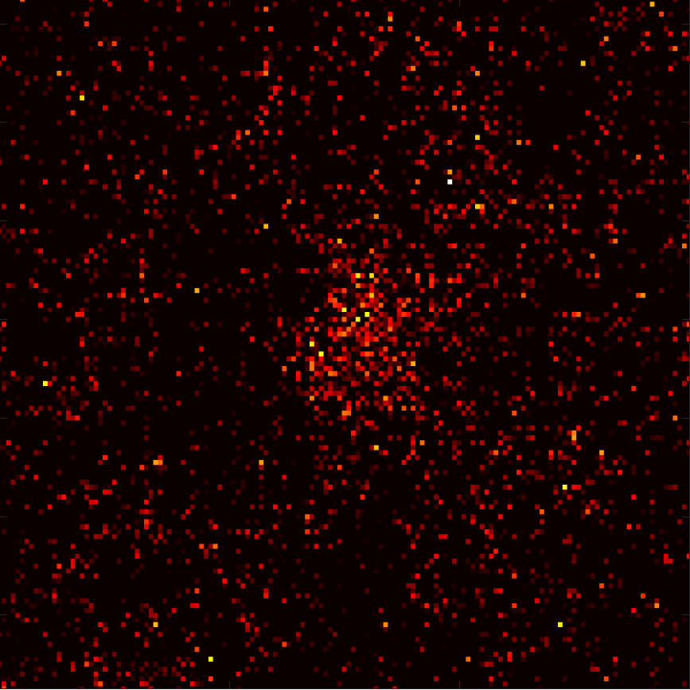
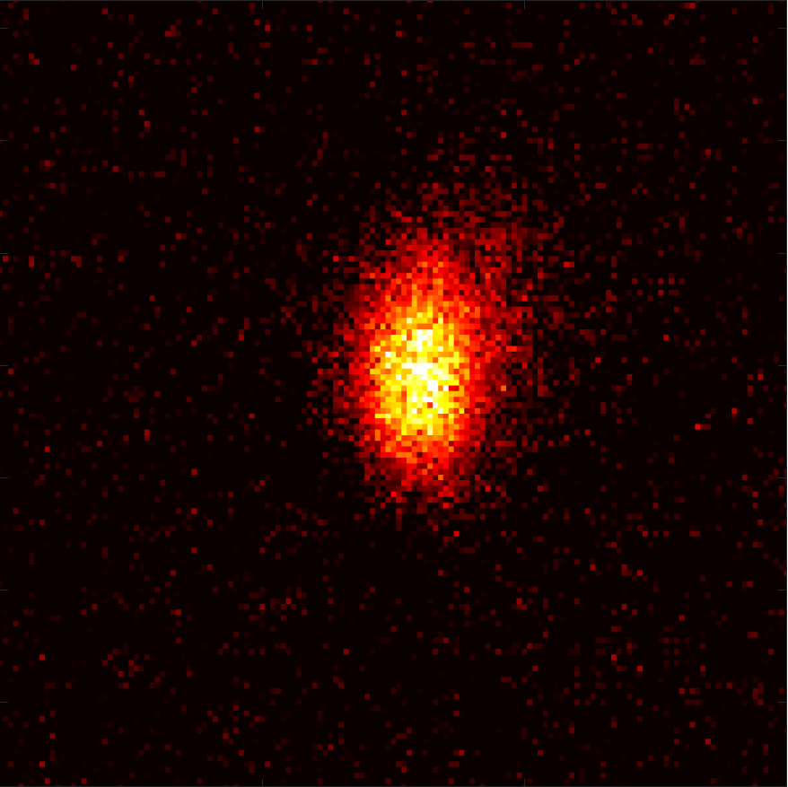
Single Atom Counting
Start from ground state for 3+3 atoms.
Modulate Binding Energy at some frequency $ω_{Drive}$.
Spill to ground state again
Count number of remaining atoms.
no Atom
1 Atom
6 Atoms

Slide 9
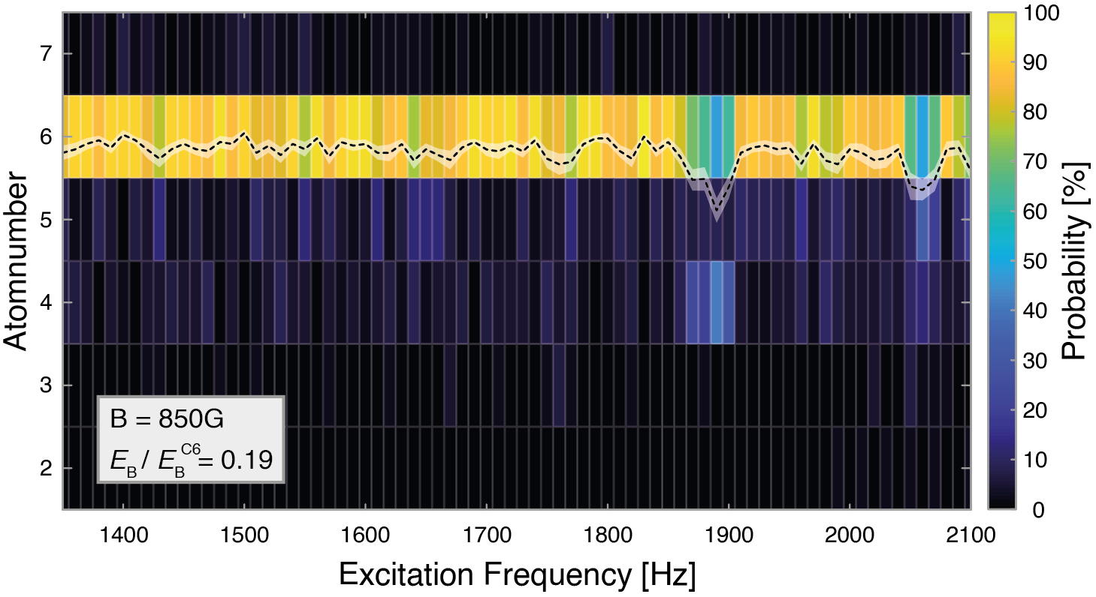
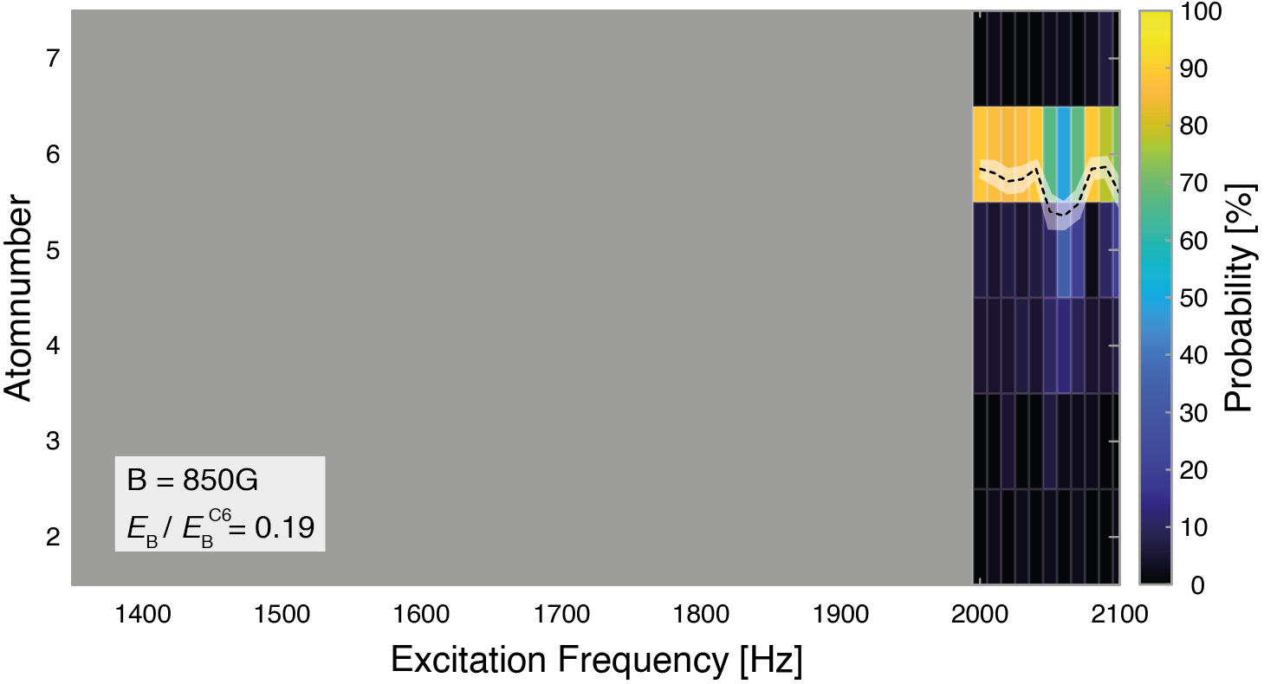
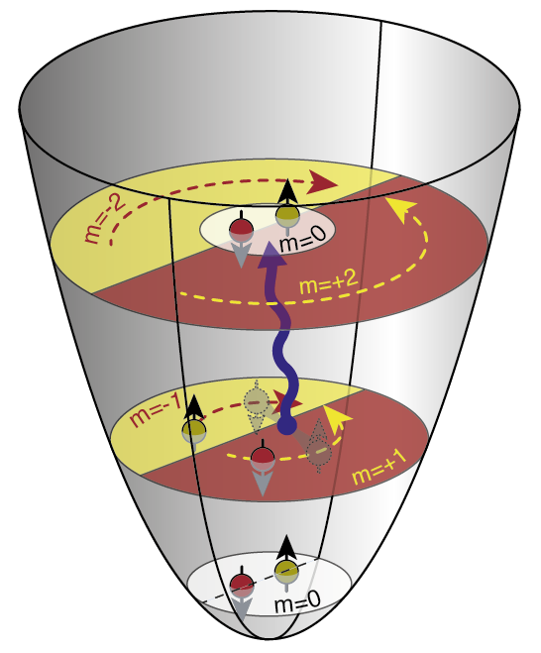
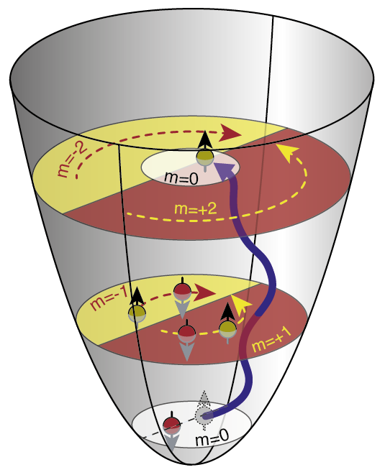
Excitation Spectrum
$$2ω_{R}$$

Slide 10
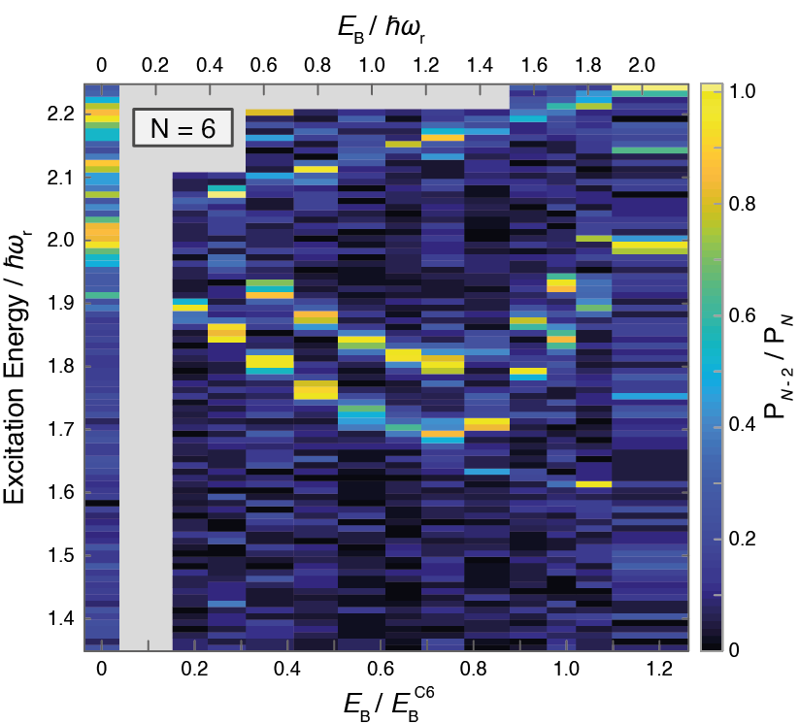
Interaction Dependence
Interactions are tuned by Feshbach resonance
Higher modes show mean-field shift with increasing attraction.
Lowest mode is non-monotonous!

Slide 11
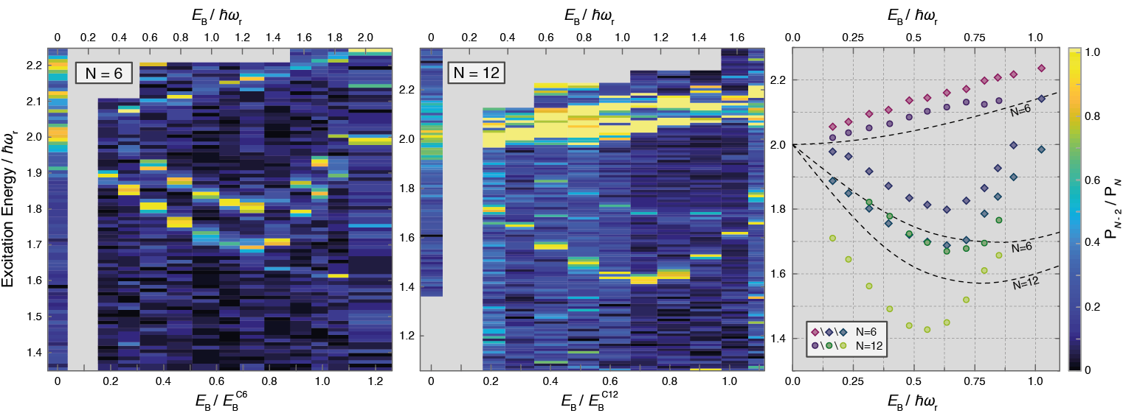
From Few to Many …
Preliminary!
Lowest mode deepens with increasing particle number.
Minimum shifts towards smaller binding energies for larger particle numbers.
Lowest mode is few-body Higgs precursor!

Slide 12
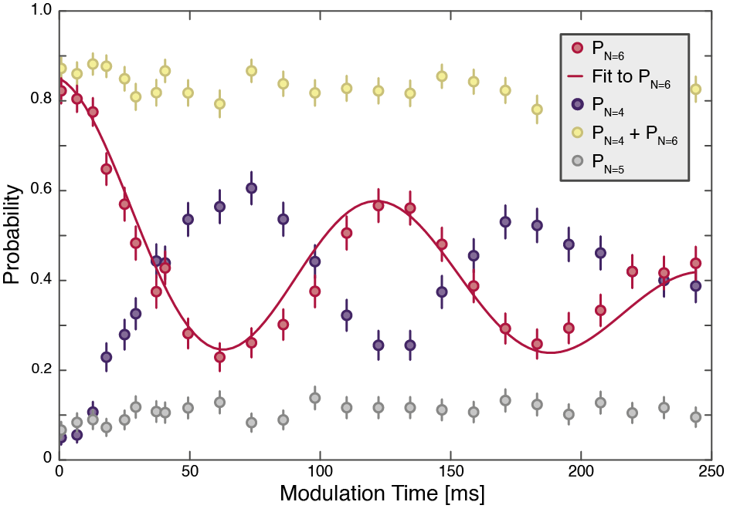
Coherent Drive
Modulate binding energy at Higgs frequency.
Observe coherent oscillations between probability for N=4 and N=6.
Oscillations decay very slowly on the order of 250ms.
Can prepare system in coherent superposition of highly non-trivial many-body states!

Slide 13
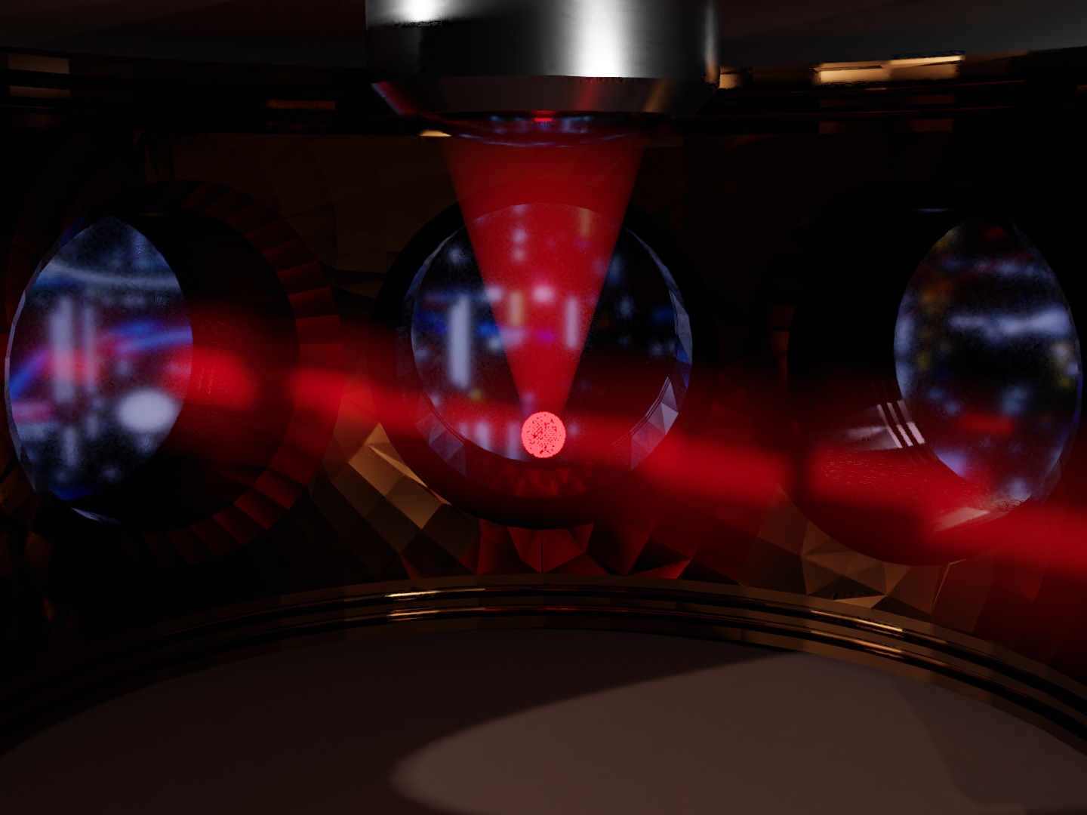
Momentum Imaging
A. Bergschneider et al., PRA 97, 063613 (2018)

Slide 14
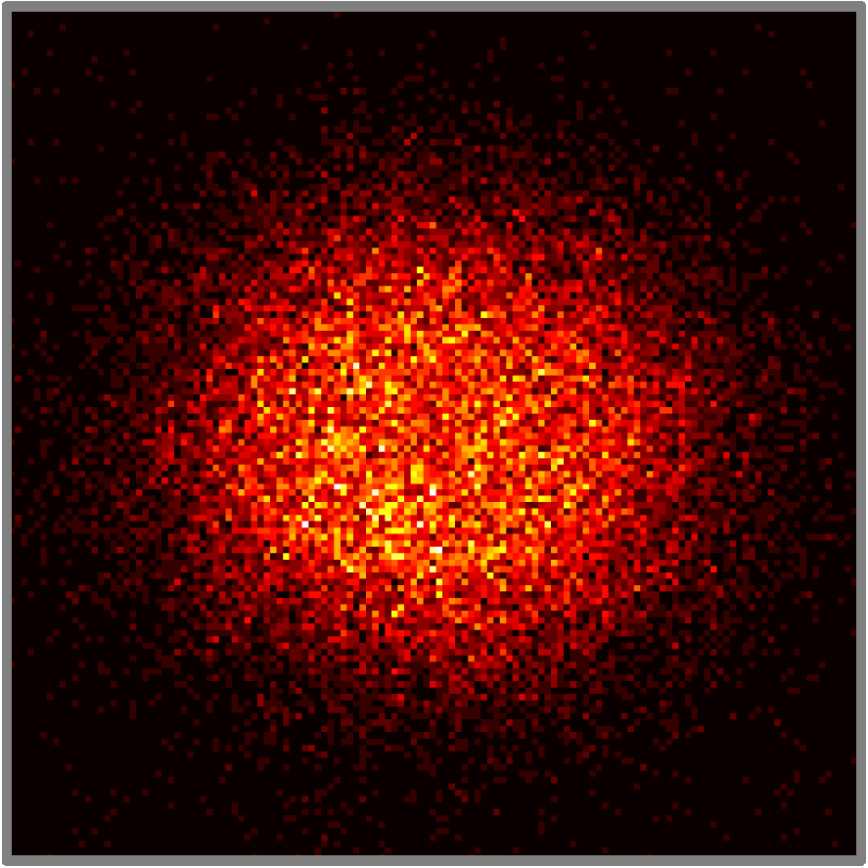
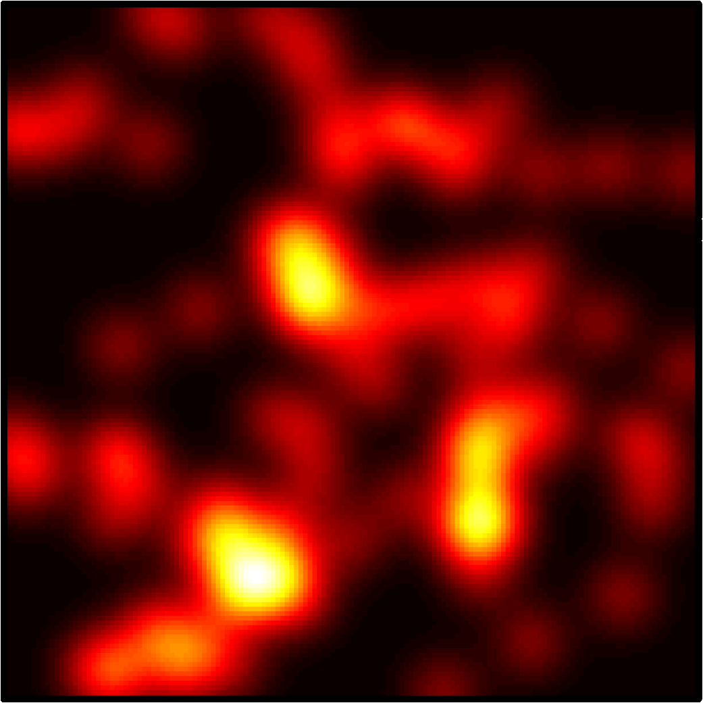
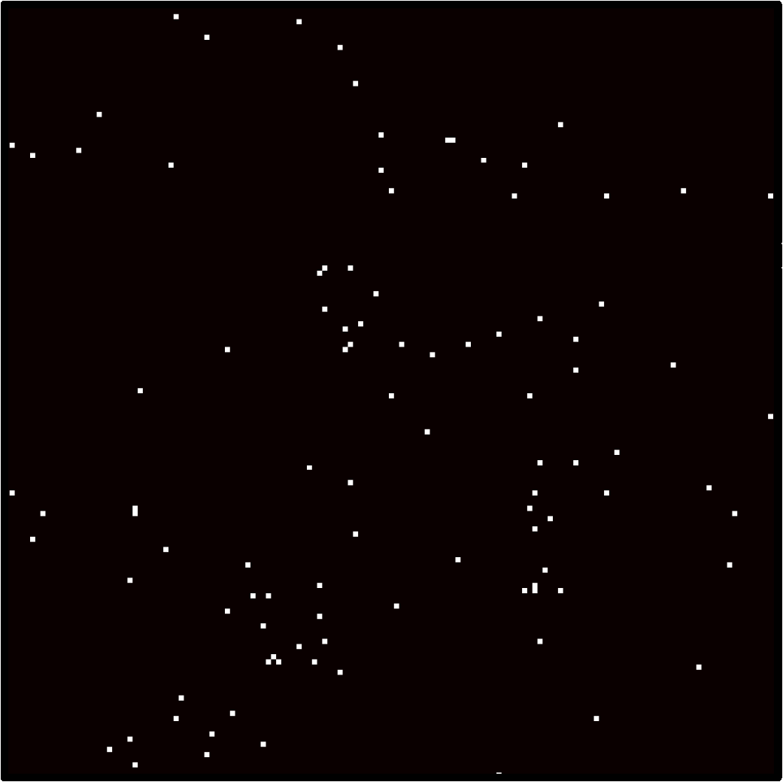
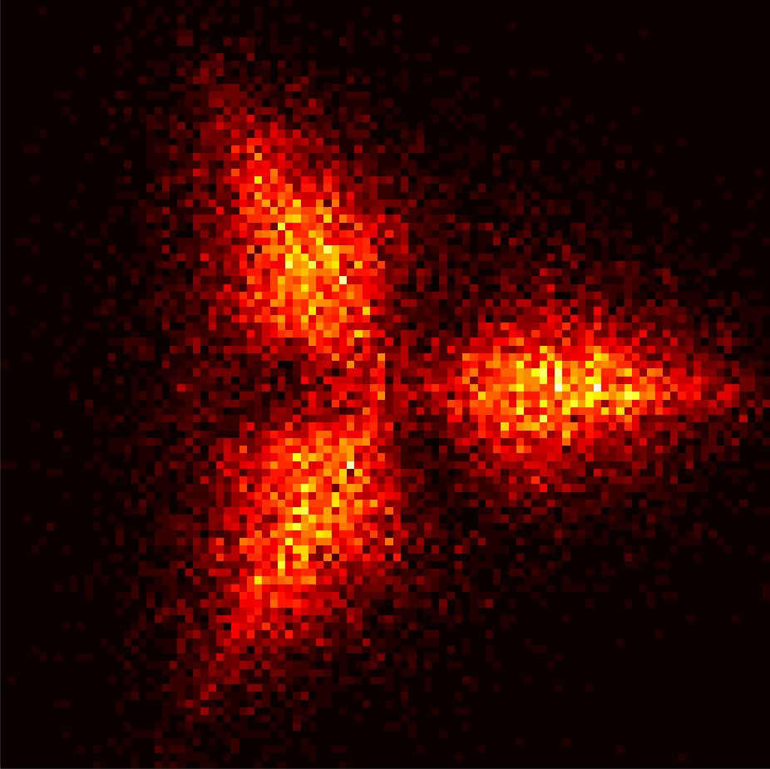
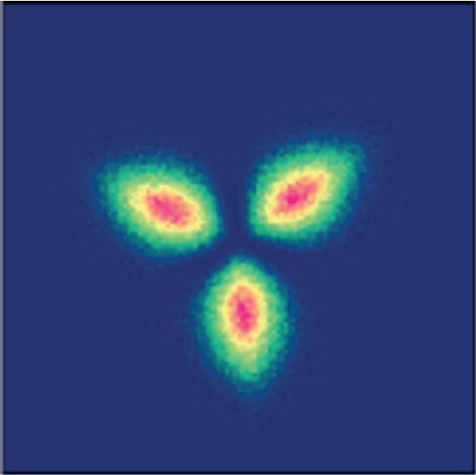
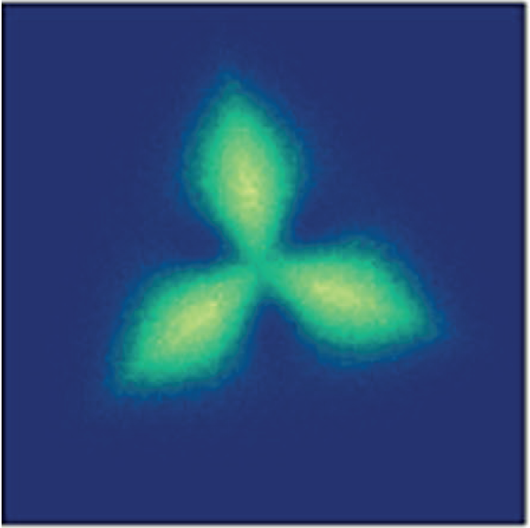
3+3 Pauli Crystal
Images of 3 identical Fermions after TOF:
Even without interactions correlations are present due to Pauli Principle
Atoms orient in “Pauli Crystals” in the 2D harmonic trap.
D. Rakshit et al., Sci. Rep. 7, 15004 (2017):
$$k_{B}T/ℏω=0$$
$$k_{B}T/ℏω=1$$

Slide 15
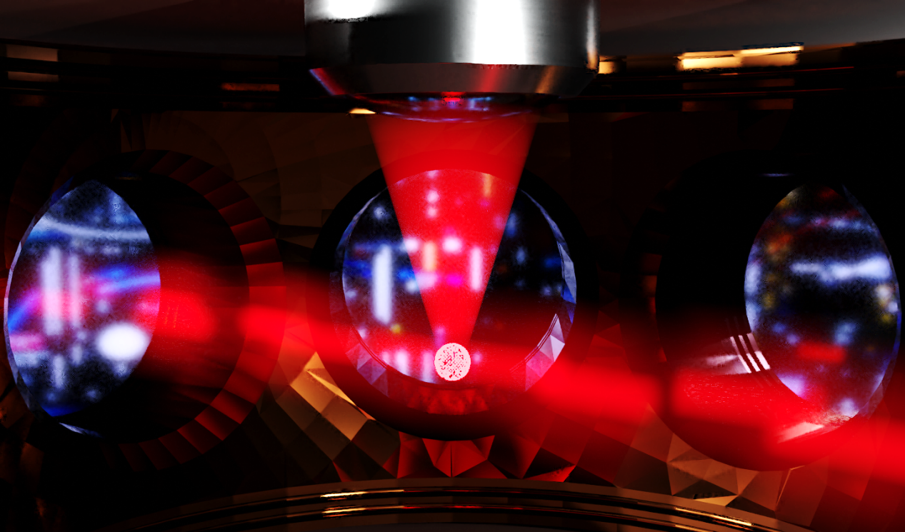
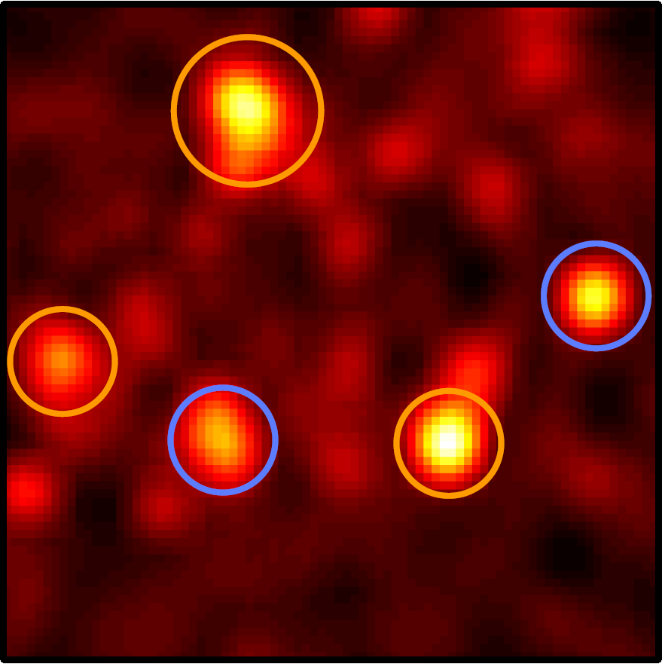
Momentum Correlations
M.G. Ries et al., PRL 114, 230401 (2015)
P.A. Murthy et al., Science 359, 6374 (2018)
Measurement of complete 2D momentum distribution after TOF:
Single Particle Resolved
Spin Resolved
Instantaneous switch to non-interacting system with microwave pulse
MH et al., PRL 121, 120401 (2018)
P.A. Murthy et al., Science 365, 6450 (2019)

Slide 16
The Team
PI:
Selim Jochim
Postdocs:
Philipp Preiß
Gerhard Zürn
Fermions in 2D:
Luca Bayha
Keerthan Subramanian
Few-Fermion Systems:
Jan-Hendrik Becher
Ralf Klemt
Ram-Janik Petzold
Thank you for your attention!
Visit us at: http://www.lithium6.de

Slide 17
Experimental Sequence

Slide 18
Pair Correlations

Slide 19
N=6 Dataset

Slide 20
N=12 Dataset

Slide 21
Experimental Apparatus

