Slide 1
Suggestion of a first Prototyp of the Central Space Frame

Slide 2
Contents:
1. Requirements
2. Material
3. Design
4. Conclusion

Slide 3
1. Requirements
Requirements:
CSF has to carry the STT, the MVD and possibly the DCDC and the GBT electronics
Electronic: ~180kg in its center of gravity 1506 mm upstream from the interaction point
STT: ~80kg
MVD: ~30kg
CSF has to fix the target pipe and the target cross
The volume of material has to be preferably low
The material of the frame should have a low density and a low nuclear charge number

Slide 4
2. Material comparision
Because of coast reasons and to be more flexible, for a first prototype we choose Aluminum instead of the carbon composite
material | Titan | Aluminum | CFRP (carbon composite)
density | 4,5 g/cm³ | 2,7 g/cm³ | ~1,6 g/cm³
nuclear charge number | 22 | 13 | 6*
young‘s modulus | 105 GPa | 70 GPa | ≥ 125 GPa

Slide 5
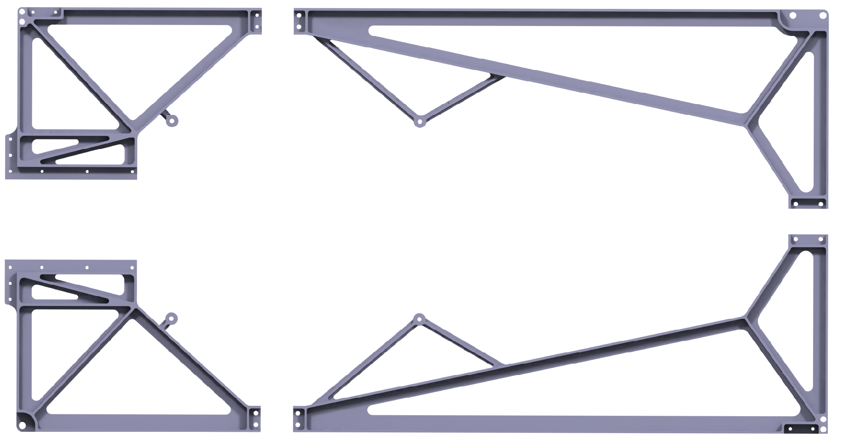
4. Extended design
the mainframe is made out of four main parts and six connectors.
main part 1
main part 3
main part 2
main part 4

Slide 6
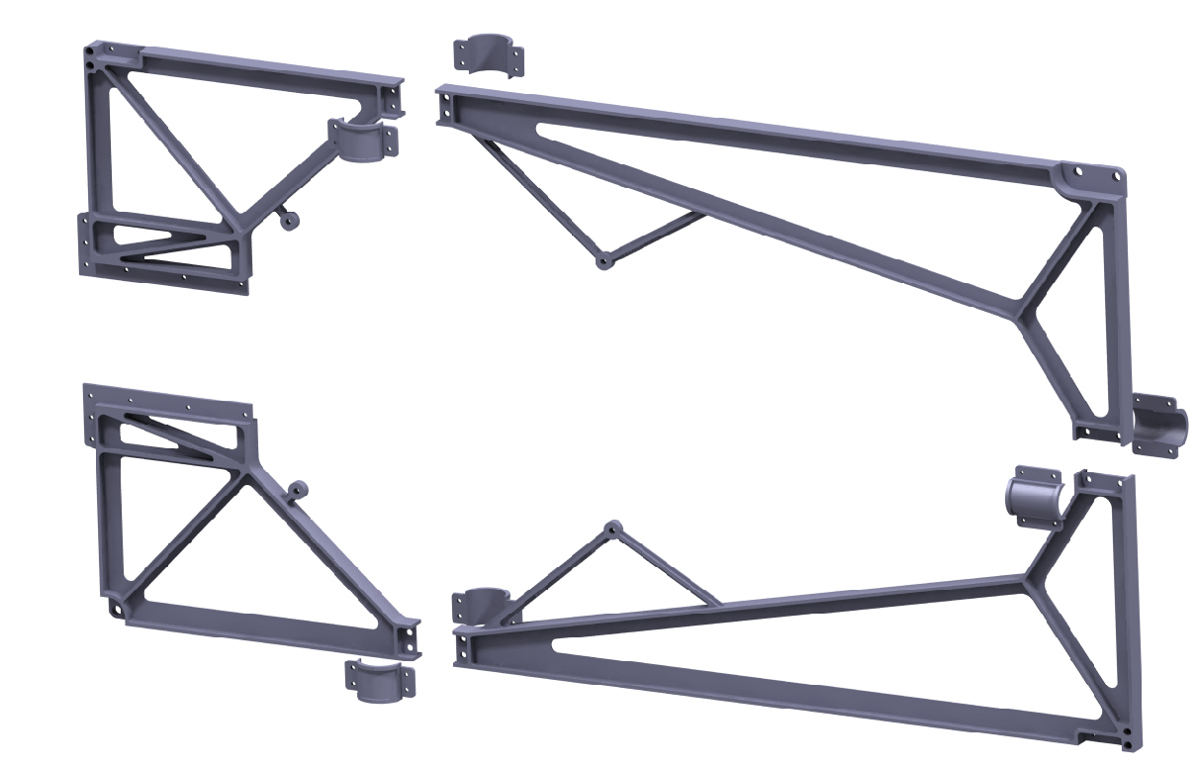
4. Extended design
the mainframe is made out of four main parts and six connectors.
connector 1
main part 3
main part 1
connector 2
main part 2
main part 4
connector 1

Slide 7
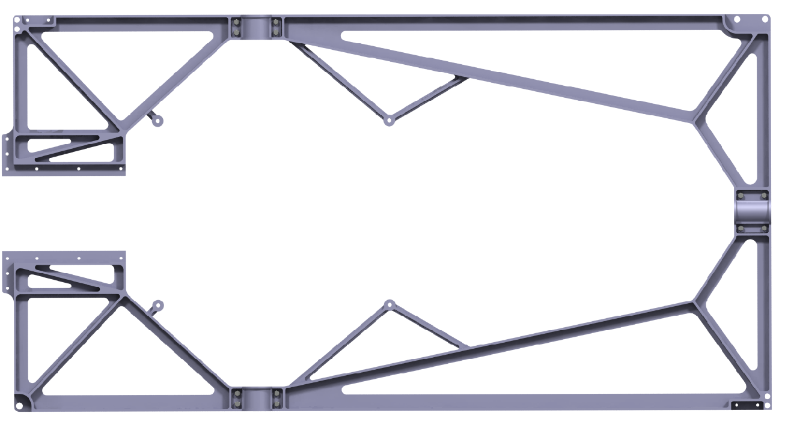
4. Extended design
the mainframe is made out of four main parts and six connectors.
main part 1
connector 1
main part 3
connector 2
connector 1
main part 2
main part 4

Slide 8
4. Extended design
the support structure is also made out of several parts.
- two ribs which are connected to a tube via screws
- two flanges with a wedge shaped geometry for fixing the target pipe
- two straps to connect the tube and the flanges
rib 1
flange
tube
strap
flange
rib 2
strap

Slide 9
4. Extended design
The two identical support structures will be attached to the mainframe via screws
Support structure
mainframe
Support structure

Slide 10
4. Extended design
In combination, the three components close the force flow and build a stiff and stable assembly.
mainframe
Support structure

