Slide 1
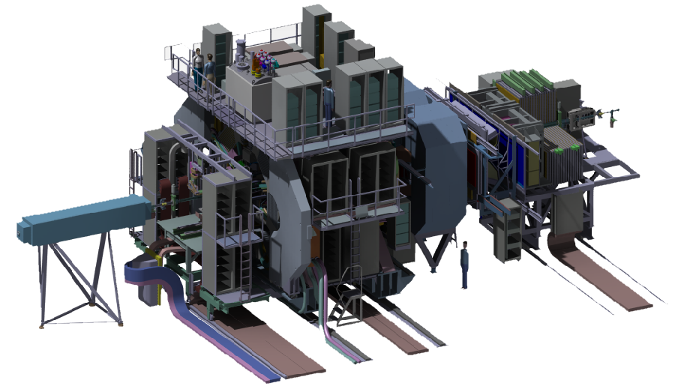
New concept for the Central Space Frame (CSF)

Slide 2
Contents:
1. Requirements
2. Material comparison
3. Overview of the first design
4. Advanced design and calculations
5. Conclusion

Slide 3
1. Requirements
Requirements:
CSF has to carry the STT, the MVD and possibly the DCDC and the GBT electronics
Electronic: ~180kg in its center of gravitiy 1506 mm upstream from the interaction point
STT: ~80kg
MVD: ~30kg
The volume of material has to be preferably low
The material of the frame should have a low density and a low nuclear charge number

Slide 4
2. Material comparision
The first step is a decision which materials are acceptable for this project.
In this presentation we focused on materials which make a good compromise between strength, stiffness, density and a low nuclear charge number.
A shortlist of suitable materials is shown in the following chart:
Material | Titan | Aluminium | CFRP (carbon composite)
density | 4,5 g/cm³ | 2,7 g/cm³ | ~1,6 g/cm³
Nuclear charge number | 22 | 13 | 6*
E-Modul | 105 GPa | 80 GPa | ≥ 125 GPa

Slide 5
2. Material comparision
Regarding to the requirement described, carbon composite seems to be the best choice for the central space frame. Special properties like radiation hardness have to be clarified.
Material | Titan | Aluminium | CFRP (carbon composite)
density | 4,5 g/cm³ | 2,7 g/cm³ | ~1,6 g/cm³
Nuclear charge number | 22 | 13 | 6*
E-Modul | 105 GPa | 80 GPa | ≥ 125 GPa

Slide 6
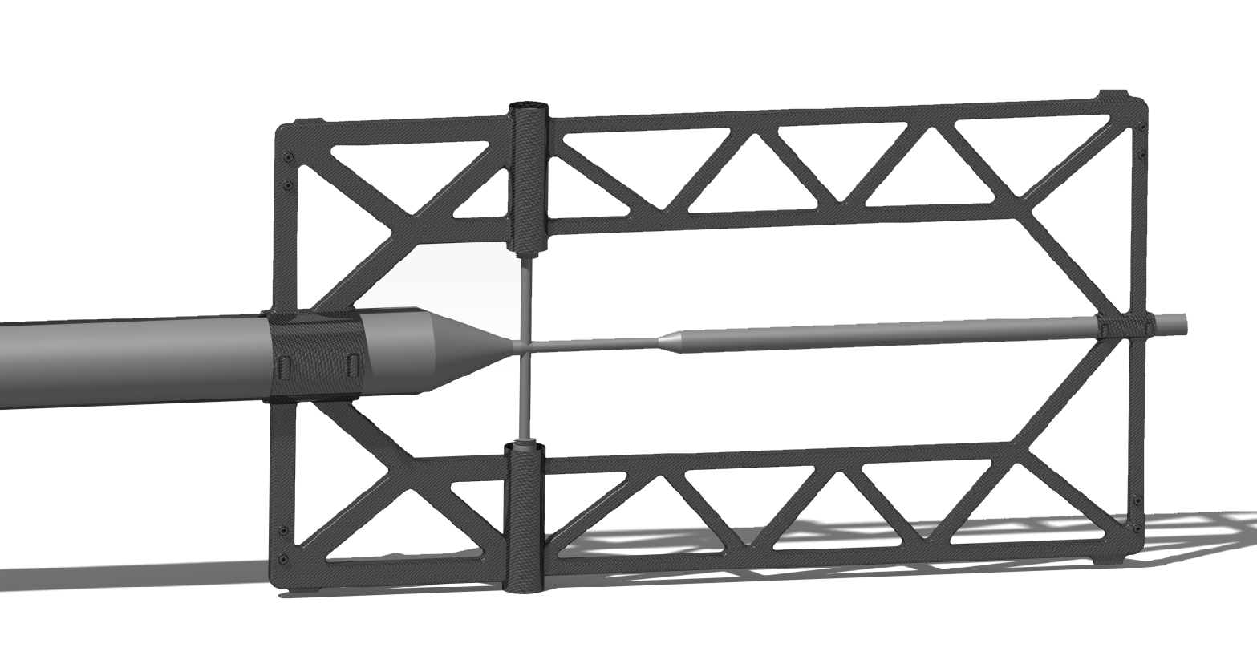
3. Overview of the first designs
Design 1: CFRP structure made of several tube segments
Y
Y
X
X
Z

Slide 7
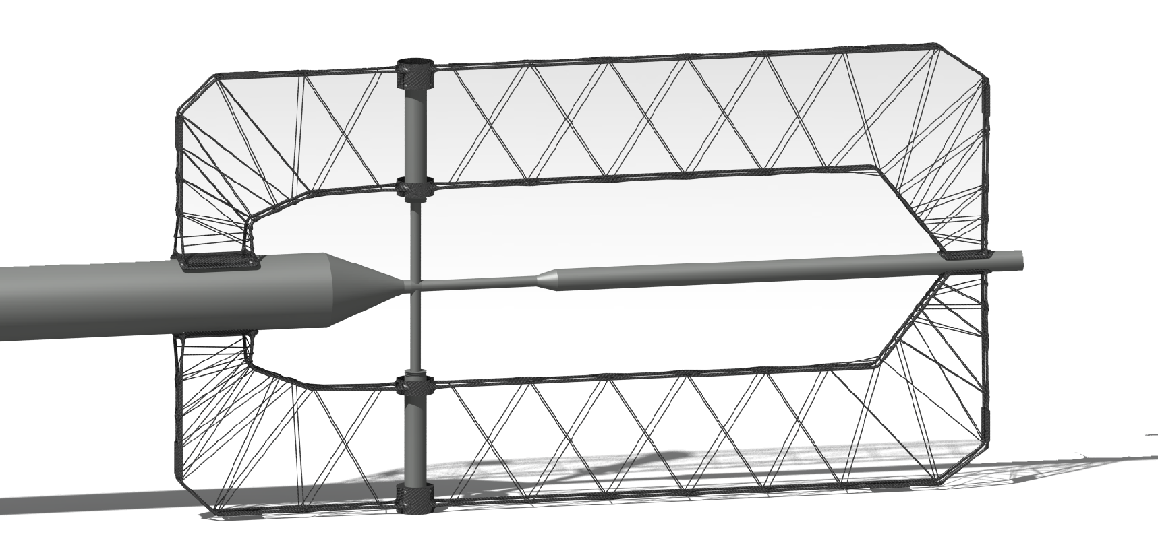
3. Overview of the first designs
Design 2: CFRP structure of tubes and fibers atached by a winding process
Y
X
Z

Slide 8
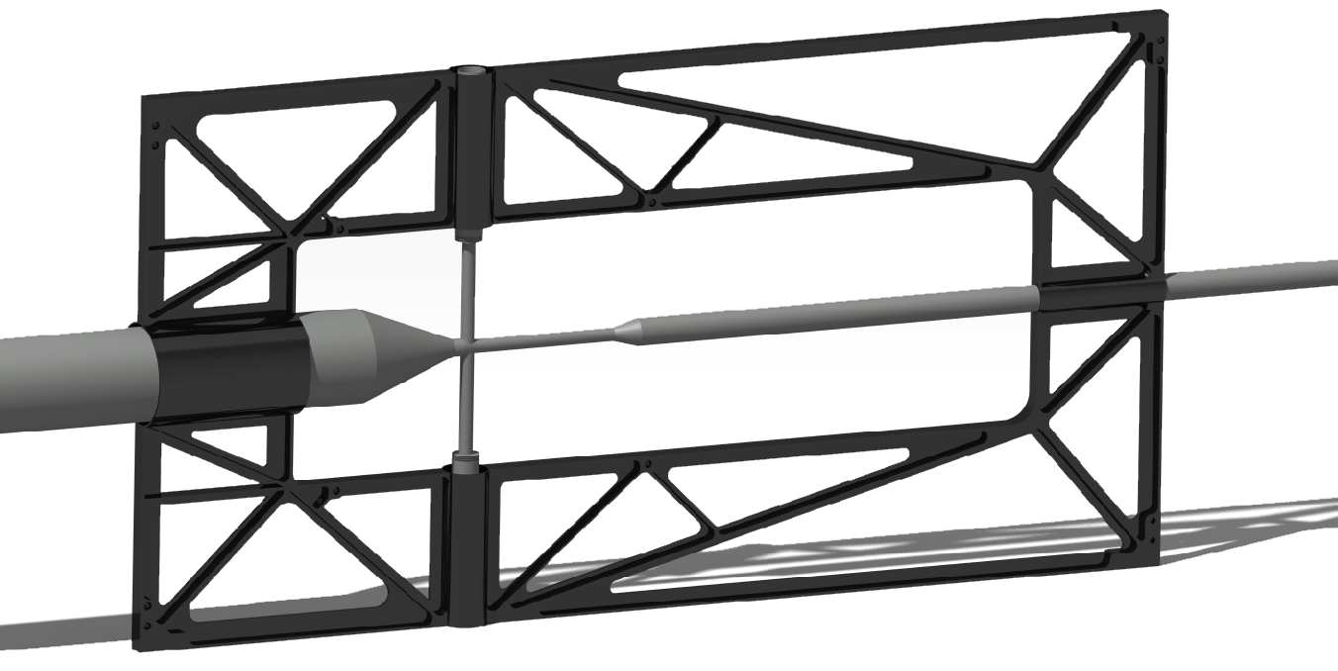
3. Overview of the first designs
Design 3: CFRP structure made by a laminate process, for example
Y
X
Z

Slide 9
3. Overview of the first designs
First conclusions:
Design 1 has to be split in the X,Z-plane so we are able to mount the target cross, which occupies some space in the area of coupling points which is reserved for the electronic for the inner detectors.
Regarding to a low material volume, a Frame like of Design 2 made by winding processes seems very useful. On the other hand, the stiffness and the strength of this construction depends a lot on the glue on the intersection points which is hard to calculate.
Design 3 is a good compromise between volume and stiffness. It gives us the opportunity to compensate the torque which is caused by the electronics of the inner detectors.

Slide 10
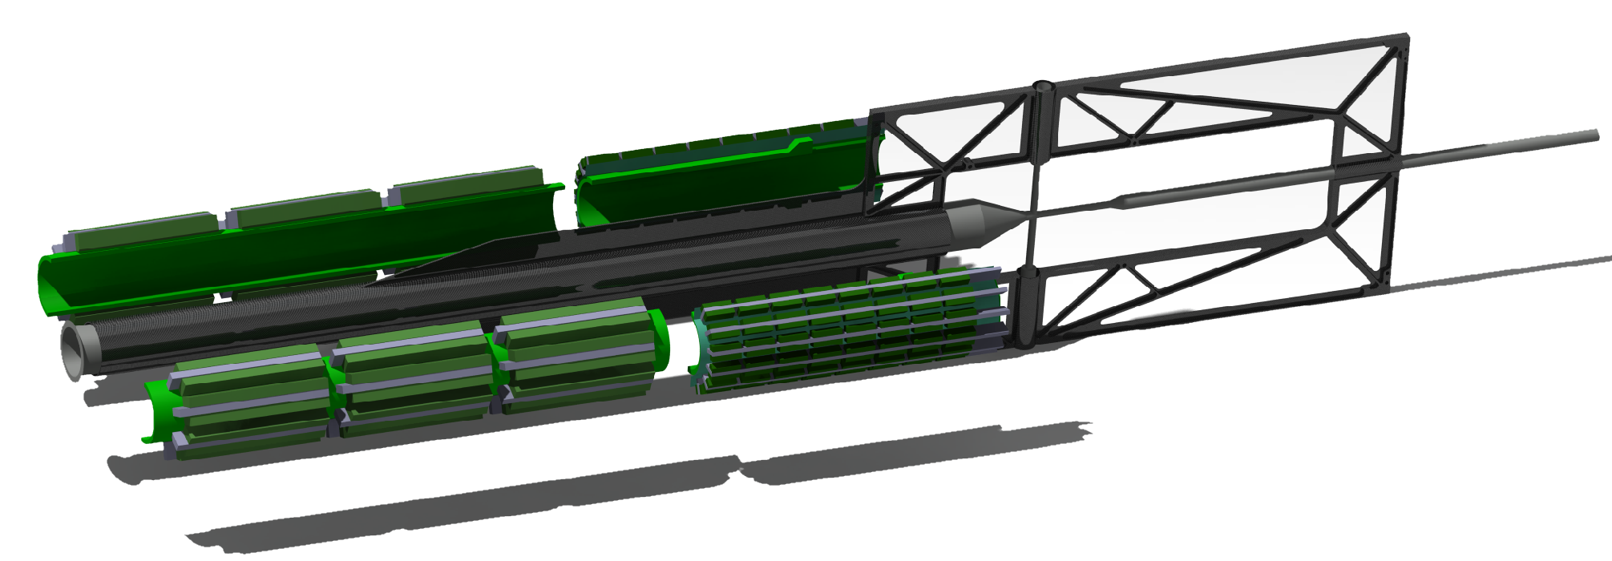
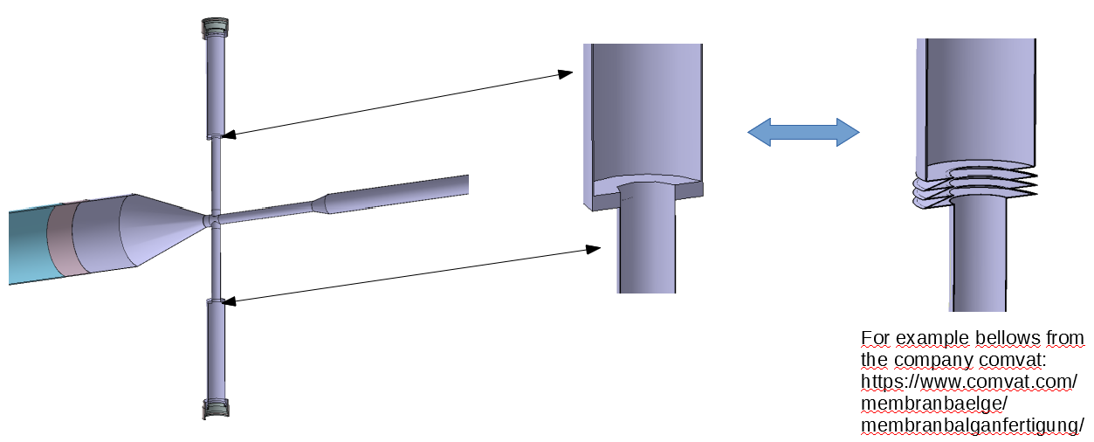
4. Advanced design and calculations
Suggestions:
1. An optimization of design 3 in combination with an aditional support structure for the electronics. It could release the beampipe of the critical torgue without any further needs for suspensions during transport or mounting.
2. With two bellows perpendicular to the target pipe, instead of the current welded flange, critical stresses in the target cross could be avoided.

Slide 11
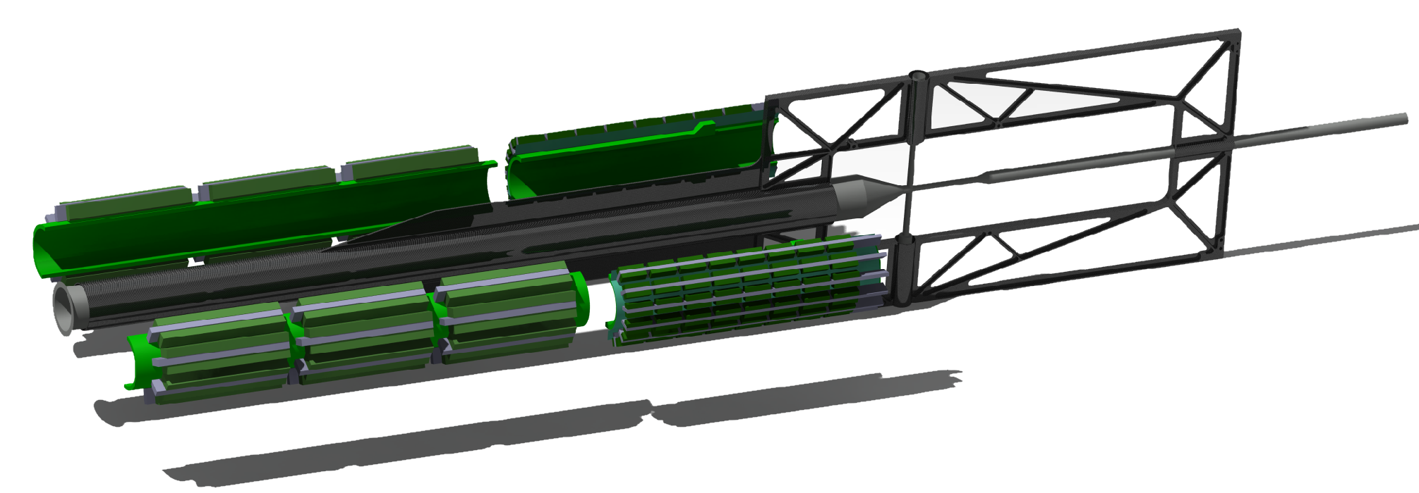
4. Advanced design and calculations
Suggestion 1:
An optimization of design 3 in combination with an aditional support structure for the electronics. It could release the beampipe of the critical torque without any further needs for suspensions during transport or mounting.
CSF
Target pipe
DCDC converter
Support structure
GBT‘s

Slide 12
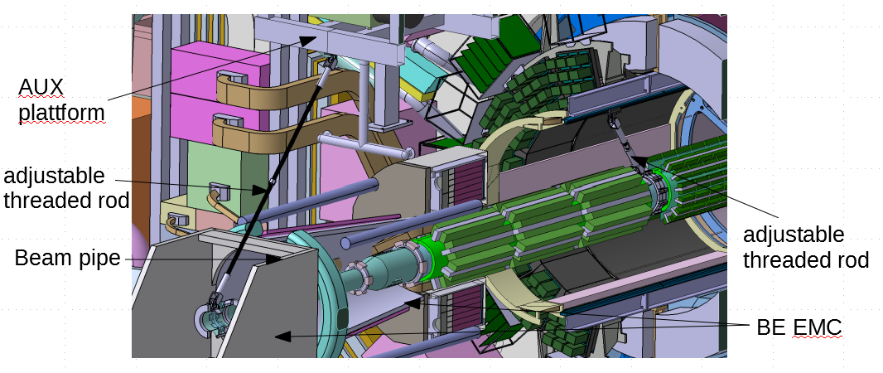
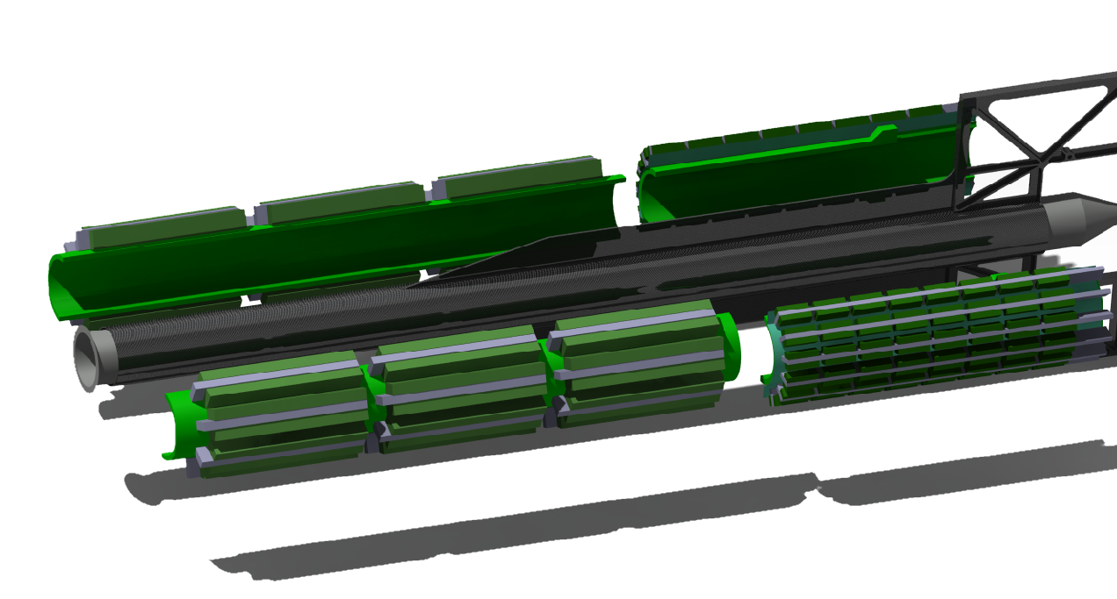
4. Advanced design and calculations
Suggestion 1:.
Old concept
New concept

Slide 13
4. Advanced design and calculations
The following boundary conditions were used for a first fem analysis:
Fixed bearing
Moveable bearing
CSF
Electronics~1800N
Half STT~400N
Target pipe
MVD~300N
1506 mm
Half STT~400N

Slide 14
4. Advanced design and calculations
The following boundary conditions were used for a first fem analysis:
For the CFRP structure, a Young‘s modulus of 150 Gpa was assumed, which complies to a commercial carbon fiber composite property.
The target pipe is supported by two holding structures in the support structure. Later, the interface could be realized via wedge-shaped half-shells, which push the pipe against the support structure.

Slide 15
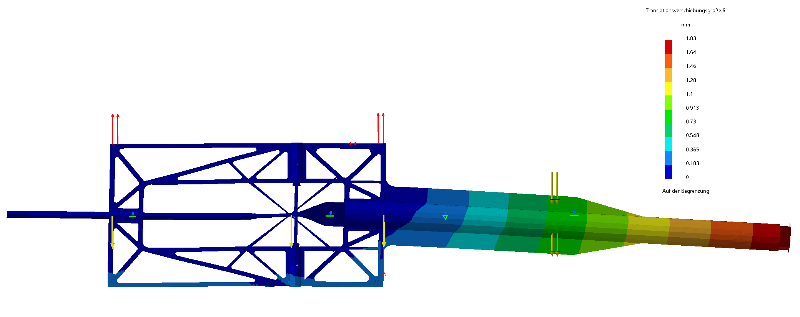
4. Advanced design and calculations
The first calculation shows low displacements with a maximum of ~1,9mm at the end of the support structure.
The space between the BW-EMC and the rip of the support structure is 10 mm( inner diameter of BW-EMC assumed to be 360 mm), so this value is uncritical.
(deformations with factor 80 shown)

Slide 16
4. Advanced design and calculations
Furthermore, the calculation shows that the stress in the frame is very low with a maximum of about 40 MPa, what is uncritically for CFRP structures(for example M35J with an flexural Young‘s-modulus of 169 Gpa, flexural strength of 1650 MPa and 90° tensile strenght of 69 MPa).
That gives us the oppurtunity to further minimize the volume.
(deformations with factor 80 shown)

Slide 17
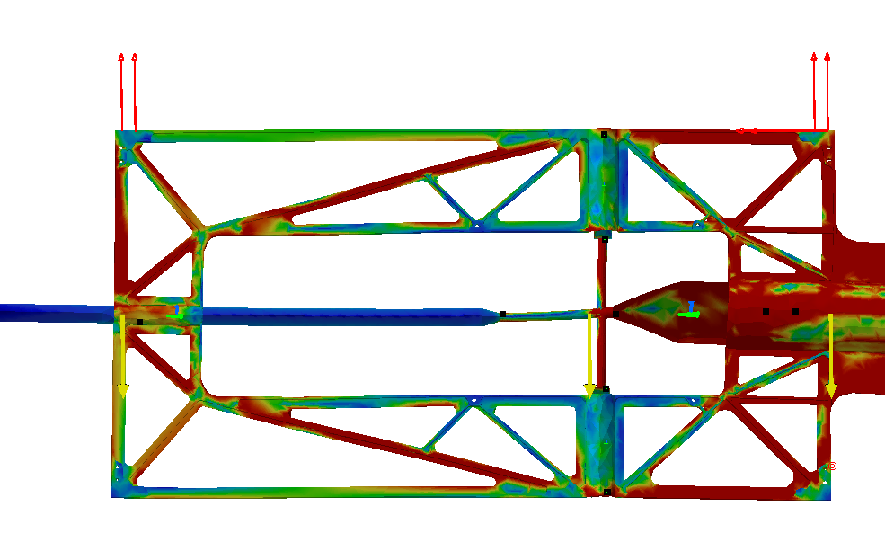
4. Advanced design and calculations
By lowering the display to low values regarding to the stress, we can see that some areas of the frame are just minimal loaded.
So these areas gives us the possibilities to reduce material, what is important for the later measurements in the experimental phase.
Stress distribution
in the component

Slide 18
4. Advanced design and calculations
After that, the model was adjusted with respect to the calculation, to reduce the mass in the target area.
First design
Advanced design with less mass

Slide 19
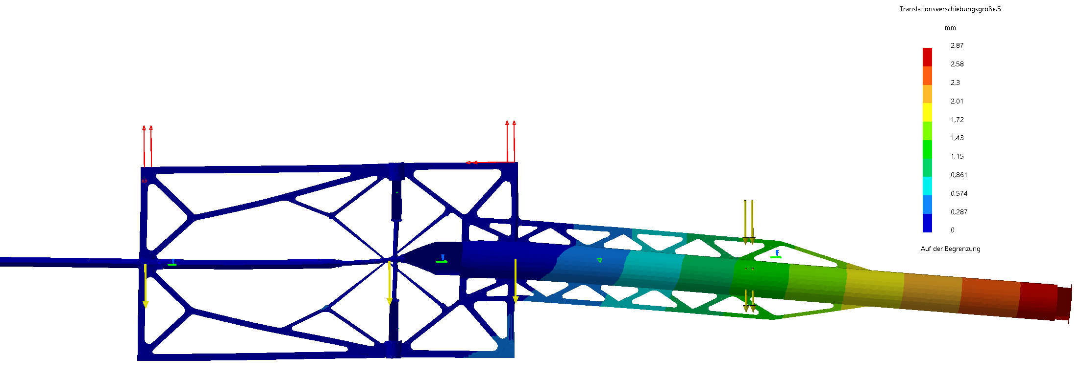
4. Advanced design and calculations
The calculation of the new design shows displacements with a maximum of ~2,9 mm at the end of the support structure, which is still ok regarding the space between the BW-EMC and the support structure (outer diameter of the support rib is 340 mm, inner diameter of the BW-EMC is 360mm).
(deformations with factor 80 shown)

Slide 20
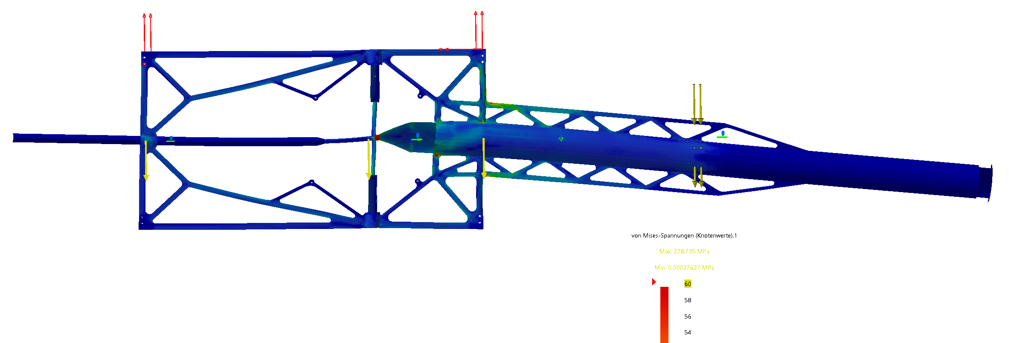
4. Advanced design and calculations
In the advanced design the stress in the frame with a maximum of about 60 MPa is still low. This is uncritical compared to the properties of the composite of the carbon fiber M35J for example(with flexural strength of 1650 MPa and 90° tensile strenght of 69 MPa). In manufacturing we will make sure that the axis of the maximum stress are nearly in direction of the fiber orientation.
(deformations with factor 80 shown)

Slide 21
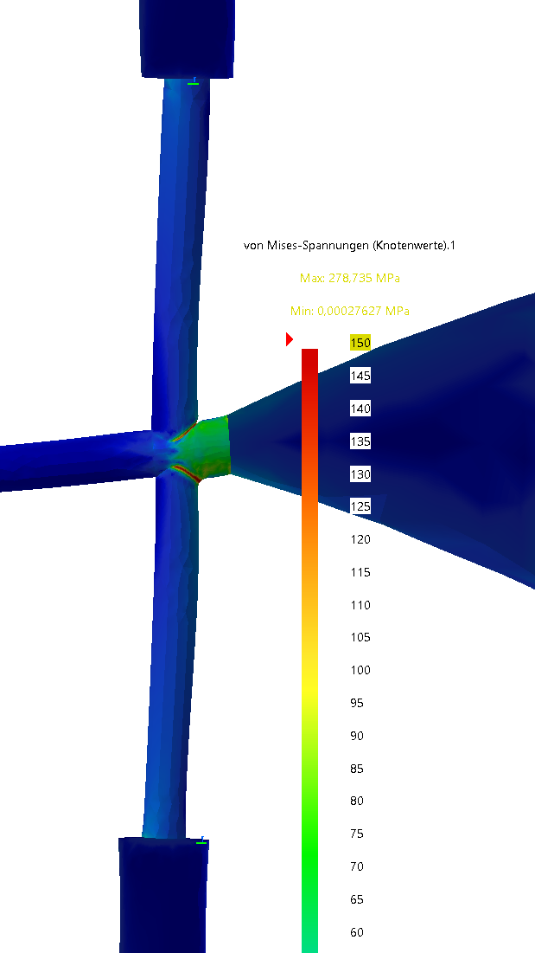
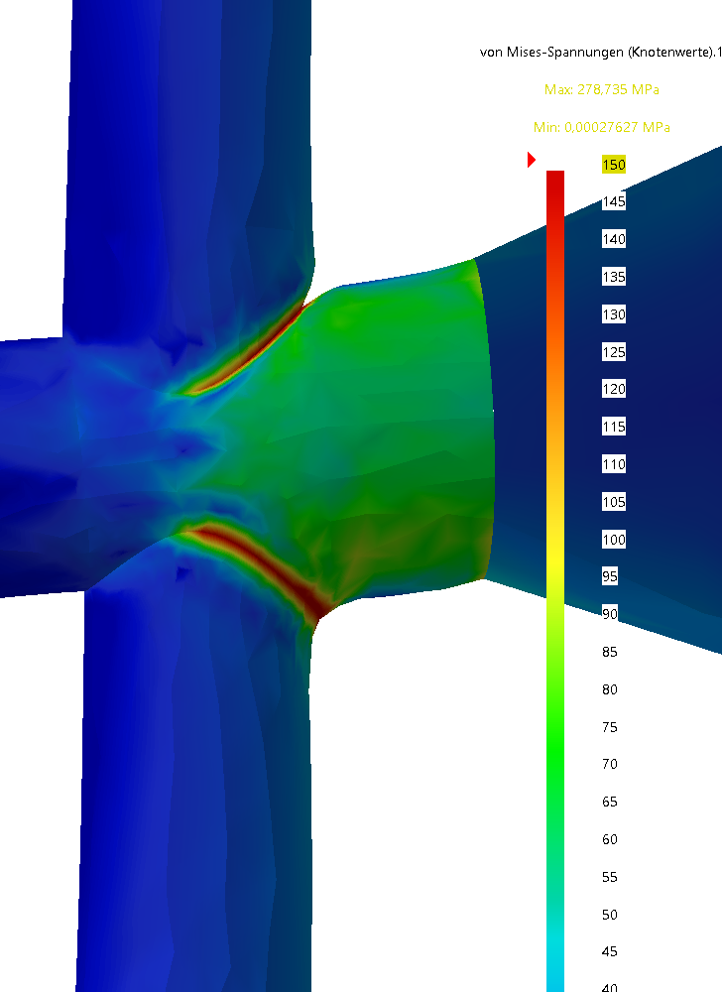
4. Advanced design and calculations
The stress in the cross section of the target pipe shows high local values from 150 MPa up to a maximum of about 280 MPa in the edge, and global stresses up to 60 MPa. The high stresses depend on the final geometry of the weld and could be much lower. Nevertheless that is a potential risk.
(deformations with factor 80 shown)

Slide 22
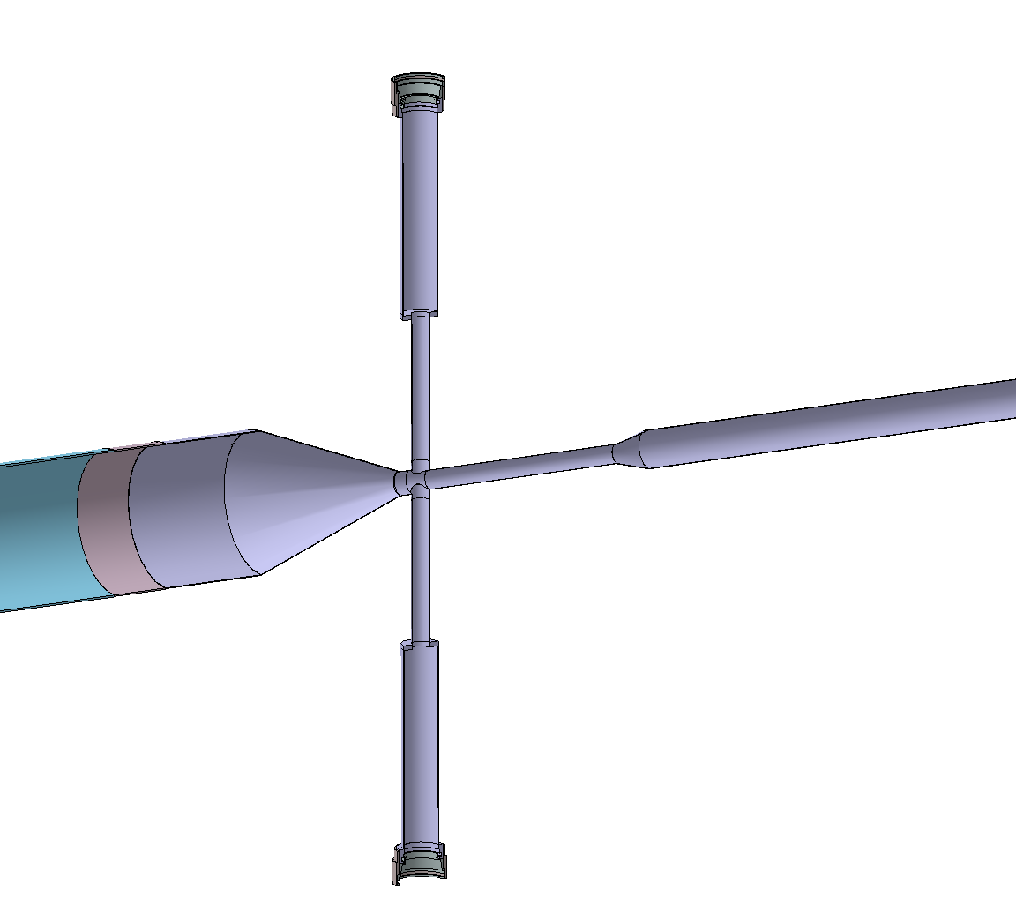
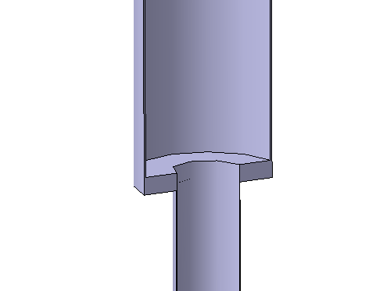
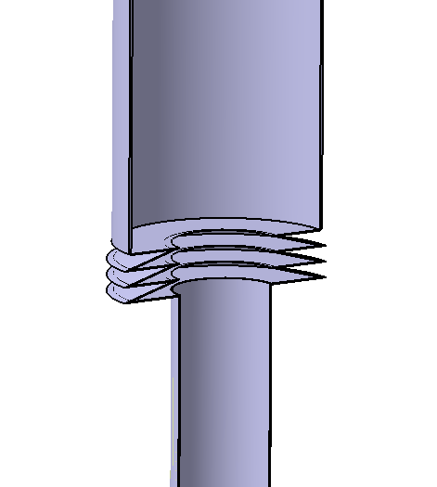
4. Advanced design and calculations
Suggestion 2:
With two bellows perpendicular to the target pipe, instead of the current welded flange, critical stresses in the target cross could be avoided.
For example bellows from the company comvat:
https://www.comvat.com/membranbaelge/membranbalganfertigung/

Slide 23
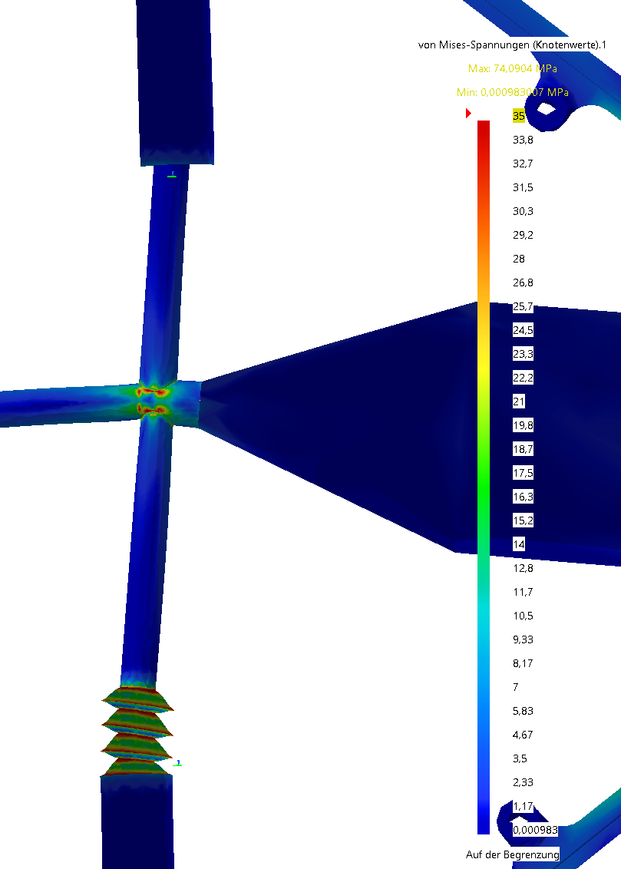
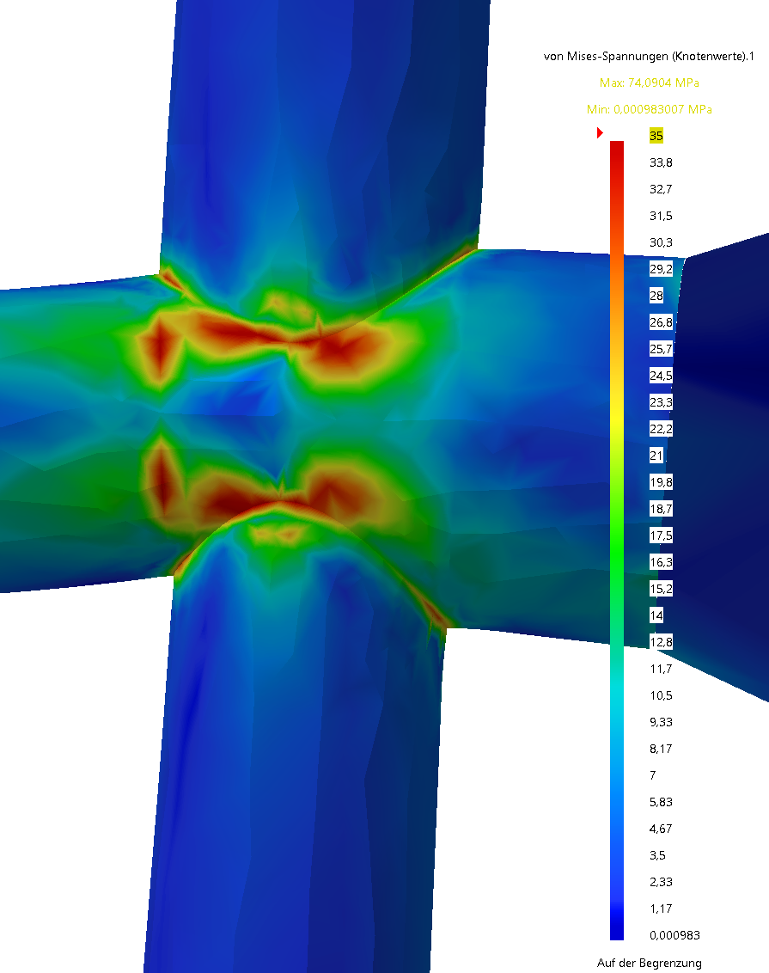
4. Advanced design and calculations
In combination with two bellows, the maximum stress is not longer in the cross. The Von-Mises stress in the cross itself is about 35 MPa, which is much lower than the proof stress of 270 MPa of titan like TiGr.2,for example. Yet such an interface of bellows is recommandable, because it will compensate lower displacements while mounting and transporting the target pipe which cause high stresses in basis of the huge lever to the target cross section.
(deformations with factor 80 shown)

Slide 24
4. Advanced design and calculations
The following pictures shows a more advanced design of the concept with two combined sections of CSF and the support structure, splitted in the Y,Z-plane of the target cross.
Y
Y
X
CSF
X
Z
support structure
Target pipe

Slide 25
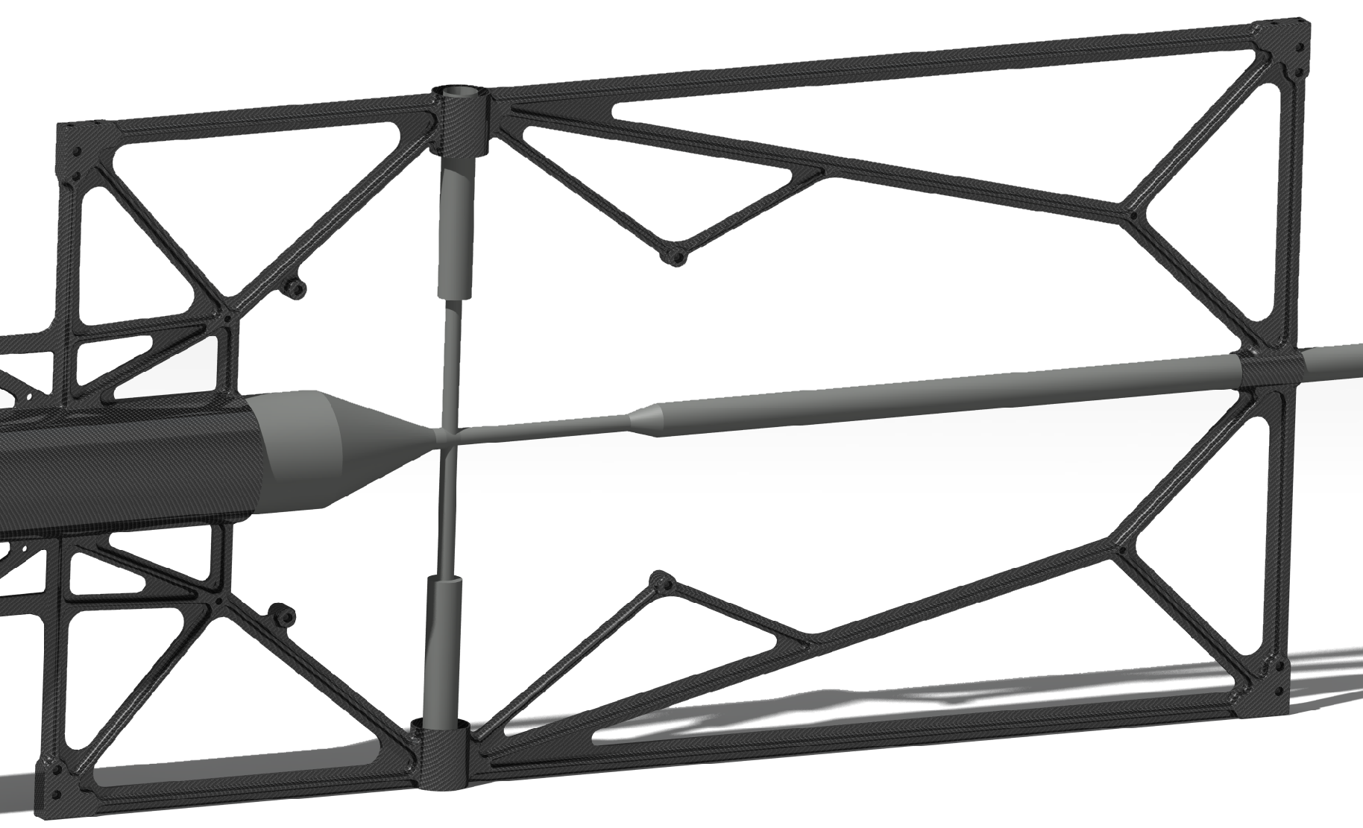
4. Advanced design and calculations
Anchorpoints
for the STT
Connection for the bayonet
Anchorpoints
for the STT
Anchor points for the MVD
Connection for the bayonet
Anchorpoints
for the STT
Anchorpoints
for the STT

Slide 26
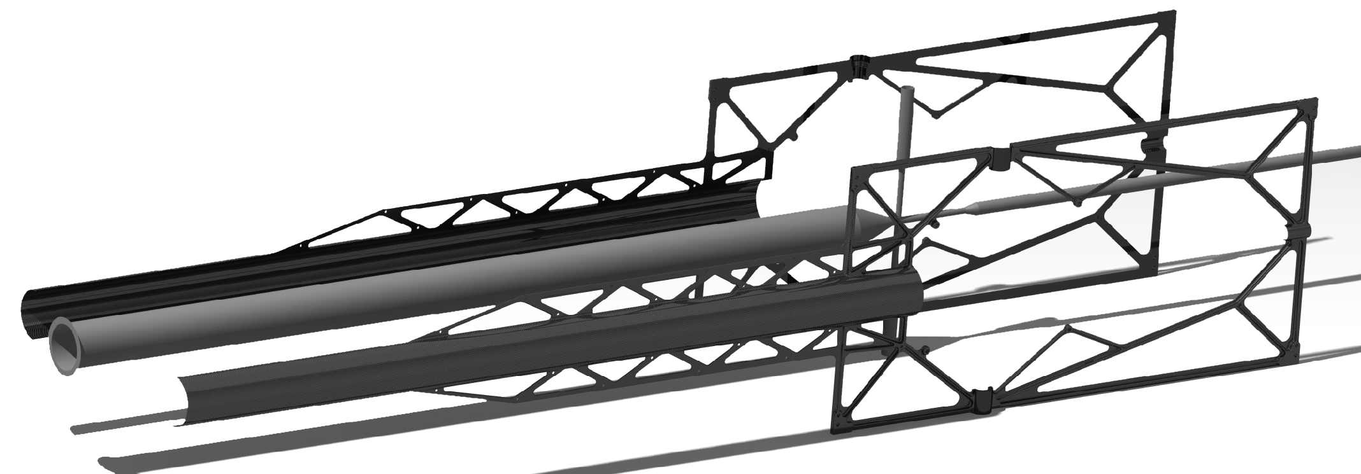
4. Advanced design and calculations
The CSF and the support structure will be made of two separate symmetric halves, to be connected in the Y,Z-plane of the target cross. The two halves will be attached together with screws and the roller skates of the rails of the Barrel DIRC. The details are not final jet and not shown in this presantation.
CSF left
Target pipe
CSF right

Slide 27
4. Advanced design and calculations
The following pictures shows some dimensions of the CSF, final dimensions have to be clarified when the other boundary conditions are clear.
3935
836
1620
ᴓ156
340

Slide 28
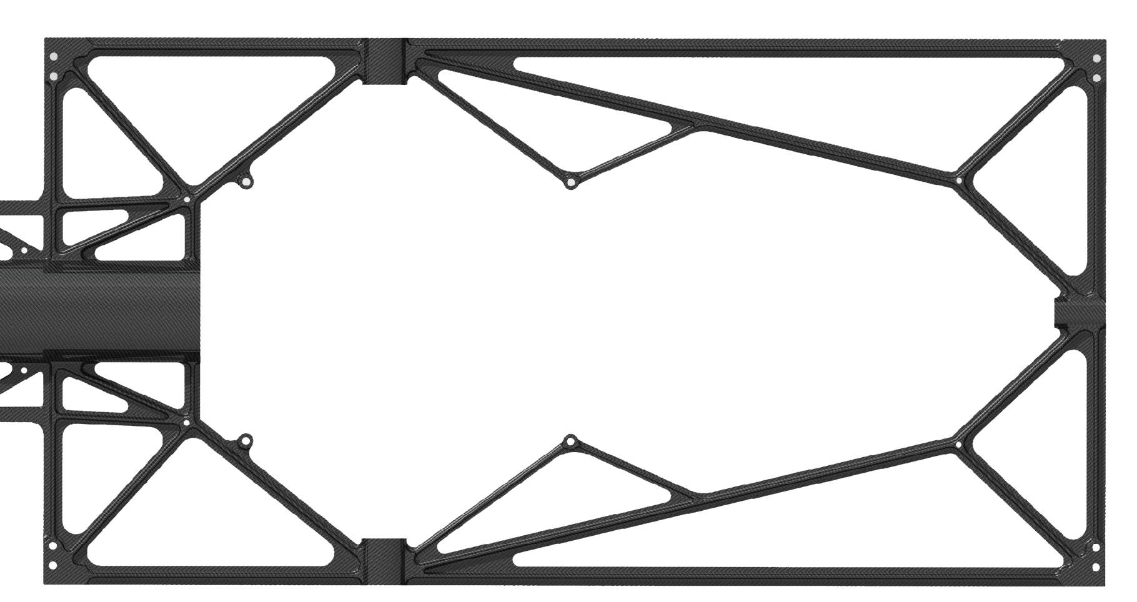
4. Advanced design and calculations
The following pictures shows some dimensions of the CSF, final dimensions have to be clarified when the other boundary conditions are clear.
1620
(211)
284
1620
395
836

Slide 29
4. Advanced design and calculations
The weight of the whole structure is about 13 kg, 6,7 kg for the CSF area, and 6,3 kg for the area of the support structure. The volume and the mass of a later and more final design, of course, could change, but the first design shows that such a concept make of carbon fiber composite makes a good compromise between high Young‘s modulus and strenght relating to a low mass and volume.
6,7 kg
6,3 kg

Slide 30
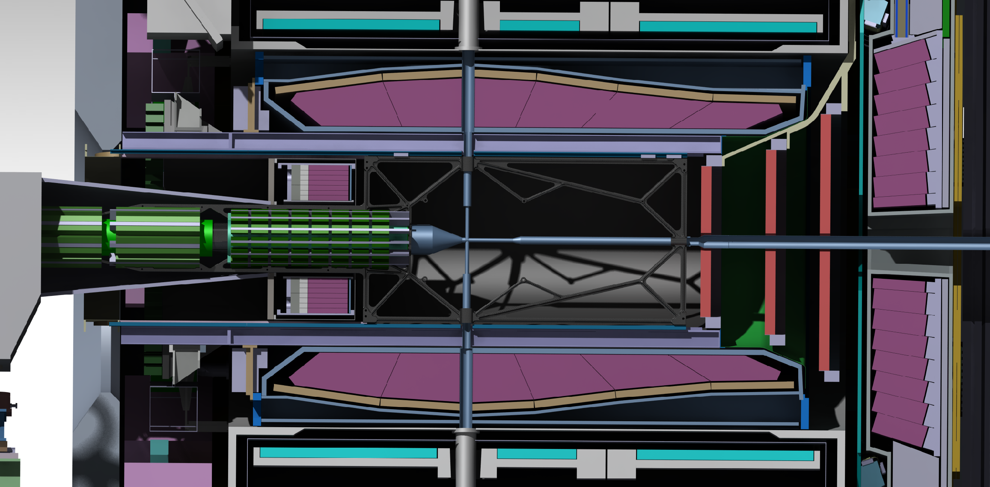
4. Advanced design and calculations
The last two pictures shows the CSF at its later position in the target spectrometer with and without the electronic, which will be attached to the support structure.

Slide 31
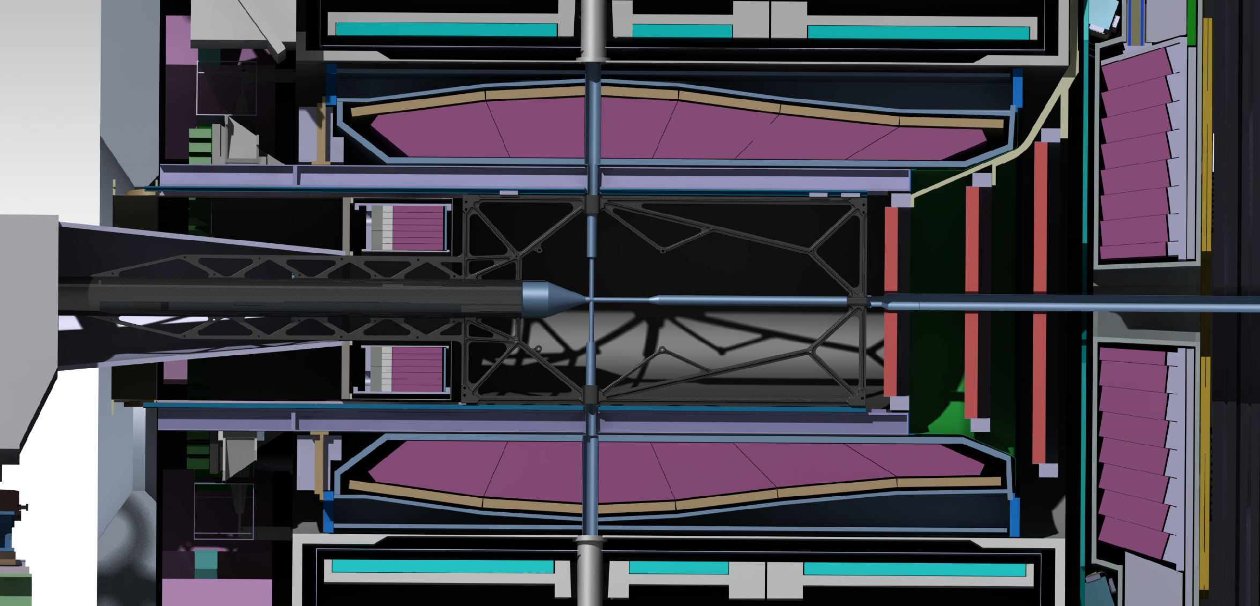
4. Advanced design and calculations
The last two pictures shows the CSF at its later position in the target spectrometer with and without the electronic, which will be attached to the support structure.

Slide 32
5. Conclusion
pros | cons
Target pipe will not be loaded by the electronic | The diameter of the target pipe has to be reduced from 150 mm to 140 mm(in the area of the support )
There is no need for suspensions during the mounting of the detectors | The CSF would be more complex regarding to the additional structure
No temporary suspension rods are necessary while installation the BW EMC in the spectrometer
There is a lower risk to cause damage to the target pipe, while exchange the suspensions for example
We need no welded anchor points on the target pipe for suspensions for the electronics
There is the possibility to adjust the beam pipe over mounts in the cfk support structure(when necessary)

