Slide 1
Theory View on Hyperon-Hyperon Interactions from Correlations
Kenji Morita
National Institute for Quantum and Radiological Science and Technology (QST), Rokkasho Fusion Institute, Japan
RIKEN Nishina Center
Contents
Introduction
What we’ve done and learned
What we should do next

Slide 2



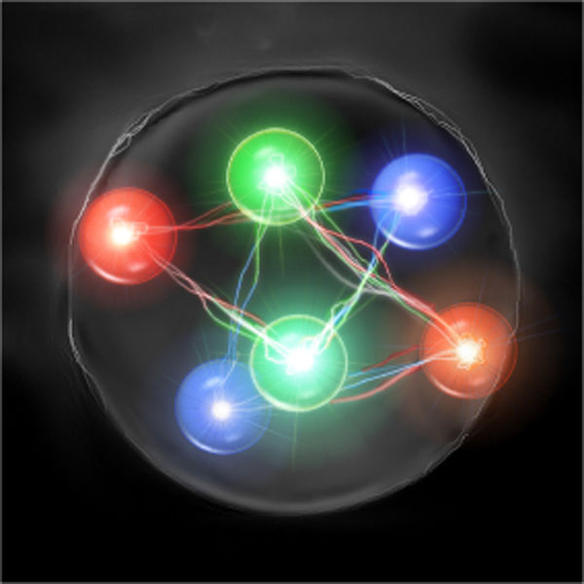
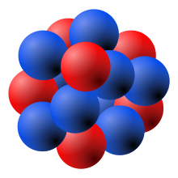
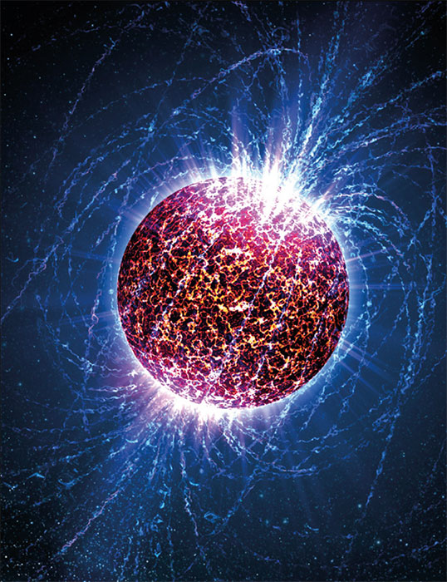
Hadron-Hadron Interaction
QCD at Low Energy
Chiral Symmetry Breaking
Confinement
u
s
Rich for NN system
Limited for strangeness
u
d
s
s
Theory: Lattice QCD
ChEFT
Various Models
Scattering Experiments
Spectroscopy
Inputs to Many-body hadronic systems
Λ

Slide 3
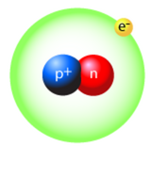
Dibaryons: Simplest BB systems
Deutron (Urey et al., 1931)
With hyperons? ----------
Flavor SU(3) classification predicts some channels with no Pauli blocking
u
u
s
d
u
d
s
e.g., NΩ (J=2)
s
s
s
u
s

Slide 4
Lattice QCD Studies by HAL QCD Coll.
s
s
S=-6 : Ω-Ω (J=0)
28-plet in SU(3)
s
s
s
s
u
S=-3 : N-Ω (J=2)
8-plet in SU(3)
s
u
d
d
s
u
S=-2 : N-Ξ (I=0, J=0)
part of “H”
singlet in SU(3)
s
d
Show strong attraction at almost physical quark masses
Experimental Confirmation – Pair Correlation in pp,pA and AA

Slide 5
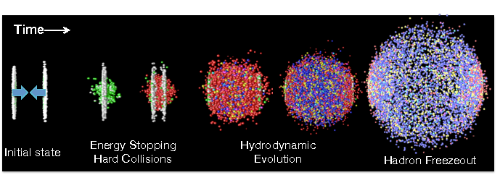
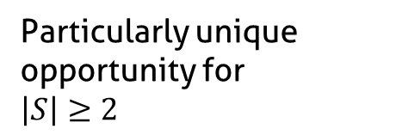
High Energy Nuclear Collisions as Hadron Factory
Production of Quark-Gluon Plasma
Crossover Transition Into Hadron Particle Abundance – Thermal Eq.
π
N
π
Λ
Expanding Medium
π
Ω
Ξ
π
Two-particle FSI
at freeze-out
K
N
π
p
K
Particularly unique opportunity for
$$\left|S\right|≥2$$
π

Slide 6
Two-Particle Correlation
Momentum in pair rest frame
Measuring Pair Correlation
→Constrain Pairwise Interaction
No Correlation
Interaction
Interference
etc

Slide 7
Two-Particle Momentum Correlation
(# of pair) = (integration over relative distribution x weight factor)
Random emission from the “Smooth” Source
Constrained from y, p_{t} spectrum etc
Non-relativistic scattering wave function
FSI and (a)symmetrization (for identical pairs)
More rigorous formula found in Anchishkin, Heinz, Renk, PRC57 (’98)

Slide 8
What we learned:
How to distinguish the nature of the interaction and existence of the bound state

Slide 9
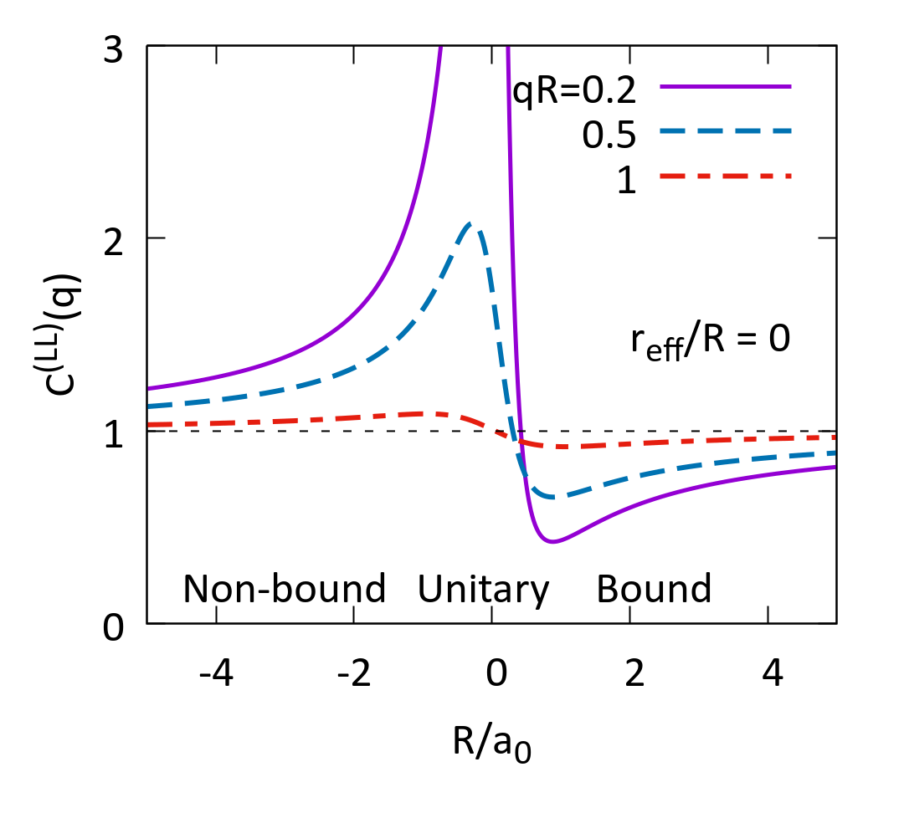
Correlation from FSI
Static/Spherical Source
Lednicky+ ‘82
Assumptions
  Gaussian Source
  Asymptotic w.f.
  Effective range formula
Results
  C(q) = C(qR, R/a₀) for r_{eff}=0
  System size dependence – Characterized by the scattering length a₀

Slide 10
Recipe for Identifying Nature of Interaction
KM+ ‘19 (PRC in press)
“Small” (R≪a₀) system :
  always enhanced C(q) at small q
Increasing R
If a bound state exists, depletion of C(q) below 1 should be seen
“Large” (R≫a₀) system:
  Small deviation from non-FSI case

Slide 11
What we learned:
Other sources of the correlation
HBT / Resonance / Coulomb

Slide 12
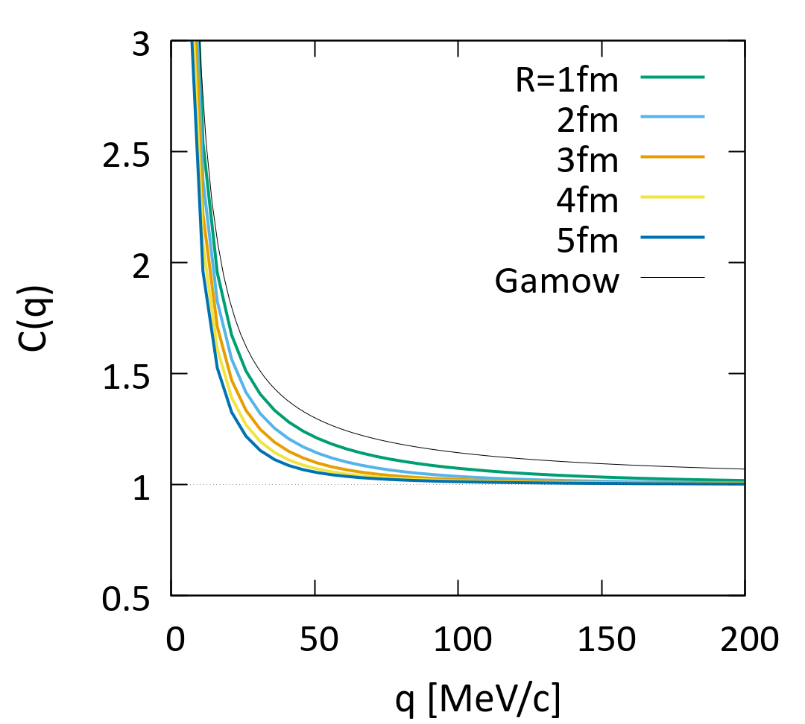
Coulomb Interaction
Long-range attraction or repulsion
Coulomb Interaction Only!
N-Ω reduced mass
Gamow factor: overcorrection
Much less size dependent
Large R
The Small-Large Ratio
KM+, PRC’16
Extract strong interaction!

Slide 13
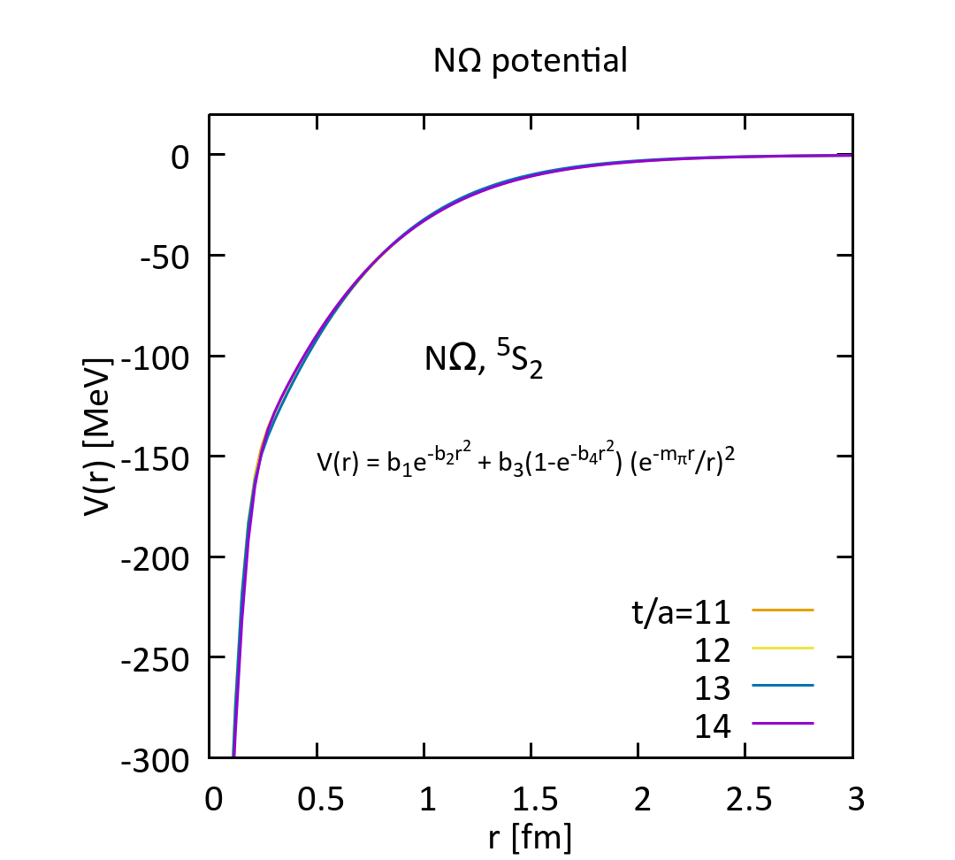
Example : pΩ Correlation
Theory : HAL QCD potential + Expanding Source model
Constrained by single-particle distribution
proton HBT radii
a₀ =3.38fm r_{eff} =1.31fm E_{B} =2.27MeV (t/a=12)

Slide 14
Example: pΩ Correlation
KM+ ‘19 (PRC in press)
40-60% Bound regime
60-80% Unitary regime
pp unitary measured: Need HI to confirm bound regime (STAR, but more statistics!)

Slide 15
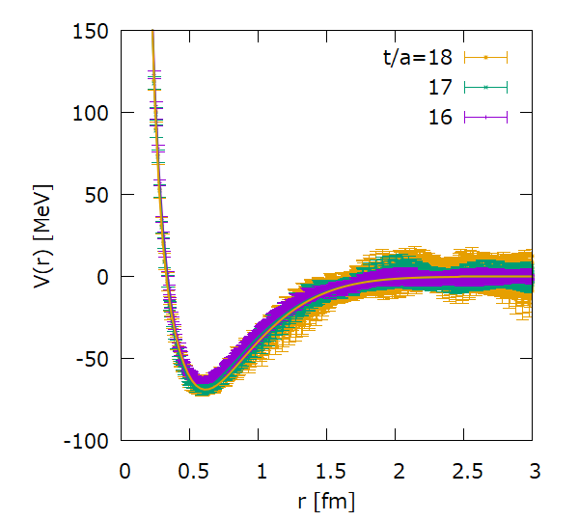
ΩΩ (S=-6) : Coulomb+HBT+Unitary
¹S₀ bound state from Lattice QCD
Gongyo+, (HAL QCD), PRL’18
m_{π}=146MeV, m_{Ω}=1713MeV
+Coulomb repulsion
t/a | a₀ [fm] | r_{eff} [fm] | E_{B} [MeV]
16 | 65.3 | 1.29 | 0.1
17 | 17.6 | 1.23 | 0.5
18 | 11.7 | 1.21 | 1.0
Unitary regime in typical source size for HIC

Slide 16
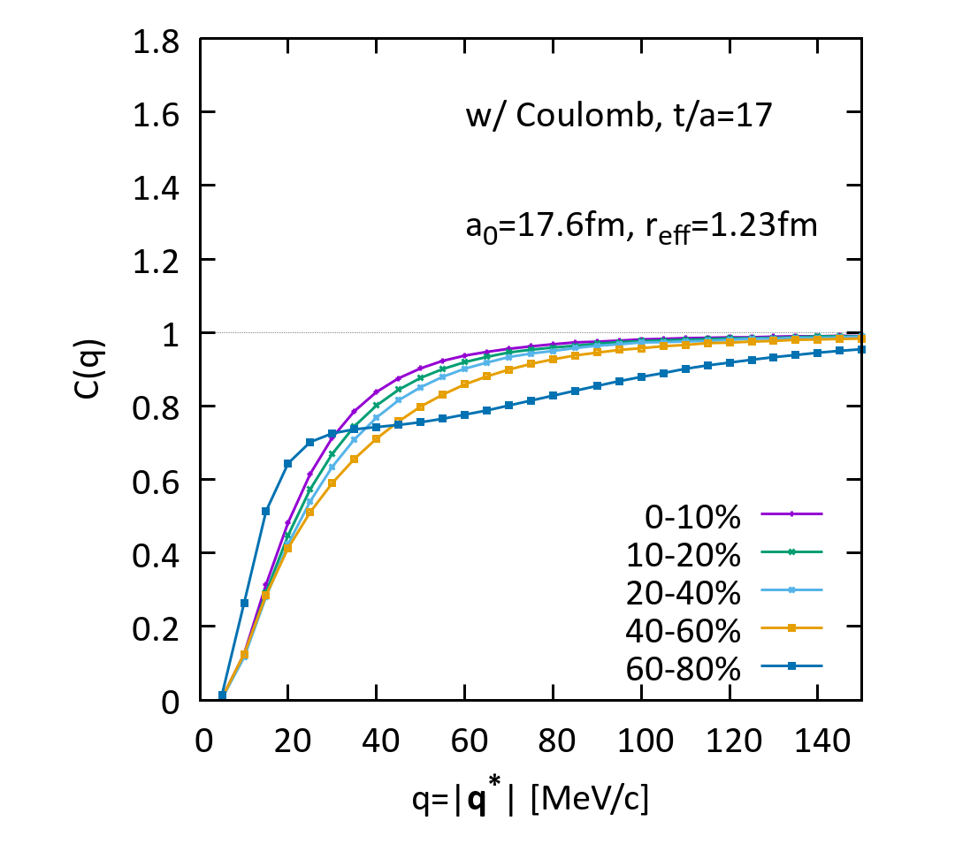
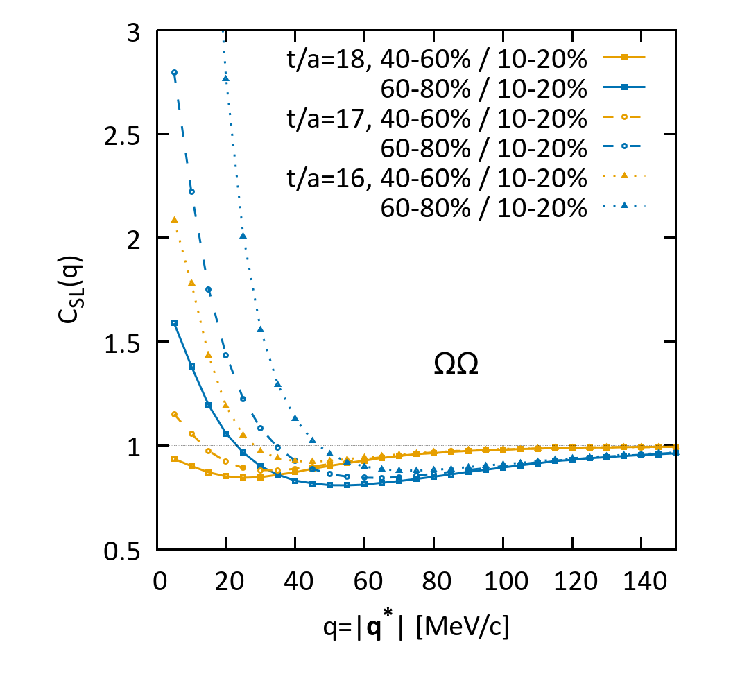
ΩΩ Correlation: Coulomb+HBT+Unitary
HBT gives suppression of C(q) for larger system
Small spin-0 contribution : unseen in C(q) despite large a₀
Highly challenging: statistics of di-Omega events
Too large system required for bound regime

Slide 17
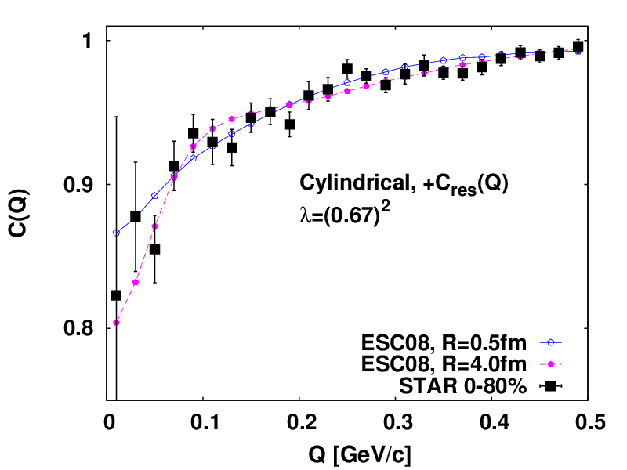
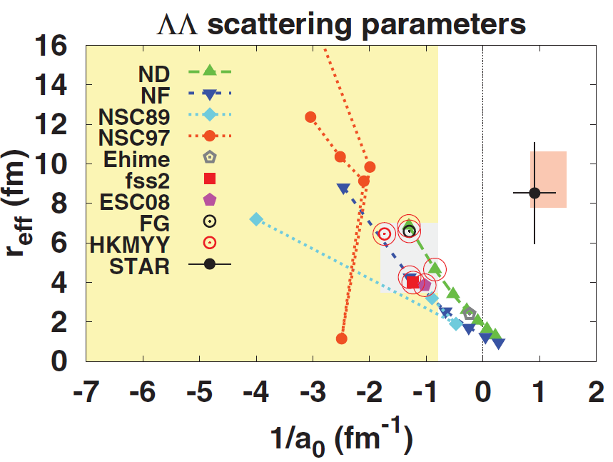

ΛΛ Correlation (HBT+resonance)
KM+ ‘15
Constraint from the STAR measurement
1
Favor weakly attracting ΛΛ pair
0.9
Cylindrical, +C_{res}(q)
λ=(0.67)²
C(q)
1/a₀ < -0.8 [fm⁻¹]
No constraint on r_{eff}
0.8
0
0.05
0.1
0.15
0.2
0.25
q [MeV/c]
Fix λ from ∑⁰→Λγ contribution
Dilution of C(q) (reduction of C(0))
Free(fitting parameter) λ can lead to a global but physically false minimum

Slide 18
ΛΛ Correlation @LHC
ALICE pp (7 and 13TeV) and p+Pb (5TeV)
Version 2019 (Fabbietti, QM2019)
Looks like weak interaction effect…
Allow H-dibaryon as ΛΛ bound state
Probably we’re here.
Larger system (HI) can kill (or confirm) the bound regime
(Statistics at q < 50MeV crucial)

Slide 19
What should we do next?
Trivial things : statistics improving experimental technique

Slide 20
Things to Check : Source function in HIC
Recollection: the HBT puzzle in ππ
t
π freeze-out:
  Positive x-t correlation
  Ko+ ’02, Pratt ‘09
Crossover Boundary
Ω, Ξ Freeze-out
What about p, Λ, K etc…?
Different size comparison (e.g., S-L ratio) may be free from the realistic source problem, but better to know
QGP
x

Slide 21
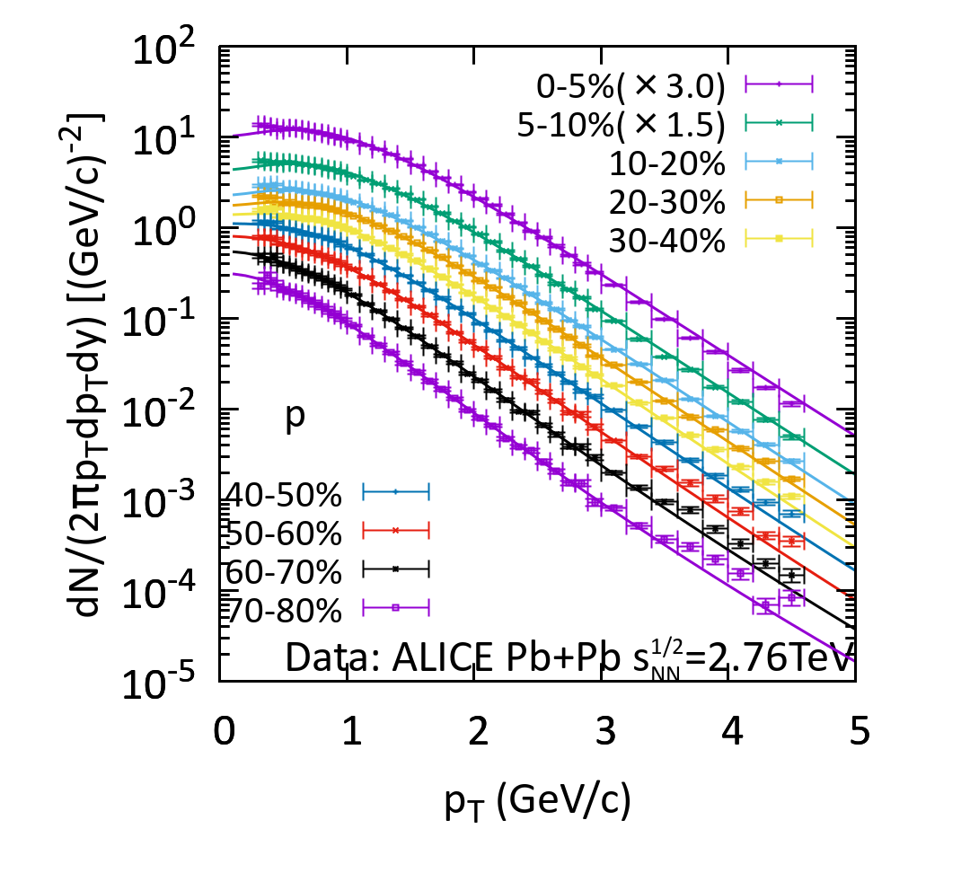
Constraint on p Source Function
Csörgő+ ‘95
+2-body decay from m_{res} <2GeV
relative distance distribution
Reasonable size at T=155MeV
HBT radii (~4fm)
Momentum dependence
Well reproduce pt-spectrum
Is this Gaussian model sufficient?
Maybe not, when one wants to have relative source function with different particle species.
KM+ ‘19

Slide 22
Coupled Channel
Most of YN, YY systems are C.C. systems!
Lednicky +’82
Haidenbauer ‘18
p
p
V_{diagonal}
Ω
V_{off-diagonal}
Ω
Λ
Ξ
Additional contribution (weight ω_{j}) and modification of Ψ though Schrödinger Equation
→ Y. Kamiya (K⁻p correlation / Thursday)
Caveat – Small V_{off-diagonal} does not mean small influence on C(q), if close to unitary regime (Sekihara+ ‘18)

Slide 23
Concluding Remarks
Single-channel analysis is established
  Correlation : complementary, sometimes unique approach to get insights into BB interaction.
  C(q) in small systems is more sensitive to FSI.
  System size scan to confirm bound state.
  Toward precision era – consider baryon source functions in HIC and coupled channel analyses.
Comment on each channels
  ΩΩ – most likely unitary regime even in HIC. Enhancement over Coulomb+HBT. Waiting for J=1,2,3 on the lattice.
  pΩ – from unitary (pp,pA,peripheral) to bound regime (AA). Coupled channel analysis necessary for quantitative determination.
  ΛΛ – Full coupled channel and system size scan for further constraint.
  K⁻p – Testing ground of the full coupled channel framework.

Slide 24
Backup

Slide 25
Spectra@T=155MeV
Direct only
V = 103 – 4160 fm³
(60-80%) (0-10%)
Include Ξ(1530) decay
V = 171 - 4100 fm³
(60-80%) (0-10%)
Include m* < 2GeV
V = 110 – 3500 fm³
(60-80%) (0-10%)
Fix τ₀ = 10 fm for 0-10% and use τ₀ ~ (dN/dy)^{1/3}→ Fix R
R= 2 – 8 fm, R_{proton-HBT} ~ 4 fm (Consistent w/ ALICE)

Slide 26
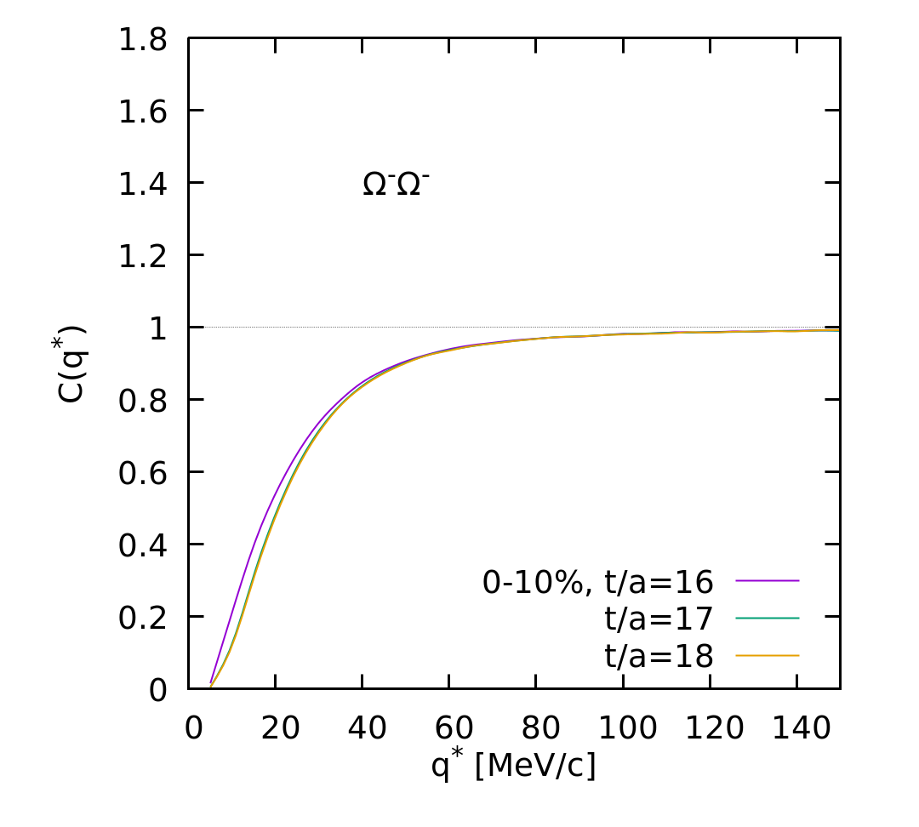
ΩΩ Correlation
Wave function
Correlation function
FSI+Coulomb+symmetrization
Coulomb+(a)symmetrization
System is too large
Coulomb+HBT dominate
Further suppressed by the spin degeneracy factor 1/16

Slide 27
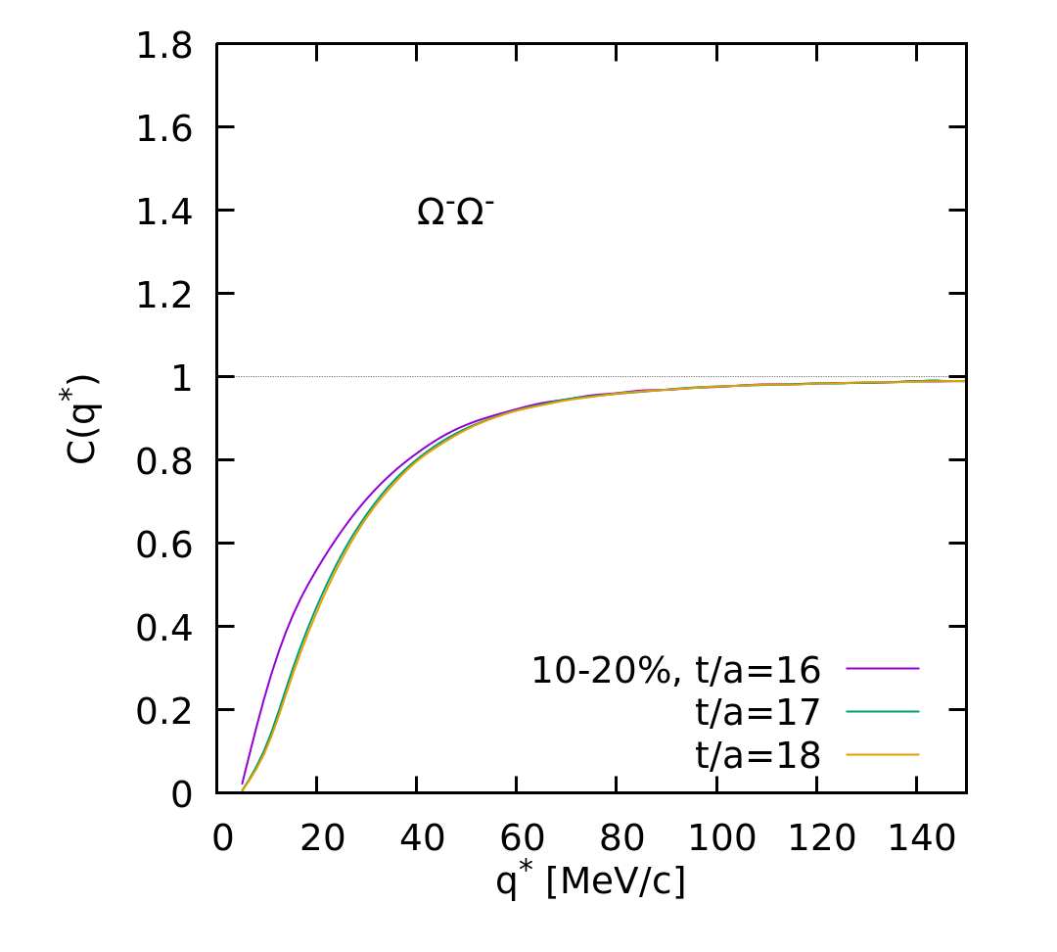
ΩΩ Correlation
Wave function
Correlation function
FSI+Coulomb+symmetrization
Coulomb+(a)symmetrization
System is too large
Coulomb+HBT dominate
Further suppressed by the spin degeneracy factor 1/16

Slide 28
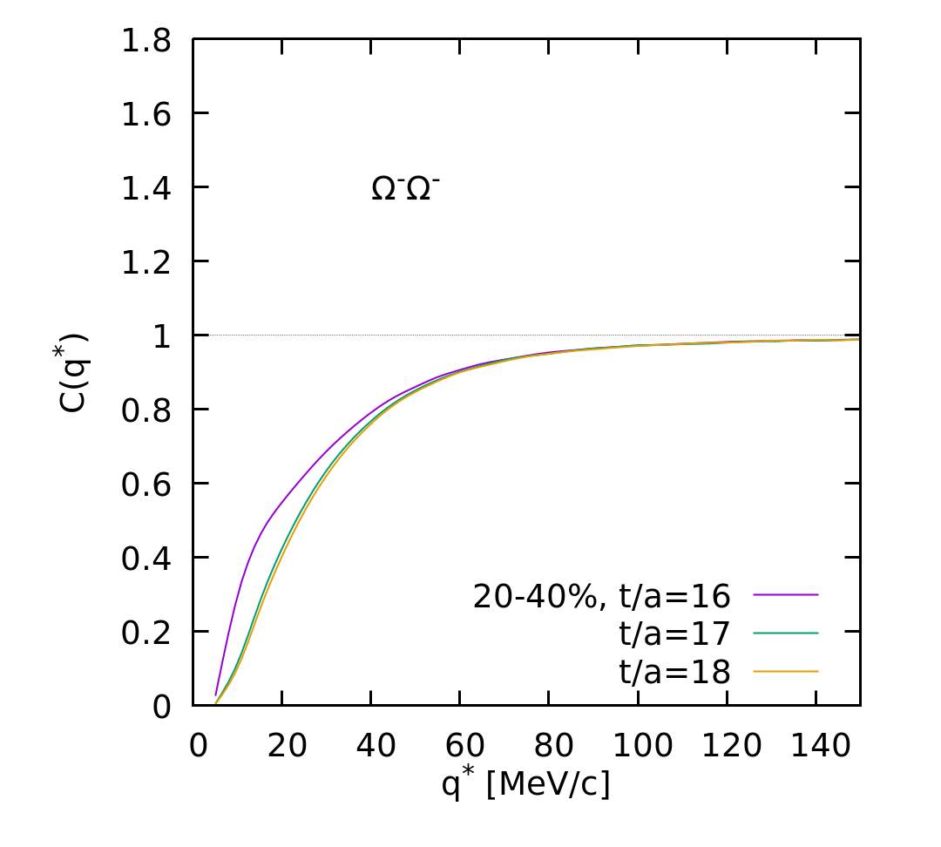
ΩΩ Correlation
Wave function
Correlation function
FSI+Coulomb+symmetrization
Coulomb+(a)symmetrization
System is too large
Coulomb+HBT dominate
Further suppressed by the spin degeneracy factor 1/16

Slide 29
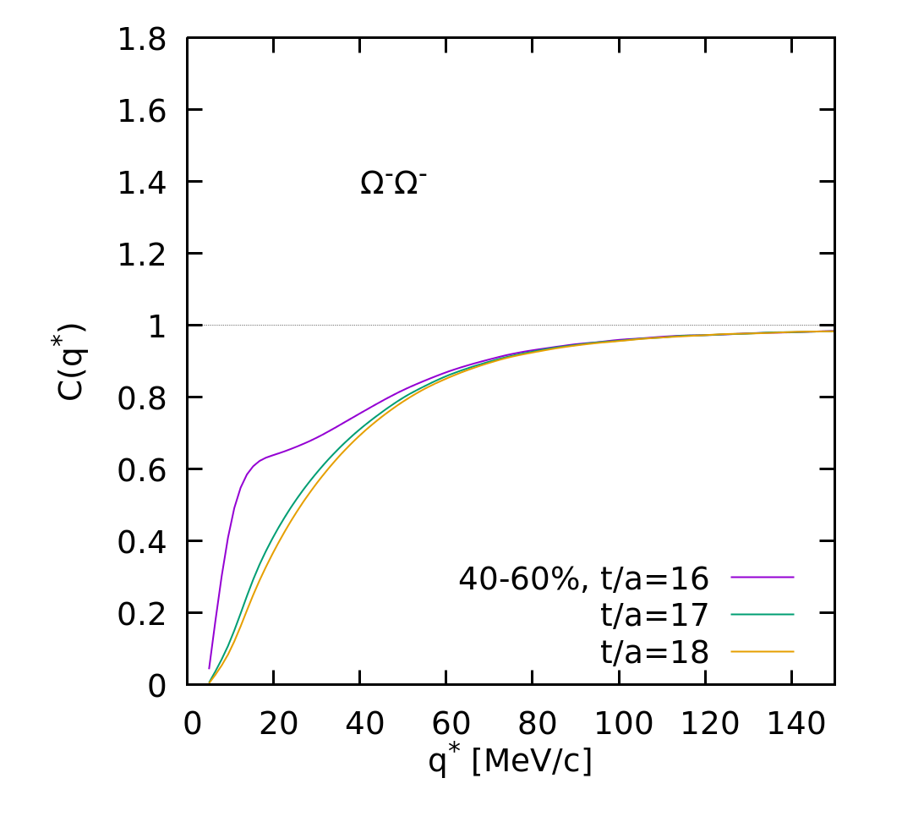
ΩΩ Correlation
Wave function
Correlation function
FSI+Coulomb+symmetrization
Coulomb+(a)symmetrization
C(q*) evolves with system size
Coulomb+HBT dominate
Further suppressed by the spin degeneracy factor 1/16

Slide 30
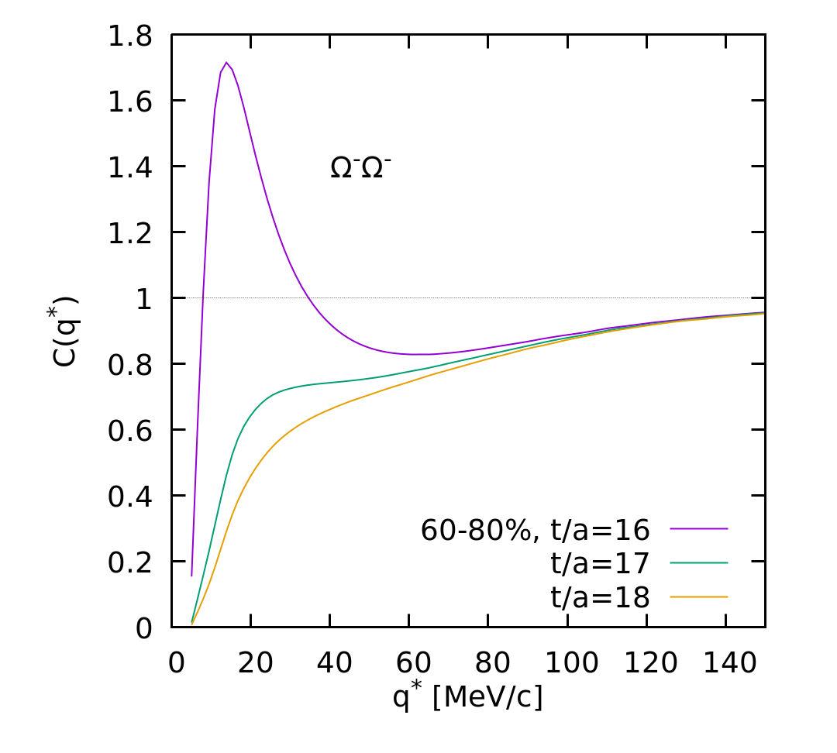
ΩΩ Correlation
Wave function
Correlation function
FSI+Coulomb+symmetrization
Coulomb+(a)symmetrization
Strong FSI effect for small systems
Further suppressed by the spin degeneracy factor 1/16

Slide 31
S=-3: pΩ @almost phys.point
Σ⁺*Ξ⁻*
u
s
Σ⁰*Ξ⁰*
u
d
s
s
Σ⁰Ξ⁰*~Σ⁺Ξ⁻*
Σ⁻*Ξ⁺
Σ⁰*Ξ⁰
ΛΞ⁰*
Spin-2 : D-wave only – suppressed
→Quasi-stable Dibaryon state?
NΩ
Spin-1 : Strongly Coupled
ΣΞ
ΛΞ
8_{f}-10_{f}, 10_{f}-10_{f}
8_{f}-8_{f}

Slide 32
Comparison to Old Potentials

Slide 33
pΩ Interaction (⁵S₂)
NΩ potential (fitted to Lattice data) : bound state exists
+Coulomb attraction
t/a | a₀ [fm] | r_{eff} [fm] | E_{B} [MeV]
11 | 3.45 | 1.33 | 2.15
12 | 3.38 | 1.31 | 2.27
13 | 3.49 | 1.31 | 2.08
14 | 3.30 | 1.33 | 2.24
Bound state regime for Heavy Ion Collisions
Close to unitary for smaller system
Long-range part is assumed to be 2π exchange
T.Iritani+ (HAL QCD)

Slide 34
pΩ Correlation
Lattice input: Iritani+
Coupled to ΛΞ (2430) and ΣΞ(2507)
Absorption of S-wave component
Large systems in
Bound state regime:
Suppression of C_{SL}(Q)
Below unity at low Q

Slide 35
pΩ Correlation
Lattice input: Iritani+
Coupled to ΛΞ (2430) and ΣΞ(2507)
Absorption of S-wave component
Large systems in
Bound state regime:
Suppression of C_{SL}(Q)
Below unity at low Q

Slide 36
pΩ Correlation
Lattice input: Iritani+
Coupled to ΛΞ (2430) and ΣΞ(2507)
Absorption of S-wave component
Large systems in
Bound state regime:
Suppression of C_{SL}(Q)
Below unity at low Q

Slide 37
pΩ Correlation
Lattice input: Iritani+
Coupled to ΛΞ (2430) and ΣΞ(2507)
Absorption of S-wave component
Large systems in
Bound state regime:
Suppression of C_{SL}(Q)
Below unity at low Q
Small systems in
Unitary regime

Slide 38
pΩ Correlation
Lattice input: Iritani+
Coupled to ΛΞ (2430) and ΣΞ(2507)
Absorption of S-wave component
Large systems in
Bound state regime:
Suppression of C_{SL}(Q)
Below unity at low Q
Small systems in
Unitary regime

Slide 39
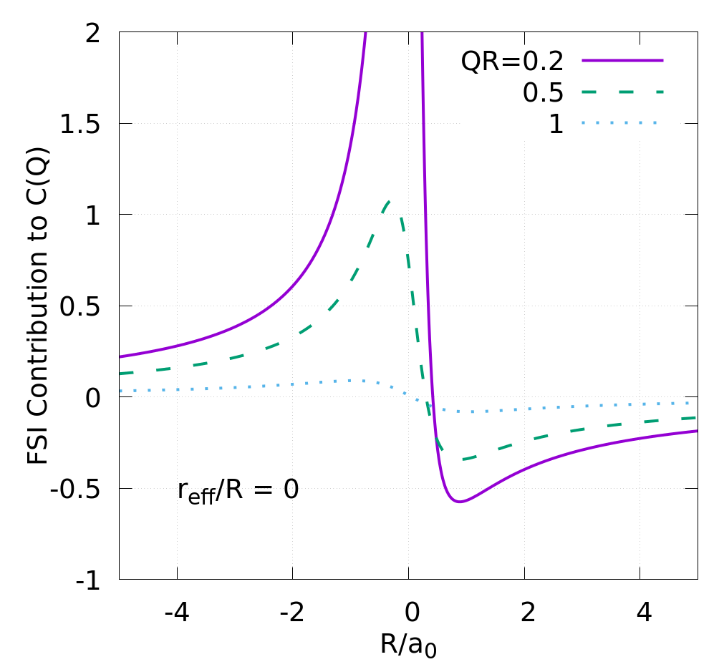
pΩ Correlation: S-L ratio
Coupled to ΛΞ (2430) and ΣΞ(2507)
Absorption of S-wave component

