Slide 1
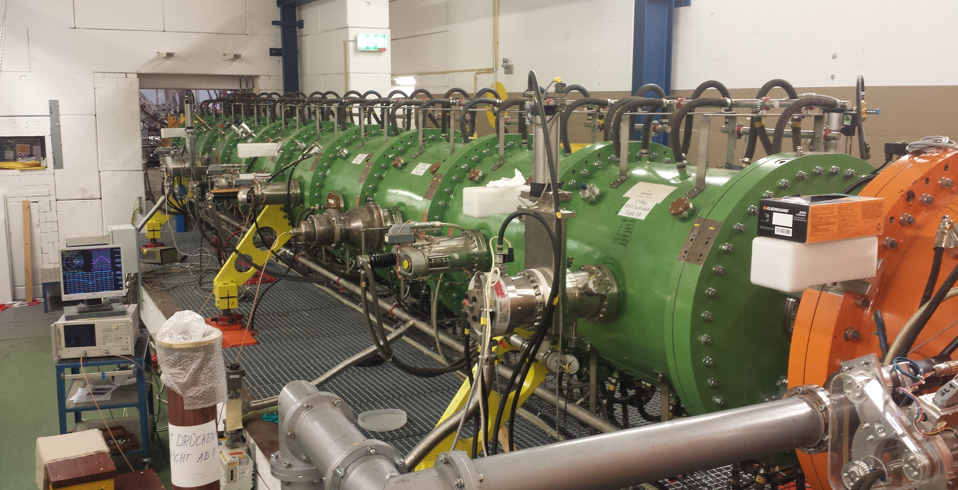
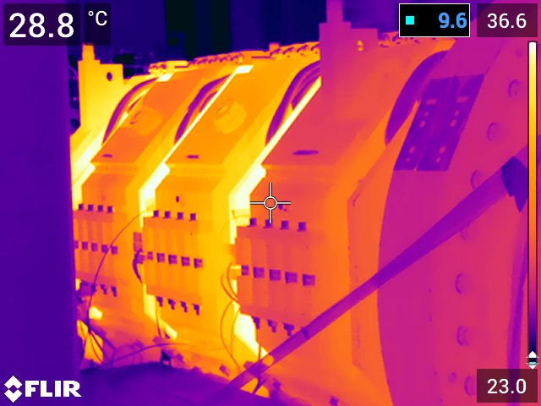
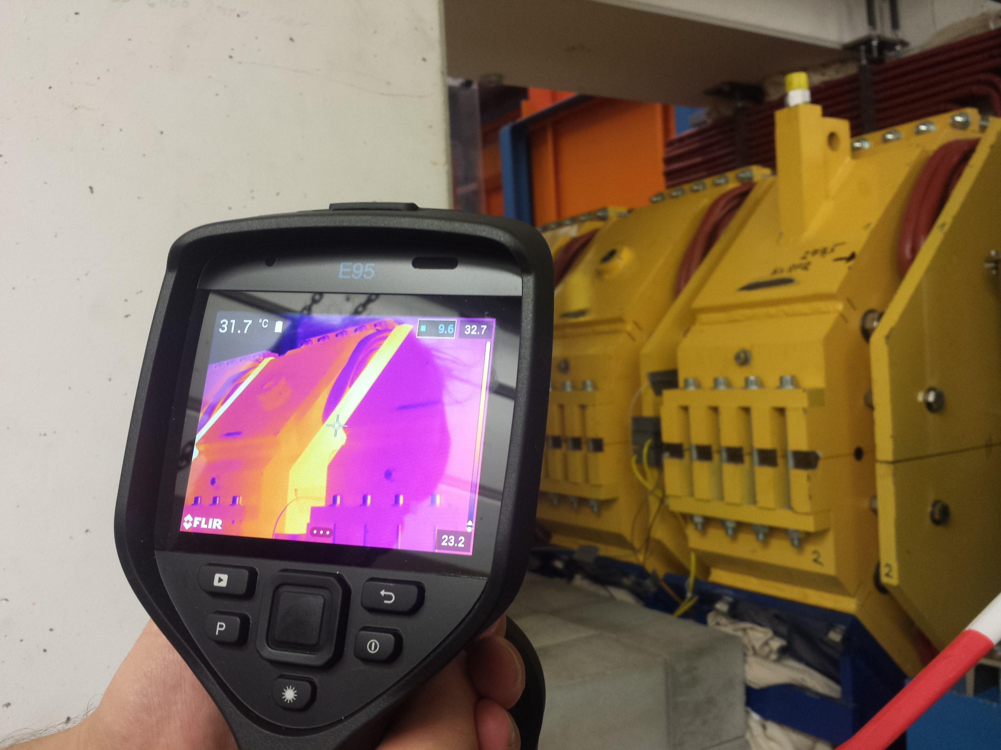
Unilac: QQ tests
RFQ: Vacuum pumping (2.xx E-7 mbar), RFQ input loop re-checked, okay.
QQ: Tests for operational limits done (12th Sep), magnet temperatures okay within limited operation. Wall closed.
Alvarez A3 pre-vac leakage (water), drying, IH2 pump valve to be exchanged/repaired

Slide 2
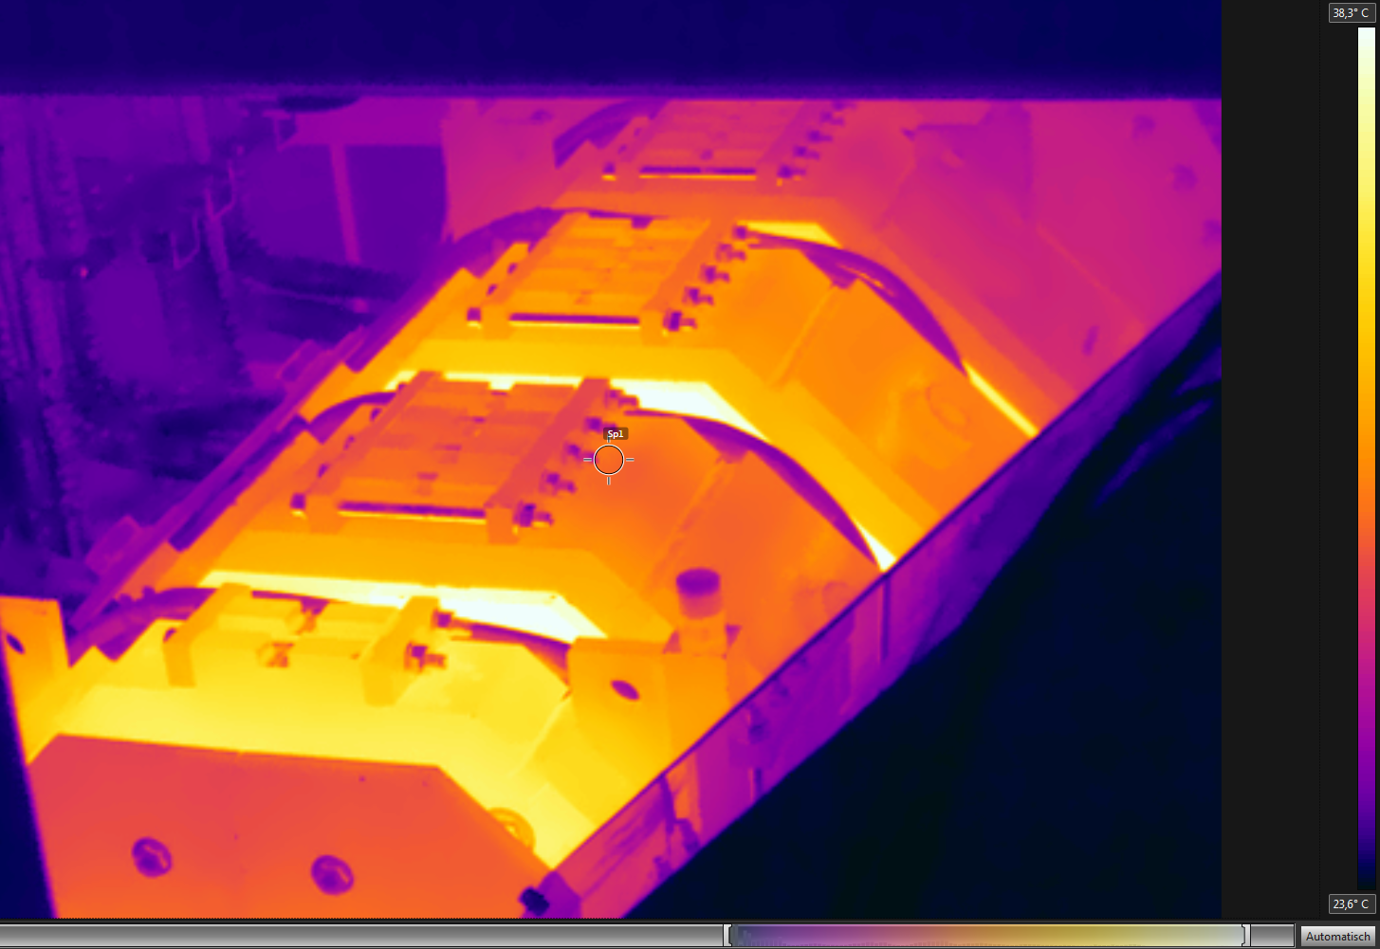
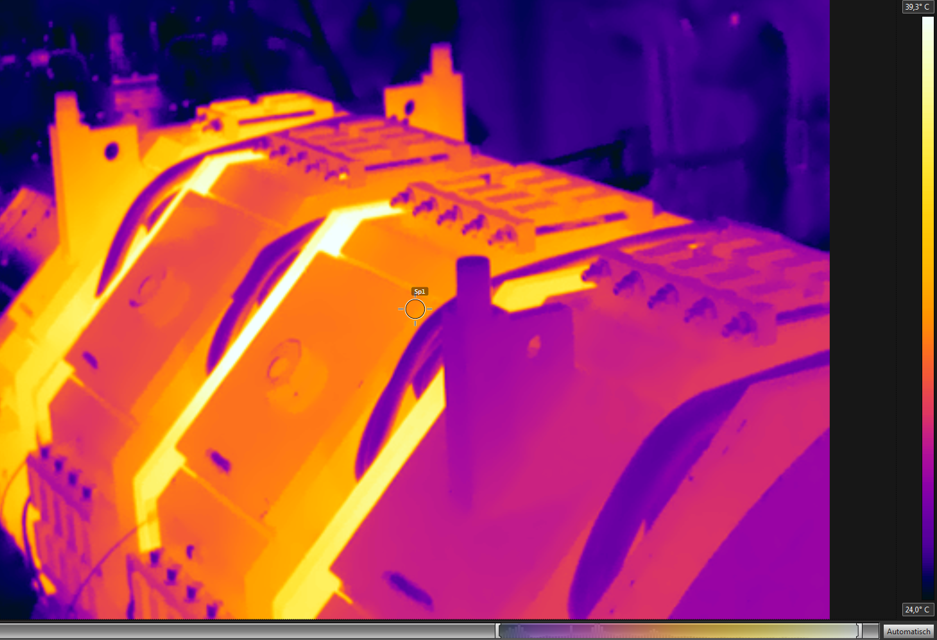
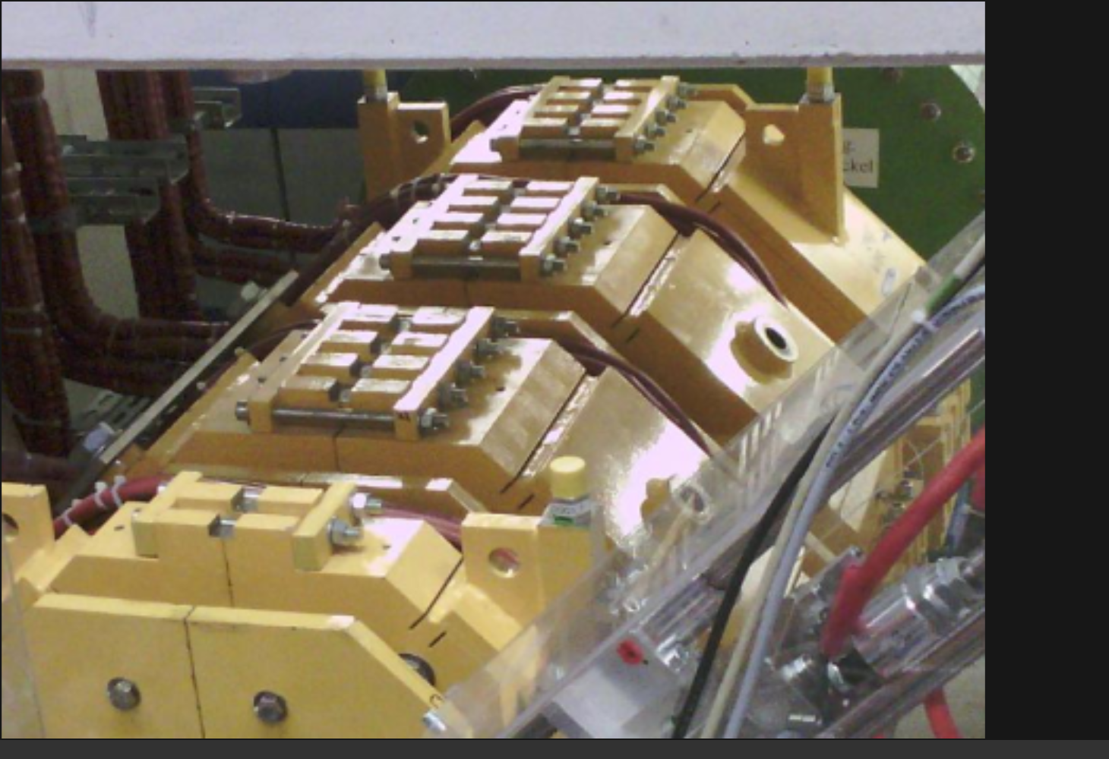
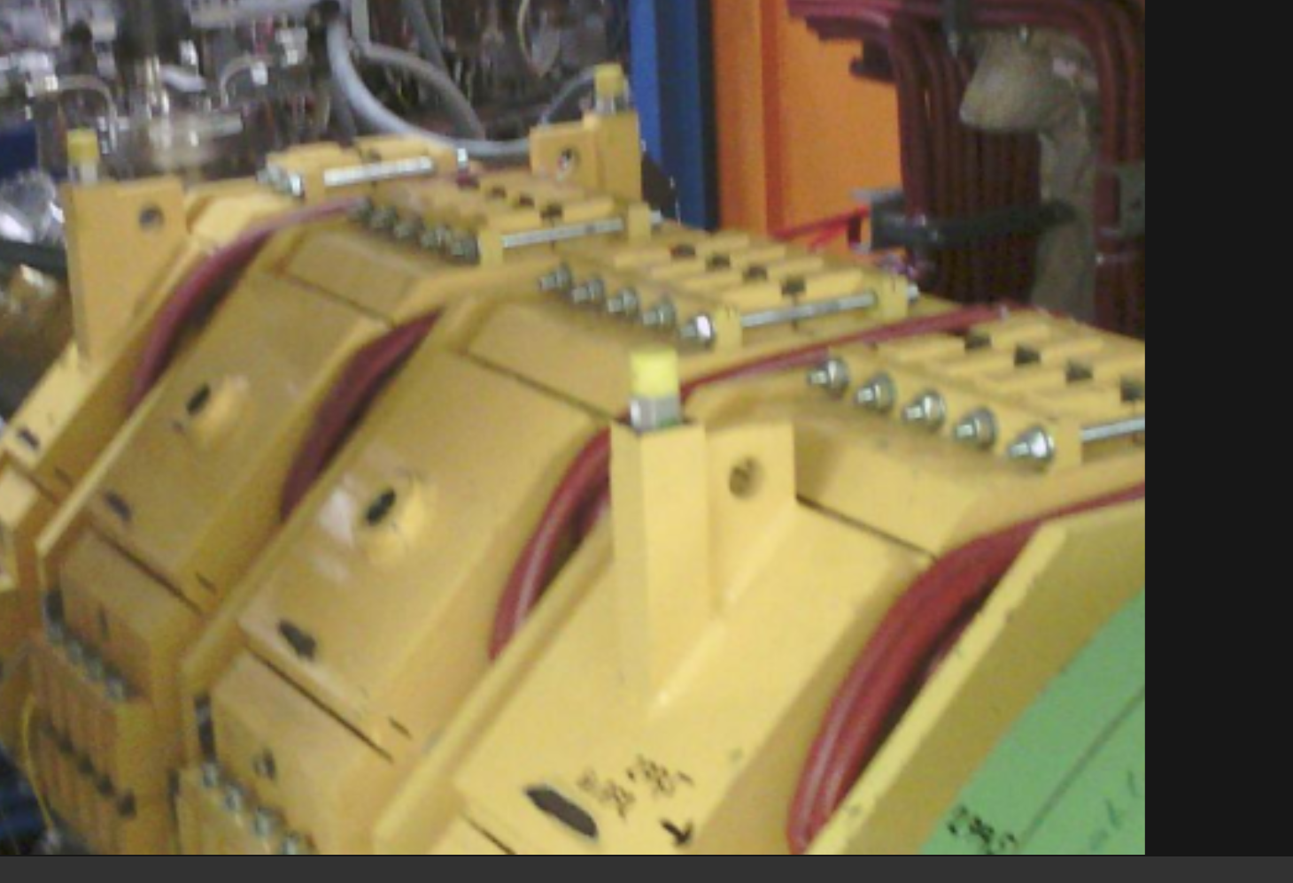
Unilac: QQ tests
View from ion source
View from UNILAC tunnel
top:IR bottom:visual
top:IR bottom:visual
1st mirror plate
QQ11
2nd mirror plate
QQ12
3rd mirror plate
QQ13
4th mirror plate
QQ14
5th mirror plate
5th mirror plate
QQ14
4th mirror plate
QQ13
3rd mirror plate
QQ12
2nd mirror plate
QQ11
1st mirror plate

Slide 3
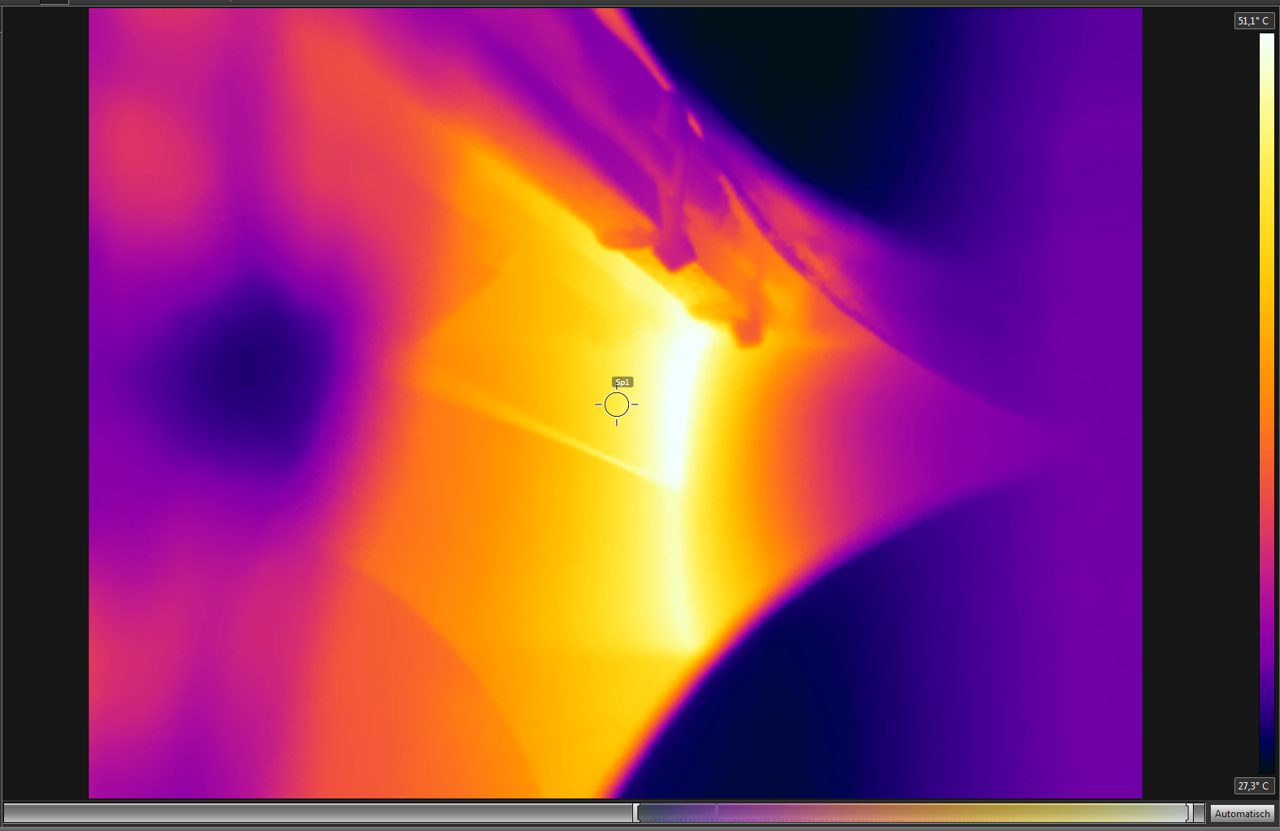
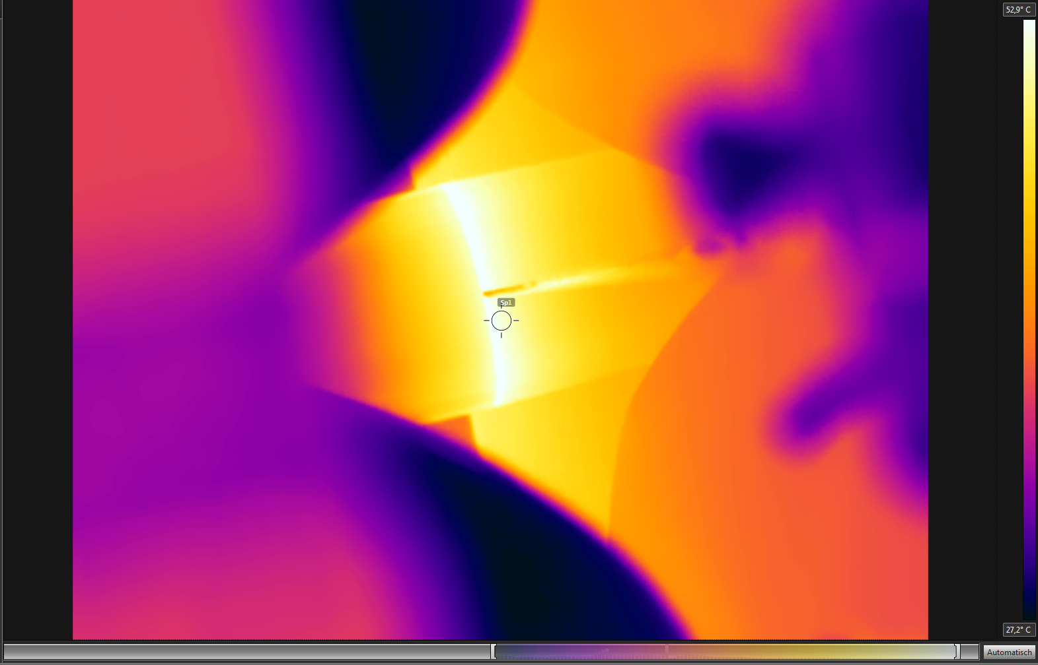
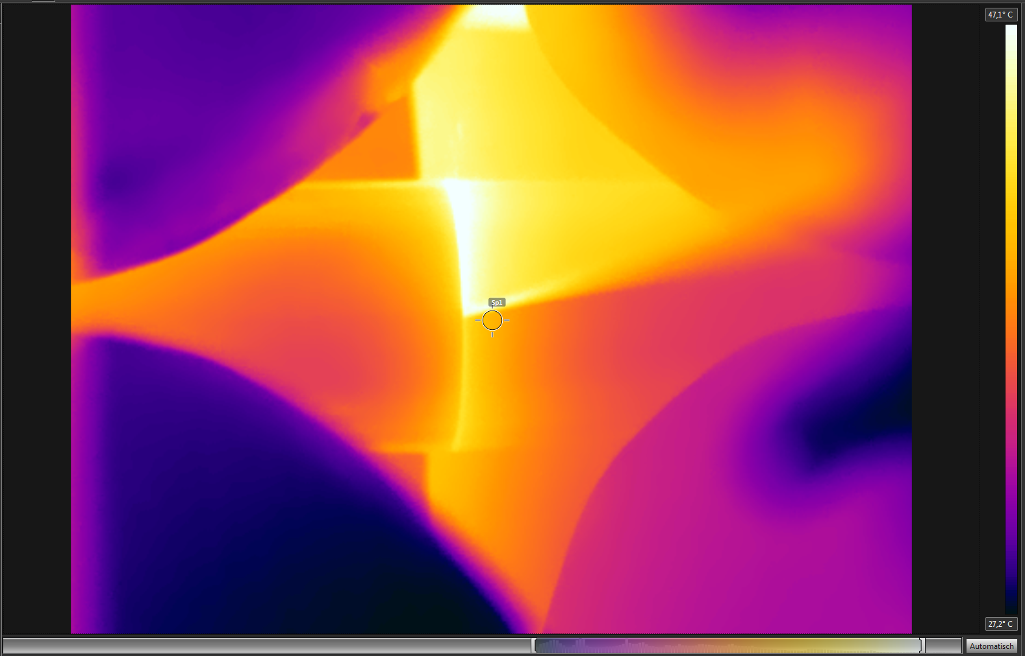
Unilac: QQ test environment
Magnets covered (cardboard) to emulate radiation protection wall
Forced air cooling of beam pipe and magnets switched on
Temperature of mirror plates 2,3,4 monitored by Type K thermocouples
Temperature monitored by FLIR IR camera
Safety switches (70°C) mounted on mirror plates 2,3,4
Limits for magnet currents adapted to operational requirements, intermediate set value optimized for lowest ramping
View between two magnets without air cooling
(mirror plates, safety switch holder, beam pipe housing, air nozzle)
... with air cooling

Slide 4
Unilac: QQ test scenarios
Magnet currents/strenghts, equivalent to max. needed for operation
Timings: always “50 Hz” operation in parallel scenarios successfully tested with air cooling scenarios not successfully tested (with and w/o air cooling)
Nomen | QQ11 | QQ12 | QQ13 | QQ14
Low-Bρ U(A/q=26) /V | 1,1 | 1,2 | 1,1 | 0,5
High-Bρ U(A/q=59,5) /V | 2,5 | 2,8 | 3,0 | 2,2
Low-Bρ I(A/q=26) /A | 119 | 132 | 122 | 54
High-Bρ I(A/q=59,5) /A | 273 | 301 | 325 | 235
Timing (reduction) | High-Bρ | Low-Bρ 2 | Rel. therm. load | Max. temp. (K / IR)
Test [1] as reference | 18 (2,7 Hz) | 0 | (1)
Test 0-10 V @ 5 Hz | 10 (5 Hz) | 0 | (5,15)
Scenario 1: High-Bρ | 10 (5 Hz) | 10 (5 Hz) | 2,5 | 41°C / 47°C ()
Scenario 2: FAIR | 20 (2,5 Hz) | 4 (12,5 Hz) | 2,7 | 40°C / 43°C 
Scenario 3a: GSI | 50 (1 Hz) | 5 (10 Hz) | 1,4 | 34°C / 37°C 
Scenario 3b: GSI | 50 (1 Hz) | 3 (16,7 Hz) | 2,7 | 39°C / 41°C 
Scenario 4: GSI fast | 50 (1 Hz) | 2 (25 Hz) | 3,9 | 41°C / 48°C ()
Scenario 1 w/o cooling: | 10 (5 Hz) | 10 (5 Hz) | (2,5) | 43°C / 54°C ()

