Slide 1
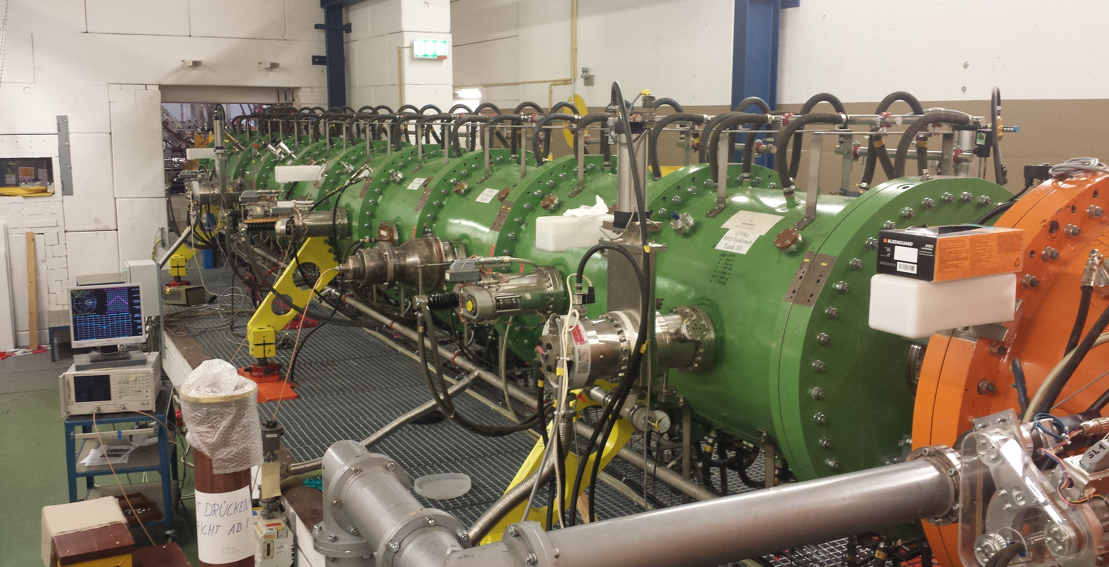
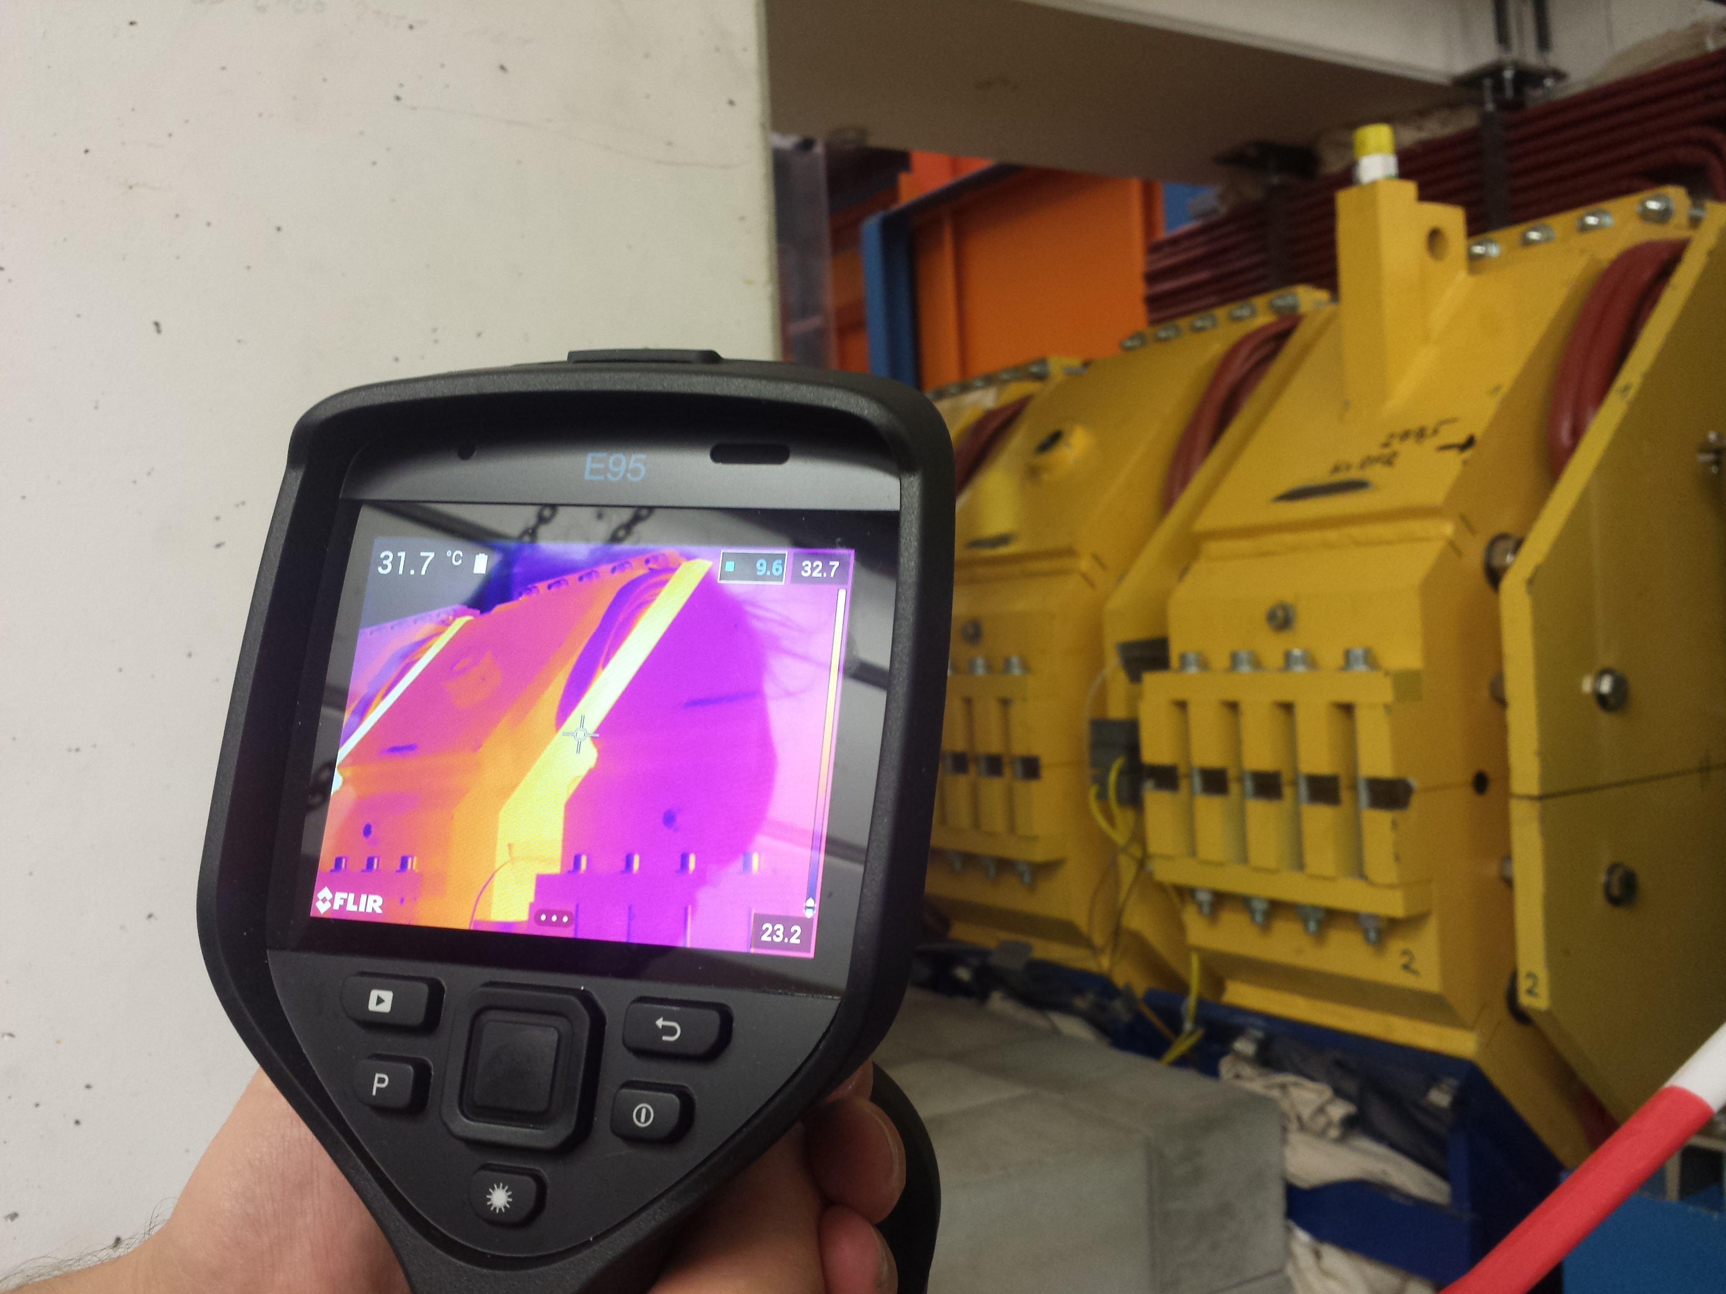
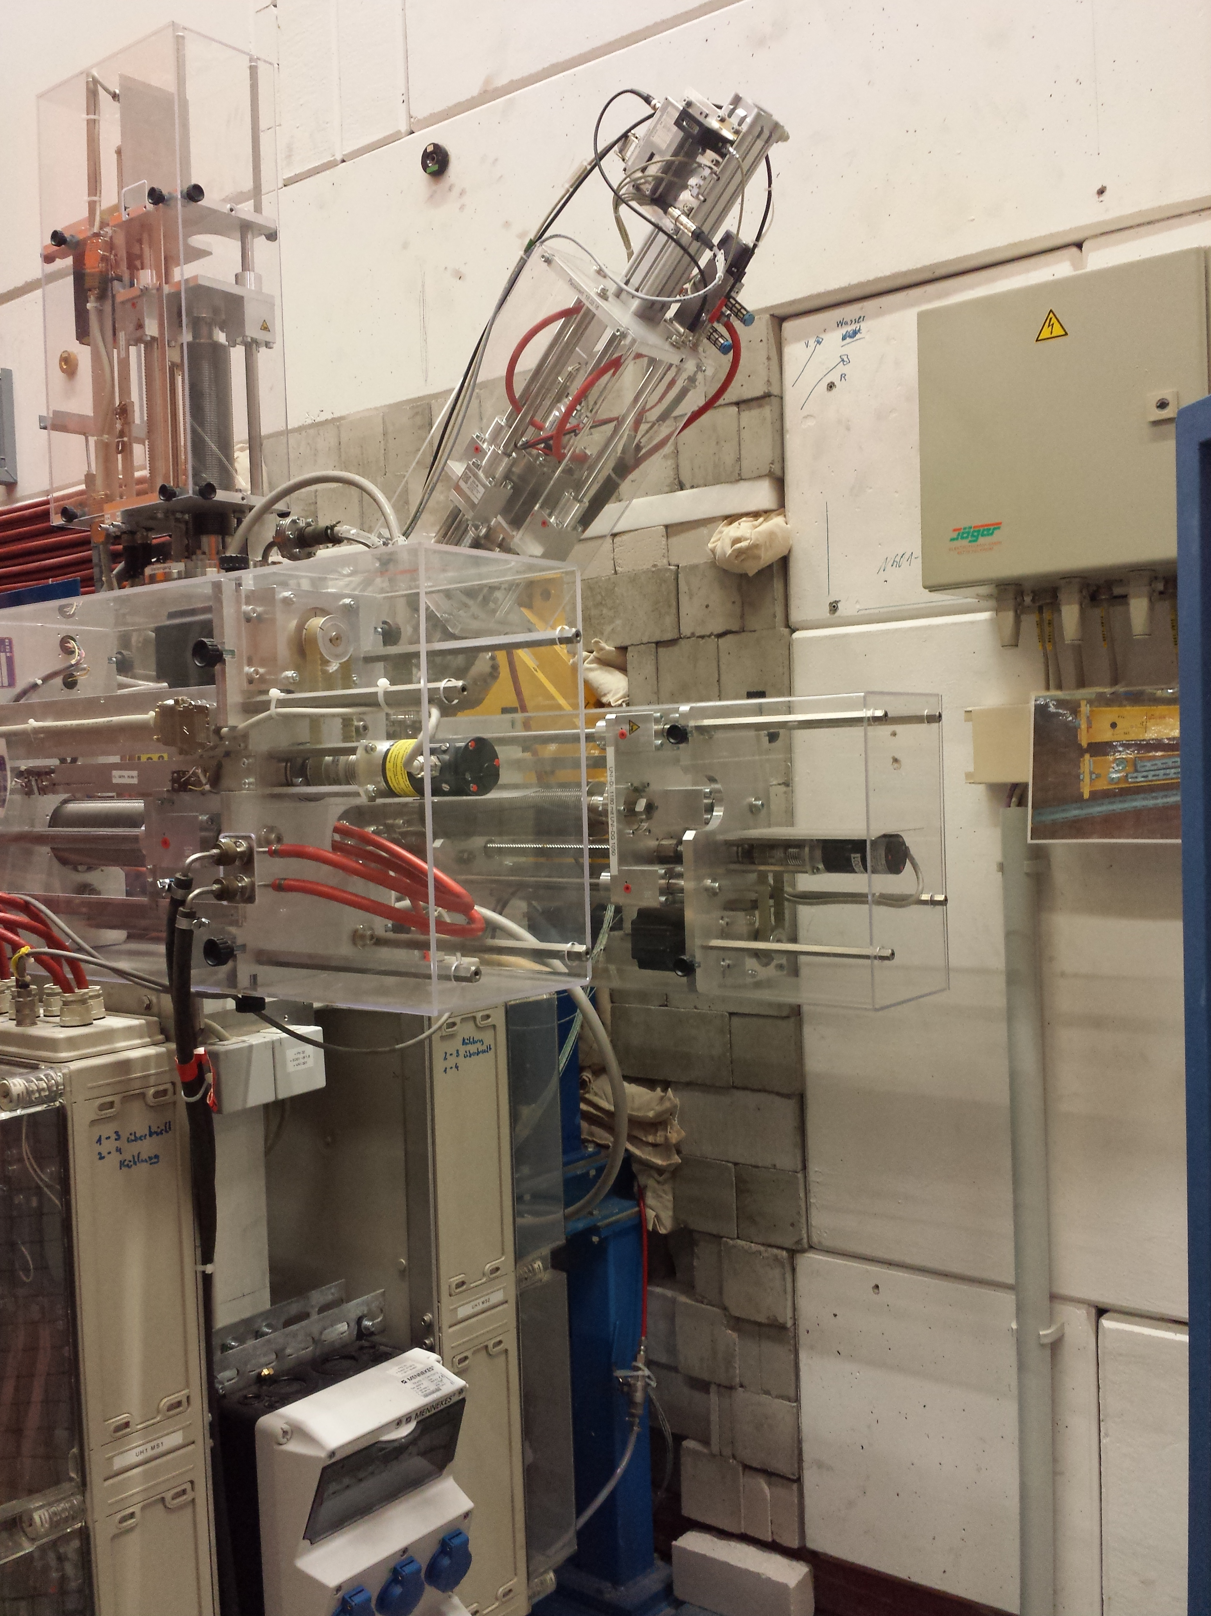
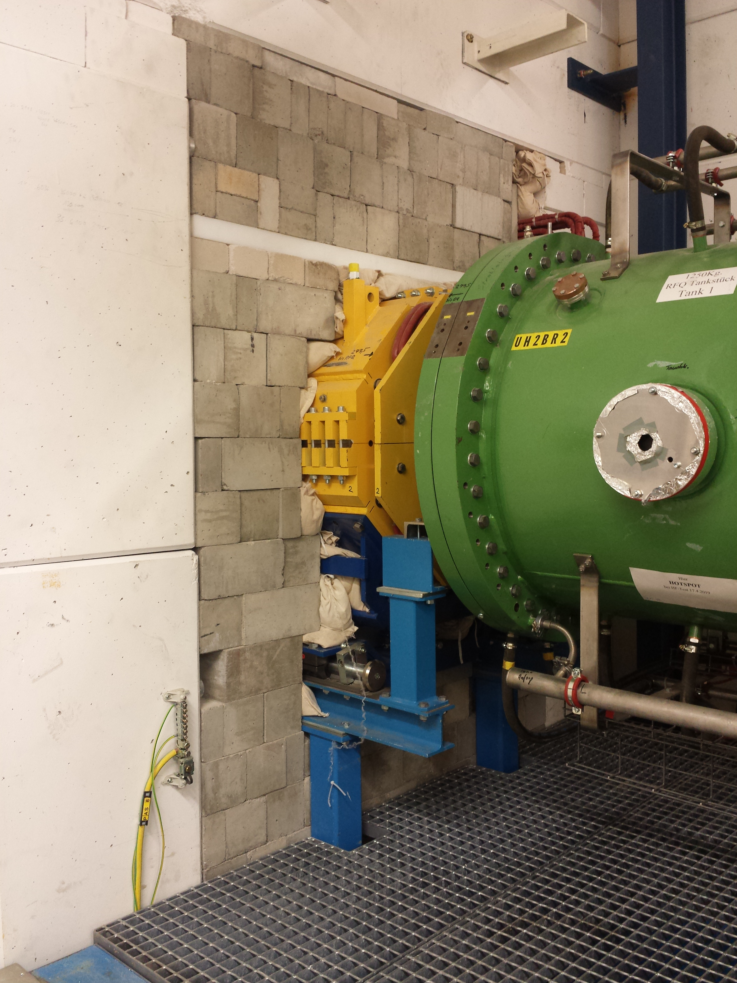
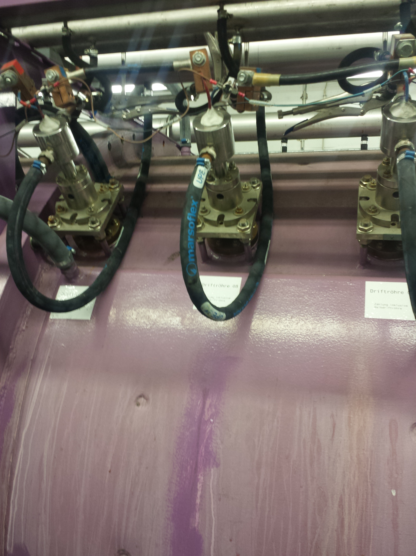
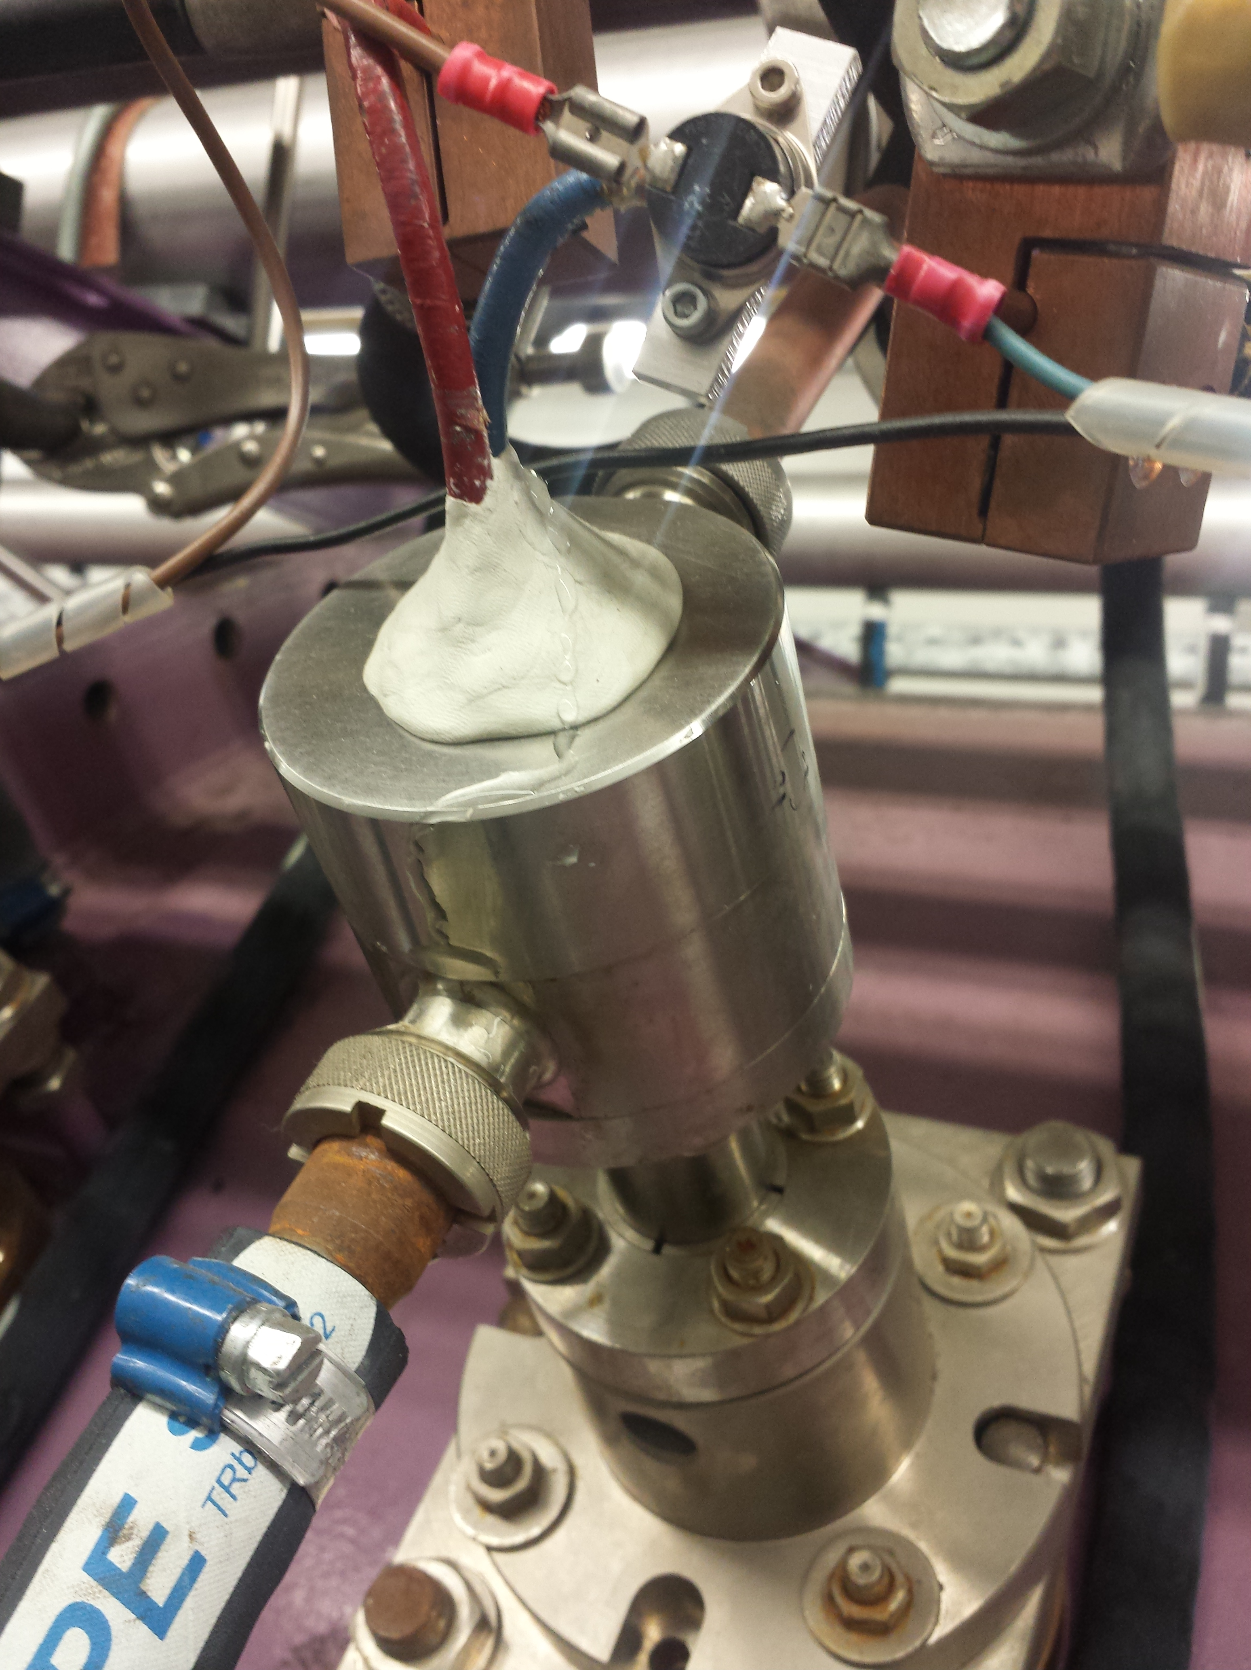
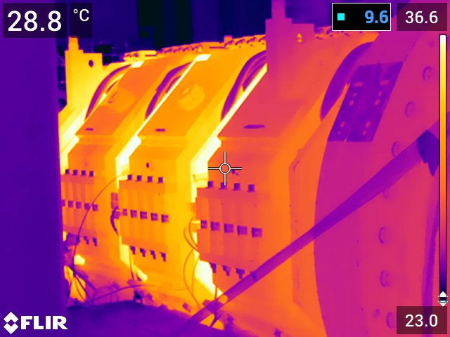
Unilac – 17(18).9.2019
RFQ: Vacuum pumping (2.xx E-7 mbar), RFQ input loop re-checked, okay.
QQ: Tests for operational limits done (12th Sep), magnet temperatures okay within limited operation. Wall closed.
Alvarez A3 pre-vac leakage (water), drying, IH2 pump valve to be exchanged/repaired

