Slide 1
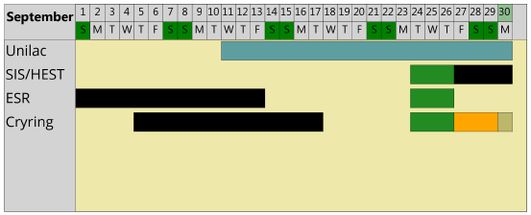
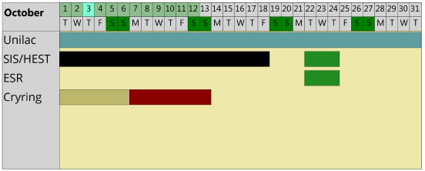
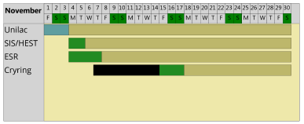
machine status
CRYRING@ESR & HITRAP
CRYRING@ESR
- electron cooler – not counting on operation in September, only little hope
user experiment beamtime (C+)
untested experiment detector leaked twice – not installed!
shifted the user time to November
three vacuum sections are baking (despite the delay due to the det.)
Control System – adapt patterns for running after LSA upgrade
- ECR from Giessen: HV problem at the interface to CRYRING@ESR – went back to the MINIS for the remainder of 2019.
HITRAP - no activity
C⁺
C⁺

