Slide 1
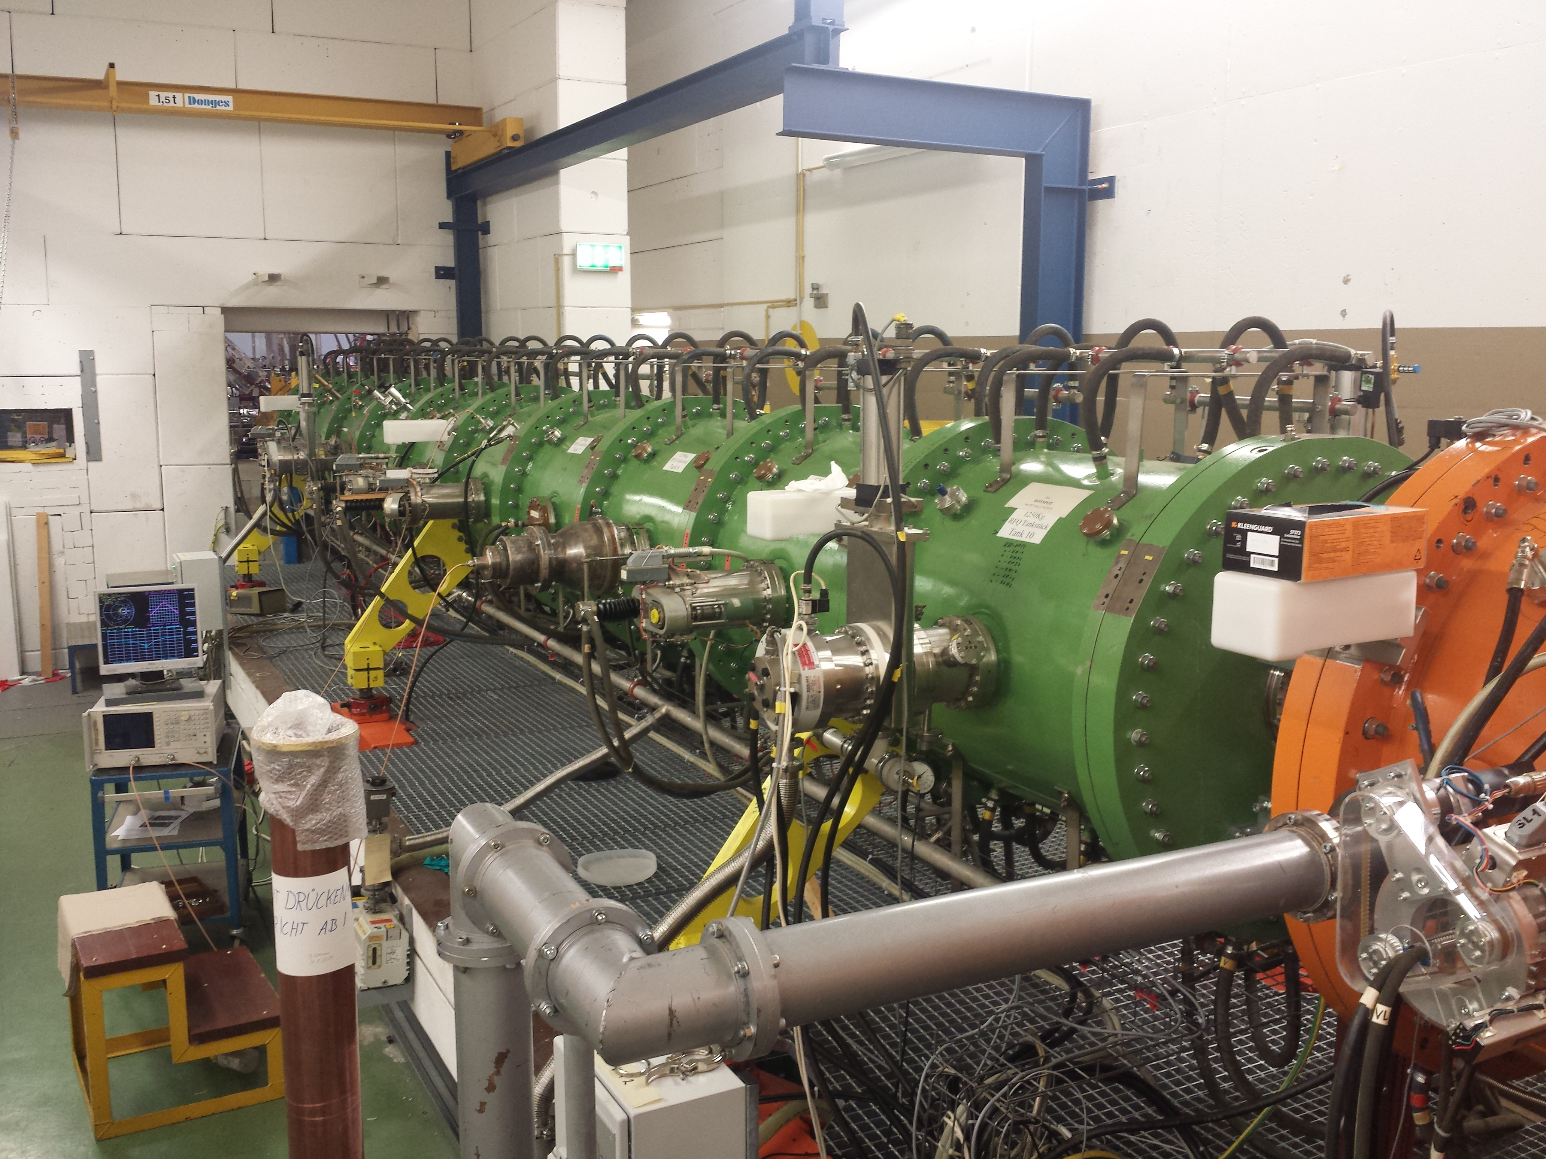
Unilac - 3.9.2019
RFQ: RFQ and Superlens back in beam line, aligned, vacuum leak at RFQ output/doublet fixed, pumping (6.xx E-7 mbar), RFQ input loop to be re-checked.
QQ: LEBT incl. QQ aligned.

