Slide 1
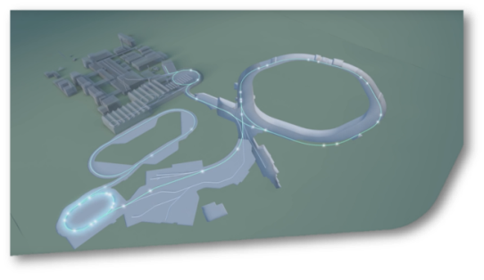
SIS18 Status Report KW37
SIS18
The replacement of the quadrupole power converter is ordered. An option for continuing operation even in case of an early failure of the existing transformer has been worked out.
The contract for the design of the new electrostatic septum has been awarded to NTG.
The UHV system of the micro spill cavity has been succesffully tested.
The fixation of the coild of the bipolar dipole magnet has been completed by Danfysik.
The IPM magnet power converters have been tested successfully with the IPM magnet system. The IPM magnets are mounted on the support frame.
The SIS18 survey is still ongoing.

