Slide 1
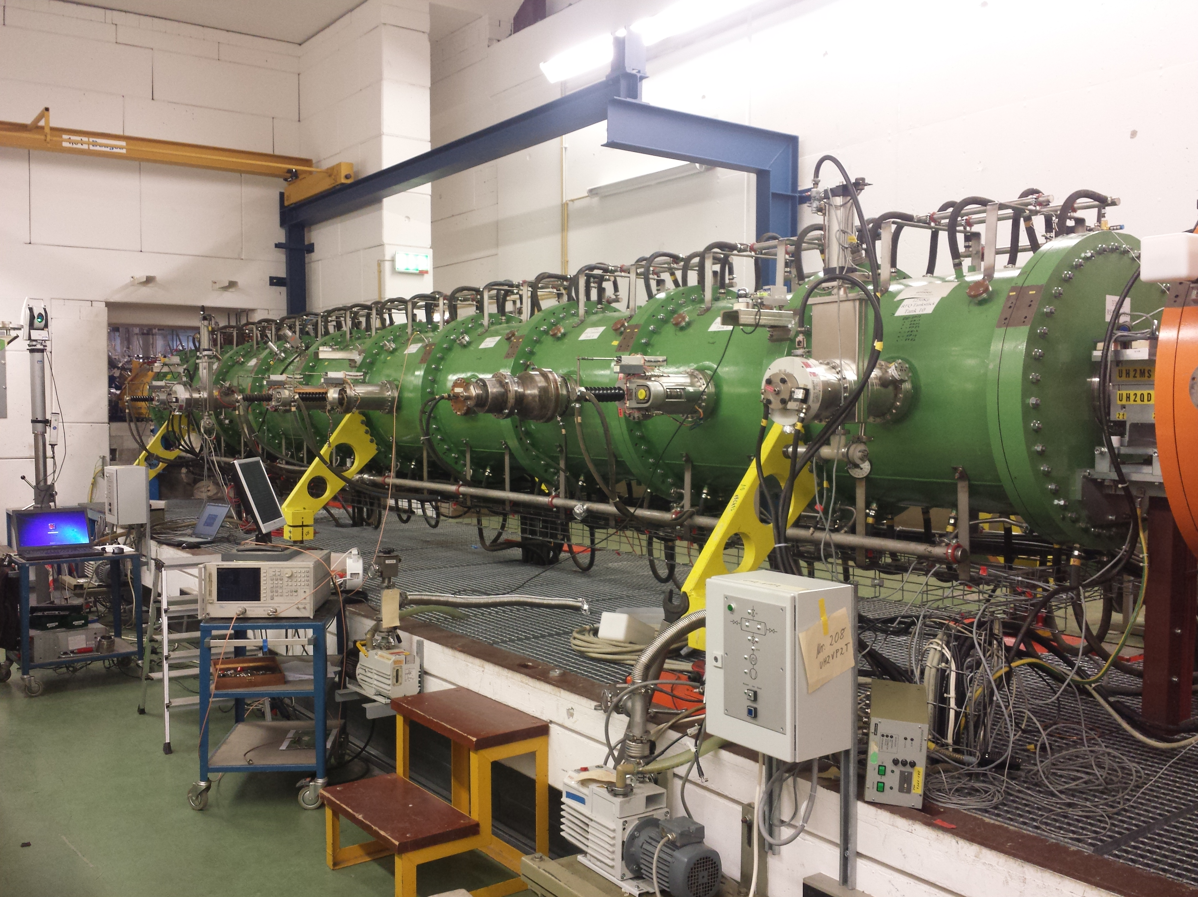
Unilac - 27.08.2019
RFQ: RFQ and Superlens are back in beam line , RFQ input loop adjusted, RFQ alignment and residual assembly works ongoing.
QQ works: LEBT incl. QQ aligned (Monday 26th).

