Slide 1
HEST vacuum system
M. Sapinski (with A. Kraemer invaluable input)
GSI Machine Meeting
Aug 27, 2019

Slide 2
Overview
Current status: what do we have?
Failures during operation.
Current and FAIR vacuum control systems.
Perspectives.
www.gsi.de/work/gesamtprojektleitung_fair/commons/vacuum_systems.htm

Slide 3
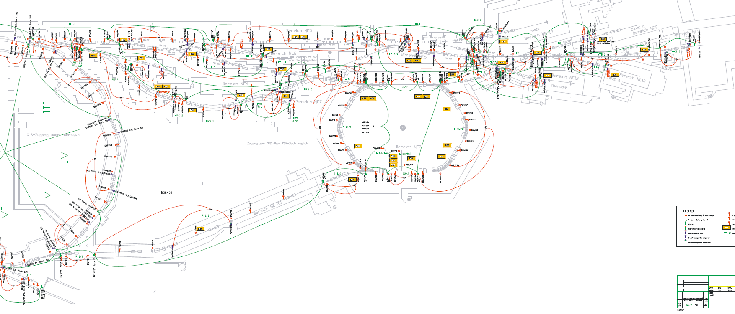
Overview plan

Slide 4
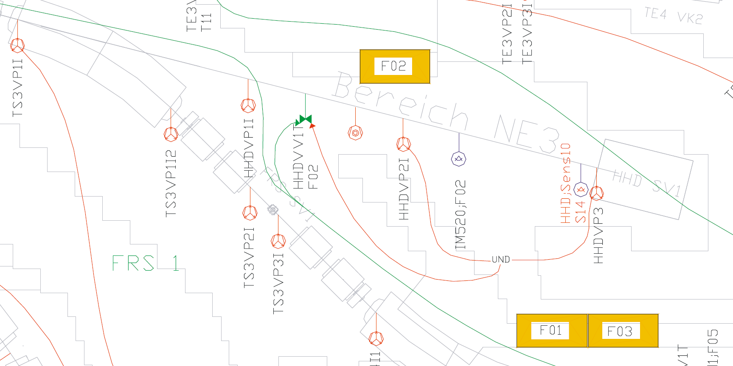
Overview plan - zoom
valve
turbo pump
gauge
ion getter pump
interlock

Slide 5
Inventory (subject to update)
Roughing pumps: 15 fixed + mobile pumping stations
one mobile pumping station ~16 kEUR
Ion getter pumps: ~110 + 10 at reinjection
one ion getter pump ~12 kEUR
Valves, gate valves and fast closing valves: ~37.
Dedicated gauges (pumps usually have one): ~30.
We do have beakable chambers but only SIS18 extraction area and ESR injection/extraction are baked.
Analog electronics in the tunnel and digital controllers in electronic rooms.
Vacuum interlocks.

Slide 6
List of failures (last 12 months)
GS06VV2T GTS1VV1T GTE2VV1T | Failure - Vacuum Transport And Installation | HEST SIS18 | 000d 02h 34m 00s
GHTDVV1T / GHTCVV1T und GHTCVV2T | Failure - Vacuum Transport And Installation | HEST | 000d 02h 28m 00s
GHTPVV1T | Failure - Vacuum Transport And Installation | HEST | 000d 07h 15m 00s
GHTDVV1T | Failure - Vacuum Transport And Installation | HEST | 005d 10h 50m 00s
GTH4QD21 / GTH4QD22 / GTH4MU1 | Failure - Vacuum Transport And Installation | HEST | 000d 01h 26m 00s
GTE1VV1S | Failure - Vacuum Transport And Installation | HEST | 000d 06h 23m 00s
GTE4VV2T GTE5VV2T | Failure - Vacuum Transport And Installation | HEST | 000d 00h 35m 00s
102321
118763
Not many failures, low criticality (eg. switch to another beam line if possible), relatively easy access.

Slide 7
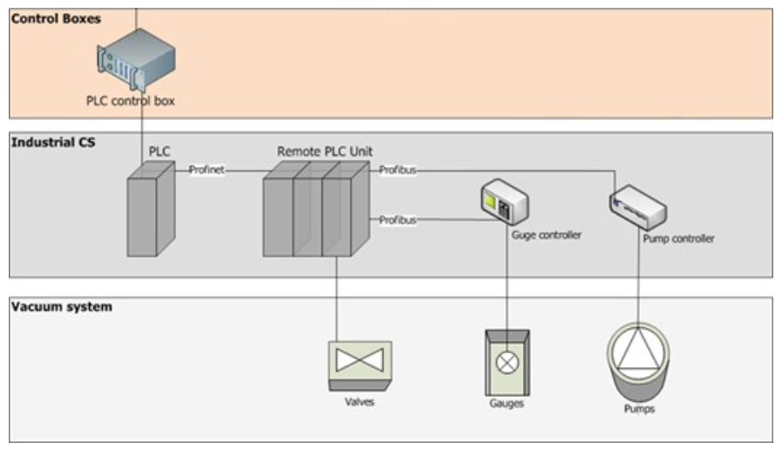
Control system
Renovated in early 1990’s
The same hardware as in SIS18 (NOT like UNILAC’s old system)
Can run for another ~10 years
Remote control of valves, reading of gauges
FAIR vacuum control system:
PLC-based Industrial CS
Easy, standard, robust reliable, radiation-compatible
HEST system is already quite centralized – probably no recabling needed
+ Remote control of pumps
already have
to be replaced
RS485, RS232

Slide 8
What should be done and when?
An online vacuum system status page (like for SIS18), centralized information page about vented sectors – ASAP.
Replacement of ion getter pumps (12kEUR each) – every year new pumps are acquired and replaced if needed (2019-2024)
Reconfiguration of new HHD beamline (2021, additional ion pump).
Upgrade of the control system (2023-2024). The vacuum system upgrade (and other upgrades) depends on long-term perspectives for HEST. What will happen when FAIR is ready? Experiments should submit proposals and decisions should be made at management level.

