Slide 1
GSI/FAIR operation status update
M. Bai on behalf of GSI ACC

Slide 2
Background and Action Items
Background
Readiness of LA 16 for safe operation of the LINAC RF has not yet been met due to additional recently discovered leaks. Two main risks in particular, 1) possibility of unwanted hazard objects such as aluminum tapes get sucked into the air cooling ducts through the leak or joints 2) humidity and temperature above required level for the RF power supplies could lead to speedy erosion of the equipment and undermines the operation reliability in the long run
Was originally planned to be ready by end of June. Then, end of July, then end of August. Now, could be after mid of Sept.
Action items for LA16 team led by Herr Becker and Herr Regler
Report of analysis results regarding the risk of having unwanted hazard objects in the LINAC RF air cooling system. This includes the possibility of whether any aluminum tapes currently on the outside of the air ducts can be sucked in at the location of the joint between two air duct sections. Simulation/calculation of such scenario should be based on the air pressure through the air cooling system and geometry.
Provide the humidity and temperature data of the LA16 (logged over a non-negligible duration). In case no data hasn’t been established, please do so when LA 16 is back in operation.
Please provide required additional duration (# of weeks) to seal all leaks in the LA16, and LA16 is in operational state that can enable the turn-on of LINAC RF equipment. This is needed prior to the Machine Meeting on August 20, 2019 https://indico.gsi.de/event/9297/
Action items for LINAC RF, UNILAC MK and OPE
Evaluate the impact of 3 more weeks of delay in LA16 readiness to the planned Engineering run plan. Please provide when Ar beam can be available for SIS18 injection. Please also provide the impact and mitigation required on the ER1 repair if Engineering run will be carried out from mid of Nov to mid of Dec.

Slide 3
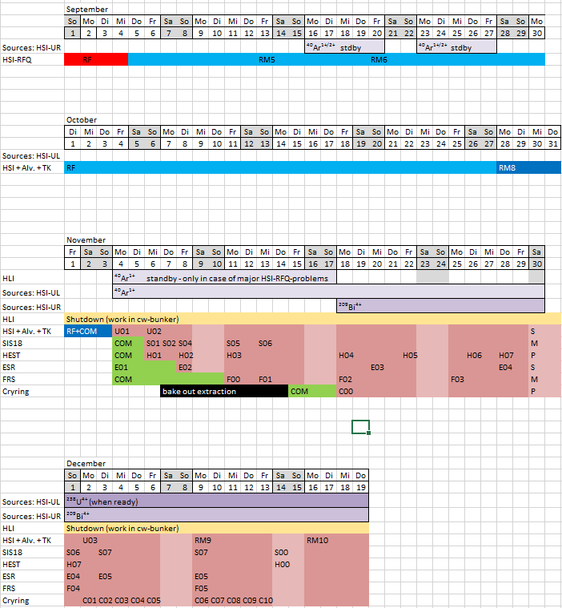
Current Engineering Run Plan
Goal of Engineering Run
Recommission the ESR w.
FAIR controls, storage ring
mode, beam stacking, etc
Establish deceleration from
ESR towards CRYRING
Establish CRYRING with
beam from ESR
Re-establish heavy ions in
UNILAC, Pb, Uranium, etc
Beam study/MD for FAIR

