Slide 1
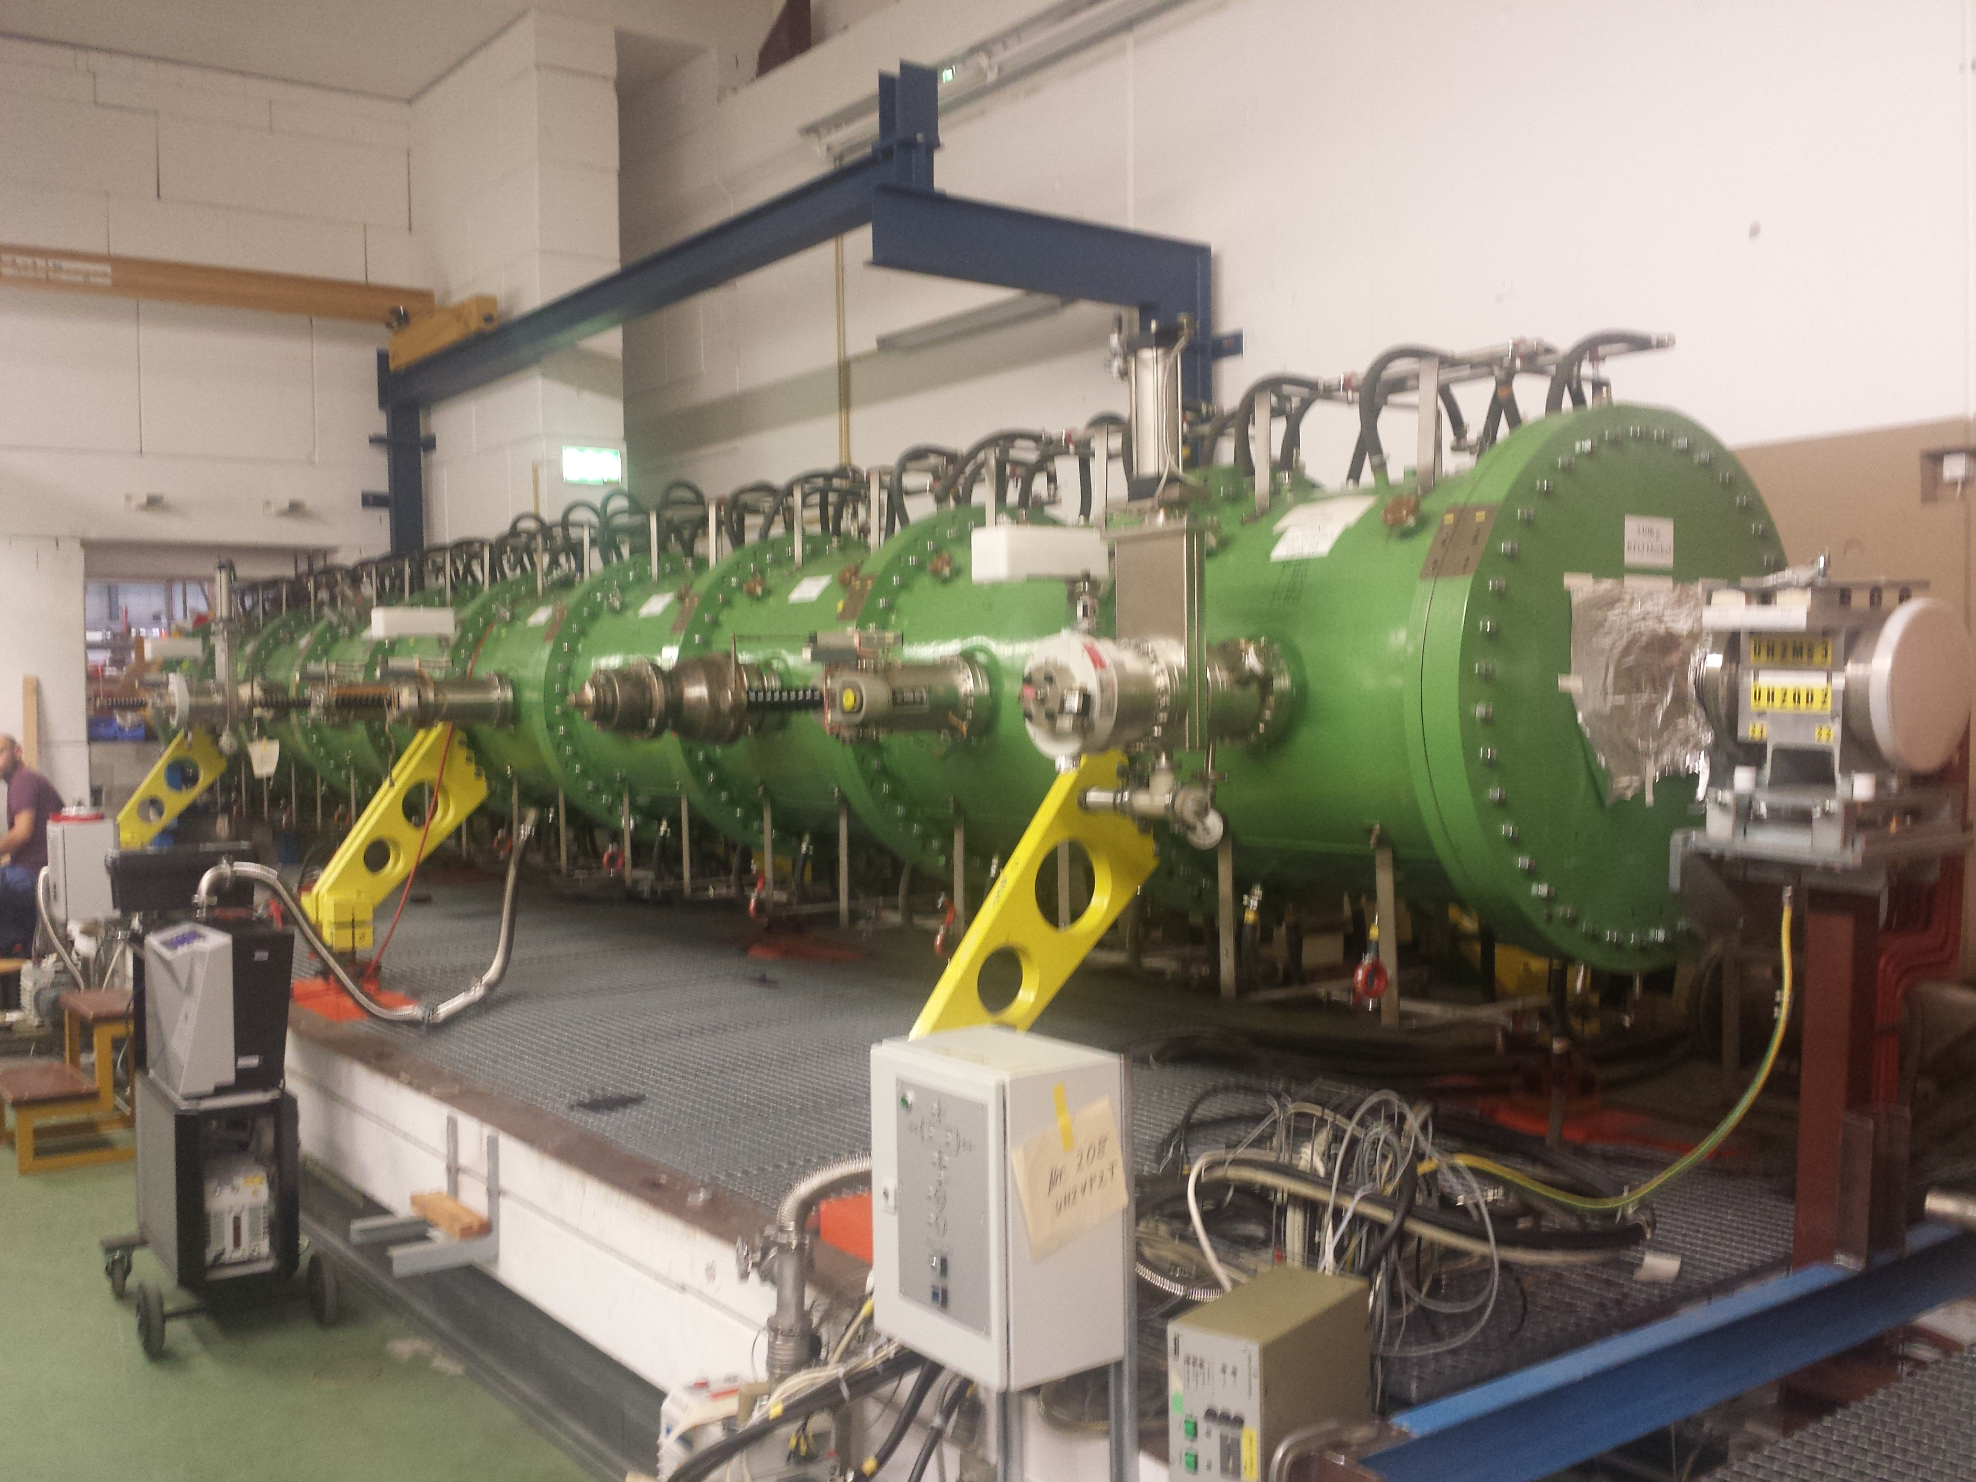
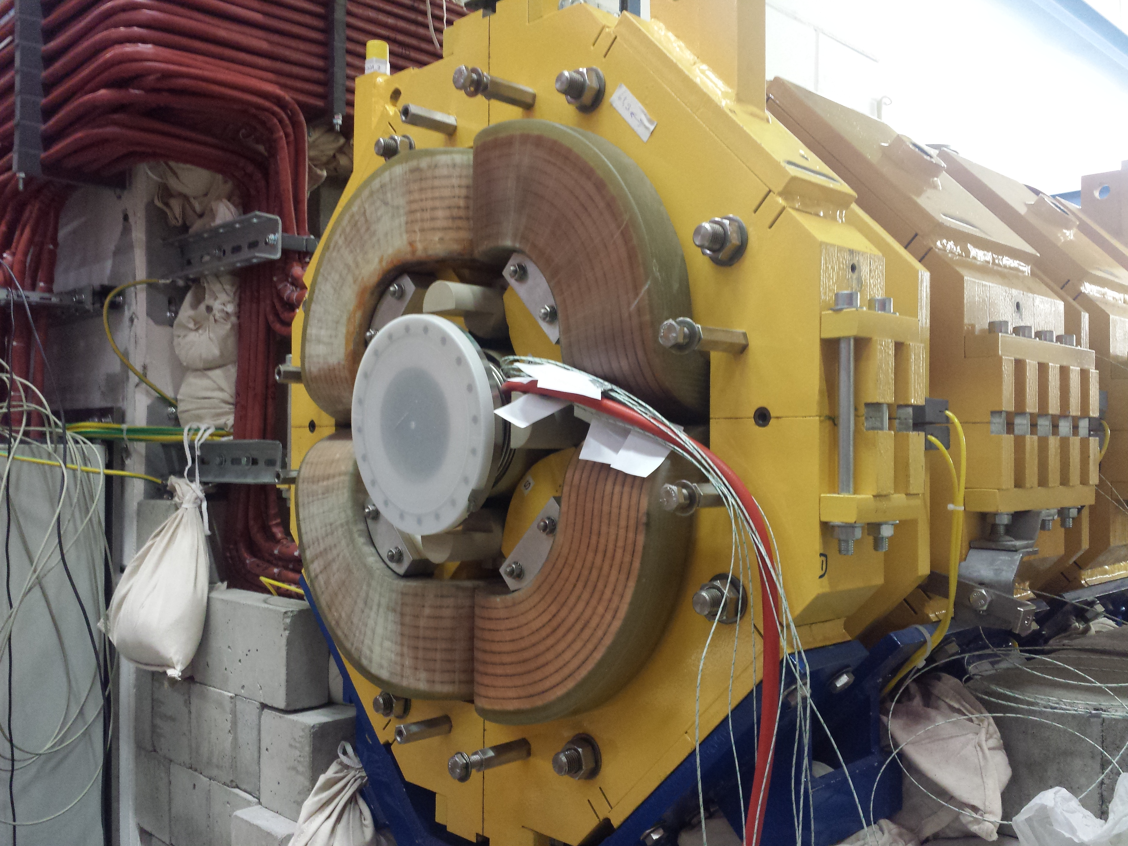
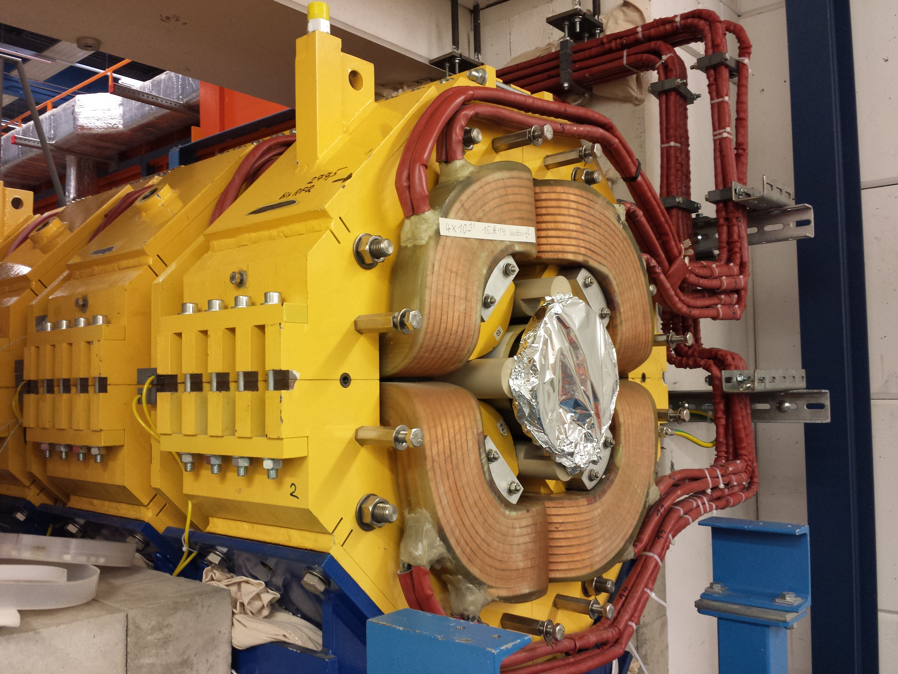
Unilac - 20.08.2019
RFQ: measurements finished, evaluation done (M. Vossberg). RFQ is put back into beam line (1st part in: Thursday 15th August). Reassembly plungers etc. ongoing.
QQ works: B-tube inserted, end flange welded.

