Slide 1
NUSTAR Project Status
J. Gerl
FAIR-NUSTAR Sub-Project Leader, NUSTAR Technical Coordinator / Project Manager
FAIR/GSI Darmstadt, Germany
Expert Committee Experiment
November 2019

Slide 2
NUSTAR Overall Schedule
2018 | 2019 | 2020 | 2021 | 2022 | 2023 | 2024 | 2025 | 2026 | 2027
Early Start
Day one
Super-FRS
construction and installation
commissioning
full operation
NUSTAR caves
civil construction
infrastructure inst.
NUSTAR experiments
construction/operation „outside“ FAIR (GSI and ext.)
installation
commissioning
operation at FAIR
Phase 0
Phase 1
Modular detectors enable step-wise upgrade of set-ups for early physics exploitation

Slide 3
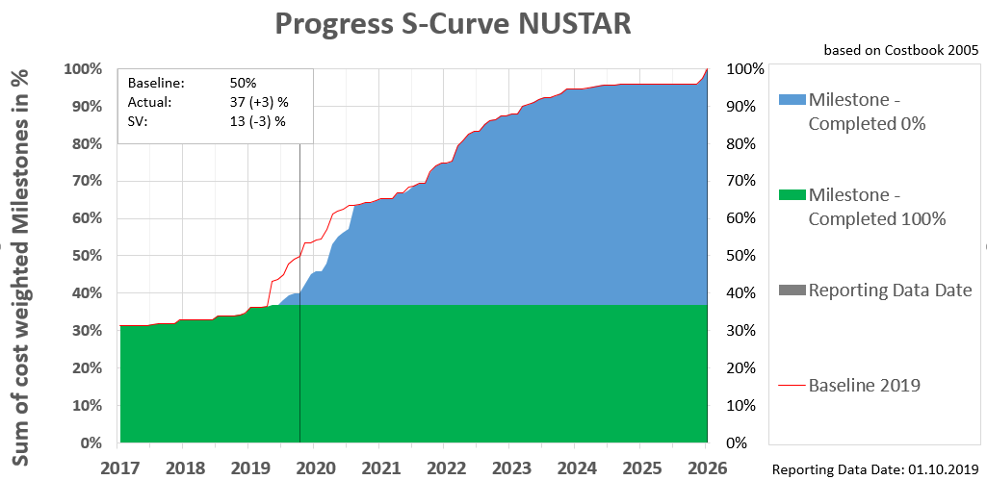
NUSTAR Project Progress
S- curve comments & mitigation proposal milestone in the past
1.2.5.1.2.5 (2.6%) – Neutron ToF spectrometer (NeuLAND)
FAT in clarification
S- curve comments & mitigation proposal progress delay
1.2.5.1.1.2 (4,8%) – GLAD magnet
Awaiting final SAT measurements
1.2.1.2.1 (3,0%) GSI-PMA Stopping cell, extraction, cooling, beam-distribution system and electrostatic beamlines
Awaiting ECE approval of TDR
1.2.3.3 (0,5%) – RFQ and switchyard
Awaiting detailed technical specs for contract
Schedule analysis
None are time critical

Slide 4
Risk Register
Risk ID | Status | Risk description | Probability | Performance impact | Risk Score | Strategy | Preventive mitigation | Contingency plan | Residual Risk | Approval status
173 | Mitigation proposed | NUSTAR Common Cause: The budget for infrastructure is not approved yet. It is supposed to come from common fund that requires a signed or at least agreed MoU. Event: No budget available to order infrastructure. Impact: Installation of experiment cannot start. | 25% | severe | 14 | mitigate | Request for additional funds from GSI (2 Million EUR) | Other money source have to be made available. | 0 | 2019-10-15
240 | Mitigation ongoing | LaSpec Cause: LEB Buncher/Spectrometer has been assigned to accelerator as part of the CBWG review. Full version is recommended by CBWG. Funding needs to be ensured. Event: Budget not yet available. Impact: Required specifications may not be reached; Realization might be delayed. Experiments cannot be performed at all (worst case scenario). | 25% | major | 13 | escalate | Further optimize the design to save costs (done) . Decision about the funding is pending. |  | 0 | to be decided @ Council until 2019-12-6
157 | Mitigation ongoing | R3B Quadrupole Triplett Cause: Multiplet R3B and cryogenic infrastructure has been assigned to accelerator as part of the CBWG review. Funding needs to be ensured. Event: Budget not yet available. Impact: R3B experiments cannot be performed. | 25% | major | 13 | escalate | Assign item to relevant area and find best market prices /technical solution (done). Decision about the funding is pending. |  | 0 | to be decided @ Council until 2019-12-6
156 | Mitigation ongoing | LaSpec Cause: Laser and DAQ Hut LEB cave has been assigned to FAIR site and building as part of CBWG review. Funding needs to be ensured. Event: Budget not yet available. Impact: Incomplete infrastructure for LASPEC and HISPEC, possible safety issue and denial of operative license. | 25% | major | 13 | escalate | Assign item to relevant area and find best market prices /technical solution (done). Decision about the funding is pending. |  | 0 | to be decided @ Council until 2019-12-6
155 | Mitigation ongoing | LEB infrastr. Cause: LEB beam dump and/or HEC beam dump has been assigned to accelerator as part of the CBWG review. Funding needs to be ensured. Event: Budget not yet available. Impact: Possible beam safety issues and denial of operative licence @NUSTAR experiment caves. | 25% | major | 13 | escalate | Assign item to relevant area and find best market prices /technical solution (done). Decision about the funding is pending. |  | 0 | to be decided @ Council until 2019-12-6
Waiting for decision on Common Funds
Assigned to ACC, decision on funding pending
Assigned to ACC, decision on funding pending
Assigned to FSB, decision on funding pending
Assigned to ACC, decision on funding pending
Inclusion of technical risks for Si-Tracker and DEGAS agreed

Slide 5
TDR Status
TDR # | title | submission | date | approval | date
 |  | status |  | status
2_01 | LEB infrastructure | expected | Nov 19
2_02 | Cryogenic Stopping cell | submitted | Aug 18
2_03 | Beam tracking/identification | obsolete
2_04 | HISPEC/DESPEC infrastructure | submitted | Nov 18
2_05 | NUSTAR DAQ | submitted | Nov 16 | approved | Jun 18
2_06 | MINOS | obsolete
2_07 | Active target (India) | expected | Nov 22
2_08 | HYDE | expected | Nov 22
2_09 | LYCCA | submitted | Jun 08 | approved | Sep 08
2_10 | Plunger | submitted | Apr 14 | approved | Jun 14
2_11 | AIDA | submitted | Aug 08 | approved | Mrz 13
2_12 | DEGAS | submitted | Aug 14 | approved | Jul 15
2_13 | FATIMA | submitted | Mrz 15 | approved | Jul 15
2_14 | BELEN | submitted | Jan 14 | approved | Aug 14
2_15 | MONSTER | submitted | Feb 13 | approved | Aug 14
2_16 | NEDA | submitted | Sep 14 | approved | Jan 16
2_17 | DTAS | submitted | Apr 12 | approved | Jan 13
2_18 | Isomeric moments | expected | Nov 19
2_19 | MATS/LaSpec | submitted | Sep 09 | approved | Mai 10
2_20 | R3B multiplet | obsolete
2_21 | GLAD | submitted | Jun 06 | approved | Jul 08
2_22 | R3B tracking | submitted | Nov 14 | approved | Jul 15
2_23 | Large Area ToF Wall | obsolete
2_24 | CALIFA barrel | submitted | Nov 11 | approved | Jan 13
2_25 | CALIFA fwd endcap | submitted | Nov 14 | approved | Jul 15
2_26 | Si tracker | expected | Mrz 20
2_27 | NeuLAND | submitted | Nov 11 | approved | Jan 13
2_28 | R3B vacuum | expected | Sep 19
2_29 | R3B infrastructure | expected | Nov 19
2_30 | R3B spectrometer | expected | Nov 21
2_31 | R3B spectrom tracking | obsolete
2_32 | ACTAF | submitted | Sep 15 | approved | Jun 17
2_33 | ILIMA Schottky | submitted | Dez 17 | approved | Dez 18
2_34 | ILIMA TOF detectors | submitted | Dez 17 | approved | Okt 18
2_35 | ILIMA Heavy ion detector | submitted | Nov 17 | approved | Okt 18
2_36 | AGATA | obsolete
2_37 | Slowed down beam setup | expected | Nov 21
2_38 | EXPERT | submitted | Sep 16 | approved | Jul 17
2_39 | Super-FRS Exp infrastructure | submitted | Mai 19
2_40 | Liquid hydrogen target | expected | Jul 21
2_41 | (Ice target and tensor force) | expected | Jul 21
2_42 | (future WASA) | expected | Jul 24
21 approved
3 under evaluation by ECE
4 needed for Day-one and are still expected in the next months
8 more expected, but not time critical

Slide 6
Score Card
progressing steadily…

Slide 7

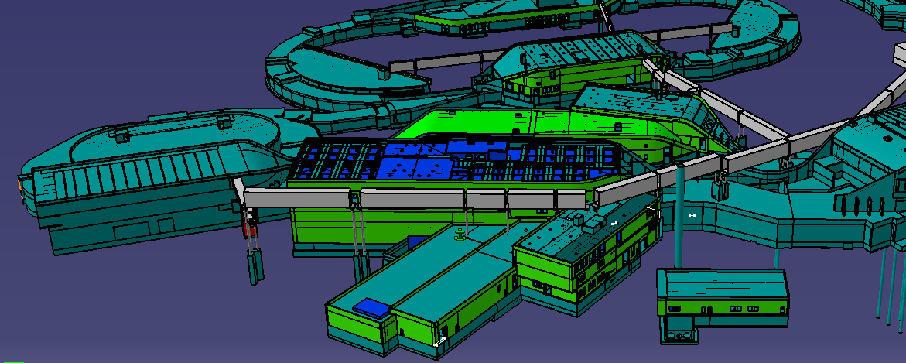
Super-FRS and NUSTAR Caves
All NUSTAR experiments are planned to move into the FAIR buildings in 2022-2024.
Realization planning is ≈3/6 months (caves/CR) behind schedule.
H-ESR
CR
HEB
Super-FRS
LEB

Slide 8
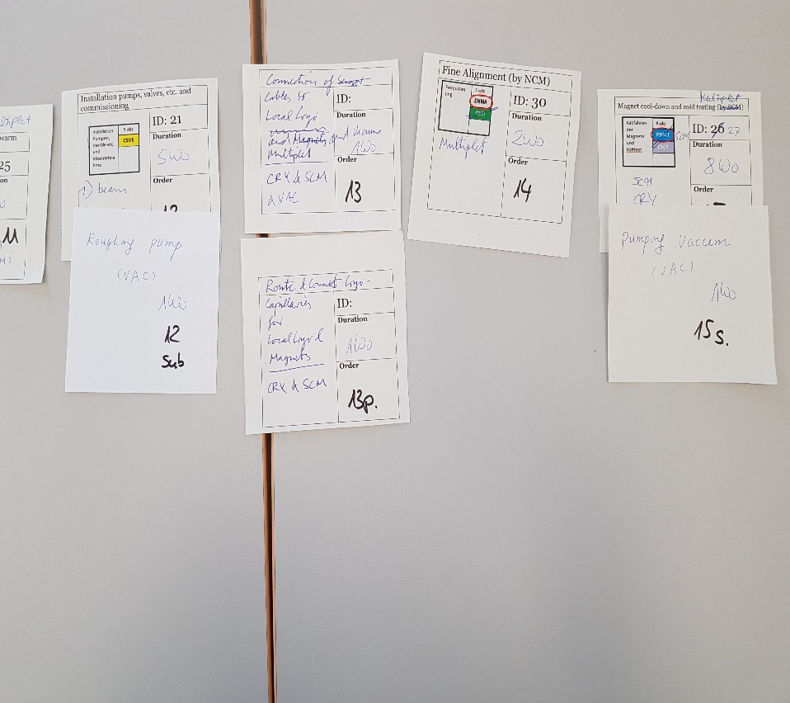
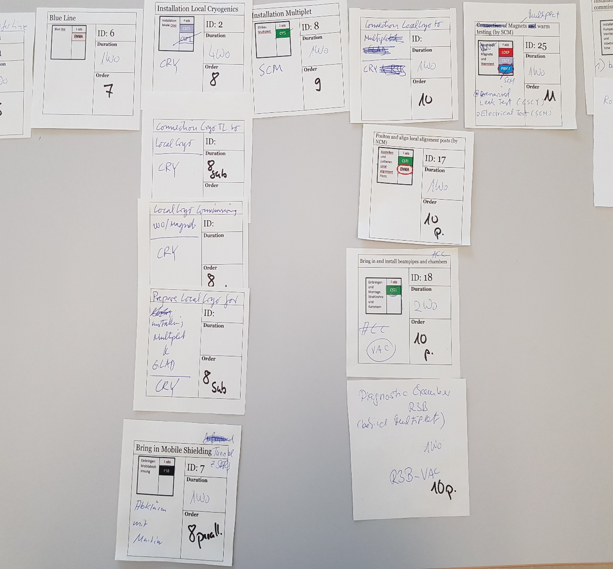
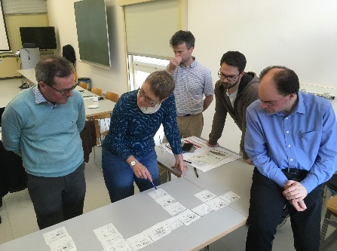
NUSTAR Installation Workshops 2019
How to install technical infrastructure and experimental equipment…
all infrastructure items identified
sequence of installation work defined
required installation personnel specified

Slide 9
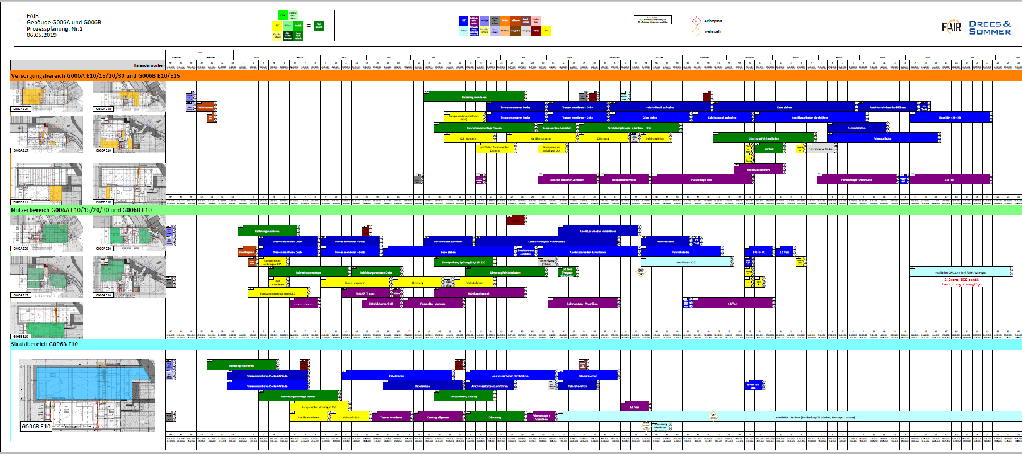
Initial installation plan
result of yet another workshop with building planners…
… will be refined and parallelized in the coming two years

Slide 10
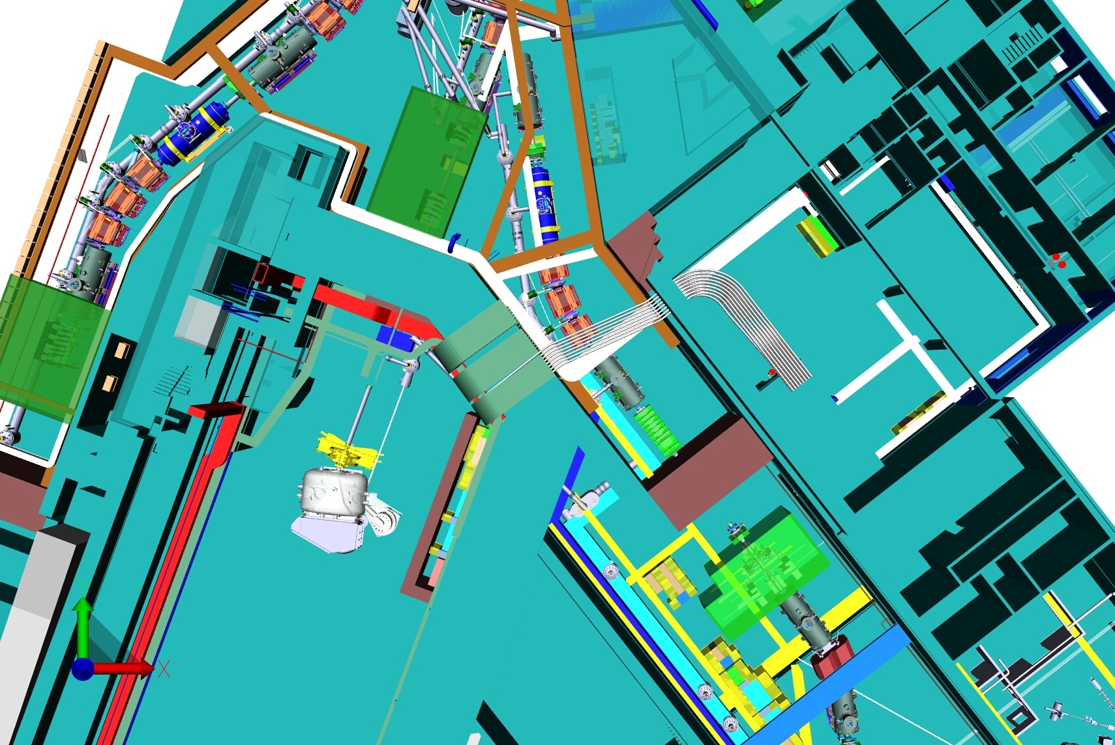
Digital Mock Up
A detailed 3D model of the whole facility helps to avoid collisions
Experiments are asked to provide set-up models to be included in the facility model

Slide 11
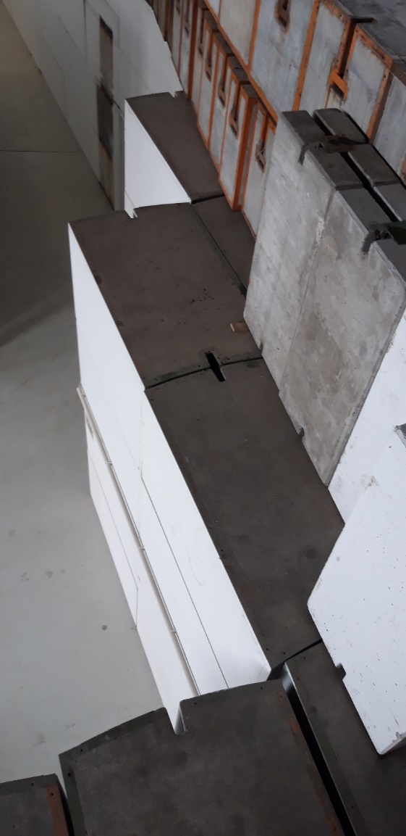
Recent Infrastructure Activities
General NUSTAR Cave Infrastructure is handled by FSB and Super-FRS machine in close consultation and collaboration with NUSTAR.
Cable data base (almost) completed
Detector gas supplies (including LN2) defined
Cooling power needs updated
Electronic racks organized
Concrete shielding blocks organized
Access defined for all doors
UPS and clean power in discussion
….

Slide 12
Critical to Success
Acquiring funding for NUSTAR infrastructure through MoU
Fulfilling all formal safety requirements to be able to operate the planned set-ups
Getting sufficient beam time at GSI for i) testing FAIR/NUSTAR equipment, ii) re-gaining operating experience and iii) training scientists and technicians

Slide 13
LEB Buncher/Spectrometer
Assigned to Accelerator (Super-FRS)
India stepped back from realization
Funding pending
Plan to go for slightly modified Super-FRS multiplets
Dipoles cannot be copied, but are producable by industry
Delivery and testing planned at the end of the Super-FRS sequence…

Slide 14
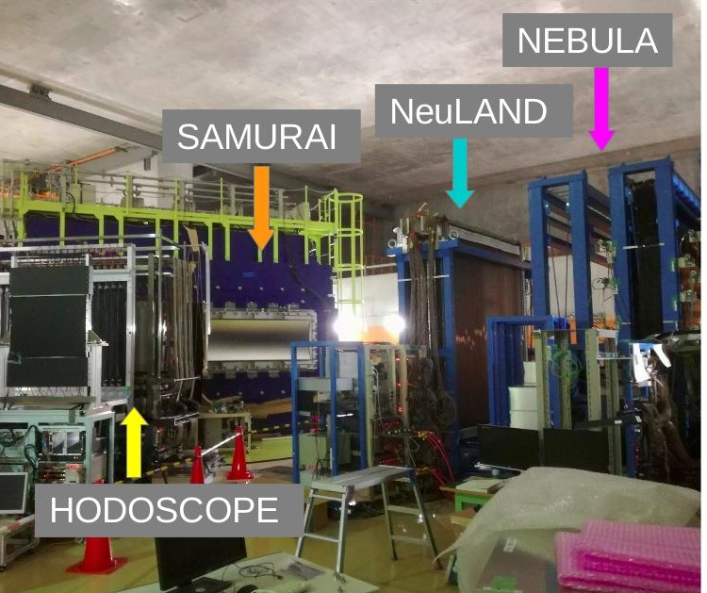
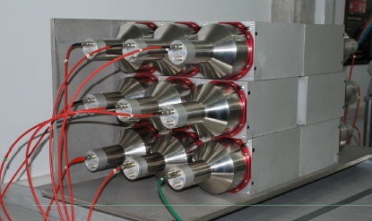
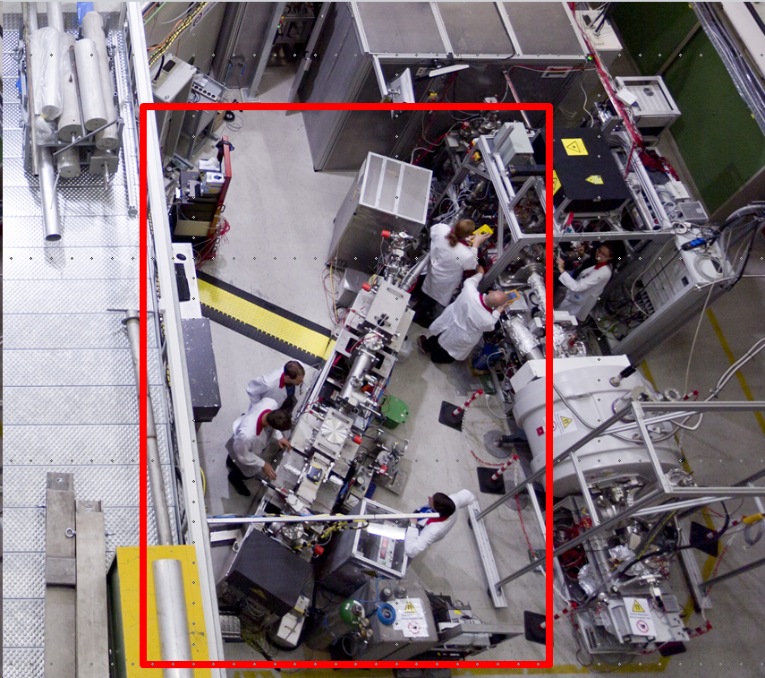
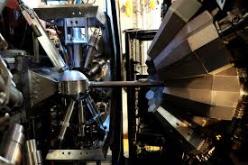
Phase-0 detectors successfully used
DTAS in operation at JYFL
NEULAND in operation at RIKEN
FATIMA
LASPEC
MATS
AGATA
FATIMA in operation at GANIL
MATS/LaSpec at TRIGA Mainz

Slide 15
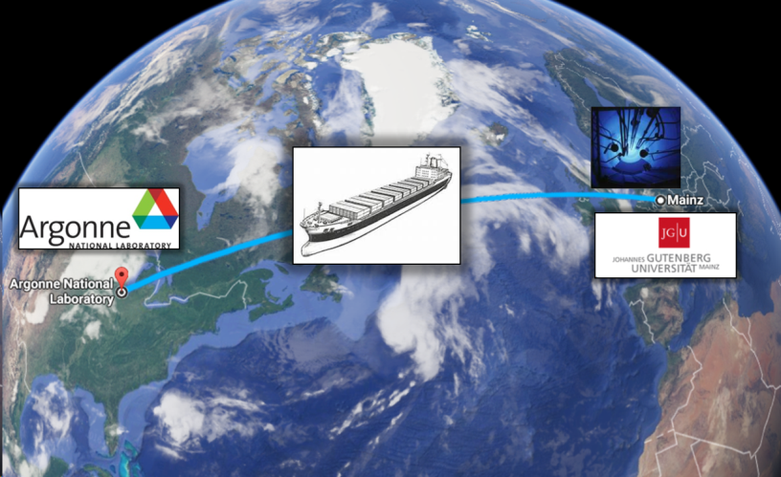

LaSpec – Phase 0 program
TRIGA-LASER Beamline
ATLAS & CARIBU:
Conditions comparable to LEB (Beams at 5 kV)
Perfect place to test and optimize the new prototypes
2021/22: Return to FAIR for Day-1 experiments
MATS/LASPEC at TRIGA Mainz
TDR done

Slide 16
MATS – Phase 0 program
Continued operation of MATS prototype TRIGA-TRAP at research reactor TRIGA Mainz
Technical and methodical developments for mass spectrometry
Characterization and improvements of cryogenic stopping cell for MATS/LASPEC
TDR done

Slide 17
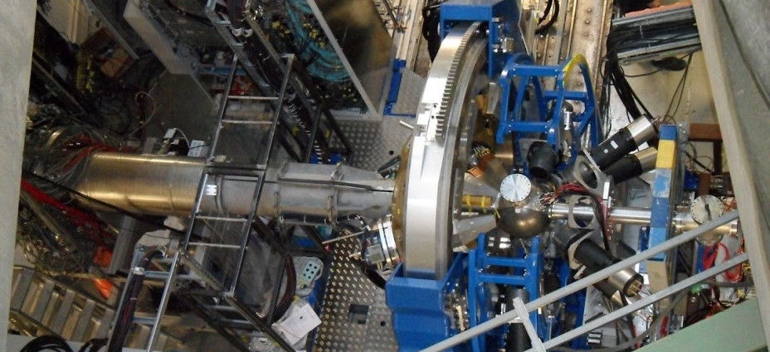
HISPEC – ready for operation
-LYCCA heavy ion calorimeter with ToF capability in operation Day-1
-AGATA gamma spectrometer in operation Day-1
-NEDA Neutron detector array under construction Phase-1
-Hyde light particle array prototype Phase-1
HISPEC-0 was used at GSI in 2012-2014, next utilization on Day-1
TDRs done

Slide 18
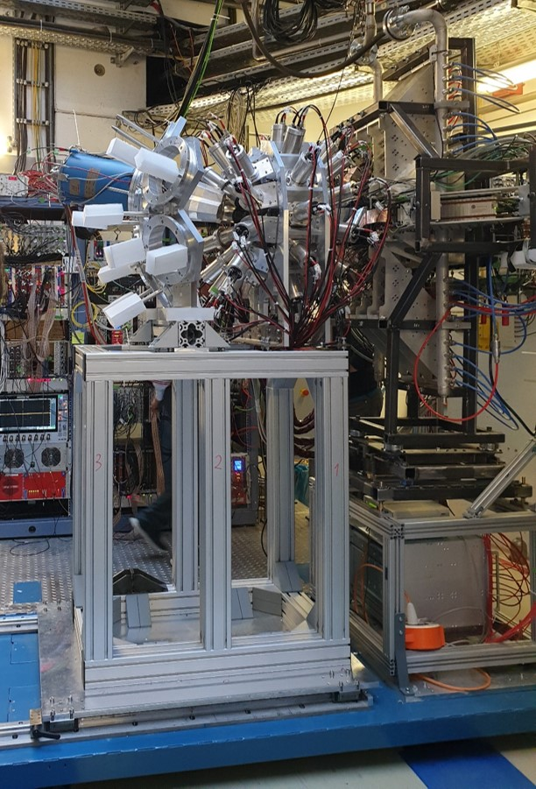
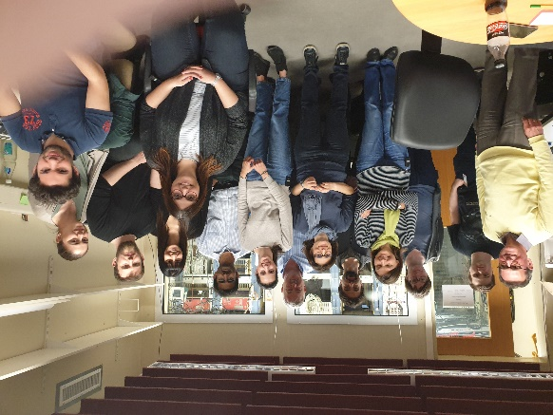
DESPEC at FRS/S4
DESPEC setup at S4 of the FRS First successful test in April
active implanter AIDA
fast beta detector b-plast
fast gamma detector array FATIMA
high-resolution gamma monitor DEGAS/GALILEO
ion timing detector FINGER
EDAQ sub-systems coupled with white rabbit
Purpose of the tests
Check basic functionality of sub-systems
Check white rabbit correlation
Investigate response of detectors to ions and radiation background
Latest news: Time resolution of FATIMA improved from 340 ps to 220 ps by
using TAMEX!

Slide 19
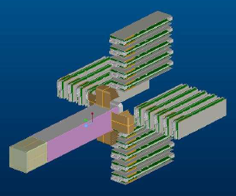
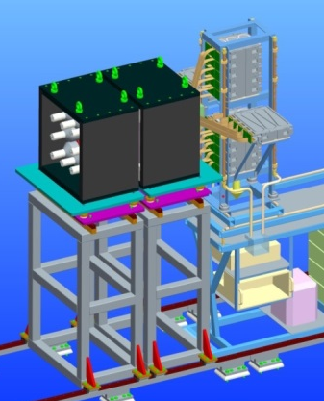
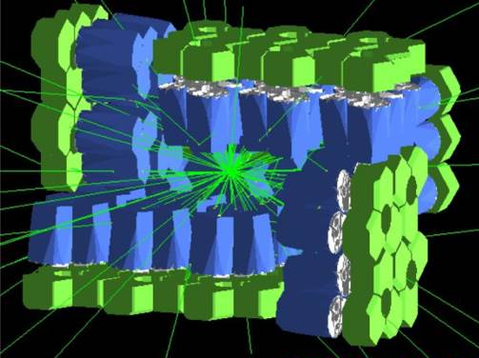
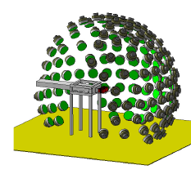
Ingredients for a successful DESPEC Phase-0 programme at GSI
take AIDA as common active implanter
use DTAS to measure β-strength distributions
use FATIMA to measure lifetimes
use DEGAS for high-resolution spectroscopy
use MONSTER to perform neutron spectroscopy

Slide 20
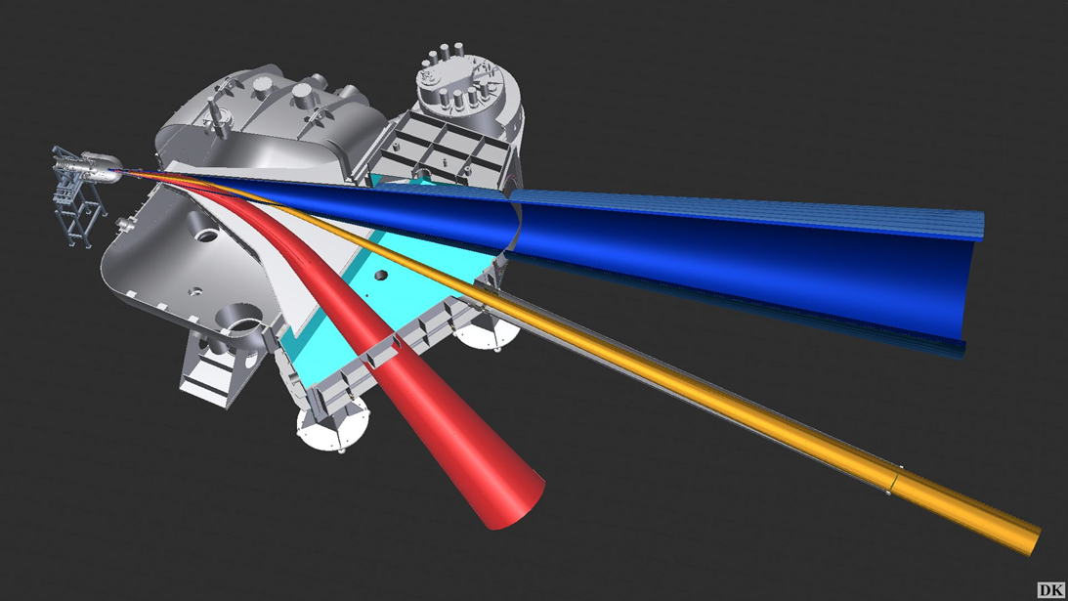

R³B Set-up
CALIFA
Si Tracker
NeuLAND
neutrons
γ-rays
protons
GLAD
Tracking
Detectors
protons
light fragments
heavy fragments
Notes:
20

Slide 21
R³B - Readiness
Experiments Phase O
GLAD : 100% in operation and employed for experiments in Q2 2019
CALIFA: Detector in DEMONSTRATOR configuration ready for experiments
NeuLAND: 40 % of final detector in operation since 2018
L3T Si-Tracker: Detector in 2 layer version not yet in operation (see report by H. Simon)
neutrons
g-rays
protons
Extended commissioning beam time has started, first runs with stable beams have been performed
Dedicated experiments for CALIFA and NeuLAND calibrations have been performed
On-site experienced man-power is required for running and maintenance of the complex equipments
Tracking
Detectors
Day 1
protons
light fragments
Full detector readiness depends on evolution of funding situation
After detector completion, dedicated calibration and commisioning experiments will be needed
heavy fragments
Most TDRs done, Infrastructure and Si-Tracker in preparation
Notes:
21

Slide 22
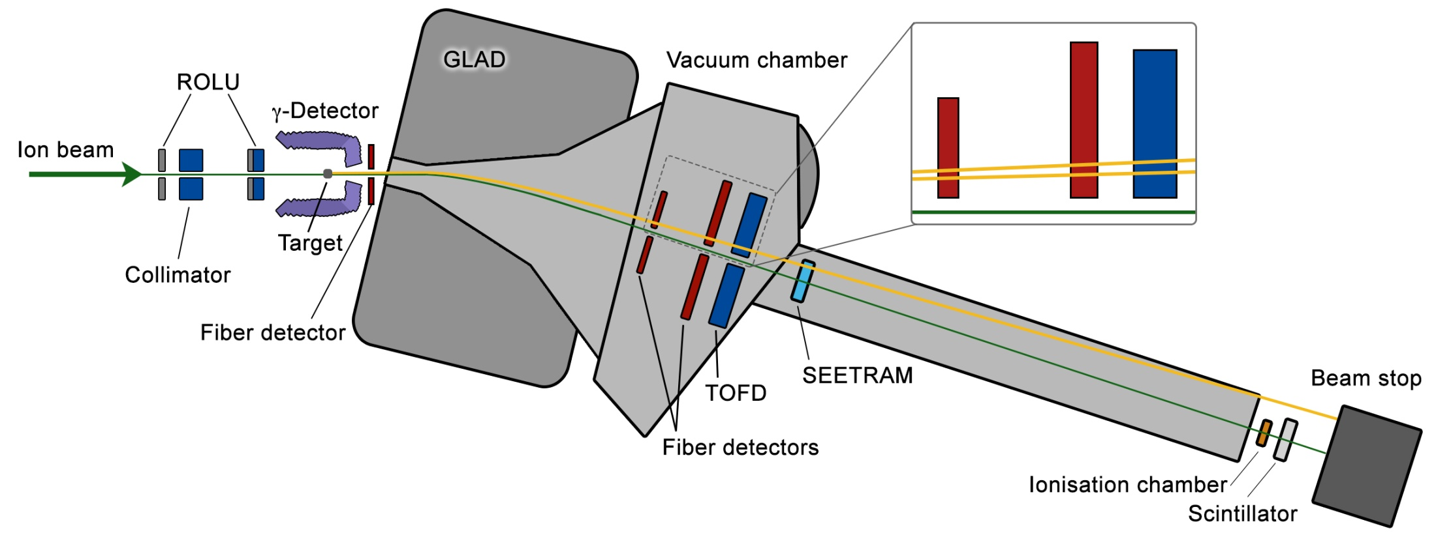
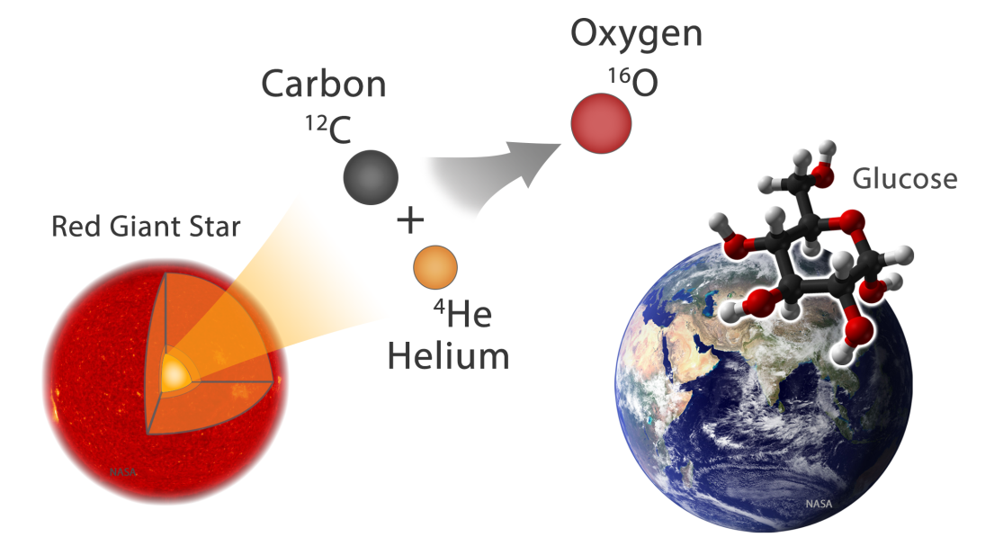
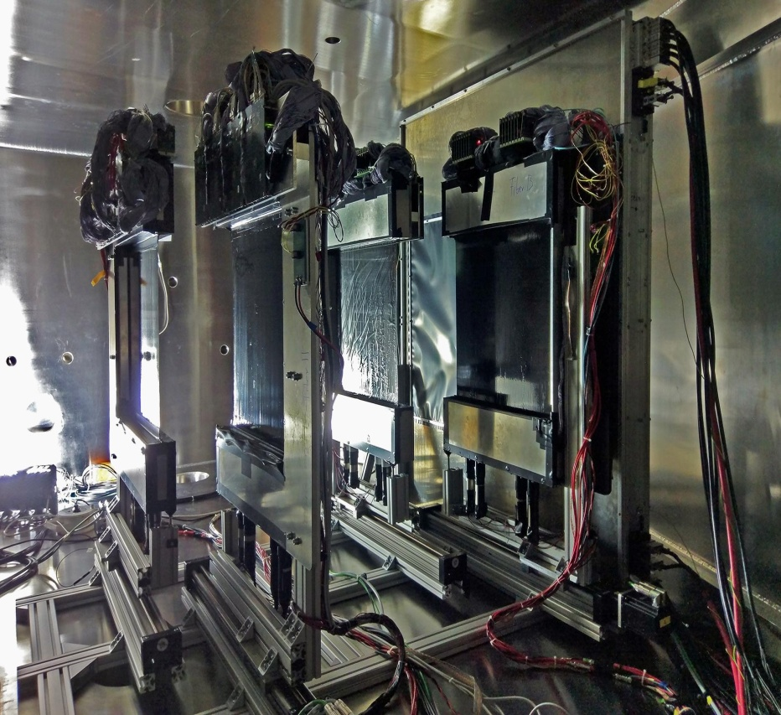
R³B - Coulomb dissociation of ¹⁶O on ²⁰⁸Pb
Challenging Setup
10⁹ pps
K. Göbel, M. Heil, R. Reifarth et al.

Slide 23
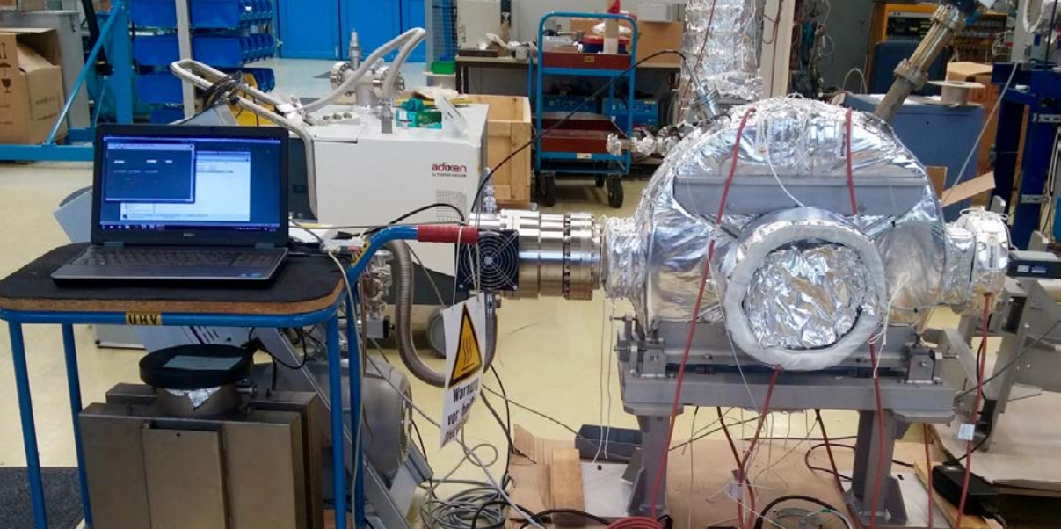
ILIMA Phase-0
New Schottky pickup being tested
Experimental program at ESR and Cryring planned starting in 2020 with already approved experiments
Critical Issues
-Repair of electron cooler drifttubes postponed
-Slow-down required to start ESR-Cryring program

Slide 24
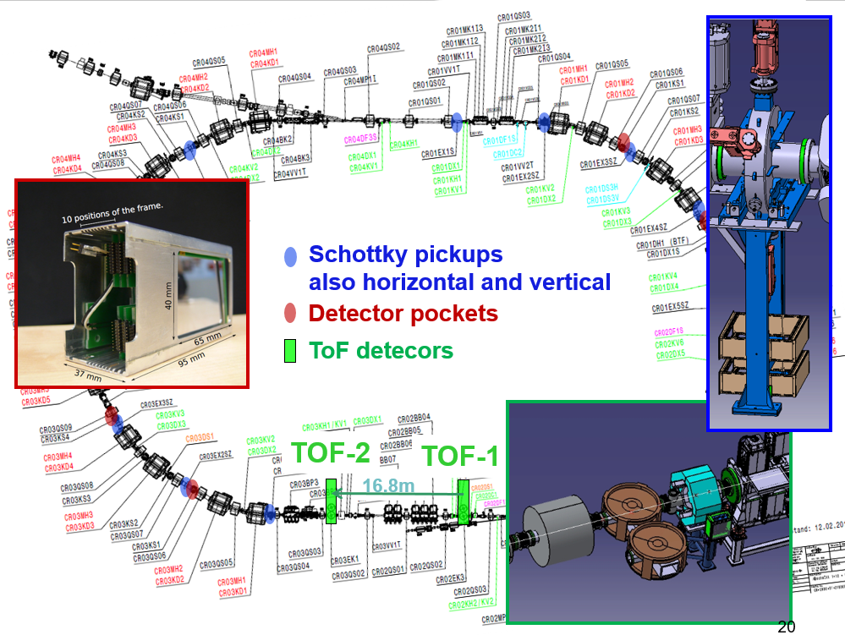
ILIMA – Day-1
Move to CR/H-ESR not before 2026
All TDRs done

Slide 25
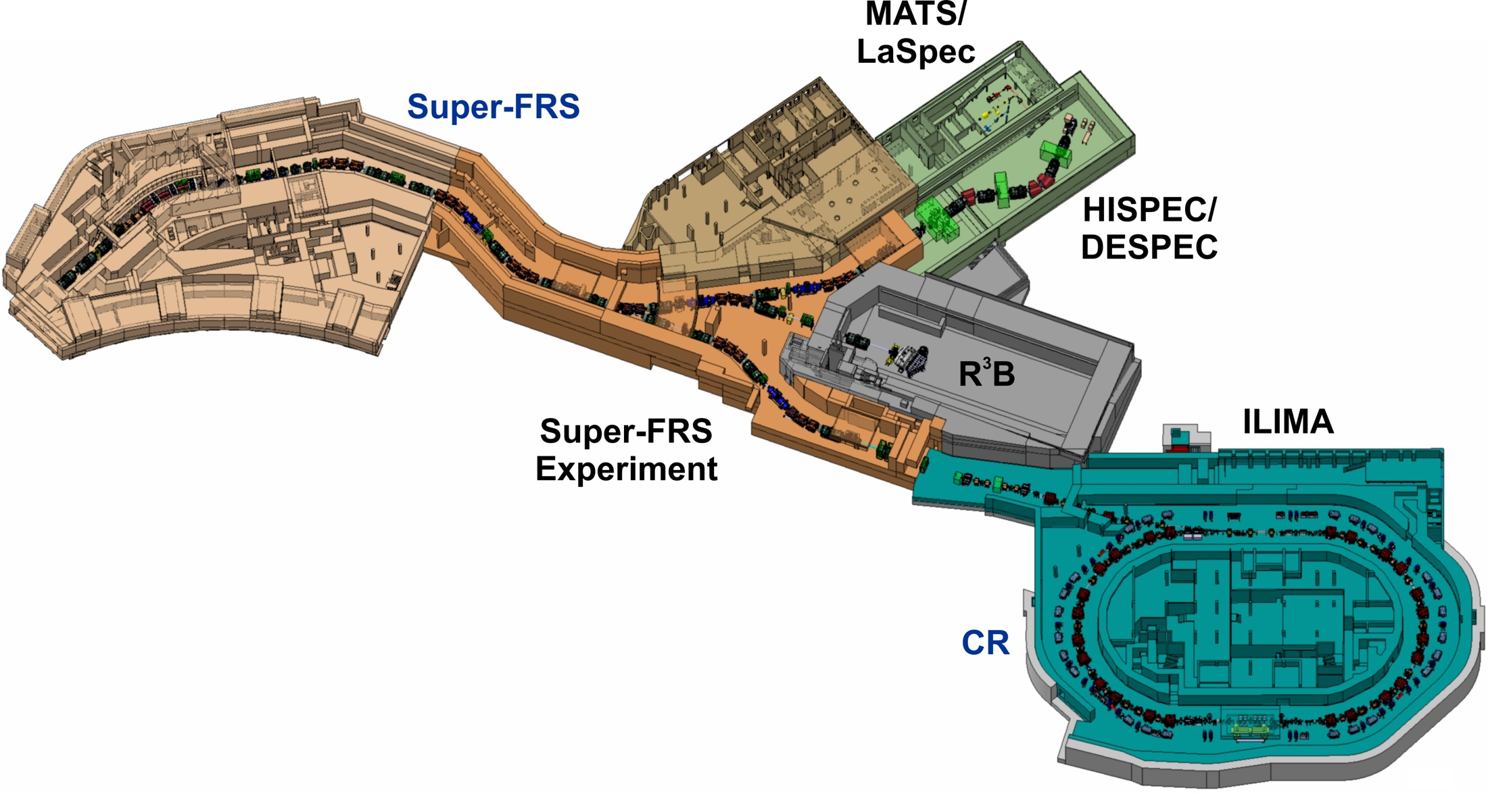
NUSTAR Early Implementation
Super-FRS including the high-energy cave
and a dedicated experimental area in front of it
Commissioning and early physics program
possible with SIS18 beams
Low-energy and ring branch will be taken
consecutively into operation

Slide 26
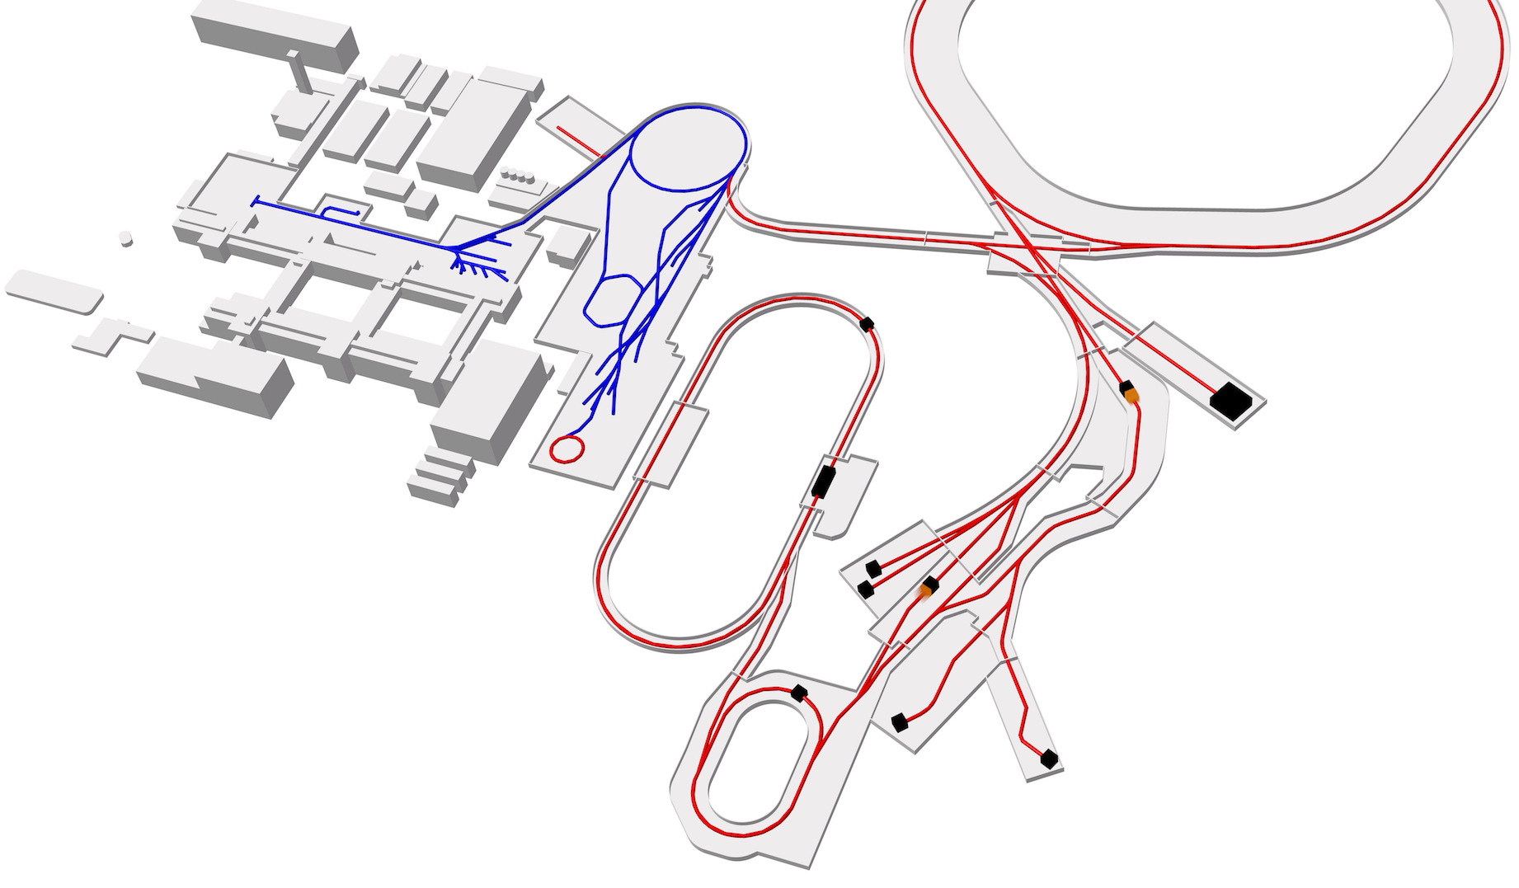
Moving to FAIR
SFRS-CSC S4
currently
DESPEC S4 currently
ILIMA at ESR
from 2020
DESPEC FHF1
early imp. 2025
R3B Cave C currently
DESPEC LEB
from 2026
R3B Cave C from 2025
SFRS-CSC
from 2026
SFRS-CSC
early imp. 2025

Slide 27
DESPEC Time Line
DESPEC Experiments |  | Year
Commission AIDA + FATIMA at FRS |  | 2019
Commissioning and experiment runs Sxxx, S452, S460 |  | 2020
Commission AIDA + DEGAS and run S450 and further experiments to be proposed |  | 2021
Continue commissioning new detectors and performing respective experiments |  | 2022
 |  | 2023
Continue experiments at moderate scale at FRS | Install compact set-up (AIDA+DEGAS) at Super-FRS FHF1 | 2024
 | Commissioning and first experiments at Super-FRS FHF1 | 2025
 | Install full initial DESPEC set-up at LEB and run first experiments | 2026

Slide 28
Conclusions
All NUSTAR Sub-Projects perform experiments in FAIR Phase-0
Preparations for Phase-0 and Day-1 are well advanced, in time, with no apparent show-stoppers (assuming funding, in particular for infrastructure items, will be available in time)
The anticipated set-ups will enable an interesting program with important results
Transition from GSI FRS to FAIR Super-FRS will be done gradually with selected experiments continuing at GSI FRS beyond the start of the Super-FRS

Slide 29
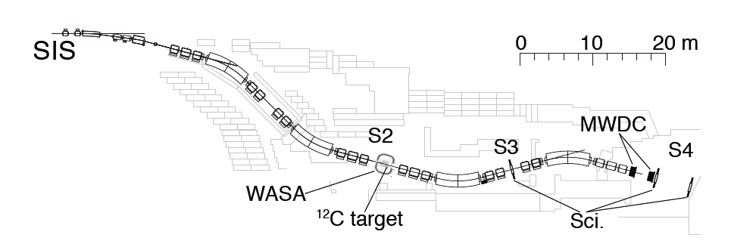
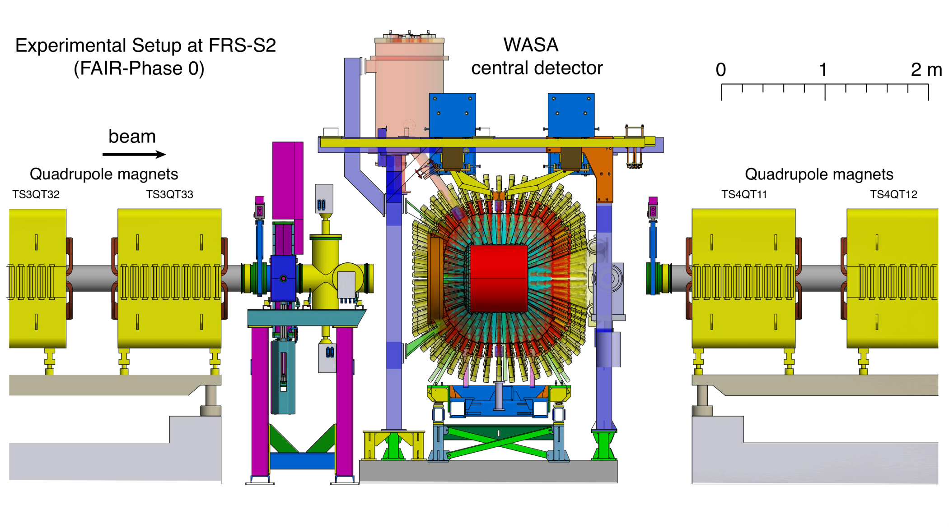
Super-FRS Experiment - WASA set-up
Planned set-up at the FRS
for Hypernuclear experiments in Phase-0

Slide 30
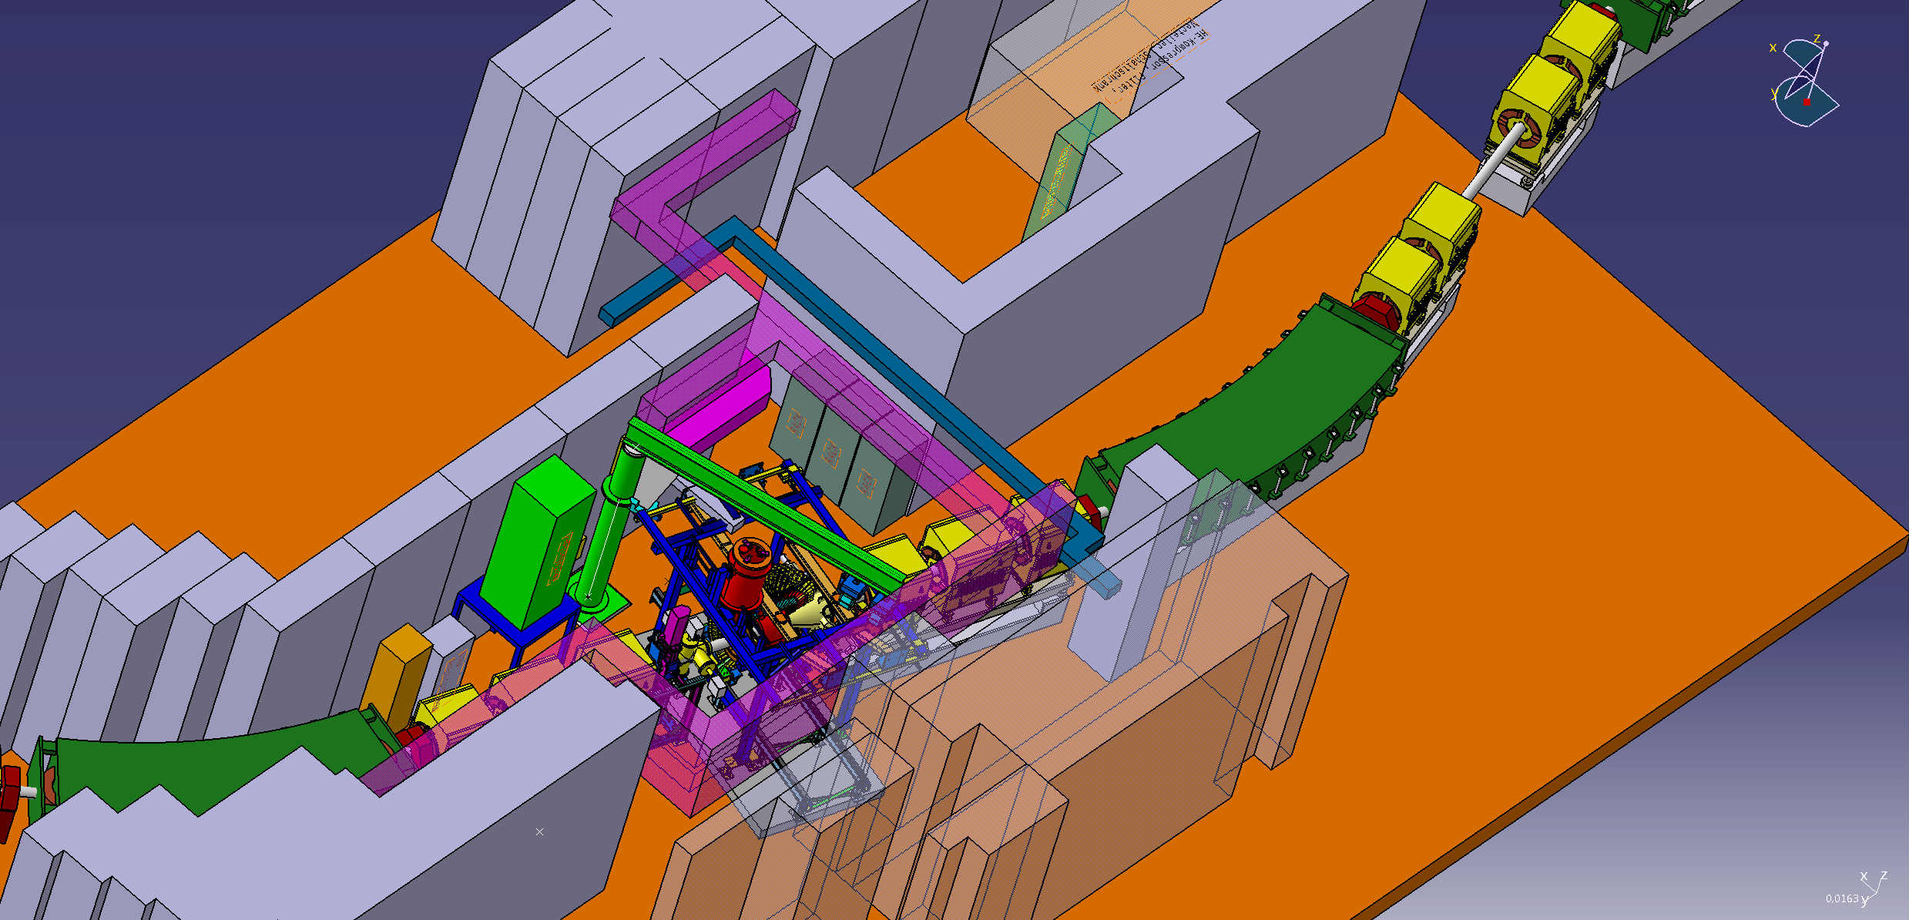
WASA at S2
Set-up and preparation time: 2-3 months planned after beam time period 2020
Experiment performance: Could be early in the beam time period 2021
Removal time: 1-2 weeks directly after beam taking

Slide 31
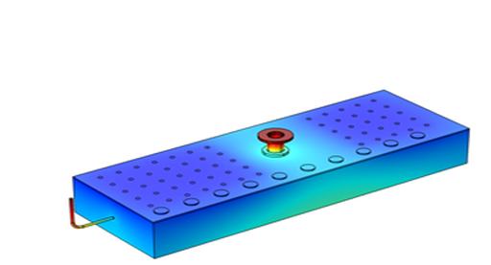
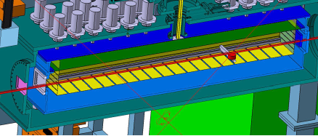
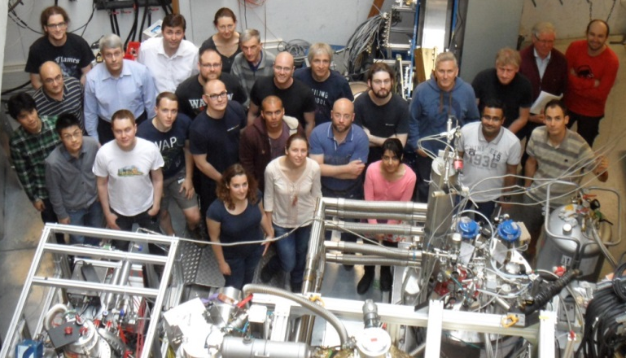
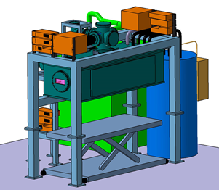
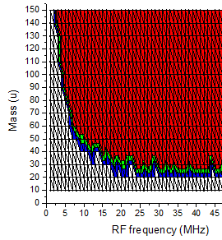
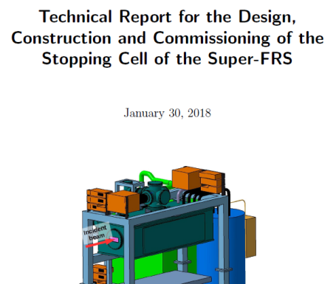
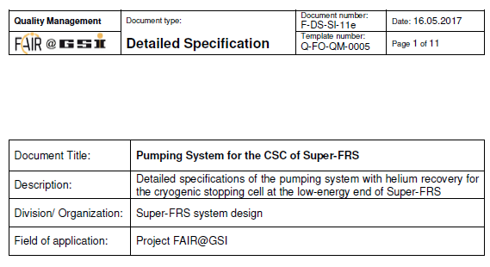
Stopping Cell for the LEB of the Super-FRS
Technical design and construction well advanced
Further tests and first experiments with prototype at the FRS Ion Catcher in FAIR Phase-0
Helium recovery unit:
approved by FAIR Council ;
in-kind contract with Sweden
/ Finland in preparation
TDR in preparation
Collaboration
GSI / JLU Gießen / KVI-CART
Univ. Jyväskylä / ELI-NP / Univ. Tel Aviv

