Slide 1
DEGAS Critical Items
R. Palit, TIFR Mumbai
I. Kojouharov, GSI Darmstadt

Slide 2
Outline
Brief description
Status of various sub-components
  Mechanics of cryostat and vacuum
  Electronics
  BGO back catcher
  Cooling machine
Challenges
Timeline

Slide 3
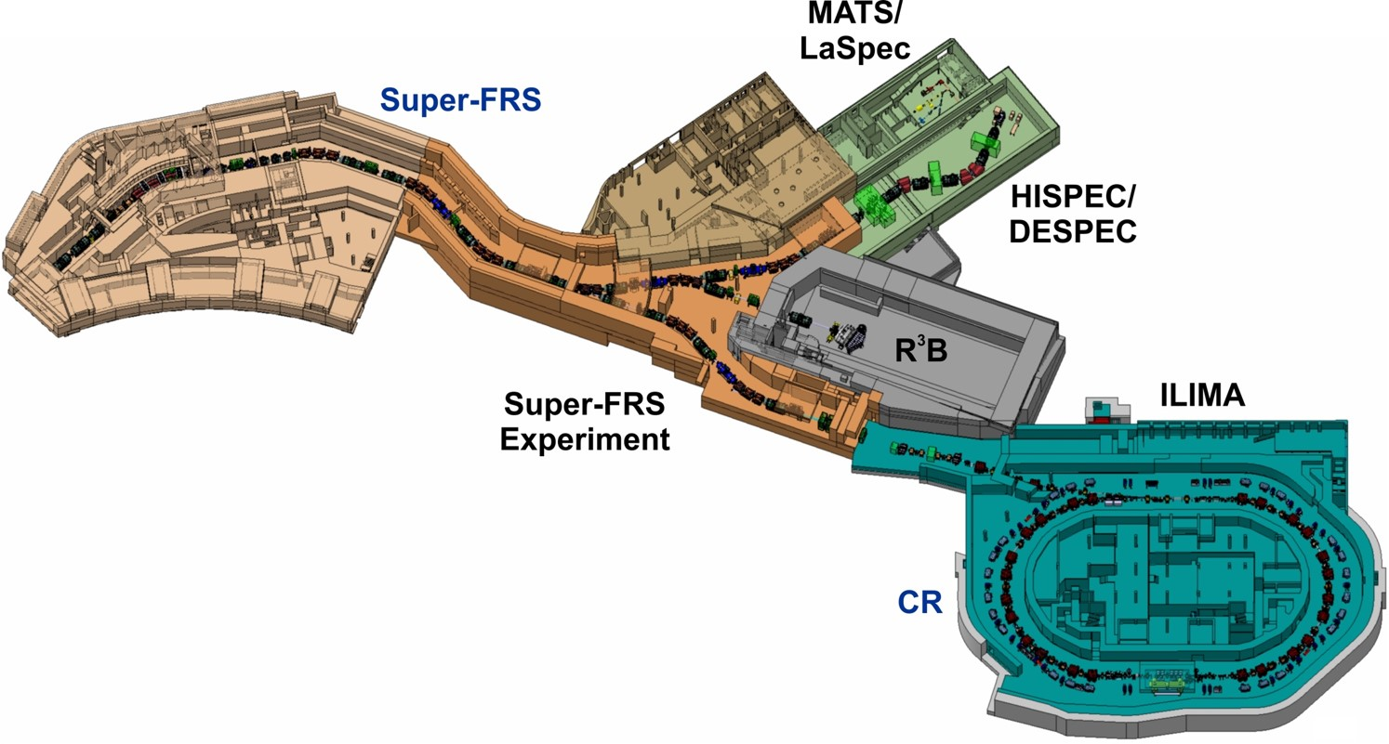
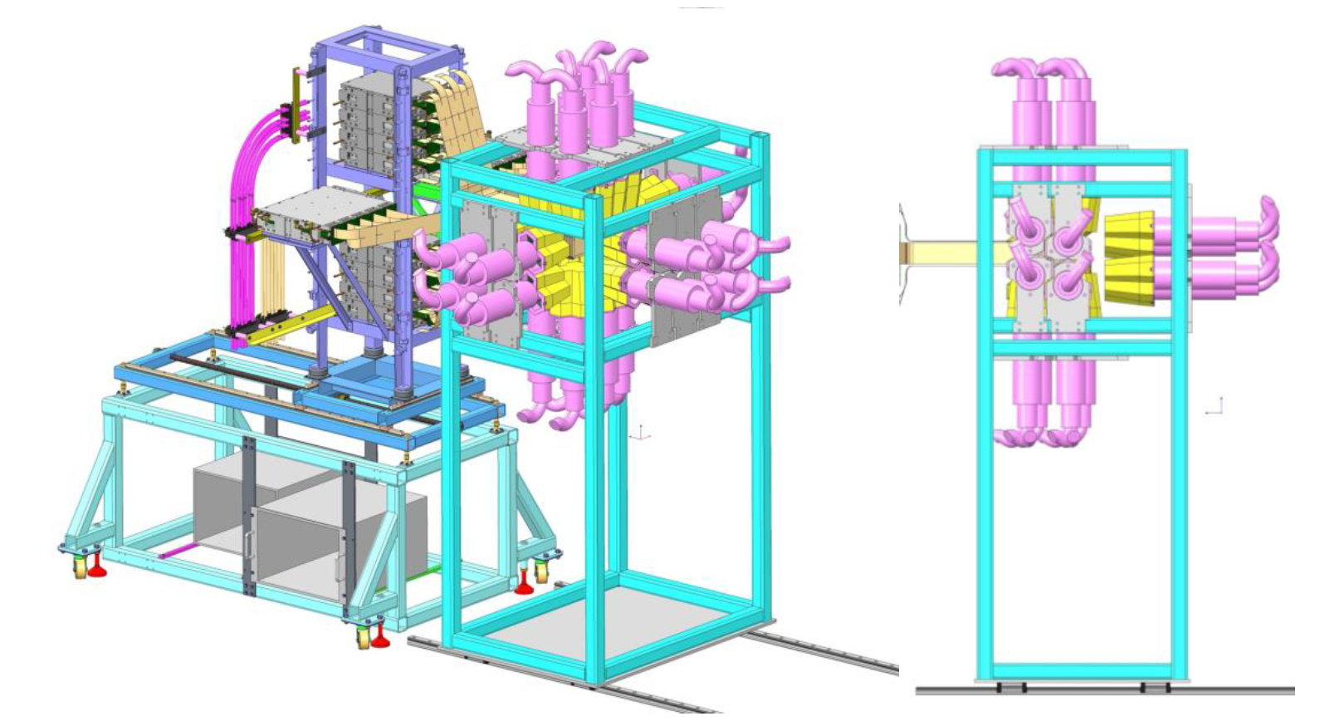
DEGAS – the HPGe array spectrometer for NUSTAR
1. HISPEC/DESPEC at NuSTAR
DESPEC (DEcay SPECtroscopy)
Runs DEGAS as the basic spectrometger
Collaboration of:
Germany
India
Turkey
Romania
Spain
Sweden
UK
Finland

Slide 4
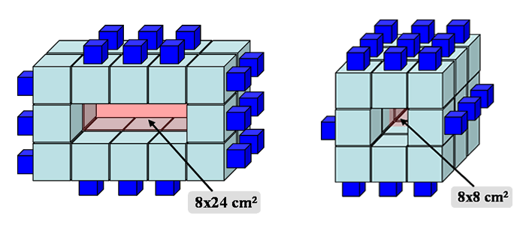
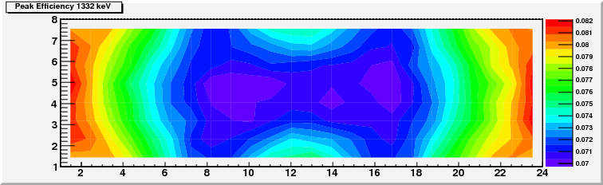
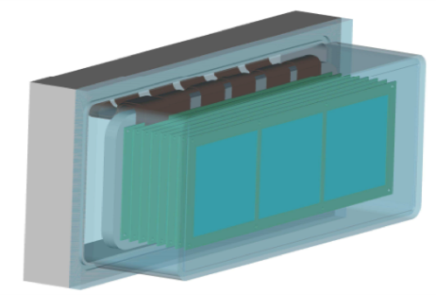
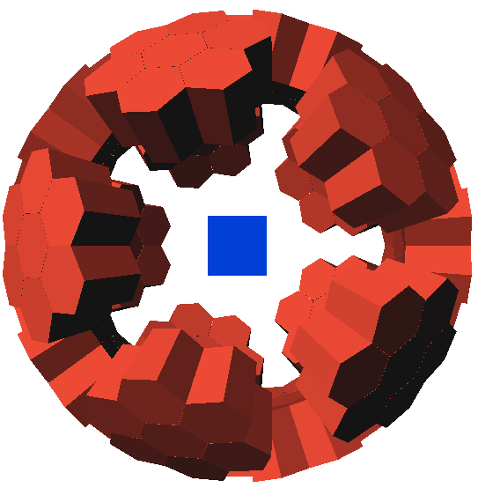
DEGAS – the HPGe array spectrometer for NUSTAR
2. DESPEC setup
Extensive simulations have been done over the years in order to evaluate the efficiency and the overall performance of the HPGe detector array. Starting from a planar detector array…
Property | RISING | Phase I | Phase II | Phase III
Array type | Composite Ge detector array | Composite Ge detector array | Phase I complem. by γ-tracking dets. | γ-imaging array
Energy range (keV) | 50-5000 | 50-5000 | 50-5000 | 50-5000
Noise threshold (keV) | 24 | 15 | 15 | 10
Energy resolution (at 1.3 MeV) | 2.3 keV | 2.3 keV | 2.3 keV | 2.0 keV
Full energy γ-detection efficiency (at 1 MeV) | 16% | 16% | 18% | >20%
Effective full energy efficiency after prompt flash blinding | 13.9% | 14% | 16% | 20%
P/T-value | 34% | 34% | 40% | >50%
Time resolution (at 1.3 MeV) | 13 ns | 10 ns | 10 ns | < 10 ns
Overload recovery time | ≤ 1ms | 100 ns/MeV | 100 ns/MeV | 100 ns/MeV
Relative background suppression | 1 | 5 | 10 | 100
Coverable implantation area | 16 x 8 cm² | 24 x 8 cm² | 24 x 8 cm² | 24 x 8 cm²
Max. acceptable event rate (kHz) | 3.5 | 10 | 10 | 10
The planar array (2004) and the peak efficiency (2008)
The model of the AIDA implantation detector with its Al housing as considered in the simulations
RISING “stopped beam” configuration coupled with the short AIDA implantation detector.

Slide 5
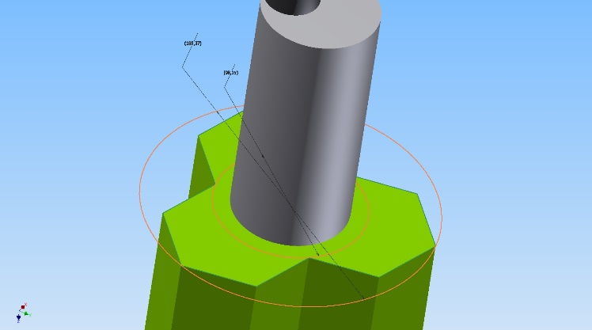
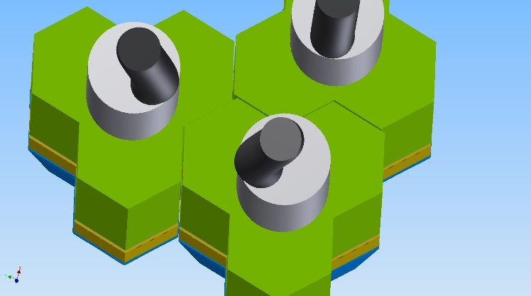
DEGAS – the HPGe array spectrometer for NUSTAR
3. DEGAS detector
DEGAS Constraints
Physical - The geometry
Functional - Too small dewar would require too frequent filling – LN2 boiling interference, reliability, too little time for reaction by alert etc.
Reliability – LN2 systems for refilling are not sufficiently reliable and too frequent filling increases the risk of failure unacceptably. Not only the filling system…
The “box” geometry does not, the dewar diameter must be no larger of the detector head size.
The spherical geometry tolerates any size of the dewar

Slide 6
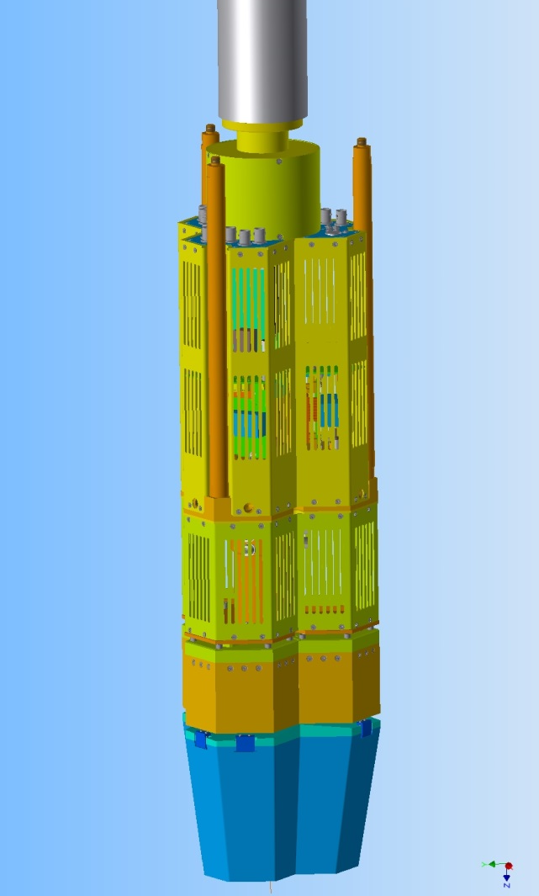
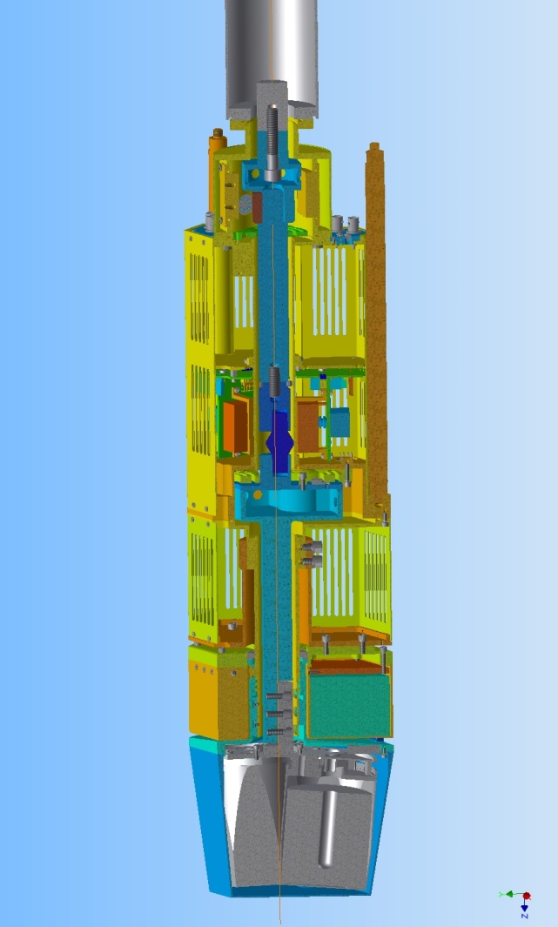
DEGAS detector
XC-2 Engine
Holding bars
Connectors
Top Deck
(Support electronics,
power supply and µPC)
Middle deck
(Ge-PA + HV)
Bottom Deck
(BC electronics,
later Ge-DAQ)
Backcatcher
Crystal capsule
HPGe Crystal

Slide 7
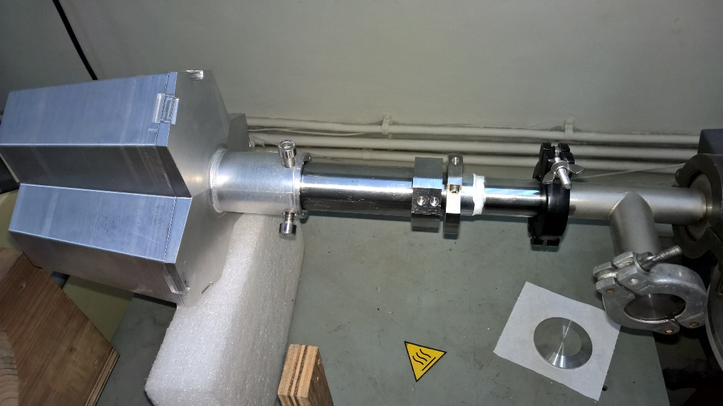
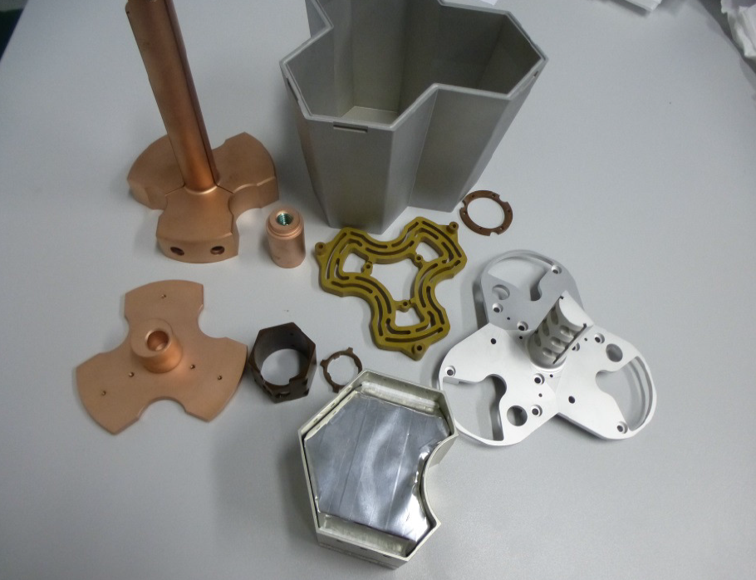
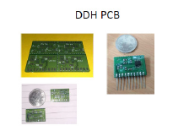
DEGAS Components
Encapsulated HPGe crystals in the cryostat with electrical cooling.
The detector consist of: 38 producible components (some of
them several pieces per cryostat)- Cu, stainless steel, Al.
High vacuum.
Signal processing electronics.
DEGAS detector

Slide 8
Power Dissipation
Current 6.4 W
TDR 7 W
Range of
Operating T

Slide 9
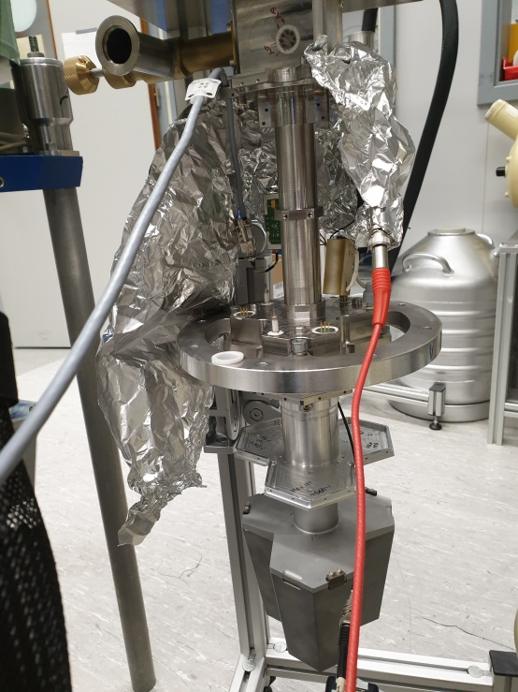
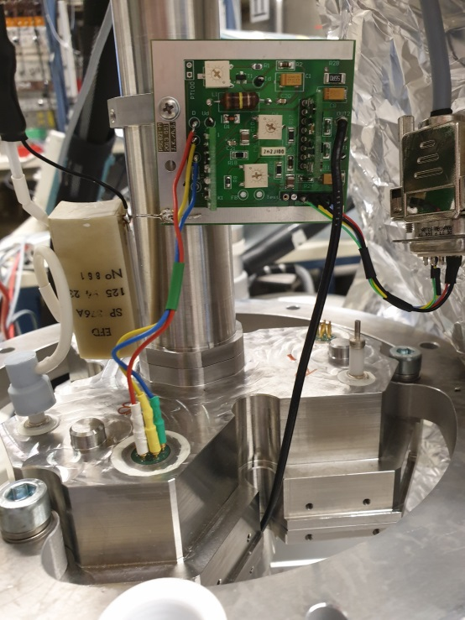
Assembly and spectroscopy test of DEGAS, June 2019
The energy resolution of 2.8 keV (with 3 µs shaping time) is measured at 1332 keV line of 60-Co. The reason for the poor energy resolution is the too high temperature of the capsules which does not allow full biasing of the capsules.
Flying assembly! The DEGAS preamplifier is developed and tested, however not in the DEGAS form factor. In this test a preamplifier PSC821M, successfully operating with EURIKA, has been used.
I. Kojouharov et al., GSI, Darmstadt

Slide 10
Status Report
I. Kojouharov, GSI Darmstadt
Cold frame (Al)
What is the thermal transfer from the various components?
What is the lifting power of the XC?
Preamplifier lid (plastic)
Detector head lid (Al)
Detector head end cap (Al)
Capsule lid (Al)
Capsule (Al)
HPGe Crystal (Ge)

Slide 11
Power Dissipation
6.4 W

Slide 12
Thermal Calibration and cooling deficit
The Cold Flex calibration. Further it will be used to measure the overall thermal transfer through the Cold Finger.
The XC shows sign of exhausting
The same thermal calibration, but on June 2019. A cooling deficit is observed and this is also a signature for the forthcoming X-Cooler failure.
I. Kojouharov et al., GSI, Darmstadt

Slide 13
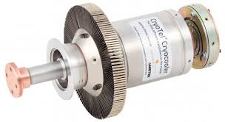
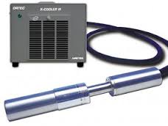
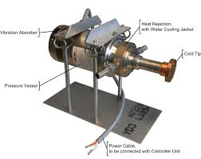
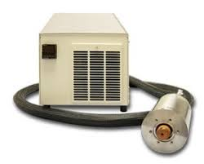
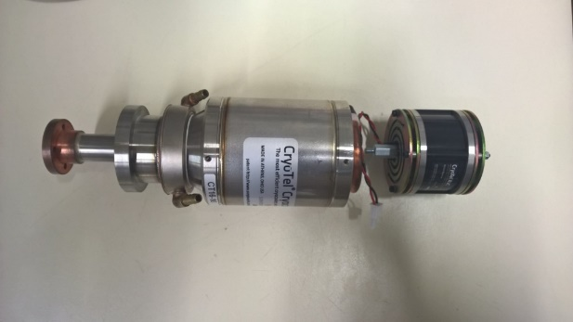
Electrical cooling of HPGe detectors
1. Cooling and coolers – available engines
Air cooled
Water cooled
MMR/ORTEC X-Cooler II or III
SunPower/ORTEC Type CT or GT

Slide 14
Cooling Scheme
XC II
  (Original XC2 for DEGAS)
  (Company will not provide service) (Upkeep is impossible)
XC III
  (Designed to improve the vacuum degradation)
  (Thermal link will be weak for composite detectors)
CT
  High power (Stirling cycle)
  Microphonics noise, special adapter for noise cancellation
  Costly, Long Delivery time
Small LN₂ dewar
  With improved design thermal load can be reduced

Slide 15
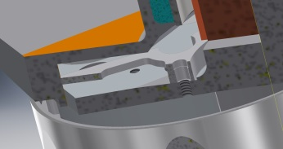
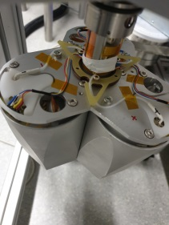
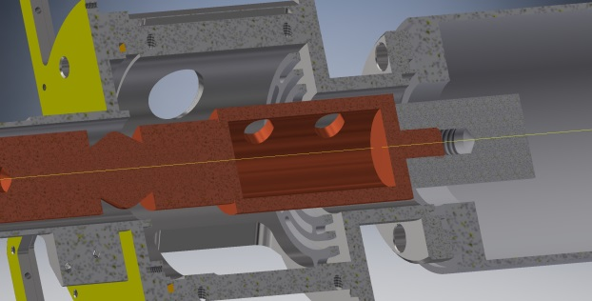
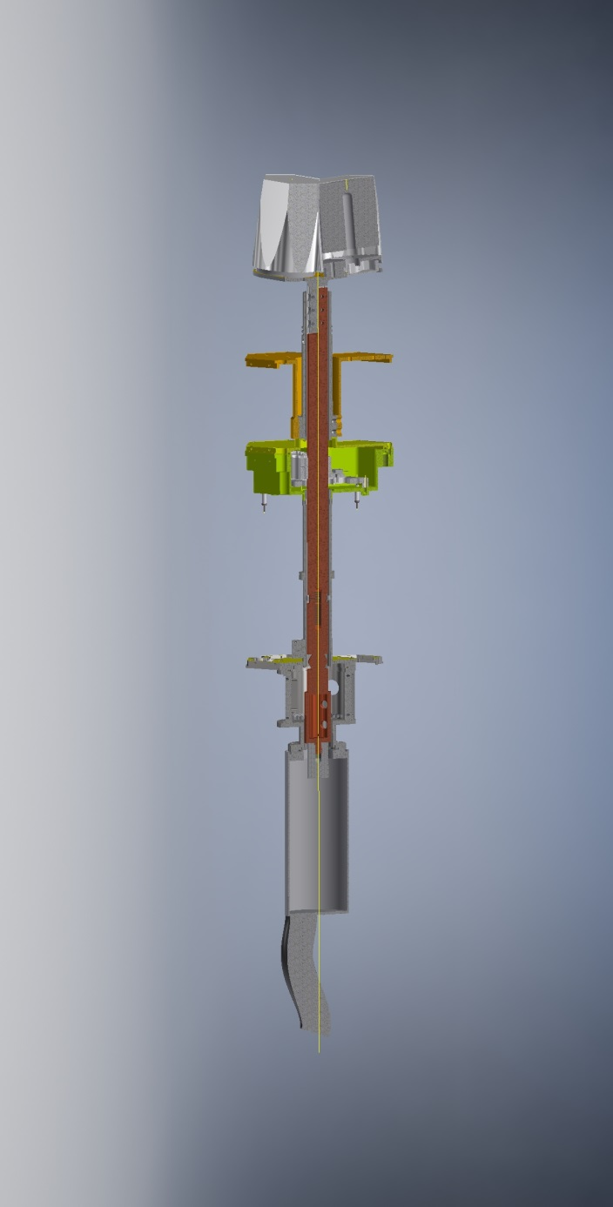
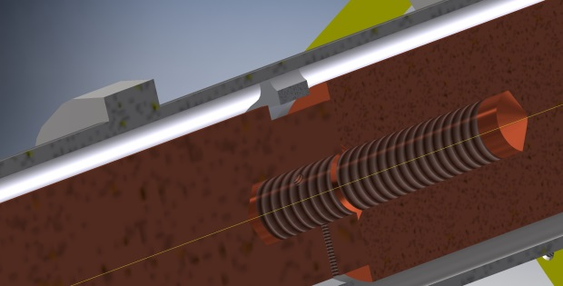

Status Report
Assembly Phase 2
First spacer
The DEGAS structure has been rebuilt in a way to simplify the cold line and to reduce the thermal bridges (Fig.1). Four Pt100 have been applied (initially only three):
one at the start absorber container, close to the cold flex.
one at the cold finger, close to the cold flex (additionally installed)
one at the main absorber container
one at the cold frame.
The section of the cold finger between the second spacer and the main absorber container has been wrapped with super-insulation and additionally with 14 turns Al-Mylar. The section of the cold finger between main absorber container and the cold frame has been wrapped with Al-Mylar 28 turns. Thermal bridges are:
- first spacer – fixed to the cryostat wall, loose connection to the cold finger.
- second spacer – fixed to the cold finger, loose connection to the cryostat tube.
- main labyrinth – fixed to the main absorber container (which is fixed to the cold finger) and fixed to the cryostat wall
Cold Frame spacer
Here Al-Mylar is applied
1 x Pt100
Main Absorber Container
Cold frame (Al)
Second spacer
Main labyrinth
1 x Pt100
Detector head lid (Al)
Here Superinsulation is applied
Second spacer
Start Absorber Container
2 x Pt100
First spacer
- cold frame spacer- fixed to the cold frame, loose connection to the end cap lid.
connection wires – 3 x HV in teflon tubes, 12 x signals, 8 x Pt100 and 2 x heating resistor. All the wires except the heating resistor are very thin – 0.15 mm², teflon insulation.
Cold Flex from XC used.
Fig.1. DEGAS Structure.

Slide 16
Conclusions
I. Kojouharov, GSI Darmstadt
Further optimization of the Cold Line of DEGAS.
Change/repair of the cooling engine.
Change the type of the cooling engine.
(Replace the X-Cooler II cooling engine with the SunPower CT cooling engine.)
Further development, test and production of the Backcatcher readout electronics. Equipping the Back-catchers with the readout, test and commissioning.
Timeline 2021 (phase 0) Early implementation 2025
Funding issue 15 to 20%

Slide 17
Status Report
Thank you

Slide 18
Electrical cooling of HPGe detectors
1. Cooling and coolers – available engines
 | MMR XC | SP CT
Cooling (total) power | 11 W (240V/500W) | 11W (24V/120W)
End temperature | -187 °C | -220 °C
Vibrations | very low | high
Life (reliability) | unknown, 3-7 Years | unknown, >200 000 h
Compactness | low | high
Principle | J-T | Stirling

Slide 19
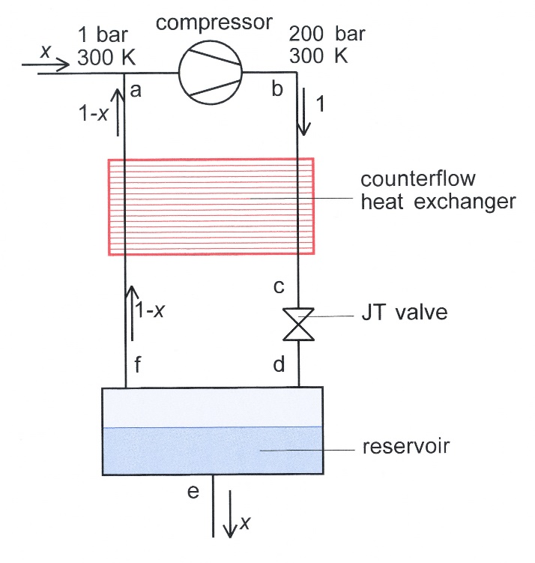
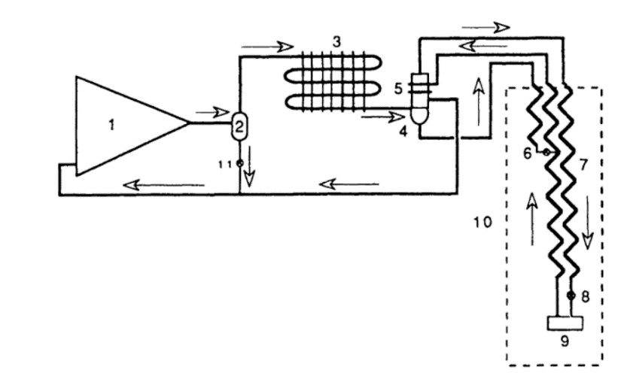
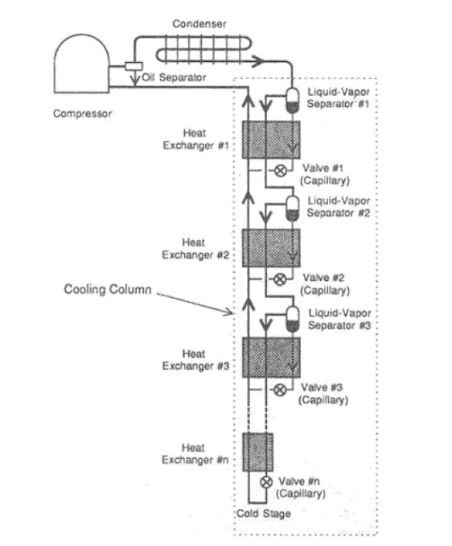
Electrical cooling of HPGe detectors
1. Cooling and coolers – the Linde cooler (Joule-Thompson cooler) and the Kleemenko cooler
Kleemenko cycle(right) and the MMR cooler X-Cooler (left). Uses multicomponents cooling agent.
From Cryocoolers 9, edited by R.G.Ross Jr.
A schematic diagram of a JT liquefier is shown left. It consists of a compressor, a counterflow heat exchanger, a JT valve, and a reservoir. The pressures and temperatures refer to the case of a nitrogen liquefier. At the inlet of the compressor the gas is at room temperature (300 K) and a pressure of 1 bar (point a). The compression heat is removed by cooling water. After compression the gas temperature is ambient temperature (300 K) and the pressure is 200 bar (point b). Next it enters the warm (high-pressure) side of the counterflow heat exchanger where it is precooled. It leaves the exchanger at point c. After the JT expansion, point d, it has a tempe-rature of 77.36 K and a pressure of 1 bar. The liquid fraction is x. The liquid leaves the system at the bottom of the reservoir (point e) and the gas (fraction 1 − x) flows into the cold (low-pressure) side of the counterflow heat exchanger (point f). It leaves the heat exchanger at room temperature (point a).

Slide 20
Electrical cooling of HPGe detectors
1. Cooling and coolers – the Stirling cooler
The Stirling cycle is a thermodynamic closed cycle invented in 1816 by the Scottish minister Robert Stirling.
In position I, all helium is at room temperature in space D. Going to position II, this gas is compressed by piston B increasing the gas temperature to about 80°C, refer to figure 2, column 1. When the displacer C moves down from position II to III, the gas is displaced from space D to space E, forcing it first through the cooler H where the compression heat is dissipated into the cooling water, reducing the gas tempe-rature to about 15°C (column 2). Next, the helium flows through regenerator G. Using the cold which was stored in the regenerator by the previous cycle, the helium gas is cooled to almost the final liquefaction temperature when arriving in space E (column 3). The final and main action is the displacer and piston moving down to position IV, expanding the helium gas. This expansion creates the actual cooling power in the cold heat exchanger J (column 3), cooling the customers process.
Graphics by Stirling Cryogenics BV, Netherlands

