Slide 1
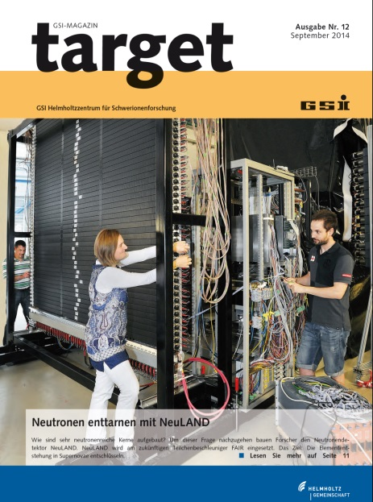
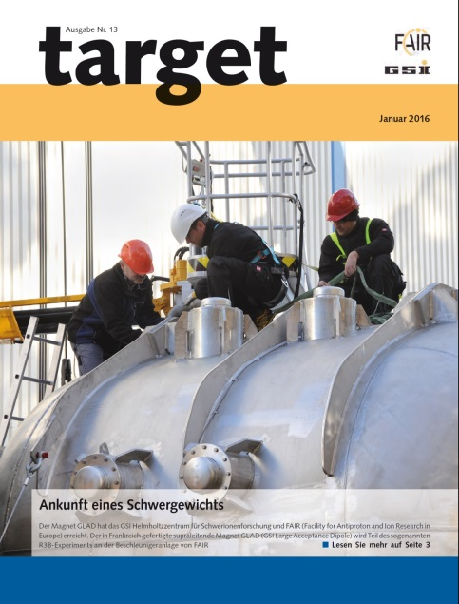
R³B critical items
ECE 11 and ECSG 02
Meeting 20191104-05
GSI Darmstadt
LOS Start detector
H. Simon ● GSI Darmstadt

Slide 2
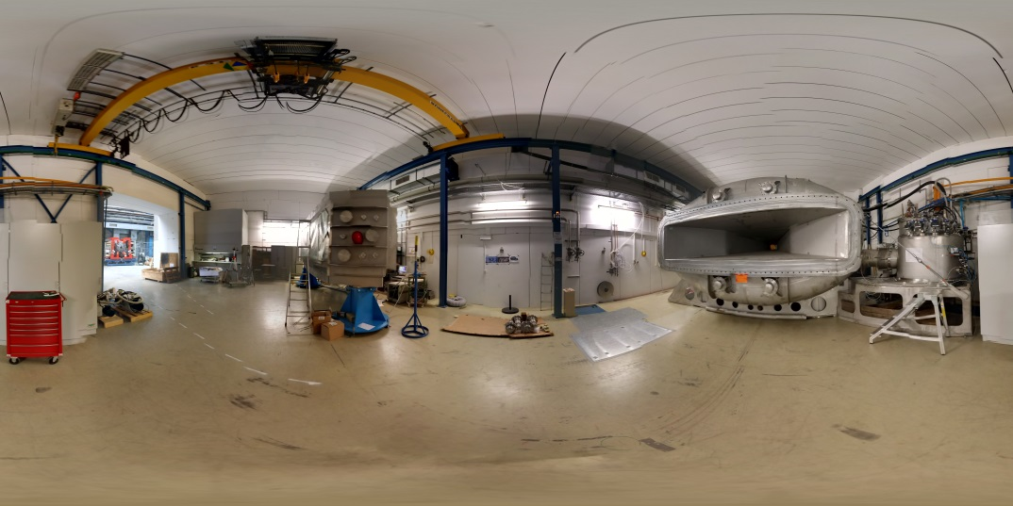
Starting point 2016

Slide 3
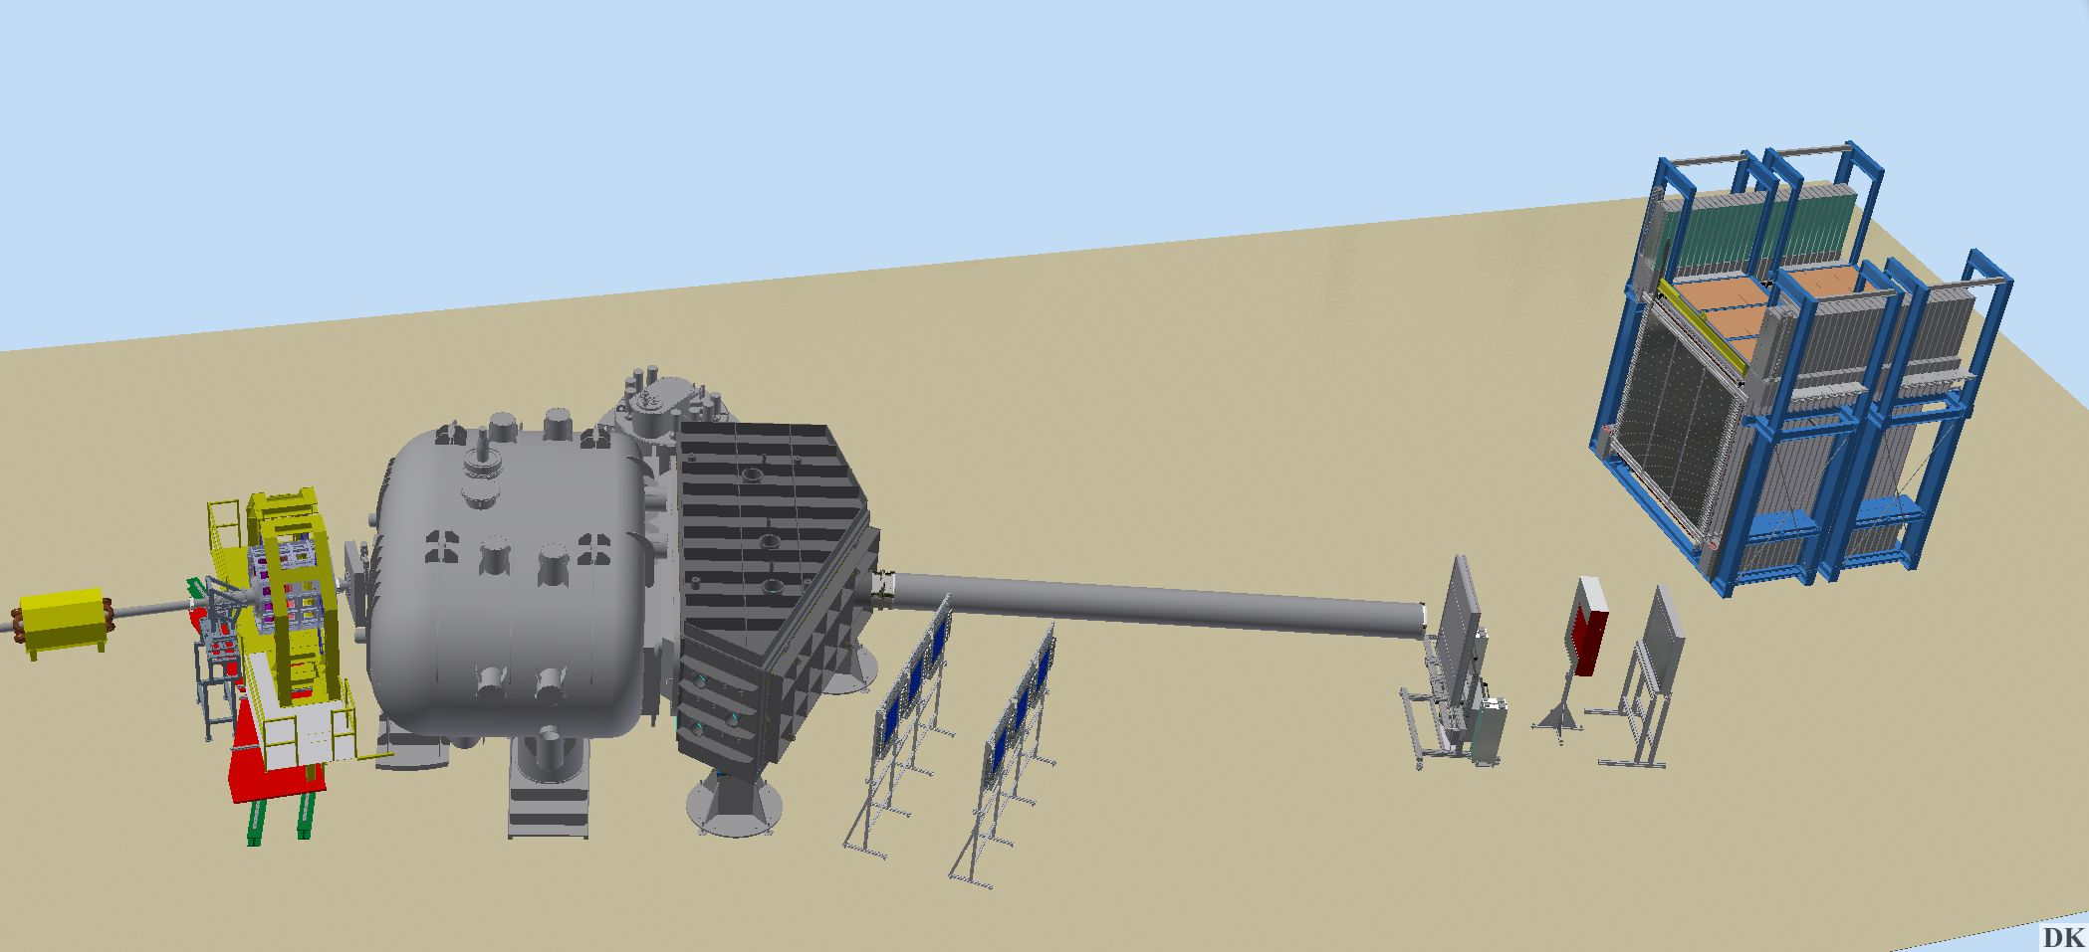
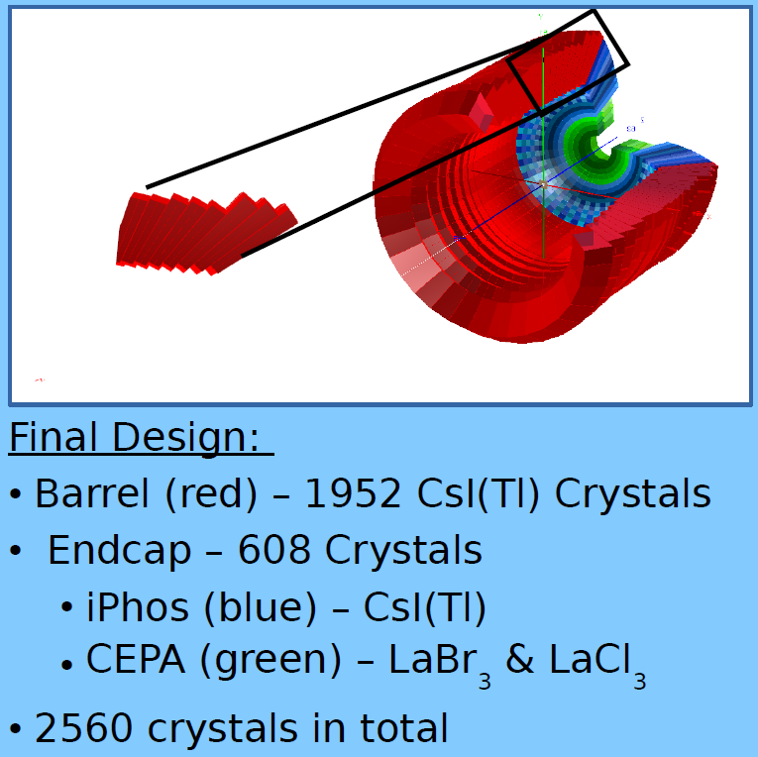
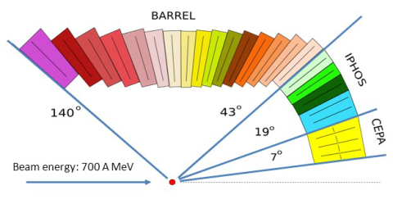
R3B set up progress
L3T (DSSSD,delayed) ➔
AMS up to 8 systems
18 det.ladders (6+12)
Strip pich 50µm
912 ASICS 116736 channels
NeuLAND
8/12 (30) double planes + frame
1600/2400 (6000) el. channels
& HV
GLAD & LH2 target station
Advanced tracking system
PSPs, MUSIC,
plastic ToF (ΔE and position via ToT)
fibre detector trackers
(partly in vacuum, with electronics)
Califa (forw. Barrel)
DAQ & Controls (NUSTAR DAQ / EPICS)
Simulation-Analysis (UCESB/R³BRoot)

Slide 4
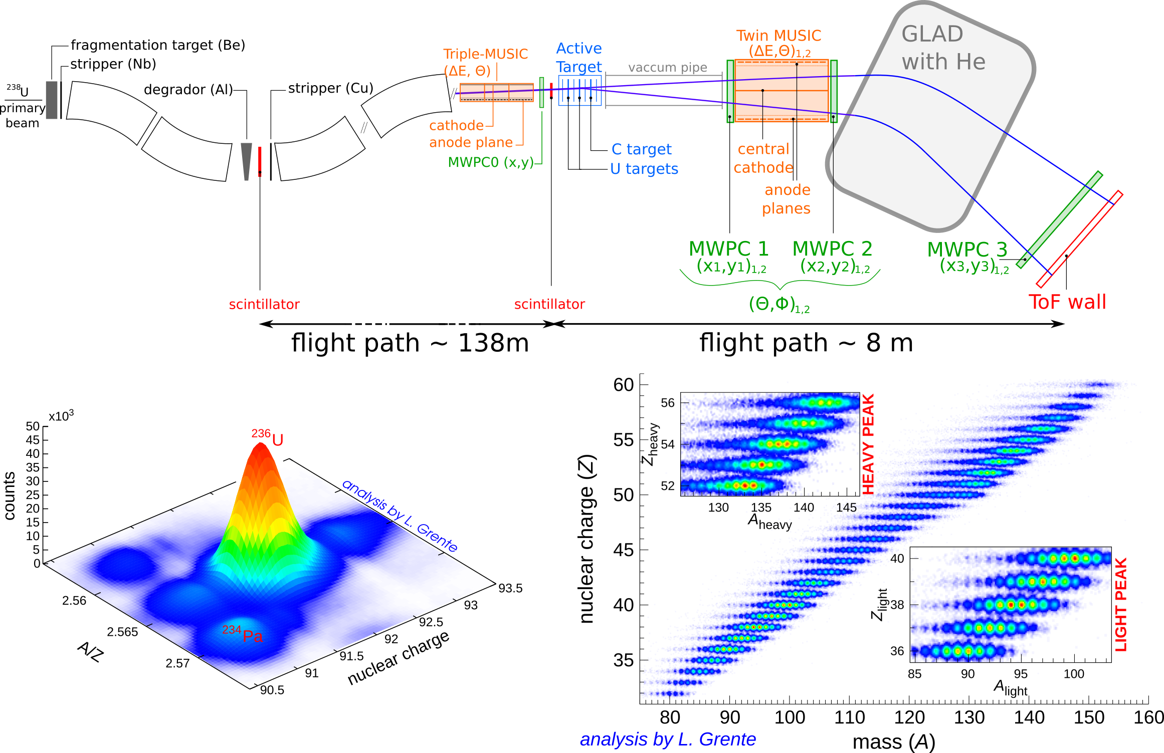
Preparations: R3B SOFIA setup
for fission campaign ➔ A. Chatillon
High rate &
resolution
2 fragment
ID: light &
heavy
+ (p, 2p) excitation energy determination
ECE - ECSG Meeting 20191105

Slide 5
Critical items
L3T Si Tracker (UK) – performance
GLAD (F/D) – technical

Slide 6
(1) L3T: Project started UK funded ~2009
Status: EoI for FAIR, no TDR; built with UK project funds

Slide 7
TDR drafted in the process …
(Draft 2017)
Two outer layers (300µm) +
thin inner layer (100µm)
reduced to two layers
Favourable to have a 100µm inner layer
300µm achievable
compromises accepted in R3B
collaboration meetings

Slide 8
Remaining issue: ASIC performance
E
T
Dynamic range 40keV – 50 MeV
Full data readout → noise determines limitations to threshold setting (req. 100keV)
No external trigger forseen (Califa cannot determine coincidence window)
Long strips with large capacitance (noise on outer layer)

Slide 9
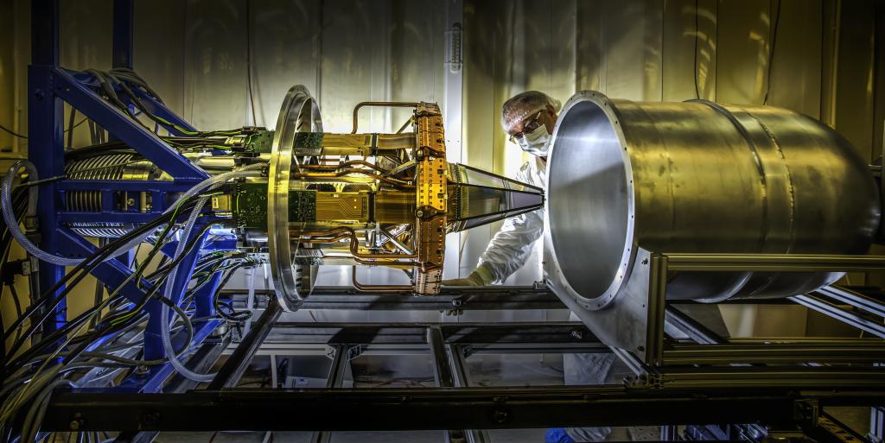
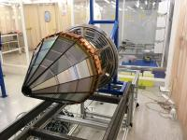
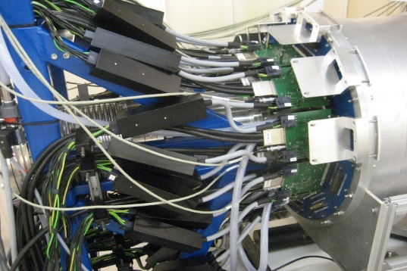
R³B
2019
WG:
Detectors
Status of L3T
Mechanics:
- Completed and tested at Daresbury lab. (DL)
- Vacuum system tested.
- Vacuum chamber delivered at GSI for 2020
campaign)
- New Vacuum chamber (simpler design)
being build to resume tests at DL
- Mechanics for KVI test produced.
Hardware :
- Both inner and outer layers assembled and
cabled at DL
- 2 assembled outer det. show HV issues.
- All 6 inner layers work fine.
- Minimum energy threshold (~150keV),
affecting high energy proton efficiency.
- Noisy strips: ~1.5% disabled per det.
- Spare detectors:
  3 inner detector spares: all working
  1 outer detector spare: has HV issue.
- Extremely low efficiency with Cosmic put
severe doubt on the efficiency.
inner layer
outer layer covering
inner layer
Cabling with additional Common-mode chokes on LV cables

Slide 10
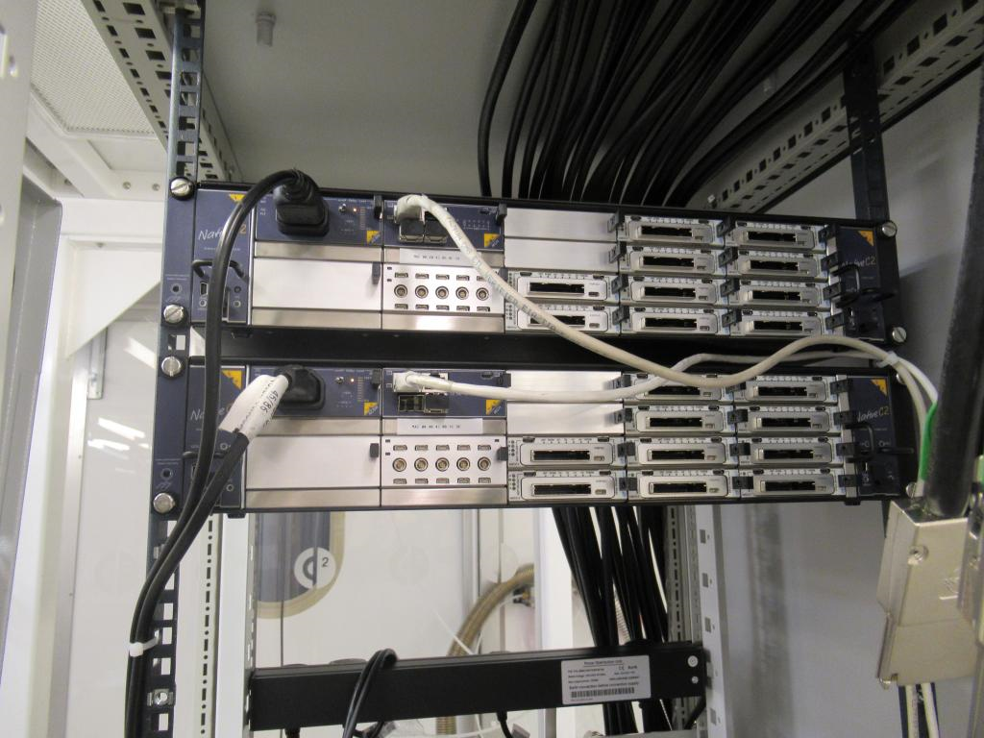
R³B
2019
WG:
Detectors
Status of L3T
DAQ:
- Triggerless mode & triggered mode available.
(Triggered mode still to be tested). ← used for data reduction in buffers!
- Up to 2 external signals (“trigger”) can be use as input
- System synchronisation tested successfully with
external Pseudo-random generator.
- Recently tested with AMS DAQ at GSI and pulse generator.
- DAQ compatibility with MBS still to be completed.
  - Requires completion of the L3T data merger with time ordered data.
  - Delayed as manpower needed for other projects (ex: AIDA at GSI)
Test with cosmic muons:
- 2 plastic scintillators used above and below L3T.
- Coincidence rate between plastic: 0.5Hz
- But coincidences rate with L3T with 150 keV threshold is very low: <1%
Test with proton beam at KVI
- To be performed in November (6-8th).
- Will determine decision regarding future work:
  ASIC replacement / 4th iteration ?
  both solutions leading to large delay and cost.
micro-TCA crates ( only 2 showed here, 3 used in total)
AMC cards
(1 per ladder)
Clock-Sync-Trigger cards (1 per crate)
Contact: Marc Labiche

Slide 11
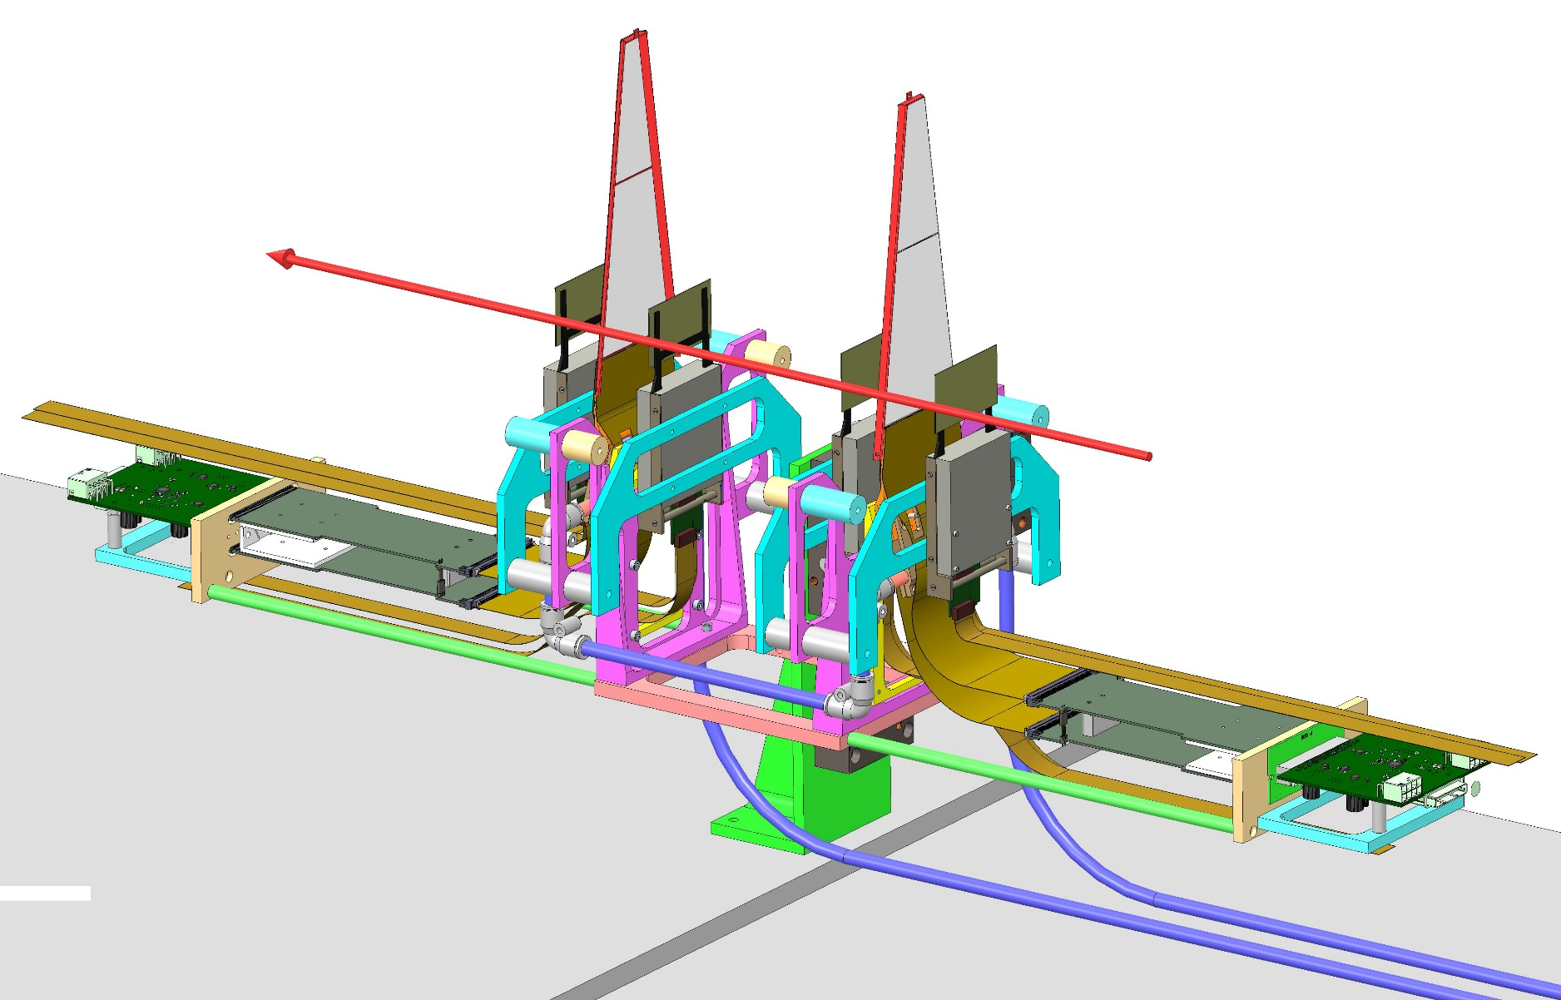
L3T and AMS detector test, KVI-CART
(End of this week)
Critical
performance
decision !
Proton beam, up to 190 MeV
XY linear stage
remote controlled
4 AMS detectors as external tracker, 2 L3T inner layer detectors as DUT

Slide 12
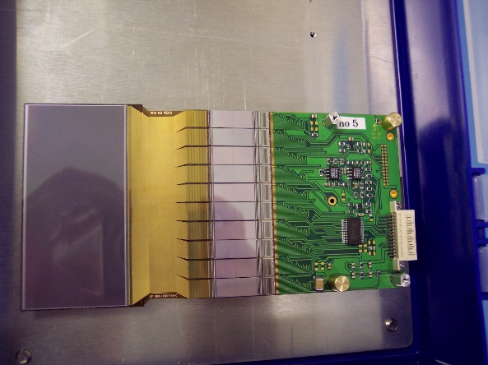
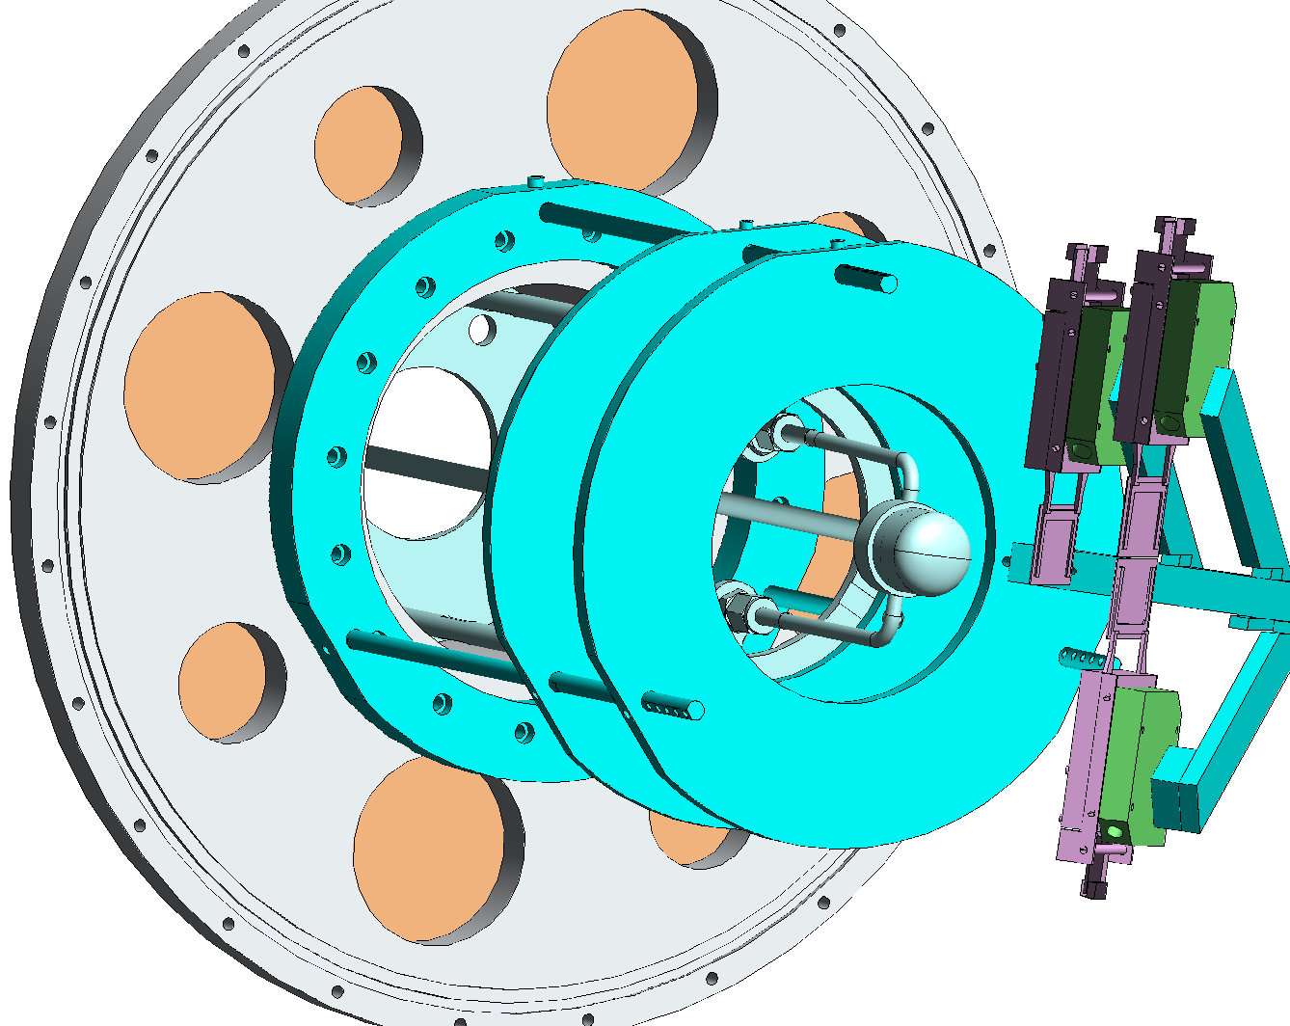
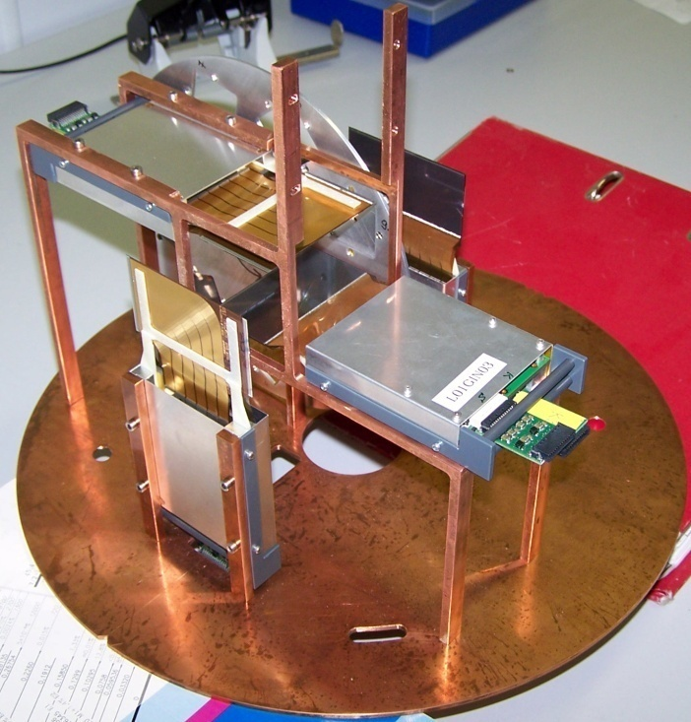
Backup: Si microstrip detector system for proton and light ion tracking
AMS detector system refurbished:
XY sensitivity, area 28 cm²,
100/110 µm strip pitch
Dynamic range – from p to Fe
1024 channels, multiplexed readout
Position resolution :
∼40 µm for protons, ∼15 µm for light ions
Tracking of protons, C, P, Ar, Ne ions
Used for quasi-free scattering and 2p-radioactivity experiments
Backup solution replacing L3T for 2020
O. Kiselev et al.
Readout – GSI SIDEREM system or AMS DAQ (as a backup)

Slide 13
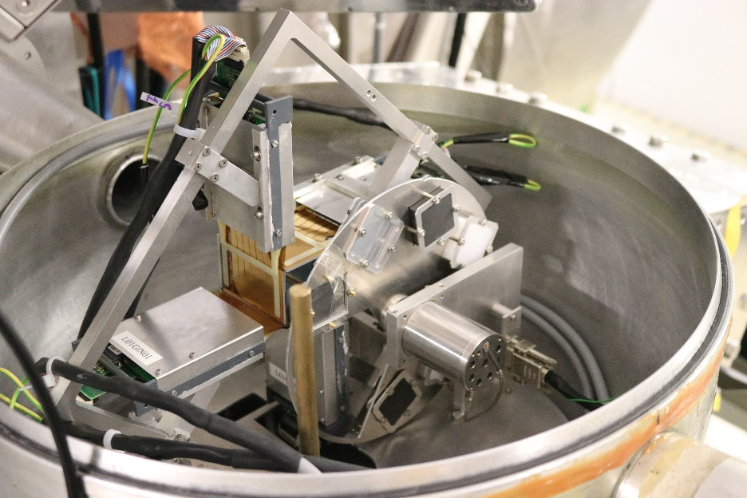
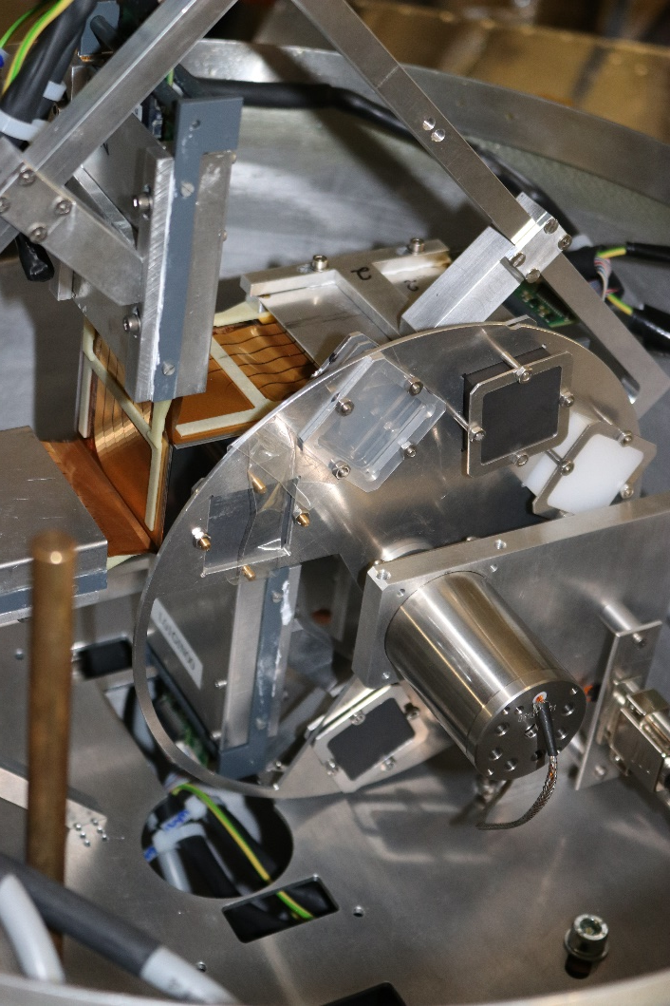
AMS detectors in Cave C, 2019
4 detectors just few mm behind the target wheel
Theta coverage ∼14 – 60°
Practically full phi coverage

Slide 14
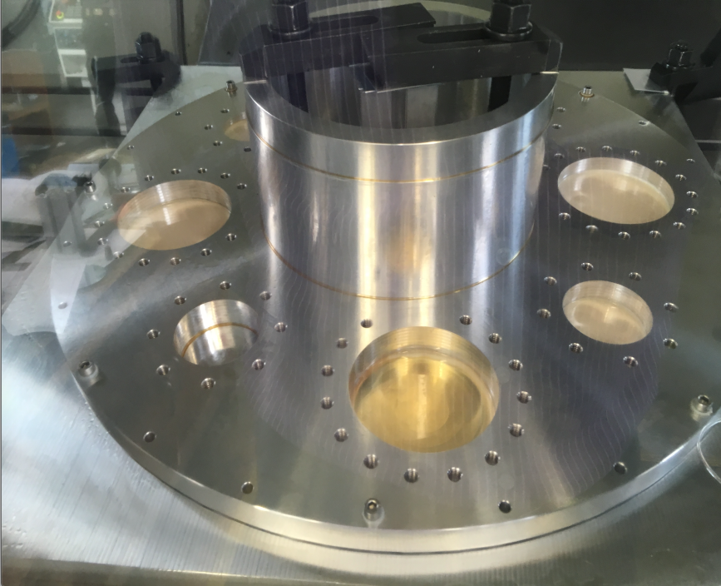
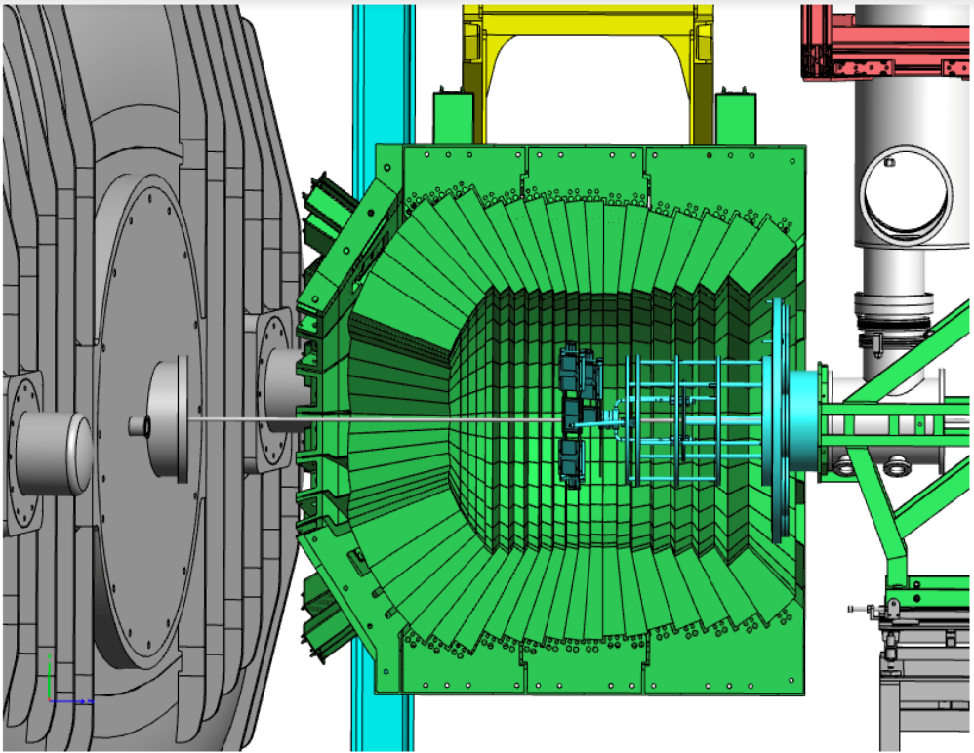
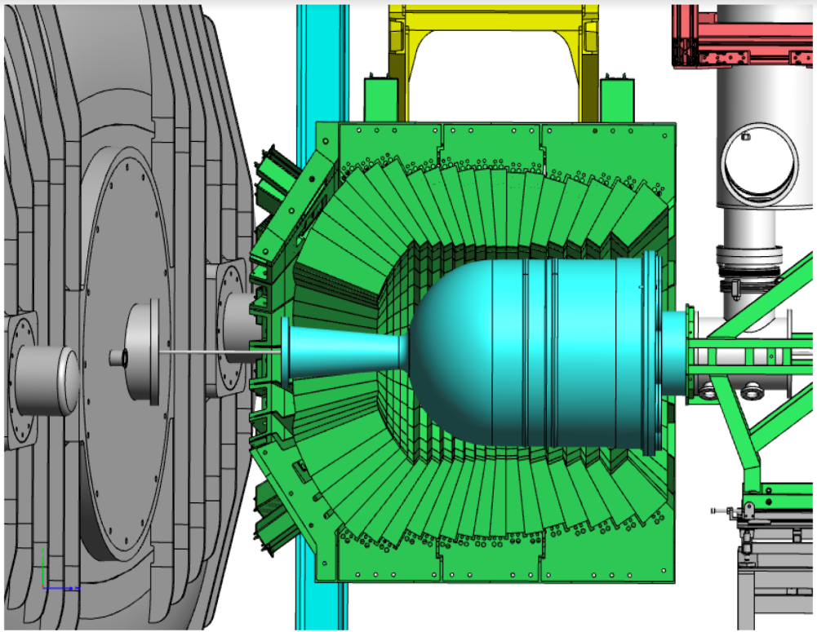
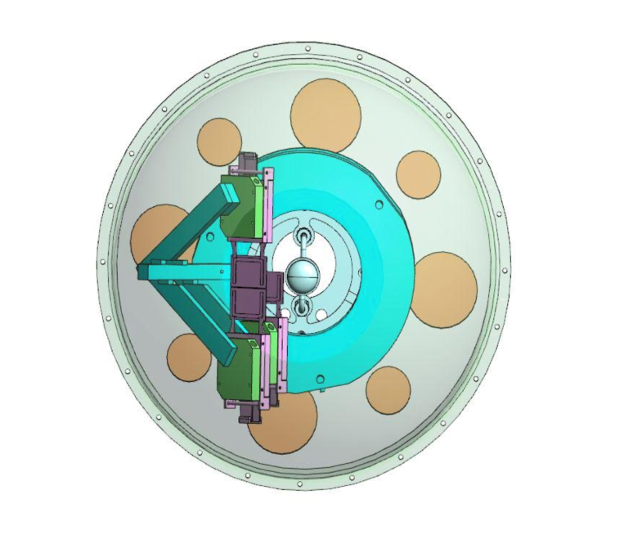
Preparations: AMS Si microstrip system
Delivered to GSI
S. Paschalis et al.
Bell chamber
Shipped from
Daresbury
ECE - ECSG Meeting 20191105

Slide 15
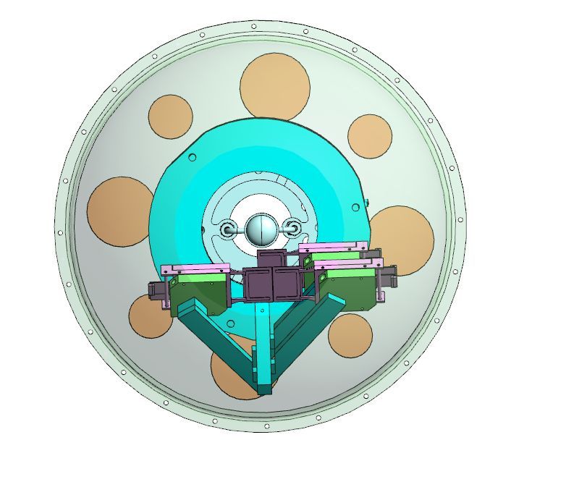
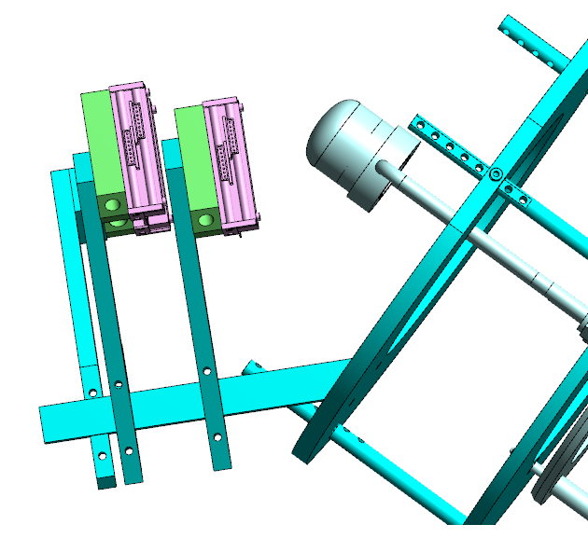
Arrangement for 2020 setup
6 detectors in left-right or up-down arragement
Solid or liquid H₂ target in the middle
Cooling with water in case of liH₂ target keeping temperature < 20-22°
Temperature measurement at each detector

Slide 16
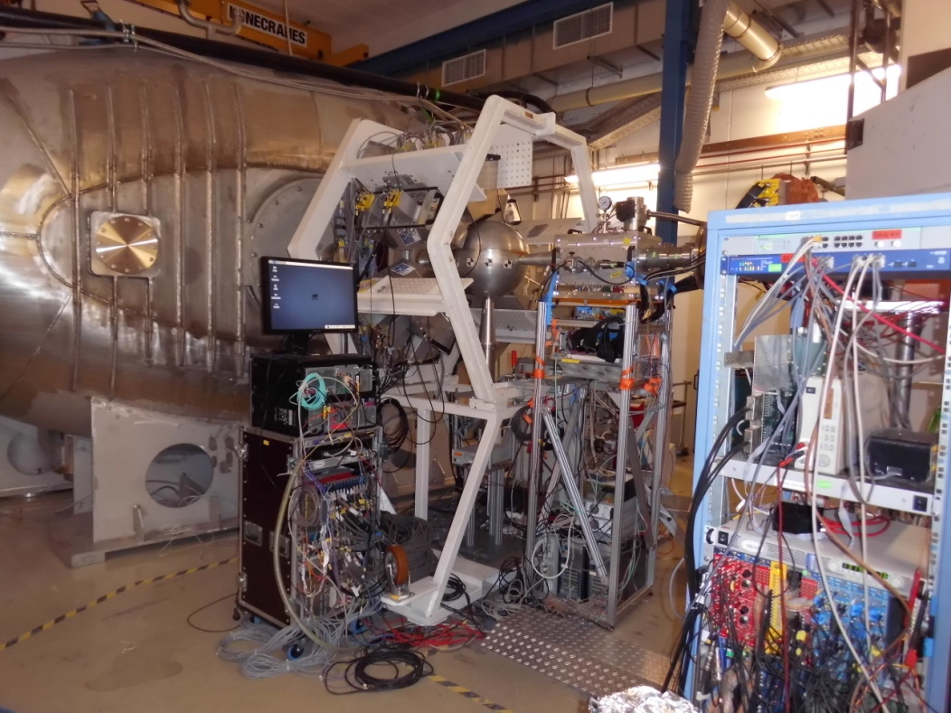
(2) GLAD Magnet
- sees field for the first time (Nov/Dec 2018)
Controls for Magnet
Powersupply, Quench Protection,
Cryo system running together
at real conditions:
He consumption tested,
Ramping tested
Field alignment verified
➔ Prerequisites for 2019 runs !
Meanwhile: LN2 pre-cooler prepared for sustained operation (07/2019).
Campus infrastructure: media supplies - computing –
counting room – preparation areas: upgrade measures (2019/20).

Slide 17
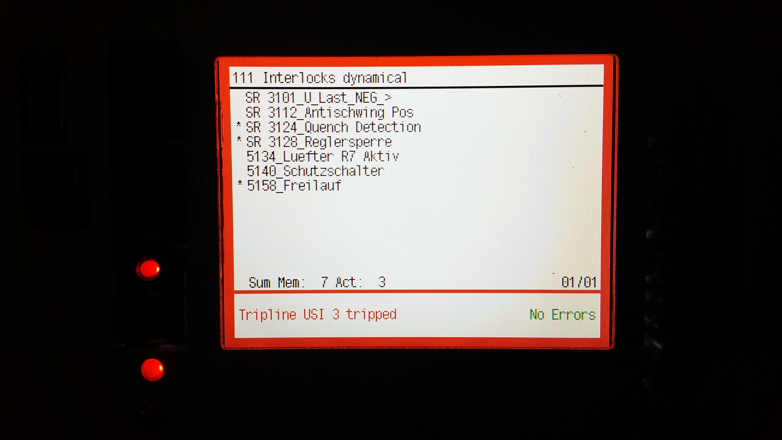
20190225 5:12 Quench @2800A !!!
Quench while ramping up for ¹²⁴Sn run
Analysis yields bad QD probe contact
Recovery within 48h !!!

Slide 18
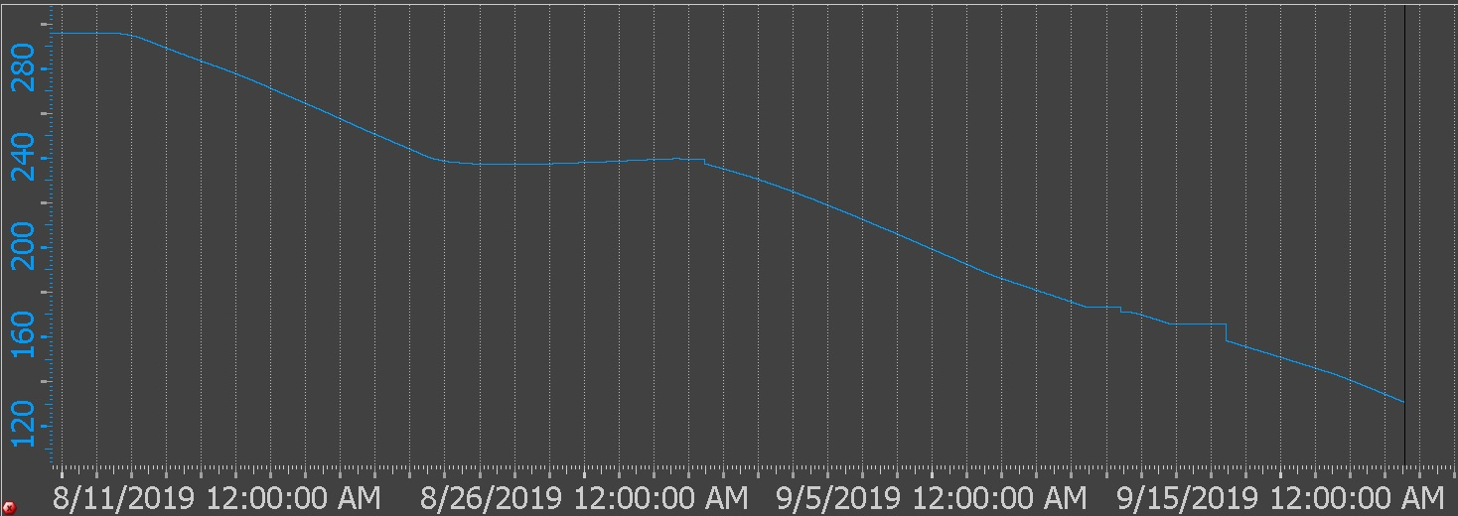
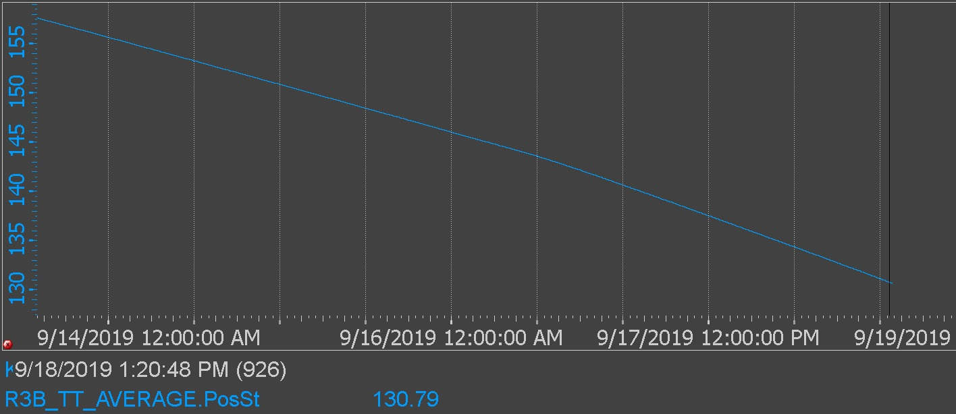
Status of GLAD magnet (F-D in-kind)
Issues solved – verification in progress
Problem tracked down to bad probe contact
… and repaired this summer
C. Mayri, H.S. T. Hackler et al.
Final Cool-down
ongoing
Dry-run Nov 14th
prior to engineering
beam time.

