Slide 1
CBM Common Fund Cost Assessment
M. Kiš for CBM Collaboration
m.kis@gsi.de

Slide 2
Outline
Common infrastructure
CBM building: layout / user areas
Experiment areas / cave layout
Major mechanical structures
Common detector services
Installation and timeline
Costs overview
Common fund - summary

Slide 3
Common infrastructure
under common infrastructure we consider primary the items that are used by subsystems in order to assure their proper integration and functioning within the experiment (one of following):
it can’t be assigned to a subsystem (e.g. vacuum pumps, beam diagnosis)
it is experiment specific building infrastructure (e.g. platforms)
it is used by two or more subsystems
common planning and procurement is essential for an efficient implementation
in the case of mechanical mounting structures the integration timeline has priority (building of experiment)
in the case of service lines the mounting/installation work has priority
distinguish between building infrastructure (FSB) and common infrastructure (user): core services are always available, local distribution has to be organized
cost assessment: list, quantity + unit price; when not applicable: lump sum, N.B. no contingency included

Slide 4
Building overview
5 nominal levels (E10 – E50)
only three levels are user relevant: E10, E30, and E40
E10: (aka CBM cave) experiment site also for HADES
E30: detector service/supply area
E40: gas storage, control room, technical area, computation room

Slide 5
Level E40
Racks E40 295,1 k€
Optical fibers (E40-IT)
120,3 k€
unloading/installation area
experiment access
5 t elevator, 30 t crane
gas storage area
preparation room:
detector pre-assembly
maintenance/repair
control room:
experiment control, shift crew, local meeting area
computation room
Gas container (E40) 15 k€
Preparation area (E40) 42 k€
Control room 86 k€
Gas lines (E40-E30) 87,9 k€

Slide 6
Level E30
Racks E30 34,5 k€
Gas alarm system (E30/E40)
40 k€
Control system back-end
28 k€
two rooms, area of 130 m²
direct access to service shaft
gas preparation area:
mixture preparation
closed-loop: recovery/purification/recycling
flammable gasses
cooling machines (STS)
racks: HV, controls, auxiliary
yellow: cable trays, blue: gas lines, red: cooling air/water

Slide 7
Level E10
upstream platform
365 k€
upstream platform
magnet foundation
shielding concrete
HADES support
access structure
service area
MUCH/RICH foundation
rail system (TRD, TOF, PSD)
rails
platforms
TOF •
• TRD
• MUCH
rail system •
• Magnet
• STS + MVD
upstream
platform
•
PSD •
RICH •
•
MUCH/RICH
foundation
• magnet
foundation

Slide 8
E10 – service area
Cable trays 28 k€
Optical fibers (E10-E40)
422,6 k€
service area underneath platform: radiation shielded
pre-installed racks: place for power supplies (cooling water + cable trays)
gas distribution from E30
services path relative to magnet foundation
MVD, STS: in front of it
RICH, MUCH: through magnet foundation (window)
TRD, TOF, PSD: above m.f., sidewise right on the wall
Cooling water distribution
69,2 k€
Racks E10 45,6 k€
Gas lines (E30-E10) 142,5 k€

Slide 9
MUCH/RICH foundation and rail system
RICH-MUCH
foundation
180 k€
MUCH-RICH foundation:
MUCH installation: 300 t (5th absorber 200 t)
parking and operation position
RICH moved by crane
rail system (TRD, TOF, PSD)
2+2 rails (4 m and 8 m span)
firmly anchored rail support
rails are subsided relative to cave floor, moving of equipment across
Rail System
496,5 k€

Slide 10
Beam line, target chamber
Beam pipes
70 k€
Beam diagnostics
box 30 k€
Vacuum pumps
79 k€
Beam abort system
80 k€
nominal target positions:
HADES 5 m
CBM 17 m (magnet opening)
two beam line areas: machine vacuum 10⁻⁸ mbar and experiment vacuum 10⁻³ mbar
target chamber houses target holder and MVD, target chamber flange is only feed-through surface
Target Box & Holder
70 k€

Slide 11
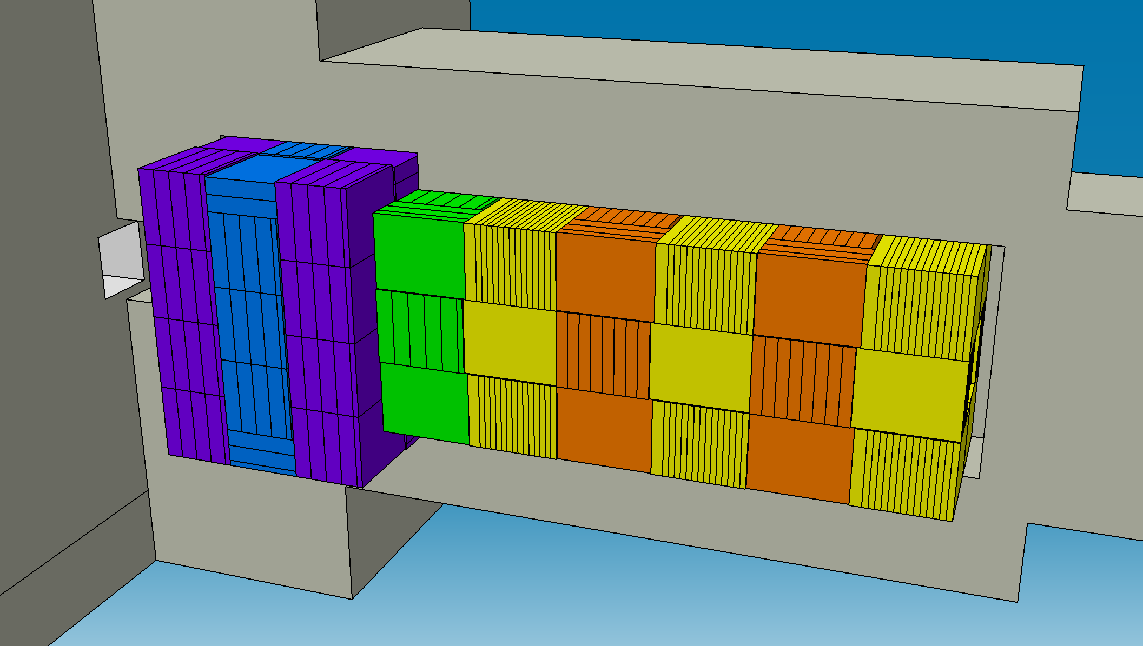
Beam dump
CBM beam dump: in annex of the CBM building, will be constructed during installation phase
iron for construction of beam dump on building site
in addition: movable radiation shield inside of the cave
HADES beam dump: modular construction installed in front of CBM magnet
stopping of the HADES beam and protection of tracking detectors in CBM
CBM beam dump (rest)
35 k€
HADES beam dump
50 k€

Slide 12
Installation
Survey tools
75 k€
Tools, scaffolding, hoisting gear
195 k€
Safety gear
12 k€
survey: service delivery + tools
beam transfer: nodes
installation of detectors:
support structures (on delivery by contracted company)
detector modules or whole detector by involved groups
installation tools and infrastructure inside of cave
subsystem specific issues
Cryo – BB
balcony
10 k€

Slide 13
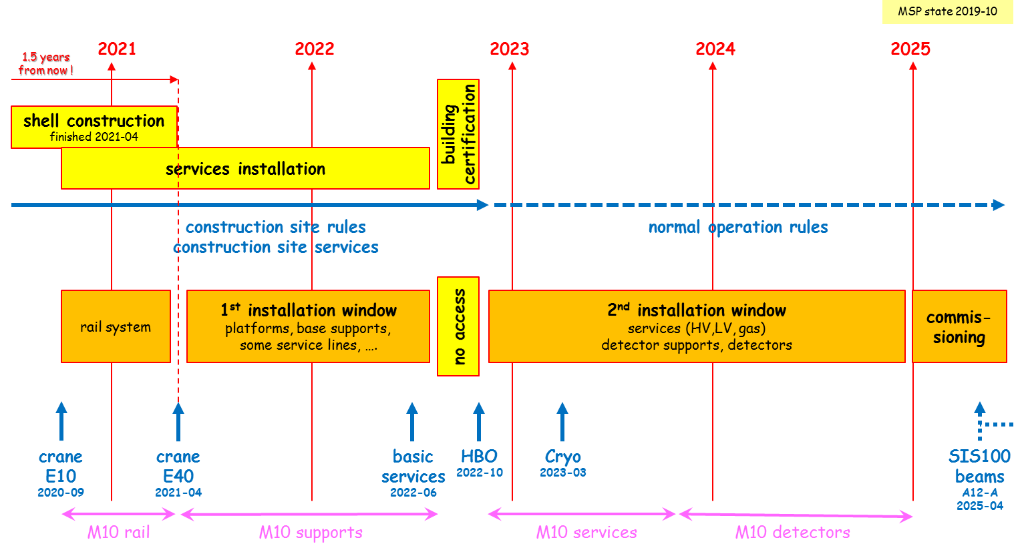
Timeline 2020-2025

Slide 14
Cost structure
PSP code Description
1.1.1.1 Micro Vertex Detector (MVD)
1.1.1.2 Silicon Tacking System (STS)
1.1.1.3.1 Ring Imaging Cherenkov Counter (RICH)
1.1.1.3.2 Muon Detector (MUCH)
1.1.1.4 Transition Radiation Detector (TRD)
1.1.1.5 Time-of-Flight System (TOF)
1.1.1.6.2 Projectile Spectator Detector (PSD)
1.1.1.7 Superconducting Dipole Magnet
1.1.1.8.1-5 Online Systems — DAQ and Controls
1.1.1.8.6 Online Systems — FLES
1.1.1.10 Common Infrastructure

Slide 15
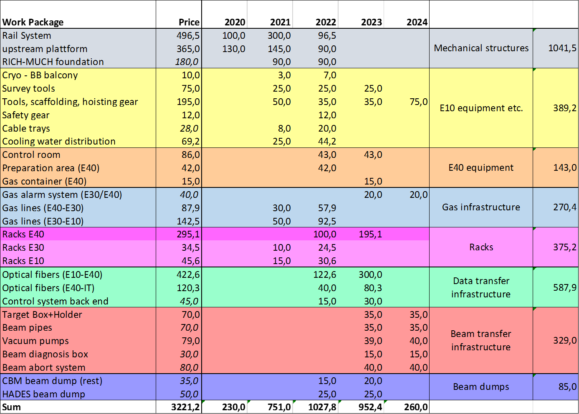

Slide 16
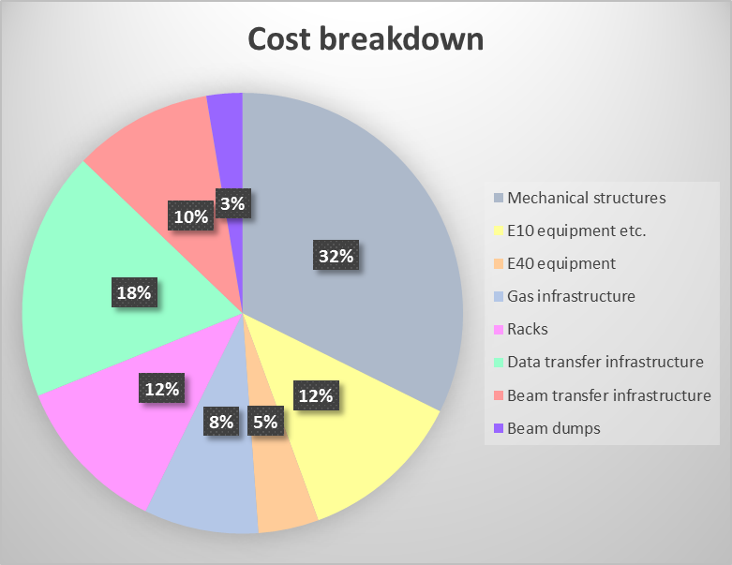
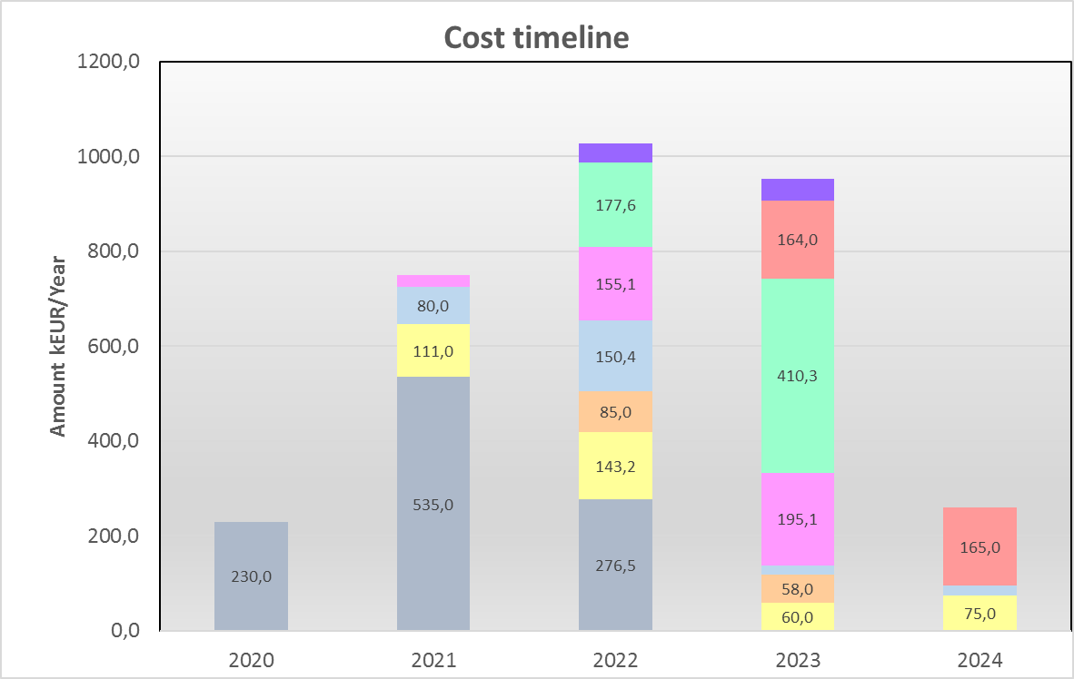
Common fund – financial overview

Slide 17
Summary
cost assessment document:
based on present state of common infrastructure concepts
cost estimates based on present prices – no contingency included
some “common infrastructure” already included via FSB e.g. beam dump
next level of detail with finalized engineering and installation plans
cash-out flow will be influenced with buying practices: for most of the complex orders we expect lead time of minimum 6-month
presently - no contingency allowance
common fund should provide for smooth integration of whole experiment upon the readiness of subsystems

