Slide 1
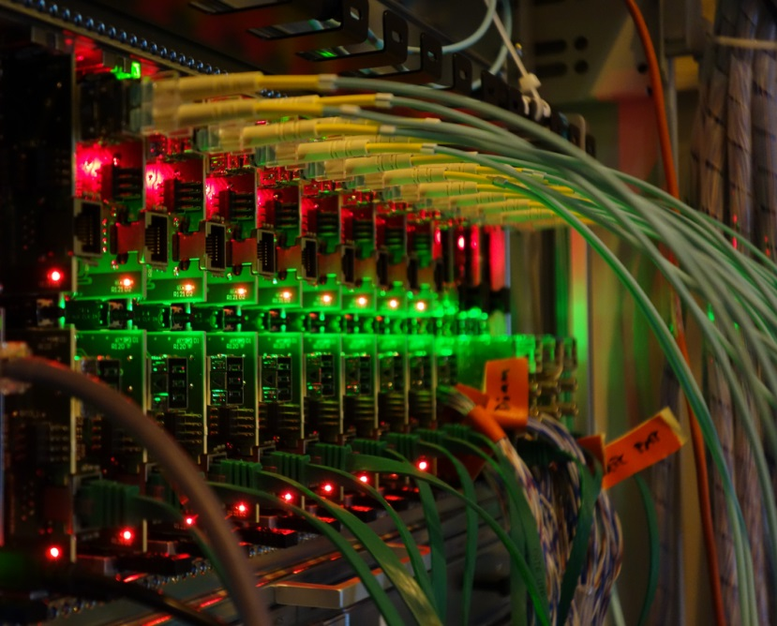
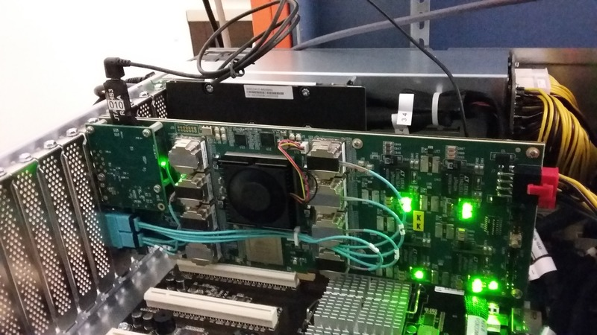
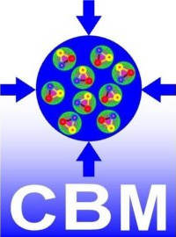
Status of CBM DAQ
David Emschermann
for the CBM Collaboration
ECE-XI - GSI - 04.11.2019

Slide 2
Outline
The CBM readout challenge
The GBT based CBM readout chain
Hardware building blocks / FLES cluster
Overload situation and throttling with TFC
mCBM as test bench – lessons we learned
Summary and next steps

Slide 3
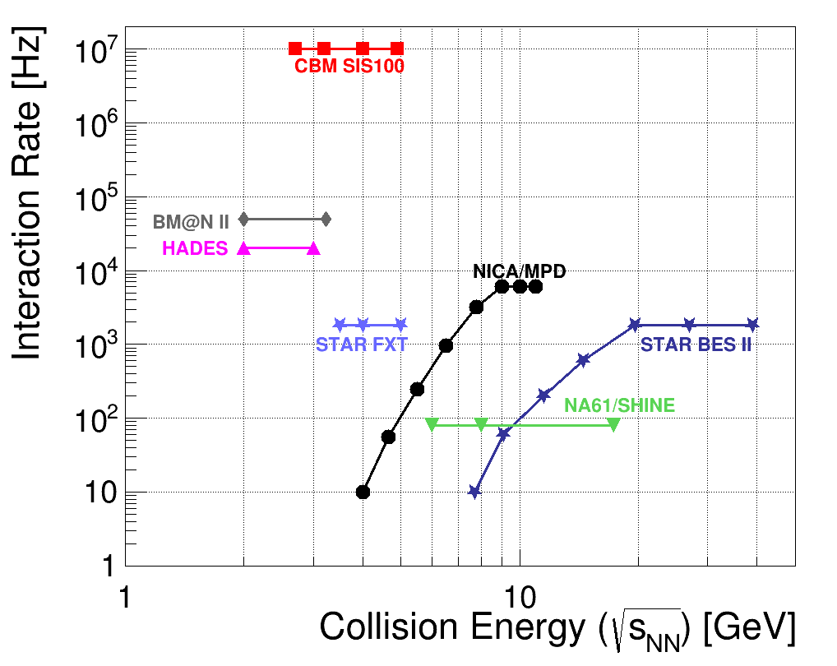
The CBM readout challenge
fixed target setup to investigate the QGP phase diagram in region of high baryon-densities
very high interaction rate environment: 10⁵ − 10⁷/s (A+A), up to 10⁹/s (p+A)
fast and radiation hard detectors with free-streaming readout electronics
high-speed Data AQuisition (DAQ) system
FPGA based readout chains complemented by state of the art computing infrastructure allowing for online event reconstruction
more than 5.000 GBT links operating at 4.8 Gbps as data source
about 2 TByte/s bandwidth to the Green IT Cube
Interaction Rate for CBM at SIS100

Slide 4
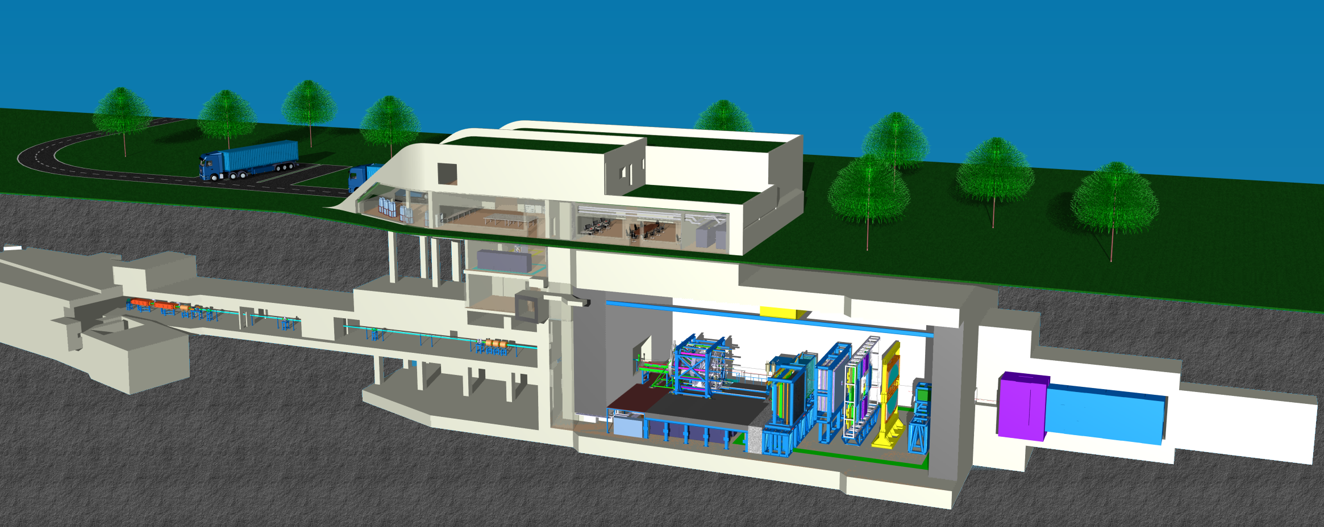
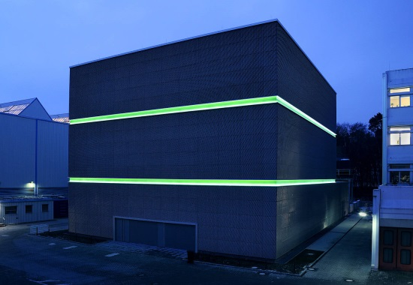
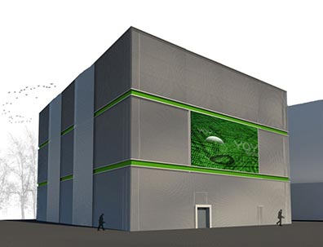
The CBM experiment
CBM: a fixed target,
high interaction rate,
heavy ion physics
experiment
DAQ room:
data pre-processing
on FLES input cluster
Green IT Cube: online timeslice building
and event selection
green
cube
μ-slices
2 TB/s
Green IT Cube
flow
~1000m
data
~100m
raw

Slide 5
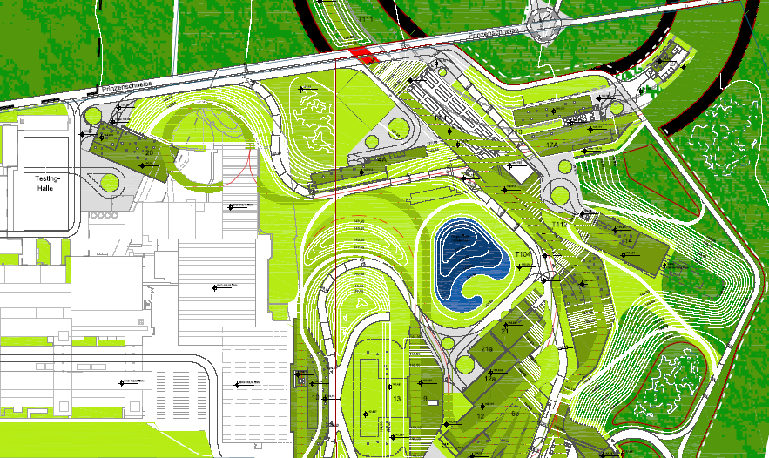
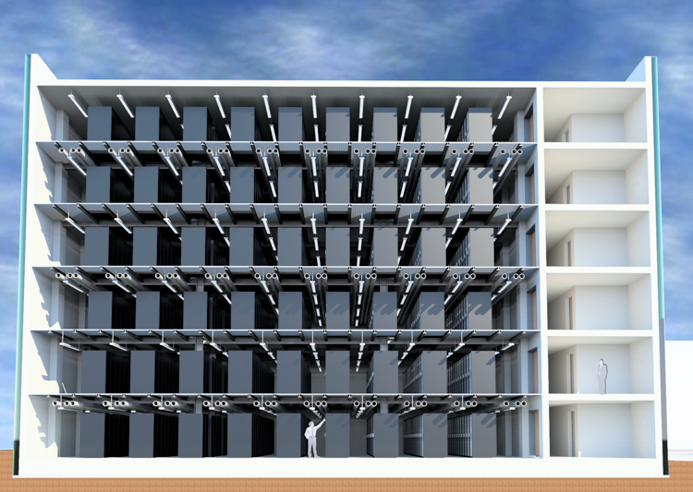
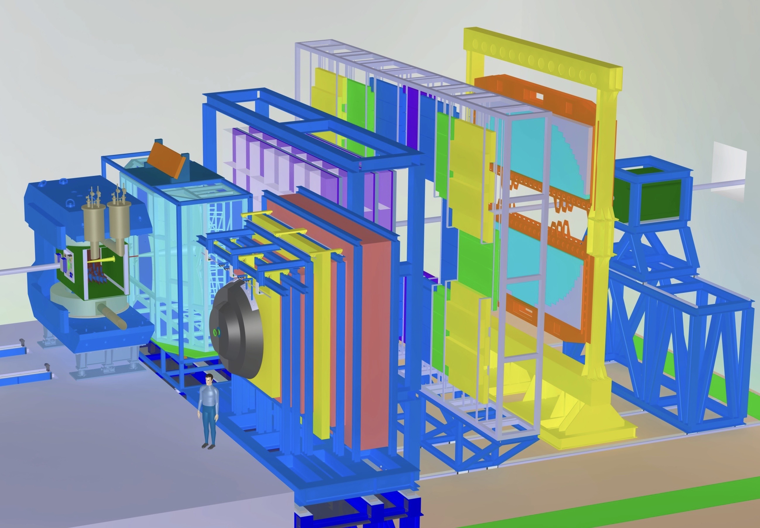
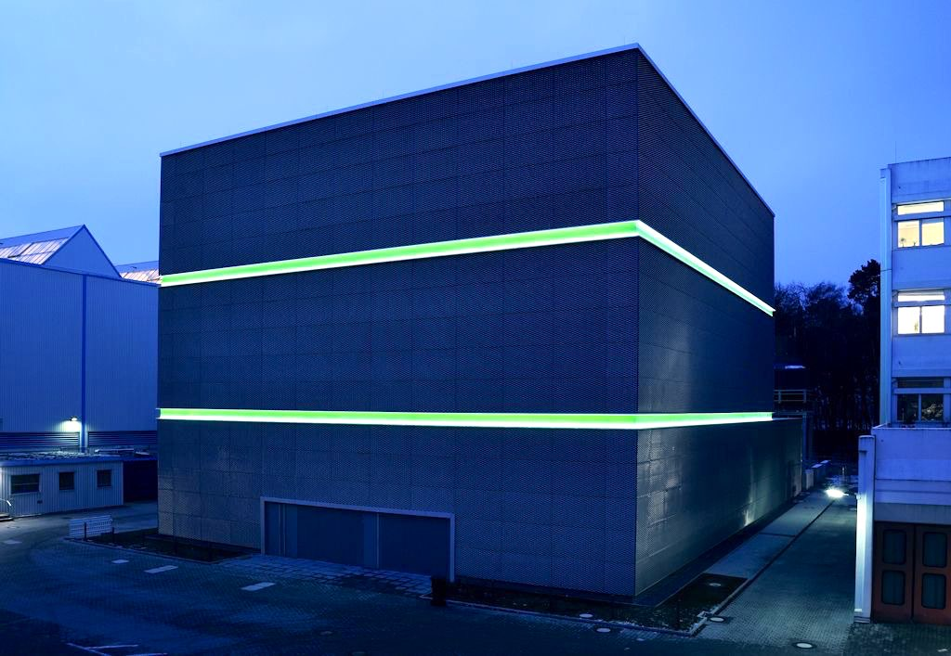
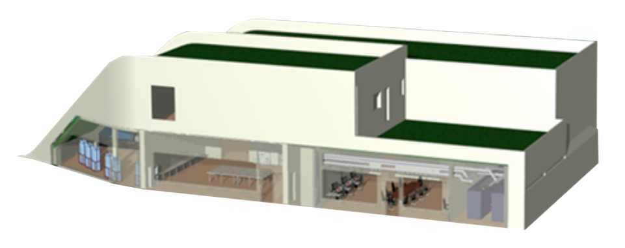
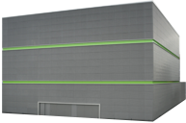
First-level Event Selector (FLES)
FLES is designed as an HPC cluster
Commodity PC hardware
FPGA-based custom PCIe input interface
Total input data rate > 1 TB/s
Timeslice building via InfiniBand network
Combines the data from all input links to self-contained overlapping processing intervals and distributes them to processing nodes
RDMA data transfer very convenient for timeslice building
Located in the Green IT Cube data center
Cost-efficient infrastructure sharing
Maximum CBM online computing power only needed in a fraction of time → combine and share computing resources
status
2016
Green IT Cube
CBM Service Building
~350 m linear distance
cable
routing
~1000 m cable length
Consequences
Transmit 10 TBit/s over 1000 m distance
Single-mode optics, increased link latency

Slide 6
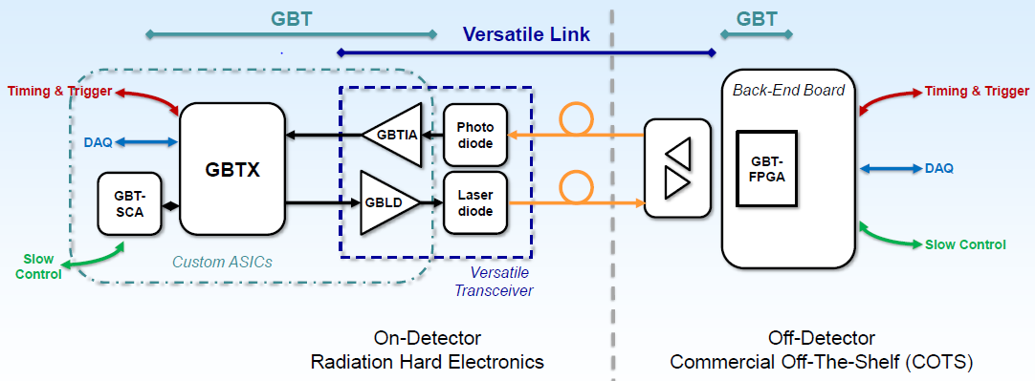
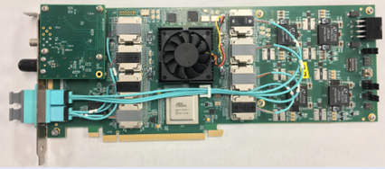
DAQ core element: the GBT link
The following components define the architecture of the CBM readout system:
2014: CBM opted for the GBT link
6643 GBTx ASICs ordered from CERN
CBM runs the GBT at f = 40 MHz, not f
2018: CBM has chosen the BNL-712 board to terminate the GBT links
board initially developed for ATLAS (FELIX)
Common Readout Interface (CRI) for CBM
it has a Xilinx Ultrascale FPGA, provides up to 48 optical connections, special clock distribution
plan for commissioning of several CRI boards in mCBM in Q3/2020
LHC
CRI / BNL-712 / FELIX board

Slide 7
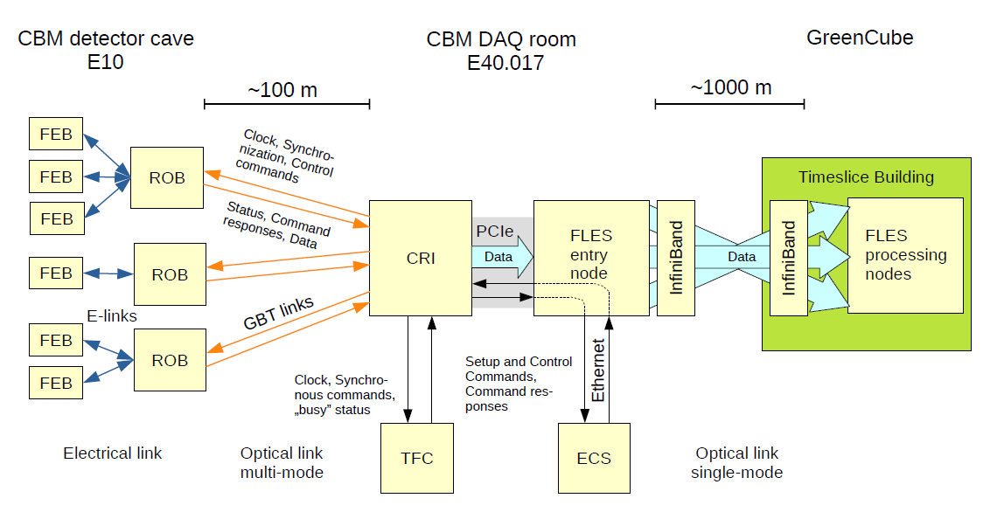
The CBM readout and control architecture
1
2
Green IT Cube
3

Slide 8
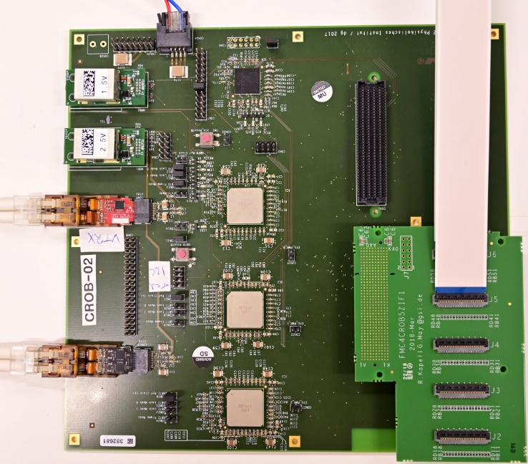
1
FEB and ROB
FEB
The Double Sided Silicon Strip (DSSS) sensors of STS are biased with a negative and a positive voltage of up to 250V
the STS Front-End Boards (FEB) are operated at this bias potential
FEBs are electrically connected to the ROBs
FEBs are therefore AC-coupled to the GBTx, their data and control paths are merged into a single connection
8b/10b encoding is used on the e-link connection to the GBTx
+250V
-250V
0V
ROB
ROB converts electrical inputs to optical signals
the ReadOut Board (ROB) is populated with 1x GBTx Master and 2x GBTx Slave ASICs, providing 42 e-links to the FEB and 1x down- and 3x uplinks operating at 4.8 Gbit/s to the readout chain
clock frequency of GBT ASICs at CBM is f = 40 MHz, not f LHC

Slide 9
The CBM readout and control architecture
1
2
Green IT Cube
3

Slide 10
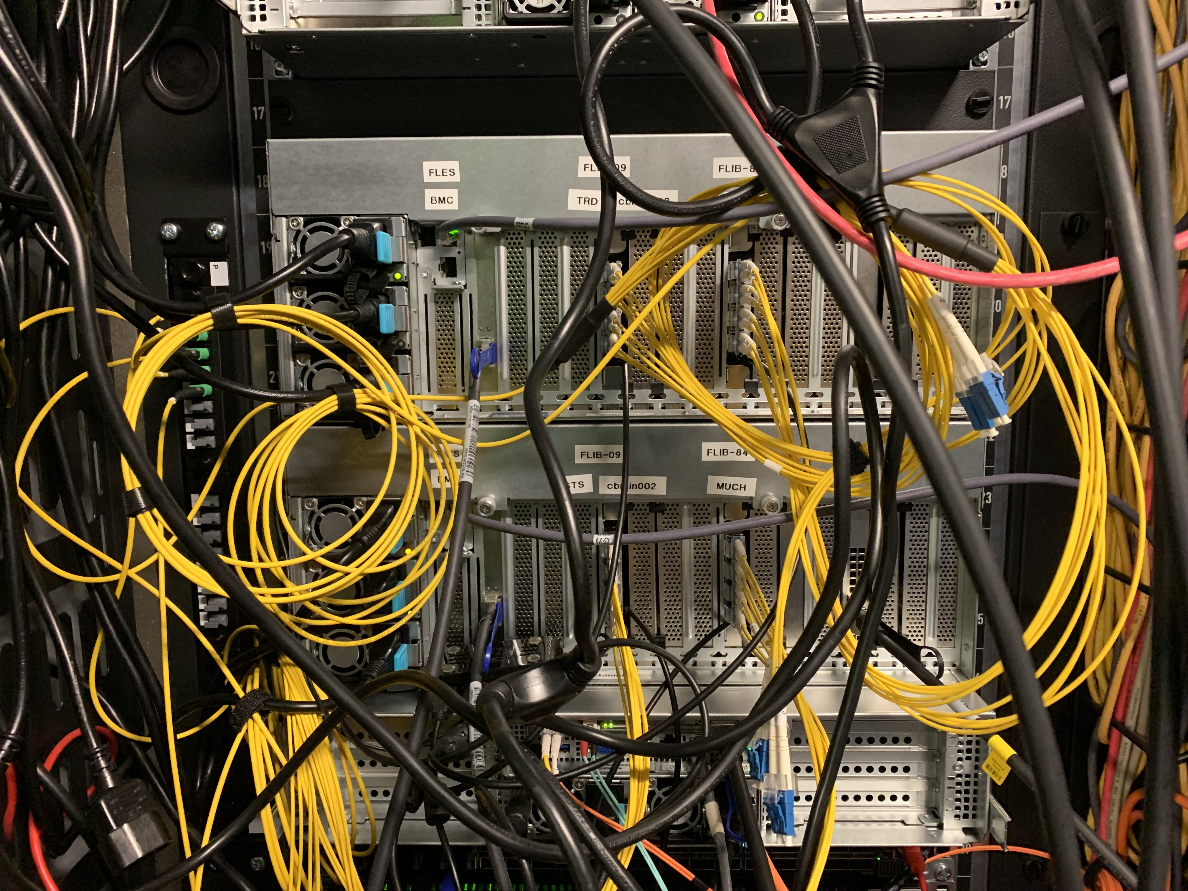
2
FLES Entry Node
FPGA-based PCIe board
Prepares and indexes data for timeslice building
Custom PCIe DMA interface, full offload engine
Optimized data scheme for zero-copy timeslice building
Transmit microslices via PCIe/DMA directly to userspace buffers
Buffer placed in Posix shared memory, can be registered in parallel for InfiniBand RDMA
Use Graphics Processing Unit (GPU) server to accommodate several FPGA-based PCIe boards

Slide 11
The CBM readout and control architecture
1
2
Green IT Cube
3

Slide 12
Timeslice Building and Online Analysis Interface
3
Microslice (μ-slice)
Timeslice substructure
Constant in experiment time
Allow overlapping timeslices
Timeslice
Two-dimensional indexed access to microslices
Overlap allows limited timing calibration in front-end
Interface to online reconstruction software
Timeslice building: combine matching time intervals from all input links to one "timeslice" (processing interval) on one particular processing node
Distribute different processing intervals to different processing nodes
Timeslice data management concept
Timeslice is self-contained
Calibration and configuration data distributed to all processing nodes
No network communication required during reconstruction and analysis
Timeslice
Time
. . .
Component 0
CONTENT MC 0
CONTENT MC 1
CONTENT MC 99
CONTENT MC 100
DESC MC 0
DESC MC 1
DESC MC 99
DESC MC 100
. . .
Component 1
CONTENT MC 0
CONTENT MC 102
CONTENT MC 1
CONTENT MC 99
CONTENT MC 100
DESC MC 0
CONTENT MC 101
DESC MC 1
DESC MC 99
DESC MC 100
DESC MC 101
DESC MC 102
. . .
Core region
Overlap region

Slide 13
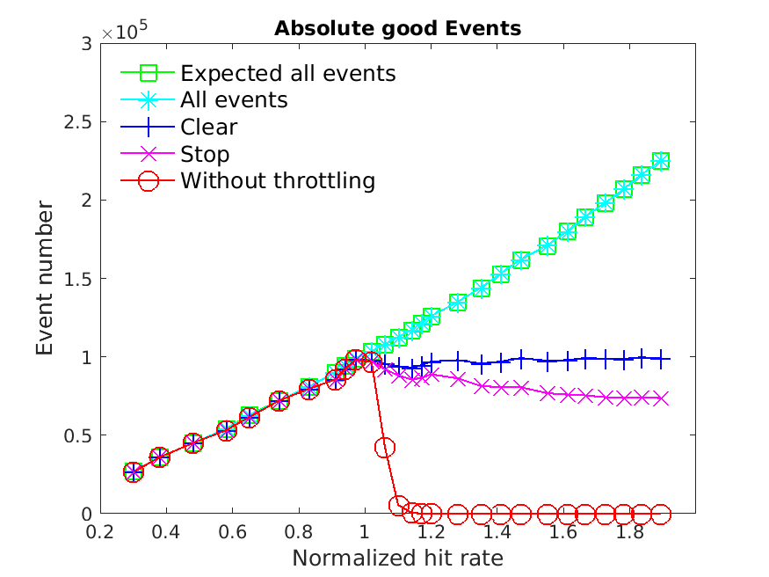
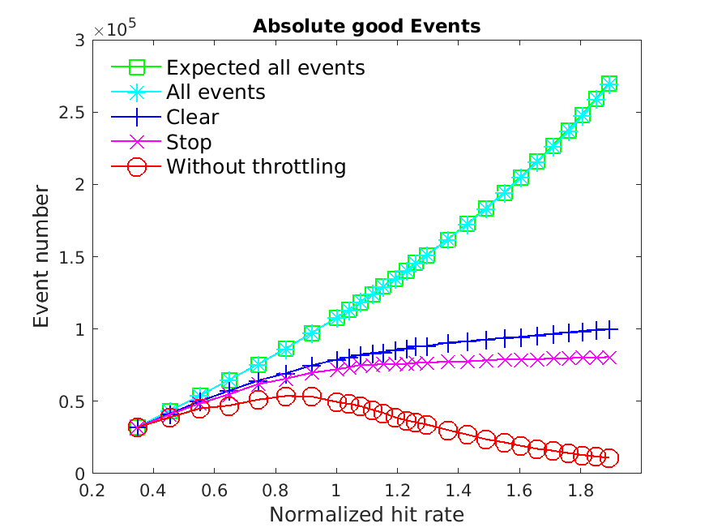
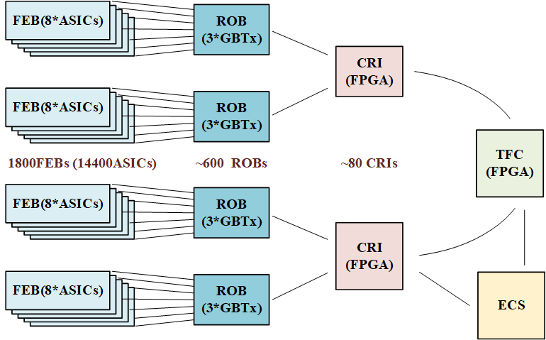
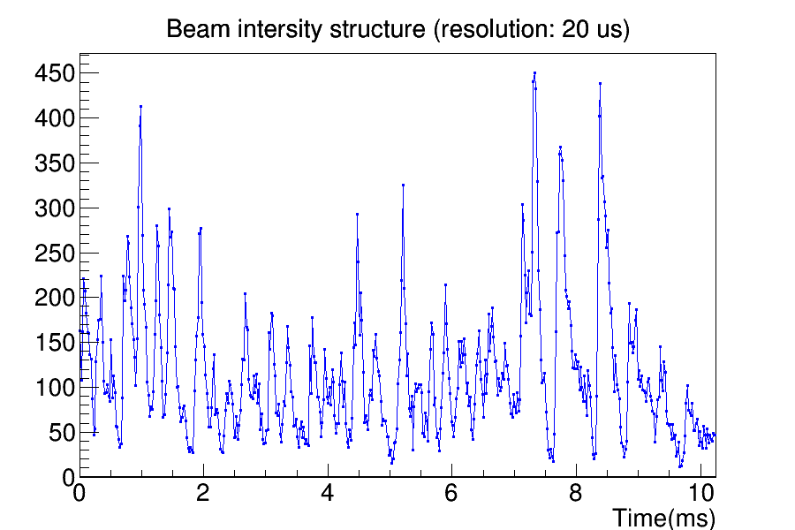
The CBM DAQ system under overload conditions
Can our free-streaming DAQ system guarantee good quality data,
even if the accelerator delivers more beam than the DAQ can digest?
Bandwidth limit of readout
Bandwidth limit of readout
Peak point
stable beam conditions
Particles per bin
expected SIS100 beam conditions
our DAQ system has a maximum bandwidth limit
data throttling with TFC allows to record almost complete events
NO THROTTLING is not an option at high beam intensities
CLEAR strategy shows slightly better performance than STOP
expected SIS100 beam structure

Slide 14
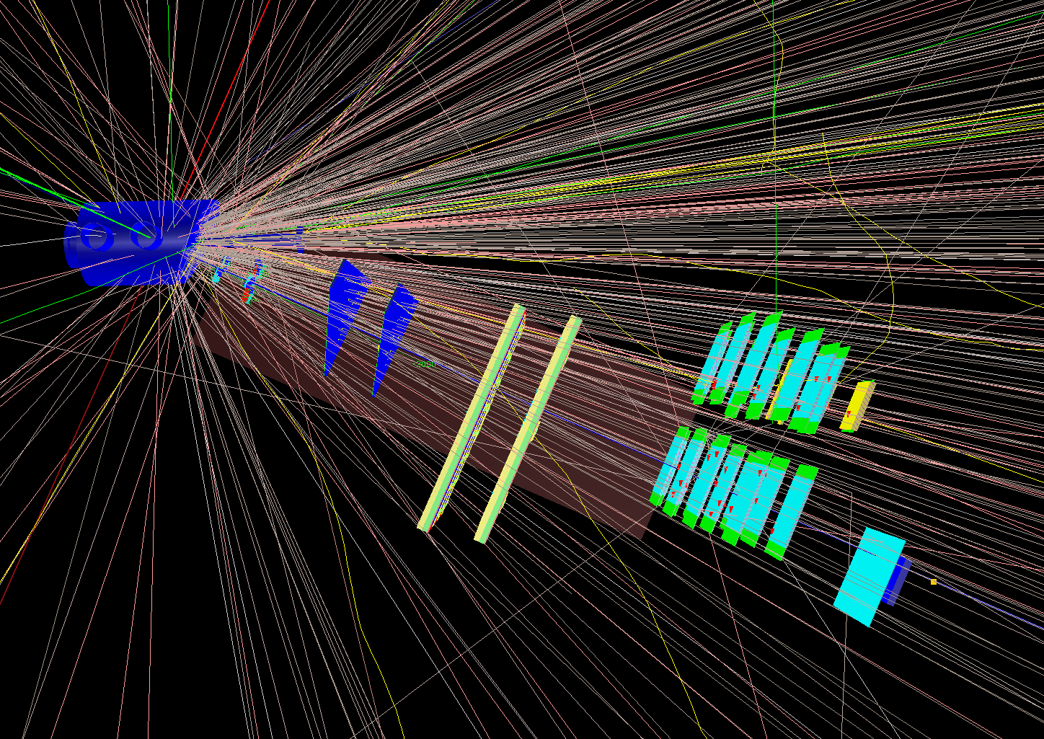
mCBM as test bench
simulation input UrQMD
Ag + Au
1.58 AGeV
target chamber
incl. diamond T0
mCBM@SIS18
CBM full system test setup for high rate A-A collisions at the SIS18 facility
mSTS
mMUCH
2x GEMs
25°
mTRD
mTOF
25x RPCs
mCBM setup
March 2019
mRICH

Slide 15
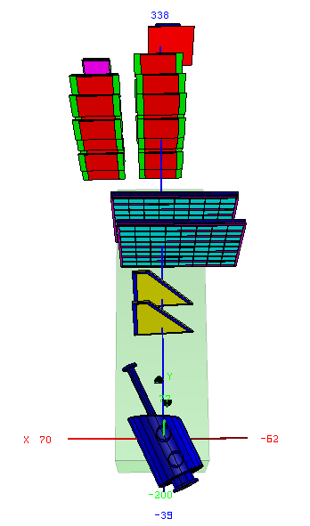
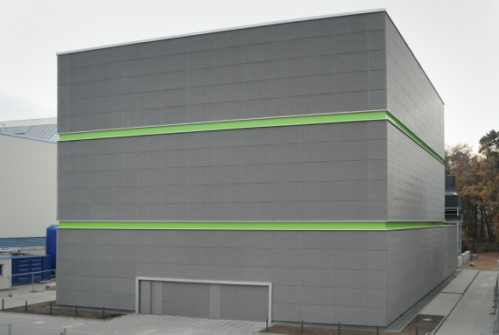
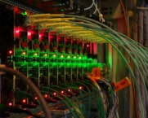
The mCBM experiment
established 2018:
1st commissioning
with beam
December 2018 and
March 2019
2nd campaign
November 2019 and
May 2020
mCBM DAQ container:
data pre-processing
Green IT Cube:
online timeslice building
green
cube
μ-slices
green cube
FLIM
Green IT Cube
flow
300m
data
50m
mCBM:
a fixed target,
high interaction rate,
heavy ion physics
experiment and test-site for CBM
GBT
technology

Slide 16
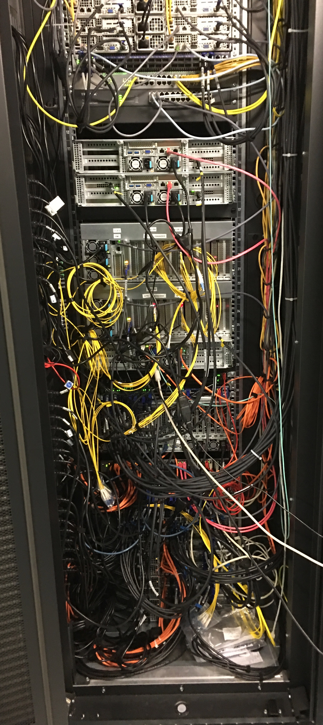
mFLES Setup and Functionalities
mFLES setup
4 FLIB input cards, 12 FLIM links (of 16/32), 2 entry nodes, 3–10 processing nodes (of 36), InfiniBand network
Single-mode links from mCBM to Green Cube
mFLES software
Distributed data taking
Full flesnet chain with timeslice building
Automated run control with prototype configuration and process management

Slide 17
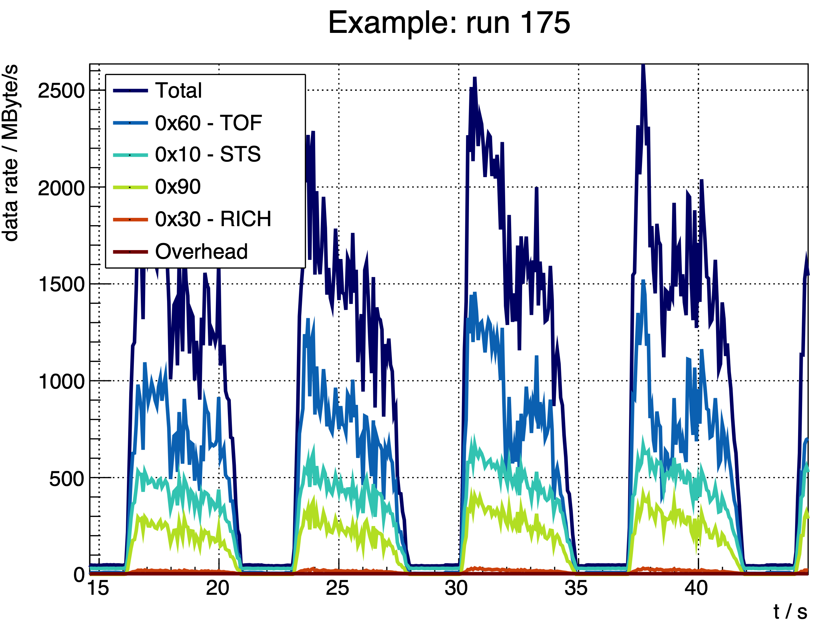
Observed Total Data Rate (Highest Intensity)
Highest intensity (T0 in saturation)
Configuration tag: sts2_much4_tof5_rich_7pn_rec
Peak data rate > 2.5 GByte/s
Recorded to 7 processing nodes, employed Flesnet buffers to average the data rates
- T
0

Slide 18
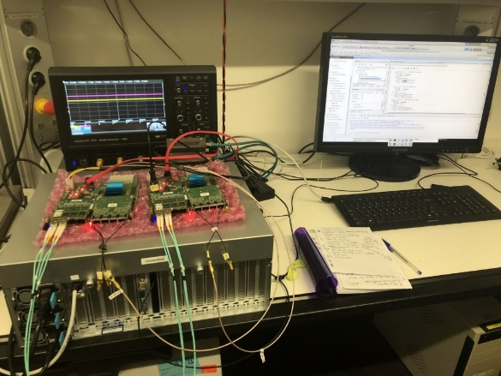
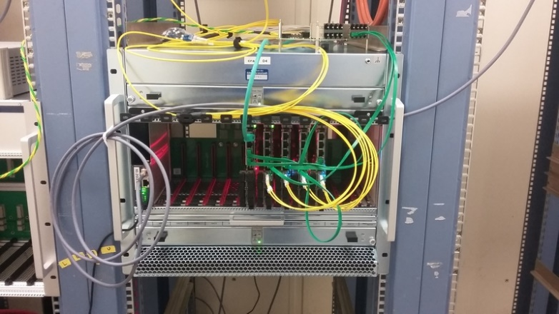
mCBM: issues with highest priority – 1/3 – from ECE report CBM
a) The stability of the various subsystems is insufficient. The system depends on a stable locking of all subsystems to an external clock that was lost too frequently to allow continuous operation.
Current Timing and Synchronisation (TS) system sends Pulse Per Second (PPS) and Clock signal. All subsystems need to count the number of PPS signals received since start of run. If one PPS is lost the readout branch gets out of SYNC and can no longer be used for analysis. The entire readout needs to be stopped, resynched and restarted.
It was the best and only system available in March 2019 as a new PhD student had recently taken over the task to develop the Timing and Fast Control System.
A new Timing and Fast Control system (TFC) is under development and will be deployed early 2020. The mTFC will provide relative timestamps on the ns scale as well as a clock. Subsystems loosing their synchronization will get individually resynchronized without the need to restart the entire readout.

Slide 19
mCBM: issues with highest priority – 2/3 – from ECE report CBM
b) The data flow control and error diagnostics is not sufficiently developed yet to allow easy diagnostics of the state of the system.
Currently new subsystems branch their FW from existing subsystems at an arbitrary position in history and start individual development. These developments are not merged back between subsystems.
The development of firmware for each subsystem needs to be streamlined and supervised.
Single firmware developers are spread across various institutes. At GSI as host lab we not have an experienced hardware developer to guide newcomers during integration of their subsystem.
We know from ATLAS and CMS experts that common firmware development in a group of individual contributors spread across several sites is a big challenge. It needs special attention to keep the developers synchronized.
We are discussing the appointment of a CBM firmware coordinator. This person should enforce common coding rules for all CBM subsystems.
Such a role will be crucial for the transition of DPB + FLIB to CRI, which requires an even tighter integration of common firmware blocks with subsystem firmware.

Slide 20
mCBM: issues with highest priority – 3/3 – from ECE report CBM
d) Operation at high load gave rise to uncontrolled data losses in the aggregation levels of the firmware.
Indeed, from the March 2019 data taking we understood only the runs at low hit rates. Subsystem correlations for runs at high rates were not investigated to the same level of detail.
Review the subsystem firmware written by individual developers with experts from other subsystems.
We will put more focus on dry runs and data challenges prior to upcoming beam tests to come to a better understanding of our readout system under high rate conditions.
Slide by J. Fruehauf
on data loss in TOF firmware

Slide 21
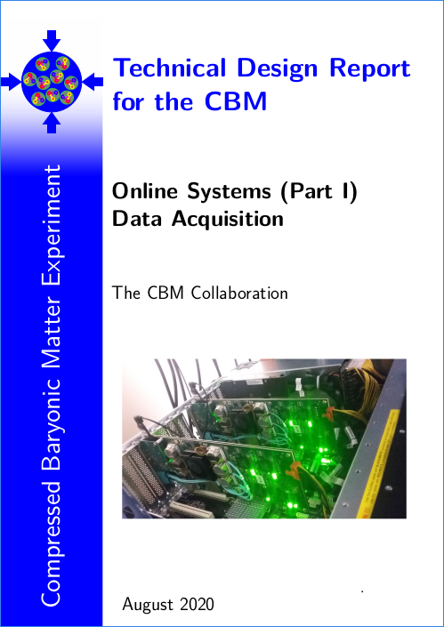
Summary and next steps
the CBM DAQ architecture is mostly defined by choice of GBT
CBM will use GBT links for timing, data and slow control signals
mCBM serves as active test bench to commission our readout
several issues identified during mCBM operation
consolidation of firmware structure is ongoing
upgrade to CRI based single-FPGA, 2-cluster system for Q3/2020
synchronization of individual firmware developers at remote sites is a challenge, appointment of CBM firmware coordinator could be a solution
Online Systems TDR (Part 1) – Data Acquisition is under preparation for submission in Q4/2020

Slide 22
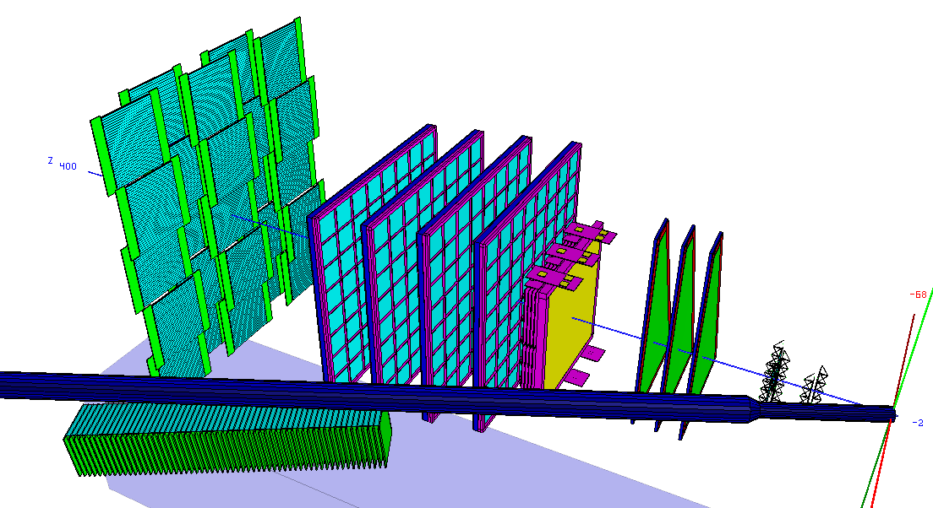
The end
Thank you
for your attention

Slide 23
Bonus
Bonus slides

Slide 24
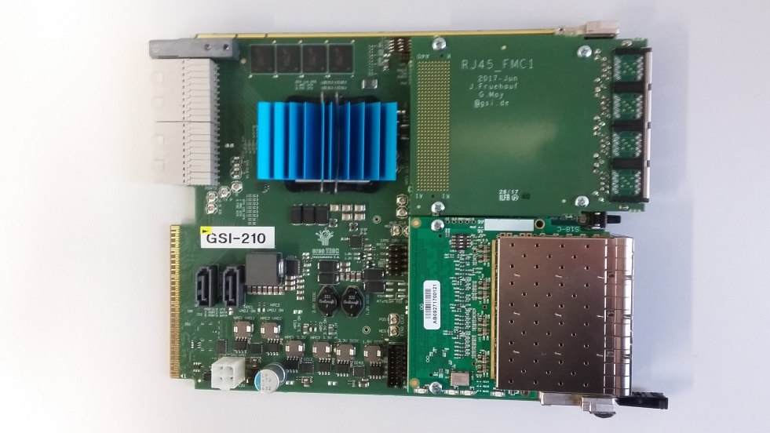
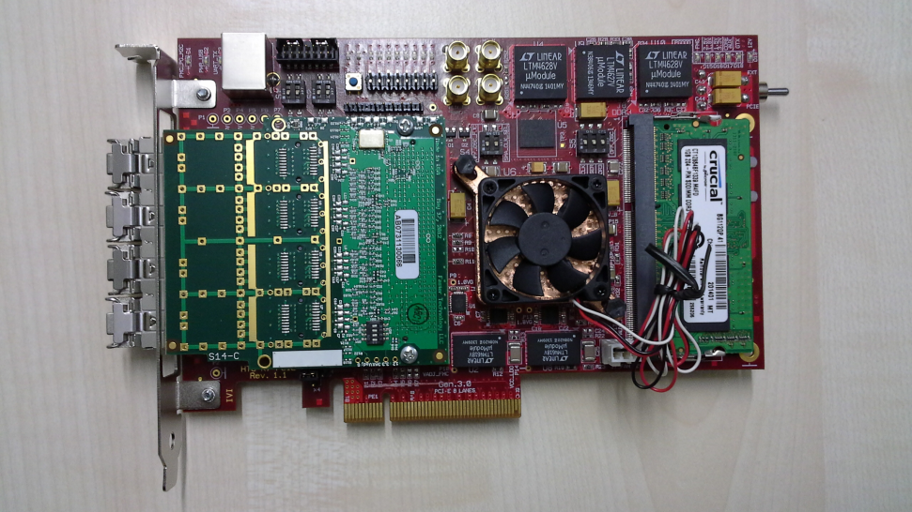
DPB, FLIB and CRI
GBTx-DPB
FLIB-4/8
2020
2021
BNL-712 as CRI-24

Slide 25
mDAQ readout chains in 2020 and 2021
mCBM DAQ container
May
2020
mCBM DAQ container
2021
CRI
Initial DAQ/FLES architecture
Single flat cluster design
Two FPGA-based stages: Data Processing Board (DPB) and FLES Interface Board (FLIB)
Long-range connection to Green Cube via custom optical links

Slide 26
mDAQ readout chains in 2020 and 2021
mCBM DAQ container
May
2020
mCBM DAQ container
2021
CRI
Future: revised DAQ/FLES architecture
Combine DPB and FLIB to single FPGA board (similar to ATLAS, LHCb and ALICE)
Split computing into 2 dedicated clusters: entry cluster and compute cluster
Long-range connection to Green Cube via standard network equipment (e.g. InfiniBand)

Slide 27
Infiniband (EDR): Bandwidth vs fibre length

Slide 28
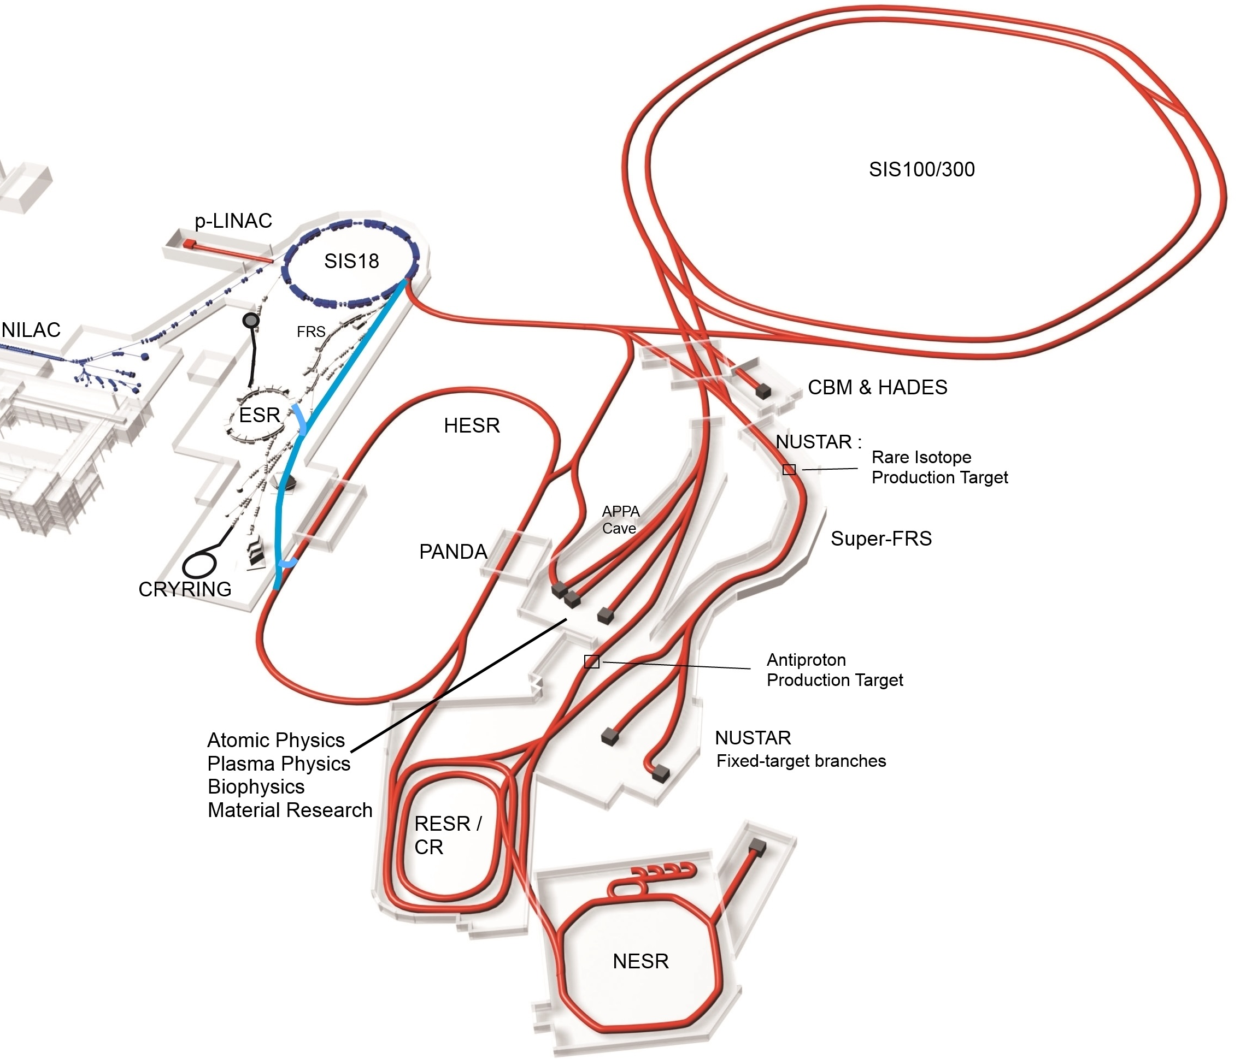
The CBM Experiment at FAIR
Fixed target heavy ion experiment at FAIR
Physics goal: exploration of the QCD phase diagram
Extreme reaction rates of up to 10 MHz and track densities up to 1000 tracks in aperture
Conventional trigger architecture not feasible
Full online event reconstruction needed
FAIR
CBM (Electron-Hadron Setup)
TRD
RICH
STS
Self-triggering free-streaming readout electronics
Event selection exclusively done in FLES HPC cluster
Darmstadt, Germany
MVD
PSD
Dipole
magnet
TOF
MUCH
ECAL
Notes:
First beam Nov. 24
User beam Feb. 25

Slide 29
CBM subsystems

Slide 30
Backup
Backup

