Slide 1
The CBM Silicon Tracking System
Status & Issues

Slide 2
Outline
Overview: Silicon Tracking System (STS)
Module & Ladder: Critical Assessment Components
  Sensors
  Micro Cables
  Readout (ASIC/FEB)
  Sensor Support Structures
  Performance Issues
Status of System Integration
  Mechanical Aspects
  Thermal Aspects
Series Production of Modules and Ladders
  Sensor QA
  Module Production Schedule

Slide 3
CBM-STS Project Teams
Germany
Helmholtz Center (GSI), Darmstadt
Eberhard Karls University (EKU), Tübingen
Goethe University (GU), Frabnkfuert
Karlsruhe Institute of Technology (KIT), Karlsruhe
Poland
University of Science and Technology (AGH), Krakow
Jagiellonian University (JU), Krakow
Warsaw University of Technology (WUT), Warsaw
Russia
Joint Institute for Nuclear Research (JINR), Dubna
Ukraine
Institute for Nuclear Research (KINR), Kiev
Japan
High Energy Accelerator Research Organization (KEK), Tsukuba (associate member)
STS timeline:
Construction: 2019/20 – 2024
Installation: 2024/2025
First beams: end 2025

Slide 4
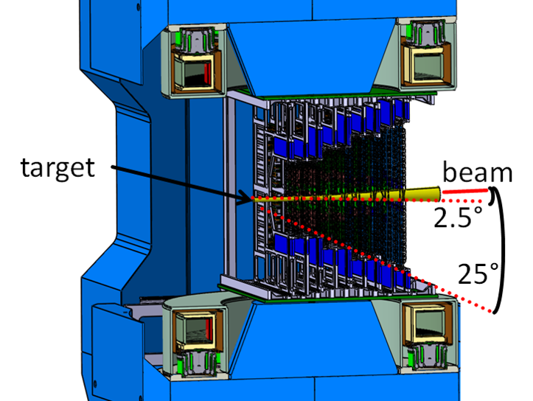
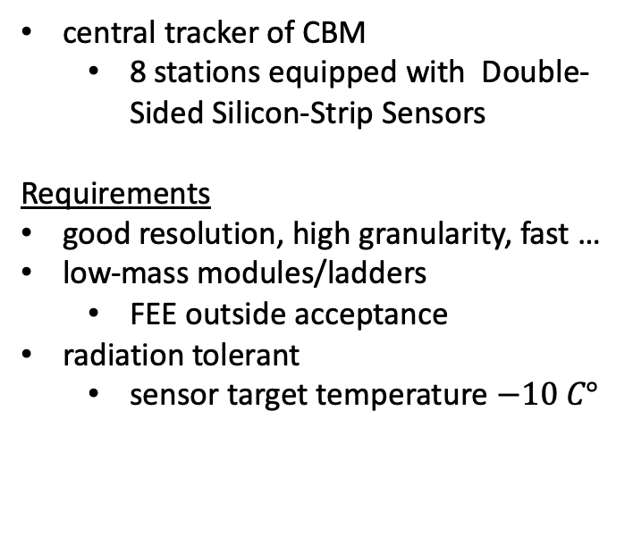
Silicon Tracking System (STS)
central tracker of CBM
  8 stations equipped with Double-Sided Silicon-Strip Sensors
Requirements
good resolution, high granularity, fast …
low-mass modules/ladders
  FEE outside acceptance
radiation tolerant
  sensor target temperature $−10 C°$
STS inside super-conducting dipole

Slide 5
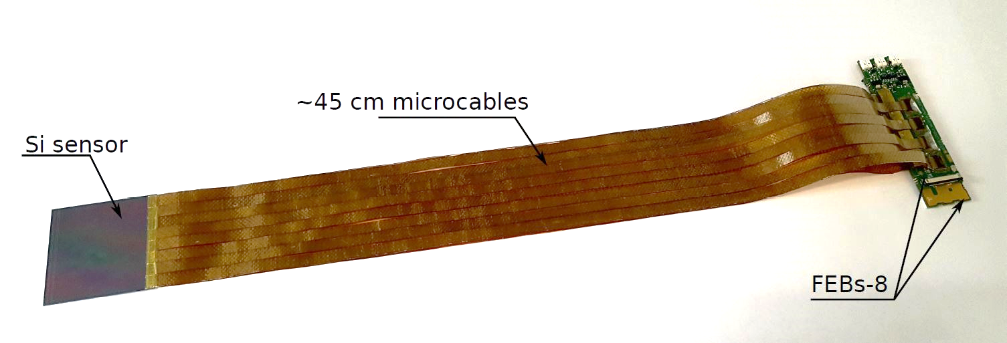
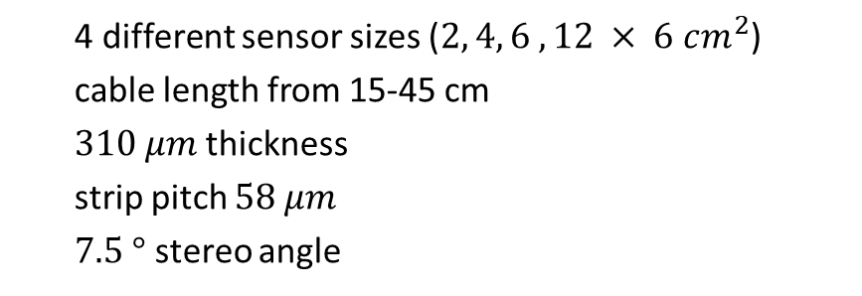
The STS Module
STS module for mSTS
4 different sensor sizes ($2, 4, 6 , 12 × 6 cm^{2}$)
cable length from 15-45 cm
$310 μm$thickness
strip pitch $58 μm$
$7.5 °$ stereo angle
18 different module types
hit spatial resolution ≈ 25 µm (x), 450 µm (y)
sensors ordered from Hamamatsu, delivery start in Nov. 2019

Slide 6
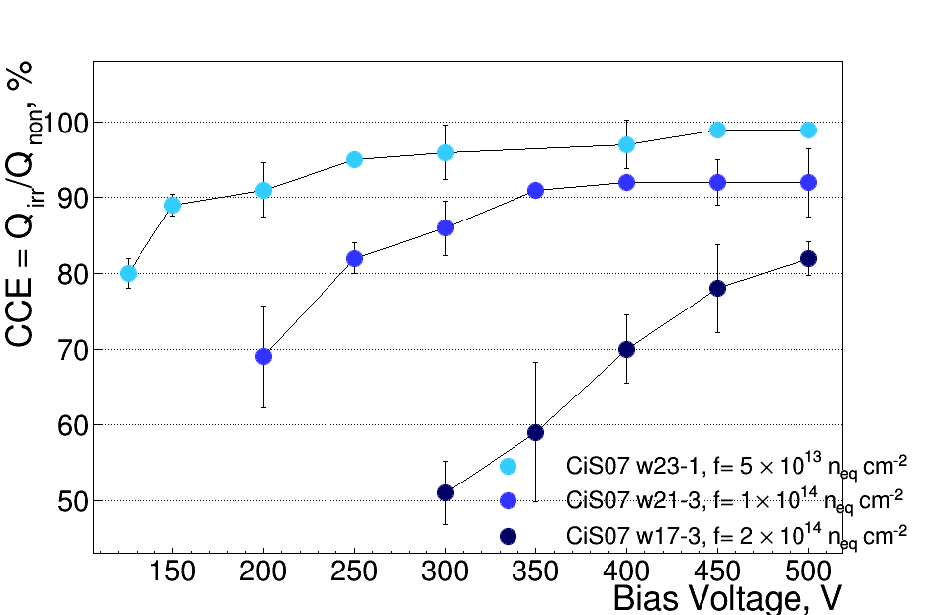
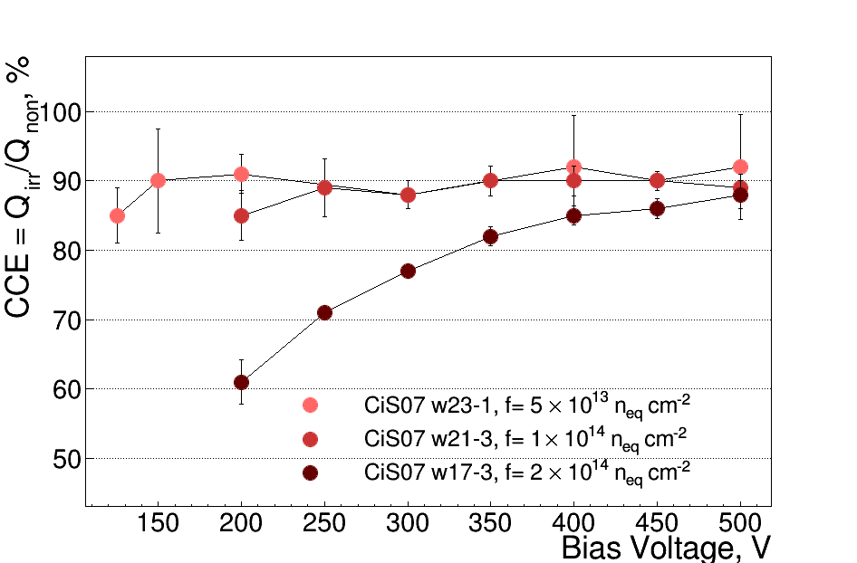
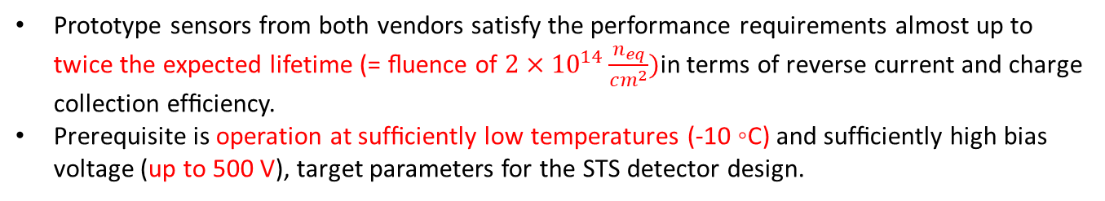
Sensor: Radiation Tolerance
E. Momot GSI:
Charge collection efficiency ($ϵ_{CC}≔100×\frac{MPV_{irr}}{MPV_{non−irr}}$) vs depletion voltage as fct. of fluence
p-side
n-side
Prototype sensors from both vendors satisfy the performance requirements almost up to twice the expected lifetime (= ﬂuence of $2×{10}^{14}\frac{n_{eq}}{cm^{2}})$in terms of reverse current and charge collection efﬁciency.
Prerequisite is operation at sufﬁciently low temperatures (-10 ◦C) and sufﬁciently high bias voltage (up to 500 V), target parameters for the STS detector design.

Slide 7
Micro Cables

Slide 8

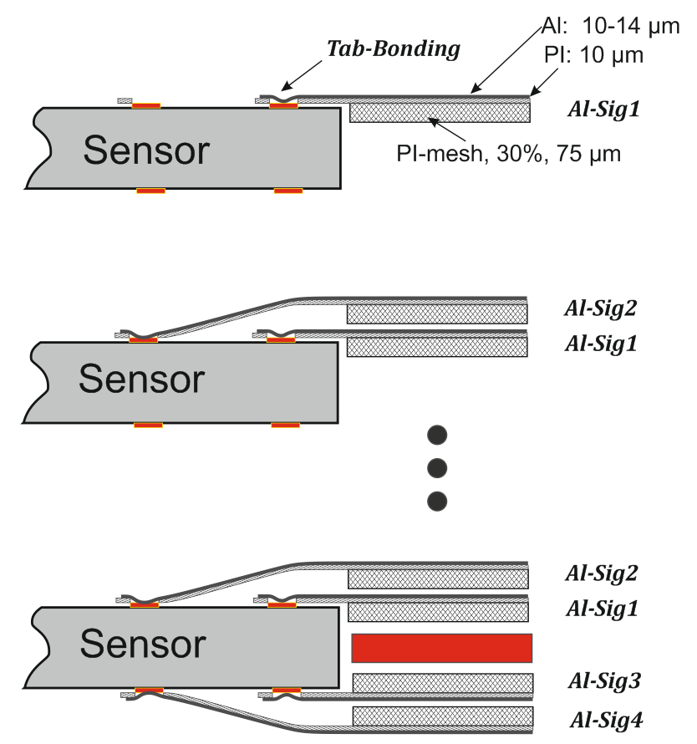
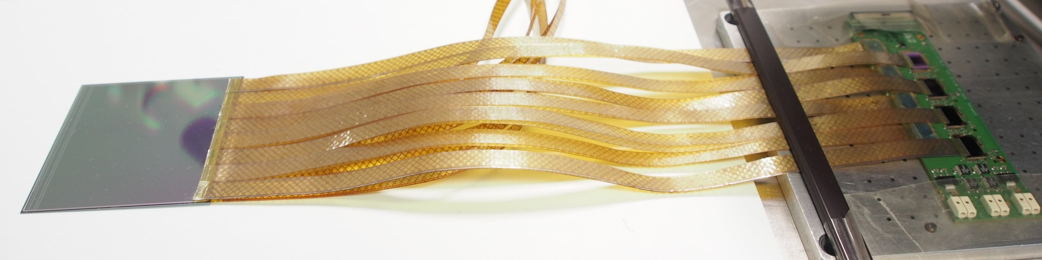
MicroCable: Type LTU, Ukraine
pro:
fast ultrasonic TAB bonding favorable for identical materials: aluminum sensor contact pads and bonded aluminum micro-cable leads
low Z material
Challenges:
semi-industrial, largely manual production
problems with quality?
yield ( = production time) ?
32 individual micro cables/module (C. Simons, R. Visinka - GSI)

Slide 9
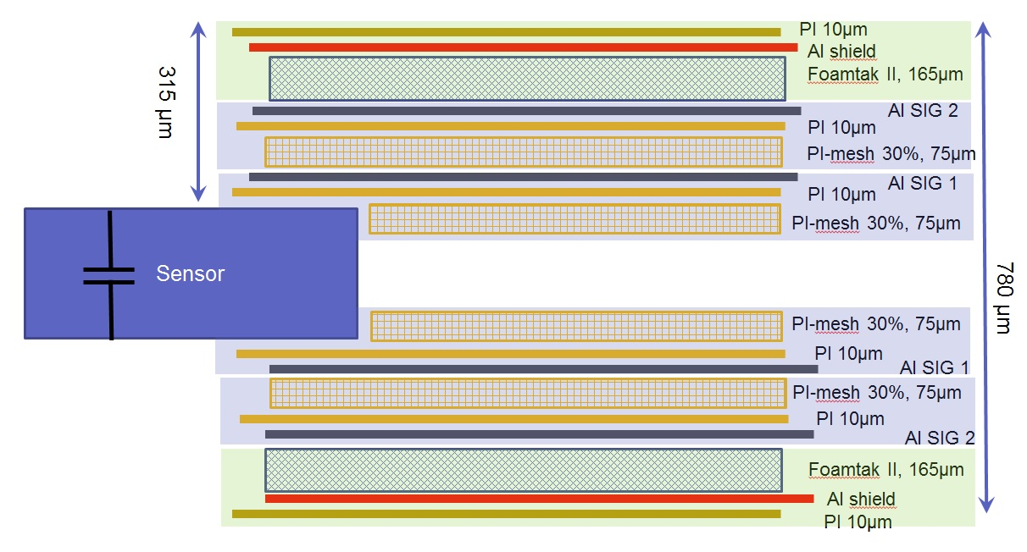
Micro Cables Stack: Type LTU
Manufacturer: LTU Kharkiv, Ukraine
ε_{r} Foamtak II = 1,5 ε_{r} PI-meshed 30% = 1,75 → strip capacitance = 0.38 pF/cm
Additional spacers (PI-mesh) are placed between two signal layers to reduce the capacitance contributions from the adjacent connecting layers.
Shielding layers reduce the noise level and prevent shorting between the stacks of cables.

Slide 10

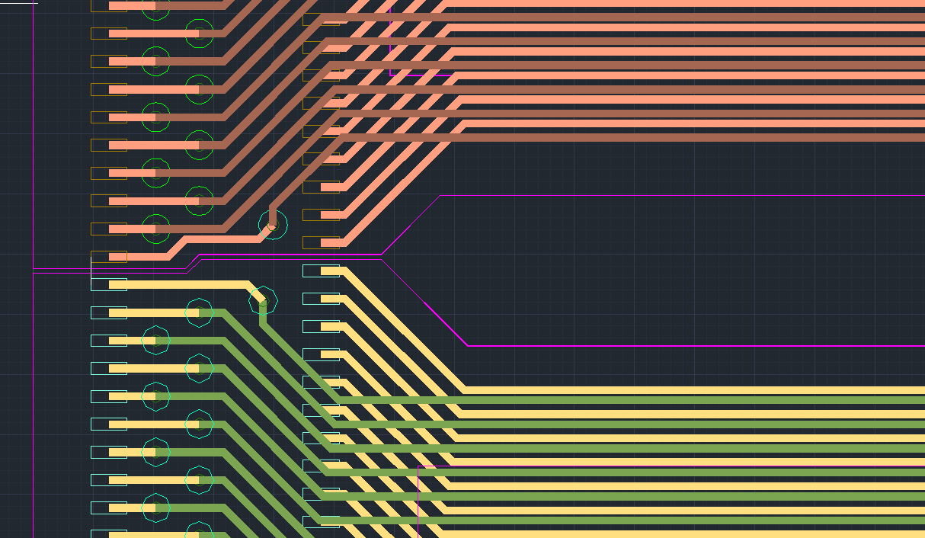
MicroCable: Type KIT
As an alternative to the Aluminum-microcables a R&D-project has been started at KIT that investigates Copper-based cables (T. Blank, P. Pfister (KIT)):
pro:
well known in PCB-Flexboard technology
industrial production (Dyconex, CH)
offers interconnected multilayer solutions one cable with two layers (bottom & top) and vias instead of two single Al-cables
challenge:
highly customized bonding technology (flip chip, soldering, …)
higher Z material (Cu/Au)
flip chip Au-stud bonding

Slide 11
MicroCable: Type KIT
example of bonding on sensor-side in Cu-technology
proof of principle of bonding technology
  but: functional module has not yet been produced
next step required: assembly and test of full module with both sensor and STSXyter2.1 in Cu-technology

Slide 12
Summary: LTU vs KIT MicroCables
Cable technology: single point of failure!
tools for both types of interconnect technologies have been developed at GSI/KIT
working and tested modules using Al-micro cables
awaiting working and tested module using Cu-micro cables (ongoing)
Decision on continuation of Cu-micro cable path by end of Q4/2019!?
  required input: working and tested modules using CU-micro cables
  KIT agrees to use TAB-bonding for module production at KIT using Al-cables

Slide 13
Readout

Slide 14
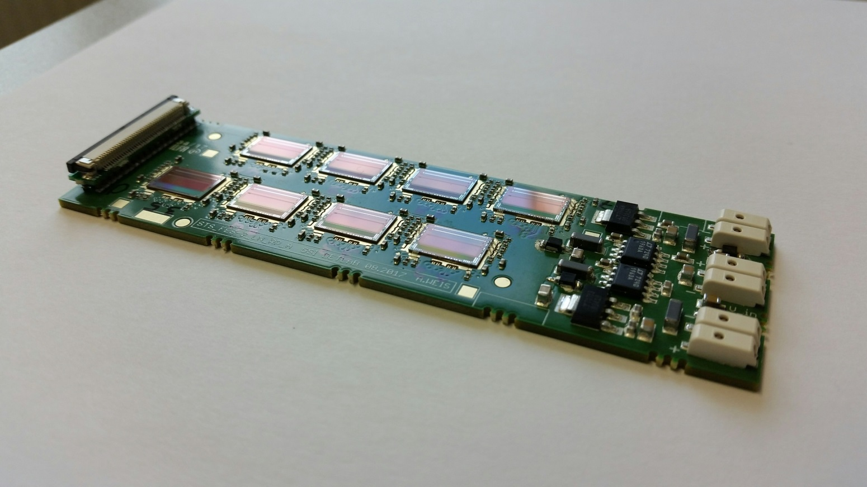
ASIC & FEB
K. Kasinski – AGH
R. Kapell, J. Lehnert – GSI,
STSxyter 2.1
ASIC:
Preliminary EDR in 9/19
No major issues found
Revive input ESD protection?
Final EDR in 11/19
launch ASIC production
FEB (Front-End Board):
FEB-8/2 available (DetLab)
prototype FEB-8/5 available as Polish in-kind contribution
  test: dielectric strength

Slide 15
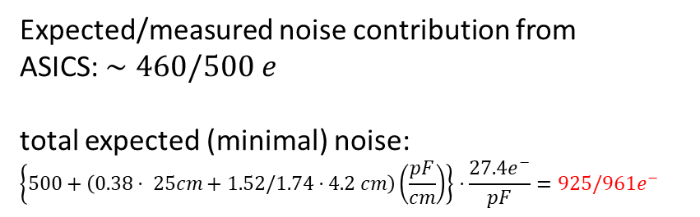
ASIC: Noise
A. Rodriguez², O. Rodriguez - GSI
Expected/measured noise contribution from
ASICS: $∼460/500 e$
total expected (minimal) noise:
$$\left\{500+\left(0.38⋅ 25cm+1.52/1.74⋅4.2 cm\right)\left(\frac{pF}{cm}\right)\right\}⋅\frac{27.4e^{−}}{pF}=925/961e^{−}$$
ASIC
cable
sensor

Slide 16
Sensor Support Structures

Slide 17
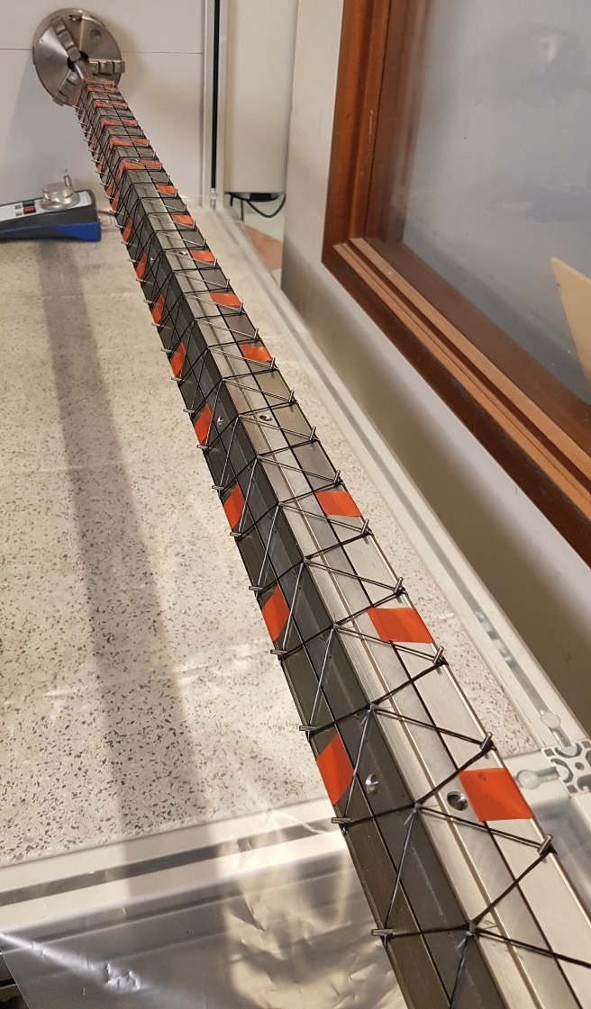
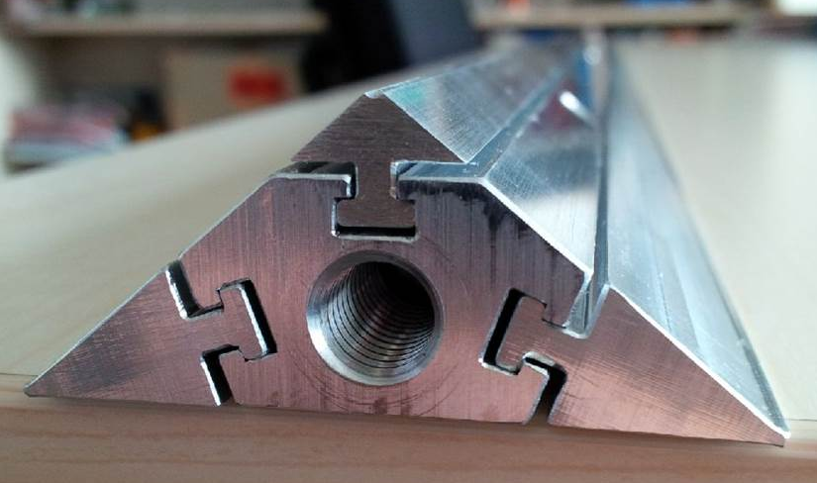
Carbon Fiber Ladders
W. Niebur, J. Heuser, U. Frankenfeld (GSI), J. Weinert – GSI DetLab
complete set of CF Ladders (130 pc.) produced at a local company in “winding” technology:
carbon tube, 1.5/0.7mm ∅
carbon fiber + epoxy resin

Slide 18
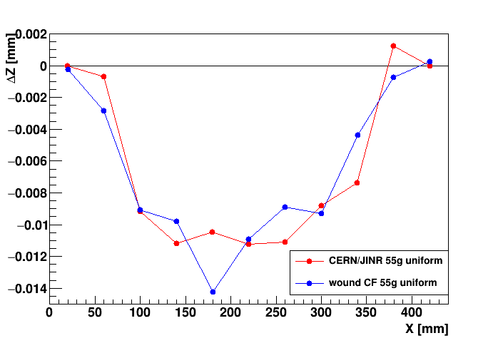
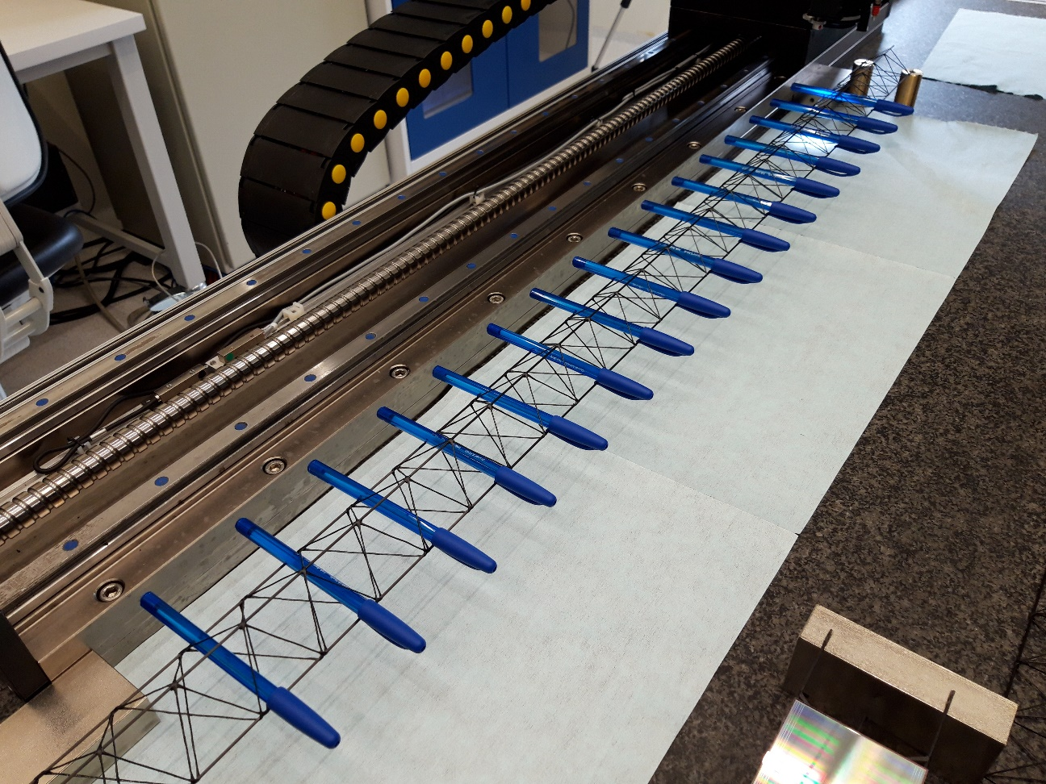
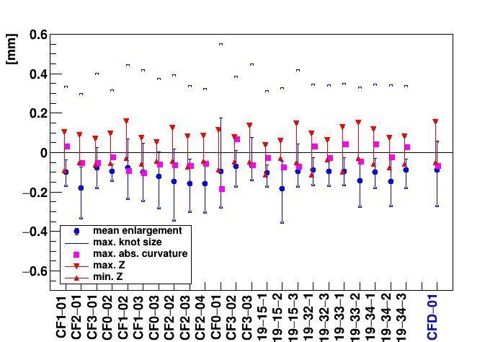
Carbon Fiber Ladders Validation
U. Frankenfeld – GSI
precision & sagging comparable to CERN/JINR type (from ALICE-ITS)!

Slide 19
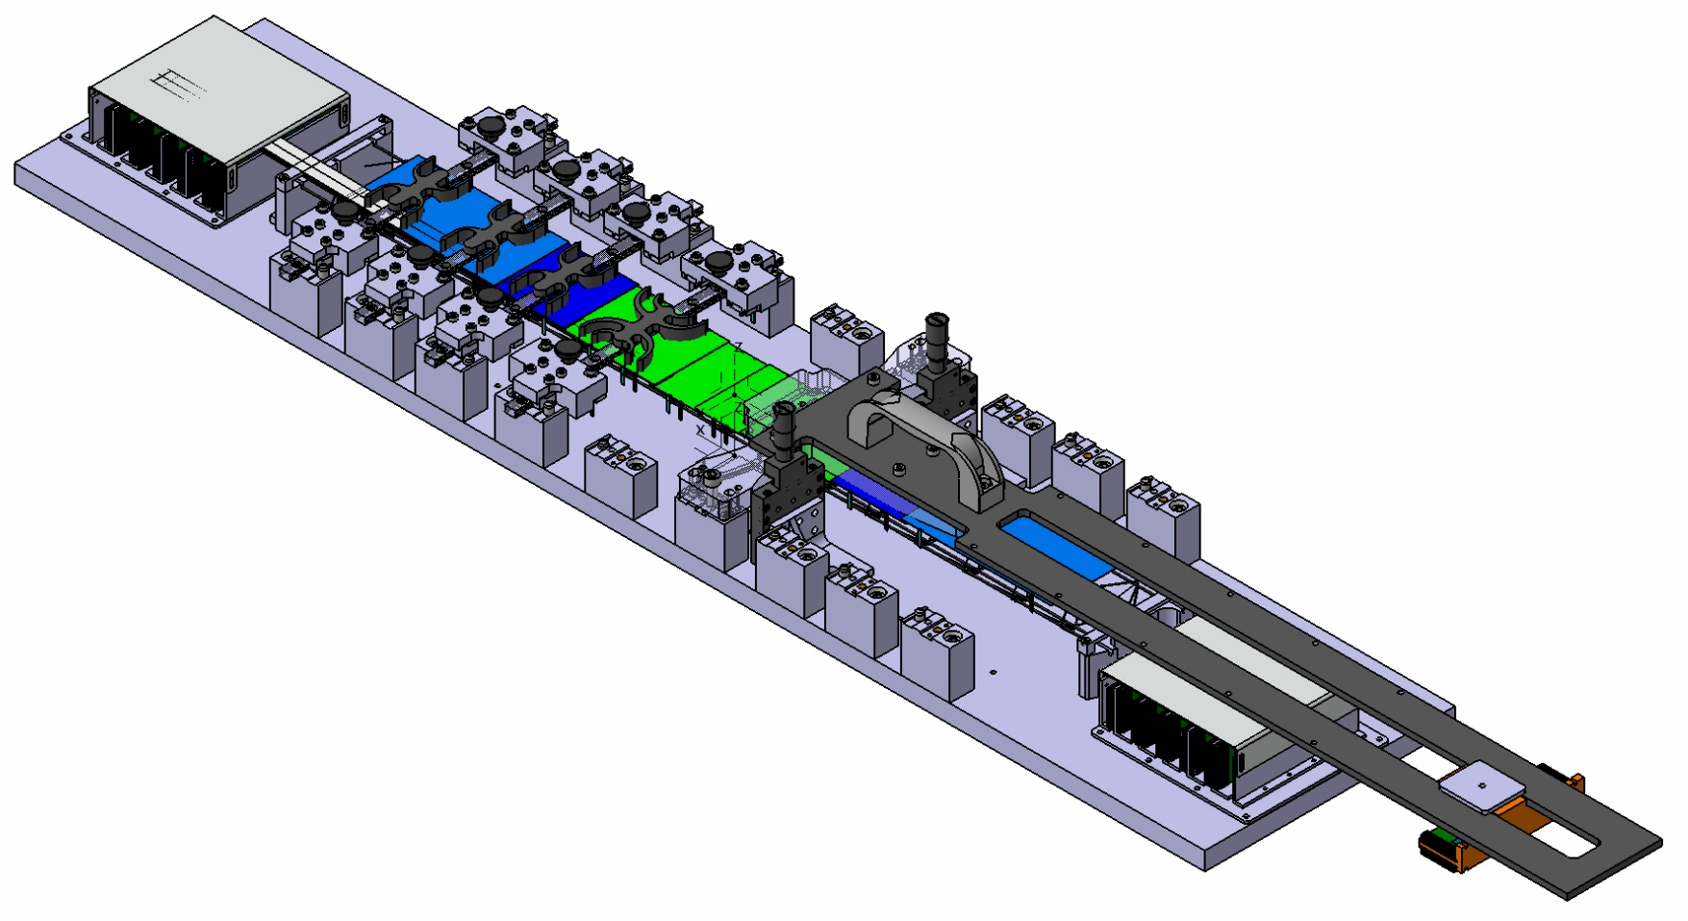
Ladder Assembly Tool
U. Frankenfeld, O. Vasylyev – GSI DetLab, S. Mehta – Tübingen
L-leg glueing tool
Sensor holder
Base plate
Mounting block sensorposition

Slide 20
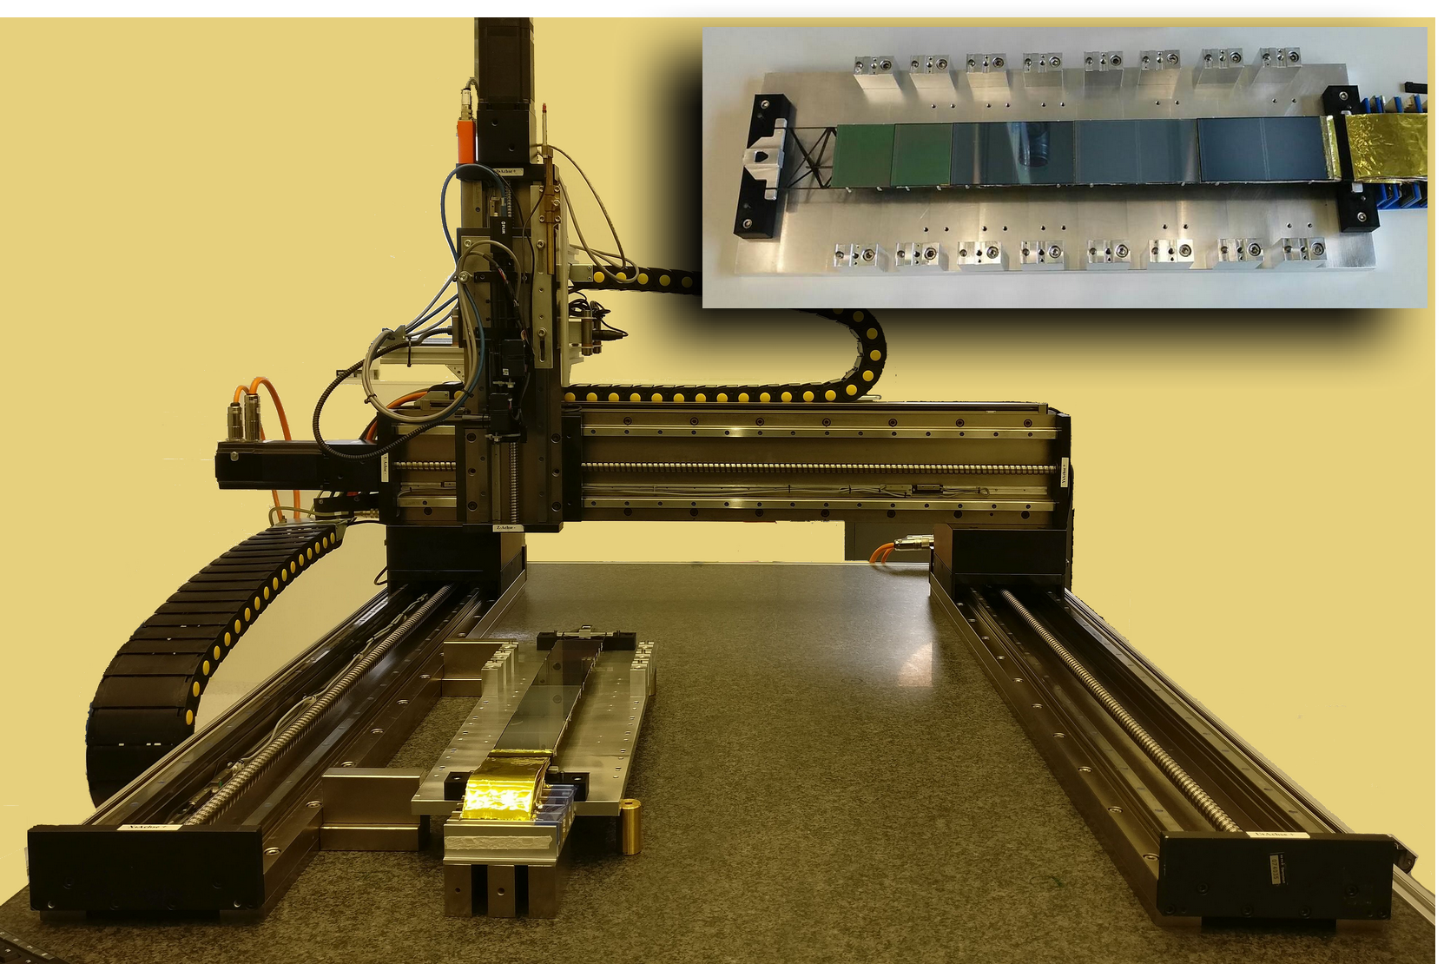
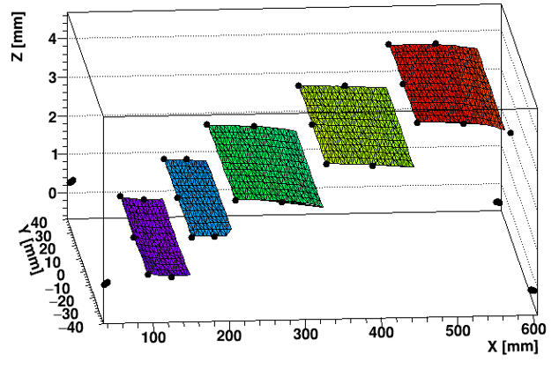
Ladder Optical Metrology
Focus based optical metrology for sensors (developed at Tübingen, E. Lavrik) adapted (U. Frankenfeld – GSI) to ladder metrology:
3D image of sensors on ladder
fiducial marks on sensors
measurement grid: 1 mm
successful vadildation of assembly technique
module placement achieved within target
± 200 µm (z), < 100 µm rms (xy)
10 µm position resolution

Slide 21
Performance Issues

Slide 22
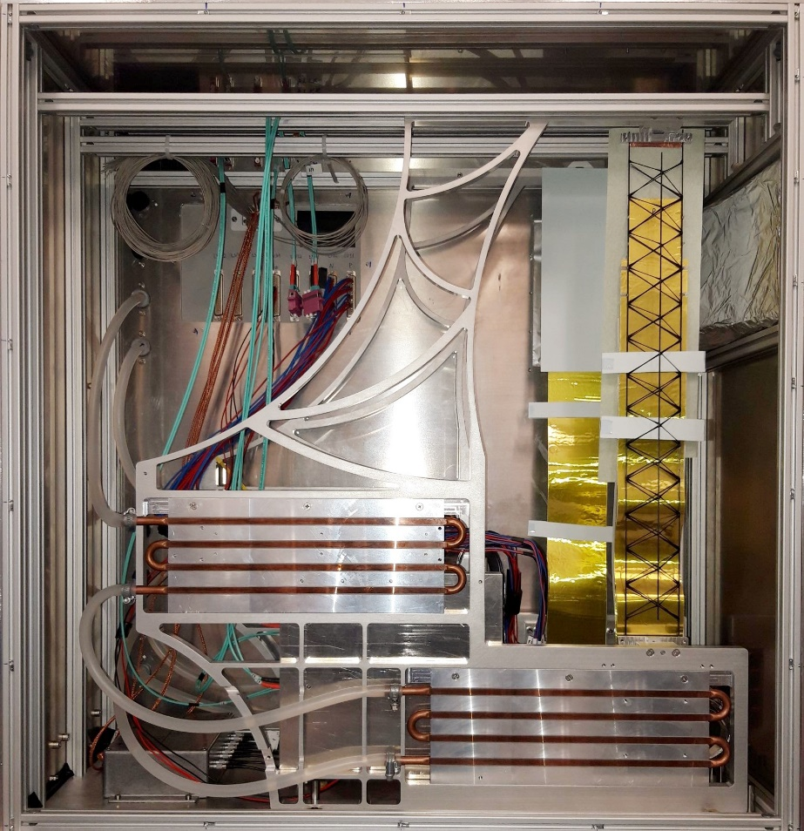
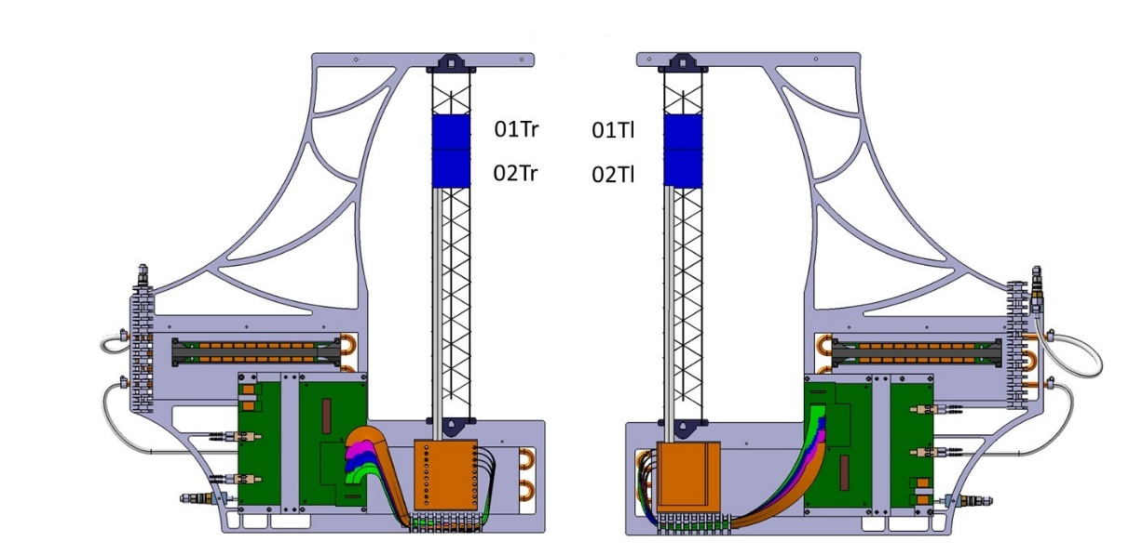
Performance Tests: mSTS
J. Heuser, U. Frankenfeld, A. Lymanets, J. Lennert, A. Toia, P. Loizeau – GSI, C. Simons, O. Vasylyev – GSI-Detlab
instrumented:
2 detector modules on 2 ladders on C-frame
analysis:
on-going
0
0
1
1
issues:
many channels “gave up the ghost“ (related to broken wire bonds due to thermal stress via glob-top on ASICS → thermal cycling tests ongoing)
larger noise then nominal (σ ~ 3 ke, pick-up noise, ground loops → solved by more careful grounding)

Slide 23
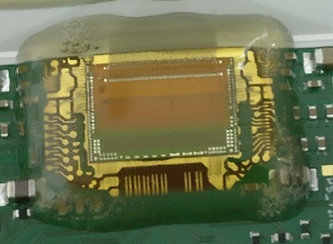
Thermal Cycling of FEBs
Shaifali Mehta - Tübingen
disruptive behavior of glob-top glue reproduced!

Slide 24
Noise Performance
A. Lymanets – GSI , A. Rodriguez², O. Rodriguez, A. Toia – GSI/Frankfurt
ENC(e)
< 1000 e⁻
500 e⁻
channel number
noise of single module: close to physical lower limit
issues to be addressed:
  system noise
    common mode noise
    full setup behavior
    ….

Slide 25
Status of System Integration

Slide 26
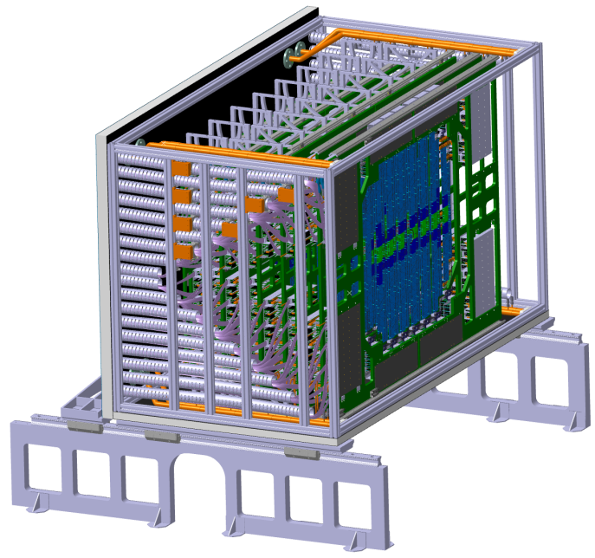
Mechanical Aspects
O. Vasylyev – GSI DetLab
rail system (to move STS in and out of magnet)
rail system ( to move C-frames)
main frame for C-frame mount
positioning / adjustment
cabling, tubes
vibrations / structural analysis
beam pipe (carbon/berylium)
overall stiffness
service / support mechanics
overall assembly procedure
material budget rear panel
addressed in mechanical demonstrator!

Slide 27
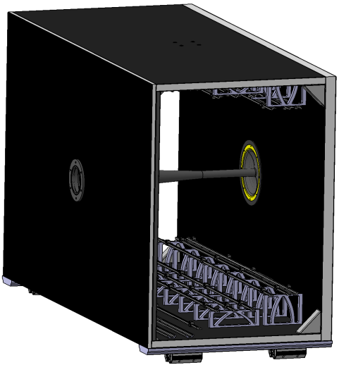
Thermal Aspects
O. Vasylyev – GSI , K. Agarwal – Tübingen
sealing
feed throughs
panel connections
electronics liquid cooling plate and distribution
gas drying & cooling for sensor
addressed in thermal demonstrator!
thermal insulation box

Slide 28
Cooling

Slide 29
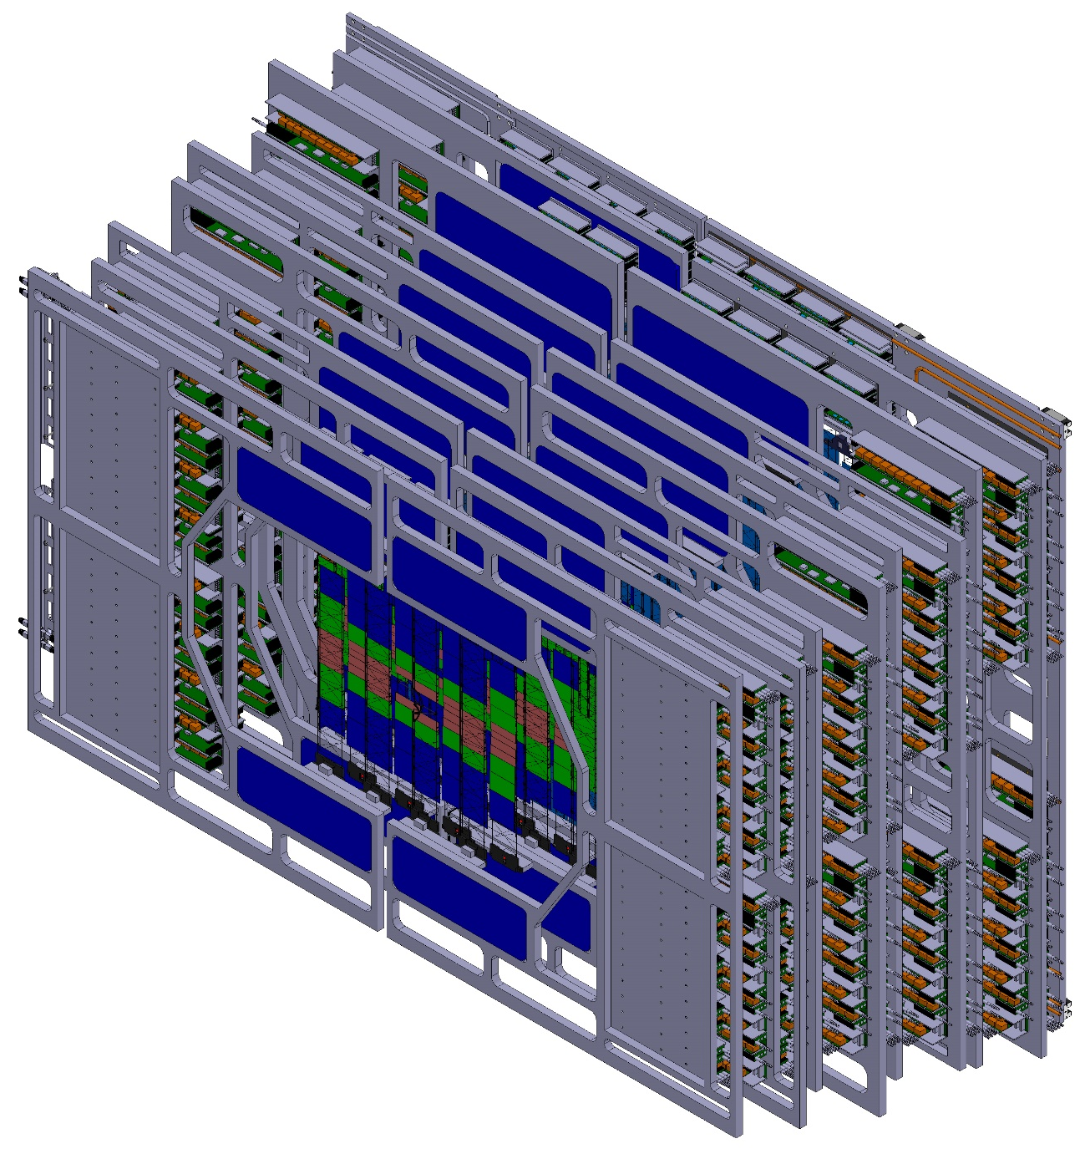
Cooling Challenge
K. Agarwal – Tübingen, H.R. Schmidt – Tübingen, GSI
Silicon Sensors:
expected power dissipation ∼ 6 mW/cm² at end-of-lifetime (fluence – 10¹⁴ n_{eq}(1 MeV)/cm²)
target temp. ≤ -10°C
gas cooling - material budget!
y
x
z

Slide 30
(CBM-S Cooling Challenge TS
Electronics, Power Cables, Walls:
expected power dissipation ∼ 40kW in < 3.5 m³
efficient heat exchanger and cooling system
Choice of cooling system is pending:
Monophase NOVEC^{*)}
Bi-phase CO₂
y
to be decided
x
z
^{*)}3M™ Novec™ 649 Engineered Fluid for heat transfer applications (GWP=1)

Slide 31
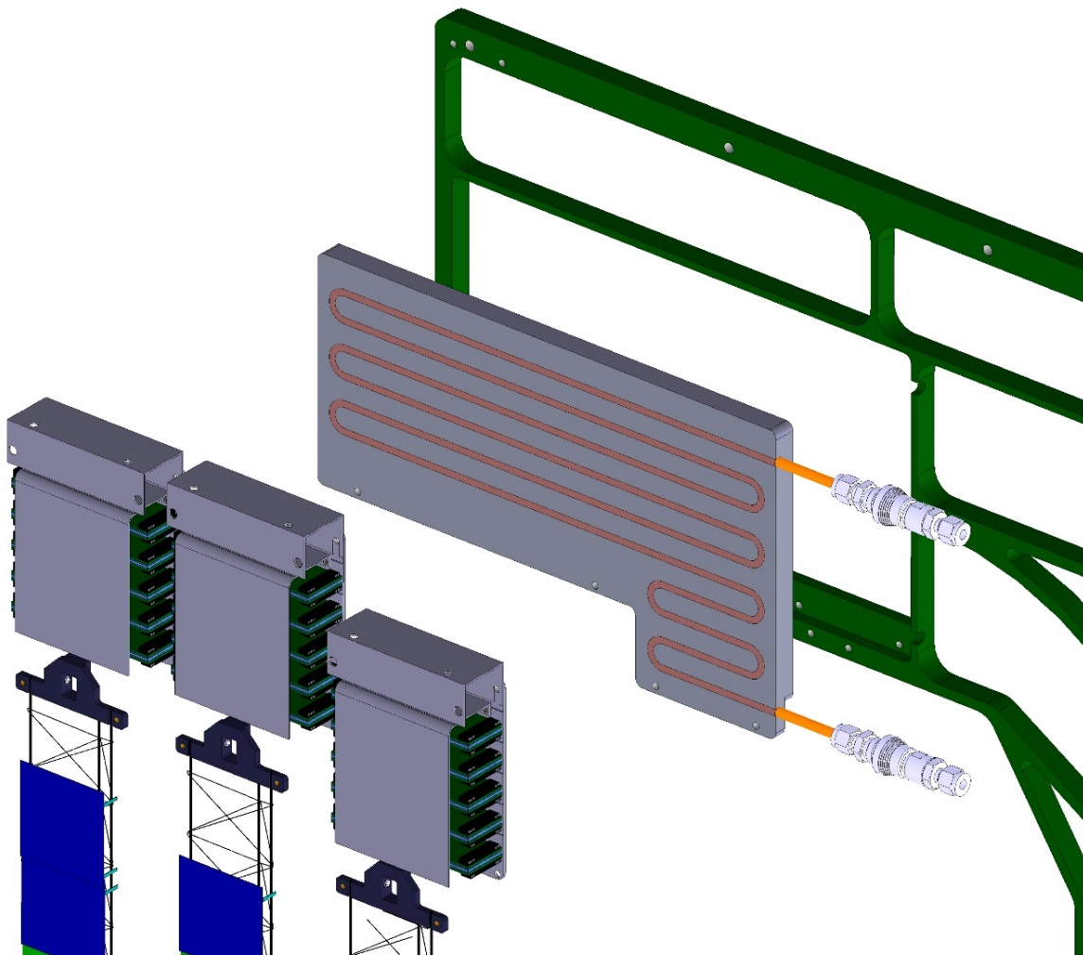
Cooling Chain
K. Agarwal – Tübingen, M. Kis – GSI-DetLab, P. Koczon – GSI DetLab
C-Frame (support structure) to hold the cooling plates and sensors mounted on ladders
Cooling Plates (press-fitted tube channels) with monophase NOVEC 649 or bi-phase CO₂ coolant
Front-End Electronics Boxes (FEB Boxes) holding the FEBs
Silicon Sensors mounted on CF Ladders

Slide 32
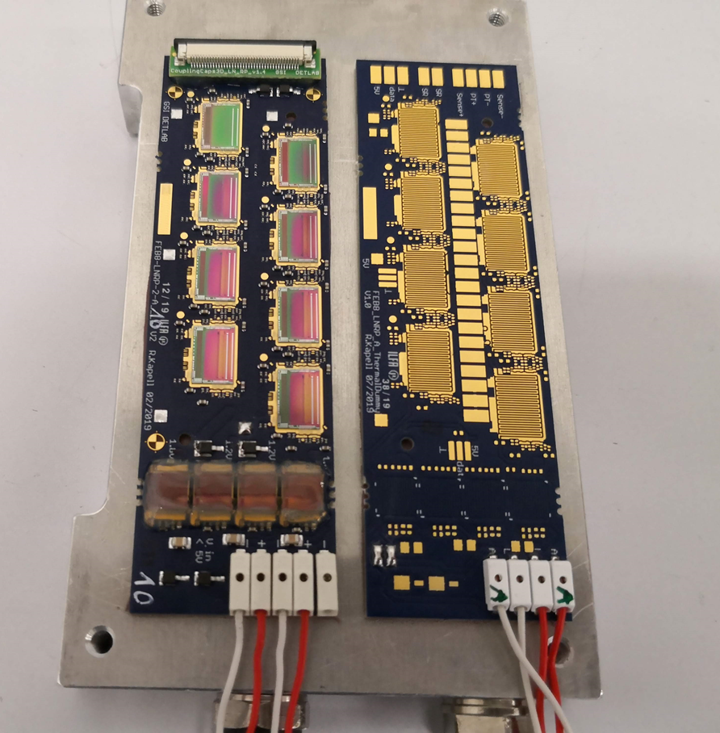
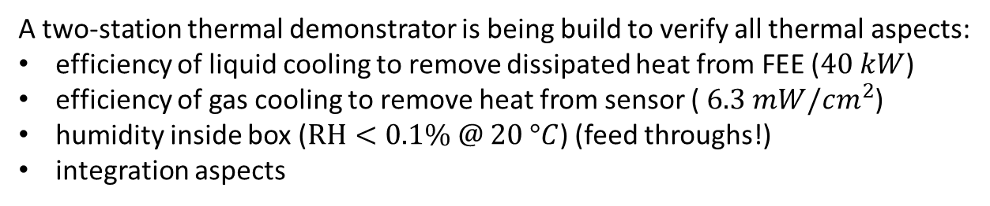
Thermal Demonstrator
K. Agarwal – Tübingen, O. Vasylev – GSI Detlab, R. Kapell – GSI DetLab,
realistic heat sources
A two-station thermal demonstrator is being build to verify all thermal aspects:
efficiency of liquid cooling to remove dissipated heat from FEE ($40 kW$)
efficiency of gas cooling to remove heat from sensor ( $6.3 mW/cm^{2}$)
humidity inside box ($RH<0.1\% @ 20 °C$) (feed throughs!)
integration aspects

Slide 33
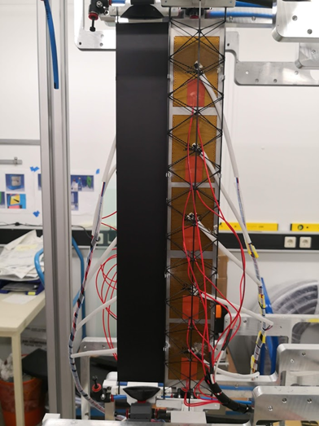
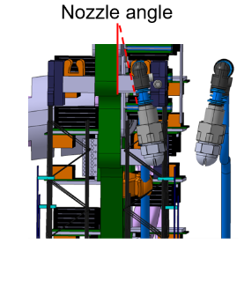
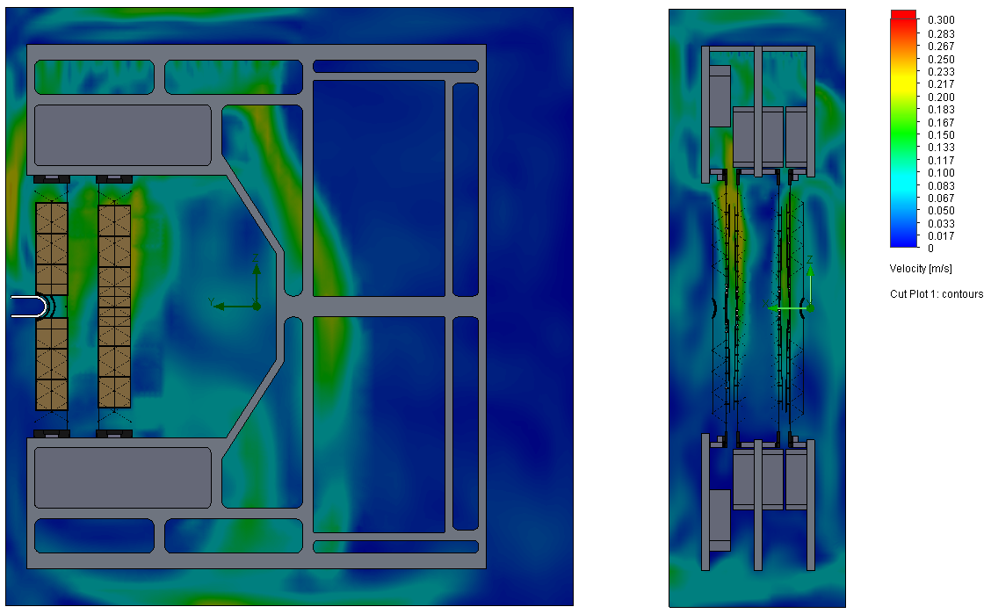
Direct Sensor Gas Cooling
K. Agarwal – Tübingen, P. Kuhl - GSI Engineer, Technicians – GSI
measurement of temperature profile along sensors
issues:
  optimization of nozzle
  gas temperature vs. relative humidity
  thermal stress
  induced vibrations vs. flow velocity
  …

Slide 34
Gas Cooling - Vibrations
S. Metha, K. Agarwal – Tübingen + GSI Technicians
C-frame mock-up with ladder dummy
sensor vibrations vs. flow velocity
structural Eigenfrequencies of ladders
…
Laser Doppler Vibrometer

Slide 35
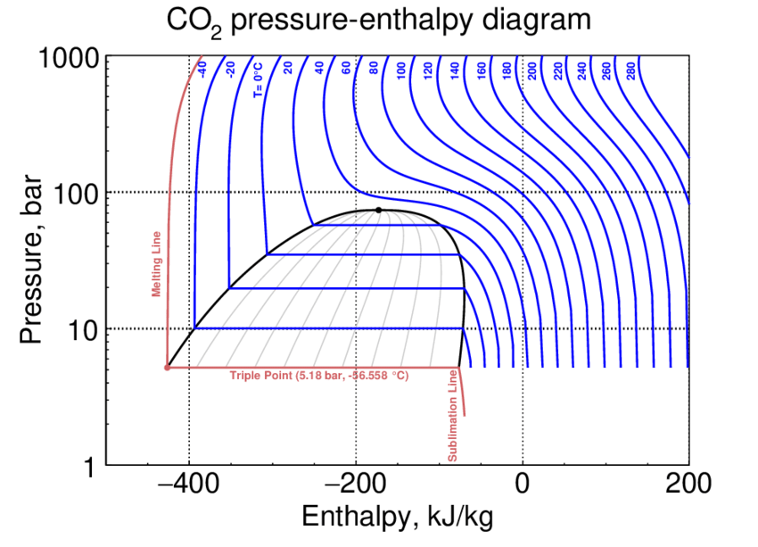
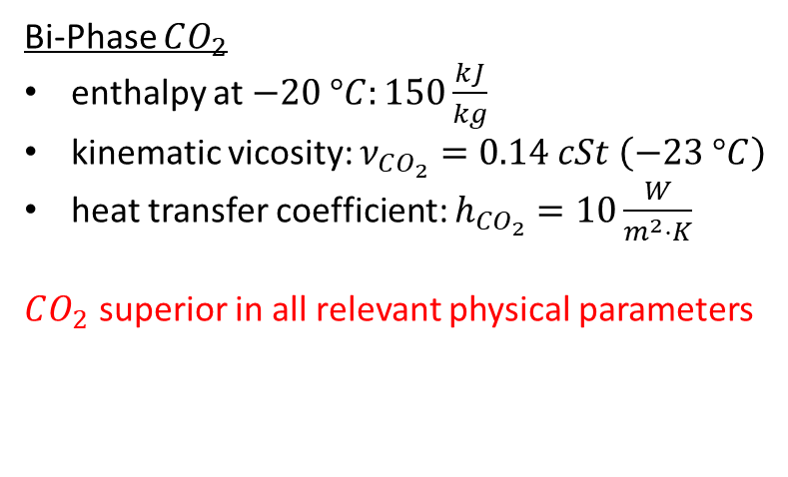
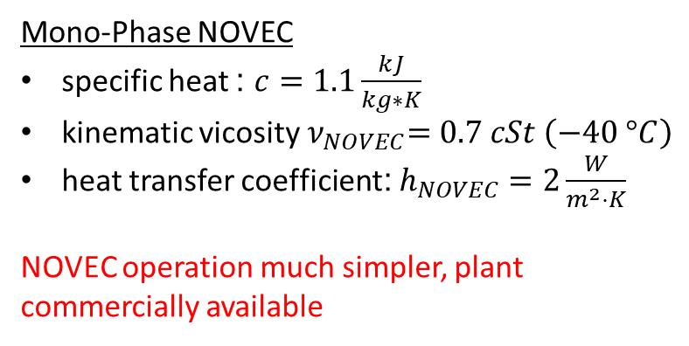
Choice of Cooling Plant
Bi-Phase $CO_{2}$
enthalpy at $−20 °C:150\frac{kJ}{kg}$
kinematic vicosity: $ν_{CO_{2}}=0.14 cSt \left(−23 °C\right)$
heat transfer coefficient: $h_{CO_{2}}=10\frac{W}{m^{2}⋅K}$
$CO_{2}$ superior in all relevant physical parameters
Mono-Phase NOVEC
specific heat : $c=1.1\frac{kJ}{kg∗K}$
kinematic vicosity${ ν}_{NOVEC}=0.7 cSt \left(−40 °C\right)$
heat transfer coefficient: $h_{NOVEC}=2\frac{W}{m^{2}⋅K}$
NOVEC operation much simpler, plant commercially available

Slide 36

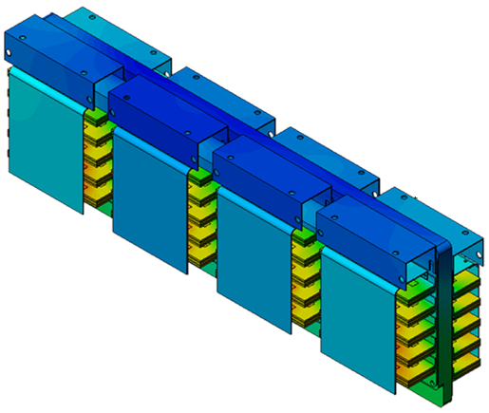
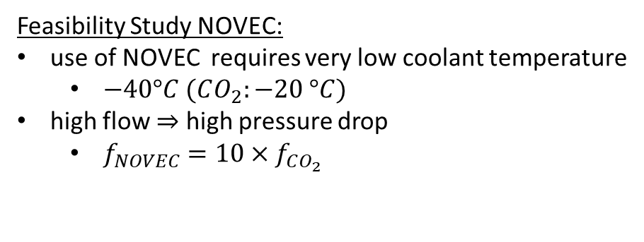
MONOPHASE NOVEC 649 – COMPUTATIONAL FLUID DYNAMICS (CFD)
K. Agarwal – Tübingen
Feasibility Study NOVEC:
use of NOVEC requires very low coolant temperature
  $−40°C (CO_{2}:−20 °C)$
high flow $⇒$ high pressure drop
  $f_{NOVEC}=10×f_{CO_{2}}$
SolidWorks Flow Simulation Module
simulation goal: Max. FEB Temp. < -10°C
Example Case NOVEC with min. temp. and max. load
Coolant Temp. = -40°C
Heat Load = 1080 W
Tube ID = 5.4 mm
Tube Length = 2.7 m
Mass Flow = 150 g/s
Pressure Drop = 1.25 bar

Slide 37
Cooling – Summary and Open Questions
NOVEC:
possible solution, but operation close to physical limits, almost cryogenic
bi-Phase CO2:
possible solution, but large uncertainties in terms of operation & cost (distribution system)
Industrial offers both for NOVEC and CO₂ based demonstrator systems available (cost for plant: comparable)
Decision on liquid cooling technology by Q4/2019! (EDR, CERN experts)

Slide 38
Series Production

Slide 39
STS Project Plan
J. Heuser – GSI, W. Müller – GSI/FAIR
Detailled planning for production phase: 2019 -2024
most time consuming step: module assembly!
  bonding of >28672 micro cables to sensor and ASICs

Slide 40
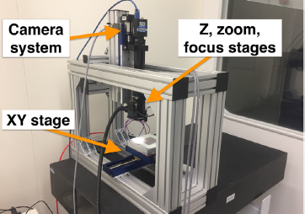
Optical QA of Sensors
E. Lavrik – Tübingen (now GSI):
custom-build scanning station in Tübingen
all sensors will be inspected optically (scanned) upon arrival
identify and classify defects on sensors employing CNN (Convolutional Neural Network)
automatic detection and recognition rate > 96 & 93%, respectively
setup will be transported from Tübingen and installed at GSI DetLab

Slide 41
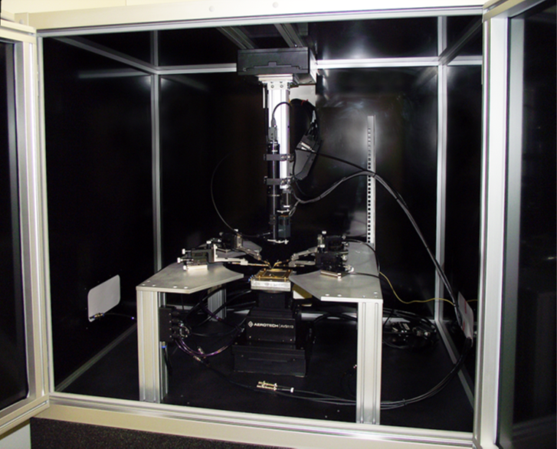
Electrical QA of Sensors
I. Panasenko – Tübingen
strip resistance
custom-build probe station in Tübingen
high precision for repetitive steps
allows to inspect 12cm sensors
inspect fraction of sensors (1%-10%) of each delivered batch
setup will be transported from Tübingen and installed at GSI DetLab

Slide 42
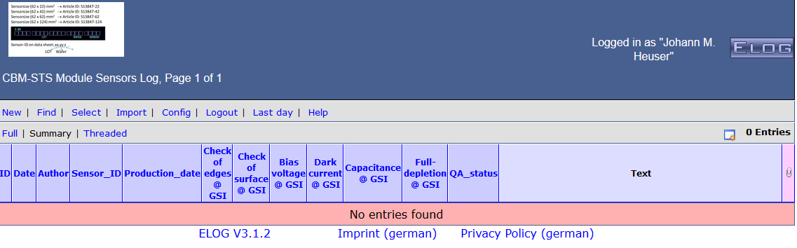
Preparation of Production: Logistics
A. Wilms – GSI DetLab, E. Lavrik – Tübingen/GSI (back-end, based on FairDB)
component data base
  component types
  nomenclatures
  e-logbook

Slide 43
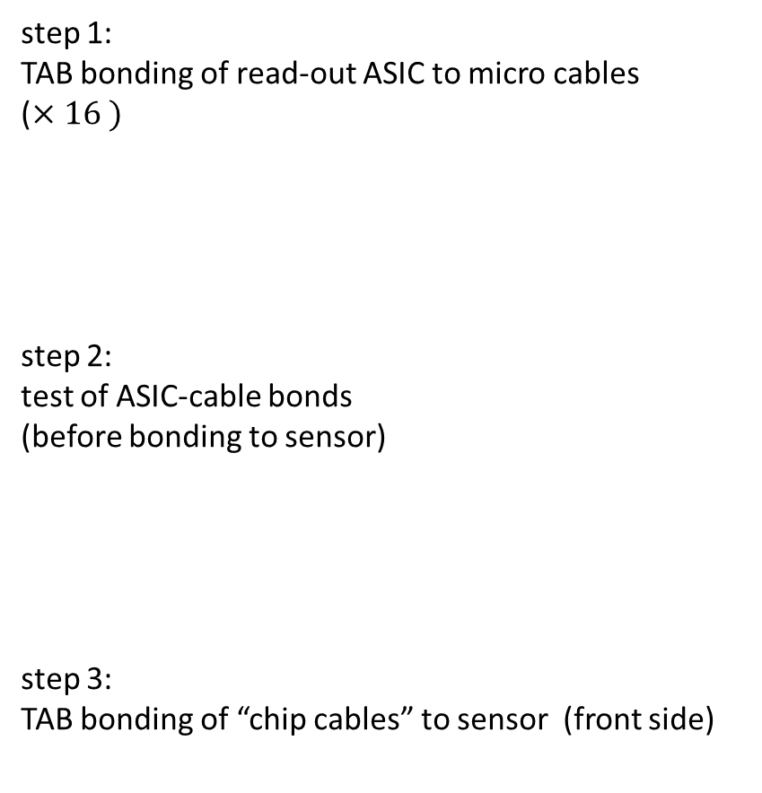
Module Production Step 1-3
step 1:
TAB bonding of read-out ASIC to micro cables
($×16 )$
step 2:
test of ASIC-cable bonds
(before bonding to sensor)
step 3:
TAB bonding of “chip cables” to sensor (front side)

Slide 44
Module Production Step 4-8
step 4:
installation of read-out chips into front-end board (front-side)
step 5-8:
repeat step 1-4 for back side cables
step 9:
testing of complete module!
tools & steps of module assembly have been worked out, but not yet optimized!

Slide 45
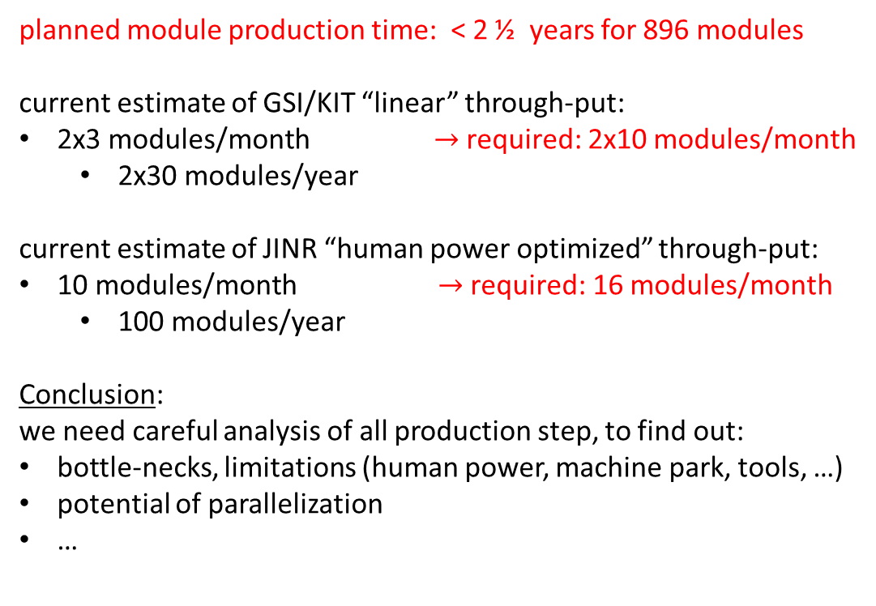
Module Assembly Through-Put
site | #modules | #ladders
JINR | 400 | 46
GSI | 248 | 60
KIT | 248 | -
+ 15% spares
planned module production time: < 2 ½ years for 896 modules
current estimate of GSI/KIT “linear” through-put:
2x3 modules/month $→$ required: 2x10 modules/month
  2x30 modules/year
current estimate of JINR “human power optimized” through-put:
10 modules/month $→$required: 16 modules/month
  100 modules/year
Conclusion:
we need careful analysis of all production step, to find out:
bottle-necks, limitations (human power, machine park, tools, …)
potential of parallelization
…
start with pre-series production soon!

Slide 46
Summary and Conclusions
were do we stand?
finishing R&D phase, few issues remain:
noise ok module level, system aspects have to be addressed (mCBM)
mechanical aspects, vibrational analysis, stiffness, …
thermal aspects, choice of cooling system, sensor gas cooling, …
starting up production phase, few issues to be solved:
micro cables (technology)
module assembly optimization (time)
Thank You!

Slide 47
Backup

Slide 48
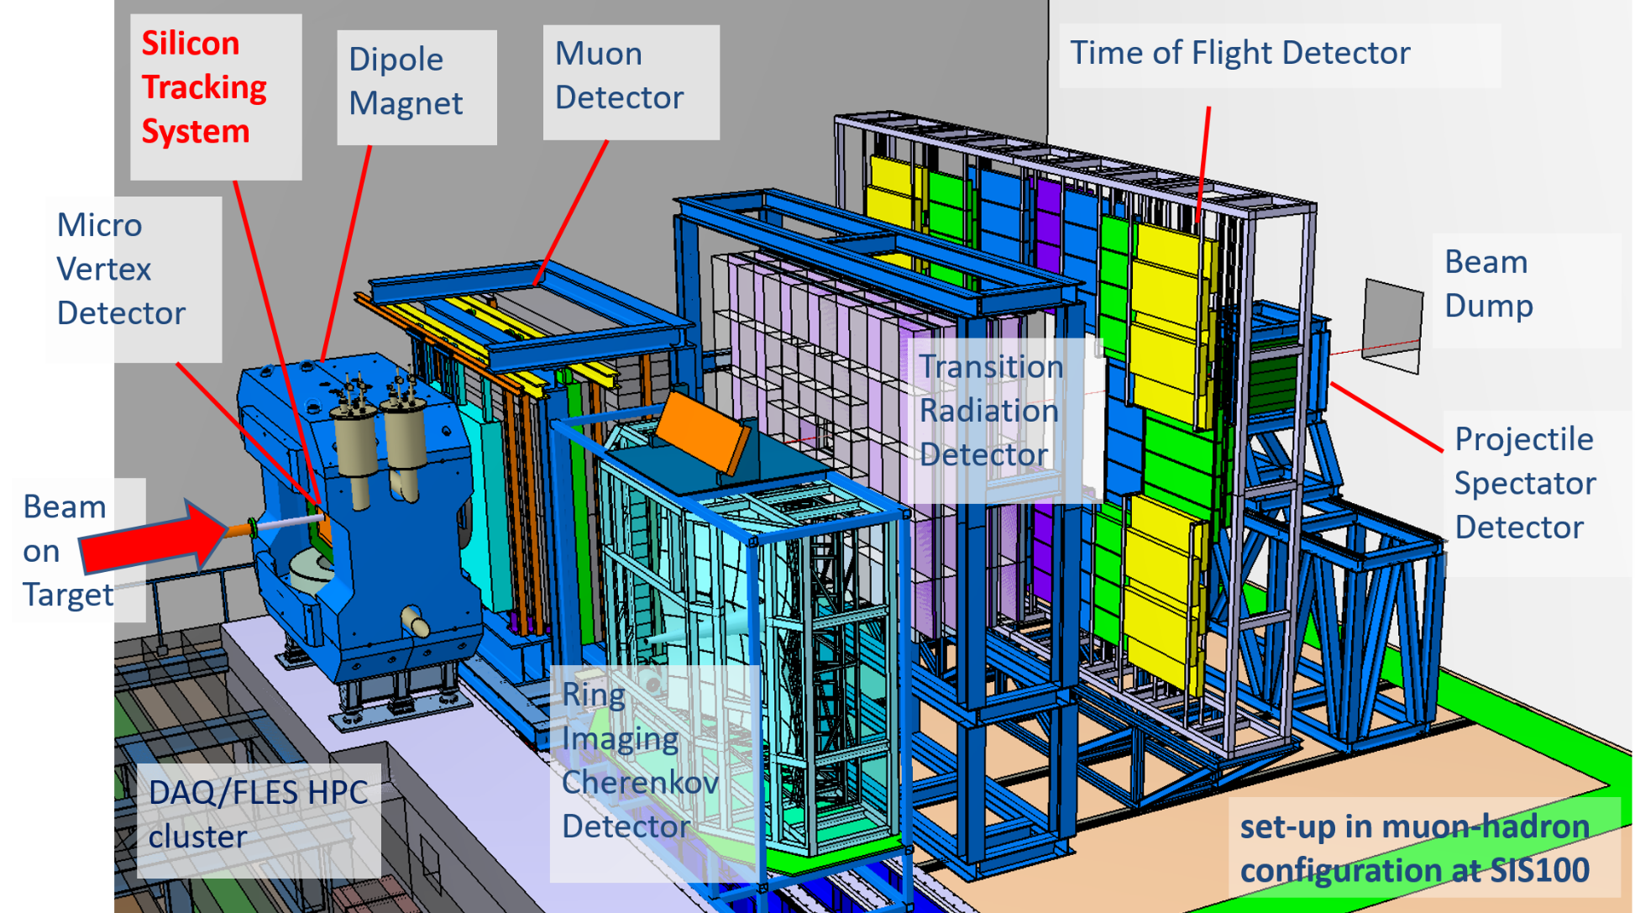
CBM Experiment at FAIR

Slide 49
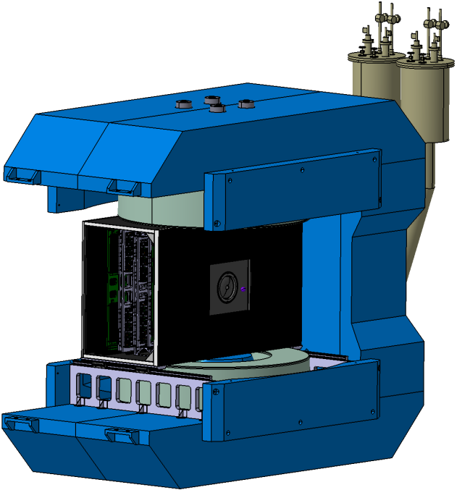
Dipole Magnet

Slide 50
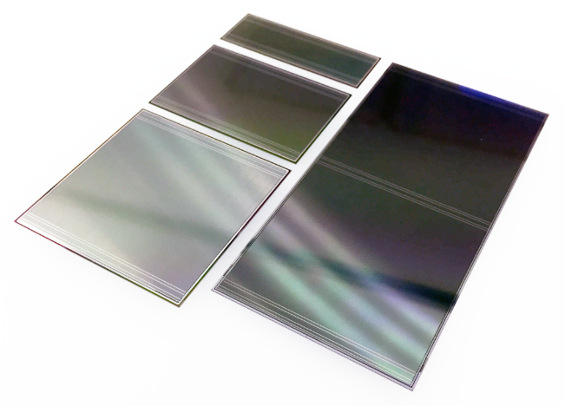
Delivery schedule of sensors to GSI/FAIR
confirmed by Hamamatsu Photonics Deutschland GmbH, 20 August 2019
sensor variant | serial number | pieces ordered
6x2 | S13847-22 | 71
6x4 | S13847-42 | 326
6x6 | S13847-62 | 326
6x12 | S13847-124 | 381
 | sum | 1104
delivery |  | sensors |  |  |  |  |  | fraction
batch | week/year | 6x2 | 6x4 | 6x6 | 6x12 | sum | integral | [%]
1 | 45/19 | 20 | 20 | 20 | 20 | 80 | 80 | 7.25
2 | 50/19 | 20 | 20 | 20 | 20 | 80 | 160 | 14.49
3 | 01/20 | 31 | 20 | 20 | 20 | 91 | 251 | 22.74
4 | 07/20 |  | 35 | 35 | 35 | 105 | 356 | 32.25
5 | 11/20 |  | 35 | 35 | 35 | 105 | 461 | 41.76
6 | 15/20 |  | 35 | 35 | 35 | 105 | 566 | 51.27
7 | 19/20 |  | 35 | 35 | 35 | 105 | 671 | 60.78
8 | 24/20 |  | 35 | 35 | 35 | 105 | 776 | 70.29
9 | 28/20 |  | 35 | 35 | 35 | 105 | 881 | 79.80
10 | 33/20 |  | 35 | 35 | 35 | 105 | 986 | 89.31
11 | 37/20 |  | 21 | 21 | 40 | 82 | 1068 | 96.74
12 | 41/20 |  |  |  | 36 | 36 | 1104 | 100.00
sum |  | 71 | 326 | 326 | 381 | 1104 | 1104 | 100.00

Slide 51

Microstrip sensors
4 main variants
strip lengths matched to particle densities in STS
6.2 cm x 2.2 cm - 71 x
6.2 cm x 4.2 cm - 306 x
6.2 cm x 6.2 cm - 296 x
6.2 cm x 12.4 cm - 381 x

Slide 52
STS-XYTER 2.1 Radiation Studies

Slide 53
Summary: Charge Collection Efficiency

Slide 54
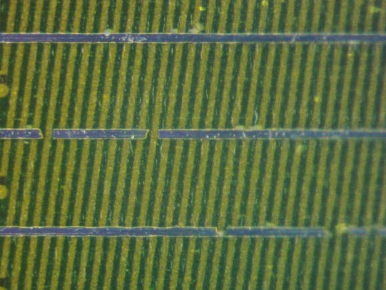
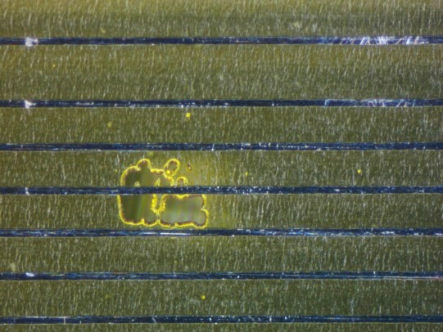
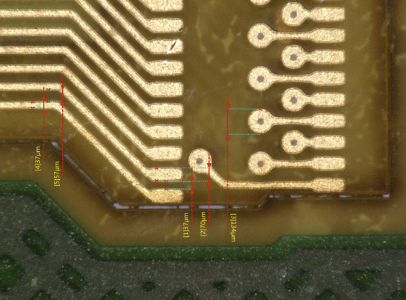
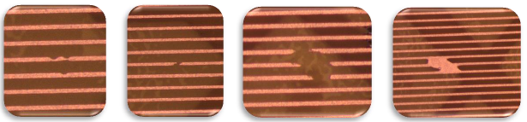
MicroCables LTU
Since the microcables are very delicate objects with fine structures, the
manufacturing processes are complex and can cause failures.
For the Aluminum microcables the yield decreases with the cable length.
Yield improvements can be achieved by:
using photomasks with higher resolution
using better equipment
using advanced raw material
improvement of photolithography process
improvement of etching parameters

Slide 55

build-up of micro-copper-cable of version 2:
two copper layers L1/L2 with spacer (30% filling),
laminated to one cable, electrically interconnected
surface finish: EPIG (Electroless Palladium, Immersion Gold),
thin (300 nm) noble surface for soldering and bonding in contrast to standard ENIG (5..7µm) (-> Pitch), Palladium serves as a highly efficient diffusion barrier
→ strip capacitance < 0,8 pF/cm

Slide 56


Material budget calculations
Alu cable stack per sensor (without shielding and central spacer)
  4 x 15 µm Alu x 1/3 fill factor + 4 x 10 µm PI + 2 x 75 µm meshed PI
  $\frac{X}{X_{0}}=0.06 \% ≅$ 60 µm Si equivalent
Cu cable stack per sensor (without shielding and central spacer)
  4 x 8 µm Cu x ¼ fill factor + 4 x 12.5 µm PI + 2 x 75 µm meshed PI + 4 x 12.5 µm glue
  $\frac{X}{X_{0}}=0.1 \% ≅$ 100 µm Si equivalent
Taken as input for GEANT3 MC simulation
  Geometry version v16g

Slide 57


STS material budget simulations
Aluminum microcables
Copper microcables (1/4 FF)
Notes:
Simulations: Geometry version v16g, 10^7 events, gkCableThickness= 0.006 cm and 0.01 cm (equivalent thickness in Silicon)
Matbudget_mc.C
Matbudget_ana.C
UrQMD (Ultra relativistic Quantum Molecular Dynamics) is a fully integrated Monte Carlo simulation package for Proton+Proton, Proton+nucleus and nucleus+nucleus interactions.
The UrQMD model is part of the GEANT4 simulation package.
The Parton-Hadron-String Dynamics (PHSD) is a microscopic off-shell transport approach that consistently describes the full evolution of a relativistic heavy-ion collision from the initial hard scatterings and string formation through the dynamical deconfinement phase transition to the quark-gluon plasma as well as hadronization and to the subsequent interactions in the hadronic phase. It has been developed by the Giessen/Frankfurt groups on the basis of the Hadron-String Dynamics transport approach (HSD) and in the hadronic sector, PHSD is equivalent to HSD.

Slide 58

LV Powering Scheme: FEB
P. Koczon – GSI

Slide 59
STS-XYTER 2.1 Radiation Studies

Slide 60

Powering
P. Koczon – GSI

Slide 61

C-frames

Slide 62


Cooling Challenge
Thermal Enclosure:
CF sandwiched foam (∼ 20 mm) → Structural support
feed throughs
thermal and moisture tight ($RH<0.1\%$ at 20°C)
y
x
z

Slide 63
Sensor QA
QA test done by manufacturer:
current-voltage (IV) and capacitance-voltage (CV) curve, up to 200V
estimation of the full-depletion voltage
strip test:
  all strips - p and n sides, including the corner strips
  AC aluminium open, AC aluminium short), at 30V
QA done done by clident:
10% of sensors/batch will be inspected for
pinholes in capacitor dielectric
strip metal and implant shorts and opens
single strip leakage current
1% of sensors/batch will undergo specific tests
coupling capacitance of the readout strip
polysilicon resistance
interstrip capacitance
strip capacitor breakdown voltage

Slide 64
NOVEC Data Sheet

Slide 65


Liquid CO₂ Properties
$$ν_{kinematic}=\frac{μ_{dynamic}}{ρ}, 100 cSt=\frac{1cm^{2}}{s}$$

Slide 66

Cooling – Summary and Open Questions
NOVEC-based cooling system
pro:
available commercially (e.g. LAUDA, Huber)
operation at “low” pressure ($<10 bar)$
standard operation, simple distribution system to heat exchanger plates
con:
operation at high flow and very low temperature ($≤−40°C)$ (to compensate for “low” heat capacity)
operation at “high” pressure (to compensate pressure loss due to high flow)
“thicker” heat exchanger plate (tube diameter helps $∼d^{4}$)
  minimal thickness 9 mm (ok)
  integration aspects
conclusio:
possible solution, but operation close to physical limits

Slide 67

Cooling – Summary and Open Questions
CO₂-based cooling system
pro:
superior physical parameters in all relevant aspects
  enthalpy/specific heat
  viscosity
  thermal conductivity, heat transfer coefficient
con:
  oil-free systems not commercially available (radiation hardness!)
    evaporative systems (not oil-free) available for supermarket etc.
  present offer is custom made (oil-free), not tested etc.
  operation more difficult (safety margin PED: $120 bar)$
  distribution system more complex (tune different flows to saturation line)
    complex, possibly expensive
conclusio:
possible solution, but large uncertainties in terms of operation & cost (distribution system)

