Slide 1
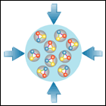


Status CBM Detector Subsystems*
Walter F.J. Müller, FAIR, Darmstadt
11th ECE + 2nd ECSG, 4+5 November 2019
* contains more material than will presented orally

Slide 2
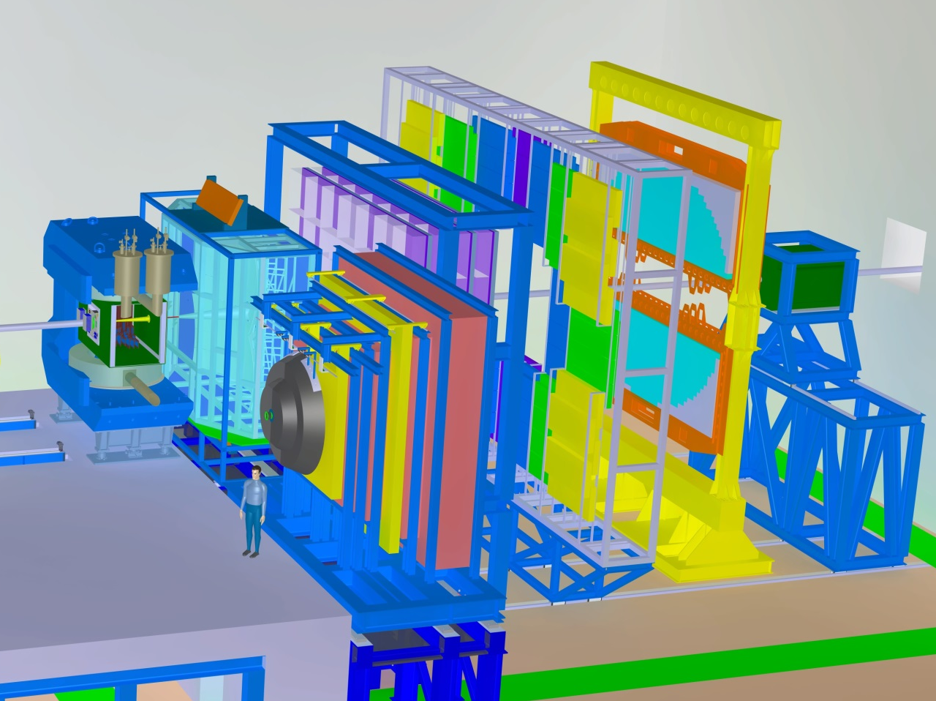
CBM Setup in CBM Cave
RICH
Ring
Imaging
Cherenkov
TRD
Transition
Radiation
Detector
TOF
Time of
Flight
Dipol
Magnet
MVD
Micro
Vertex
Detector
STS
Silicon
Tracking
System
MUCH
Muon
Detector
(parking)
ECAL
Electromagnetic
Calorimeter
not in Day-1 setup
PSD
Projectile
Spectator
Detector

Slide 3
Milestone Naming
The FAIR standard terms
  PDR – Preliminary Design Review
  FDR – Final Design Review
  aren’t very descriptive. We use them in collaboration contracts.
  In practical life we use instead the more descriptive terms
  EDR – Engineering Design Review
  PRR – Production Readiness Review
  In some cases, especially for mechanics and services, we also have
  CDR – Conceptual Design Review
  which isn’t foreseen in the FAIR Milestone scheme. Bottom line is
  M5 – CDR (use code of plan review)
  M6 – EDR (aka PDR)
  M7 – PRR (aka FDR)

Slide 4
Systems critical for success of CBM
Technical view
  all CBM experiments require
    Magnet
    STS → most complex system → separate presentation by R. Schmidt
    TOF
    PSD
    DAQ → everything depends on it → separate presentation by D. Emschermann
    Computing (Online, Offline, Controls, …)
  Phase-1 experiments require in addition
    MVD for low p reconstruction (initially) and charm physics (later)
    RICH for di-electron measurements
    TRD for intermediate mass di-leptons and hyper nuclei
    MUCH for di-muon measurements
  initial commissioning setup (beyond STS,TOF,PSD)
    MVD maybe intentionally out, is closest to beam …
    RICH should be in (long learning curve for di-lepton physics)
    TRD desirable to be in
    MUCH can’t be in, separate commissioning

Slide 5
Online Systems
Status
  decided to split topic into two TDRs
    Online Systems: Data Acquisition (DAQ)
      describes all custom hardware be purchased from CBM project funds
      submission Q4’2020
      → current status in separate presentation
    Online Systems: Data Processing
      covers the software running on the Green IT Cube nodes
      and describes computing model
      done in close synchronization with the FAIR Computing CDR/TDR
      TDR submission in 2023
      CDR in preparation

Slide 6
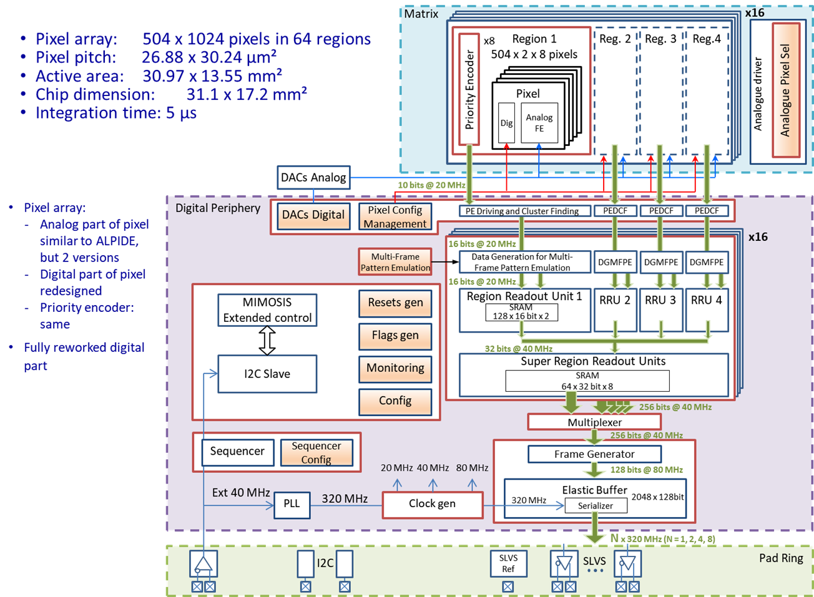
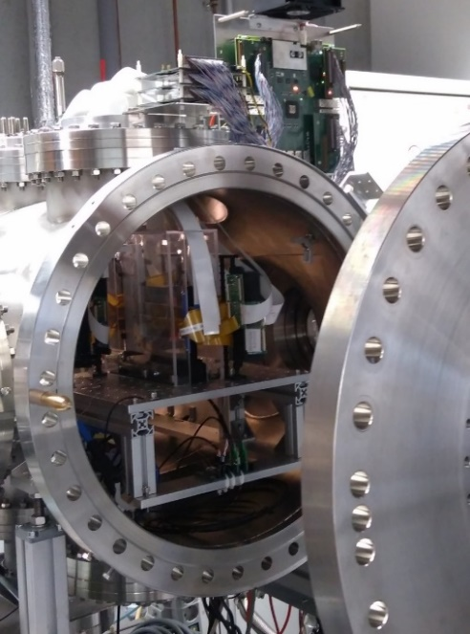
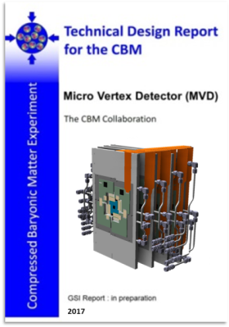
MVD (Micro Vertex Detector)
Sensor → MIMOSIS-1
Integration tests
Participating institutes: Univ. Frankfurt, IPHC Strasbourg

Slide 7
MVD – Sensor
Progress since mid 2018
  MIMOSIS-0 evaluation well advanced and promising
  Fully MIMOSIS-1: first full size sensor
    design review successfully concluded in Jun 2019
    in the process of submission to TOWER Jazz
    analog part adopted from ALICE ALPIDE
    digital part re-designed to better support rate gradients and beam fluctuations
Essential milestones in next 12 month
  MIMOSIS-1 back and integrated in evaluation boards
  MIMOSIS-1 evaluation (lab tests, test beam, radiation hardness)
  Preparation of MIMOSIS-2
Major risks
  Work load on existing manpower
  MIMOSIS-1 test imply additional actions → delay for MIMOSIS-2

Slide 8
MVD – Integration
Progress since mid 2018
  PRESTO-1 yield problem identified (bonder settings)
  24/7 operation over several month of PRESTO-1 in vacuum
  Improvements w.r.t. integration techniques and flex cable
Essential milestones in next 12 month
  Setup PRESTO-2: MIMOSA26 based, new carrier
  Demonstrate better integration yield
  MIMOSIS-1 integration in small telescope (e.g. demonstrator for CREMLIN+)
Major risks
  Limited manpower (overlap with MIMOSIS-1 testing)
  Funding of PRESTO activities (not BMBF funded)
  Engineering support (detector integration, CAD)
Other common activities in next 12 month
  Realistic simulations with updated digitizer
  Completion of TDR

Slide 9
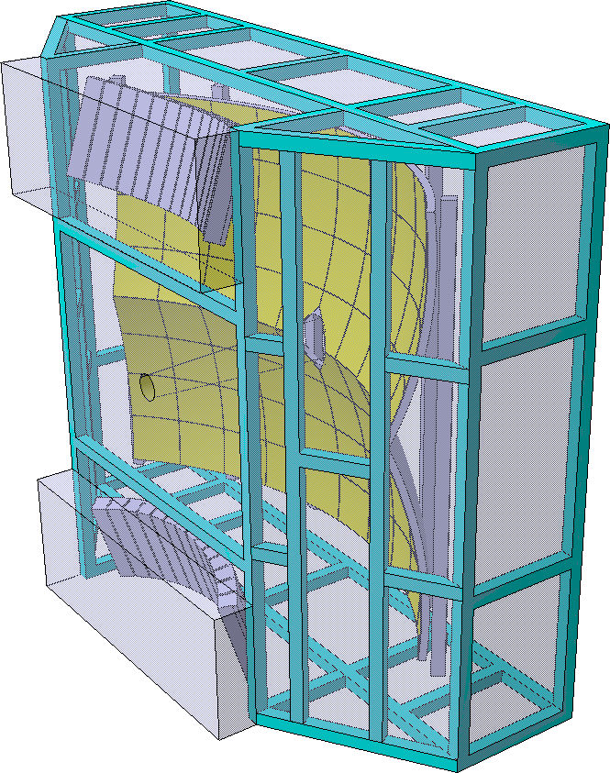
RICH (Ring Imaging Cherenkov Detector)
Participating institutes: Gießen Univ., Wuppertal Univ., PNPI Gatchina
And contributions from: GSI Darmstadt, JINR-LIT Dubna

Slide 10


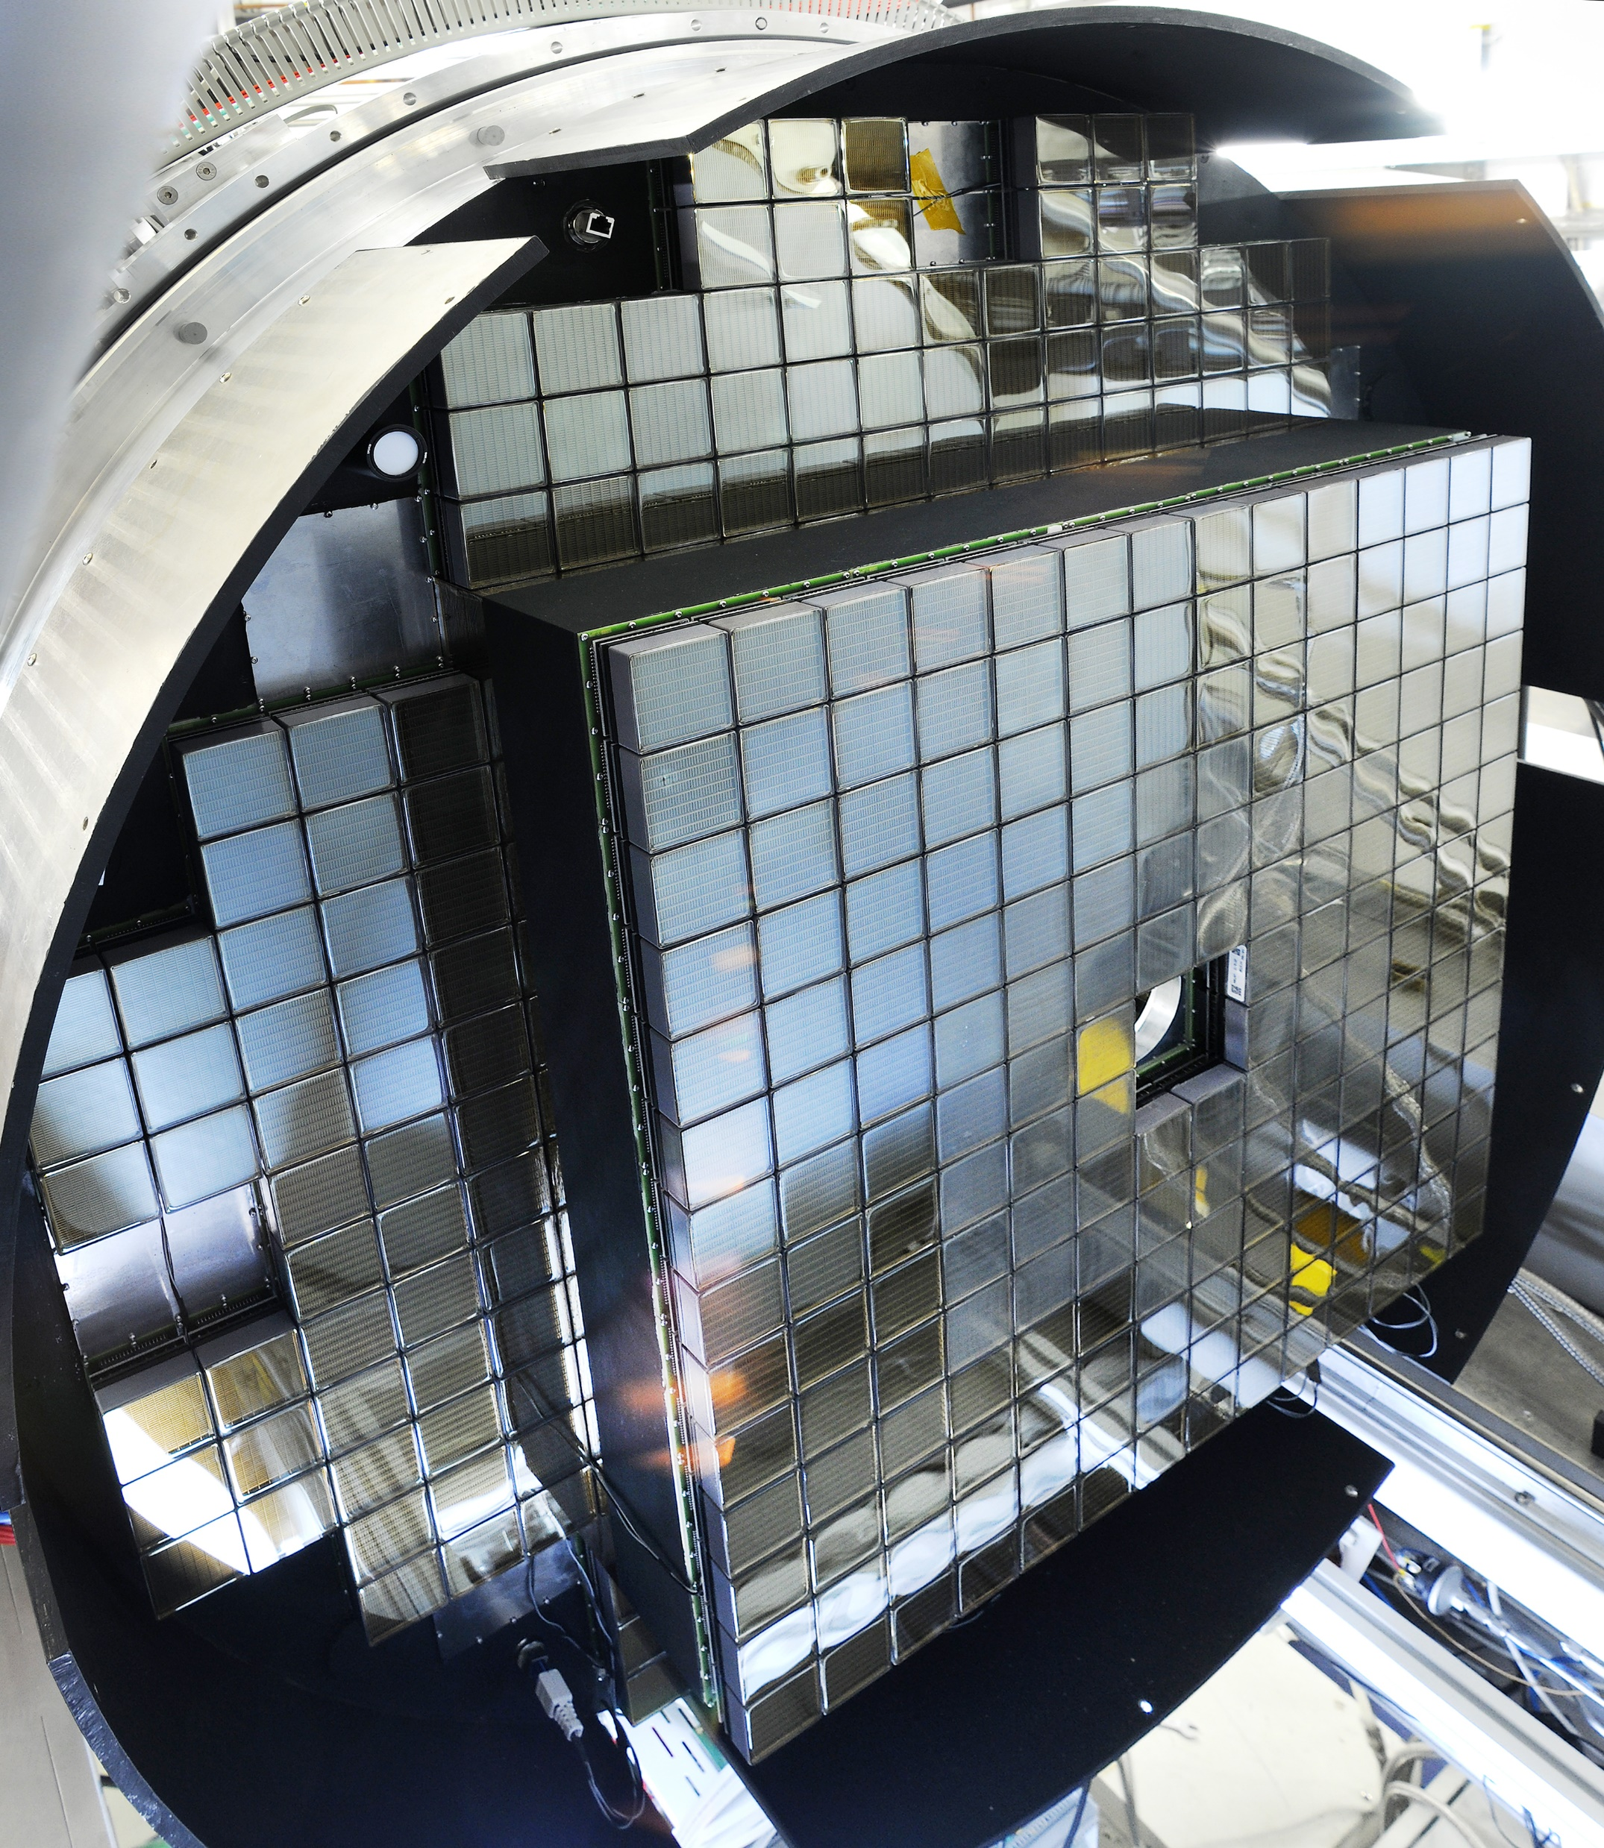
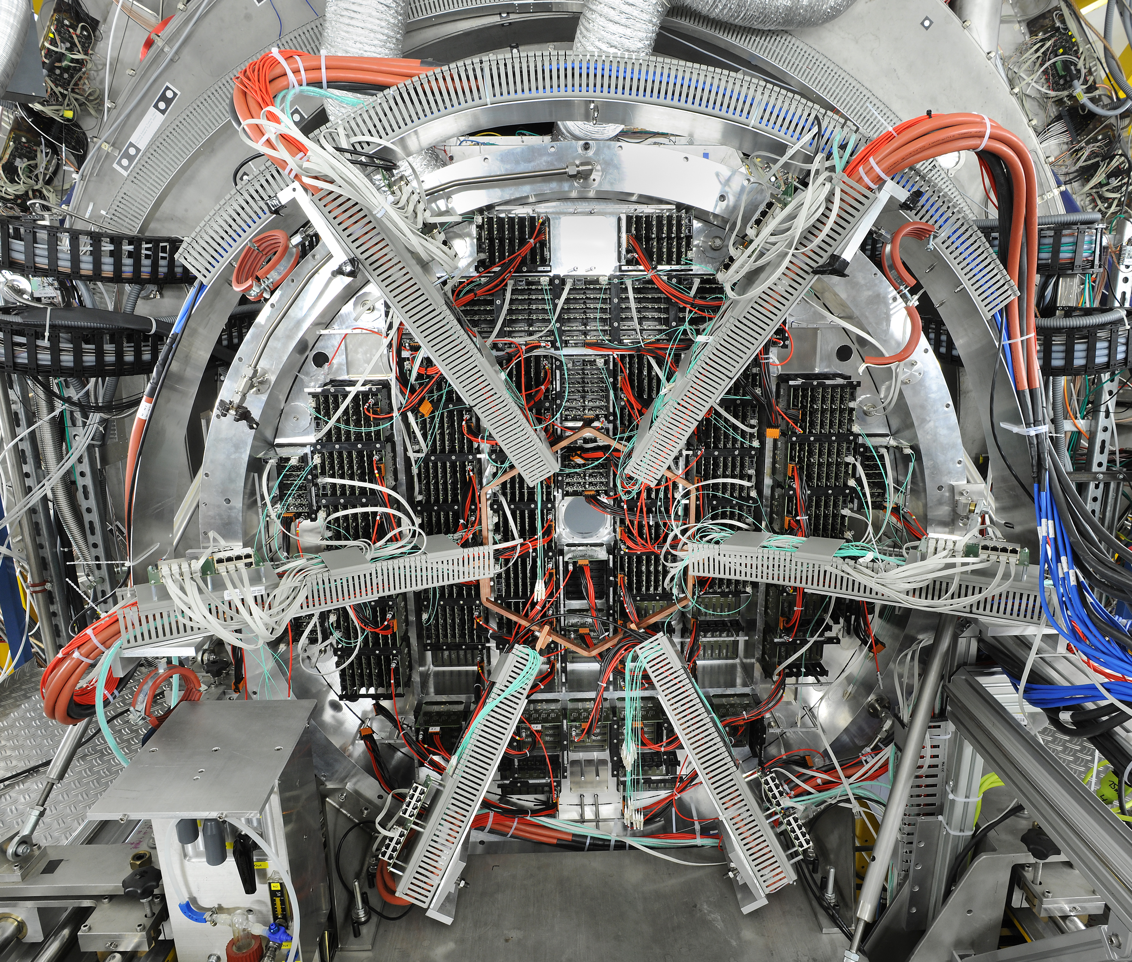
RICH
number of hits per ring
Progress since mid 2018
  HADES RICH upgrade
    uses roughly half of the purchased MAPMTs
    uses same FPGA TDC based readout architecture
    very good performance
      homogeneous distribution over detector
      on average 14 photons per ring
      single photon time resolution 250 ps
      ToT amplitude available
      very clean data due to time and amplitude cuts
    wealth of data from beam time
single event display
with tight cuts
ring center distribution

Slide 11
RICH
Progress since mid 2018 (cont’d)
  Photon detector (aka Camera): First mechanical design in cylindrical geometry; development of cooling concept
  Mirror support: mechanical prototype with two pillars
  prototype of carbon pillar
  Mirror: Additional 12 prototypes with different coatings
  mCBM: Successful integration of mRICH, time and spatial correlations seen, integration of TRB readout in CBM DAQ
  DAQ: Significant progress towards CRI based readout
Essential steps in next 12 month
  Gas system: CDR under approval since Mar 2019
  MAPMT coating: CDR (Dec 2019): gives status, no decision
  Mechanics: CDR (re-scheduled to Jun 2020)
  Photon detector: CDR (re-scheduled to Jun 2020)
  DiRICH FE: design update (Mar 2020)
  Full mRICH prototype; CRI based readout
  Decision: carbon/aluminum pillars: simulations, stability tests
  Decision: mirror coating (Al+MgF2 or Al+MgF2+HfO2): ageing tests
mirror holding frame
prototype

Slide 12
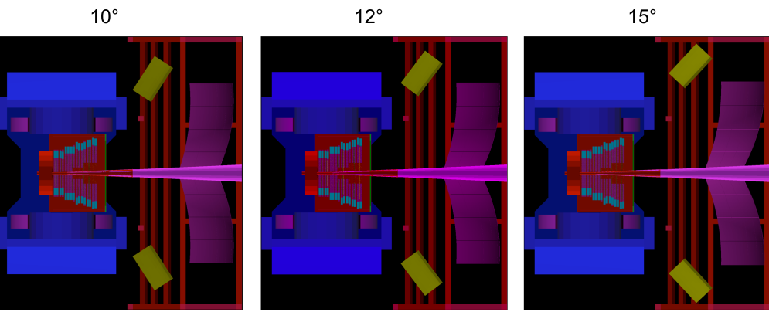
RICH
Open issues
  Magnet shielding box design (critical)
    need to compromise between increase of background and successful shielding
    revision of RICH geometry ongoing: increase mirror tilting angle to 12° or 15° ?
    mechanics CDR and camera CDR depend on this
  Cooling concept for RICH
  LV powering scheme: DC/DC convertors or external LV supply?
  Beam pipe interface to STS (critical)
  Radiation hardness of readout electronics: no dedicated tests of FPGA based FE modules, but experience from HADES (SEU seen, could be coped with)

Slide 13
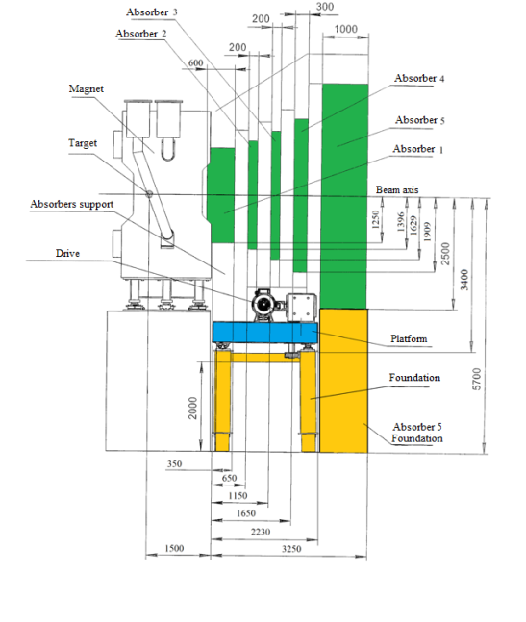
MUCH (Muon Chambers) System
Overall layout
New support concept
Participating institutes: VECC Kolkata + 12 Indian Inst., PNPI Gatchina

Slide 14
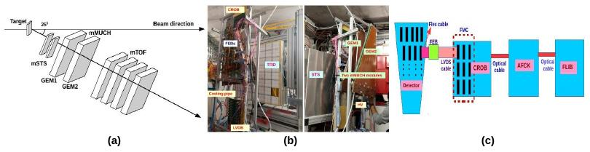
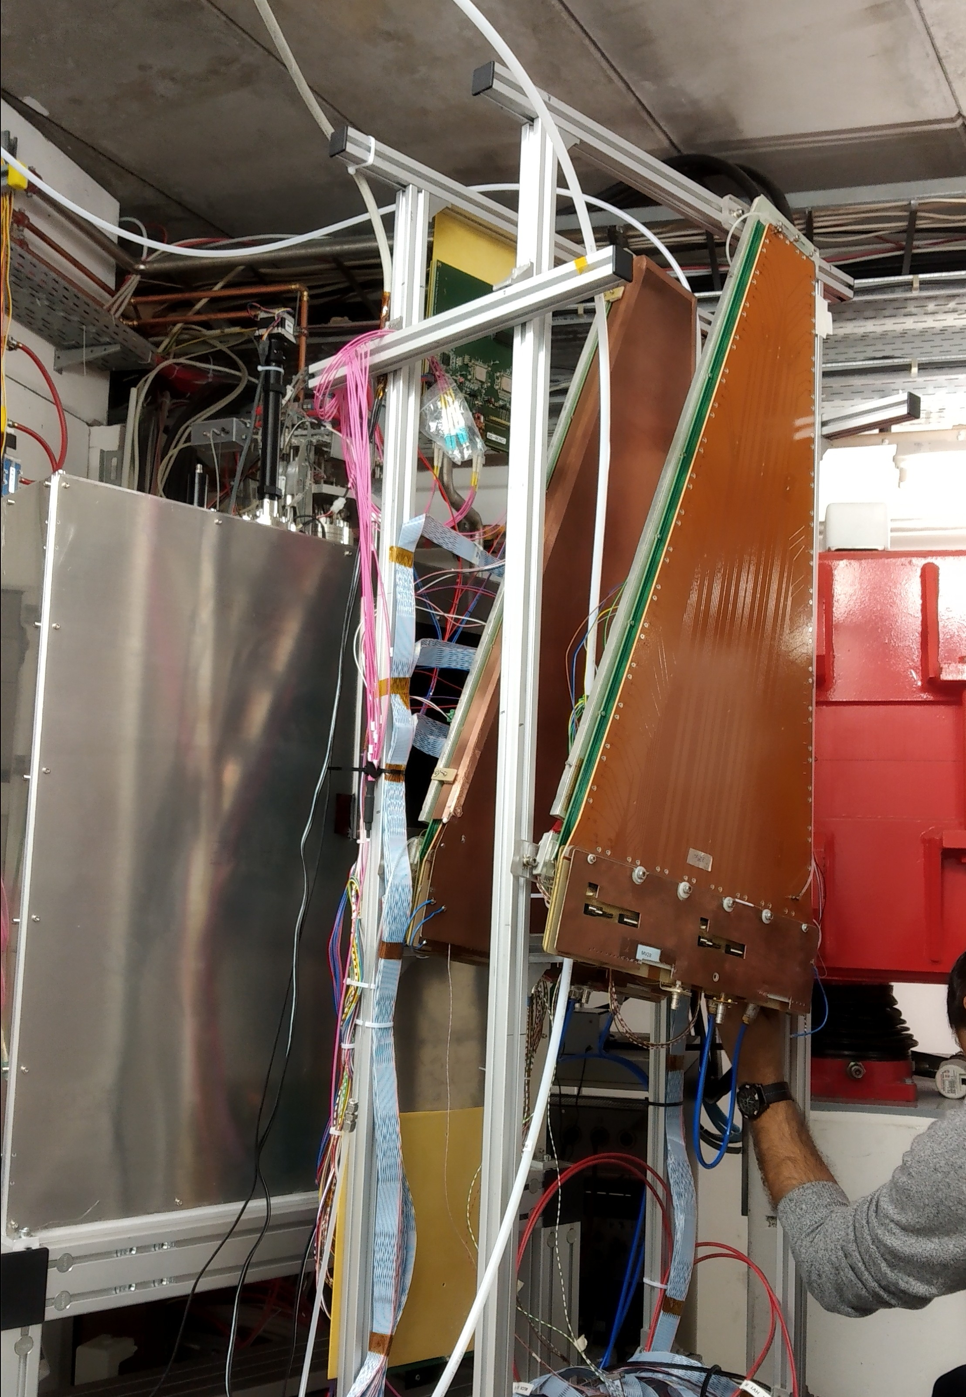
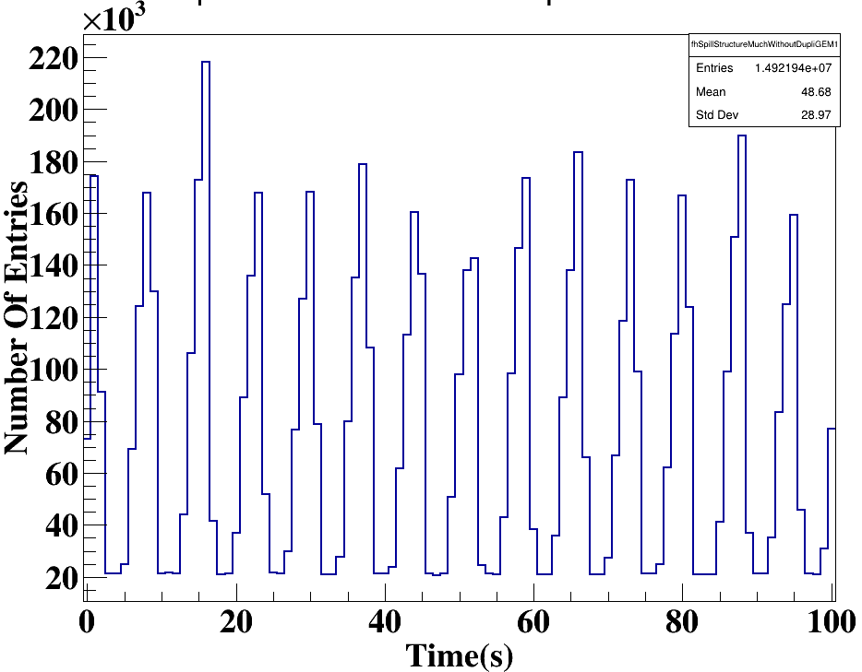
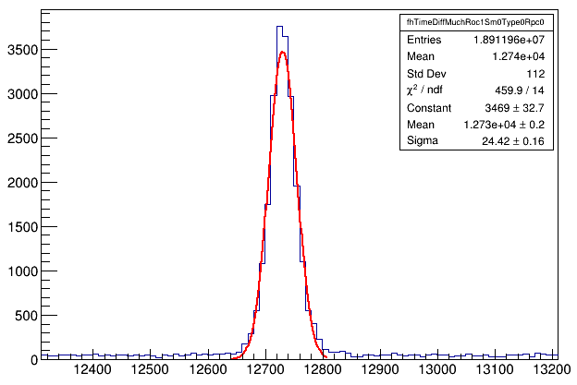
MUCH – Station 1+2
Progress since mid 2018
  Two real-size GEM chambers built at VECC
  Two GEM chambers took data in mCBM setup
  STS-XYTER 2.0 (in low gain mode) used for data taking
  Time and space correlations of GEM chambers with other detectors in the setup look OK
  Clustering implemented in the software, tracking in progress
  LV and HV distribution systems developed and tested
  A HV module for GEM developed at VECC
mCBM setup
spill structure
seen by GEM
time correlation between TOF and GEM

Slide 15
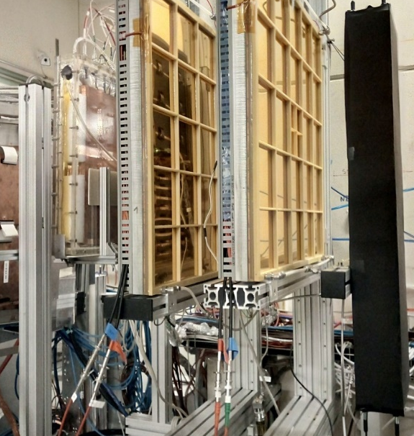
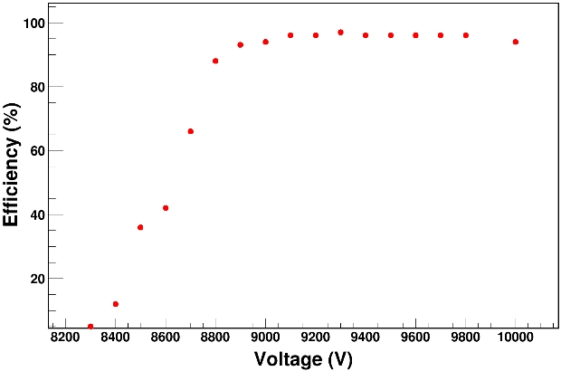
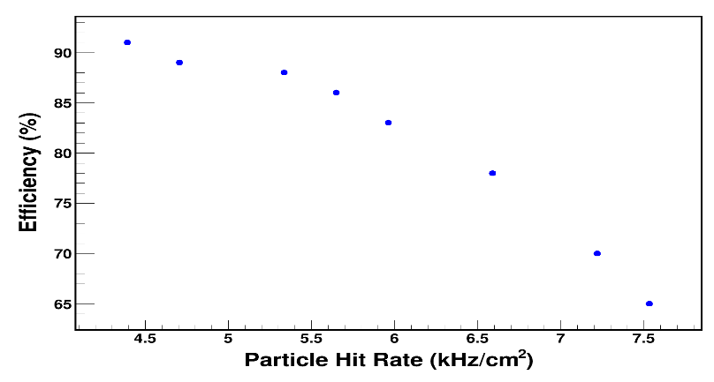
MUCH – Station 3+4
Progress made since mid 2018
  One low-resistivity 30 × 30 cm RPC tested at GIF++
  as a candidate for 3rd and 4th stations
  STS-XYTER (in low gain mode) used for RPC readout
  Detector can handle muon beam at 6 KHz/cm² with 90% efficiency in avalanche mode
  Reduction of noise to reduce the threshold is in progress
main RPC parameters
Electrode Material | Bakelite
Gas Gap Size | 2 mm
Bulk Resistivity | 3 x 10¹⁰ Ω-cm
Linseed Oil Coating | Double layered
GIF++ setup
efficiency vs HV
for source off
efficiency vs rate
for 9000 V
TRD detectors
Finger Scintillator detector
RPC prototype
Gas Mixture R134a : iC₄H₁₀: SF₆ :: 94.3 : 4.5 : 0.3

Slide 16
MUCH
Progress made since mid 2018
  1st version of mainframe mechanical design completed
  1st mechanical design of chamber movement system completed
  Implementation of services under discussions
  One cleanroom built at Bose and another in progress at VECC for detector assembly
Essential steps in next 12 month
  full sized GEM module for 2nd station
  GEM and RPC modules with STS-XYTER V2.1 readout in mCBM 2020
  Platform & rail system CDR and EDR
  Common MUCH/RICH support structure EDR
  Mainframe CDR
  Station 1+2 gas system CDR
  Station 3+4 CDR → go for TDR addendum
Open issues
  Low gas gain plus STS-XYTER readout operation of RPC

Slide 17
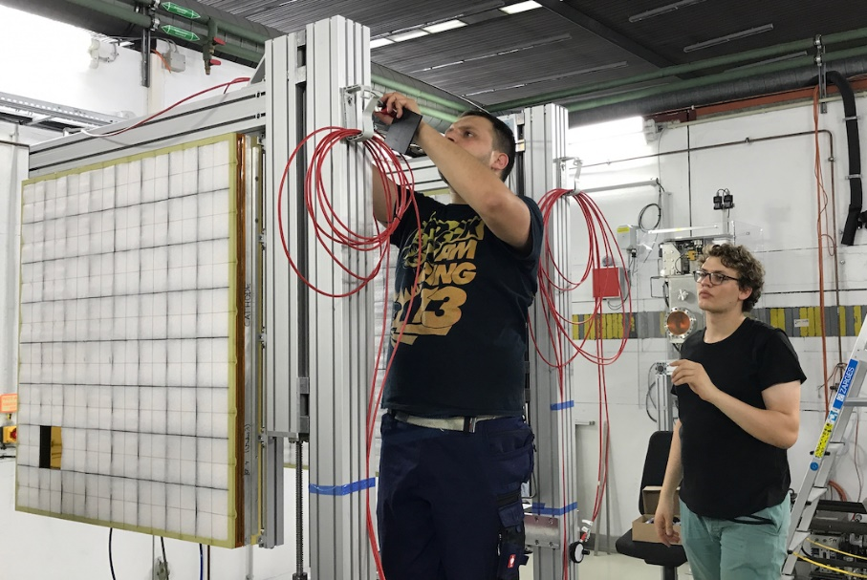
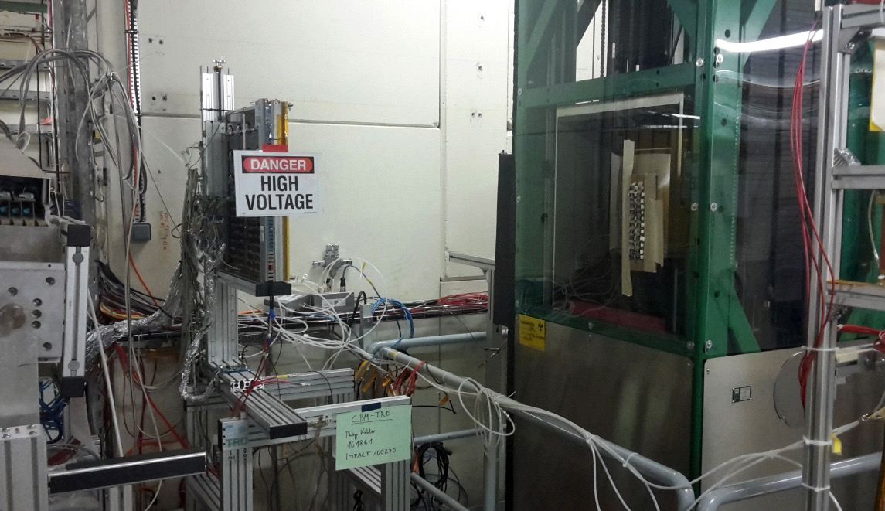
TRD (Transition Radiation Detector)
TRD test setup at DESY e−-beam (2019)
TRD Prototype at GIF++ (2018)
Participating institutes: NIPNE Bucharest, JINR Dubna, Univ. Frankfurt,
Univ. Heidelberg, Univ. Münster

Slide 18
TRD
Progress since mid 2018
  Technical Design Report (TDR) accepted by ECE in Oct 2018
  Design of readout large chambers finalized: EDR on 25 Oct 2019
  ASIC (SPADIC 2.2) produced in engineering run in 2018
  Design of Front-End-Boards (FEBs) finalized
  Design of support structure ongoing, first version existing
  Test beams:
    e-beam at DESY Aug 2019
    high rate γ-irradiation at GIF++/CERN
  Revision of detector software done
  (4D-simulation, detailed detector + electronics response)
  Funding: German BMBF core-invest granted (FRA and MS)
Essential steps in next 12 month
  Validation of SPADIC 2.2 and decision on FEB production
  Participation in mCBM-production run next May 2020
  PRR (outer region) in mid-2020 after mCBM beam time
  CDR (inner region) in mid-2020 after mCBM beam time
  → decision on design of inner detector region
  Preparation of production sites for large modules (FRA and MS)

Slide 19
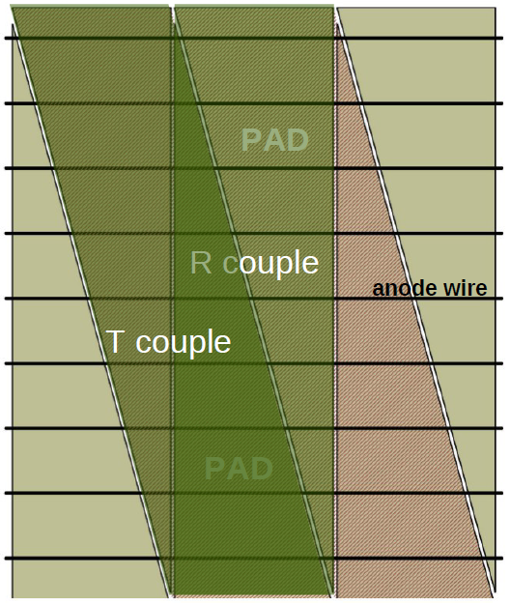
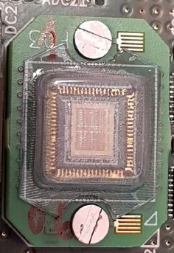
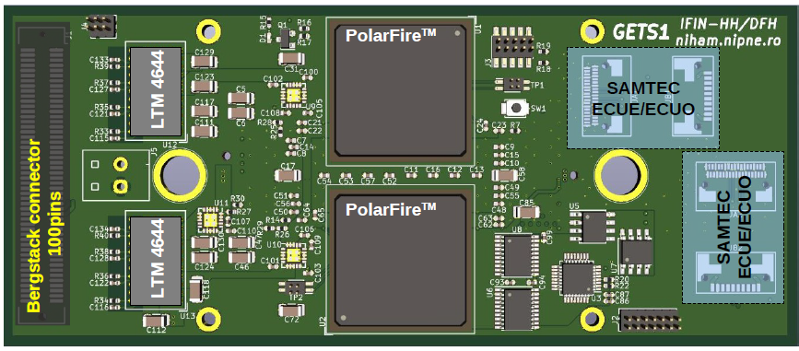
TRD
Open issues
  Demonstrate rate and multi-hit performance (in mCBM 2020)
  Resolve SPADIC 2.2 ADC issue (is re-submission needed ?)
  Water cooling needed in inner regions ?
  Being evaluated with test setup in laboratory (MS)
  Gas system: design activities started in MS
  Manpower for final construction to be found
  Detector performance studies for inner (high hit density) region
  ⟹ Need for alternative pad plane layout and
  readout electronics for inner detector region ?
Bucharest concept of inner region (40 of 216 modules)
triangular pads
FASP analog part
ADC+FPGA based backend
(might be combined in mixed signal ASIC)

Slide 20
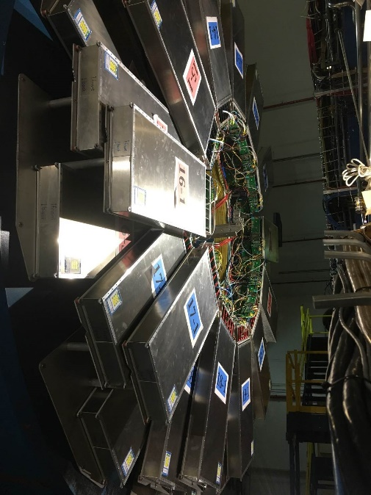
TOF (Time of flight)
Usage of CBM TOF modules as eTOF in STAR @ RHIC
Participating institutes: THU Beijing, NIPNE Bucharest, GSI Darmstadt,
TU Darmstadt, IfI Frankfurt, USTC Hefei, Univ. Heidelberg,
ITEP Moscow, HZDR Rossendorf, CCNU Wuhan

Slide 21
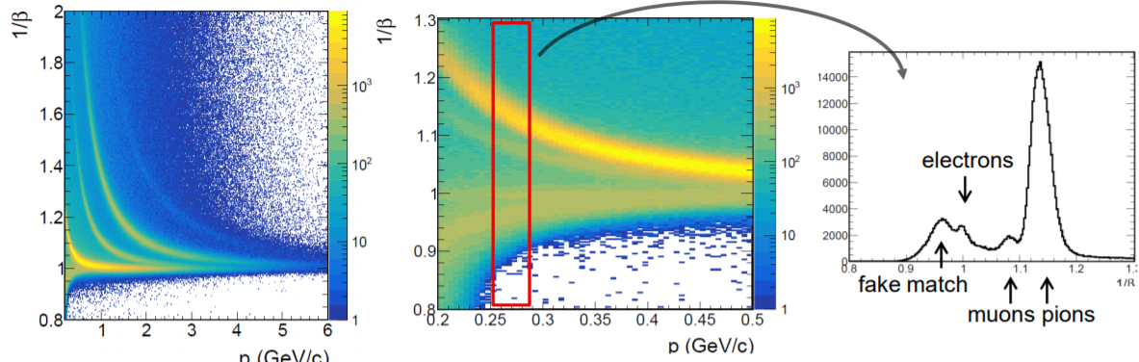
TOF
Progress since mid 2018
  eTOF @ STAR
    installed, commissioned and running
    BESII started in February
    System time resolution better than 85 ps
    PID capability demonstrated

Slide 22
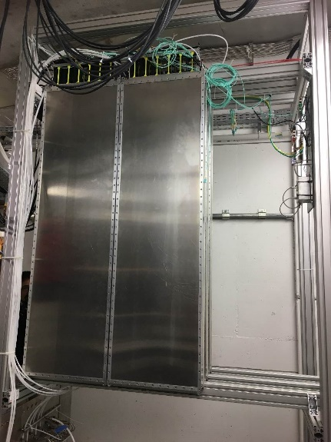
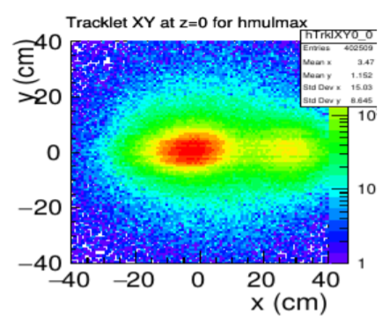
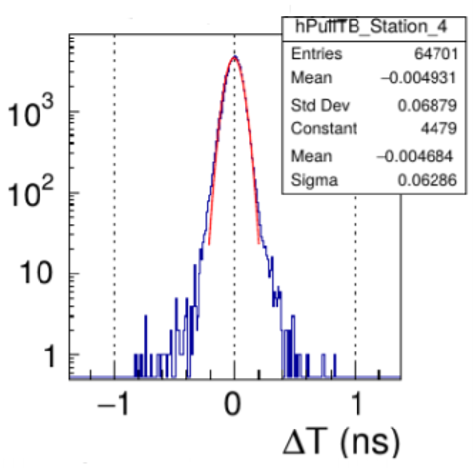
TOF
Progress since mid 2018
  mTOF @ mCBM
    mTOF@mCBM is complete, installed, commissioned and running
    mCBM is a perfect and the only place to test detector under CBM conditions
    Beside mTOF many additional counter were tested in 2019
    During the data analysis phase many readout problem where detected (e.g. GET4 mismatch, data loss) and partially solved
    Analysis of the data is still ongoing
mCBM setup
tracking capability
time resolution

Slide 23
TOF
Essential steps in next 12 month
  High rate test with mCBM in 2020 (crucial for upcoming milestones [PRR = M7])
  PRR for outer wall counters [M7] (MRPC2,3,4)
  Maintenance work on eTOF and preparation for Run 2020 (starting Dec. 2019)
  Construction of a M1 module for the inner wall (planed for Run 2021)
  Construction of 2 prototypes with “new” low resistive glass
  Construction of 1 (mini)module for the BFTC
  Finalizing the in-kind contracts with ITEP [M4]
  Ageing test with low resistive glass in Bucharest (IRASM facility at IFIN-HH)
  R&D on cave infrastructure (Gas system, HV, LV, Main frame), CDRs [M5]
  Contract signing with GSI [M4]
Open issues
  Gas system development including a recycling system for RPC gas
  Main frame outer wall
  Missing GBTx chips for full TOF wall (solution on horizon)

Slide 24
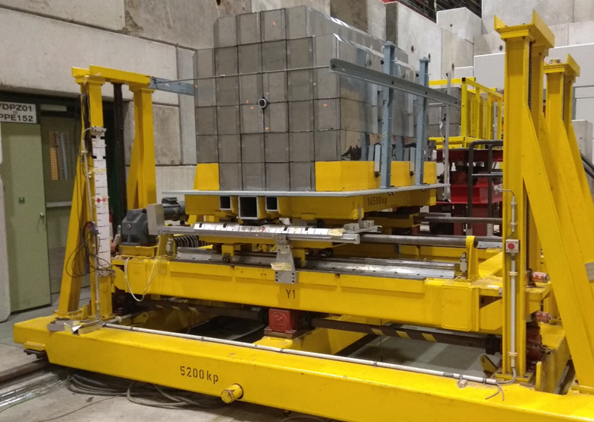
PSD (Projectile Spectator Detector)
PSD modules on the road
BM@N – FHCAL upgrade
NA61 – PSD upgrade
uses 20 CBM PSD modules and 34 old FHCAL modules
adds 12 CBM PSD modules
to existing setup
Participating institutes: INR Moscow, Prague, Rez, TU Darmstadt

Slide 25
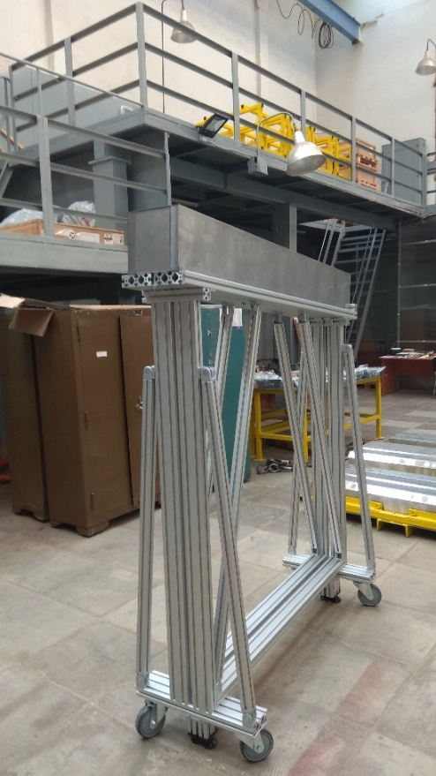
PSD
Activities and Outlook
  BM@N FHCAL upgrade
    new FHCAL assembled and installed in Sep 2019
    DAQ integration and cosmics tests in 2020
    1st physics run in 2021
  NA61 PSD upgrade
    CBM modules added in May 2019
    DAQ integration and cosmics tests in 2020
    physics run in 2022
  mPSD in mCBM
    one module for mCBM delivered in May 2019
    integrate readout based on PANDA ECAL ADC in mCBM DAQ
    participate in mCBM 2020 run
mPSD

Slide 26
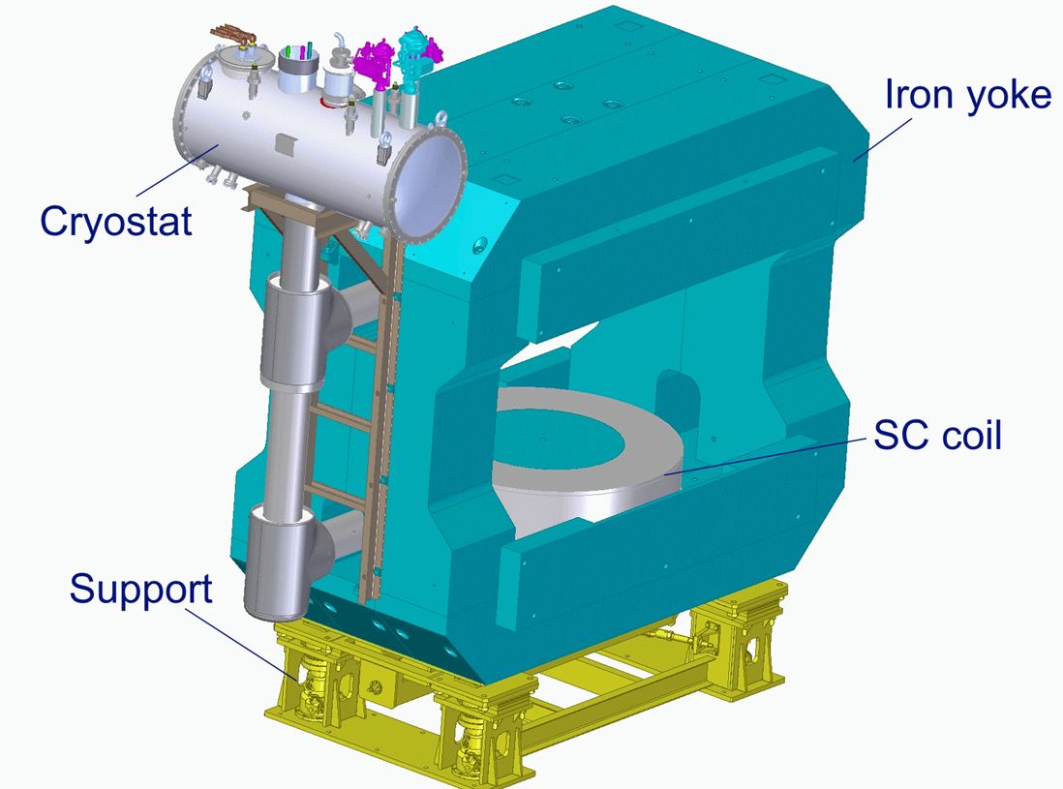
Superconducting Dipole Magnet
Contracted to: BINP, Novosibirsk

Slide 27
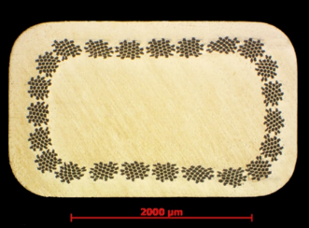
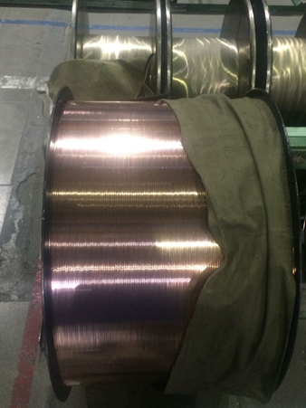
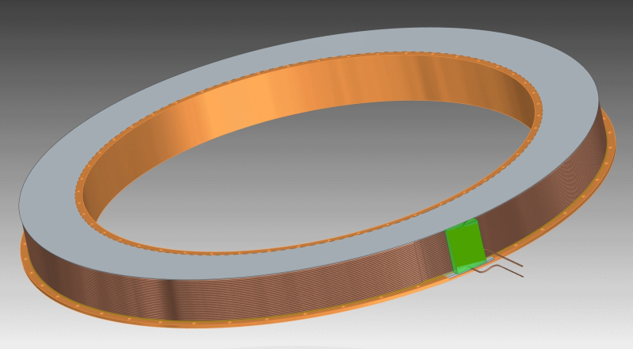
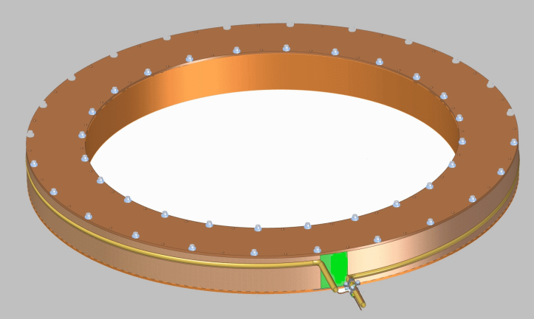
Superconducting Dipole Magnet
cable
Progress since mid 2018
  Yoke: Manufacturing drawings finished. Production start in Nov 2019.
  Field clamps: designed, will be reviewed in EDR (aka PDR).
  SC cable: Six cables for 3 coils manufactured in Dec 2018
  by Bochvar Institute, Moscow.
  Cable insulation: Contract with VNIIKP in Podolsk, work starts Nov 2019, end Mar 2020.
  Impregnation tests: The impregnating mold is manufactured.
  The copper cable is purchased for impregnation tests,
  2x4 mm2 uninsulated sizes. The insulation is a fiber glass
  with gluceryl-phtalate (glyptal) varnish.
coil after winding
coil after epoxy impregnation

Slide 28
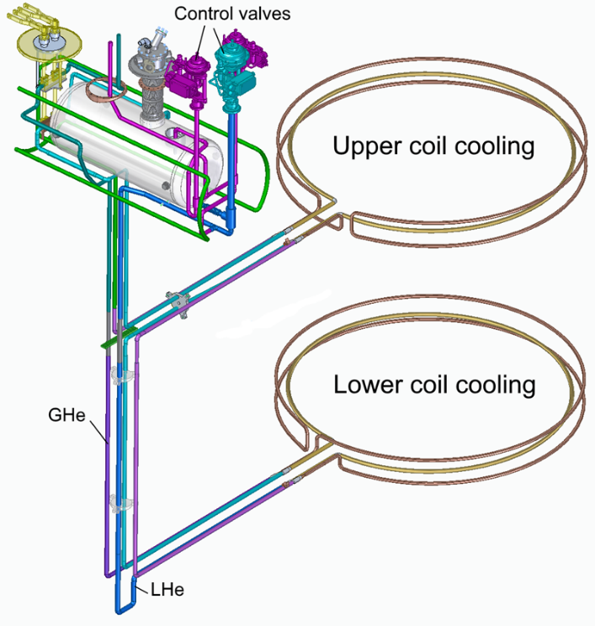
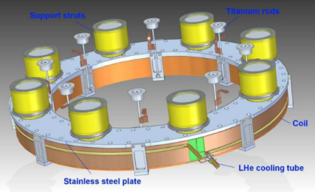
Superconducting Dipole Magnet
Progress since mid 2018 (cont‘d)
  Cryostat: Will use serial thermosiphon cooling
  An inclination of the horizontal tubes and a 5 W
  heater are foreseen for stabilization of He flow.
Essential steps in next 12 month
  EDR (aka PDR) scheduled for 18-19 Nov 2019
  PRR (aka FDR) planned May 2020
Open Issues (to be resolved during EDR)
  Design of field clamp
  Design of coil support (single cylindrical support ?)
Schedule
  Construction: Jun 2020 to Jan 2022
  Factory test: Feb 2022 to Jul 2022
  Shipment to FAIR: Oct 2022
  Cryo in CBM Bld: Mar 2023
Cold mass of the cryostat
Proposed change of coil support

Slide 29
CBM Installation
Basics
  installation of Magnet, MUCH, and RICH is many dependencies
  installation of STS, TRD, TOF, PSD has very little dependencies
Magnet – MUCH – RICH - Sequence
  install magnet
  magnet cold commissioning (when cryo available)
  magnet mapping (with MUCH absorber)
  install and test RICH (so MUCH goes to park position)
  install and test MUCH (MUCH back to operation position)
  RICH ready for 1st beam (so MUCH goes to park position)
Installation concepts
  STS: fully assembled & tested in integration lab @ GSI → bring in as one piece
  MVD: same, from Uni Frankfurt
  MUCH: comes as kit, significant pre-assembly done in E40 pre-area
  RICH: comes as kit, significant pre-assembly done @ GSI (area to be found)
  TRD: modules pre-assembled & tested @ Mu/Fr → ready to be integrated in support
  TOF: same, from Hd
  PSD: some pre-assembly needed, done in E10 or E40

Slide 30
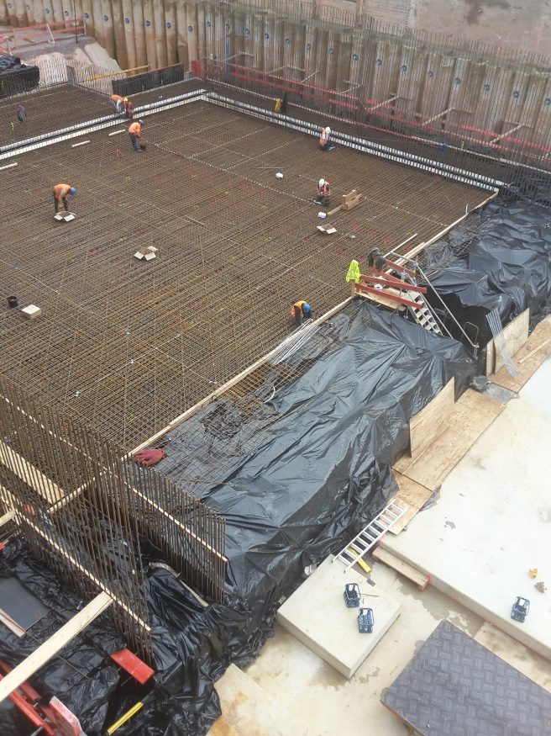
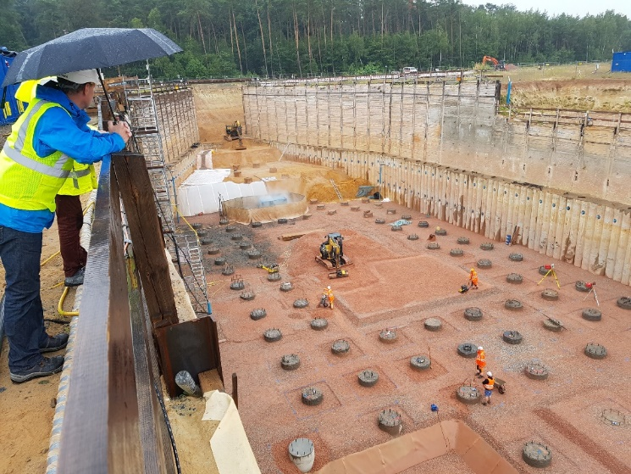
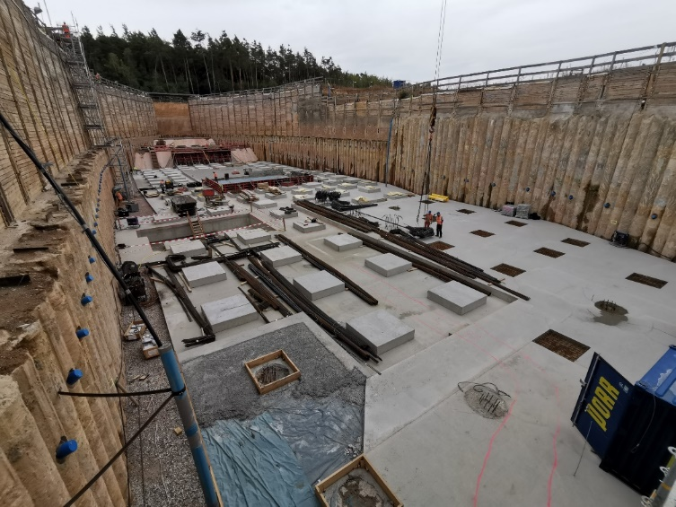
CBM Building Status
CBM building essentially on schedule
currently preparing to cast floor slab
October 22nd, 2019
July 2019
September 2019

Slide 31
CBM Installation – Overview
MSP state 2019-10
1.5 years
from now !
2021
2022
2023
2024
2025
shell construction
finished 2021-04
building
certification
services installation
construction site rules
construction site services
normal operation rules
rail system
1st installation window
platforms, base supports,
some service lines, ….
2nd installation window
services (HV,LV, gas)
detector supports, detectors
commis-
sioning
no access
crane
E10
2020-09
crane
E40
2021-04
basic
services
2022-06
HBO
2022-10
Cryo
2023-03
SIS100
beams
A12-A
2025-04
M10 rail
M10 supports
M10 services
M10 detectors

Slide 32
CBM Installation – Detectors
MSP state 2019-10
2023
2024
2025
building
certification
2nd installation window
services (HV,LV, gas)
detector supports, detectors
commis-
sioning
MUCH
to
park
MUCH
to
oper
MUCH
to
park
Magnet
install & warm comm
cold comm
mapping
MUCH
MUCH mechanics & absorber in place →
det pre-assembly
det inst & comm
RICH
box & mirror pre-assembly
det inst & comm
STS
inst & comm
MVD
inst & comm
TRD
inst & comm
TOF
inst & comm
HBO
2022-10
Cryo
2023-03
SIS beams
A12-A
2025-04
M12-A
2025-07

Slide 33
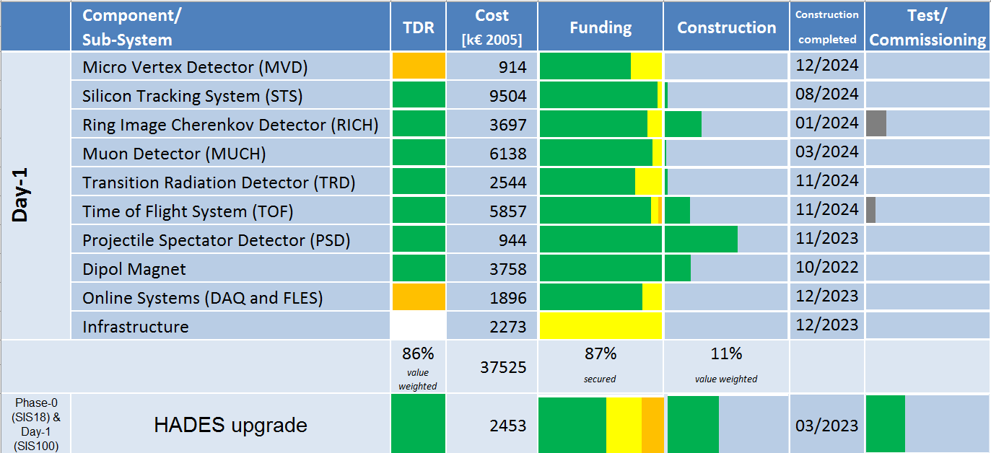
CBM Score Card

Slide 34




The End
Thanks for
your attention

Slide 35
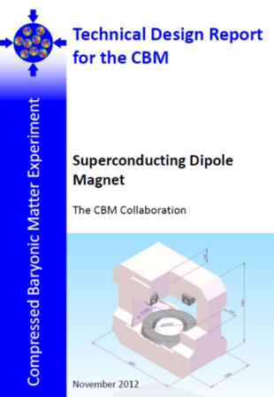
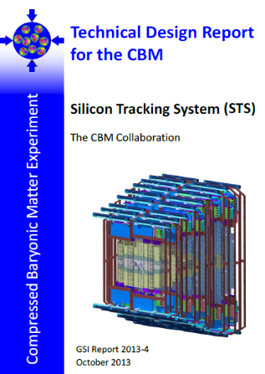
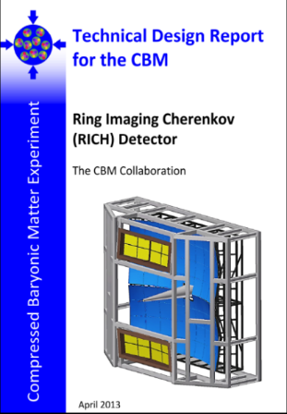
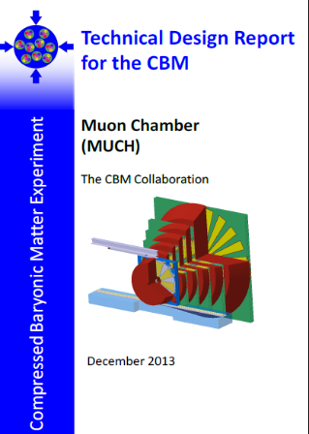
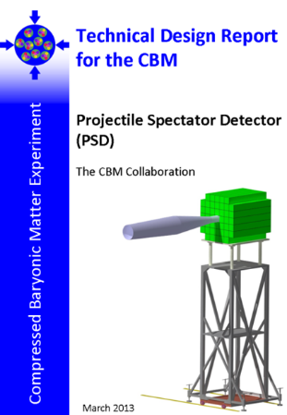
CBM Technical Design Reports
# | Project | TDR Status
1 | Magnet | approved 2013
2 | STS | approved 2013
3 | RICH | approved 2014
4 | TOF | approved 2015
5 | MuCh | approved 2015
6 | PSD | approved 2015
7 | TRD | approved 2018
8 | MVD | subm Q2‘2020
9a | Online-DAQ | subm Q4‘2020
9b | Online-FLES | subm Q1‘2023
10 | ECAL | Not in startup configuration

