Slide 1
Hydrodynamics and jets
ExtreMe Matter Institute Rapid Reaction Task Force Symposium
The space-time structure of jet quenching: theory and experiment
GSI, Darmstadt, Germany, August 12, 2019
Tetsufumi Hirano
Sophia Univ.

Slide 2
Outline
1. Introduction
2. Dynamical Modeling
3. Fluid-dynamical behavior of QGP
4. Hydrodynamics and jets
in the RHIC era
5. Hydrodynamics and jets
in the LHC era
6. Summary and Outlook

Slide 3
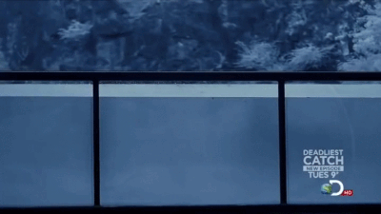

Fate of a bullet in water
Drag force of water against a bullet
$$F_{D}=\frac{1}{2}ρC_{D}A v^{2}$$
Mass density
of water
Speed of
bullet
http://sciabc.us/wIRX0
Drag coefficient
(shape effect)
Reference area
Notes:
Let me start with this movie as an Introduction. This is a movie of bullet shot into the water. As you see, a bullet can move in a water only for a few meter due to large drag force. The drag force of water against a bullet has already know to be like this

Slide 4
Fate of a bullet in water
Drag force of water against
a bullet
“Drag force” of QGP against jet propagation
Talks by Mehtar-Tani, Zapp, …
Response of water to propagation of bullet
Response of QGP to propagation of jets
This talk
http://sciabc.us/wIRX0
Notes:
To understand this phenomenon, the drag force plays an important role. Coming back to jet physics in heavy-ion collisions, this can be rephrased as drag force of the QGP against jet propagation. This was covered by previous speakers. Here in this talk I am going to talk about response of the QGP to propagation of jets.

Slide 5
Standard picture of dynamics in heavy-ion collisions
Hadronic observables
time
Hadron gas
jet
jet
hadron gas
Recombination
Fragmentation
QGP fluid
QGP
fluid
(Mini-)
jets
interaction
Glasma
collision axis
Glasma
0
Gluon
saturation
Gluon saturation
Dilute parton gas
Soft sector
energy scale
Hard sector

Slide 6


Slide 7









Anisotropy of initial profile
$$ε_{n}=\frac{\left\langle r^{n}e^{inφ}\right\rangle }{\left\langle r^{n}\right\rangle }=\left|ε_{n}\right|e^{inΨ_{n}}$$
$$\left\langle ⋯\right\rangle =\int{dxdy⋯s(x,y)},$$
$$r=\sqrt{x^{2}+y^{2}}$$
TH et al. (2013)
$$y$$
ex.)
Entropy density distribution just after collision
$$φ$$
$$x$$
$$s(x,y)$$
Large $ε_{2}$
Small $ε_{2}$

Slide 8


Hydrodynamic response to initial anisotropy
Response of the system to anisotropic geometry
Response
$$ε_{n}$$
$$v_{n}$$
TH et al. (2013)
Anisotropic
geometry
Fourier coefficients of
azimuthal angle distribution
in momentum space
Small
→Large viscosity
Large
→Small viscosity
Response

Slide 9




Recent results from hydrodynamics
Pb+Pb $\sqrt{s_{NN}}=5.02 TeV$
$$n=2$$
Transverse momentum and centrality dependences well reproduced by hydro
Hydrodynamic behavior of bulk matter
Utilization to quantify jet quenching
$$n=3$$
Fourier coefficient
$$n=4$$
Transverse momentum, p_{T}
ALICE (2018)

Slide 10
Brief history of “Hydrodynamics and jets” in the RHIC era
2002- Utilize hydrodynamic profile to quantify jet quenching (Th)
Gyulassy et al. (2002), TH, Nara (2003), Majumder et al. (2007), TECHQM (2008-2010), Bass et al. (2009), JET Collaboration (2010-2015), …
2004 Double humped structure in di-hadron correlations (Ex)
STAR Collaboration
2005- Interference of sound wave induced by supersonic partons (Th)
Stoecker (2005), Casalderry-Solana et al. (2006), Renk et al. (2006), Neufeld et al. (2008), Qin et al. (2009), …
2006- Hydro simulations beyond linearization (Th)
Chaudhuri, Heinz (2006), Betz et al. (2009), Tachibana, TH (2013), …
2008- Other approaches (Th)
AdS/CFT: Gubser et al. (2008), Chesler et al. (2008), Noronha et al.(2009), …
Parton cascade: Ma et al. (2006), Bouras et al. (2012),…
Notes:
Once one recognized hydrodynamics works in description of bulk matter, one utilized hydrodynamic profile to quantify jet quenching

Slide 11
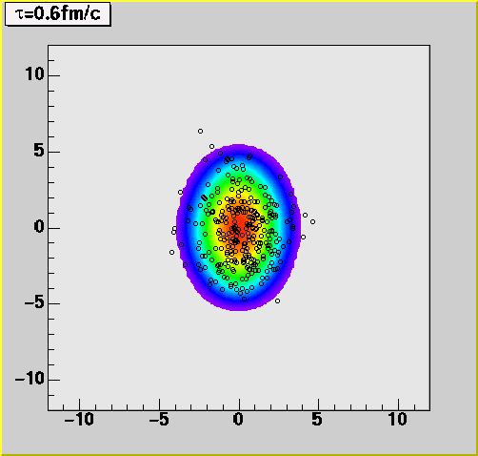
Fluids + quenched mini-jets picture
TH, Nara (2002)
Low p_{T}: Exponential spectrum
Particlization from thermalized and boosted fluid elements
High p_{T}: Power-law spectrum
← Fragmentation from quenched mini-jets
Quantification of parton energy loss without back reaction

Slide 12
Brief history of “Hydrodynamics and jets” in the RHIC era
2002- Utilize hydrodynamic profile to quantify jet quenching (Th)
Gyulassy et al. (2002), TH, Nara (2003), Majumder et al. (2007), TECHQM (2008-2010), Bass et al. (2009), JET Collaboration (2010-2015), …
2004 Double humped structure in di-hadron correlations (Ex)
STAR Collaboration
2005- Interference of sound wave induced by supersonic partons (Th)
Stoecker (2005), Casalderry-Solana et al. (2006), Renk et al. (2006), Neufeld et al. (2008), Qin et al. (2009), …
2006- Hydro simulations beyond linearization (Th)
Chaudhuri, Heinz (2006), Betz et al. (2009), Tachibana, TH (2013), …
2008- Other approaches (Th)
AdS/CFT: Gubser et al. (2008), Chesler et al. (2008), Noronha et al.(2009), …
Parton cascade: Ma et al. (2006), Bouras et al. (2012),…

Slide 13



Double-hamped structure in away-side and Mach cone formation
$$c_{s}$$
$$θ_{M}$$
$$v$$
Information on sound velocity?
(~equation of state)
Mach cone formation(?)
Shock wave of nuclear matter
Chapline et al. (1973), Scheid et al. (1974)
F. Wang(STAR, 2003)
Stoecker (2005),
Casalderry-Solana et al. (2006), …

Slide 14
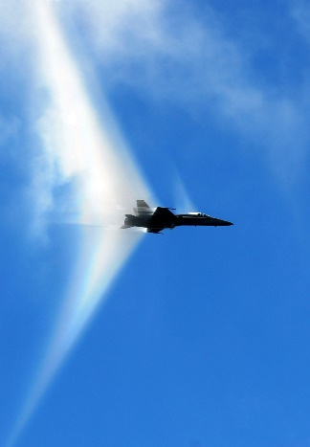
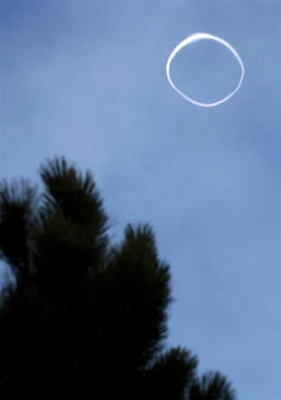

Mach cone formation and its structure
Background temperature $T=0.3 GeV$
Typical structure
Mach cone (coherence of sound waves caused by moving source at supersonic velocity)
Diffusion wake (from momentum deposition)
Vortex ring
Y.Tachibana, Ph.D thesis (2015)
http://twistedsifter.com/2012/06/pictures-of-airplanes-breaking-the-sound-barrier/
http://photoblog.nbcnews.com/_news/2013/04/12/17720274-mount-etna-blows-smoke-ring-during-volcanic-eruptions

Slide 15
Brief history of “Hydrodynamics and jets” in the RHIC era
2002- Utilize hydrodynamic profile to quantify jet quenching (Th)
Gyulassy et al. (2002), TH, Nara (2003), Majumder et al. (2007), TECHQM (2008-2010), Bass et al. (2009), JET Collaboration (2010-2015), …
2004 Double humped structure in di-hadron correlations (Ex)
STAR Collaboration
2005- Interference of sound wave induced by supersonic partons (Th)
Stoecker (2005), Casalderry-Solana et al. (2006), Renk et al. (2006), Neufeld et al. (2008), Qin et al. (2009), …
2006- Hydro simulations beyond linearization (Th)
Chaudhuri, Heinz (2006), Betz et al. (2009), Tachibana, TH (2013), …
2008- Other approaches (Th)
AdS/CFT: Gubser et al. (2008), Chesler et al. (2008), Noronha et al.(2009), …
Parton cascade: Ma et al. (2006), Bouras et al. (2012),…

Slide 16
First hydrodynamic simulations of Mach cone beyond linearization
Chaudhuri, Heinz (2006)
No clear double-humped structure
due to diffusion wake
(2+1)-dimensional boost invariant simulations

Slide 17
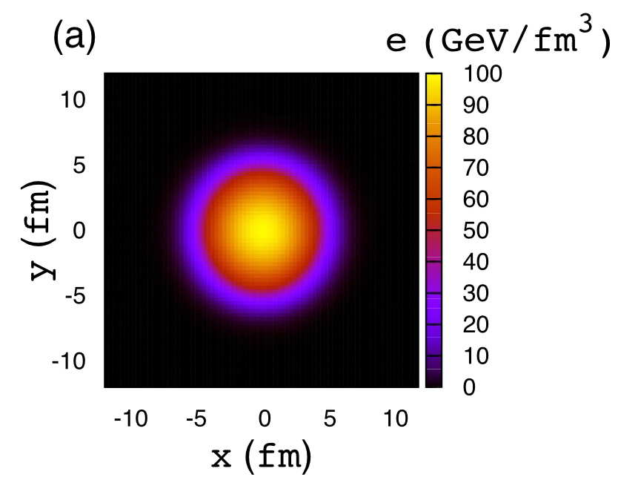
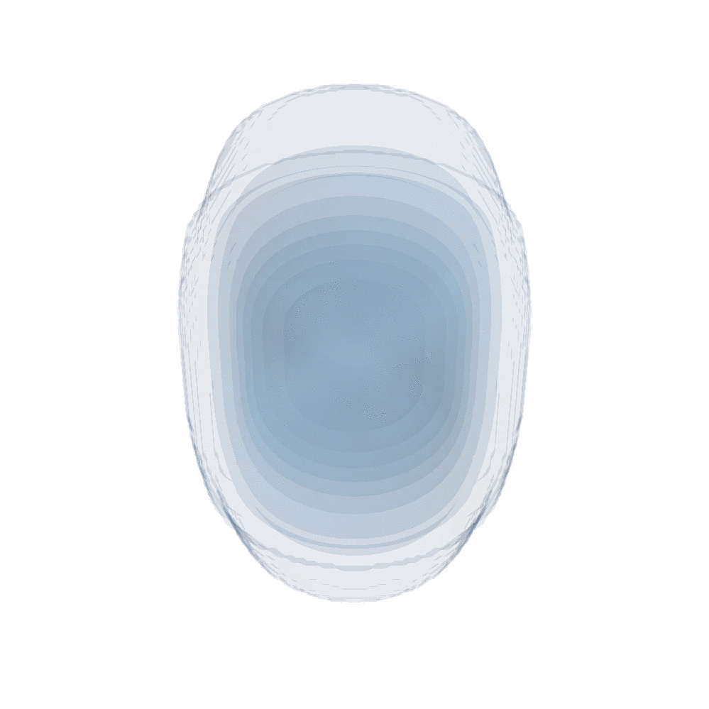
Medium excitation under QGP expansion
Mach-cone like medium response
Movie: Courtesy of Y.Tachibana (Wayne State Univ.)

Slide 18




Medium excitation in non-uniform background
(Energy density with jet propagation)
$−$(Energy density without jet propagation)
$$γ$$
$$τ=2.0fm/c$$
jet
Mach cone like structure (positive, red)
Diffusion wake (negative, blue)
$$τ=4.8fm/c$$
Mach cone structure can be seen even in non-uniform background
Coupled Linear Boltzmann Transport and Hydrodynamics
W.Chen et al. (2018)

Slide 19
Brief history of “Hydrodynamics and jets” in the LHC era
2012- Enhancement of soft hadrons away from jet axis (Ex)
CMS Collaboration
2014- Momentum transport away from jet axis (Th)
Tachibana, TH (2014), Casalderry-Solana et al. (2017), Gao et al. (2018), Park et al. (2019)
2016- Activities by JETSCAPE Collaboration (Th & Ex)
2017- Hydrodynamic responses to full jet (Th)
Tachibana et al. (2017), Chen et al. (2018), …

Slide 20

Asymmetric di-jet event in nucleus-nucleus collisions
CMS Collaboration (QM2011)
$E\sim 200 GeV$ jet dragged by$T\sim 300 MeV$ medium
Where does the lost energy/momentum go?

Slide 21
Enhancement of soft hadrons away from jet axis
Y.Tachibana, talk at QM2018
Momentum balance btw. hemispheres
←Large angle emission of low momentum particles
at large angle from jet axis

Slide 22
Brief history of “Hydrodynamics and jets” in the LHC era
2012- Enhancement of soft hadrons away from jet axis (Ex)
CMS Collaboration
2014- Momentum transport away from jet axis (Th)
Tachibana, TH (2014), Casalderry-Solana et al. (2017), Gao et al. (2018), Park et al. (2019)
2016- Activities by JETSCAPE Collaboration (Th & Ex)
2017- Hydrodynamic responses to full jet (Th)
Tachibana et al. (2017), Chen et al. (2018), …

Slide 23
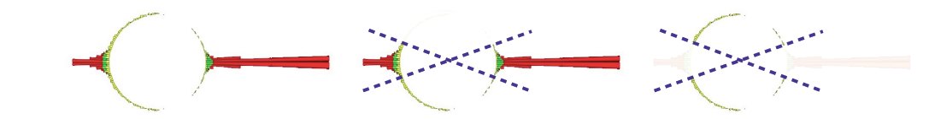
Momentum transport away from jet axis
In-cone
Out-of-cone
Energy deposition to medium
＋
Hydrodynamic expansion of medium
Y.Tachibana, TH (2014)
Resolution of
energy balance problem
CMS (2011)

Slide 24
Brief history of “Hydrodynamics and jets” in the LHC era
2012- Enhancement of soft hadrons away from jet axis (Ex)
CMS Collaboration
2014- Momentum transport away from jet axis (Th)
Tachibana, TH (2014), Casalderry-Solana et al. (2017), Gao et al. (2018), Park et al. (2019)
2016- Activities by JETSCAPE Collaboration (Th & Ex)
2017- Hydrodynamic responses to full jet (Th)
Tachibana et al. (2017), Chen et al. (2018), …

Slide 25







Interplay between hydrodynamics and jets
Jet shape function
$$ρ\left(r\right)= \frac{1}{Δr}\frac{1}{N_{jet}}\sum_{jet}{\frac{\sum_{r}{p_{T,assoc}}}{p_{T,jet} (R)}}$$
$$r=\sqrt{Δη^{2}+Δφ^{2}}$$
$${\vec{p}}_{T,jet}$$
$$η$$
$$r$$
$$Δr$$
$$φ$$
Y.Tachibana et al. (2017), see also T.Luo et al. (2018)
Jet shape function at large $r$ interpreted by medium response
New channel to constrain transport coefficients

Slide 26
Summary and outlook
So far, in heavy-ion jet physics, hydrodynamics plays an important role in
  describing space-time evolution of background medium.
  quantifying the amount of energy loss and momentum diffusion.
  describing response of the medium to propagation of the jet.
In future, these will bring us medium properties and how the deposited energy and momentum are equilibrated.
Developing a self-contained framework with cutting-edge hydrodynamics and jet evolution under medium remains to be needed.

Slide 27




Jet as source of shear flow
$$y$$
Shear flow
$$x$$
$$π^{yx} ∝−η\frac{∂v_{x}}{∂y}$$
Shear stress
Y.Tachibana, Ph.D thesis (2015)
Momentum in $x$ direction transport to $y$ direction
New channel to constrain shear viscosity?

Slide 28


Vapor to moisture
Atmospheric water vapor
$$c_{s}≈1200km/h$$
Condensation to liquid due to rapid decrease of pressure
http://twistedsifter.com/2012/06/pictures-of-airplanes-breaking-the-sound-barrier/

Slide 29


April 13, 2013 at Mt. Etna, Sicily Island
http://photoblog.nbcnews.com/_news/2013/04/12/17720274-mount-etna-blows-smoke-ring-during-volcanic-eruptions

Slide 30
Collision of two vortex rings
https://twitter.com/InterestingSci1/status/1159102135180640256

Slide 31

Current understanding
TH et al. (2013)
$n=3$ (hexapole)
Triangular flow
J. Jia (ATLAS), talk at QM2011
Alver, Roland (2010)
Double-humped structure from third harmonics
← Mach cone interpretation was dead(!?)

Slide 32
(Ideal?) Dynamical modeling
hadronic
observables
Hadronic transport
time
jet
jet
hadron gas
string
fragmentation
Recombination
model
QGP fluid
Hydro-
dynamics
Modification of
jet structure
hydro+jet
model
Glasma
collision axis
Classical Yang-Mills
0
Gluon
saturation
CGC theory
pQCD
Soft sector
energy scale
Hard sector

Slide 33
Precision physics from
Bayesian parameter estimation
Sound velocity vs. Temperature
Paquet, poster at QM2018
Pratt et al.(2015)
Exp. data meets 1st principle results for the first time!
From discovery to precision!

Slide 34






Linearized hydrodynamic framework
Sound attenuation length $Γ_{s}$
Energy-momentum
conservation
$$∂_{t}ε+ikg_{L}=0$$
Sound mode
$$∂_{t}g_{L}+ic_{s}^{2}kε+\frac{4}{3}\frac{η}{ε_{0}+p_{0}}k^{2}g_{L}=0$$
$$∂_{μ}T^{μν}=0$$
$$∂_{t}g_{T}+\frac{η}{ε_{0}+p_{0}}k^{2}g_{T}=0$$
Linearization
under static
and uniform
background
Diffusion mode
$⊥$ wave number $k$

Slide 35



Medium excitation in smooth background
$$τ=7.5 fm/c$$
(Energy density with jet propagation)
$−$(Energy density without jet propagation)
Mach cone like structure (positive, red)
Diffusion wake (negative, blue)
$$τ=12 fm/c$$
Mach cone structure clearly tilted due to radial expansion in an off-central jet path
Coupled Jet and Fluid
Y. Tachibana et al. (2017)
Tilted Mach cone,
Satarov et al. (2005), Chaudhuri (2007), Betz (2009), …

Slide 36

Snapshots of energy density distribution
($τ=12 fm$)
Initial position
Initial momentum
Mach cone structure clearly tilted in an off-central jet path

Slide 37
Hydrodynamic analysis
H.Niemi, talk at QM2018
B.Schenke, talk at QM2018
M.Luzum, talk at QM2018
IP-Glasma
+3D hydro (shear+bulk)
+lattice EoS
+afterburner
Trento
+2D hydro (shear)
EKRT saturation
+2D hydro
(T-dep. shear)
+Lattice EoS

Slide 38
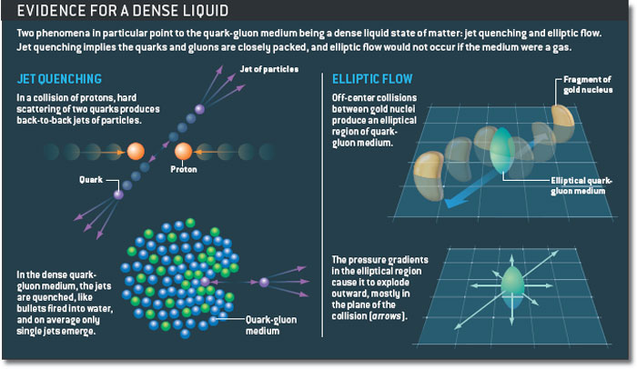
“Evidence for a dense liquid”
Michael Riordan and William A. Zajc
Scientific American 294, 34 - 41 (2006)
Two milestones in high-energy nuclear collisions at RHIC

