Slide 1
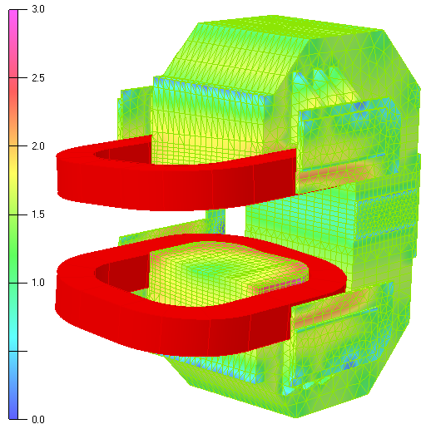
FEM Simulations of Ramping-Up the PANDA dipole
J. Lühning, GSI, 2019-06-26
Colour scale, values in Tesla
FEM model of PANDA dipole: field on steel surfaces of the western half of the yoke at 100% nominal current (beam path integral 2.0 T·m)

Slide 2
Ramp-up Current used in Simulations
Intent of simulations:
to determine the delay of field integral on beam path.
Assumptions made for yoke material:
Quality St-10, thickness of electrically insulated plates 16cm, steel resistivity 100nOhm·m.
lead-out parabola
2 seconds
rate 1.3% / second
The dipole current will rise from 25% to 100% nominal current in 60 seconds. In order to reduce simulation CPU-time, here it was assumed that the current will rise from 64% to 100% in 30 seconds (same rise rate: 1.3% / second).

Slide 3
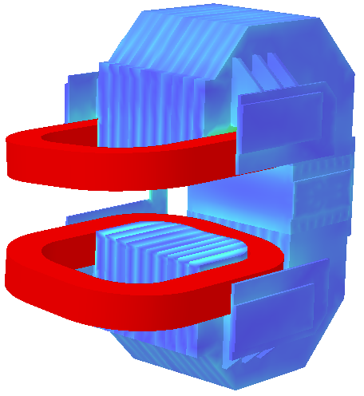
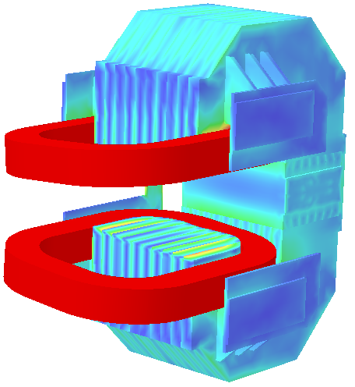
Colour scale, current density / [A/cm²]
t = 1 second
t = 2 seconds
(end of lead-in parabola)

Slide 4
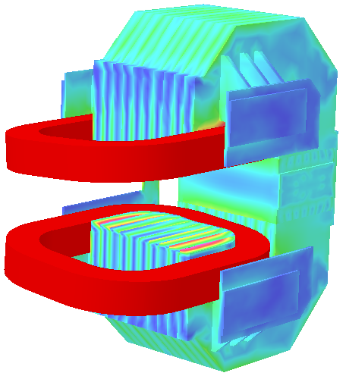
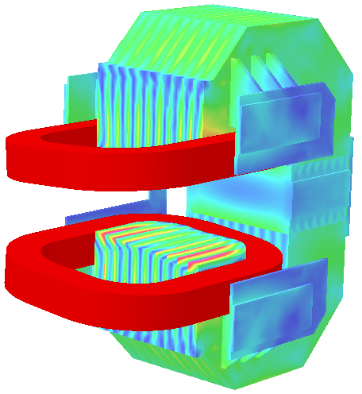
Colour scale, current density / [A/cm²]
t = 3 seconds
t = 15 seconds

Slide 5
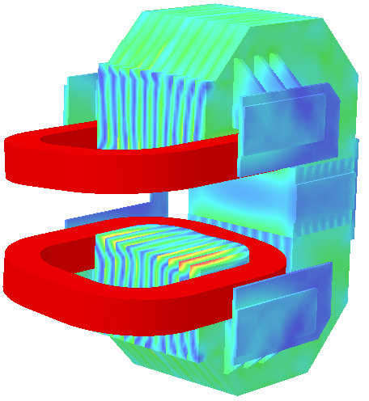
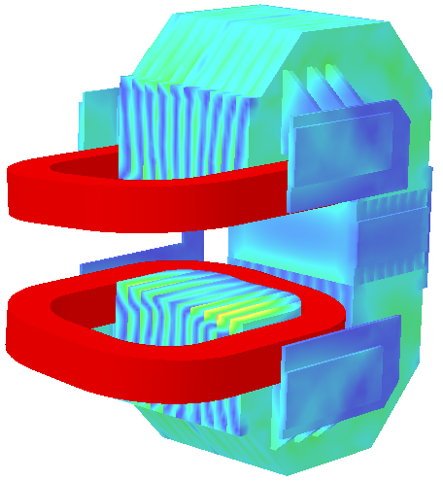
Colour scale, current density / [A/cm²]
t = 28 seconds
(start of lead-out parabola)
t = 29 seconds

Slide 6
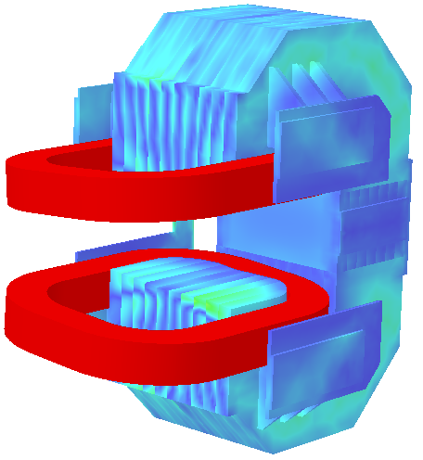
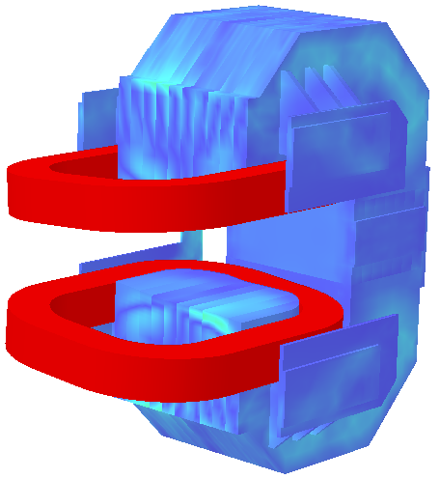
Colour scale, current density / [A/cm²]
t = 30 seconds
(end of lead-out parabola)
t = 32 seconds

Slide 7
Delay of Field Integral
delay increases
ca. 0.5 s
Simulations indicate that at the end of the ramp-up the delay becomes much bigger

Slide 8
Eddy Current Power
330
lead-in time
lead-out time
After reaching the flat-top the eddy currents seem to decay very slowly

Slide 9
Conclusion
Simulations for a yoke made of 16cm thick steel plates suggest that the delay between the driving current and the field integral on the beam path is not longer than 0.6 seconds during the constant phase of the ramp-up.
The yoke is now planned to be made of 106mm thick steel plates, so we can expect an even shorter delay.
Caveat:
At the end of the ramp-up the eddy currents seem to decay very slowly. If simulations are correct then a small current “overshoot” is needed.

