Slide 1
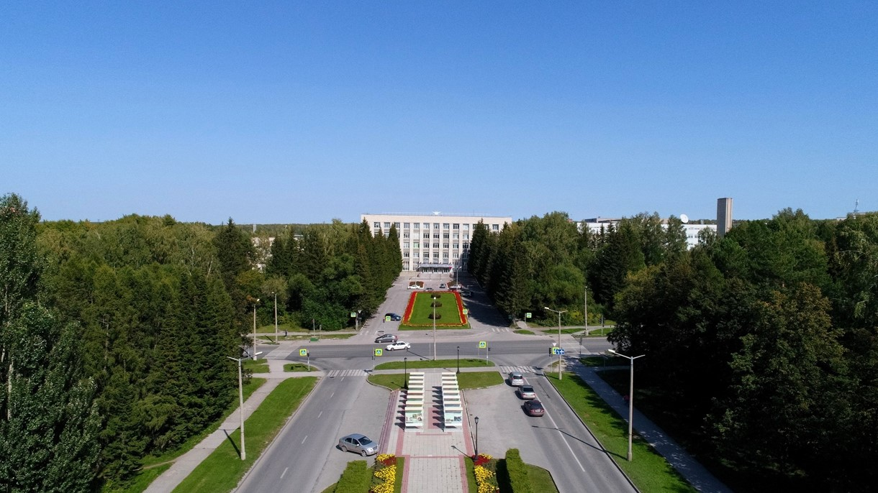
Status of the PANDA Solenoid Magnet Production in BINP

Slide 2
The main milestones of production of the PANDA solenoid magnet
The scope of delivery includes:
Magnetic and engineering design of the magnet including tools and support;
Production and delivery of the magnet (consisting of yoke, cold mass and cryostat, alignment components, proximity cryogenics, support frame and platform beams) and all tools;
Power converter and quench protection and instrumentation.
Item | Date
Start contract | 03/2017
Control assembling of the Yoke of solenoid at the Novosibirsk plant site | 09/2019
Magnetic tests of the PANDA solenoid including safety system and electrical components at BINP (additional contract) | 05/2021 - 11/2021
Assembling and tests at the FAIR site
Assembling of the Yoke at Darmstadt | 2/2022
Acceptant tests at FAIR | 08/2022
Installation of the PANDA solenoid magnet at worked position and start final acceptance tests | 01-05/2023
Table 1. The main milestones.

Slide 3
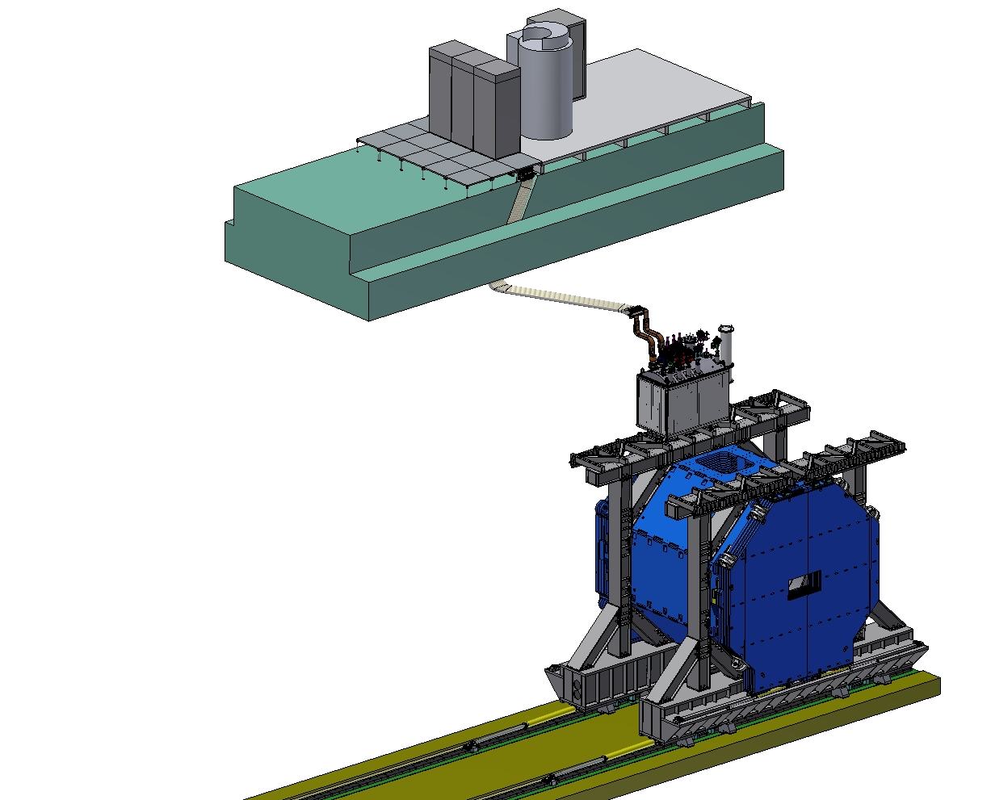
PANDA solenoid magnet, BINP responsibility
Power supply and energy extraction system
The PANDA solenoid is designed to provide a magnetic field of 2 T with a uniformity of ± 2% and radial magnetic field integral in the range 0 to 2 mm over the central tracking region. The magnet is characterized by a warm bore of 1.9 m diameter, a free length of 4 m and 22.4 MJ of stored energy. The magnet is split in 3 interconnected coil modules.
Control Dewar box
Cable channel
Frame of solenoid
Solenoid and yoke
Figure 1. Arrangement of the components of the PANDA solenoid.

Slide 4
Development of the PANDA solenoid magnet
Name of item | Status of work
Yoke and frame | Design is ready, production
Cryostat of solenoid | Design is ready, FDR 46th week 2018
Cold mass | Design is ready, FDR 46th week 2018
Conductor purchasing | Development work
Control Dewar box | Design in progress
PANDA solenoid power cabling | Design in ready
Power supply and energy extraction system | Detail design is ready, purchasing
Magnet safety system | Start discussing 11th week 2018 in process
Table 2. Status of work of the PANDA solenoid production.

Slide 5
The main milestones of the yoke production
Name of milestone | Date 2017/10
PDR of the yoke | 04-07/10/2017
FDR of the yoke | 20-25/11/2017
Contract with SibMash (SET), signed | 2/11/2017
Purchasing raw materials (1st batch, 60 t) | 26/12/2017
Start of production of the 1st octant | 01/2018
Status production
Delivery raw material to SibMash (SET) | Final delivery 23/01/2019
Manufacturing parts of tooling for assembly of octants | 09/2018
First octant production, W3 | 11/2018
Machining sheets of the octants | ready
Welding of 7 octants | ready
Final machining of the bottom octant | 07/2019
Final machining of the upper octant | 08/2019
Final machining of the frames | 09/2019
Production of a tooling for the yoke assembly | 09/2019
Assembling barrel part of the yoke together with frames | 10/2019
Table 3. The main milestones of the yoke production.

Slide 6
The main milestones of the yoke production
Name of milestone | Date 2017/10
Production of the all barrel octants | 08/2019
Production of the frame and beams | 08/2019
Production of the doors | 09/2019
Control assembling at SET | 10/2019
Finalization of the parts | 10/2019
Assembling of the Yoke at BINP | ? Q2-2020
Table3. The main milestones of the yoke production.

Slide 7
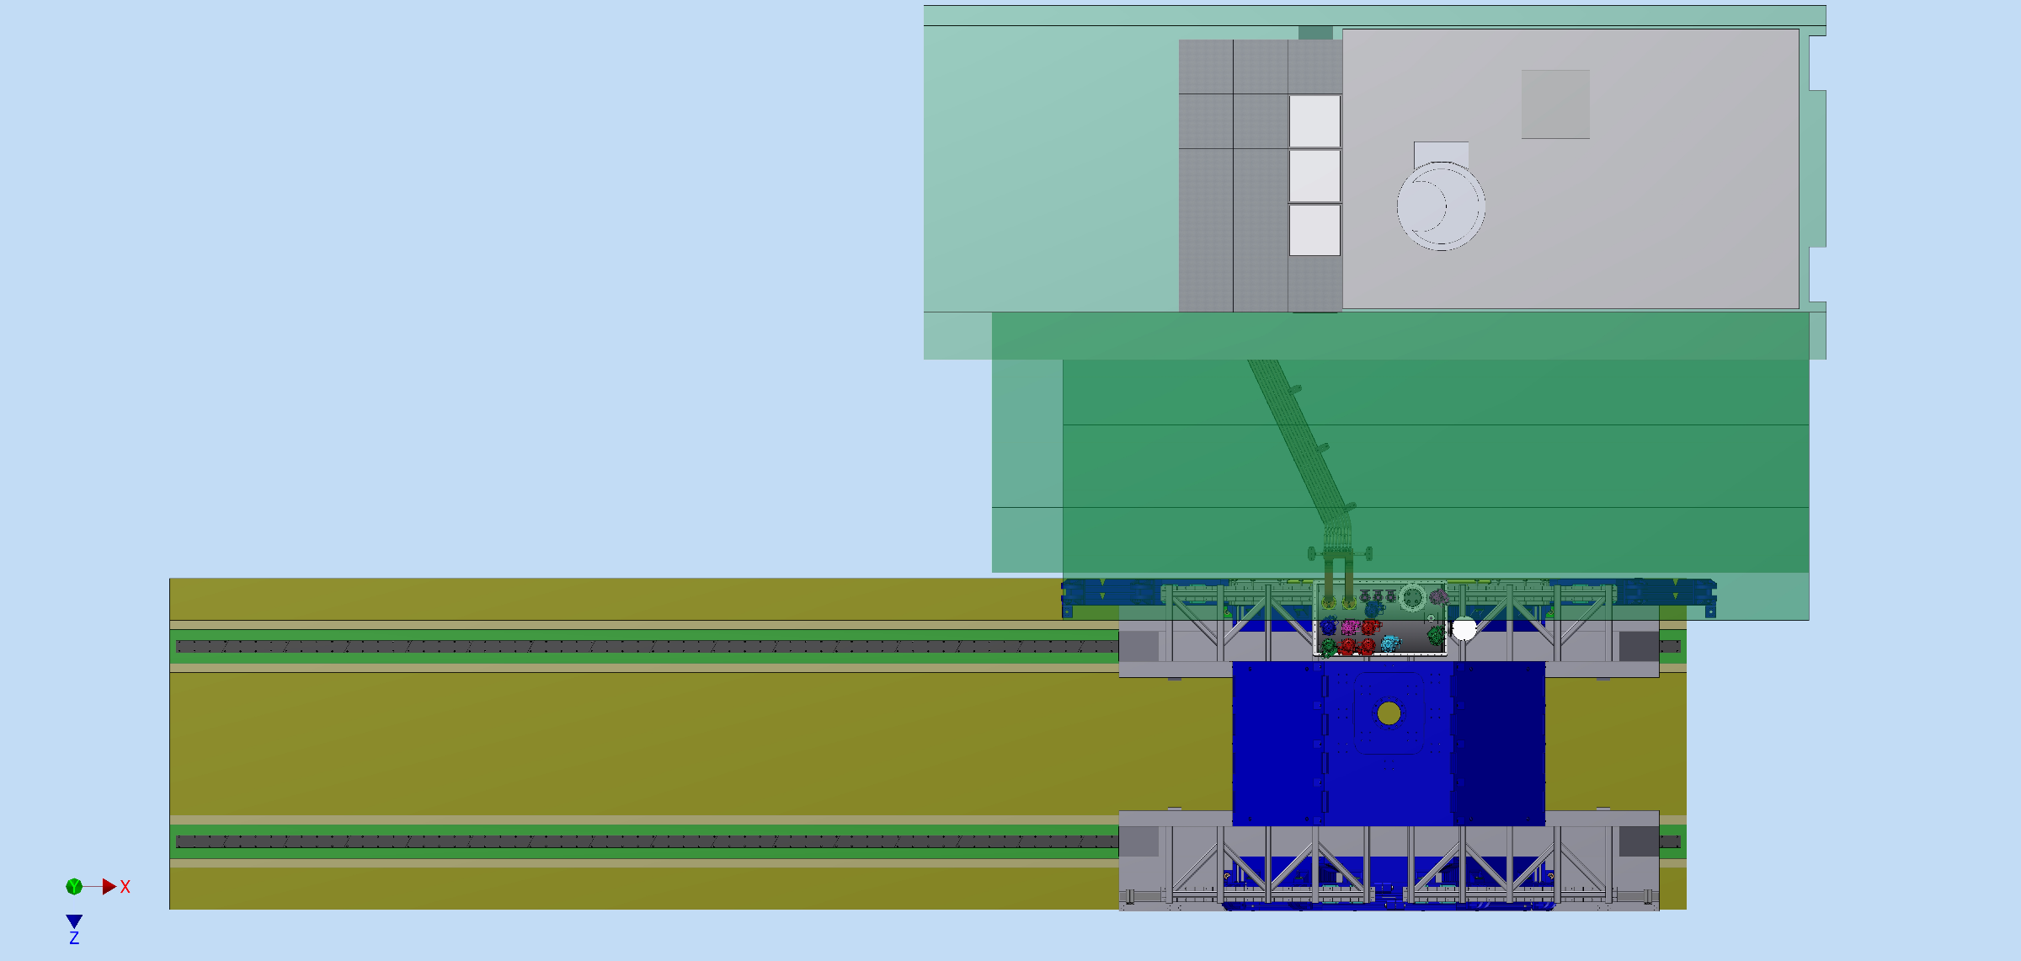
The views of the PANDA Solenoid Power Cable laying
Fig.2. The PANDA Solenoid Power Cable laying top view.

Slide 8
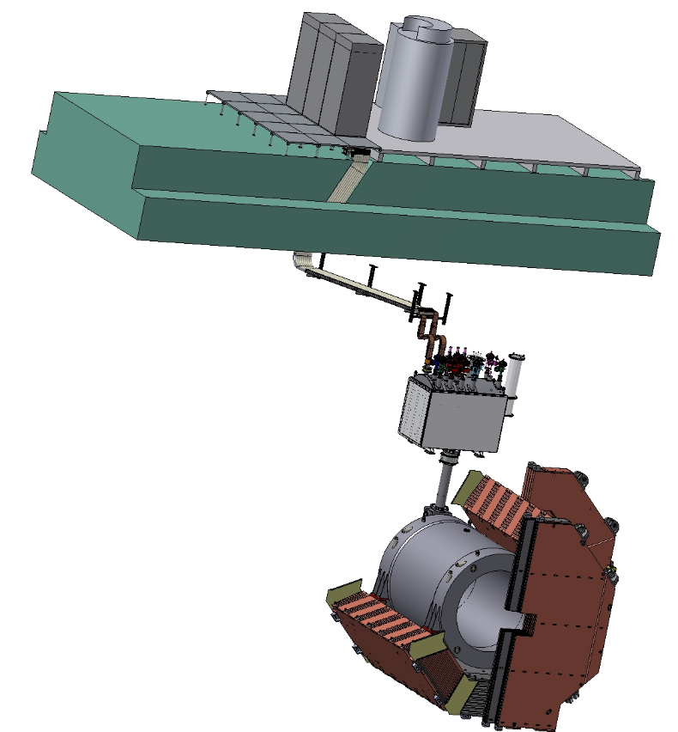
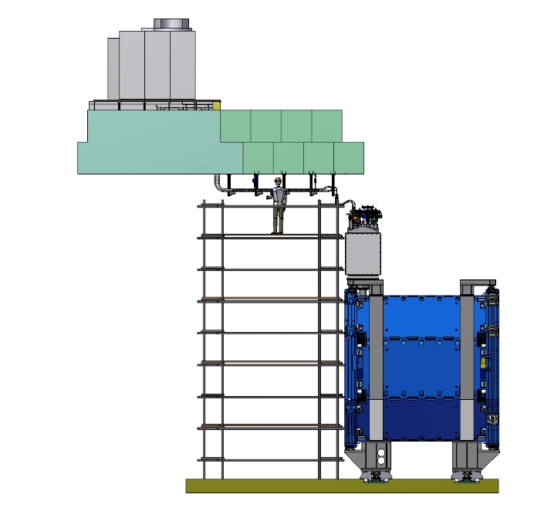
The views of the PANDA Solenoid Power Cable laying
Fig.3. The PANDA Solenoid Power Cable laying.

Slide 9
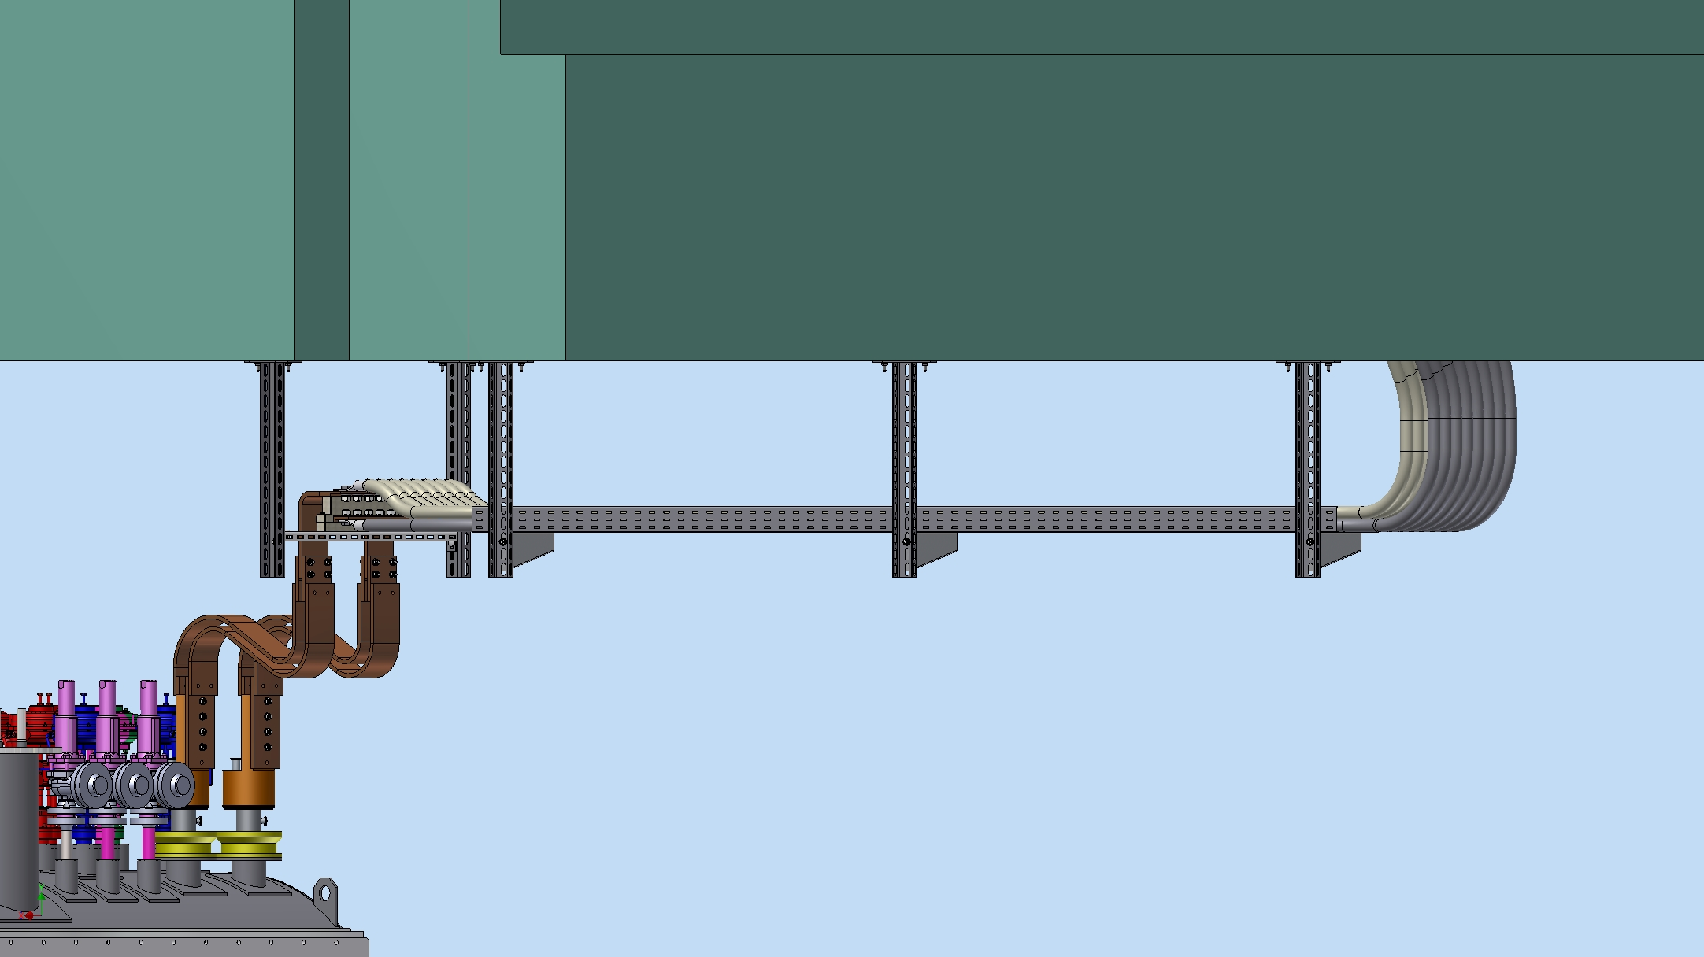
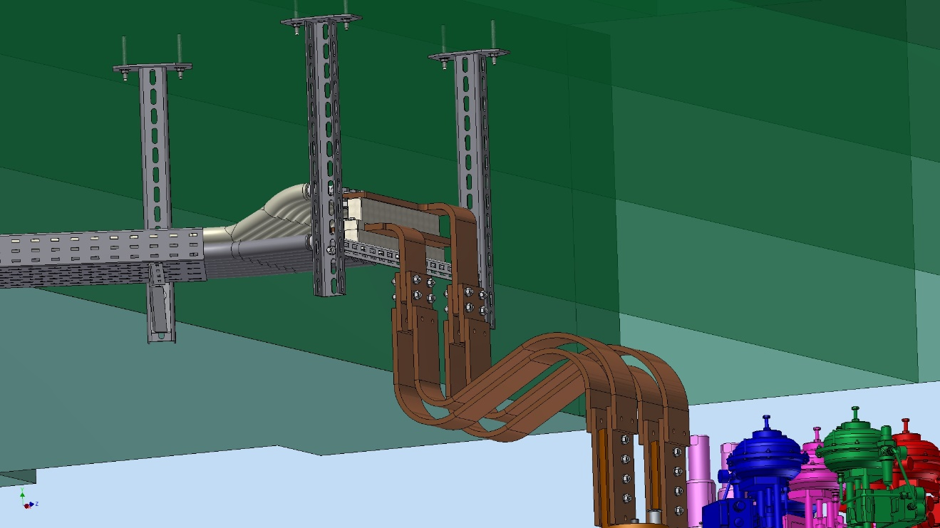
PANDA solenoid cables
Fig.4. The PANDA Solenoid Power Cable laying.

Slide 10
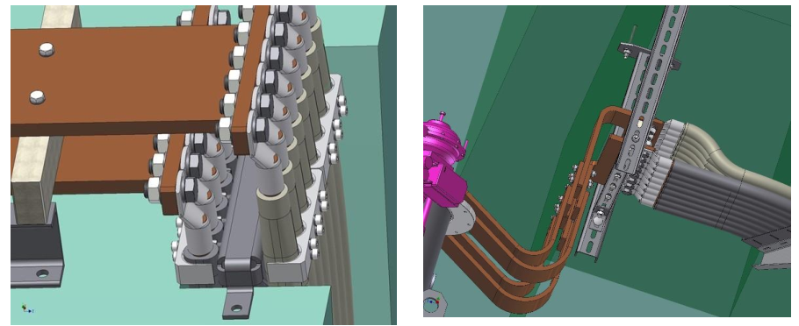
Fig. 5. Connection of the cable lugs with the busbars.

Slide 11
Status of the PANDA conductor development/ procurement

Slide 12
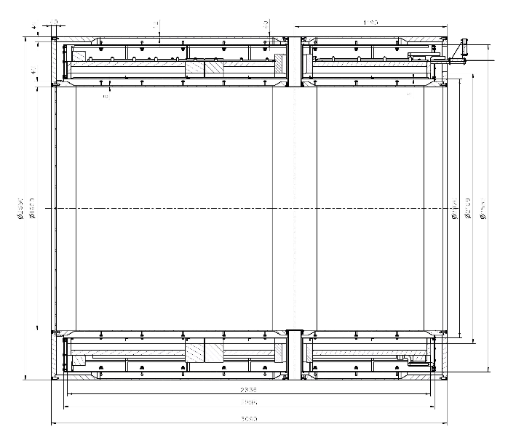
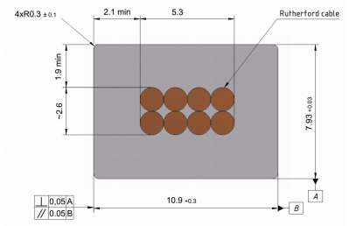
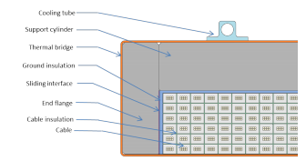
Main risks
Purchasing super conductive conductor - lack of a manufacturers
Rutherford cable, 8 strands, extruded in Al matrix
Thickness (after cold work) at 300 K | mm | 7.93 | ± 0.03
Width (after cold work) at 300 K | mm | 10.95 | ± 0.03
Critical current (at 4.2 K, 5 T) | A | > 14690
Critical current (at 4.5 K, 3 T) | A | > 16750
Overall Al/Cu/sc ratio |  | 10.5/1.0/1.0
Aluminum RRR (at 4.2 K, 0 T) |  | > 1000
Al 0.2% yield strength at 300 K | MPa | > 30
Figure 6. Longitudinal section of the cryostat with cold mass.
Table 7. Conductor mechanical and electrical parameters.
Figure 5. Cold mass cross-section.
Figure 9. Drawing of the conductor.

Slide 13
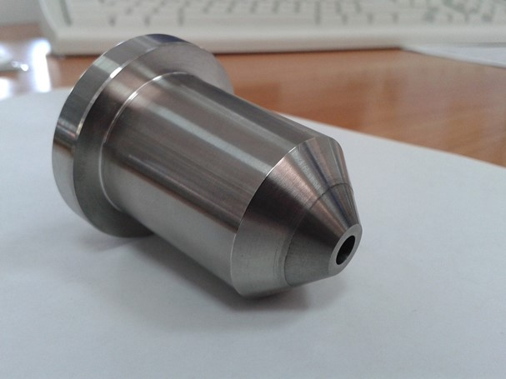
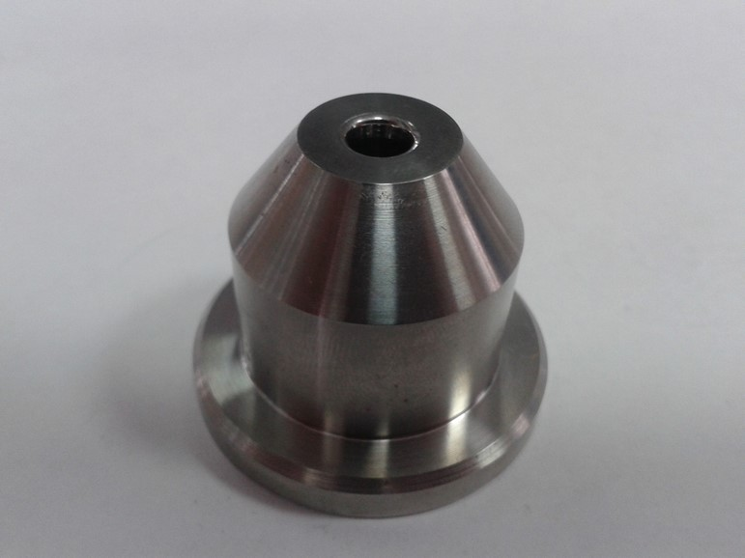
Sarko
Matrices for pipe and plating Al alloy.
Figure 10. Dies, the first variant.

Slide 14
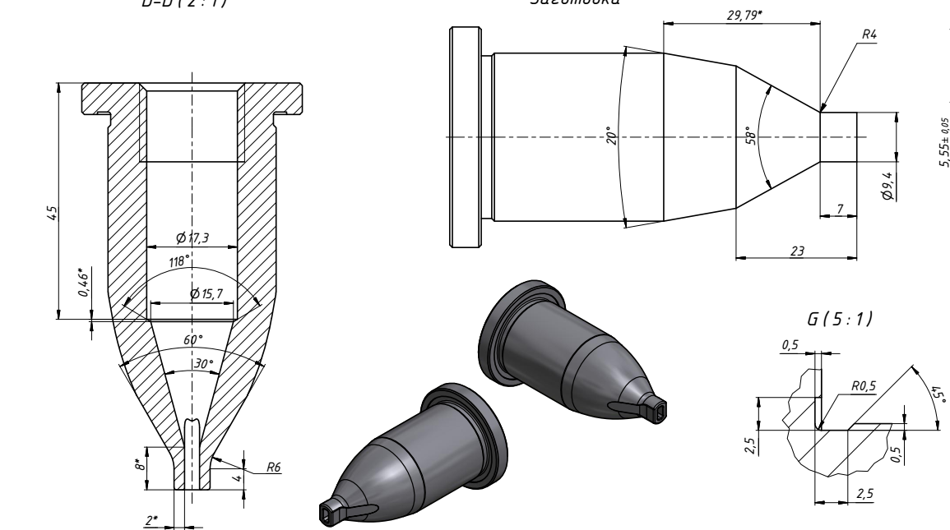
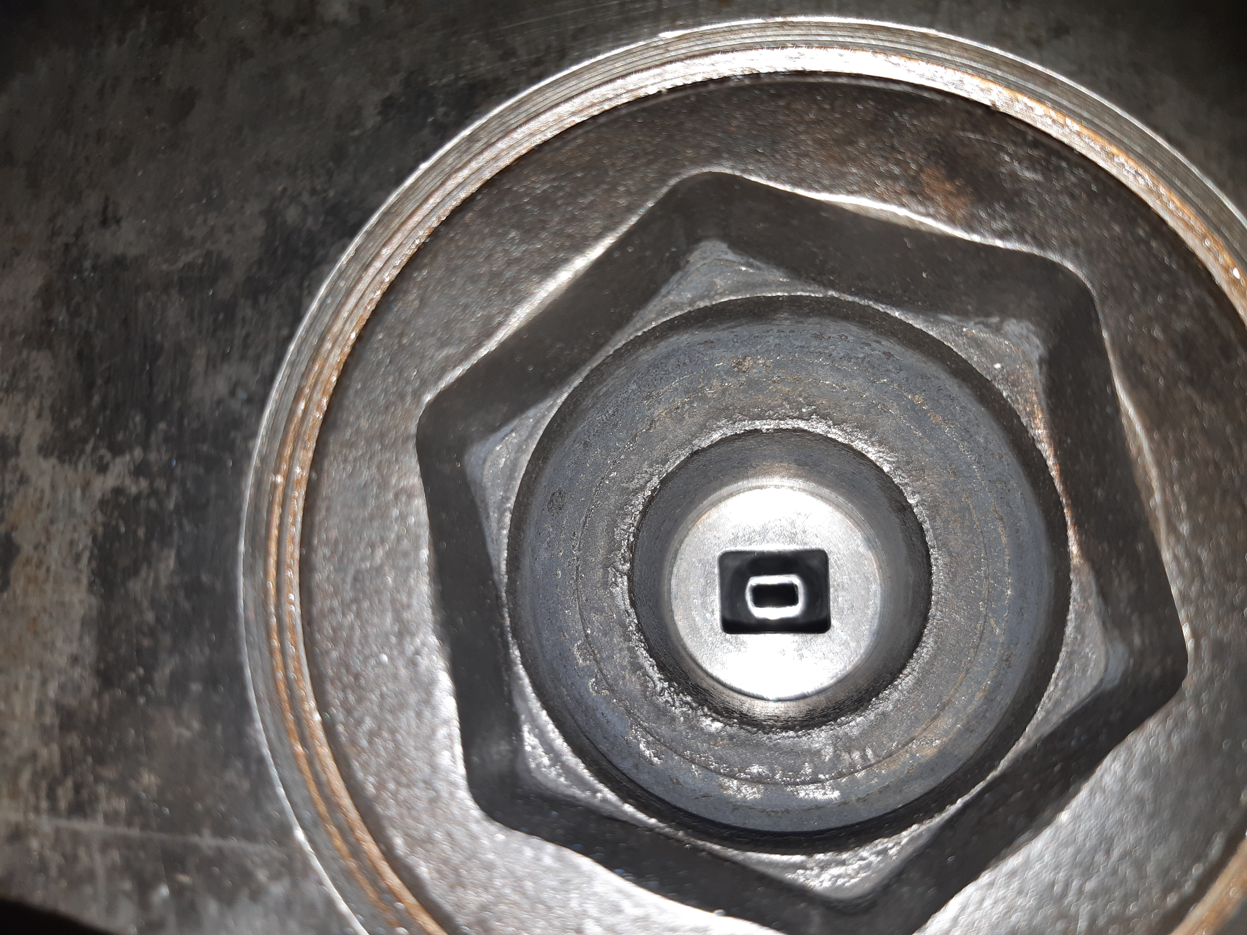
Sarko
Fig.11. Photo of extrusion chamber with dies for
PANDA conductor production.
Fig.12. Input die.

Slide 15
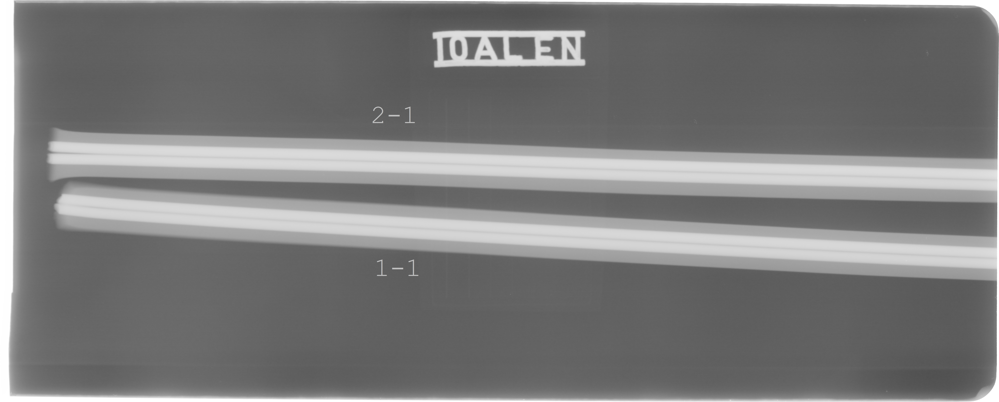
Sarko
First tests of production
Al conductor was produced in Sarko September 20 about 50m long. Two steel wires 2,66mm diameter were used instead a Rutherford cable.
It was checked a possibilities of conductor production in Sarko.
T _{extrusion} = 380°C
V ≤ 5 m/sec
X-ray control of wires position inside an Al matrix.
Measurement of shear stress between cable and aluminum and Al 0.2% yield strength
at 300 K in process.
Figure 13. X-ray control films of wires position inside an Al matrix.

Slide 16
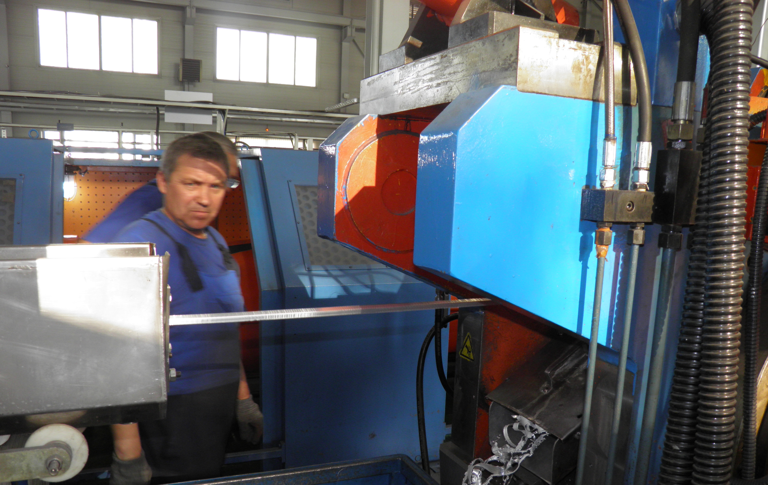
Sarko.
Production a conductor with copper cable length about 50 meters.

Slide 17
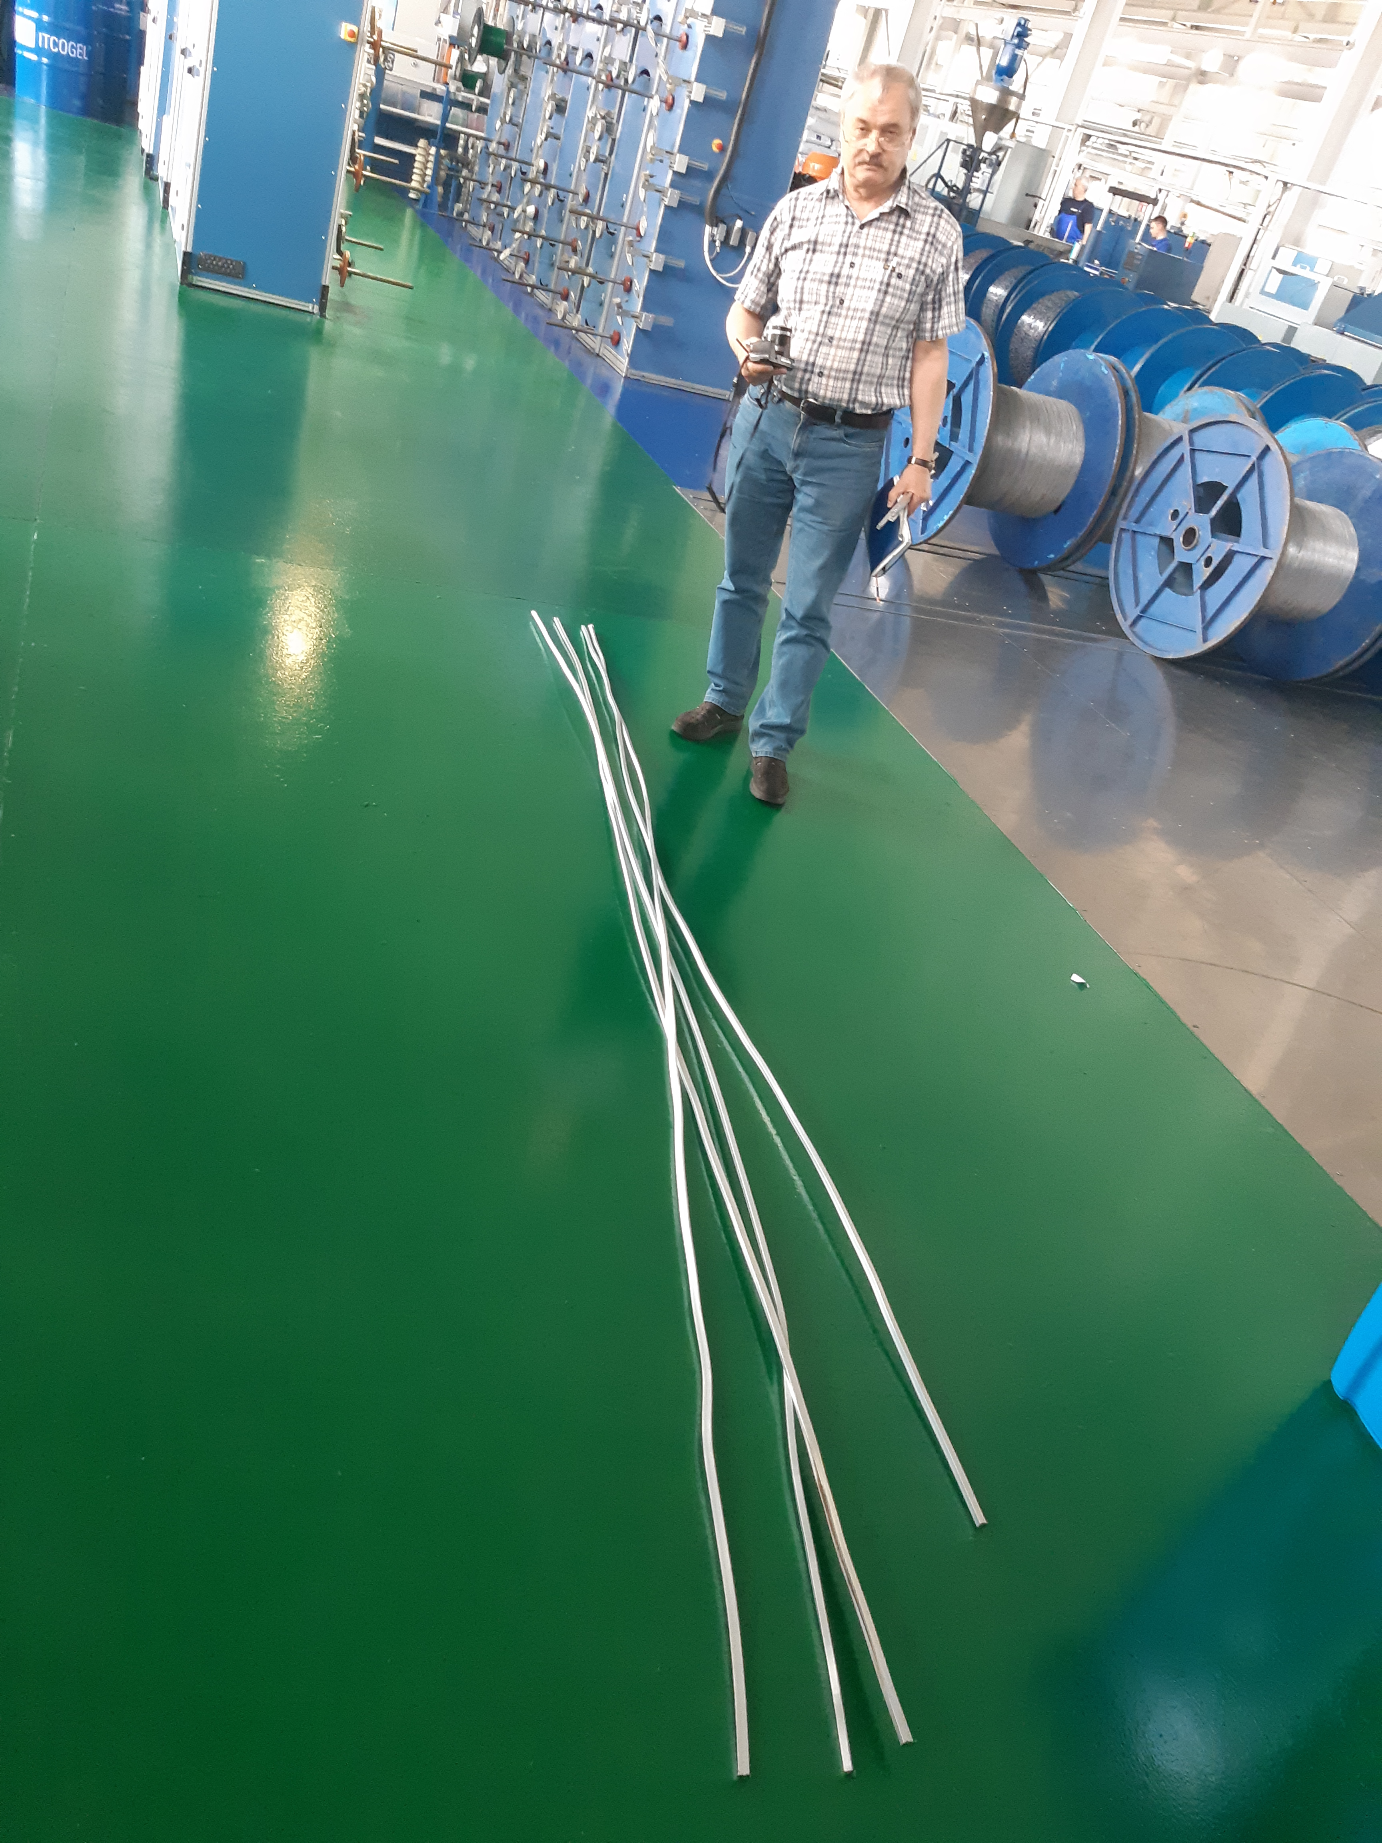
Sarko.
Produced about 20 meters a conductor from A95 and NbTi cable;
4 pieces the conductor 3,5m prepared for following tests;
Mechanical tests should be in BINP;
Cryogenic tests for RRR and critical currents should be carried out in Bochvar institute and CERN.

Slide 18
Rutherford cable co-extrusion/ conforming in a pure Al
Plans
Delivery A95 conductor 7,93x10,85 for a prototype of the PANDA solenoid coils production 1500 meters - February 2019.
Production of new dies - July 2019.
Tests of the conforming - July 2019.
Cryogenic tests - September
Request 1000m Cu Rutherford cable for tests in SARKO - September
Preparation contracts for PANDA Rutherford cables production - 11/2019
Co-extrusion/conforming.
Cold work to result the overall geometrical conductor dimensions
Procurement A995/998 wire 9,5 mm Q1/ 2020

Slide 19
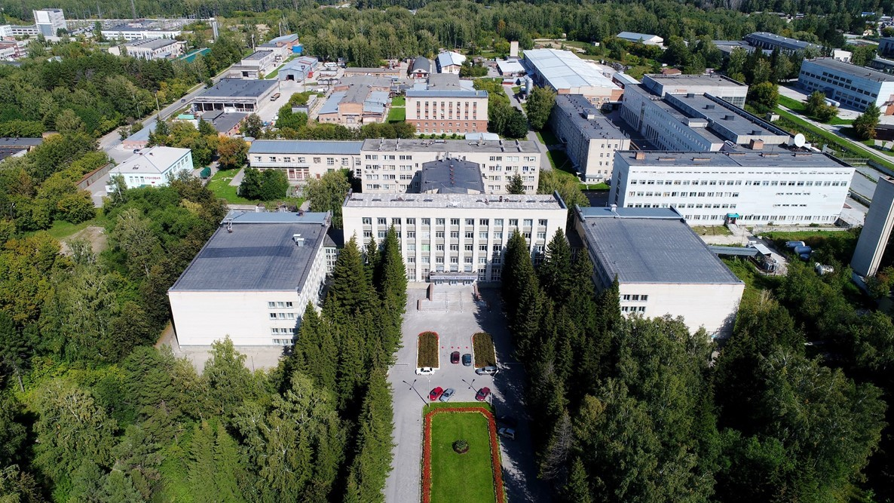
Thank you for your attention

