Slide 1
PANGEA irradiation test at TRIGA
M. Bölting
HIM
PANDA Meeting 19/2, 2019-06-24

Slide 2
Why?
Degration of HPGe under radiation
Develop / optimize correction methods
Test at COSY not optimal
Dynamic range
Cooling problems
New test desirable
2

Slide 3
Possible Facilities
COSY
Knowledge of proton beam
Similar background
Difficult to get higher irradiation
TRIGA
High irradiation possible
No long wait time
Ease of access
Unknown rates

Slide 4
TRIGA Mainz
Swimming pool reactor
Available power 100 mW – 100 kW
4 beam tubes
thermal column
rotary specimen rack

Slide 5
TRIGA Mainz
Swimming pool reactor
Available power 100 mW – 100 kW
4 beam tubes
thermal column
rotary specimen rack

Slide 6
Neutron spectrum
550 eV kinetic energy threshold for irradiation damage
Quelle: http://nbn-resolving.de/urn:nbn:de:bsz:14-qucosa-231889
6
Notes:
PhD thesis Dr. Wortmann, 2007 simulations
Beam tube D user for ultra-cold neutron experiment
Beam tube a, b free
For Questions:
Graphite neutron reflector in center, D passes through it.
A, B, C don‘t
A, B, D look directly at the reactor.
C is tangential.
Thermal column ich mainly graphite

Slide 7
TRIGA beam tube A
Electronics
Detector
7

Slide 8
Fast neutrons @ TRIGA?
Three steps
Measuring total rate
Measuring fast neutron rate
HPGe Irradiation
8

Slide 9
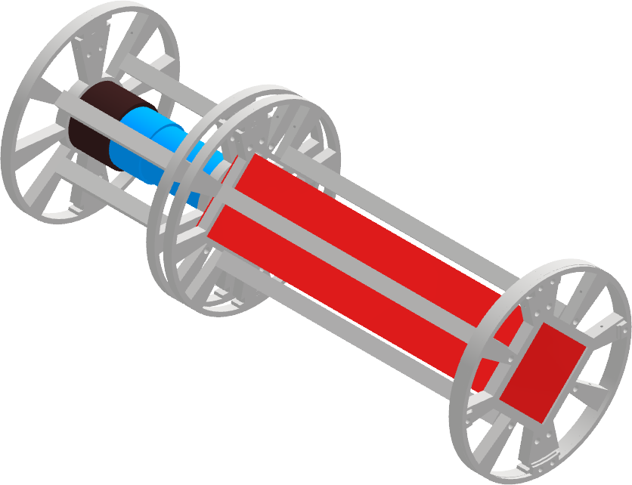
Total Rate
Existing hardware – fast test (hours)
Simple DAQ
Slow neutron / γ shielding ?
9
Notes:
DAQ: trigger rate of scope…
How much neutrons?
Is the next test feasible?
Bild beschriften!
Neutronen-Quelle Pfeil

Slide 10
Fast neutron rate
Similar setup
Adjust power of TRIGA
Scintillator EJ276
Discriminate fast n and γ
PSA similar to HPGe analysis
1-2 days
Nyibule et. Al. Digital Gamma-Neutron Discrimination with Organce Plastic Scintillator EJ 299-33
10
Notes:
Feasibility study for irradiation test

Slide 11
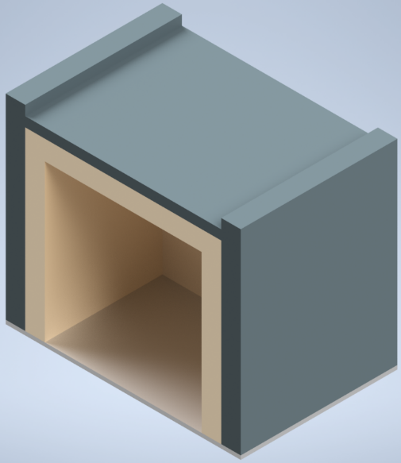
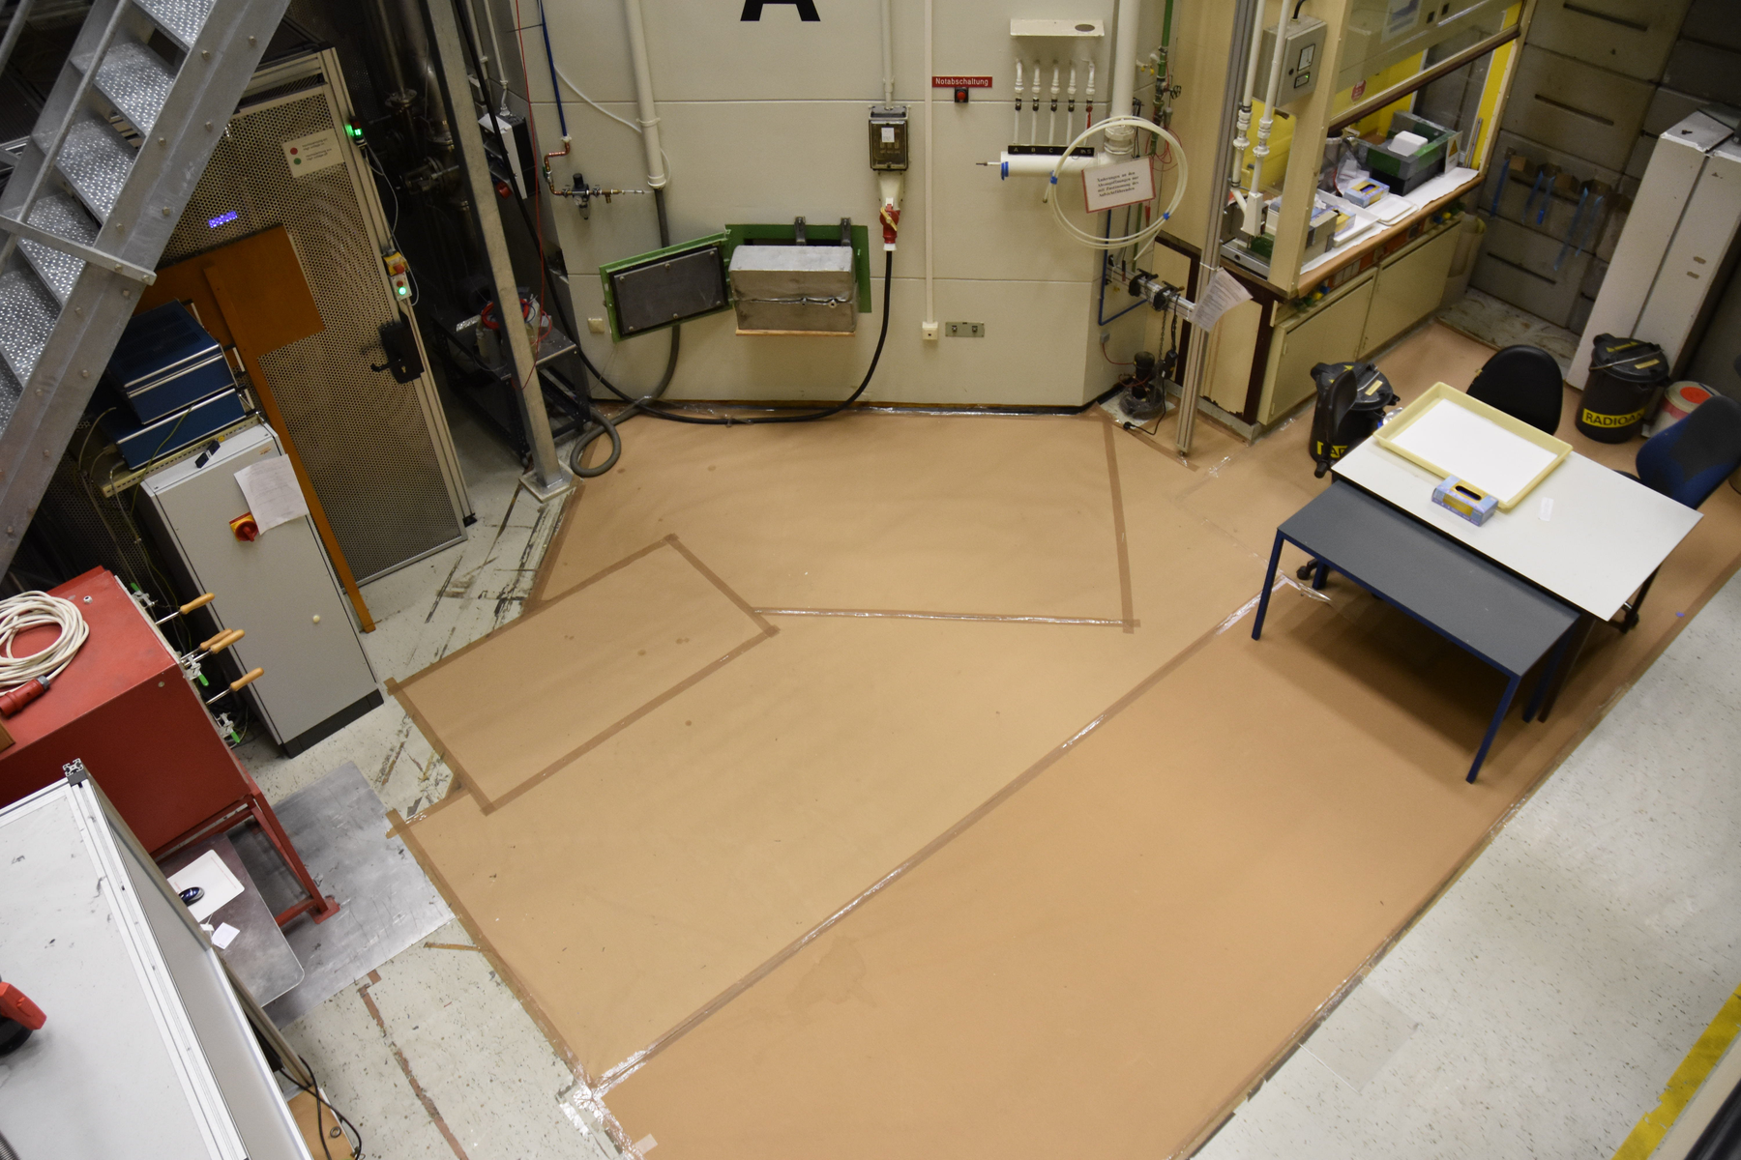
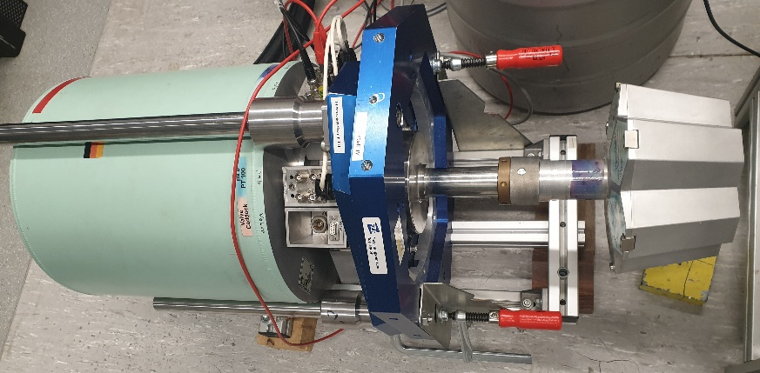
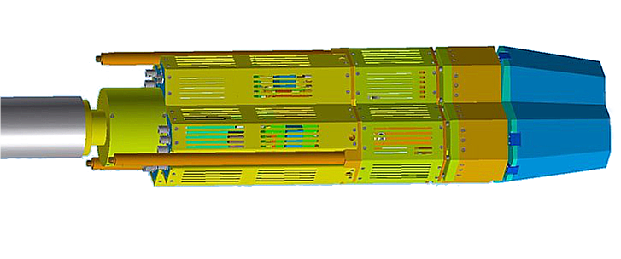
HPGe irradiation test
?
11
Notes:
Which cluster?
Placement of cluster?
Neutron rate?
Slow neutron / gamma shielding between core and cluster?
Radiation Shielding?

