Slide 1
HPGe irradiation test and hyperatom experiment
Marcell Steinen
Helmholtz-Institut Mainz
Panda Meeting 19-2, GSI, 6-25-19

Slide 2
Outline
HPGe Irradiation test at COSY
Feasibility studies of the hyperatom experiment

Slide 3
HPGe Irradiation test at COSY
HPGe Irradiation test at COSY

Slide 4
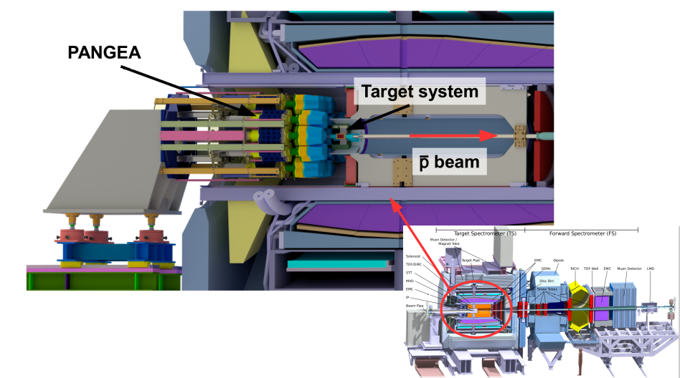
PANGEA in PANDA
HPGe crystals susceptible to neutron irradiation
PANDA (180 days): n fluence ≈10¹⁰ n/cm²

Slide 5
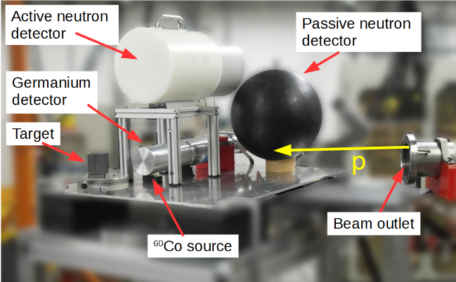
HPGe irradiation test
Irradiation test at COSY with single crystal prototype
5.5 days COSY → 96 days PANDA

Slide 6
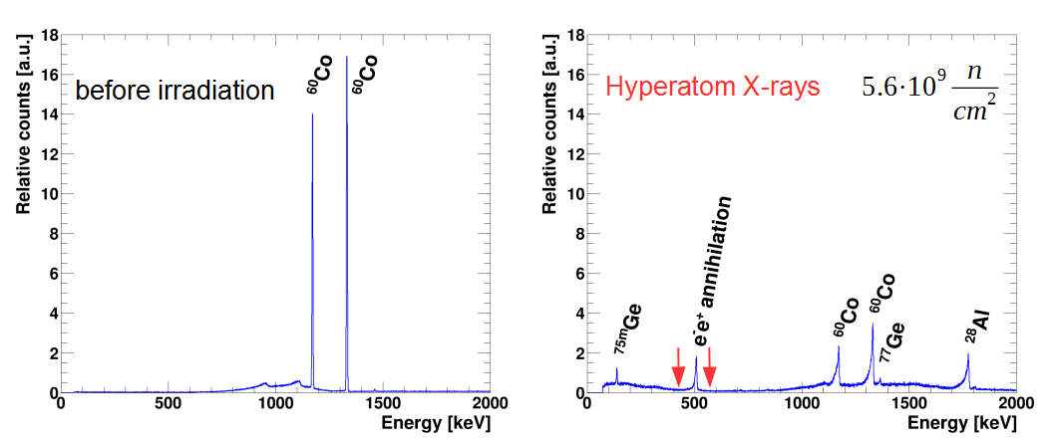
Influence on spectrum of ⁶⁰Co
Additional lines; enhanced compare to PANDA
Line shape changes: Low energy tails, worse resolution
Pulse shape analysis (PSA) allows partial recovery

Slide 7
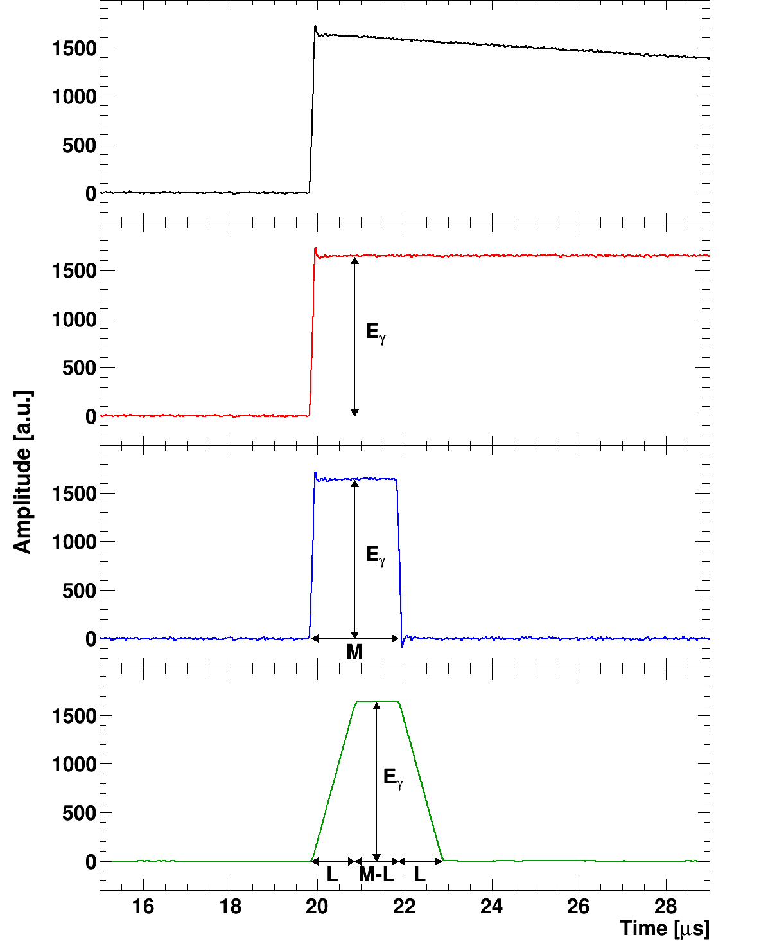
PSA: Moving window analysis
Digital pulse processing via moving window deconvolution
Deconvolution
Numerical differentiation
Moving average (low pass)
Increased rate capabilities → Pile-up handling
M. Lauer, http://doi.org/10.11588/heidok.00004991

Slide 8
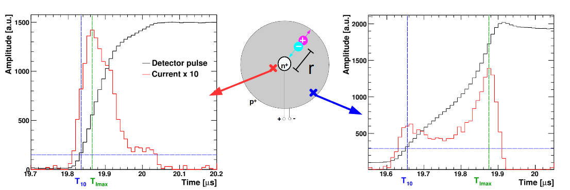
Radiation damage correction
Low energy tails cause by trapped holes
Trapping prob. depends on path length of holes
Analysis of rising edge of detector signal → Radial interaction point

Slide 9
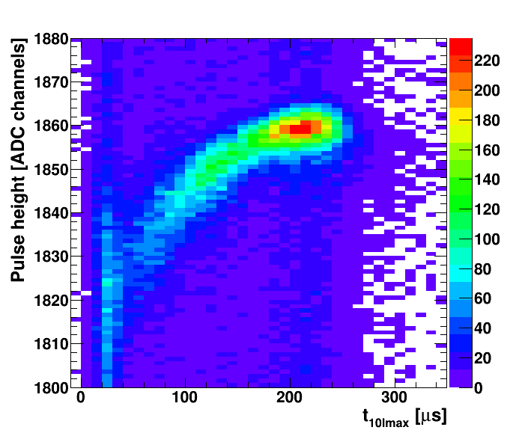
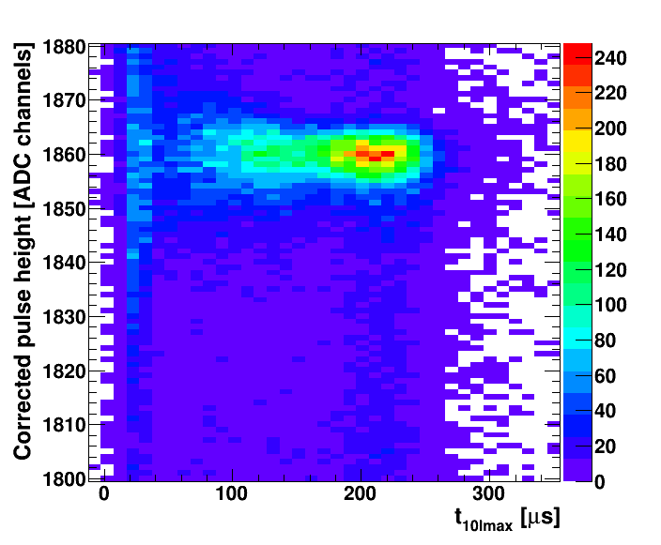
Effect of Corrections
No correction After correction

Slide 10
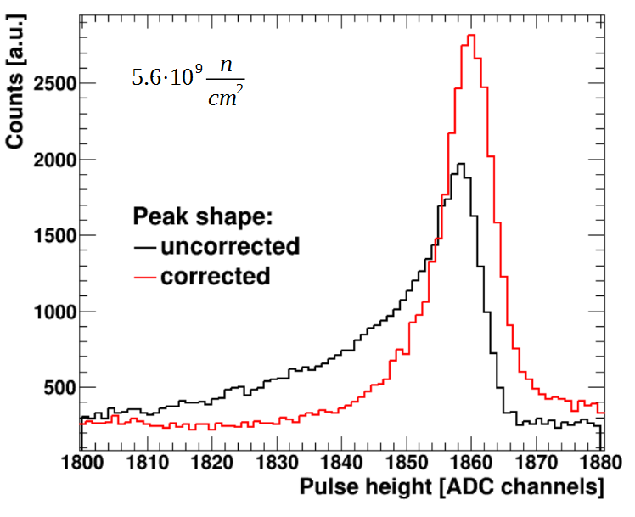
Gaussian shape recovery

Slide 11
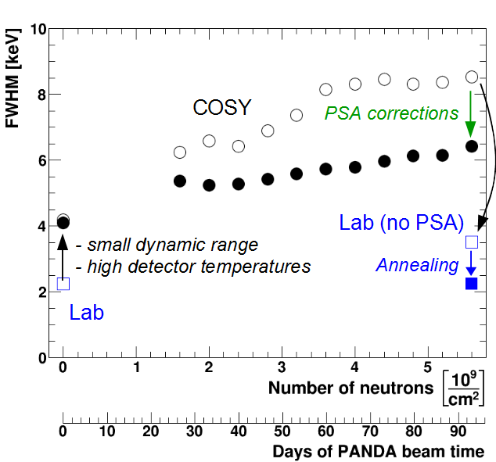
Results
DAQ and therm. issues decrease performance
PSA allows partial resolution recovery
Annealing recovers initial crystal performance → Detector withstands irradiation
New systematic test: TRIGA reactor (2019/20)

Slide 12
Feas. studies: hyperatom exp.
Feasibility studies of the hyperatom experiment

Slide 13
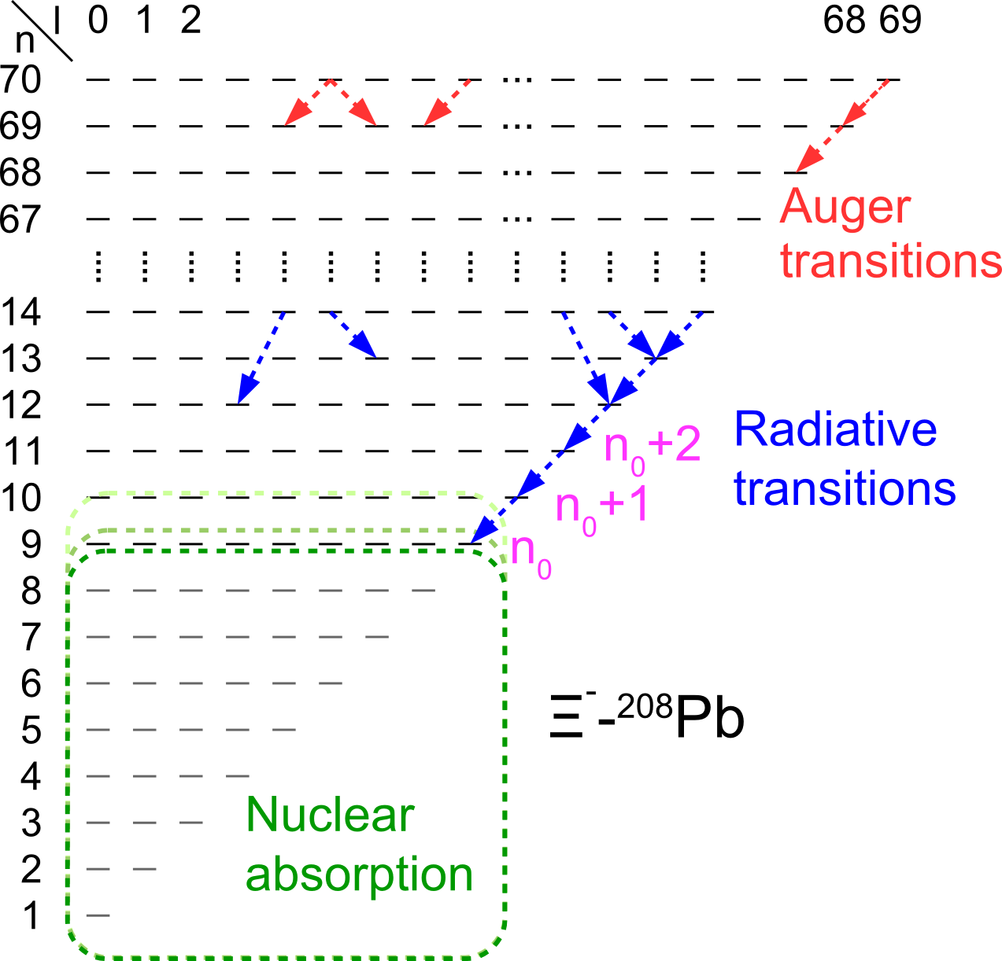
Hyperatoms
Hyperon puzzle in neutron stars
$m_{red,Ξ} ≈2570 m_{red,e}$
High initial (n,l) states
X-ray energy to keV-MeV
→ Germanium detectors
Radius of states: $r∝ \frac{n^{2}}{m_{red}}$
→ Nuclear interaction in neutron rich periphery
→ Measurement of $V_{Ξ}$
Adaptation from T. Aramaki et al Astroparticle
Physics 49 (2013), pp. 52-62

Slide 14
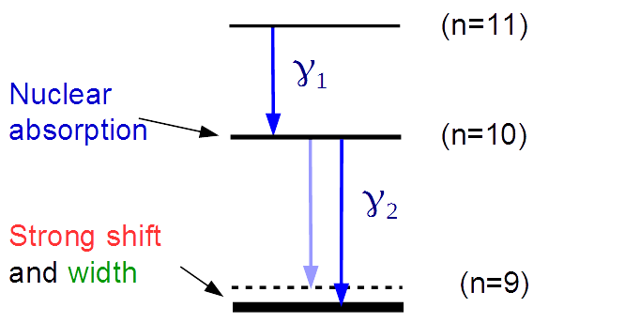
Observables
$Γ_{n_{0}+1 }^{abs}→ Y_{γ_{2}}$
$$ΔE_{n_{0}}^{nuc}$$
$$Γ_{n_{0}}^{abs}$$

Slide 15
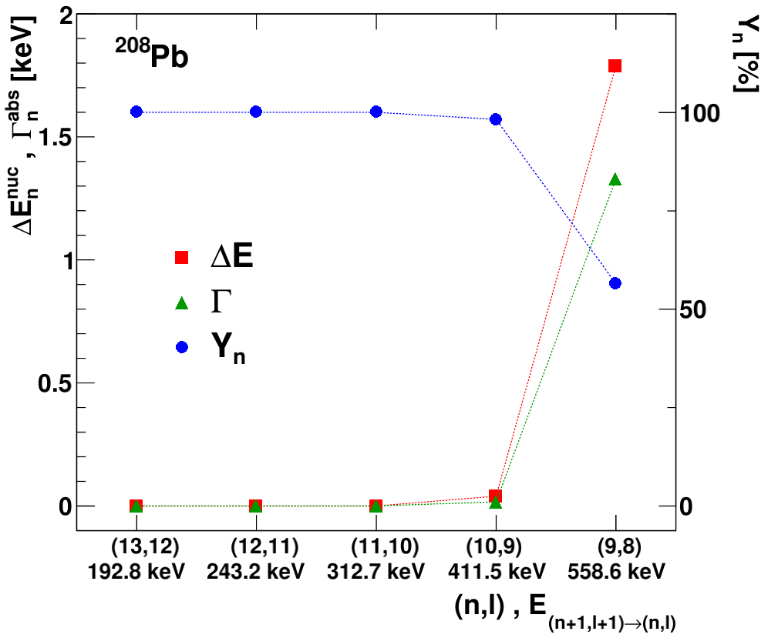
Ξ⁻ - ²⁰⁸Pb observables
(9,8):
1.83 keV
1.33 keV
56.5 %
Calculations based on code by E. Friedman

Slide 16
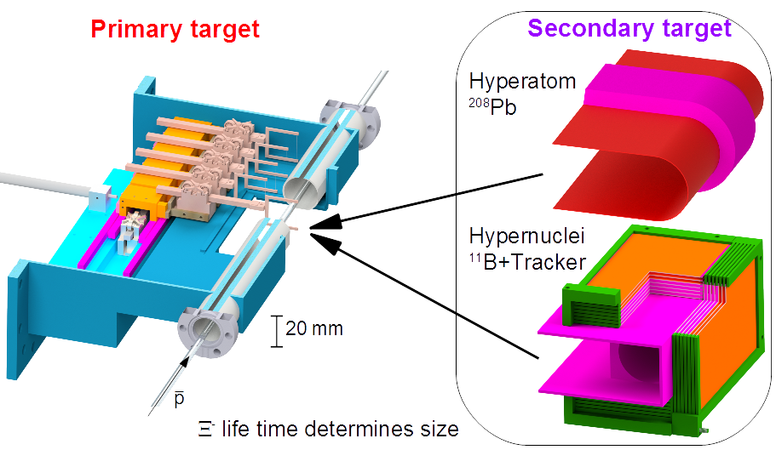
Production: Target system

Slide 17
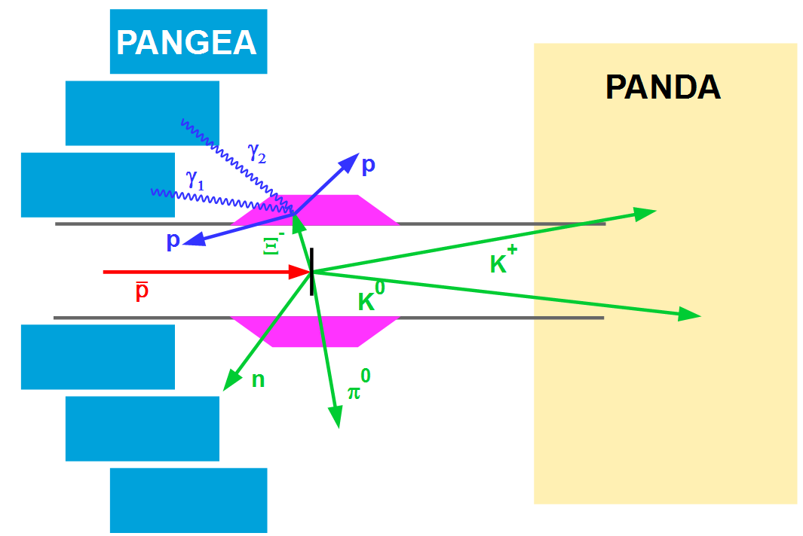
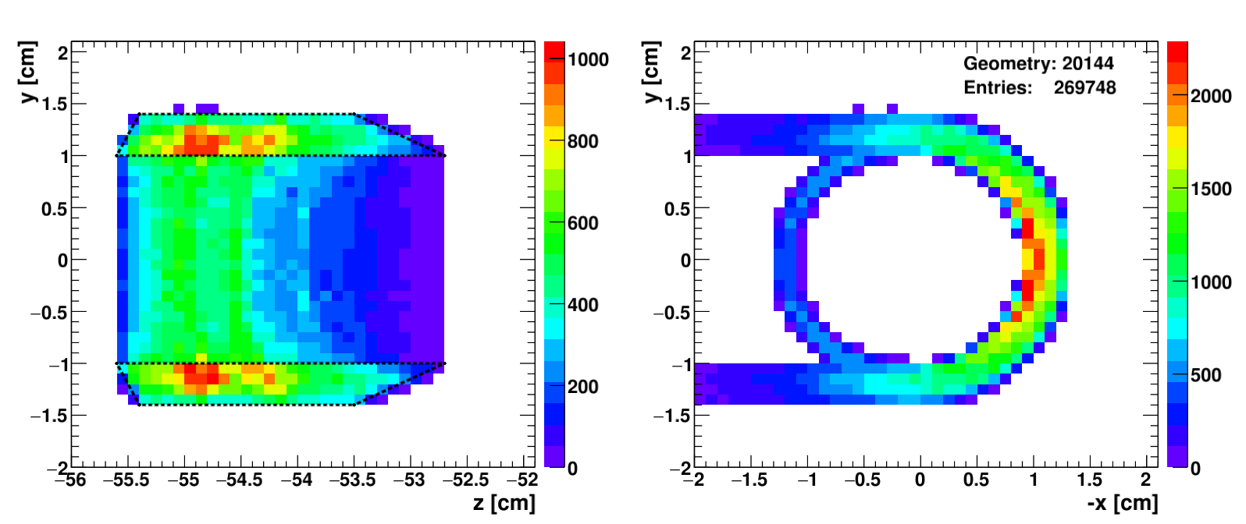
Secondary target
Split target system unique
-> heavy targets possible
Optimization
Max. Ξ⁻ stopping
Min. X-ray absorption
Based on events generated in GiBUU

Slide 18
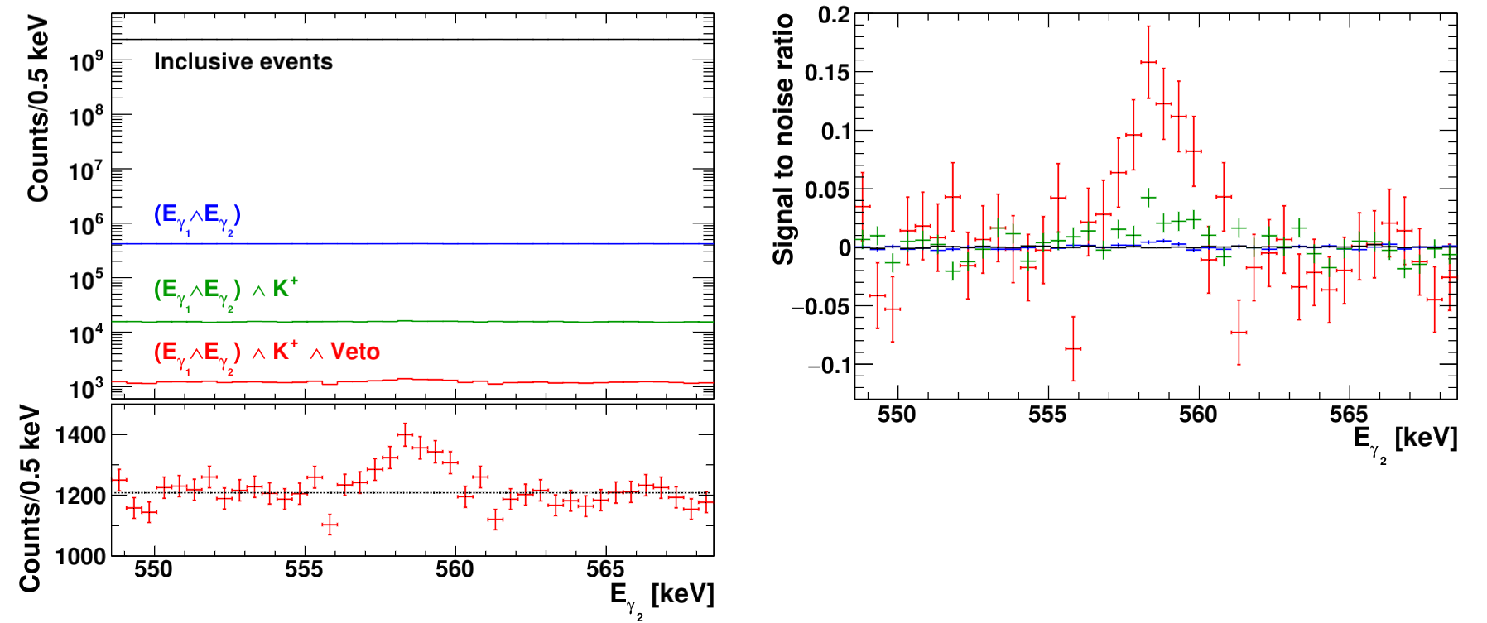
Event selection
Signals after cuts (180 days): 1237
Signal efficiency: 0.9 %
Background suppression : 2∙10⁶

Slide 19
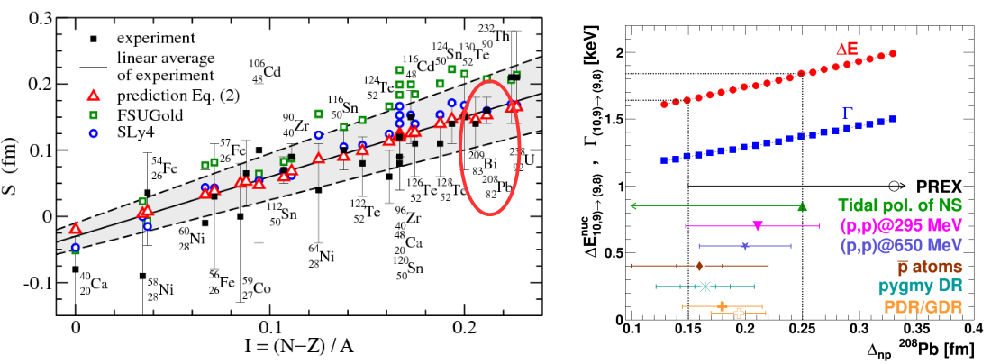
Systematics
Dominated by uncertainty of nuclear shape
High precision calibration via ¹⁵²Eu
Centelles et al., Phys.Rev.Lett. 102 (2009) 122502

Slide 20
Predictions
$$δ(Re{\left(V_{Ξ}\right)}_{stat}≈δ(Im{\left(V_{Ξ}\right)}_{stat}≈1 MeV$$

Slide 21
Experimental Landscape

Slide 22
Summary
Promising irradiation test at COSY
PSA allows partial recovery of radiation damage
Improvements at TRIGA in 2019/2020
²⁰⁸Pb hyperatoms allow to study Ξ⁻ optical potential in neutron rich matter
Heavy hyperatoms unique at PANDA
Higher rates than experiments at J-PARC
$δ(Re{\left(V_{Ξ}\right)}_{stat}≈δ(Im{\left(V_{Ξ}\right)}_{stat}≈1 MeV$
Further improvement possible by more sophisticated cuts
Thanks for your attention

Slide 23
Backup Slides

Slide 24
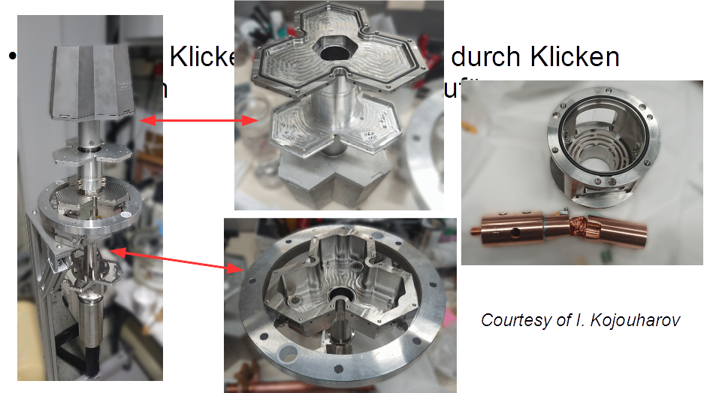

Slide 25
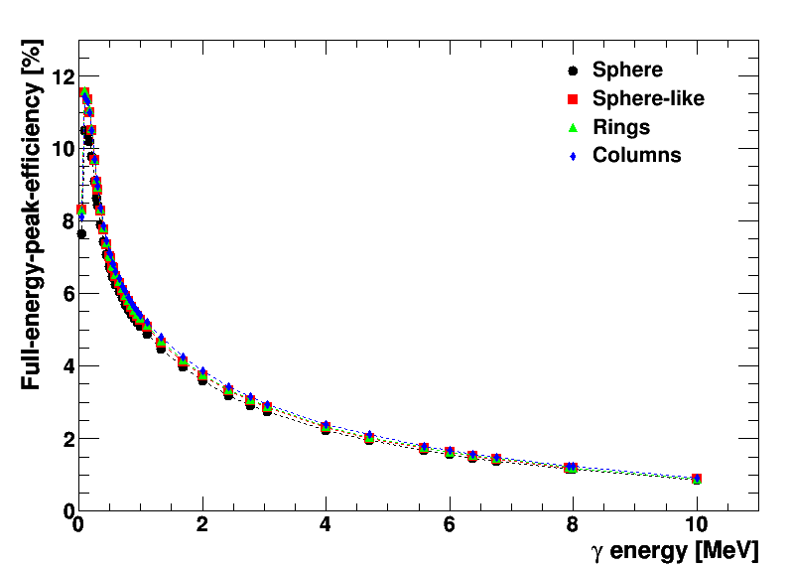
FEP-efficiency PANGEA

Slide 26
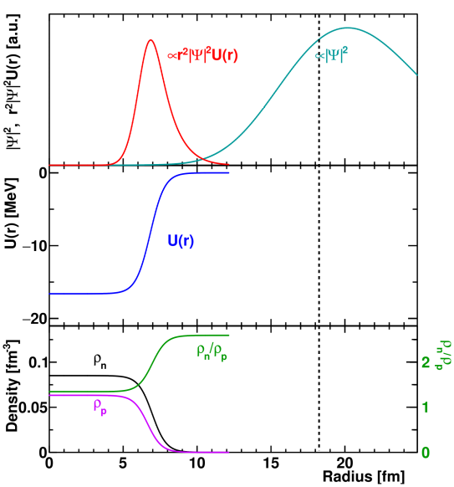
Ξ⁻ - ²⁰⁸Pb

Slide 27
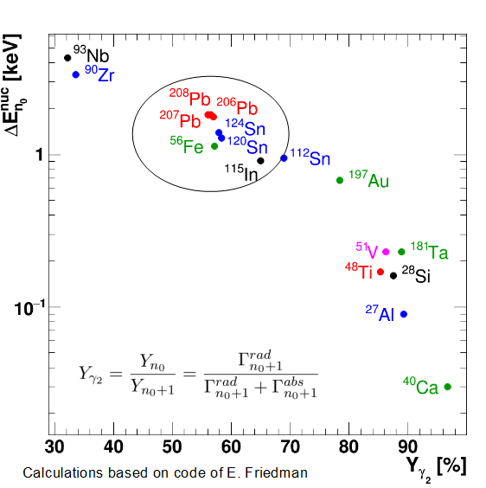
Absorber materials - observables

