Slide 1
SEU test of 110 nm CMOS UMC technology
Daniela Calvo, Paolo De Remigis,
Maria Fisichella, Richard Wheadon
INFN-Torino
and
Serena Mattiazzo
INFN-Padova and Dip. Fisica Universita’ Padova
Enrico Verrroi
INFN-TIFPA
Francesco Tommasino
INFN-TIFPA and Dip. Fisica Universita’ Trento
Andre’ Zambanini
ZEA 2- Electronics Systems, FZJuelich

Slide 2
Study of Single Event Upset in the registers of PASTA
Technology 110 nm CMOS UMC
Global configuration (GC) register with 172 bit
Global test configuration (GTC) register with 14 bit
Channel configuration registers (CC00 ÷ CC63) with 2688 bits,
42 bits each channel (64 channels)
Channel test configuration (CTC) with 64 bits (1 bit/channel)
TMR (Triple Modular Redundancy) technique for fields just 1 bit long
Hamming encoding for fields longer than 1 bit

Slide 3
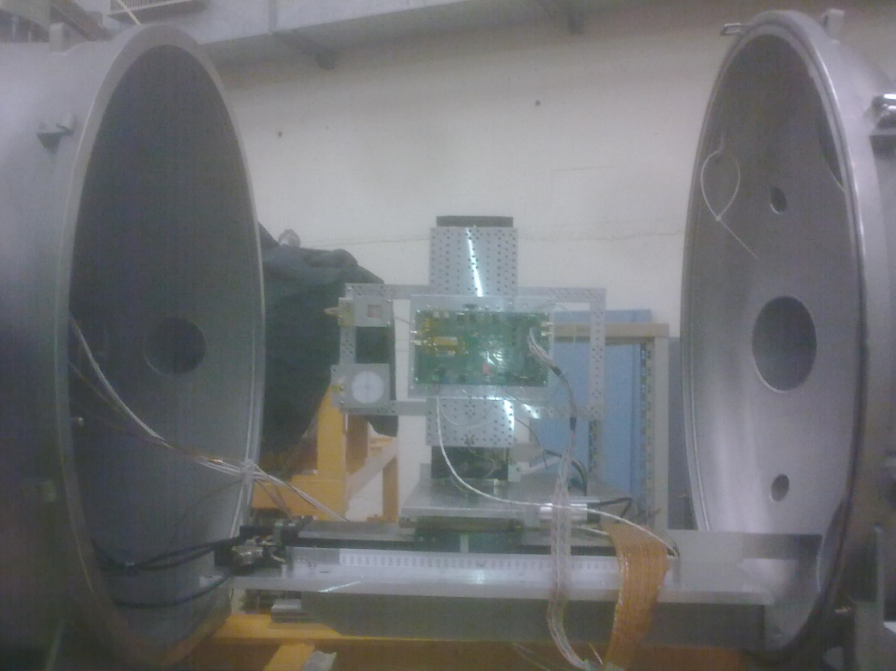
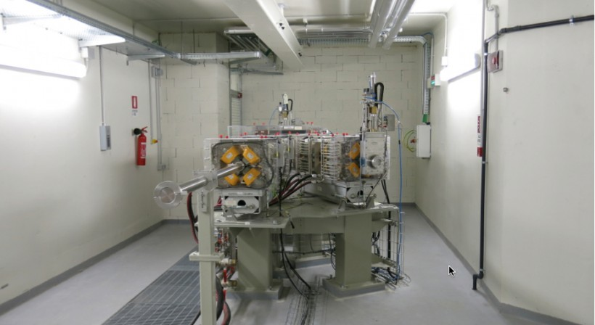
Study with ion and proton beams
Ion beams at SIRAD facility (INFN-LNL)
Proton beam at the experimental room of INFN-TIFPA,
in the Proton-Therapy Centre (Trento, Italy)
SIRAD
Proton-therapy Centre Research Room

Slide 4
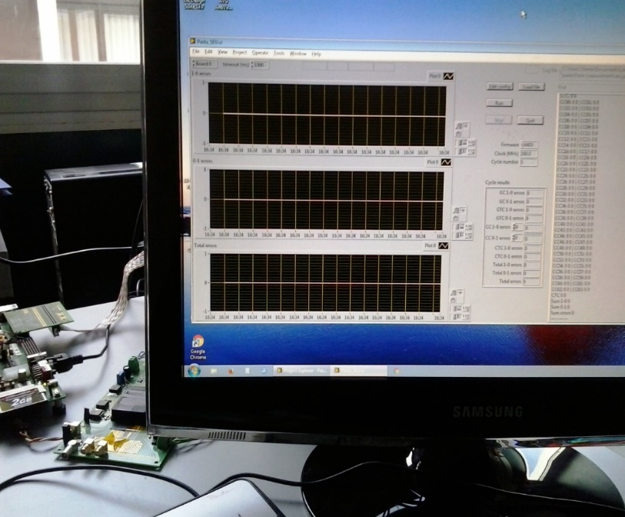
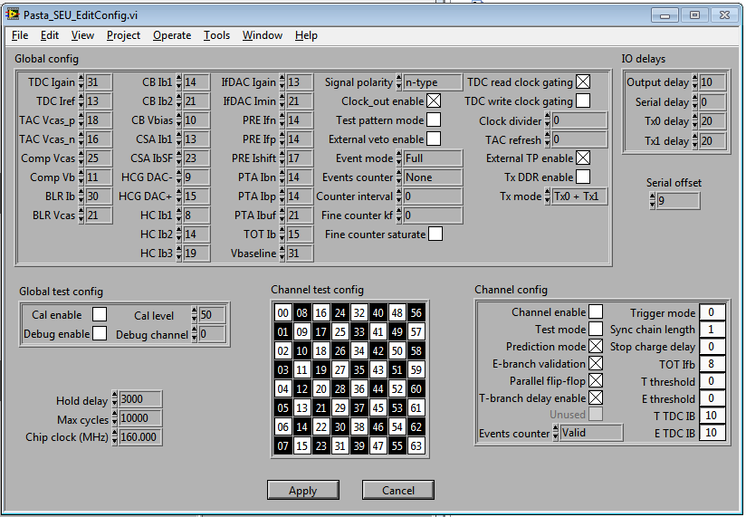
SEU test setup
Xilinx board with VIRTEX6
DAQ based on LABView
Online plots are available:
1→ 0 bit value counts vs time
0→ 1 bit value counts vs time
Bit change information channel by channel and for GC, GTC and CTC are listed
d.u.t .
ASIC configuration interface

Slide 5
Procedure
Balanced sequences of 1 and 0 are used to evaluate different behavior of the circuits, in the registers configuration phase
The procedure to detect SEU effects is the following:
A writing command to configure the ASIC is followed by a reading command until a SEU occurs
The SEU (bit error) is detected and registered
The sequence starts again from the writing command
The acquisition program counts the number of time when a bit changes its value (1 → 0, 0 → 1) and write it in the output file

Slide 6
Test @ SIRAD
Ion | E [MeV] | LET [MeV· cm² /mg]
C | 87.66 | 2.59
O | 95.40 | 4.62
Si | 141.61 | 11.34
Cl | 162.66 | 14.94
Ni | 190.81 | 25.14
Br | 218.91 | 31.23
Ag | 247.04 | 38.72

Slide 7
Results for the channel configuration registers
Cross section of SEU
for the channel configuration registers
(2688 bit)
1 → 0 bit upset number
is about 2-3 times the 0 → 1 bit upset number
Measurement for the channel configuration registers

Slide 8
Comparison to the ToPix family

Slide 9
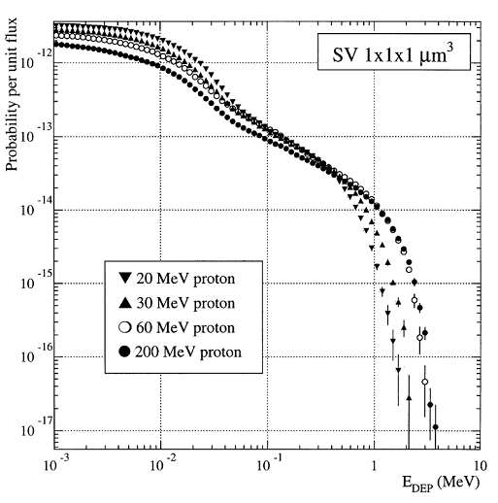
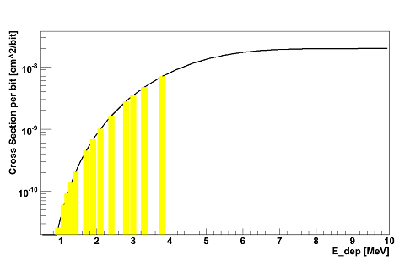
Cross section Σ in the PANDA environment I
The SEU cross section Σ in the hadron environment is evaluated on the basis of:
M. Huhtinen and F. Faccio
Computational method to estimate the Single Event Upset rates
in an accelerator environment, NIM A 450 (2000), 155-172
Weibull fit convolution
Energy deposition probabilities.
Sensitive volume: 1x1x1 μm³

Slide 10
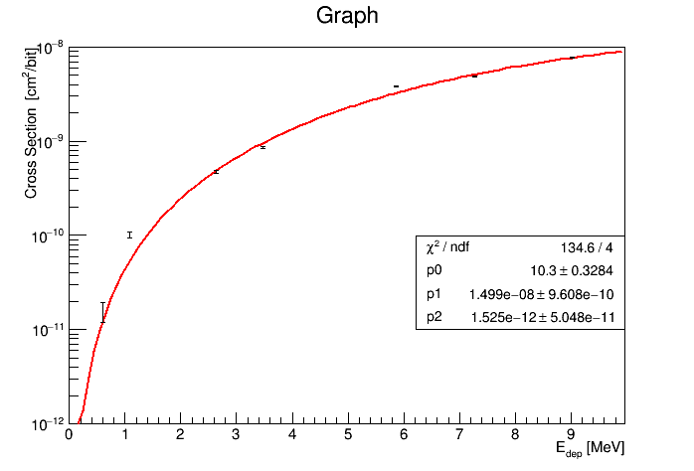
Cross section Σ in the PANDA environment II
FIT of 7 experimental points
Σ: 3.6 ∙ 10⁻¹⁶ cm² /bit

Slide 11
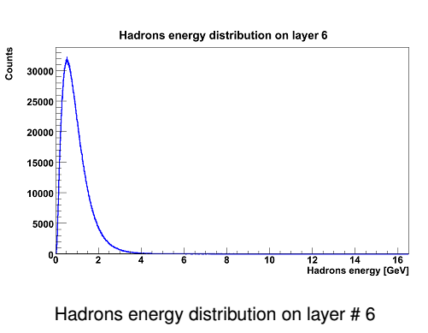
Hadron flux in PANDA
All hadrons can be assimilated to protons featuring about 100-200 MeV ,
the energy deposition probability is almost independent from the particle energy
First pixel disk
Maximum hadron flux
(antiproton-proton annihilations @ 15 GeV/c):
5 ∙ 10⁶ hit /(s ∙ cm² )

Slide 12
Estimation of SEU for PASTA registers
The hadron flux in the first pixel disk is the worse case for the strip readout
Upper limit for the SEU number
for the 64 channel configuration registers
(42 bit each)
< 1.8 ∙ 10⁻⁹ SEU /(s ∙ bit)

Slide 13
TEST with proton beam I
Advantages
Setup in front of the beam exit, with short cable between the ASIC and the DAQ, that allows to work at the nominal clock signal value (160 MHz). Tests at 50 MHz clock signal value were done to compare results to the LNL test
Several proton energies are available in the range 70 ÷ 228 MeV
Beam extraction current can be in the range 1 ÷ 300 nA
Beam Gaussian profile

Slide 14
TEST with proton beam II
Disadvantages
The higher the intensity of the beam, the shorter the run must be and the longer the waiting time between two consecutive runs
Some hours/day only for research activities
Cost

Slide 15
Proton beam features
Proton beam energy of 131.3 MeV (nominal value)
Expected flux @ 1 nA beam current of about 2.7 · 10⁷ p/s
Gaussian profile of the beam spot
Two counters (based on ionization chambers) measure the proton fluxes at the several beam current set during tests.
I [nA]
1
10
100
200
300

Slide 16
Results for the configuration registers
Performed tests at two different clock frequency
Clock frequency [MHz] | Beam current [nA]
 | 1 | 10 | 100 | 200 | 300
50 | Yes | Yes | - | Yes | Yes
160 | - | - | Yes | Yes | -
Any Upset was detected at 50 MHz with 1, 10, 200 nA beam currents
for the channel configuration registers
Upsets were detected at 50 MHz with 300 nA beam current

Slide 17
Results with all the configuration registers I
TMR is more tolerant than Hamming Encoding
The number of SEU increases with the beam intensity
Proton flux on the chip (10% of error):
100 nA → 2.8 ∙ 10⁸ p/s
200 nA → 5.5 ∙ 10⁸ p/s
300 nA → 7.8 ∙ 10⁸ p/s
Clock @ 50 MHz
TMR is more tolerant than Hamming Encoding (HE)
The number of all the upsets is stable, (within the error-absolute) in the range of tested beam intensity
TMR decreases (HE increases) its tolerance as the beam intensity increases
Upsets increase with the clock value
Clock @ 160 MHz

Slide 18
Results with all the configuration registers II
Number of flips 1 → 0 is higher than 0 → 1 event
They increase as the beam intensity increases
Proton flux on the chip (10% of error):
100 nA → 2.8 ∙ 10⁸ p/s
200 nA → 5.5 ∙ 10⁸ p/s
300 nA → 7.8 ∙ 10⁸ p/s
Clock @ 50 MHz
Number of flips 1 → 0 is higher than 0 → 1 event
Flips 1 → 0 decreases as the beam intensity increases, vice-versa for 0 → 1 events
The difference decreases as the beam intensity increases
Clock @ 160 MHz

Slide 19
Results with the channel configuration registers I
TMR is more tolerant than Hamming Encoding
The number of SEU increases with the beam intensity
Proton flux on the chip (10% of error):
100 nA → 2.8 ∙ 10⁸ p/s
200 nA → 5.5 ∙ 10⁸ p/s
300 nA → 7.8 ∙ 10⁸ p/s
Clock @ 50 MHz
TMR is more tolerant than Hamming Encoding (HE)
The number of all the upsets decreases, in the range of tested beam intensity
TMR decreases (HE increases) its tolerance as the beam intensity increases
Upsets increase with the clock value
Clock @ 160 MHz

Slide 20
Results with the channel configuration registers II
Number of flips 1 → 0 is higher than 0 → 1 event
They increase as the beam intensity increases
Proton flux on the chip (10% of error):
100 nA → 2.8 ∙ 10⁸ p/s
200 nA → 5.5 ∙ 10⁸ p/s
300 nA → 7.8 ∙ 10⁸ p/s
Clock @ 50 MHz
Number of flips 1 → 0 is higher than 0 → 1 event
Flips 1 → 0 decreases as the beam intensity increases, vice-versa for 0 → 1 events
The difference decreases as the beam intensity increases
Clock @ 160 MHz

Slide 21
Comparison (channel configuration) and conclusion
From proton test:
@ 7.8 ∙ 10⁸ p/s → 2.19 ∙ 10⁻⁶ SEU/(s∙bit)
From ion test:
Σ∙hadron flux (=proton flux) → 2.26 ∙ 10⁻⁶ SEU/(s∙bit)
The good agreement between the proton test and ions one gives us confidence that the Σ value calculated under certain hypotheses is acceptable.
The number of upsets is here evaluated at a hadron flux ≈ 3 orders of magnitude higher that in PANDA, first pixel disk.
The results correspond to a 50 MHz clock frequency
Upset number (per second and per bit) at 160 MHz clock frequency increases about of one order of magnitude with respect the bit flips evaluated at 50 MHz clock frequency. The measurement was performed at 200 nA beam current (≈ 5.5 ∙ 10⁸ p/s )

