Slide 1
Barrel EMC Assembling
Andrey Ryazantsev
on behalf of the NRC “Kurchatov Institute” – IHEP Protvino group

Slide 2
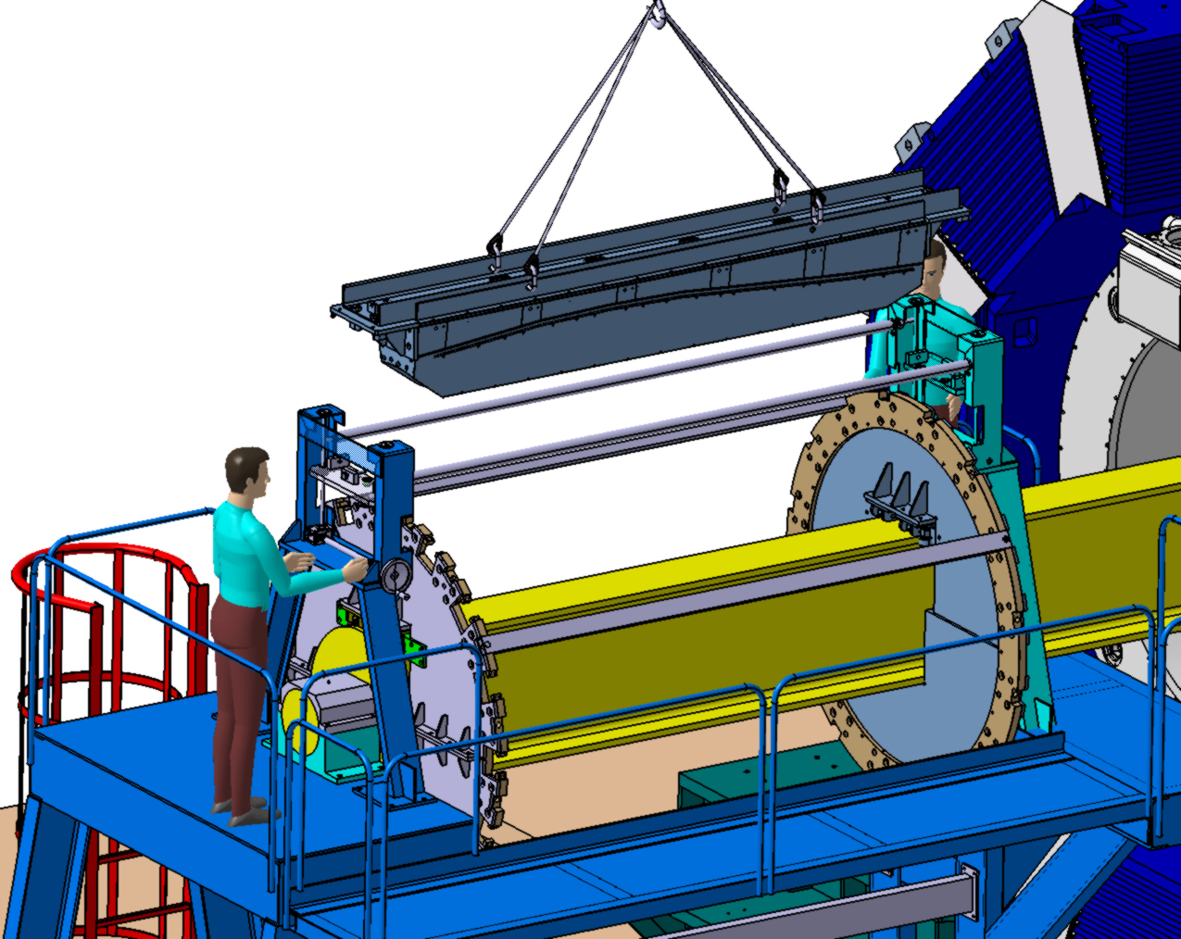
Previous approach (V. Ferapontov)

Slide 3
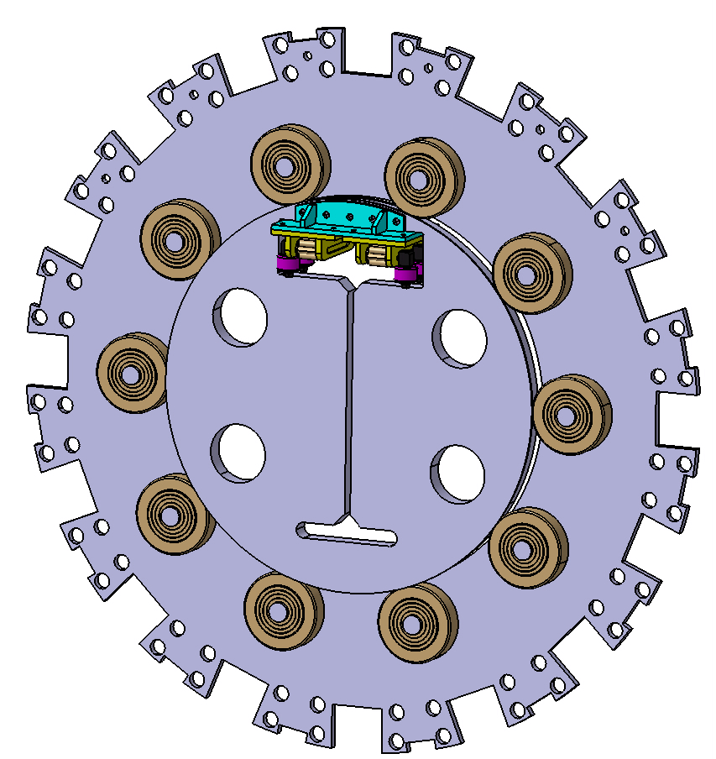
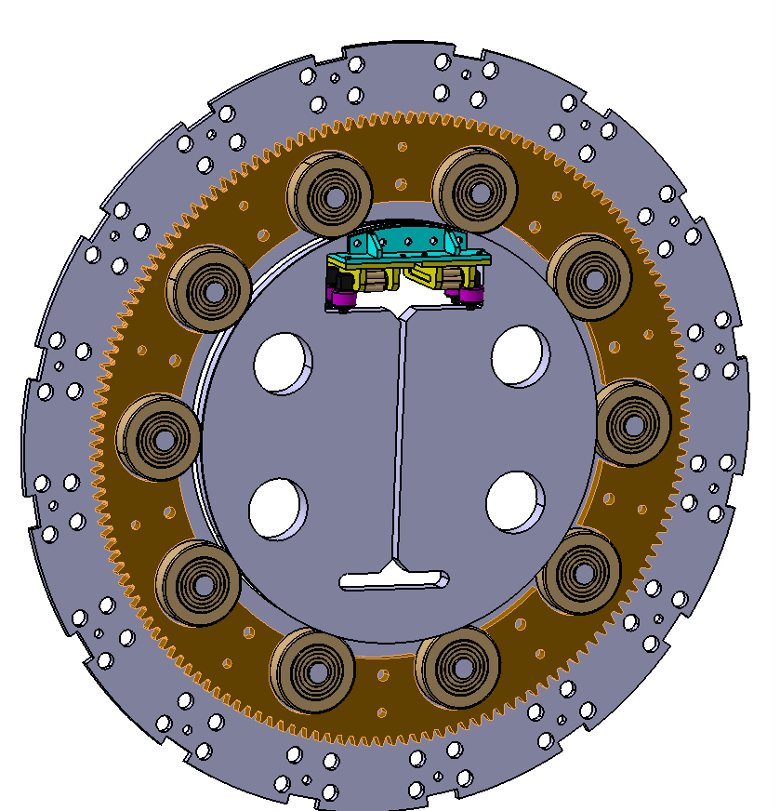
Assembling procedure step-by-step (V. Ferapontov)

Slide 4
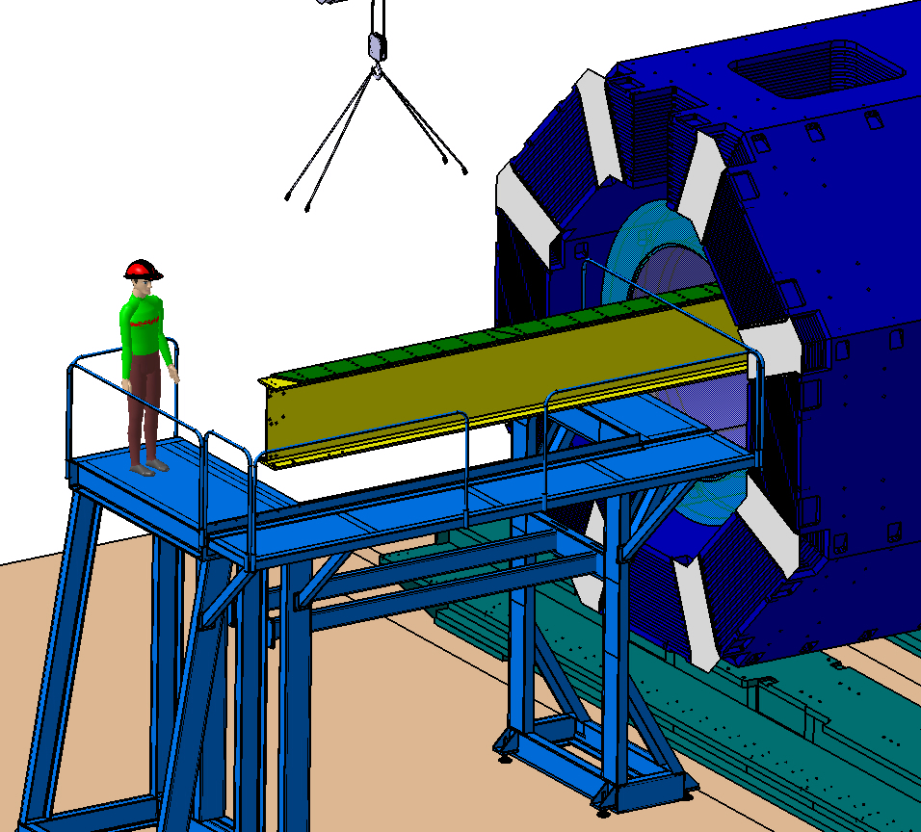
Assembling procedure step-by-step (V. Ferapontov)

Slide 5
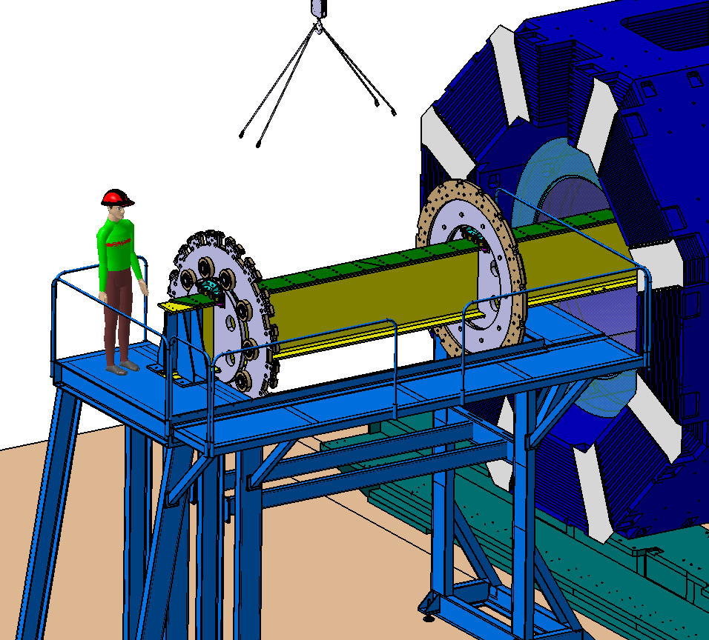
Assembling procedure step-by-step (V. Ferapontov)

Slide 6
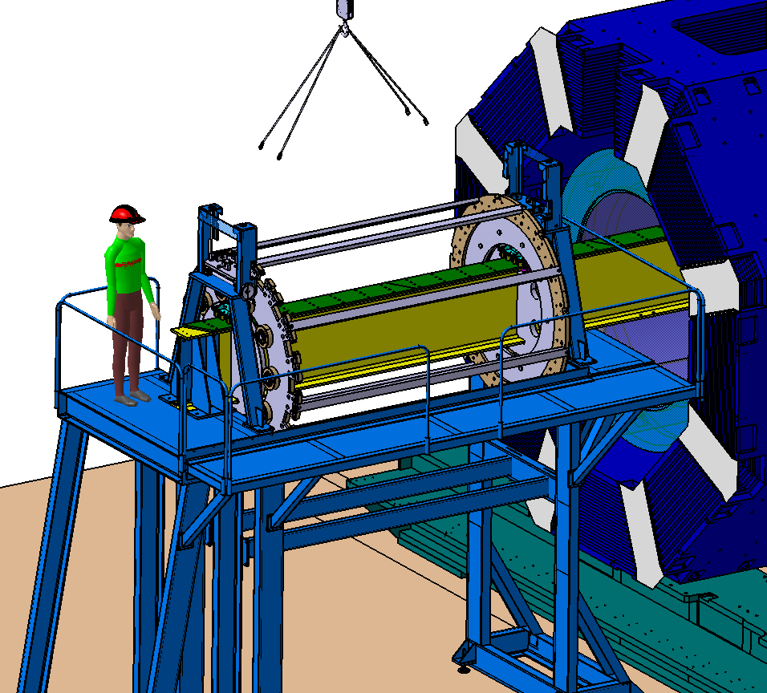
Assembling procedure step-by-step (V. Ferapontov)

Slide 7
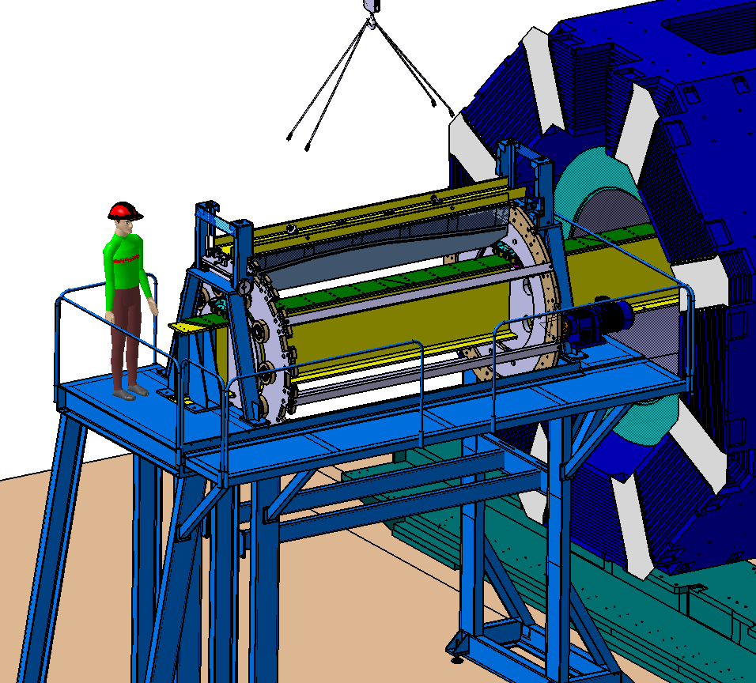
Assembling procedure step-by-step (V. Ferapontov)

Slide 8
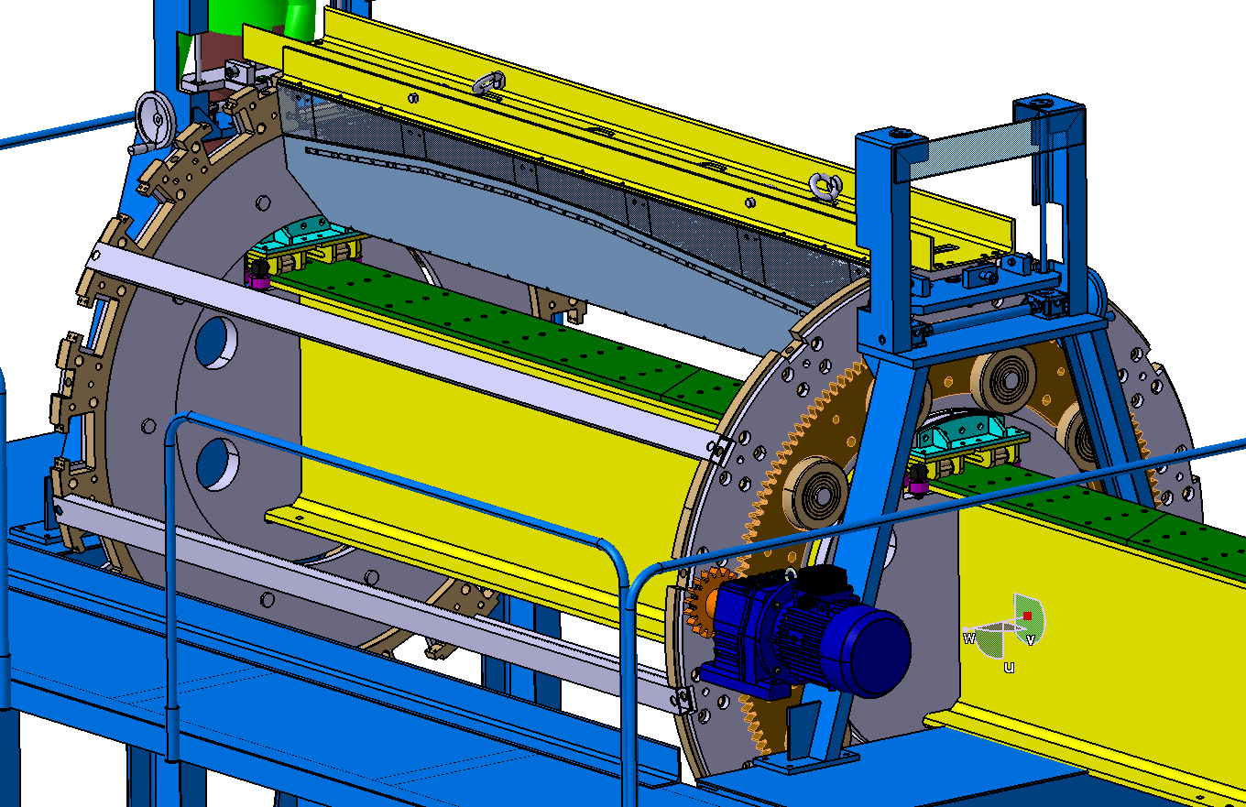
Assembling procedure step-by-step (V. Ferapontov)

Slide 9
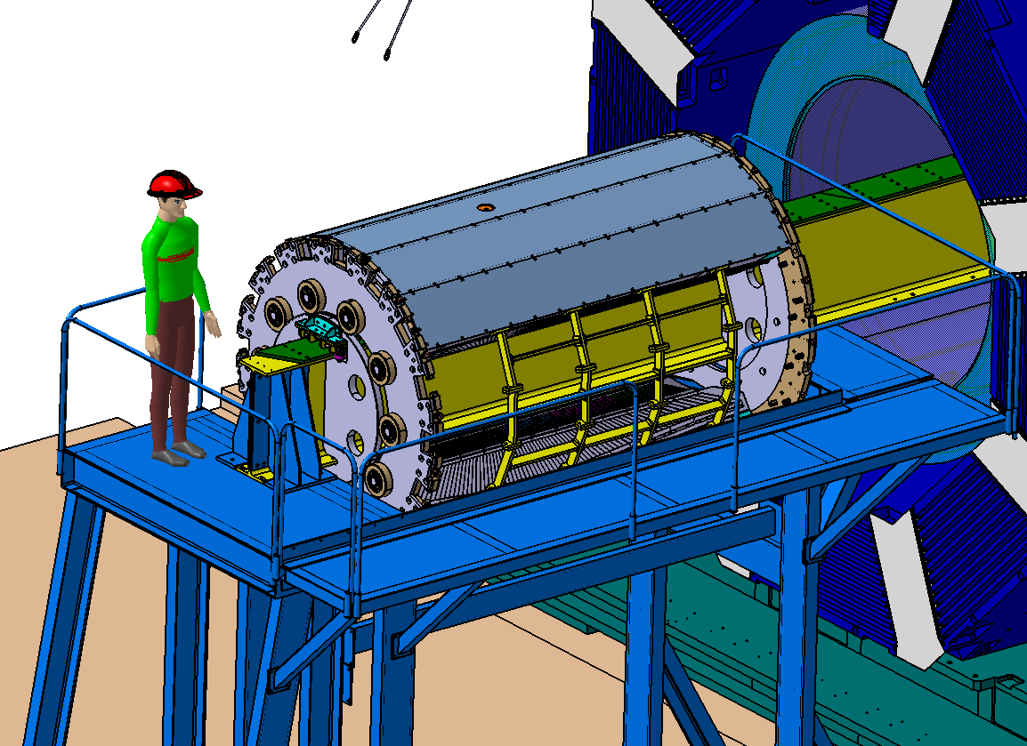
Assembling procedure step-by-step (V. Ferapontov)

Slide 10
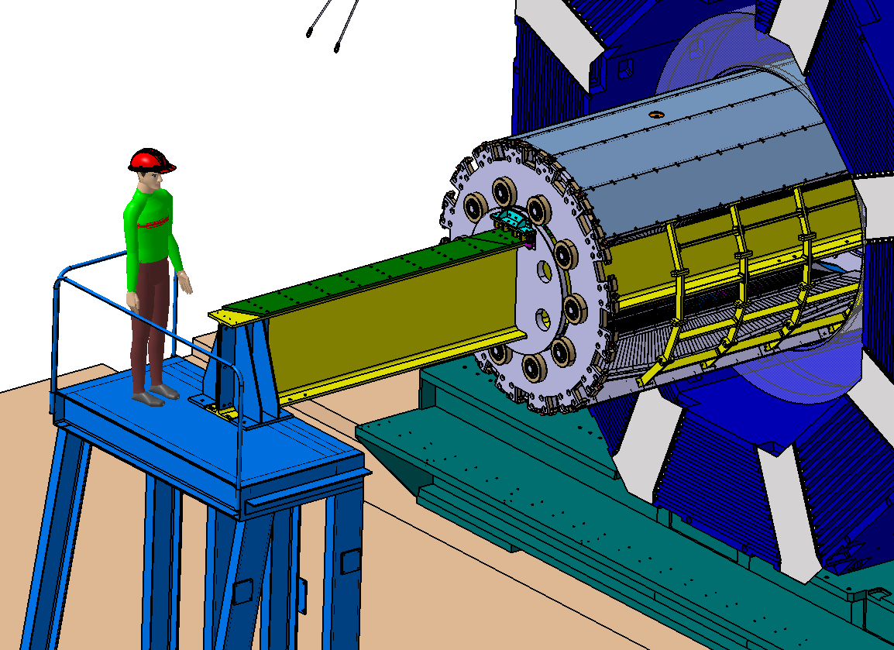
Assembling procedure step-by-step (V. Ferapontov)

Slide 11
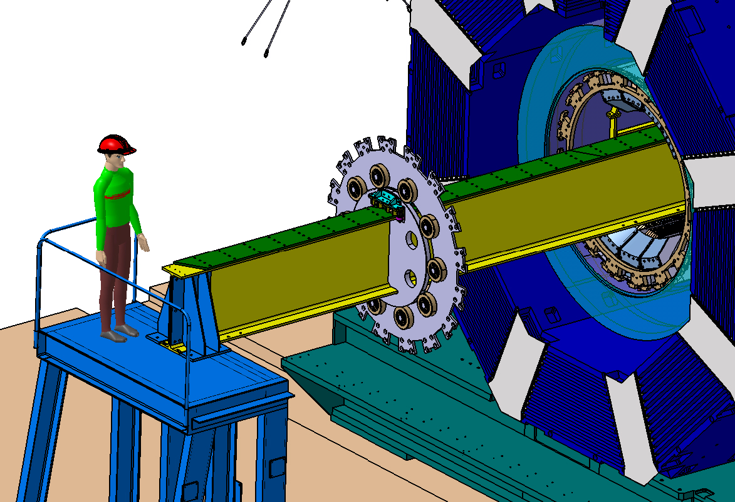
Assembling procedure step-by-step (V. Ferapontov)

Slide 12
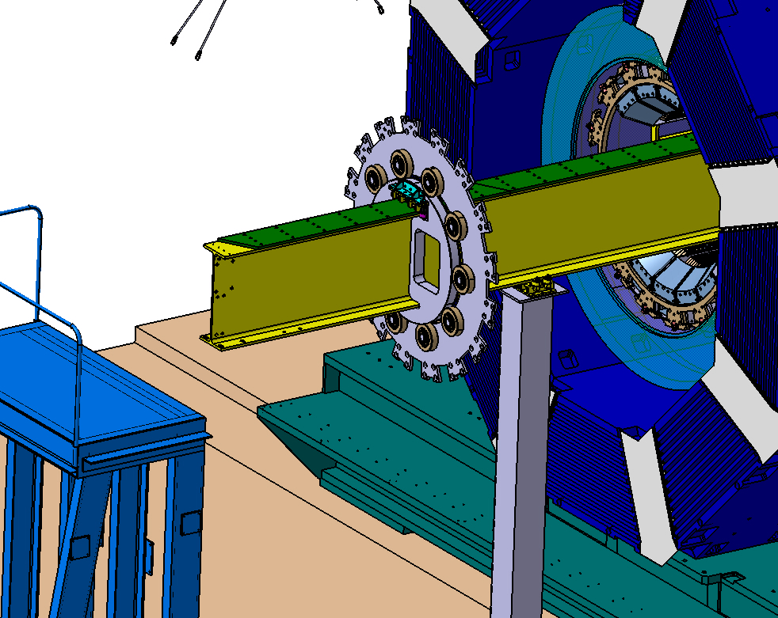
Assembling procedure step-by-step (V. Ferapontov)

Slide 13
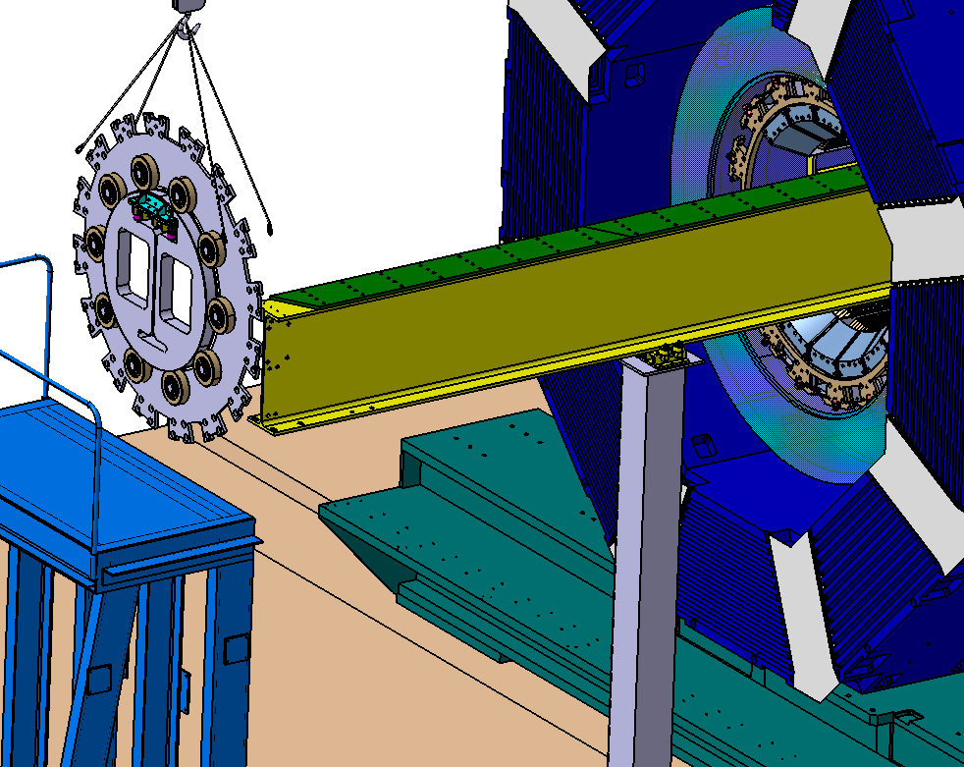
Assembling procedure step-by-step (V. Ferapontov)

Slide 14
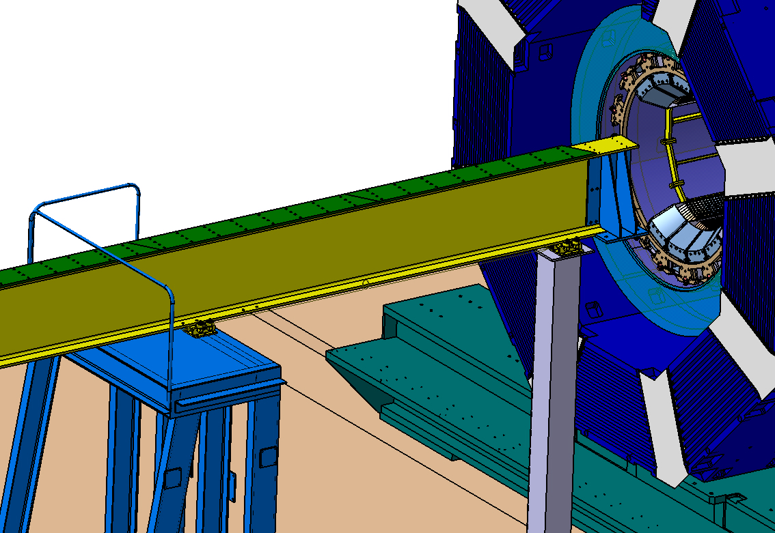
Assembling procedure step-by-step (V. Ferapontov)

