Slide 1
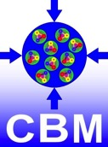
FairDB TGenBase - universal database for FAIR experiments
Evgeny Lavrik,
Facility for Antiproton and Ion Research in Europe, for CBM Collaboration

Slide 2

Introduction
FairDb is a ROOT based library for direct database communication
was used for parameter storage
no user role management, no relations between classes, no query building, slow, only specific logic
TGenBase overcomes these limitations + more
general purpose, templated generation of code
Client-Server architecture, clients, deployments, …
C++/ROOT based FairDb solution turned out to be not very fast
Why not to serve faster?

Slide 3
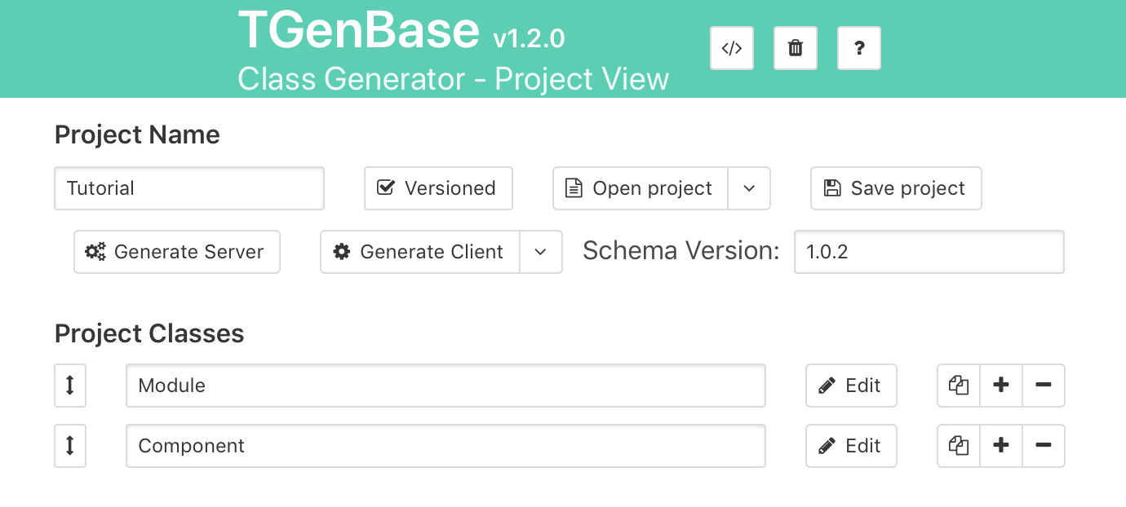
Data description made easy
We provides a web application to describe the data
Provides usual CRUD (create, read, update, delete) logic
And versioned insert-only logic -> no need to update, data will not be overwritten, all history is available
Name and configure your project, add classes to it
Or open sample projects ready to us

Slide 4
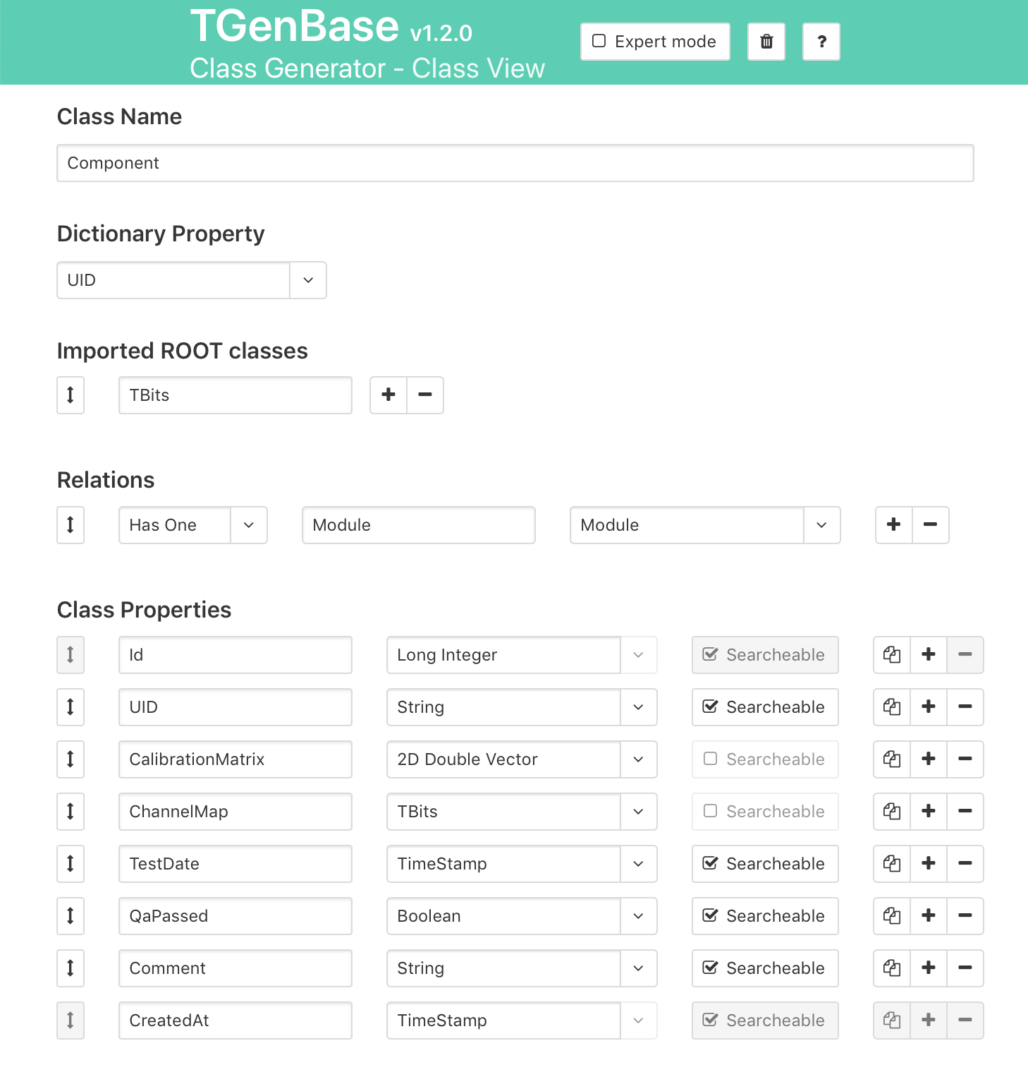
Data description made easy (cont.)
In this workplace one defines the properties of the data, their types, relations with other classes, etc.
Property configurations are predefined, with possibility to customize their behavior, validation rules, etc.
Support for STL containers and ROOT classes

Slide 5
Database server
Is in fact an HTTP server with secure data exchange by SSL
Provides standard RESTful API to access data with JSON message exchange with clients
Provides configurable role-based user permission management
Caches data for frequent access
Exchanges data with underlying DB Management Systems
Blinks with lights, spins itsfans,
sends us stuff

Slide 6
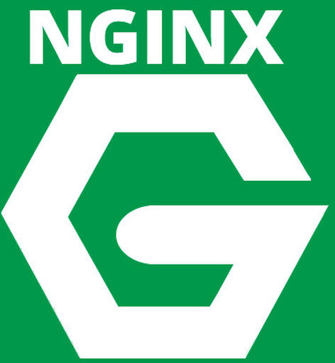
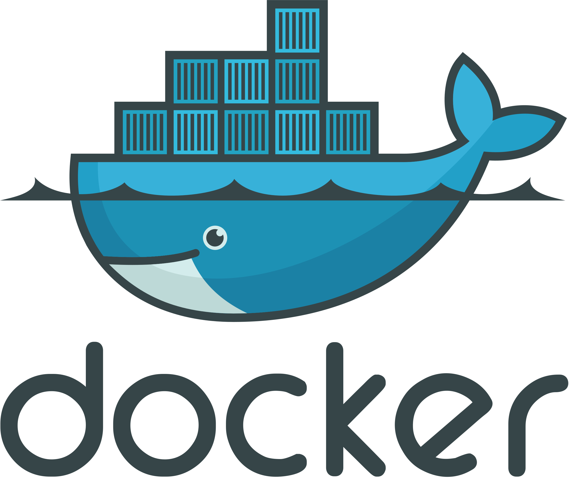
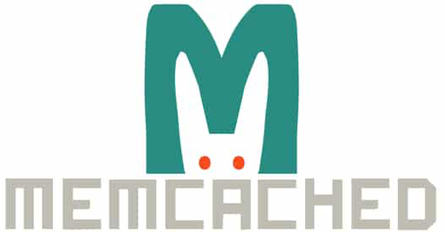
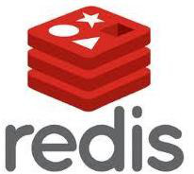
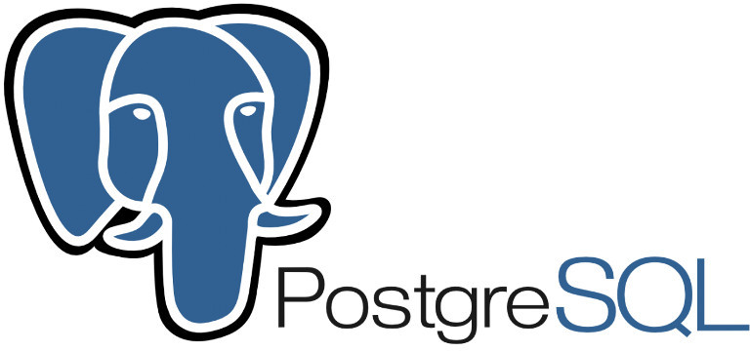
DB server software stack
HTTPS Thin Clients
Server / load balancer
User Management
REST API
+
Fast Caching
Container deployment
or 8 others
to choose
Database Layer

Slide 7
Development/testing Server
Light version of the full software stack
Can be installed on Linux and macOS systems
Has minimal dependencies, which are easily installed with a script provided
Perfect solution for prototyping or small-sized data hosting

Slide 8
"Thin" clients to access data
There are following clients for FairDb
  C++ library
    requires only basic ROOT to be installed
    minimal dependencies
  Web based application - CMS
  Python module for scripting
  LabVIEW library
  Matlab library?
Allow to browse, query and modify data easily

Slide 9
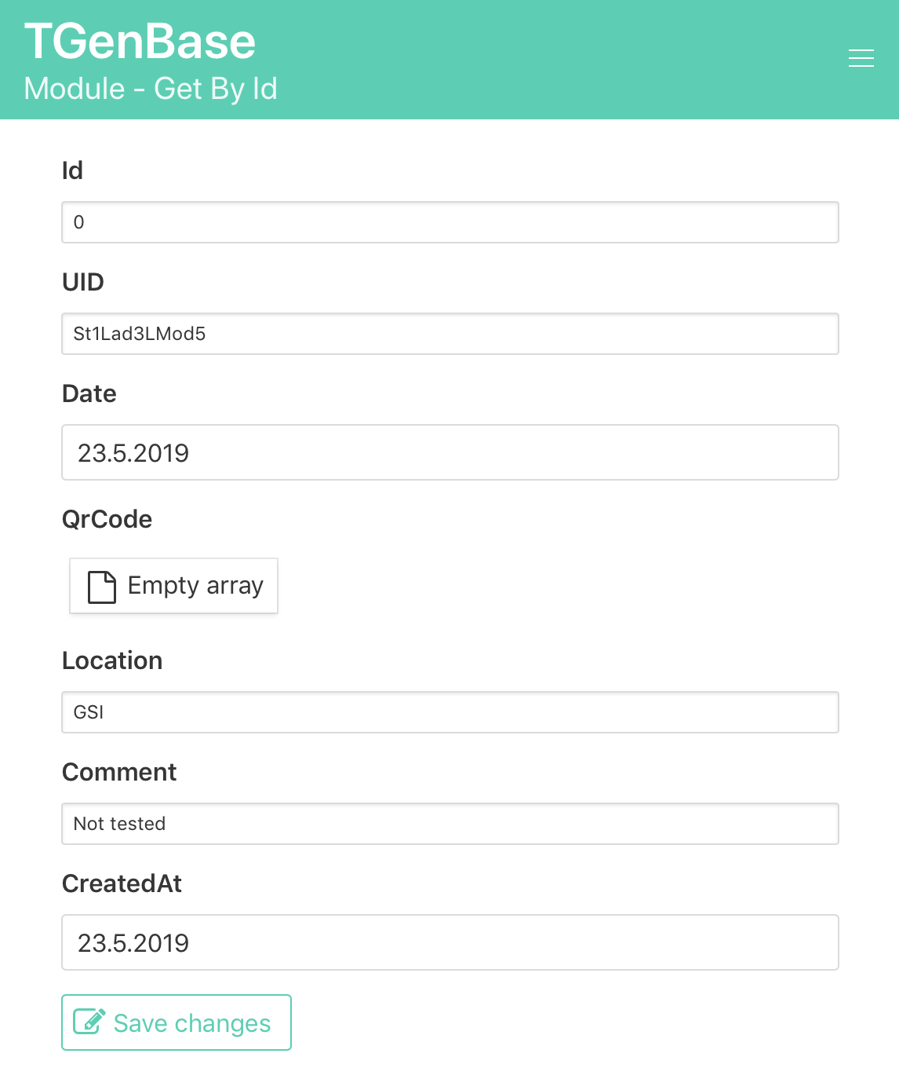
Web Client
You get, out of the box, a content management system ready to be used
Provides the workplaces for data input, querying, editing, etc.
Users can register with their email or use their existing LDAP accounts (GSI-weblogin)
Image: data input/editing interface

Slide 10
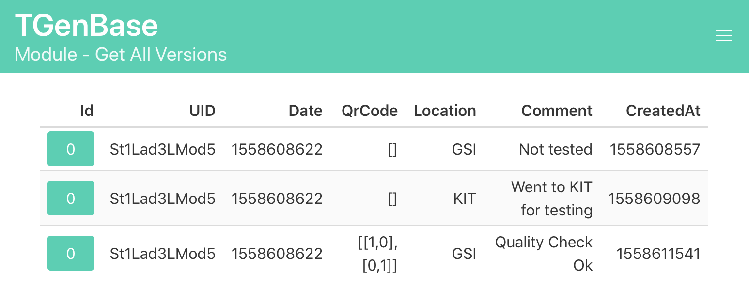
Web Client, cont.
Web client provides the administrator UI to manage users and their access rights
For versioned logic, the history of the entries can be viewed
Image: logistics out of the box ☺

Slide 11
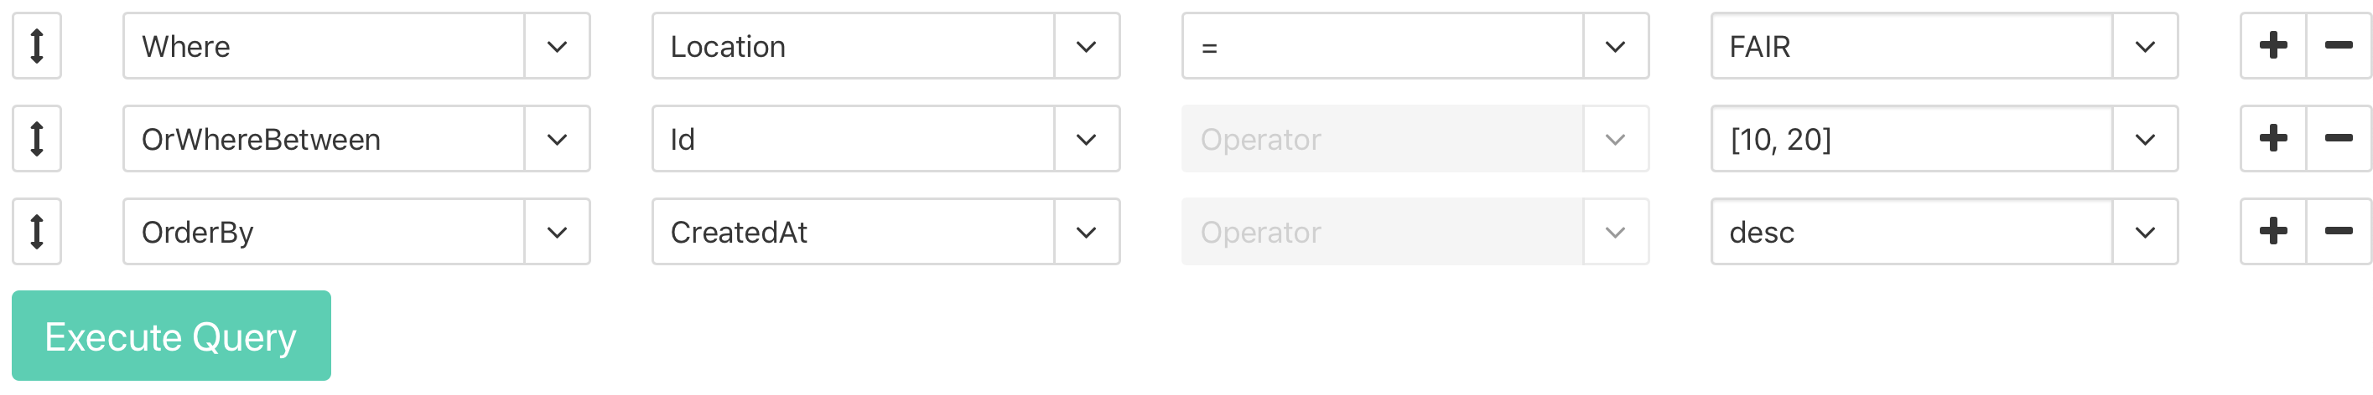
Data Querying
Web client
Dynamic UI allows to add, remove and rearrange the search criteria

Slide 12
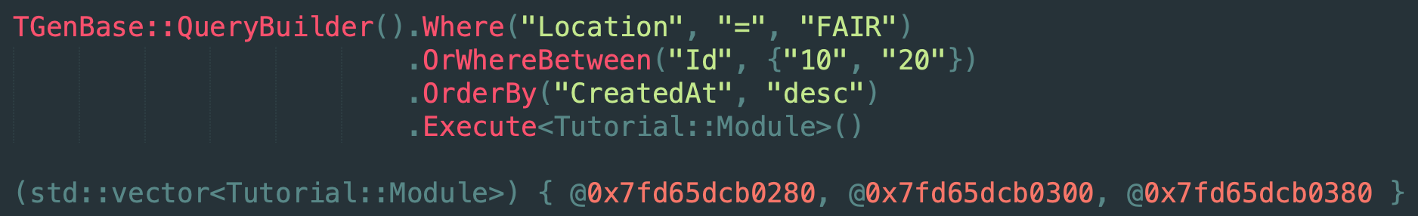
Data Querying
C++
Fluent interface which follows the ActiveRecord pattern
Allows to chain the selection criteria and build complex queries
Results are vectors (arrays) of objects

Slide 13
Schema
Complete description of the classes and relations between them defines the data storage schema
Ultimately it defines the contract between the client and server
It maps easily to the database structure
It has version which is incremented every time you generate server
Schema evolution is done with migrations

Slide 14
Workflow
Local dev
Describe you data format, prepare data export
Established and well-working for CBM
Used for detector components and quality control data
Deployment request
Published in central schema store
https://git.cbm.gsi.de/TGenBase/SchemaStore
Accepted and deployed
Central databse server:
compdb.cbm.gsi.de
Connection
details
Address of server endpoint
to be used in clients

Slide 15
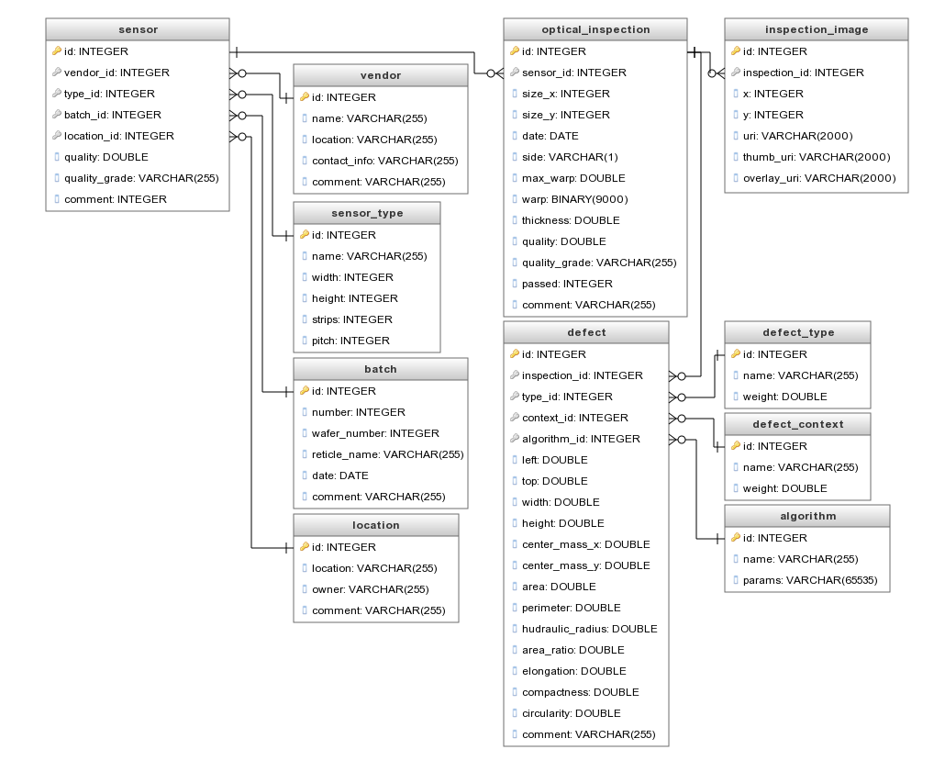
DB Schema Example
User needs are different: from one single class to complex hierarchies with class relations
Example: description of detector components, logistics and quality control data for CBM silicon tracker‘s sensors

Slide 16
Other applications
Component database for detector components of full Silicon Tracking System (estimated row count is tens of millions)
DCS (Detector Control System) database for hardware in collaboration with NA61 people
Calibration data storage
Analysis metadata storage – breakdown of data files in subsets, such as run periods, physics trigger based, etc.

Slide 17
Summary
TGenBase is a powerfull set of tools to describe, host and access data with many language bindings
It provides the data management and visualisation out of the box
Provides two logic sets: CRUD and versioned insert-only
General purpose: can be used for any data storage task
Check out the data description UI https://tgenbase.com
source code https://tgenbase.com/#/git
and the tutorial example online https://tgenbase.com:5050/

