Slide 1
Failure Tracking @FAIR: Future Perspectives
Oksana Geithner
ACC Operation Department

Slide 2
General Comments
As GSI + FAIR is going to be quite large facility, automated failure tracking is a legitim requirement for the future accounting.
Such complex task cannot be achieved over night. Stepwise approach would be
a good way. Let‘s have a look onto the approximate roadmap.
Parallel Operation @GSI+FAIR is an essential topic. We want to account the
Failures (Availability) for both perspectives: experiments (whole beam production chain) and separate accelerators

Slide 3
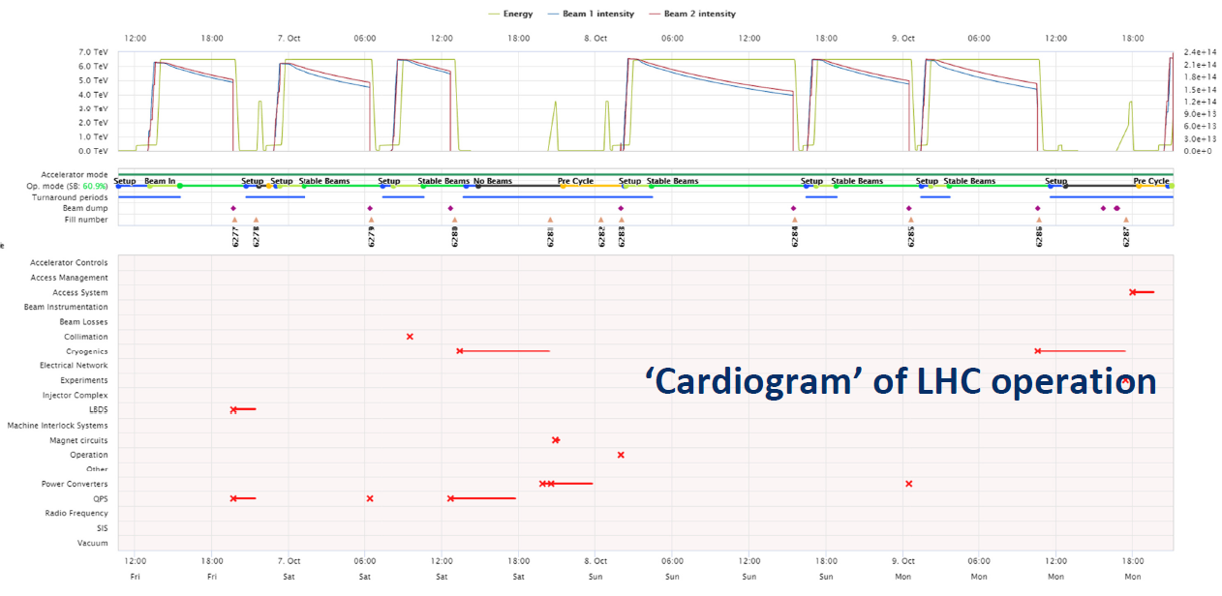
Operation History Viewer
Intensity
Magnet Current
Interlocks

Slide 4
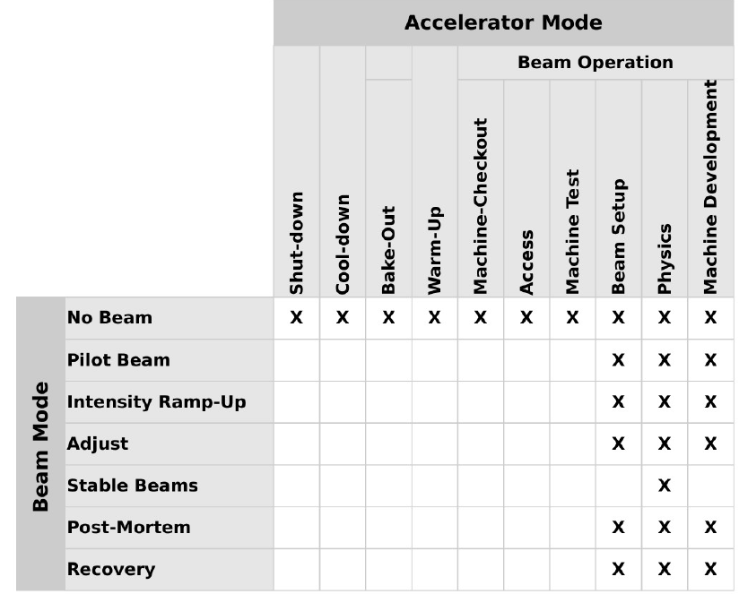
Next Steps
Get the data from the Archiving System (Trafo)
Put several Subsystems to the Archiving System for tracking and testing
Match the archiving data with setup data (virtual accelerators)
Define different accelerator/beam modes and introduce the correspondent central logic to control it
Introduce an Alarm System to collect alarms for each subsystem (difference to Interlocks?) Define different types of alarms (info, warning, fatal => acc status is changed to FAILURE)
Introduce a Logic to find a root course for the tracked Failure (Postmortem is required)

Slide 5
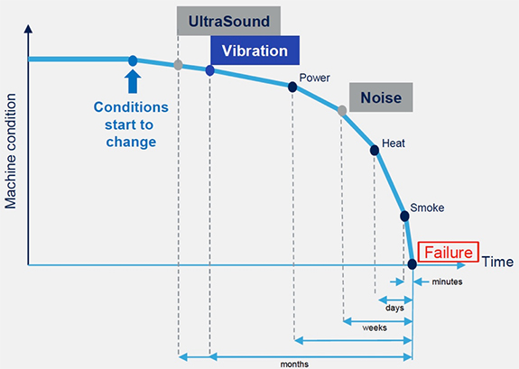
Christmas Wish: Failure Prediction

