Slide 1
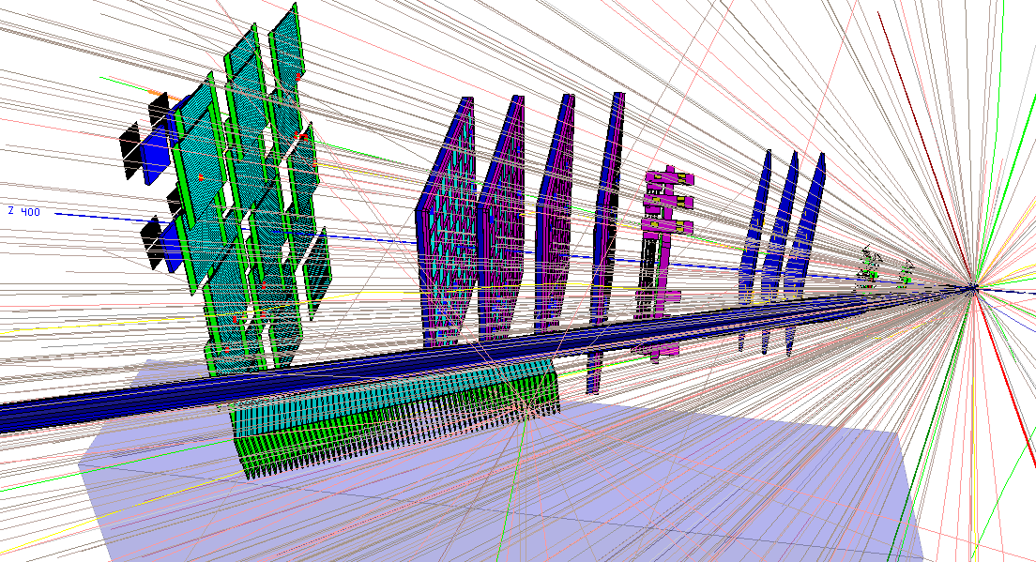
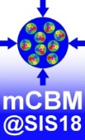
UrQMD
Au+Au 1.24 AGeV collision
Status of the mCBM@SIS18 experiment at GSI/FAIR
FAIR Phase-0 experiment
Christian Sturm
for the CBM Collaboration

Slide 2
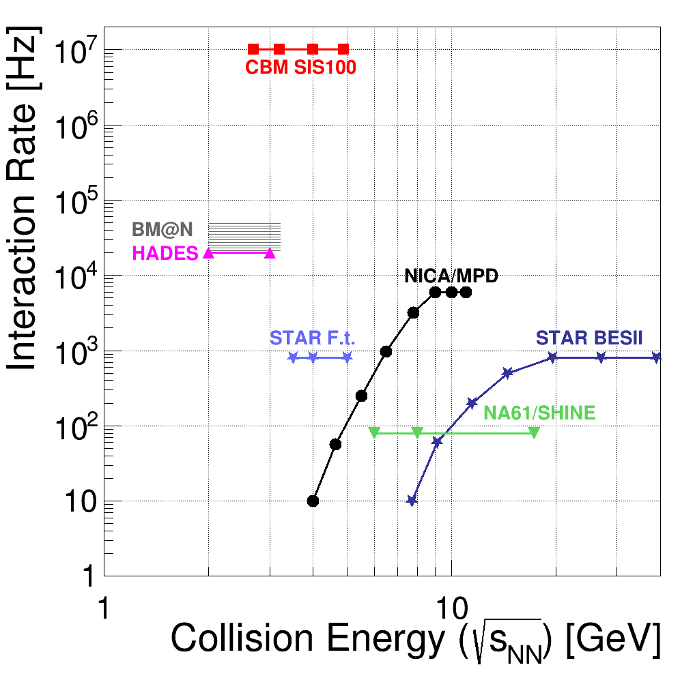
Experiments exploring dense QCD matter: Rate capabilities
FAIR SIS100 energies (Au ions)
$E_{kin}^{lab}$ [A∙GeV] | $\sqrt{s_{NN}}$[GeV]
2 | 2.7
4 | 3.3
8 | 4.3
11 | 4.9
14 (Ca) 29 ( p ) | 5.5 7.6
CBM‘s unique feature:
ultimate rate capability for
high statistics measurement
of rare probes

Slide 3
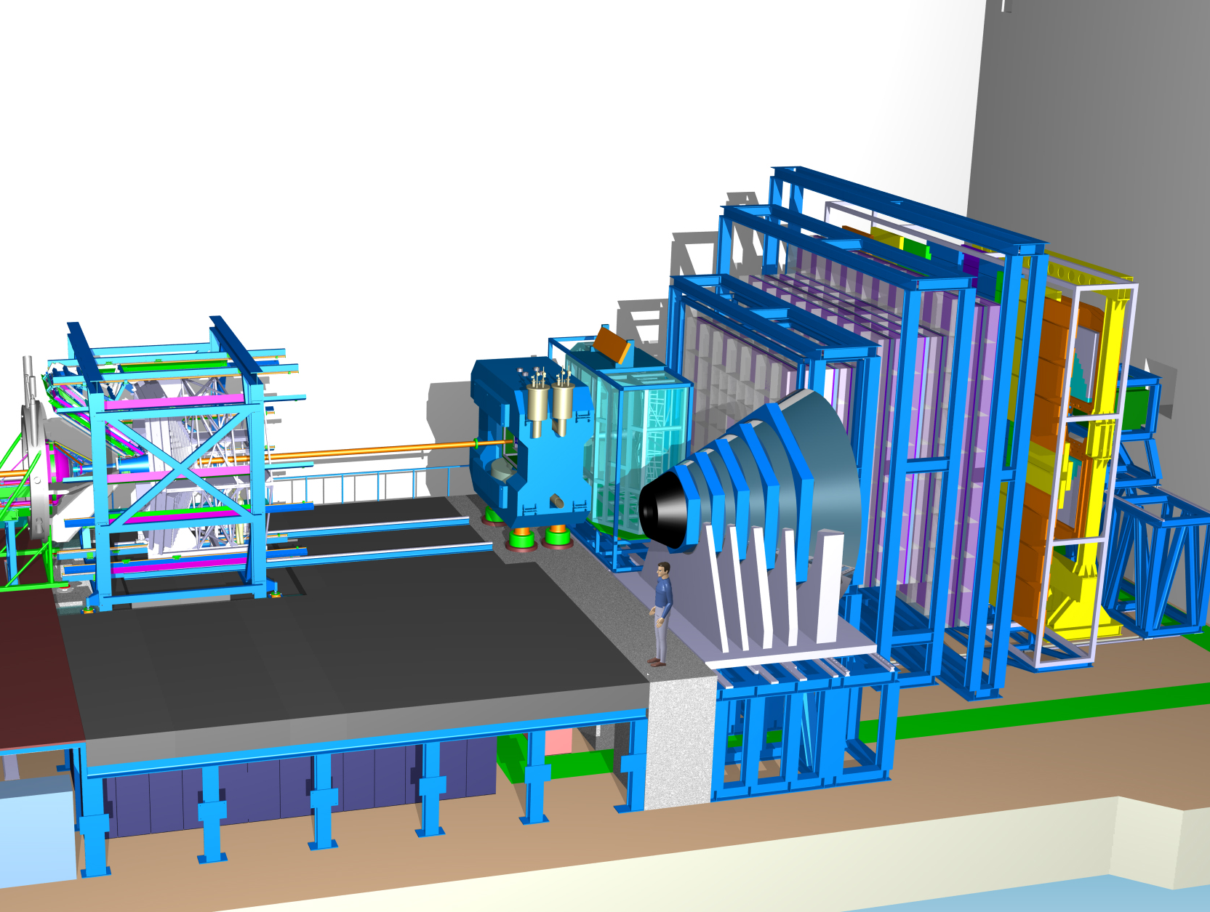
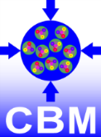
CBM experiment
for dileptons :
Ring
Imaging
Cherenkov
Time of Flight
Silicon
Tracking
System
Transition
Radiation
Detector
(4/10)
s.c. Dipol
Magnet
Micro
Vertex
Detector
Muon
Detector
(SIS100 version)
Projectile
Spectator
Detector
data transport to
DAQ/FLES HPC cluster

Slide 4
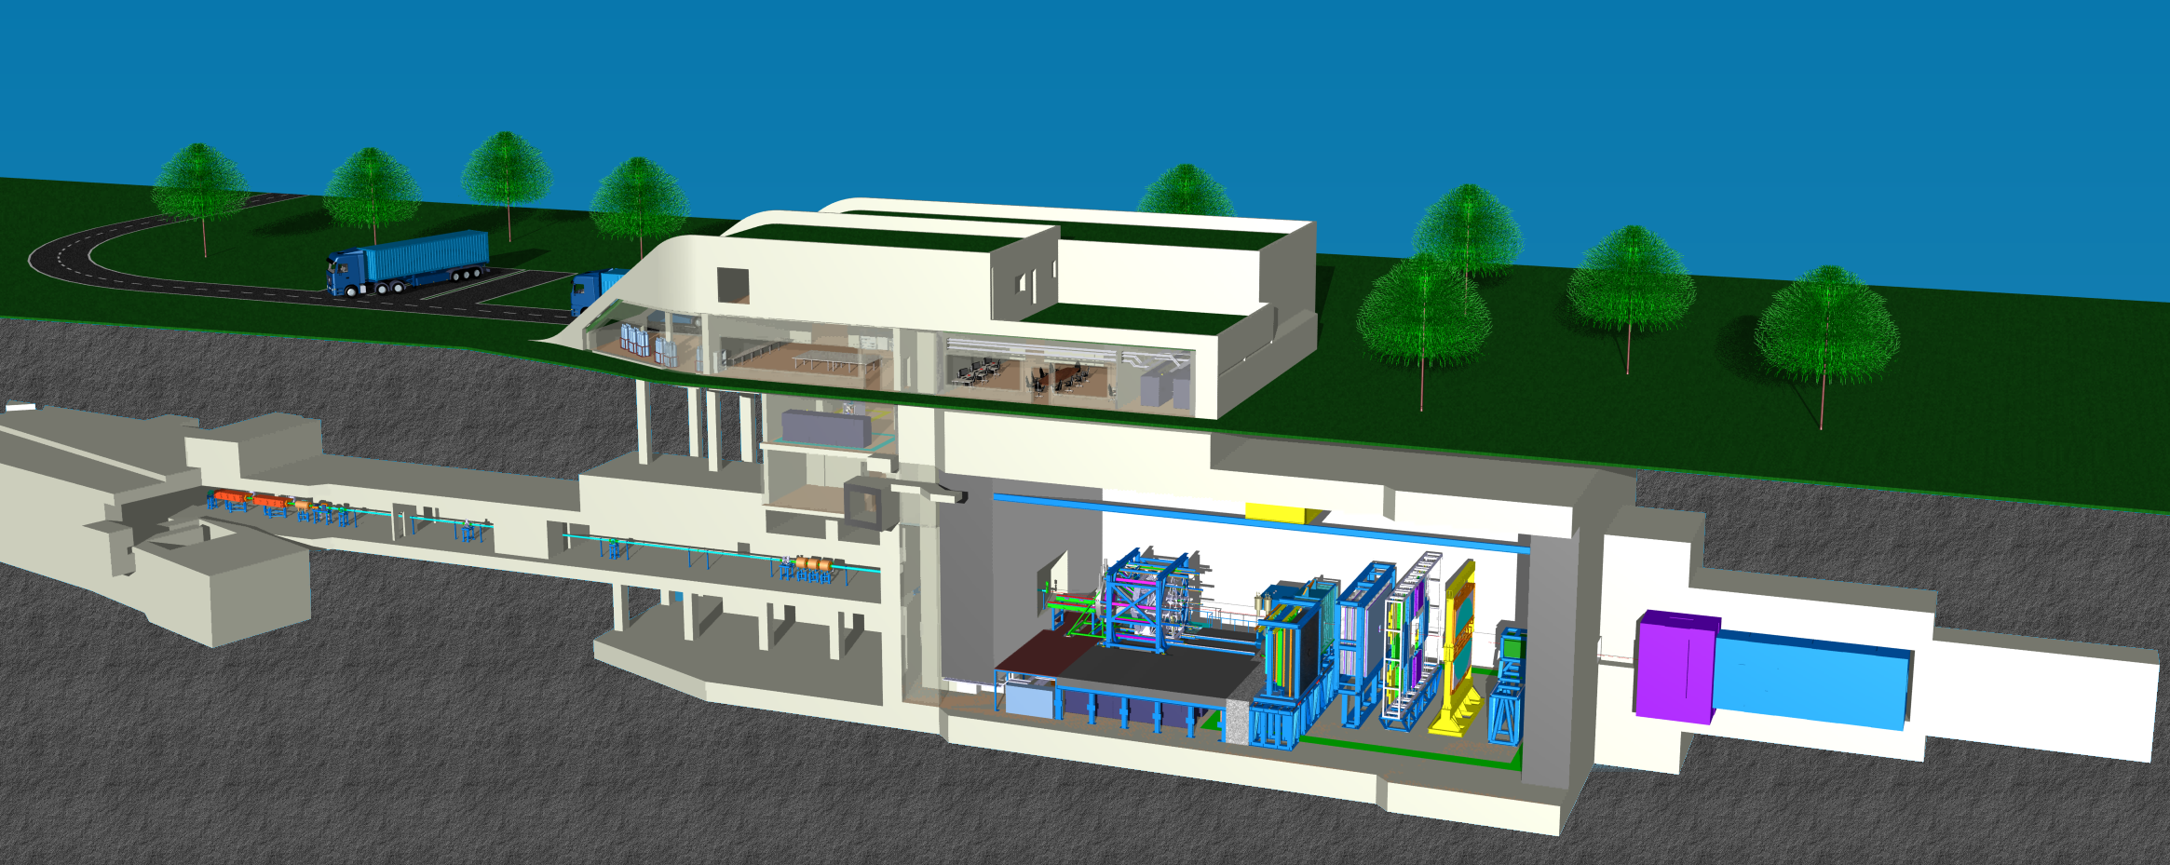
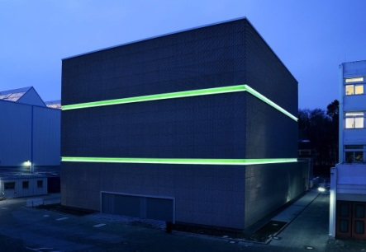
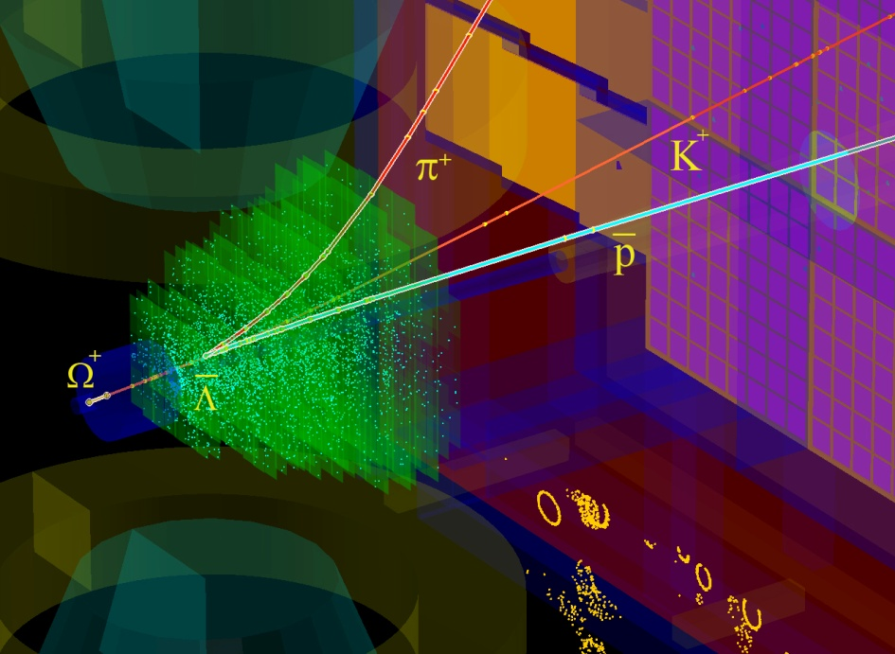
The high-performance free-streaming DAQ system of CBM
DAQ room:
data pre-processing
on FLES input cluster
Green IT Cube:
online
time slice building and event selection
data transport
μ-slices
data
tree
flow
2 TB/s
Green IT Cube
data
~ 800m
~80m
raw
Main features:
radiation tolerant detectors and front-end electronics
free-streaming DAQ system
all detector hits with time stamps,
software based event selection

Slide 5
CBM data transport and processing
FLES
Timeslice Building
Free-streaming FEE
assigning
time stamps
to hits
FPGA: DPB, µslice building,
FLES interface
Event Reconstruction
1-100cm
Copper
GBTx
100 m
Optical
800 m
Optical
Event Selection
TFC
Archiving
GBTx : CERN rad.-hard interface ASIC
DPB : Data Processing Board
TFC : Timing and Fast Control Syst.
FLES : First Level Event Selector
µslice (µS) : self contained data block for a subset of the experiment, minimal size depends on degree of data time sorting
Timeslice : collection of µS, self contained data block for the full experiment and a given time interval, includes overlap to avoid edge losses

Slide 6
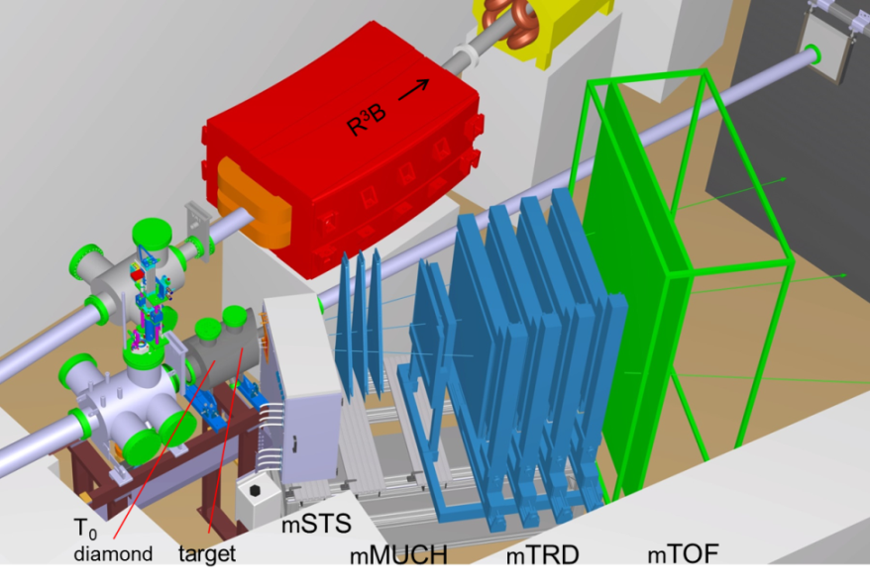
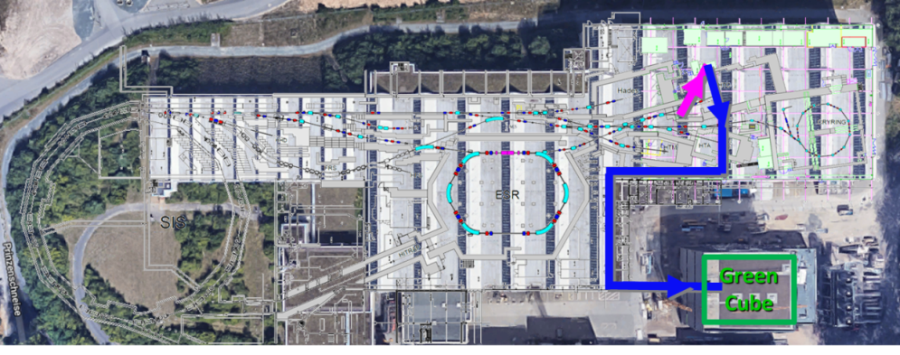
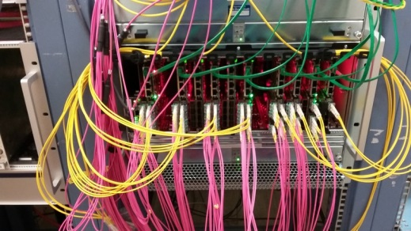
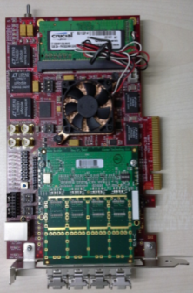
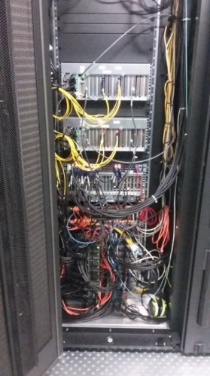
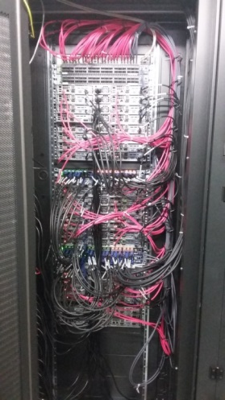
mCBM setup
Cave-D (HTD)
DAQ container
optical
fibers
green IT cube
optical fibers
30 m
300 m
mCBM@SIS18
A CBM full system test-setup
for high-rate nucleus-nucleus collisions at GSI/FAIR
input stage
CBM prototype detector systems
free-streaming read-out and data transport to the mFLES inside the GreenITCube
online event reconstruction and selection
up to 10 MHz collision rate
first commissioning beam in December 2018
processing stage

Slide 7
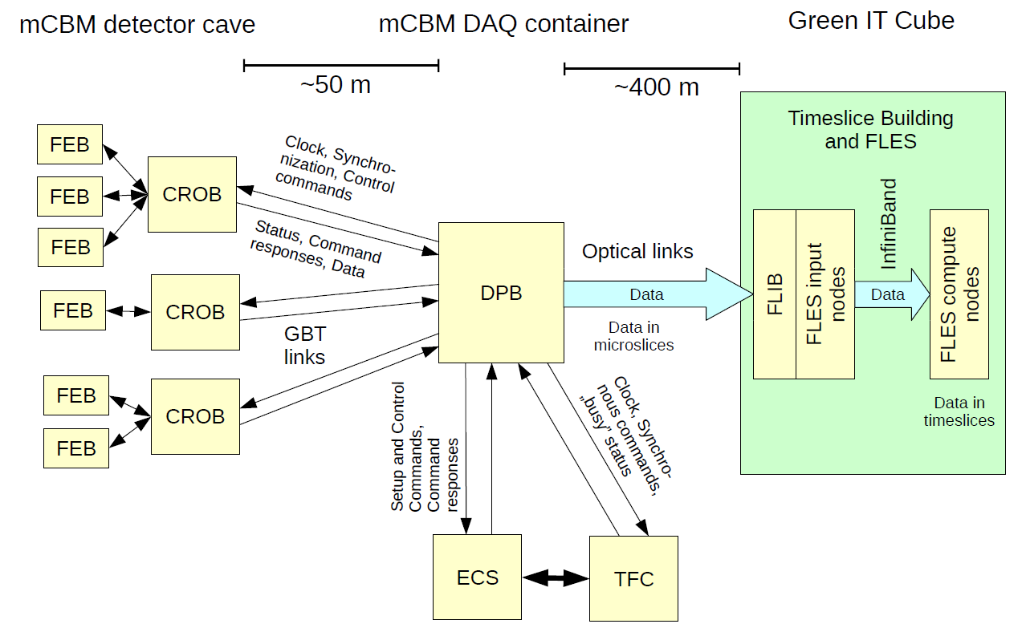
mDAQ and mFLES 2018 (start version)
present design
1
6
2
3
4
5
 |  | Device | Function | Location
1 | 70x | GBTx | data concentrator | Cave, on detector
2 | 12x | AFCK | 1st layer FPGA board | DAQ container
3 | 96x | Optical fibers | Data transport | DAQ → Green IT Cube
4 | 4x | FLIB | 2nd layer FPGA board | Green IT Cube
5 | 2x | mFLES input node | Input stage | Green IT Cube
6 | 42x | mFLES compute nodes | Processing stage | Green IT Cube

Slide 8
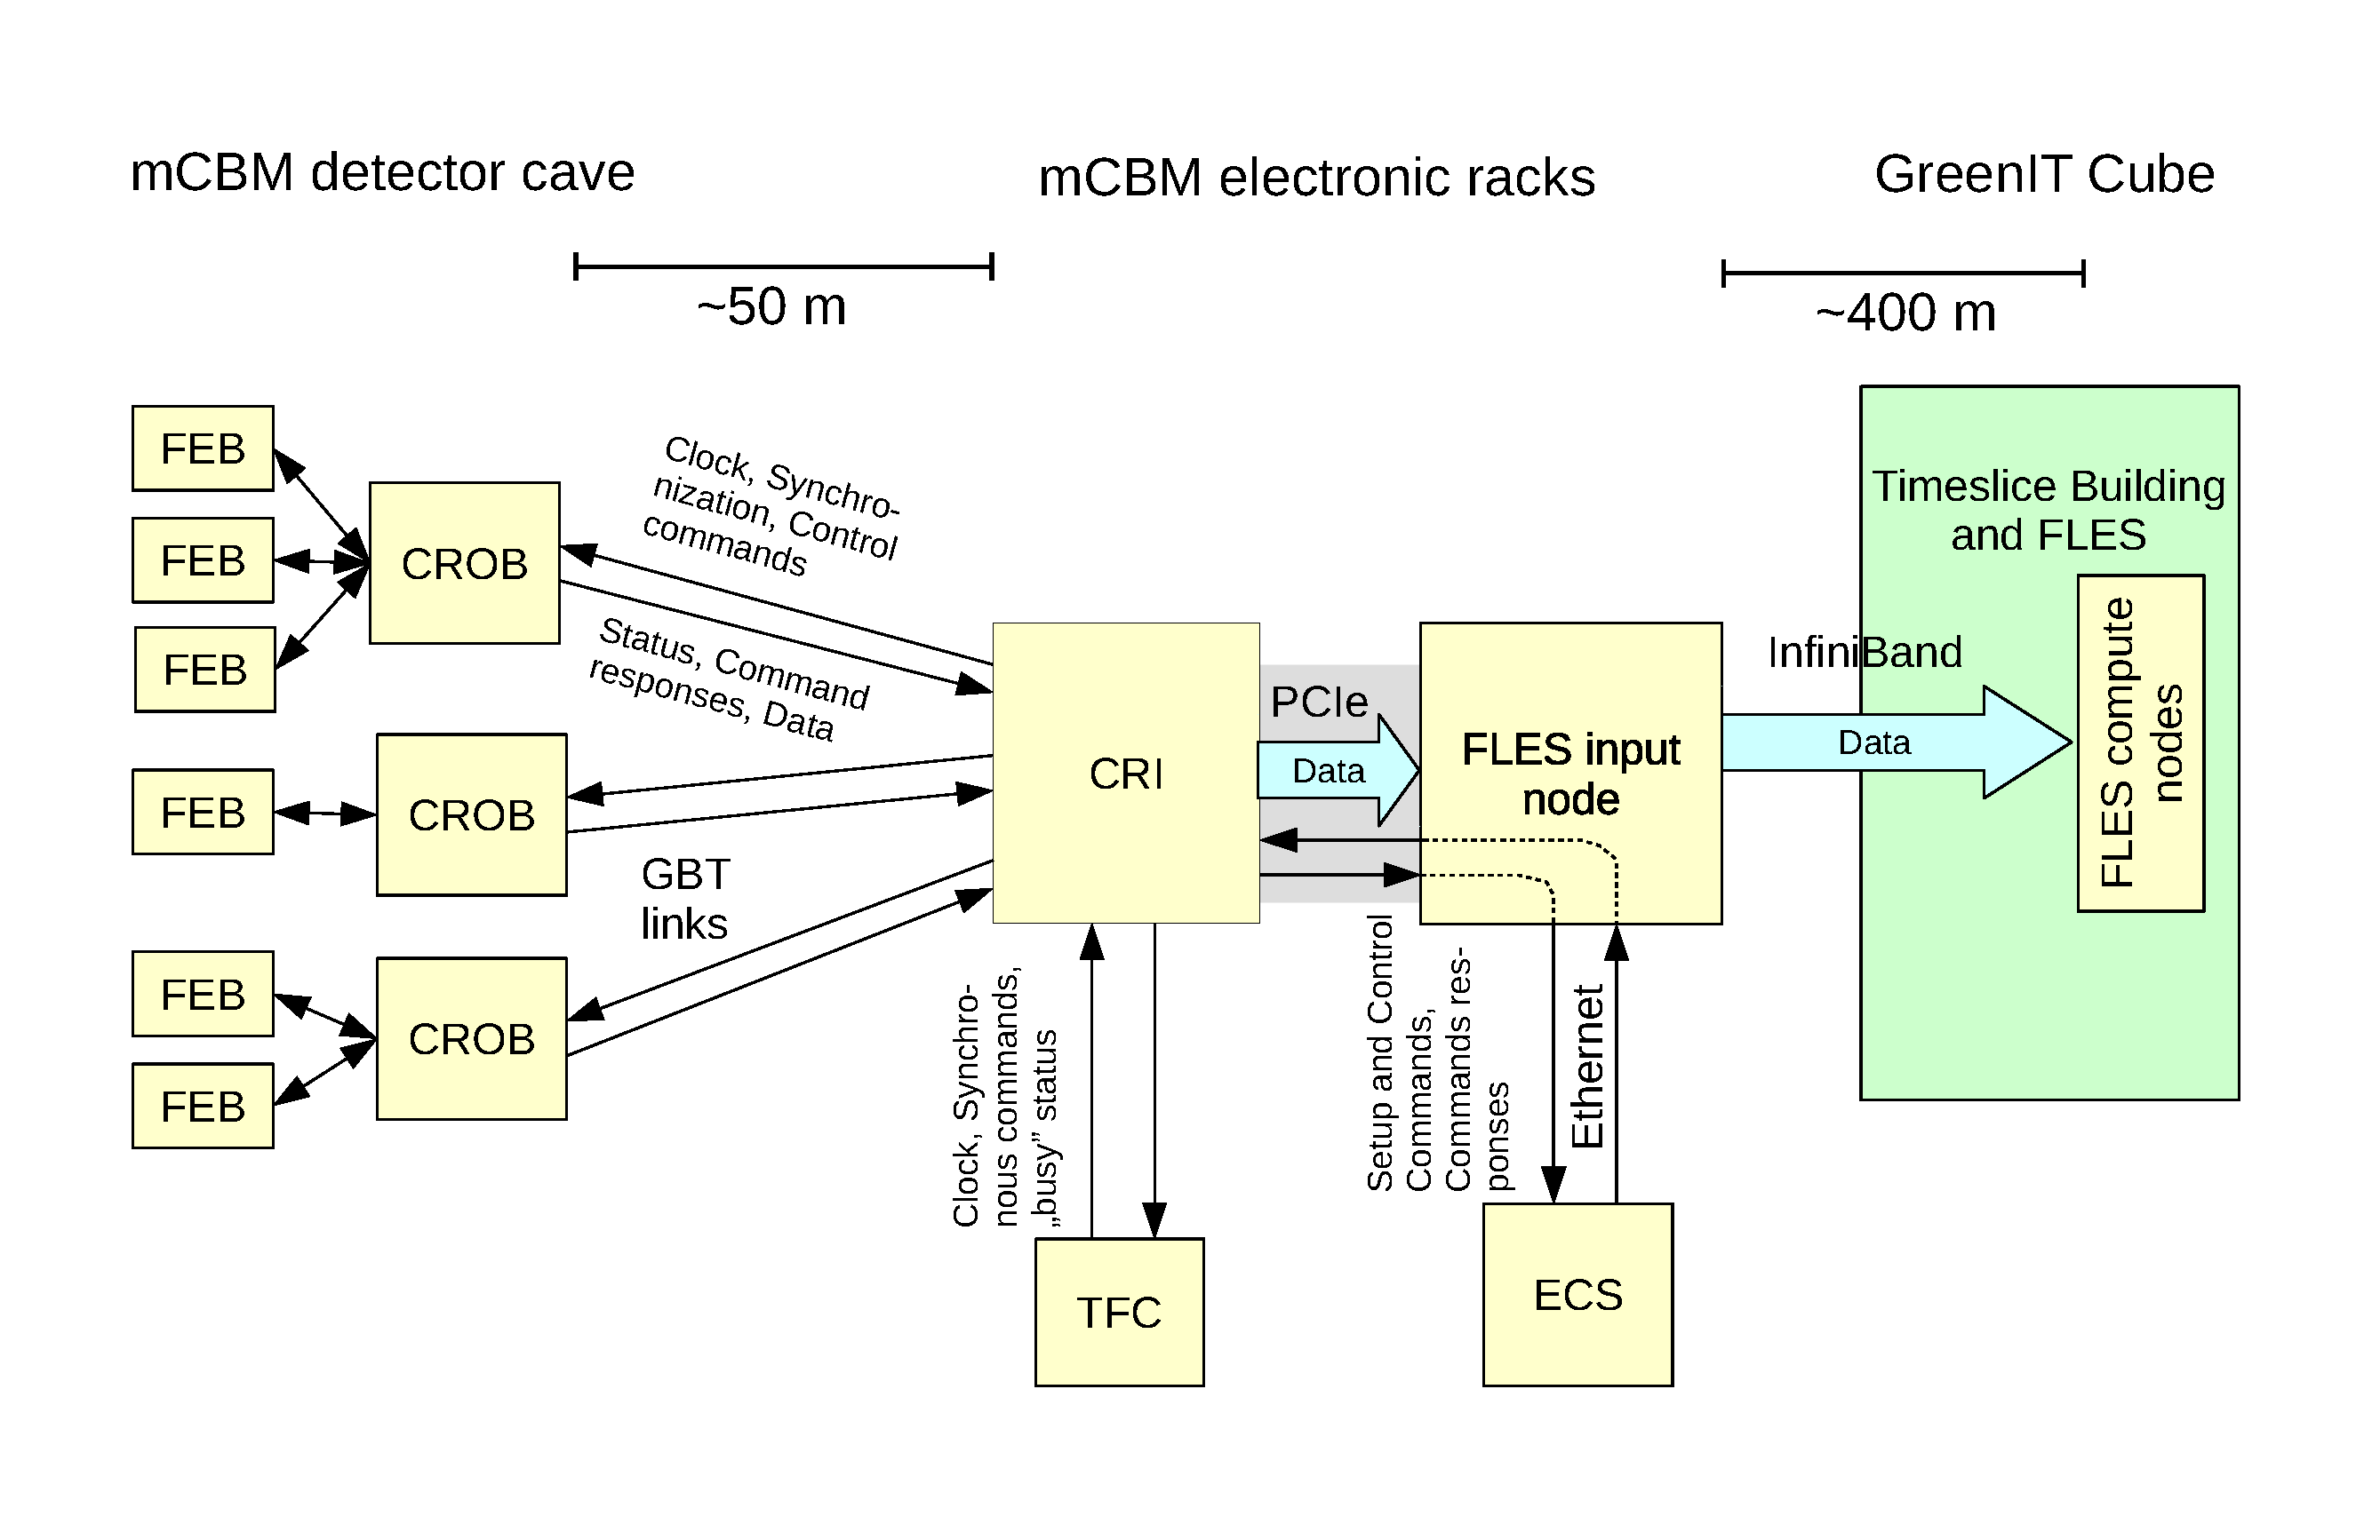
mDAQ and mFLES 2019
1
2
3
4
5
 |  | Device | Function | Location
1 | 70x | GBTx | data concentrator | Cave, on detector
2 | 6x | CRI | FPGA board (1x layer only) | DAQ container
3 | 2x | mFLES input node | Input stage | DAQ container
4 | 96x | Optical fibers | Data transport | DAQ → Green IT Cube
5 | 42x | mFLES compute nodes | Processing stage | Green IT Cube

Slide 9
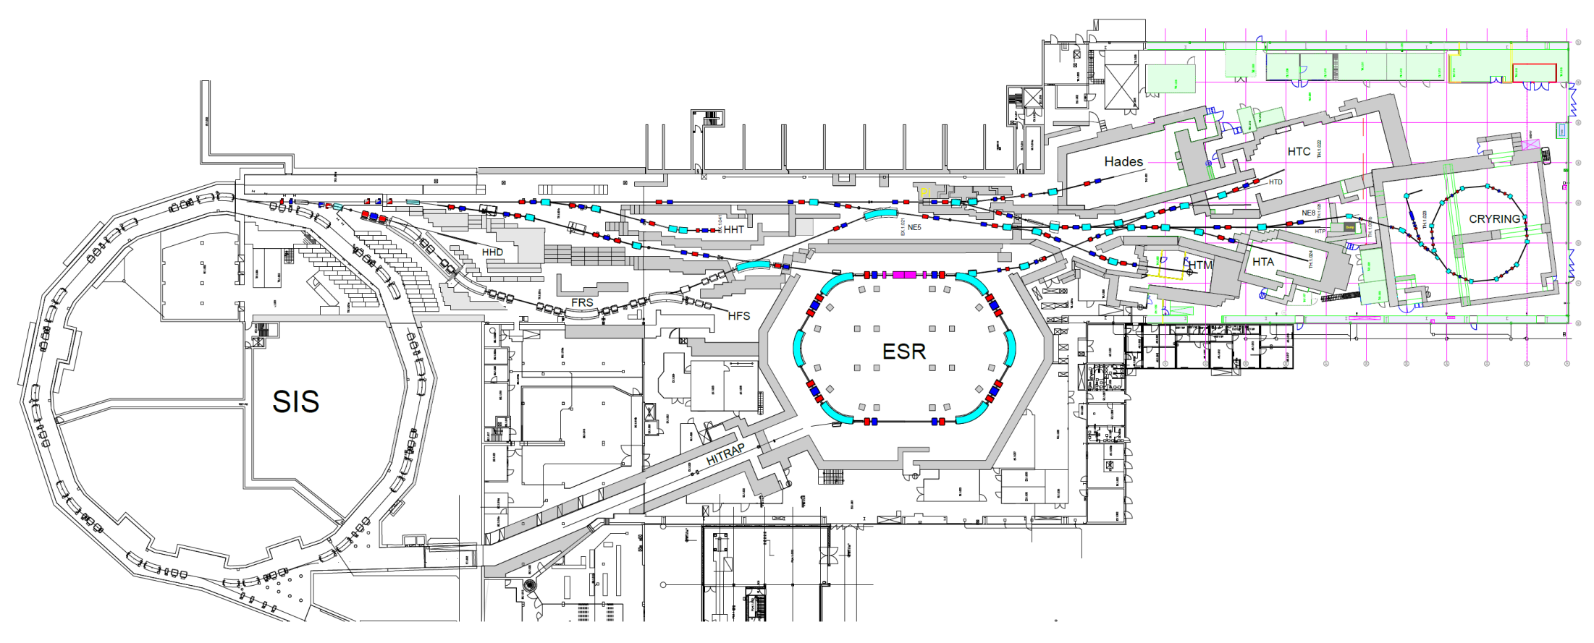
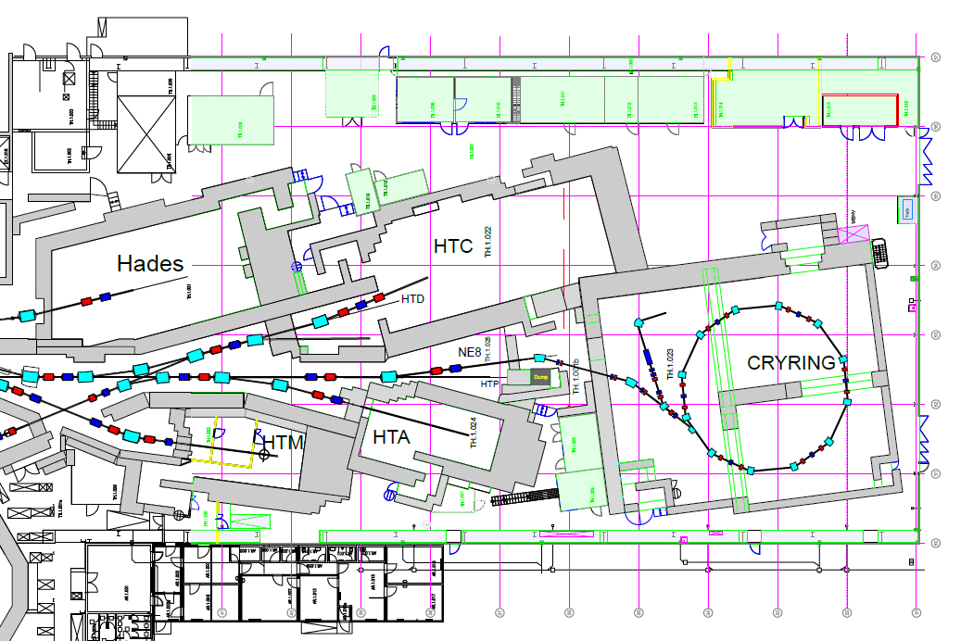
mCBM @ GSI / FAIR

Slide 10
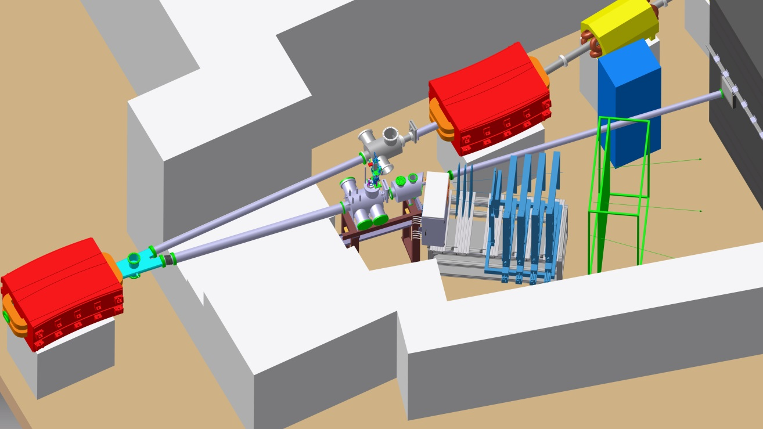
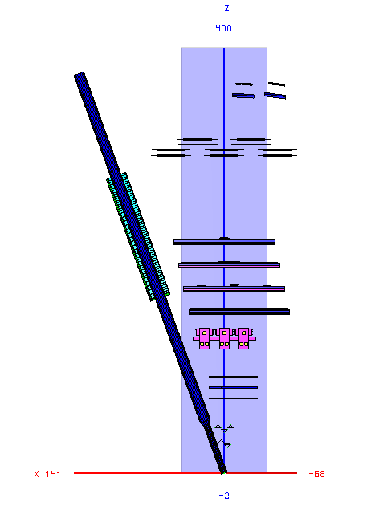
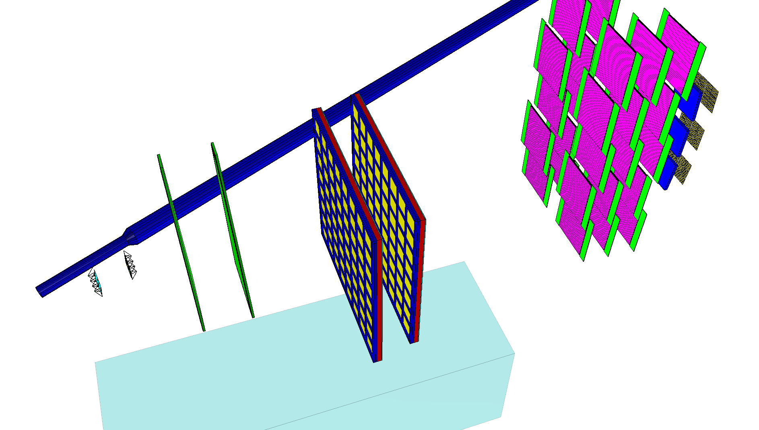
Design of the mCBM test-setup
mCBM Cave (HTD)
ttop view
R³B →
mTOF
switching
magnet
mCBM →
mTRD
mPSD
mCBM setup
March 2019
(ROOT geom.)
mMUCH
mSTS
target
mRICH
Aerogel
MAPMTs
T0
support table
(with rail system)
mTOF
5x RPC modules
3x & 2x stack
beam
mSTS
2x carbon
ladders
mMUCH
2x GEM stations
mTRD
2x stations

Slide 11
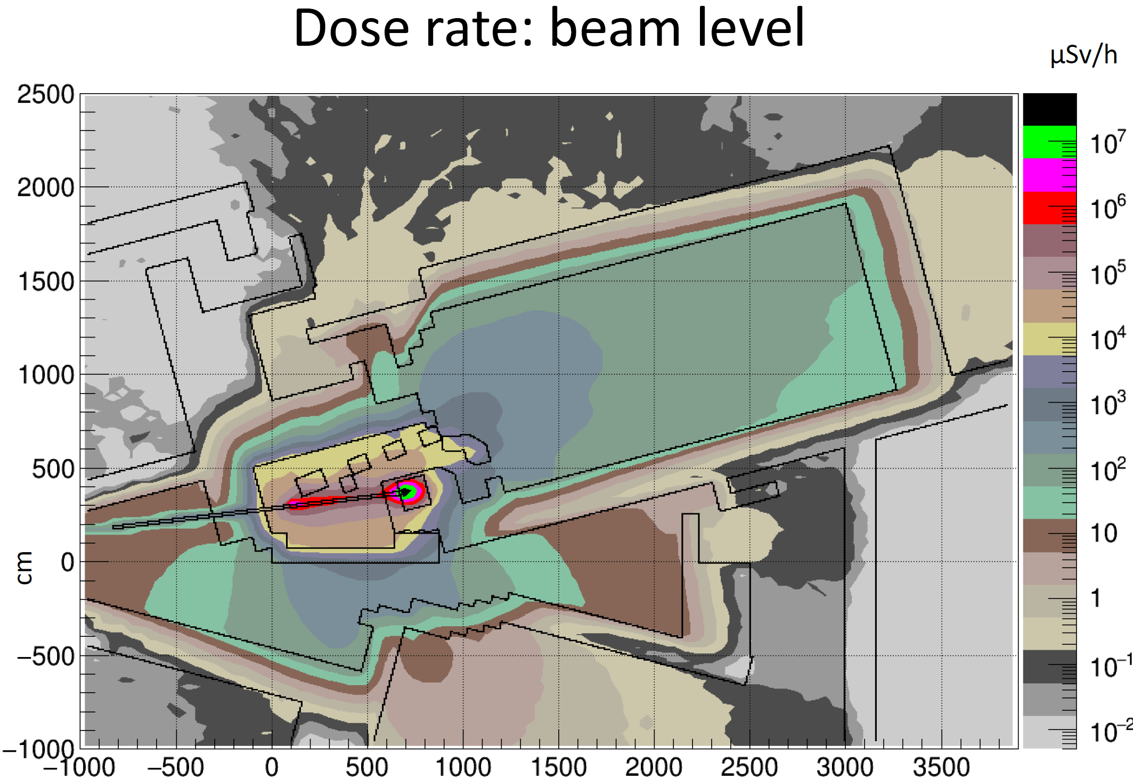
Monte Carlo shielding calculations (FLUKA)
10⁸ Au ions s⁻¹, 1.24 AGeV, on 2.5 mm Au target (P_{int} = 10%)
vertical section: beam level
dose rate
requirement: $\dot{D}≤ 0.5 μ$Sv/h

Slide 12
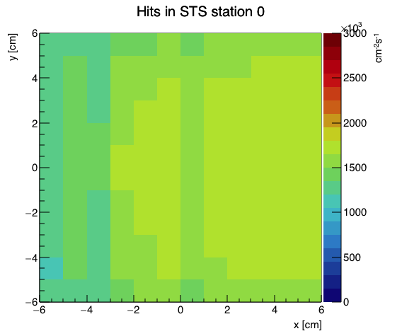
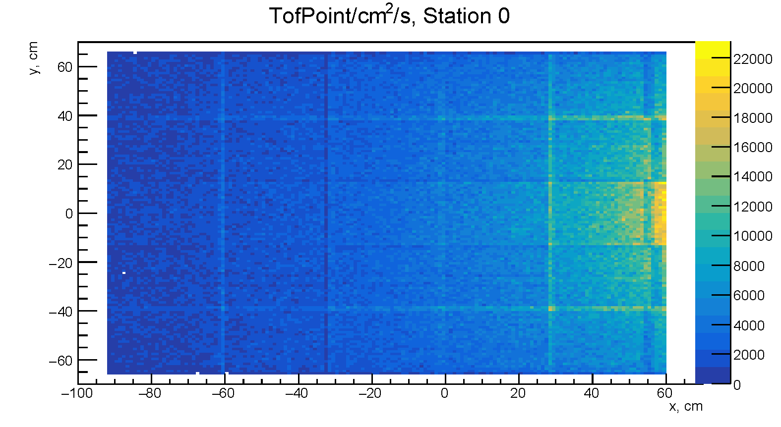
Hit rates at mCBM (simulation)
mSTS, 1st station
max. (design) rate: 1.5 MHz/cm²
mTOF
max. (design) rate: 20 kHz/cm²
Input:
UrQMD, Au+Au 1.24 AGeV, mbias,
incl. δ-electrons

Slide 13
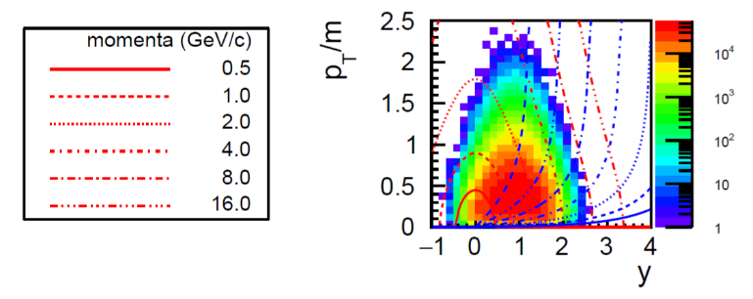
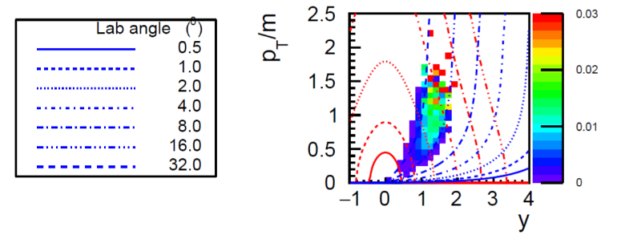
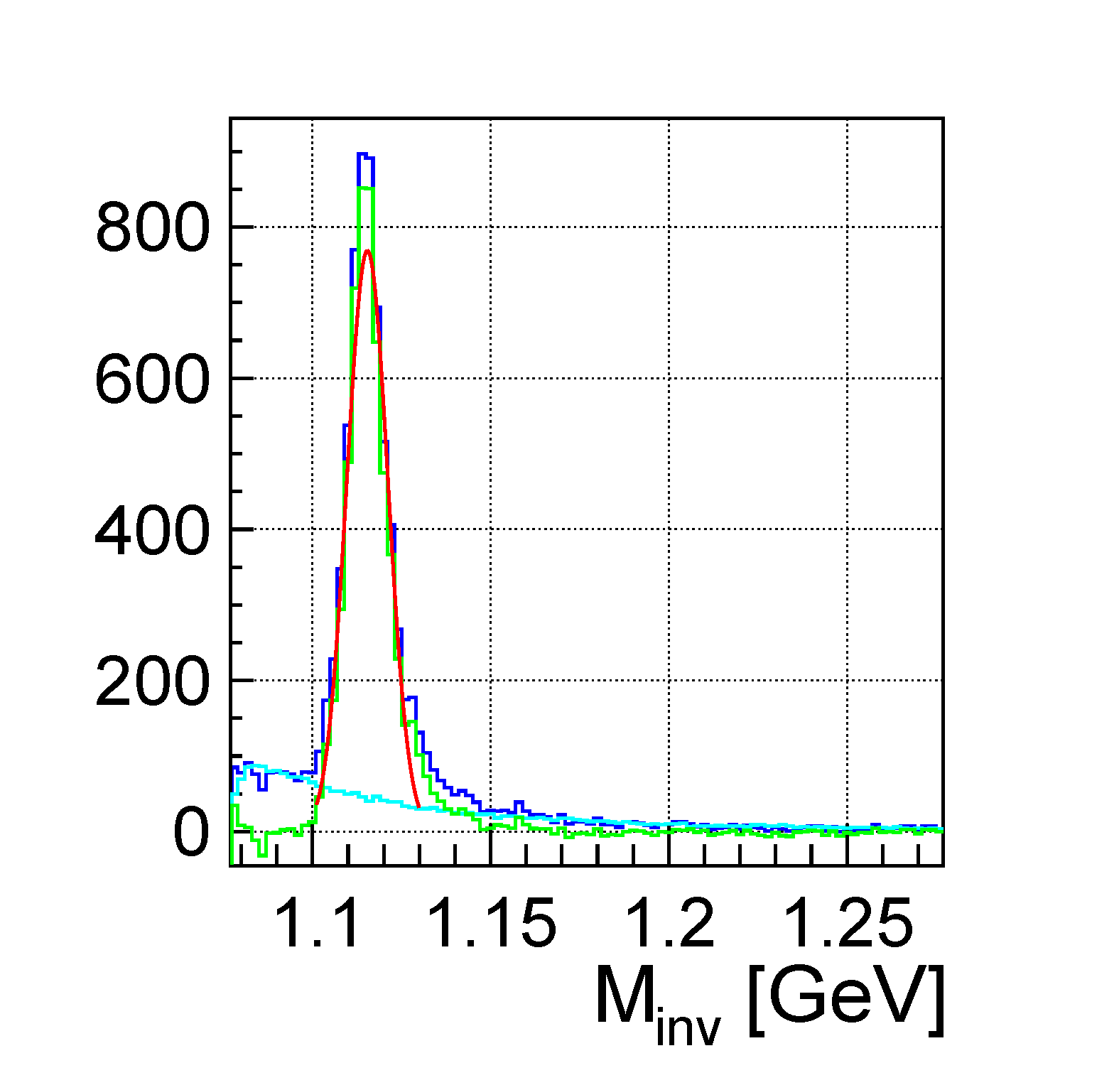
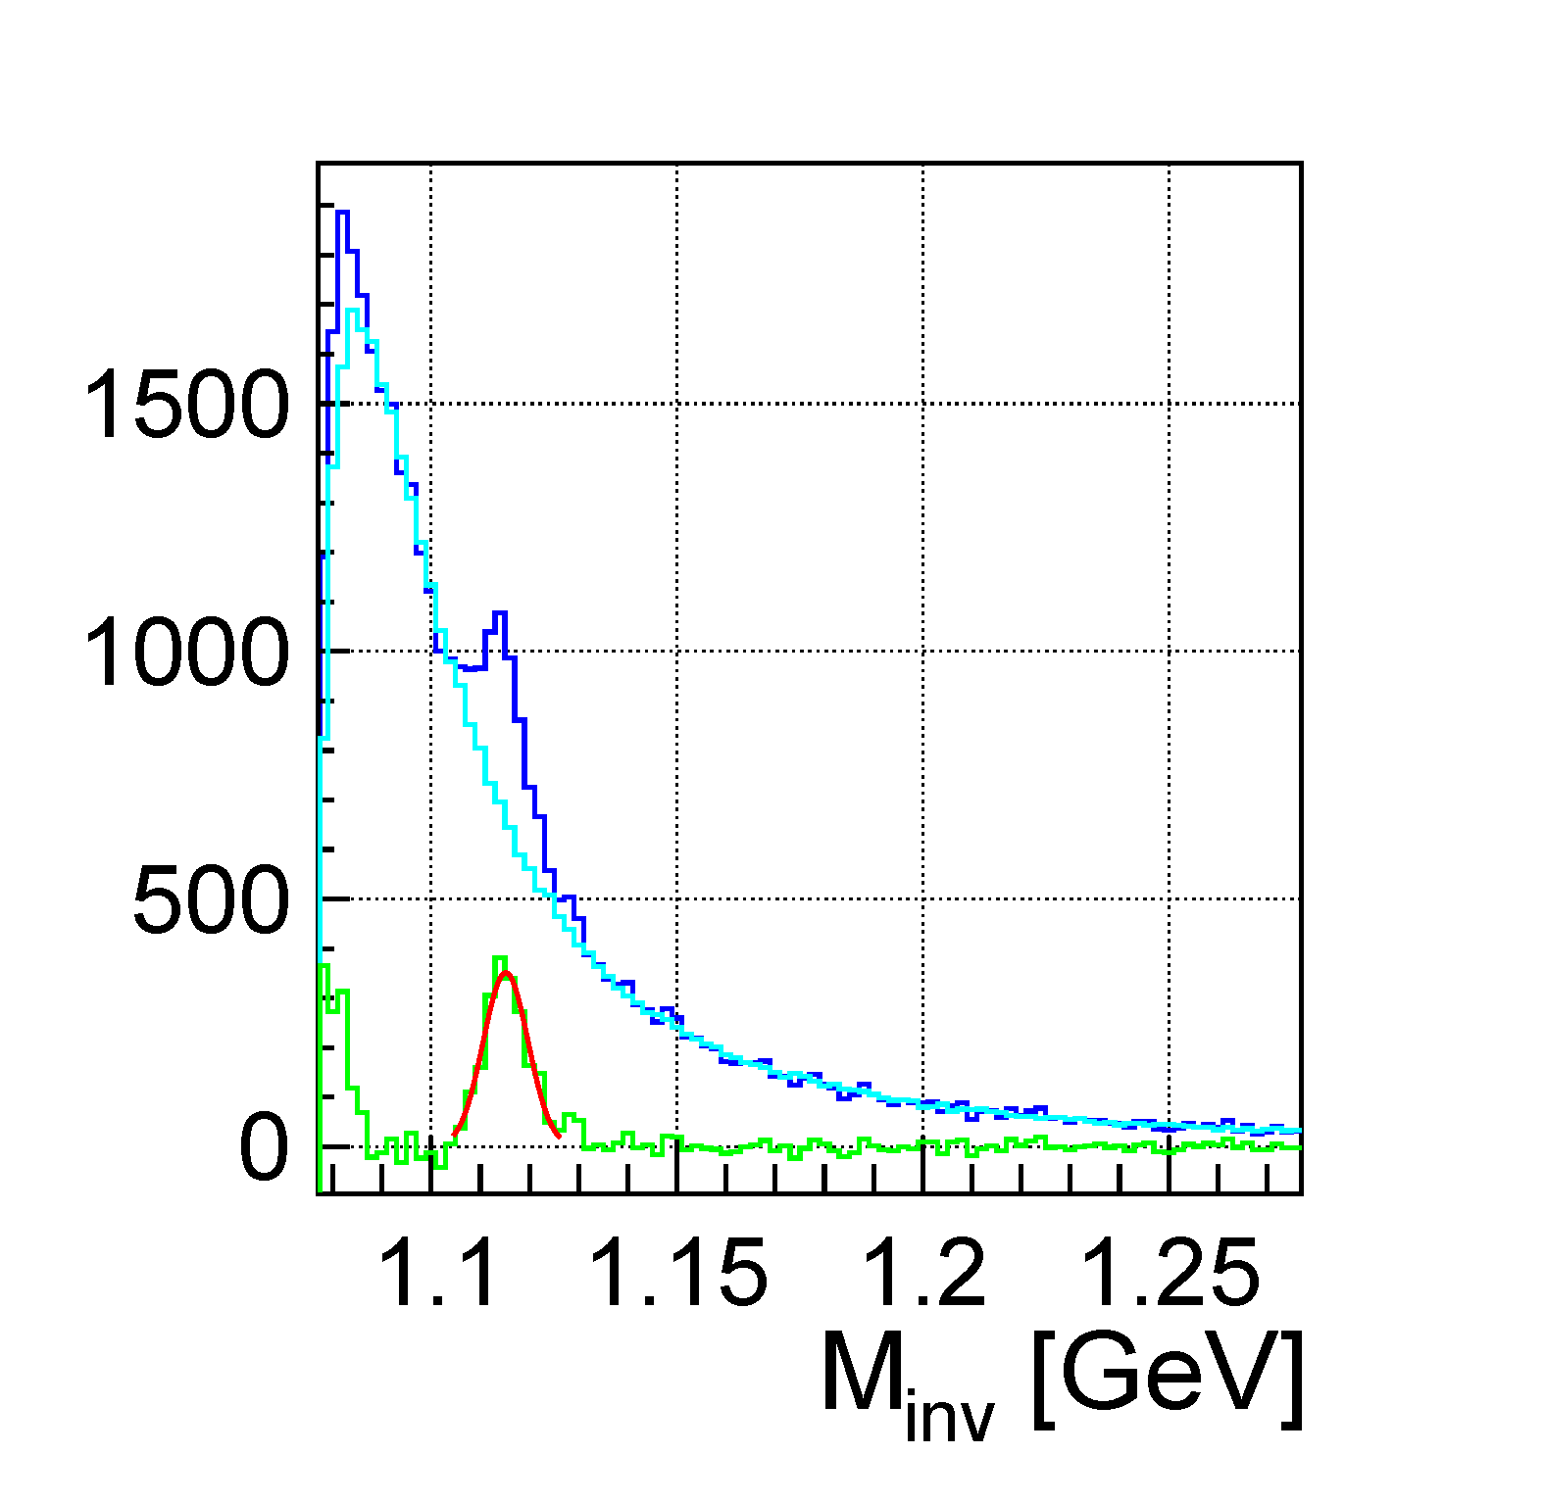
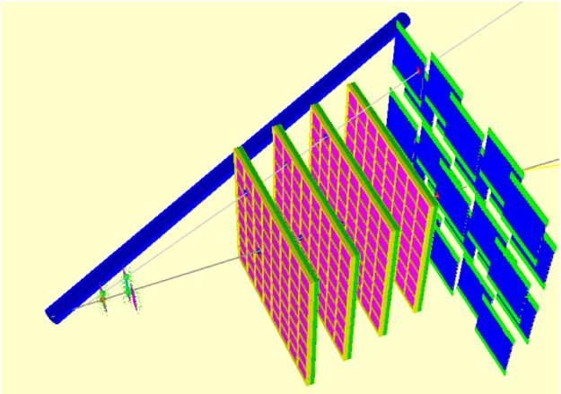
mCBM benchmark observable: Λ reconstruction
Simulation input: 10⁸ UrQMD events, min. bias
Acceptance
Efficiency
Ni+Ni 1.93AGeV
Au+Au 1.24AGeV
S/B = 8.4
S/B = 0.24
$$π^{−}$$
$$p$$
$$Λ→p+ π^{−}$$

Slide 14
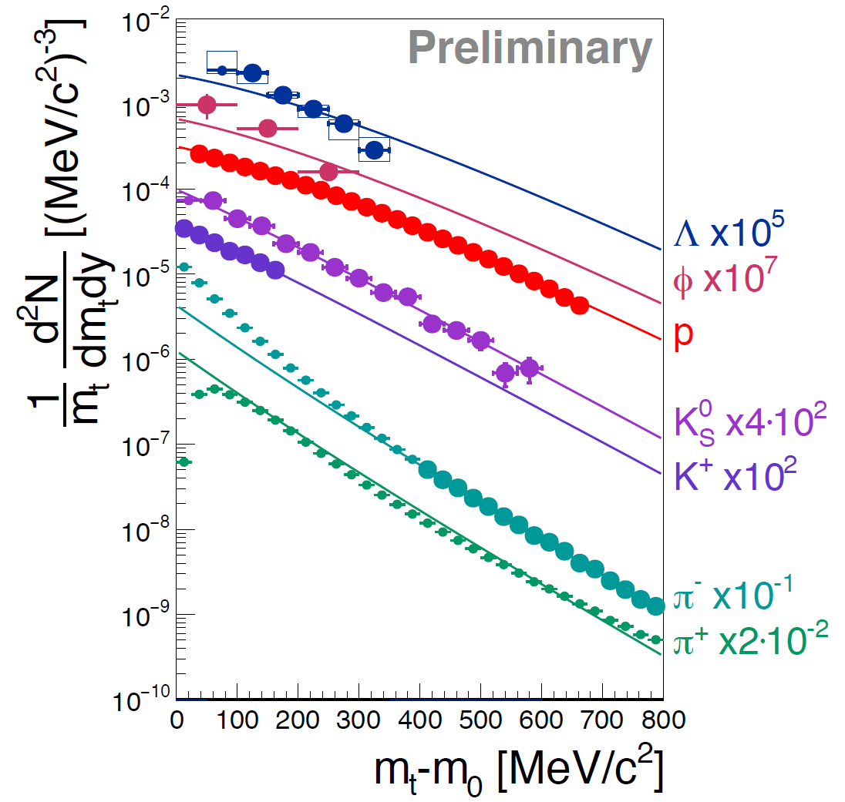
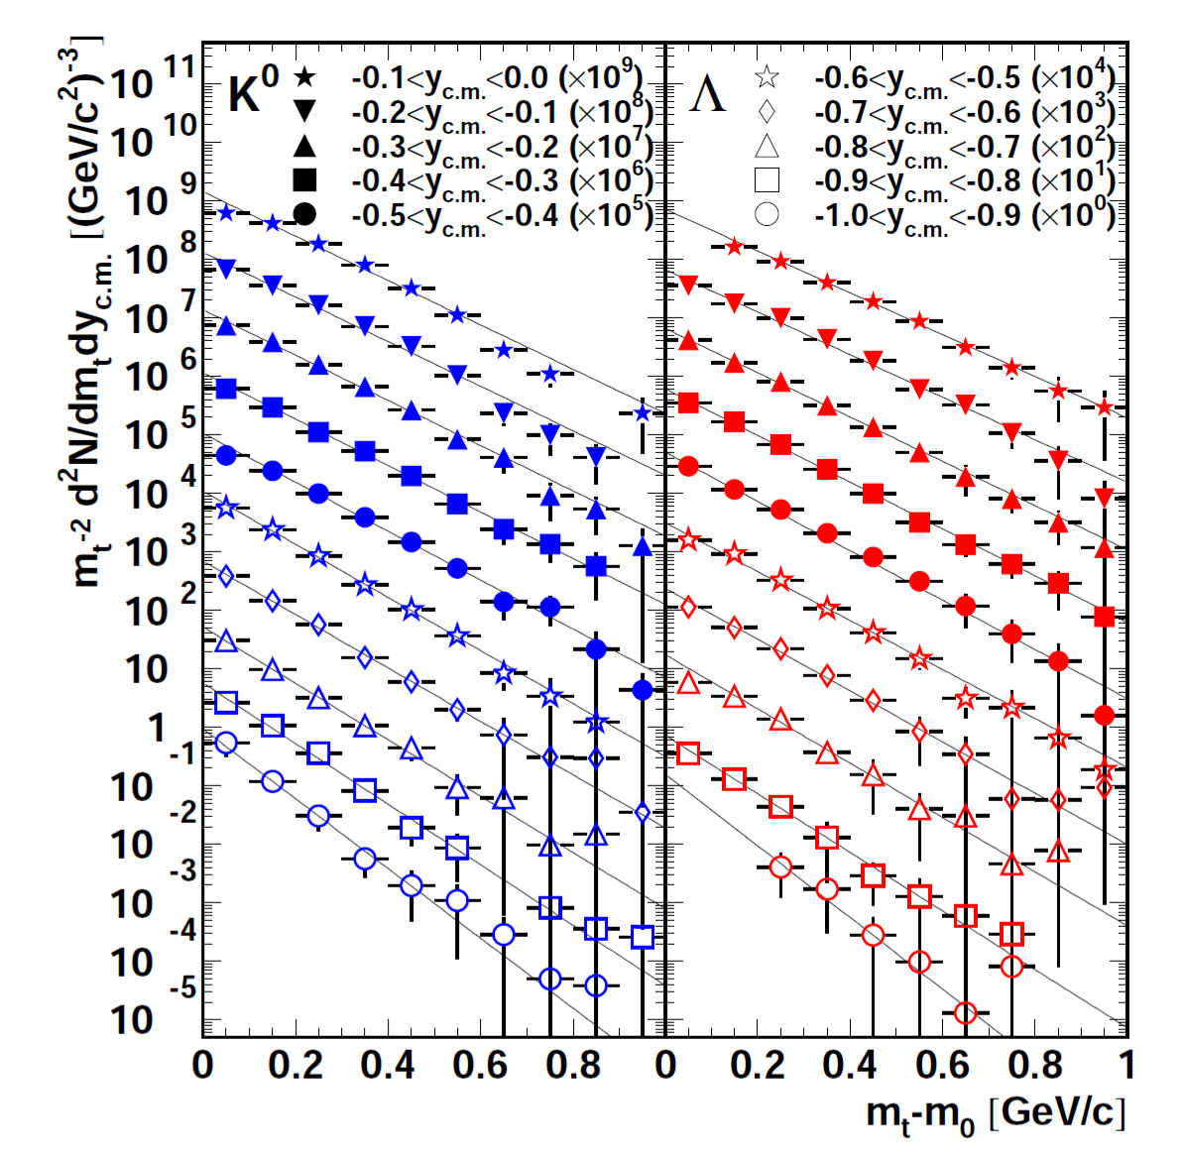
Λ production at SIS18 energies – mCBM reference data
Ni + Ni 1.93 AGeV
Au + Au 1.23 AGeV
M. Merschmeyer et al. (FOPI), PRC 76, 024906 (2007)
H. Schuldes et al. (HADES)
EPJ Web of Conferences 171, 01001 (2018), SQM2017
midrapidity

Slide 15
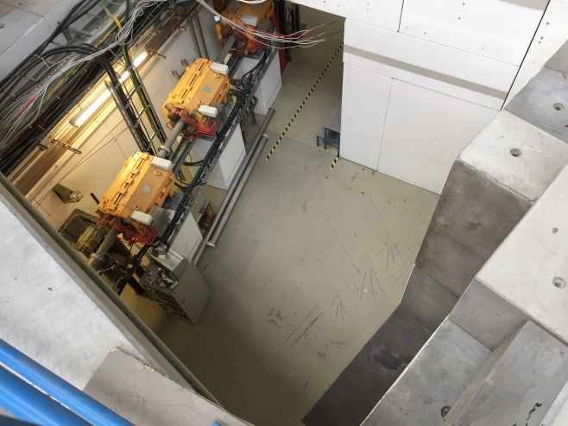
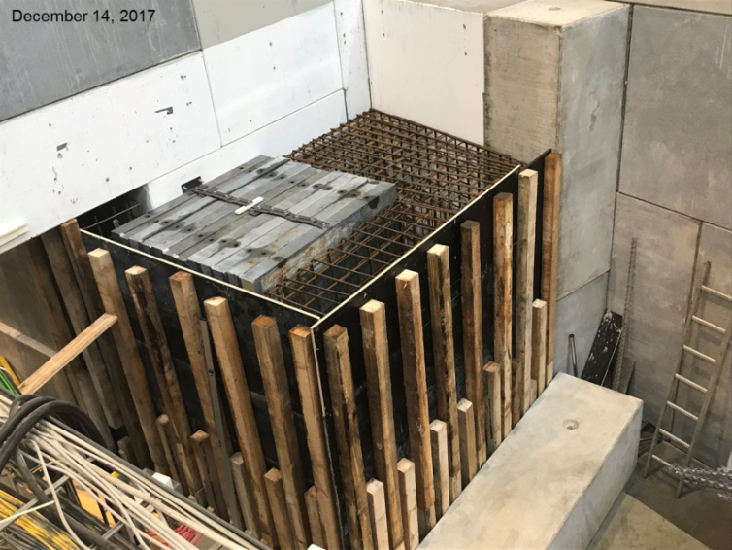
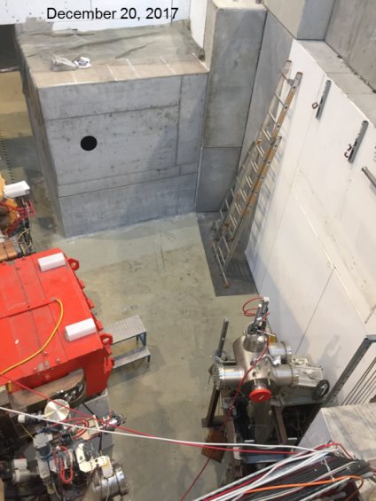
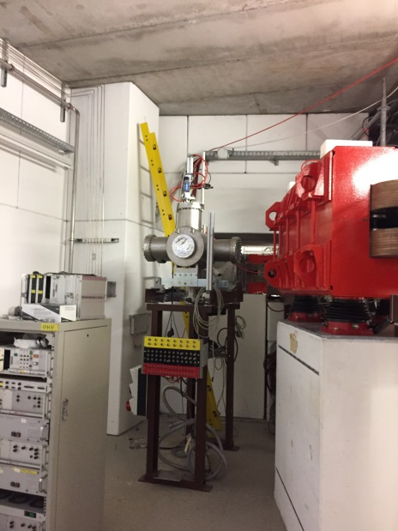
Construction of mCBM
Nov. 2, 2017
Feb. 8, 2018

Slide 16
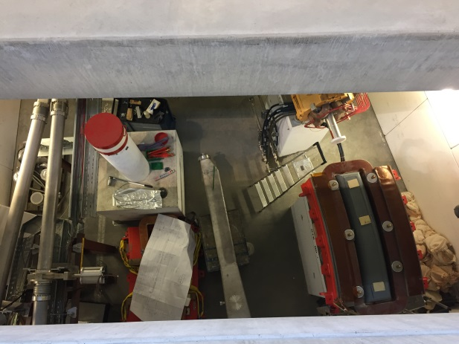
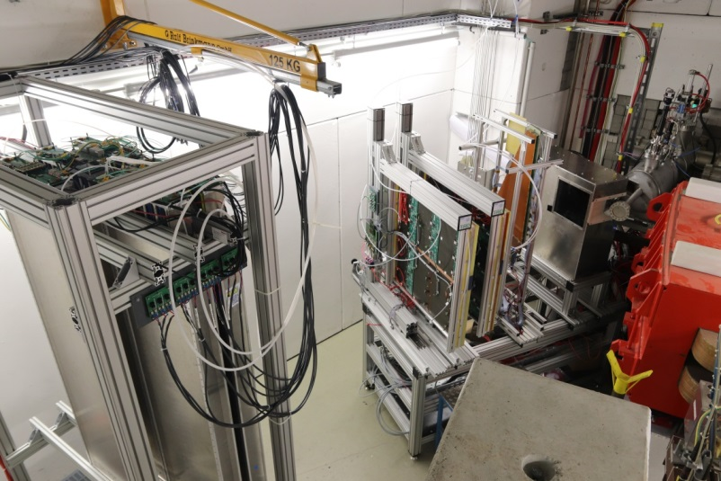
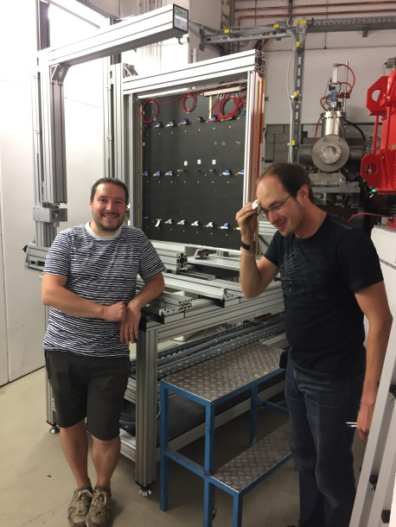
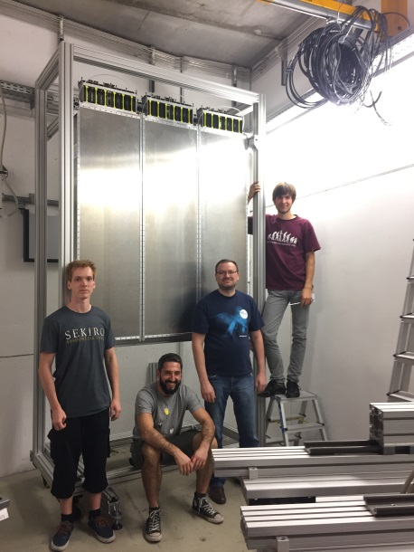
Construction of mCBM
March 21, 2018
Sept. 20, 2018
Nov. 29, 2018
Sept. 9, 2018

Slide 17
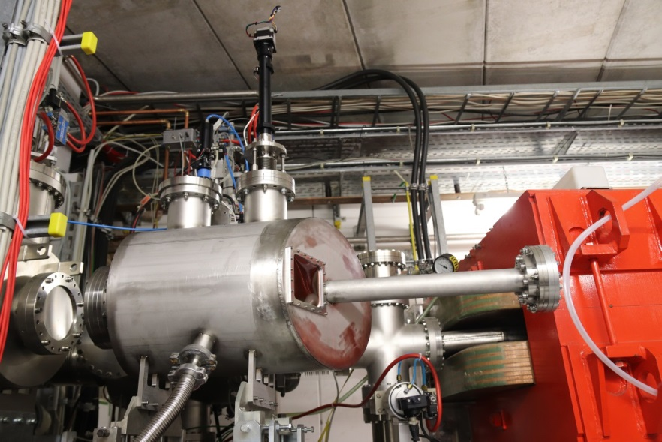
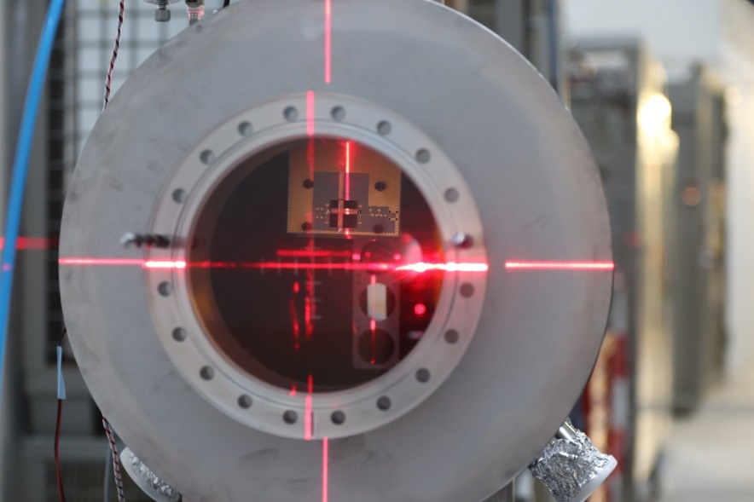
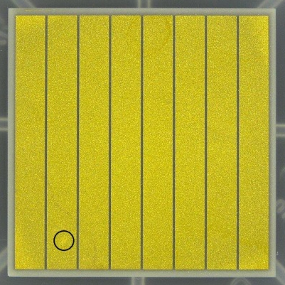
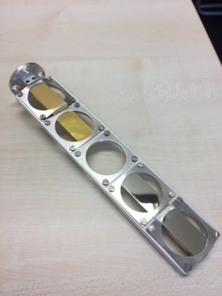
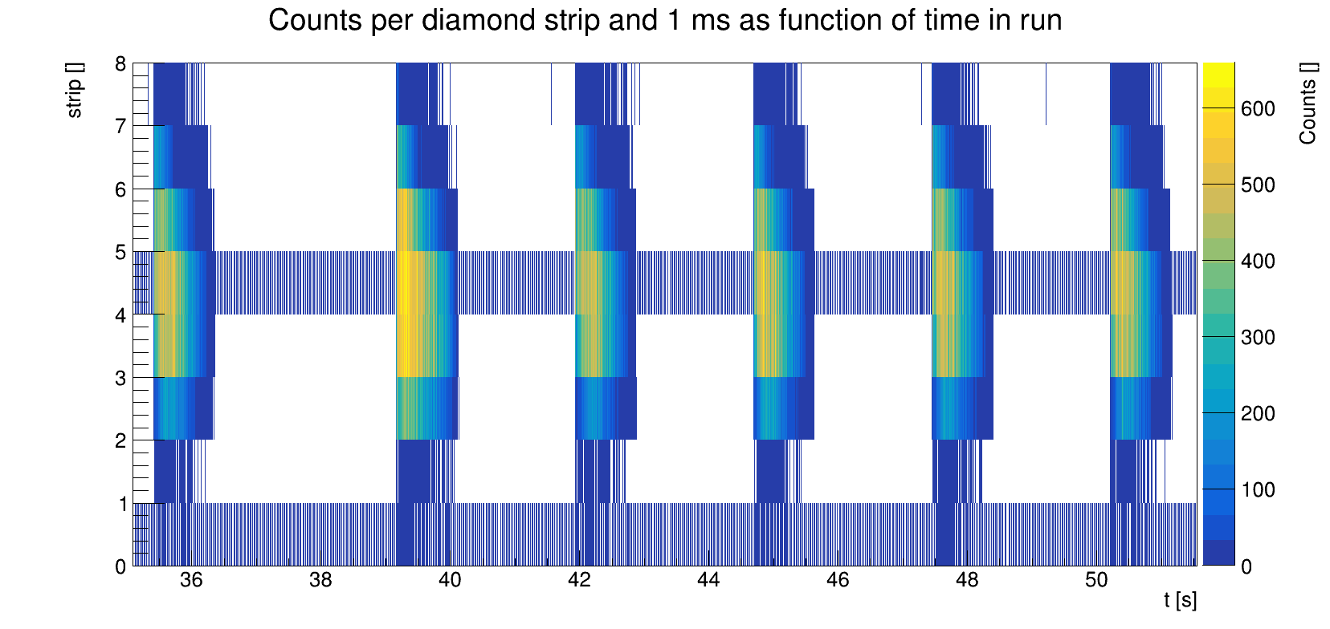
Diamond T0 counter: first preliminary results
back side
target
ladder
diamond counter:
8x strips
2mm width each

Slide 18
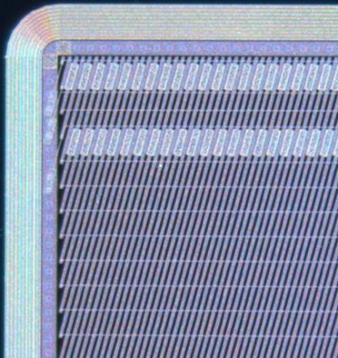
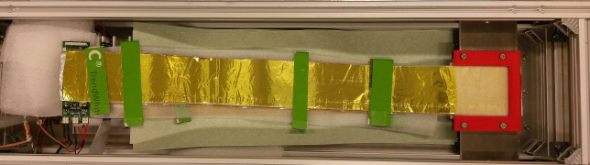
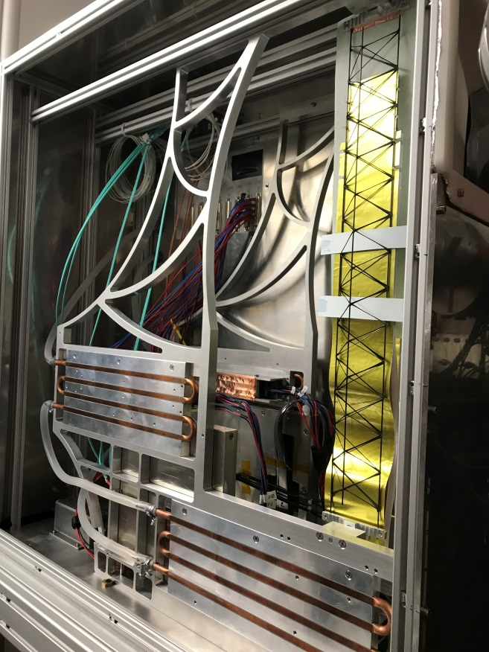
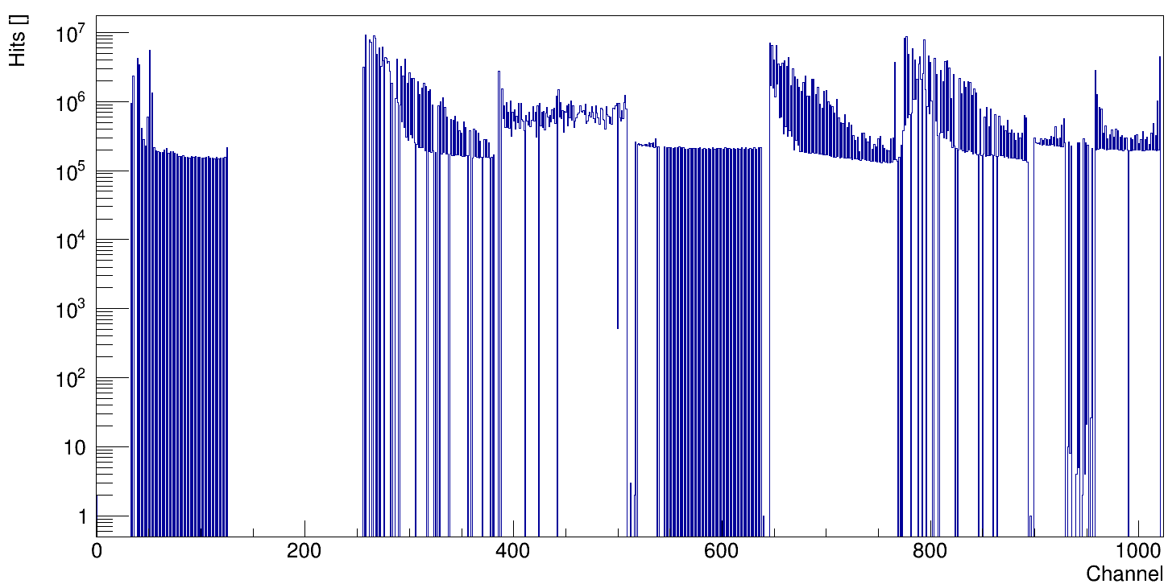
mSTS - first preliminary results
Double-sided silicon micro strip sensor (58 μm pitch, 300 μm thickness)
module
FEB-8
microcables and shield
sensor
mounting plate
module 01Tr
module 02Tr
sensor
6x6 cm²
carbon fiber support
micro cables
March 11, 2019
FEE box

Slide 19
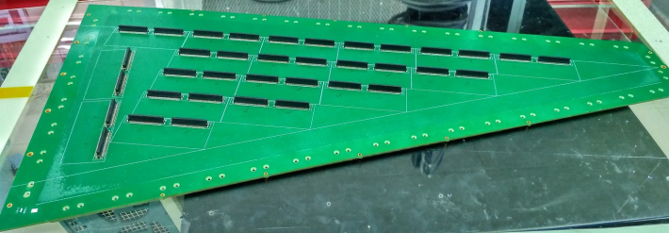
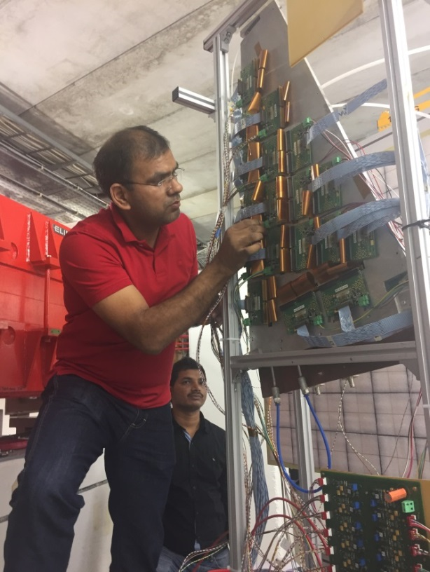
mMUCH - first preliminary results
real-size GEM modules, ≈ 2000 pads (3mm – 2cm)
black: all
blue: noisy ch. removed
red: noisy ch. + dupl. hits removed

Slide 20
mTRD subsystem
M W PC 95 x 95 cm² :
Pad sizes: 155 x 7.2 mm²
6 x 128 = 768 Pads per chamber
Groups of 2 x 16 Pads on one connector
7 of 8 groups read per line to suit 14 e-links per line
Active volume spacing:
– 3.5 / 3.5 / 5 mm
Nominal 1850 V on anode wires,
-500 V on entrance window
ArCO₂ with 3 l/h as operating gas from , gas mixing station,
outlet to Oxygen monitoring

Slide 21
mTOF - first preliminary results
configuration:
double stack
triple stack
beam
1600 channels:
32(channels) * 2(sides) * 5(MRPCs) * 5(modules)
event building
by time clustering

Slide 22
mRICH subsystem
6 × 6 H12700 64ch MAPMT
6 FEE modules
1 for 6 PMTs, each with:
• 12 DiRICHs (32ch TDC)
• combiner & power board
TRB3sc
subevent building
Installation:
Fr. & Sa., March 15/16, 2019
aerogel pads
mRICH: aerogel proximity focusing RICH
to adapt to energy of SIS18

Slide 23
mFLES (First Level Event Selection)
New Hardware
Login Node
• 2x Xeon Gold 6140: 18 cores, 2,3 - 3,7 GHz
• 192 GB RAM, 2x 2 TB NVMe SSD
• 10 G ethernet uplink to GSI
Processing Nodes
• 2x Xeon Gold 6130: 16 cores, 2,1 - 3,7 GHz
• 192 GB RAM, 2x 2 TB NVMe SSD
• Infiniband HDR (200 Gbit/s)
Network
• 40 port Infiniband HDR switch
• 4 dual socket HDR HCAs (200 GBit/s)
green IT cube

Slide 24
First commissioning with beam during machine engineering runs, December 2018
Dec. 14, 2018, 01:12
beam:
Ag (45+), 1.2 AGeV,
1.4 s spill
2x spills
mSTS
mMUCH
mTOF A
mTOF B
1st combined,
synchronized
data transport
of all installed
subsystems:
→ correlations !
very preliminary -
not calibrated !
diamond
T0 counter
t_{subsystem} – T0 [ns]

Slide 25
mCBM commissioning data taking, March 16, 2019
Diamond T0:
GSI
mSTS:
GSI &
Univ. of
Tübingen
mRICH:
Univ. of
Gießen &
Wuppertal
mTOF:
Univ. of
Heidelberg
mTRD:
Univ. of
Münster &
Frankfurt
mMUCH:
VECC
Kolkata
mFLES:
FIAS &
Univ. of
Frankfurt

Slide 26
Summary
Sep. 2017 mCBM proposal accepted
Oct. 2017 construction started
Apr. 2018 civil construction completed
Dec. 2018 comm. with beam started
Nov. 2017
Dec. 2018
Data transport to a computer farm
inside the GreenITCube established
combined & synchronized
data transport → correlations
prelim.
not cal.
ongoing:
completion of detector stations
installation of subsystems
stabilizing synchronous read-out
development of data analysis

Slide 27
2018 - 2022
mCBM@SIS18
full system test-setup for high-rate A+A collisions
to test prototype detectors
to test front-end electronics (FEE)
to develop & test the data transport to DPB & FLIB (1st and 2nd FPGA)
to develop & test the data transport to FLES
to develop & test μ-slice + time-slice building
to develop & test the data analysis
to test & develop data transport using a CRI
to develop & test a general timing + fast control system (TFC)
to develop & test the detector + experiment control system (DCS & ECS)
to develop & test the online reconstruction + selection
to develop & test the software online framework
2018 –
Q2 2019
Q2 2019
+
CBM @SIS100
2025 -

Slide 28
mCBM data taking at FAIR Phase-0
2018→ 2019 | development & commissioning data transport, data analysis, detector tests
2019→ 2020 | approaching full performance subsystems completed, high-rate data transport / processing → online reconstruction
requested beamtime
was fully granted
by GSI/FAIR G-PAC
2021 | 1st benchmark run Λ reconstruction production runs benchmark coll. systems: Ni+Ni 1.93AGeV & Au+Au 1.24AGeV
2022 | 2nd benchmark run Λ reconstruction in Ni+Ni and Au+Au collisions at various projectile energies → Λ production excitation function
proposal to be submitted in 2019/20

Slide 29
Transition from DPBs to CRI in 2019
2018
2019
CRI
replace DBP & FLIB by a single PCIe board called CRI (Common Readout Interface)
(→ μTCA crates and AFCKs will disappear from the DAQ)

Slide 30
CBM Collaboration: 55 institutions, 470 members
China:
CCNU Wuhan
Tsinghua Univ.
USTC Hefei
CTGU Yichang
Chongqing Univ.
Czech Republic:
CAS, Rez
Techn. Univ. Prague
France:
IPHC Strasbourg
Germany:
Darmstadt TU
FAIR
Frankfurt Univ. IKF
Frankfurt Univ. FIAS Frankfurt Univ. ICS
GSI Darmstadt
Giessen Univ.
Heidelberg Univ. P.I.
Heidelberg Univ. ZITI
HZ Dresden-Rossendorf
KIT Karlsruhe
Münster Univ.
Tübingen Univ.
Wuppertal Univ.
ZIB Berlin
Russia:
IHEP Protvino
INR Troitzk
ITEP Moscow
Kurchatov Inst., Moscow
VBLHEP, JINR Dubna
LIT, JINR Dubna
MEPHI Moscow
PNPI Gatchina
SINP MSU, Moscow
Ukraine:
T. Shevchenko Univ. Kiev
Kiev Inst. Nucl. Research
India:
Aligarh Muslim Univ.
Bose Inst. Kolkata
Panjab Univ.
Univ. of Jammu
Univ. of Kashmir
Univ. of Calcutta
B.H. Univ. Varanasi
VECC Kolkata
IOP Bhubaneswar
IIT Kharagpur
IIT Indore
Gauhati Univ.
Korea:
Pusan Nat. Univ.
Poland:
AGH Krakow
Jag. Univ. Krakow
Warsaw Univ.
Warsaw TU
Romania:
NIPNE Bucharest
Univ. Bucharest
Hungary:
KFKI Budapest
Eötvös Univ.
30th CBM Collaboration meeting in Wuhan
24-28 September 2017
CBM Scientists

