Slide 1
HE Beschleuniger und Technologien
(50 Jahre in 10 Minuten!)
Frank Tecker, BE department, CERN
Linearbeschleuniger + Beschleunigungsstrukturen:
  CLIC
  ILC
Ringbeschleuniger + Hochfeldmagnete:
  FCC-hh, FCC-eh, FCC-ee
  HE-LHC
Andere Beschleuniger Projekte

Slide 2
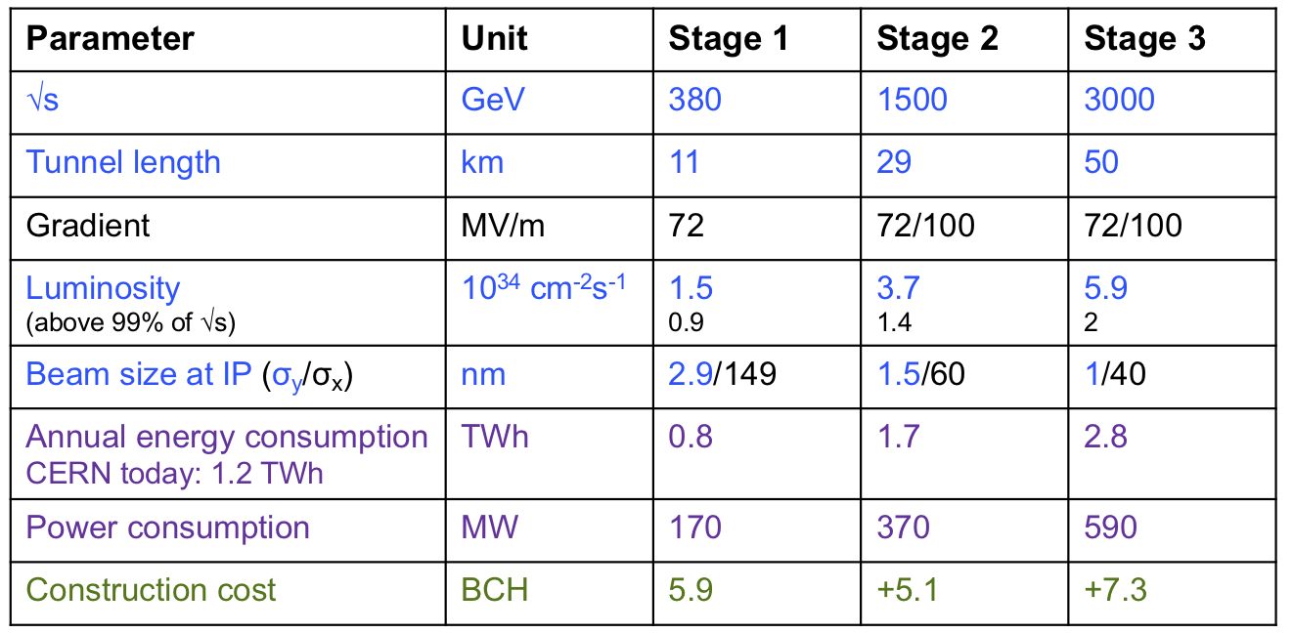
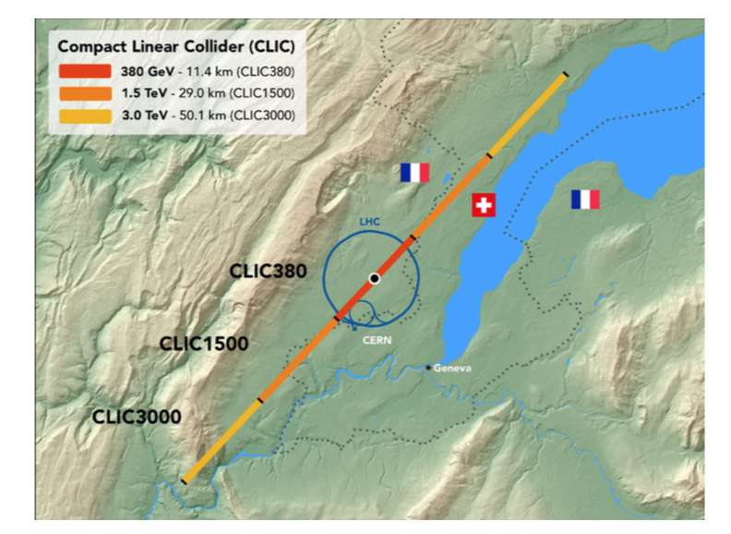
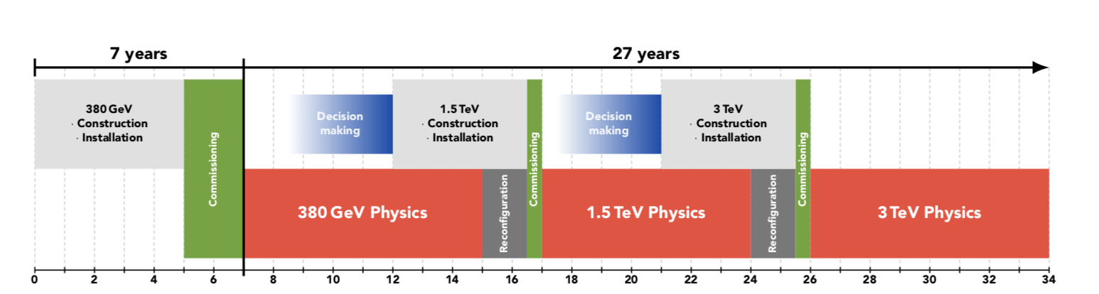
CLIC: multi-TeV e⁺e⁻ linear collider
Fabiola Gianotti
Recent development of key technologies, progress towards demonstration of design parameters:
100 MV/m accelerating structures with low breakdown rate
two-beam acceleration scheme demonstrated (CTF3) up to 145 MV/m
R&D on alignment and vibration stabilization systems
reduction of energy consumption (optimisation ongoing for 1.5 and 3 TeV) and cost
Technically:
construction could
start in ~2026
(TDR in 2025)
start operation at
√s=380 GeV in ~2035
1 ab⁻¹
2.5 ab⁻¹
5 ab⁻¹

Slide 3
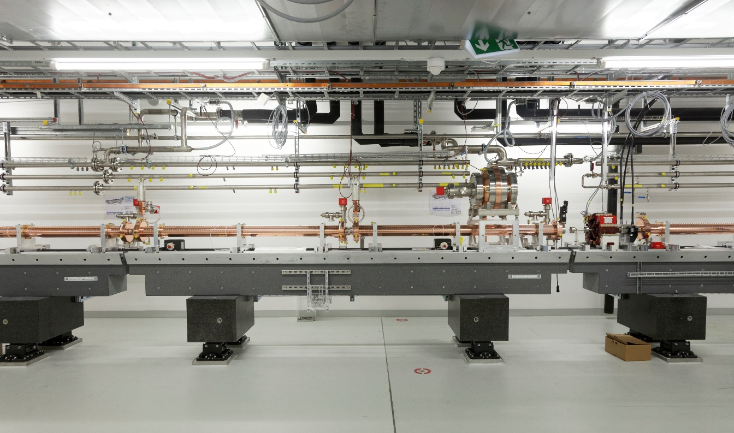
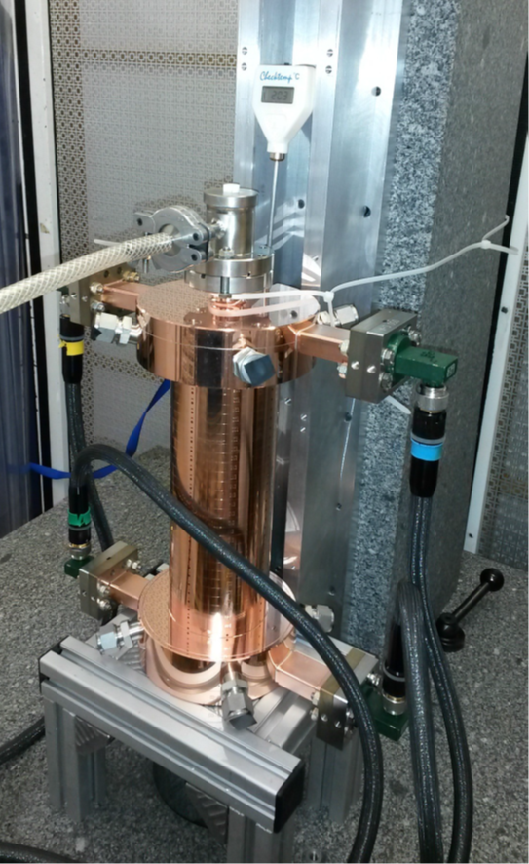

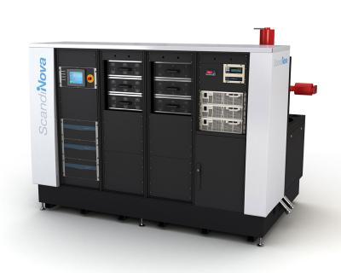
X-band NCRF technology
Swissfel: Specs similar,
reached
Prototype components
Laboratory with commercial
Accelerating structures
pulse compressors
alignment
stabilization
etc.
Full commercial supply
X-band klystrons
solid state modulators
etc.
Normal-conducting, low- emittance GeV-range facilities
Operational (C-band)
SACLA
SwissFEL
Systems and 100 MeV-range facilities
XBoxes at CERN
(NEXTEF KEK)
Test stand at Tsinghua
Frascati
NLCTA SLAC
Linearizers at Electra, PSI, Shanghai and Daresbury
Deflectors at SLAC, Shanghai, PSI and Trieste
NLCTA
Smart*Light
FLASH
Gradients
X-band GeV-range facilities
Planning:
EU-Praxia
eSPS
CompactLight
Technology now commercially produced, and used at various laboratories
Gradients around 100 MV/m well-demonstrated

Slide 4
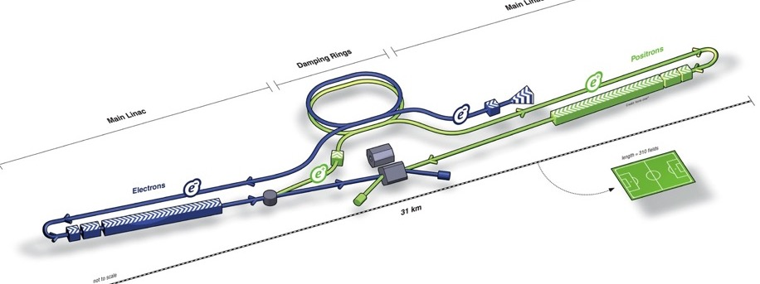
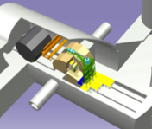
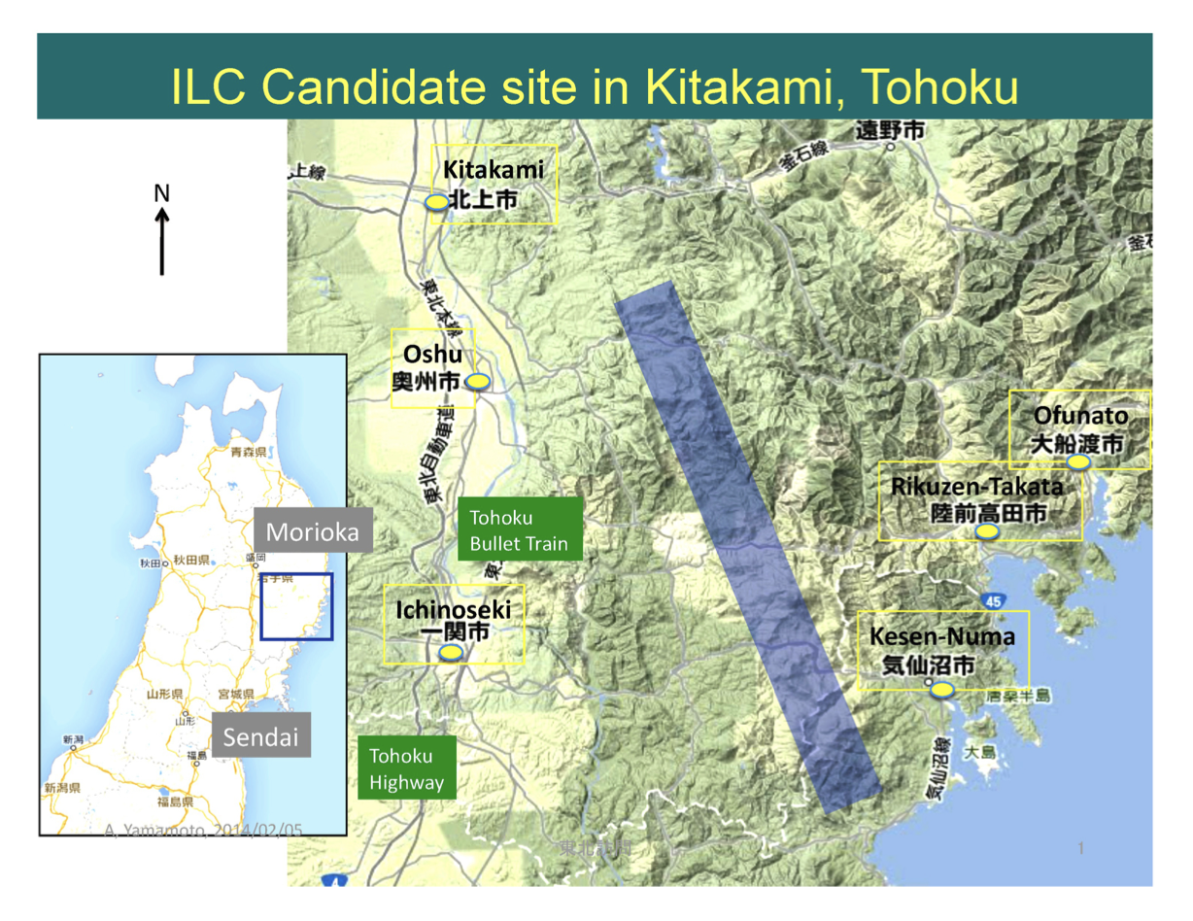
ILC: international linear collider
Damping Ring
e- Source
Physics Detectors
e+ Main Linac
e+ Source
e- Main Linac
250 GeV centre-of-mass energy
(option of later upgrade to energies of around 1 TeV)
Superconducting RF technology
~20 km length
Site chosen in north of Japan
¥800bn ($7.5bn) construction cost

Slide 5

Advances in L-band (~ 1GHz) SRF Cavity Gradient
Courtesy: R. Geng,
ILC upgrade goal
ILC 250 spec.
Very good progress in SC Cavity technology
Steady increase in gradients

Slide 6
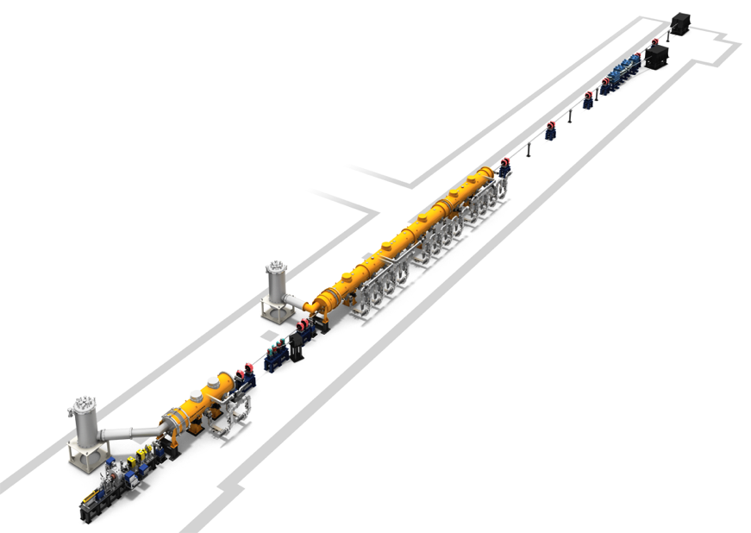
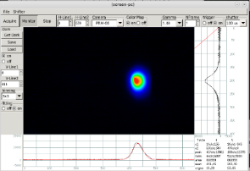
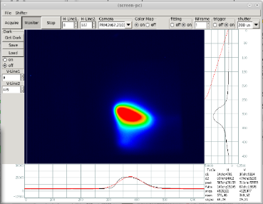
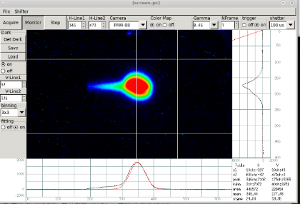
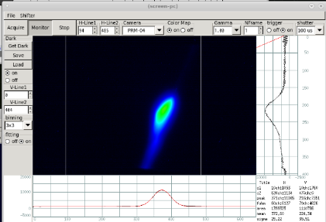
SCRF: beam commissioning in STF-2 (KEK)
32 MV/m operation is confirmed by beam operation on March, 2019
preliminary
~260 MeV
CM1 + CM2a
~40 MeV
Achievements in STF-2 accelerator
Beam energy | ~271 MeV
Beam power | ~68 W
Beam current | ~263 nA
Average gradient @CM1/2a | ~32 MV/m
Capture CM | ~20 MV/m
Capture CM
(Two cavities)
~3 MeV
High gradient also operationally demonstrated
Well-demonstrated in large scale at Euro-XFEL

Slide 7
ILC: international linear collider status
2018: Science Council of Japan (SCJ) report failed to support the ILC’s construction in Japan.
  did not yet have enough international backing
  collider’s importance beyond research “unclear” and “considered to be limited”
2019: Statement by MEXT (Japanese Ministry of Education, Culture, Sports, Science and Technology) at ICFA and LCB meetings on 7 March 2019 in Tokyo https://www.kek.jp/en/newsroom/2019/03/13/2100/
Japanese government has formally “expressed an interest”
but has not decided whether to host the machine
The final go-ahead will only be given if
  enough international support and funding can be found to construct the ILC
  - negotiations on cost sharing will be carried out by officials from KEK
  and
  consensus within the Japanese scientific community that it is worth pursuing:
  - needs to be included in the next roadmap of large science projects
  - ILC proposal submitted with recommendation letter from Barry Barish
”Preparation plan for European participation in the ILC”, describing possible scientific and industrial contributions of Europe to the ILC over a four-year preparatory phase, prepared by E-JADE (Europe-Japan Accelerator Development Exchange Programme, H2020)

Slide 8
(Linear Collider) Summary
CLIC and ILC have both submitted very complete ESU proposals for implementation of a LC being ready for start up ~2035
  One focused on being hosted at CERN, the other hosted in Japan
  In both cases promoted and set up as international projects
The main accelerator technologies have been demonstrated
The cost and implementation time are similar to LHC
The physics case is broad and profound, and being further developed
The detector concept and detector technologies R&D are advanced
Implementing a LC now provides a very attractive, implementable way forward, with a good match between scientific progress and further technology development – not only for LC technologies ..
The projects are presented in number of comprehensive publications:
https://clic.cern/european-strategy and https://ilchome.web.cern.ch/content/ilc-european-strategy-document
Thanks to all my Linear Collider colleagues – all the work and summaries presented are theirs

Slide 9
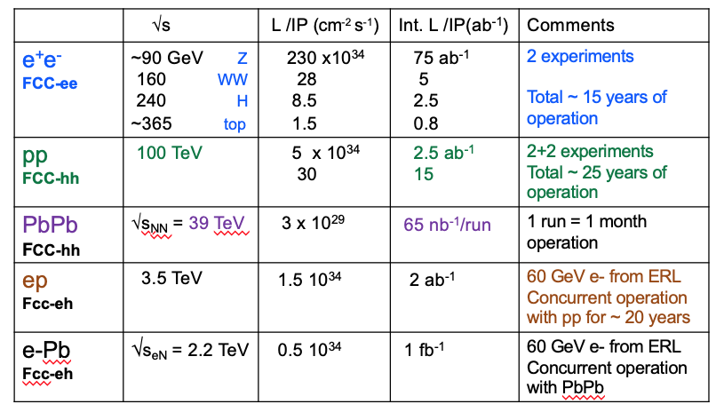

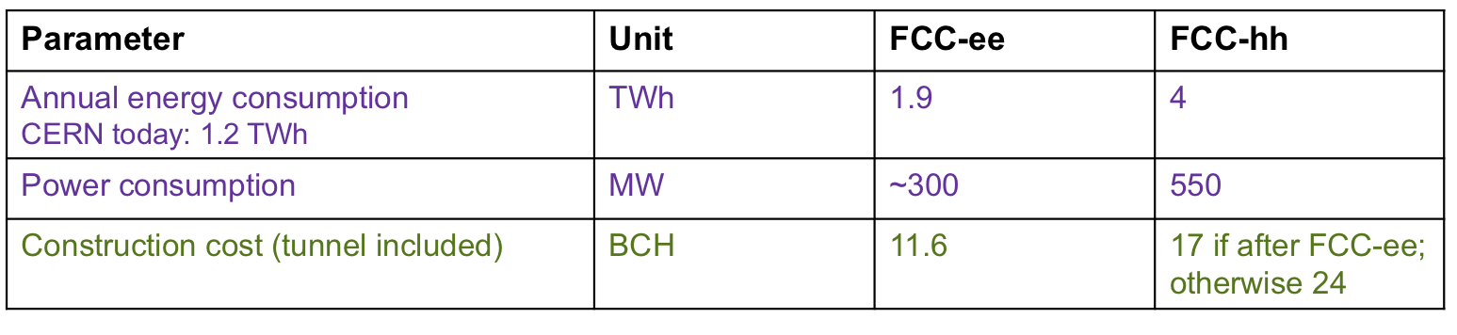
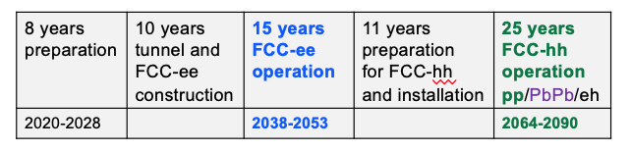
FCC: Future Circular Collider
Fabiola Gianotti
HE-LHC
Also studied: HE-LHC: √s=27 TeV using FCC-hh 16 T magnets in LHC tunnel; L~1.6x10³⁵ → 15 ab⁻¹ for 20 years operation
Preliminary, purely technical schedule for
integrated programme (FCC-ee followed by
FCC-hh), assuming green light to
preparation work in 2020.

Slide 10

FCC integrated project technical schedule
FCC integrated project plan is fully integrated with HL-LHC exploitation
provides for seamless further continuation of HEP in Europe.

Slide 11
Conclusions from HE LHC studies
Performance
26 - 27 TeV cm collision energy
~10 ab⁻¹ per experiment collected over 20 years
Key technology: high-field magnets FCC-hh
Very challenging option due to existing boundary conditions:
Machine integration due to space limitations (tunnel cross section, straight section length, caverns) of existing underground infrastructures
Compatibility with safety requirements
Increased cryogenics requirements
Injector requirements
  LHC tunnel diameter 3.8 m
8 additional 1.8 K refrigeration units
8 new higher-power 4.5 K cryoplants

Slide 12
Conclusions and outlook
As recommended by the ESU 2013, the FCC study was organised as an international collaboration focused on the conceptual design of high-performance energy frontier circular colliders for the post-LHC era.
The first phase of FCC conceptual design studies is completed. Baseline machine designs and associated infrastructures, with performance matching the physics requirements, were established and are documented in 4 CDRs.
A possible integrated FCC programme has been developed and submitted to the ESU, together with descriptions of the individual machines.
The next steps, in parallel to ESU process and in harmony with its recommendations, will develop a concrete local/regional implementation scenario in collaboration with host state authorities, accompanied by machine optimization, physics studies and technology R&D.

Slide 13
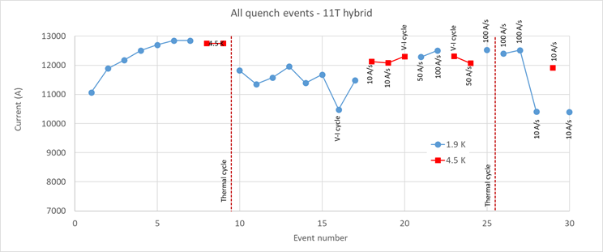
HL-LHC 11.2T magnets
LBH_A (11T)
By-pass cryostat with collimator
LBH_B (11T)
Complete 11.2 T cryo-assembly replacing a 15 m long 8.3 T LHC dipole
Operation 7 TeV
7 TeV
L. Bottura & A. Devred
HiLumi WP11- F. Savary et al.
Hybrid (long proto): Excellent!, But strong permanent degradation after thermal cycle. Absence of thermal gradient control in the procedure.

Slide 14
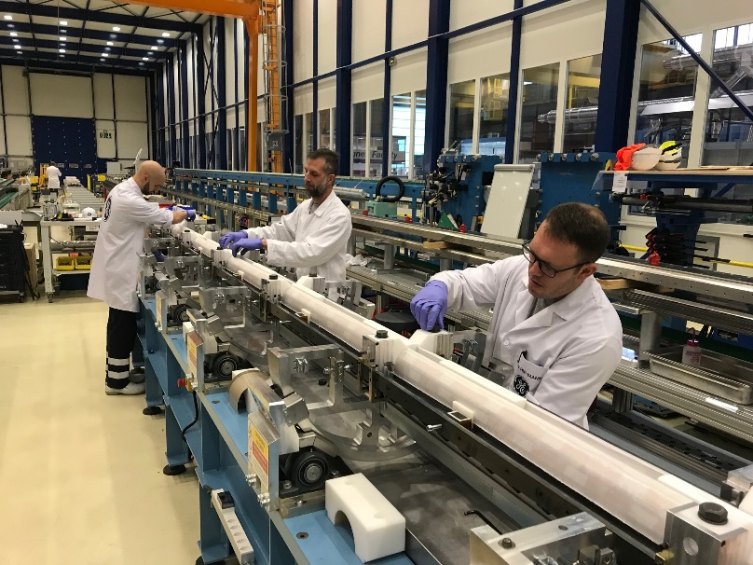
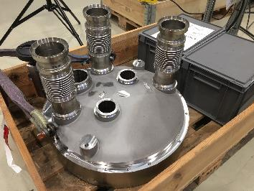
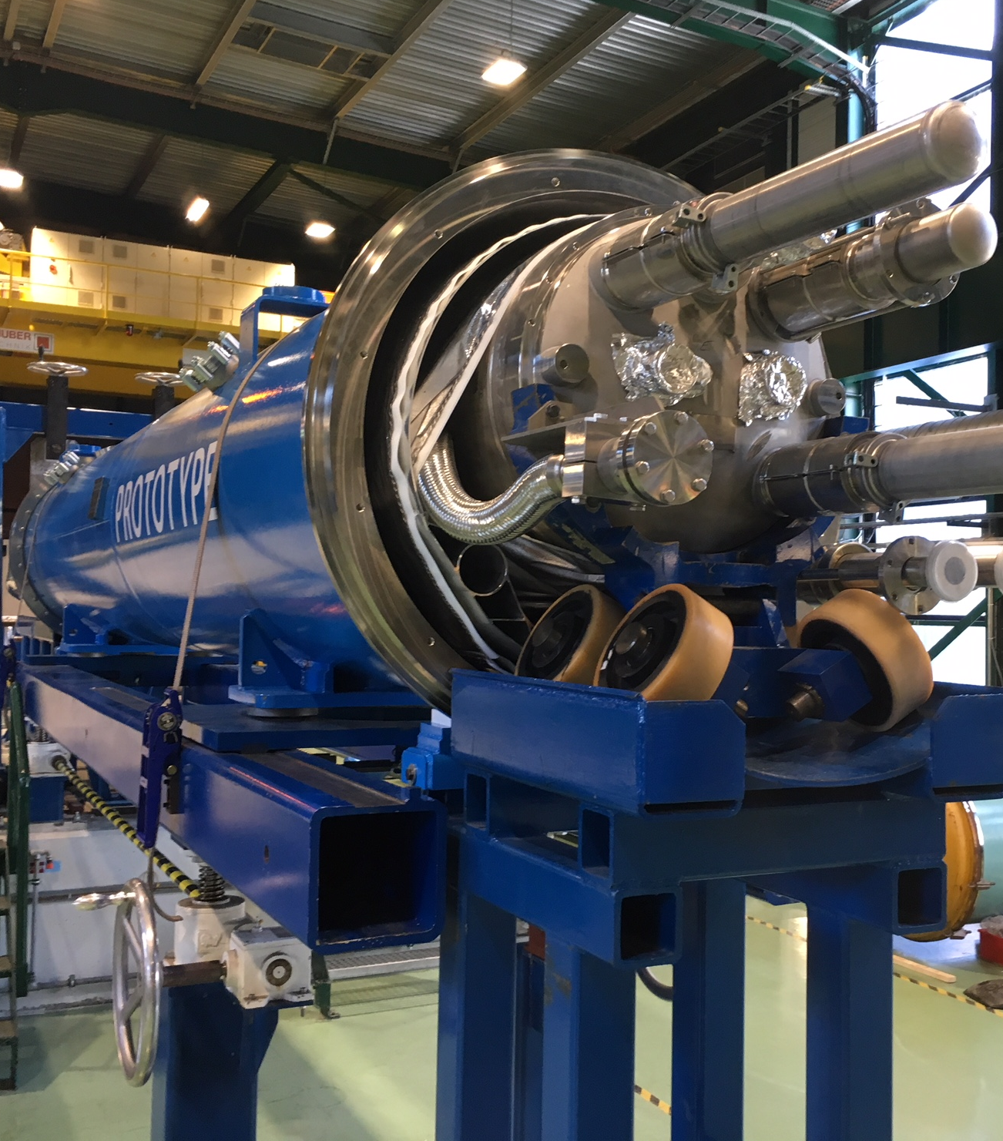
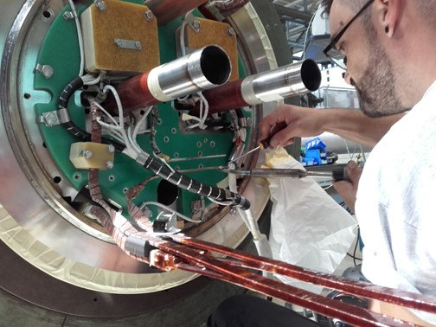
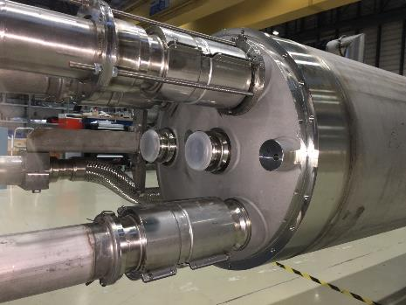
11 T in full swing production: LS2 installation in 2020! great care given the stress sensitivity of Nb₃Sn

Slide 15



Overview of 16 T magnet R&D
EuroCirCol WP5 (CEA, CERN, CIEMAT, UNIGEneva, KEK, INFN, TampereU, UTwente)
Feed the FCC CDR with design and cost model of 16 T magnets
FCC 16 T Magnet Development, supporting:
conductor development & procurement
R&D magnets and associated development
model magnets
US Magnet Development Program (ASC/NHMFL, BNL, FNAL, LBNL)
14-15 T cosine-theta magnet (2017-2019)
Design, manufacture, and test of a 2-layer 10 T CCT magnet
Novel diagnostics and advanced modeling techniques
Prototype magnets are being assembled
Nb₃Sn Technology challenging

Slide 16
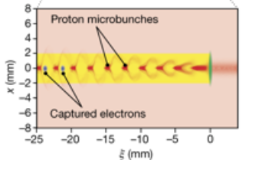
Other accelerator activities
Physics Beyond Colliders
Study group set up in 2016 to explore opportunities offered by CERN’s accelerator complex and other scientific infrastructure to get insight into some of today’s outstanding questions in particle physics through projects complementary to high-energy colliders (i.e. projects requiring different types of beams and experiments) and other initiatives in the world.
AWAKE (Advanced Proton Driven Plasma Wakefield Acceleration Experiment) :
Goal: proof-of-concept demonstration of new acceleration technique: 400 GeV p from SPS generate
strong EM fields in a 10 m plasma cell → injected e⁻ beam accelerated in the wake of the p beam
camera
Laser
RF gun
spectrometer dipole
e⁻
10m Rubidium plasma
scintillator
SPS
protons
p
quadrupoles
Proton diagnostics
OTR, CTR, TCTR
Laser
dump
protons
2018: first demonstration of p-driven e⁻ acceleration: 20 MeV → 2 GeV over 10 m
→ corresponds to gradient of 200 MV/m
Next step (AWAKE Run 2): demonstrate ~ 1 GV/m gradient and e⁻ beam emittance preservation
→ towards the use of AWAKE beams for physics applications

Slide 17
Conclusion
A variety of future HE accelerator are being studied
Designs reached a mature level
Technologies have been / are being developed
European Strategy Update should give some priorities
ILC decision in Japan can change the picture
Many thanks to
Fabiola Gianotti, Michael Benedikt, Lucio Rossi, Steinar Stapnes, Paul Collier, Davide Tommasini for the material

Slide 18
Spares

Slide 19
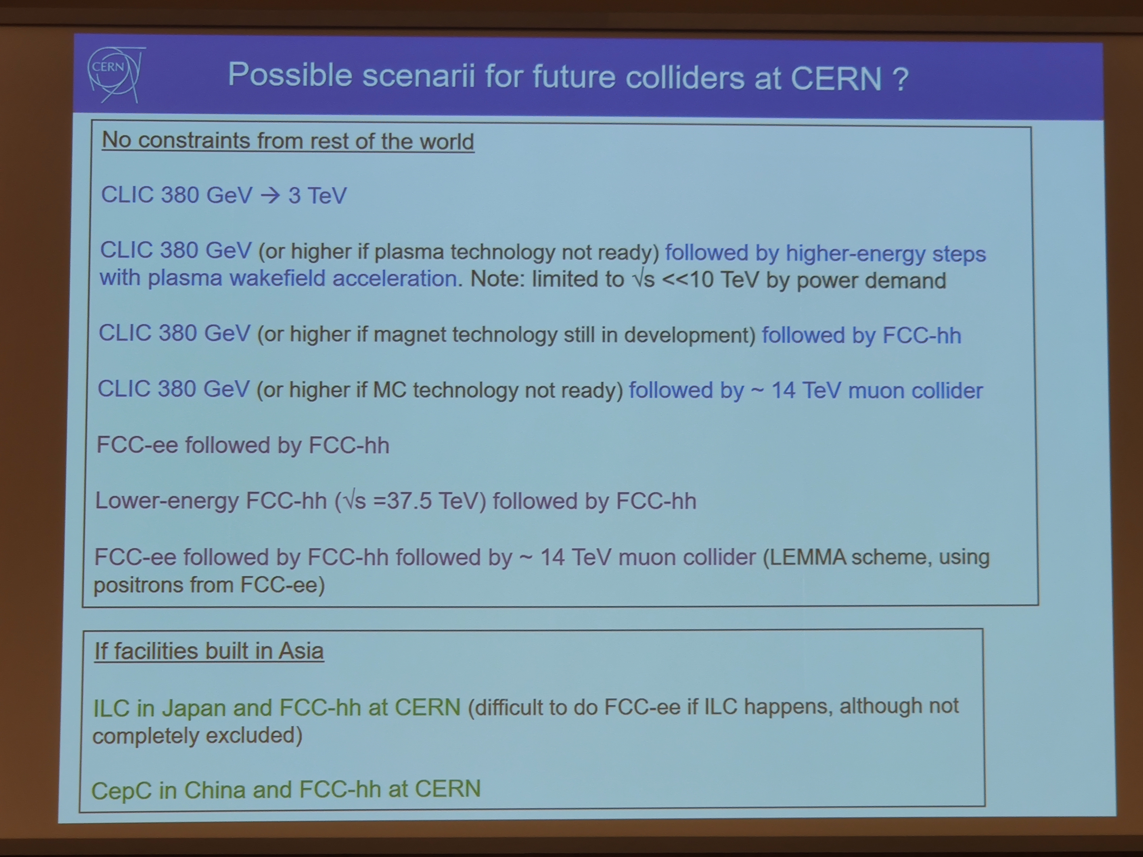
F.Gianotti: Outcome of the Granada Open Symposium (3 July – CERN)

Slide 20
Physics Beyond Colliders (PBC)
Fabiola Gianotti
Physics Beyond Colliders study group set up in 2016 to explore opportunities offered by CERN’s
accelerator complex and other scientific infrastructure to get insight into some of today’s outstanding
questions in particle physics through projects complementary to high-energy colliders
(i.e. projects requiring different types of beams and experiments) and other initiatives in the world.
Projects should exploit the uniqueness of CERN accelerator complex and infrastructure.
QCD measurements
COMPASS++, DIRAC++
NA61++, NA60++
Fixed target (gas, bending crystals) in ALICE and LHCb
Hidden sector with “beam dump”
NA64++ (e,μ)
NA62++
Beam Dump Facility at North Area (SHiP)
LDMX@eSPS
AWAKE++
Rare decays and precise measurements
KLEVER (K⁰_{L} → π⁰𝜈𝜈)
TauFV@BDF: 𝜏 → 3μ
REDTOP (𝜂 decays)
MUonE (hadronic vacuum polarization for (g-2_{μ}))
Proton EDM
Long-lived particles from LHC collisions
FASER, MATHUSLA, CODEX-b, milliQAN
Other proposed facilities:
𝛾-factory from Partially Stripped Ions; nuSTORM
Non-accelerator projects
Exploit CERN’s technology (RF, vacuum, magnets, optics, cryogenics) for
experiments possibly located in other labs.
E.g. axion searches: IAXO (helioscope), JURA (Light Shining through Wall)
20

Slide 21
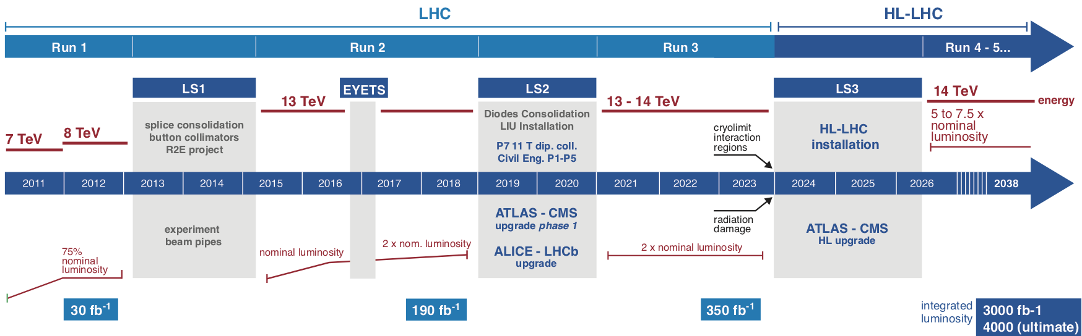
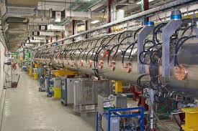
HL-LHC parameters and timeline
Fabiola Gianotti
LS2 (2019-2020):
LHC Injectors Upgrade (LIU)
Civil engineering for HL-LHC equipment P1, P5
Installation of (part of) 11T Nb₃Sn dipoles for HL-LHC
Phase-1 upgrade of LHC experiments
LS3 (2024-2026):
HL-LHC installation
Phase-2 upgrade of ATLAS and CMS
LIU will provide beams of intensity and brightness
needed by HL-LHC (2.3x10¹¹ p/bunch, ε~ 2.1 μm)
Linac 4: 160 MeV H⁻
PSB: 1.4→ 2 GeV
PS: new injection and feedback systems
SPS: new 200 MHz RF system
21

Slide 22
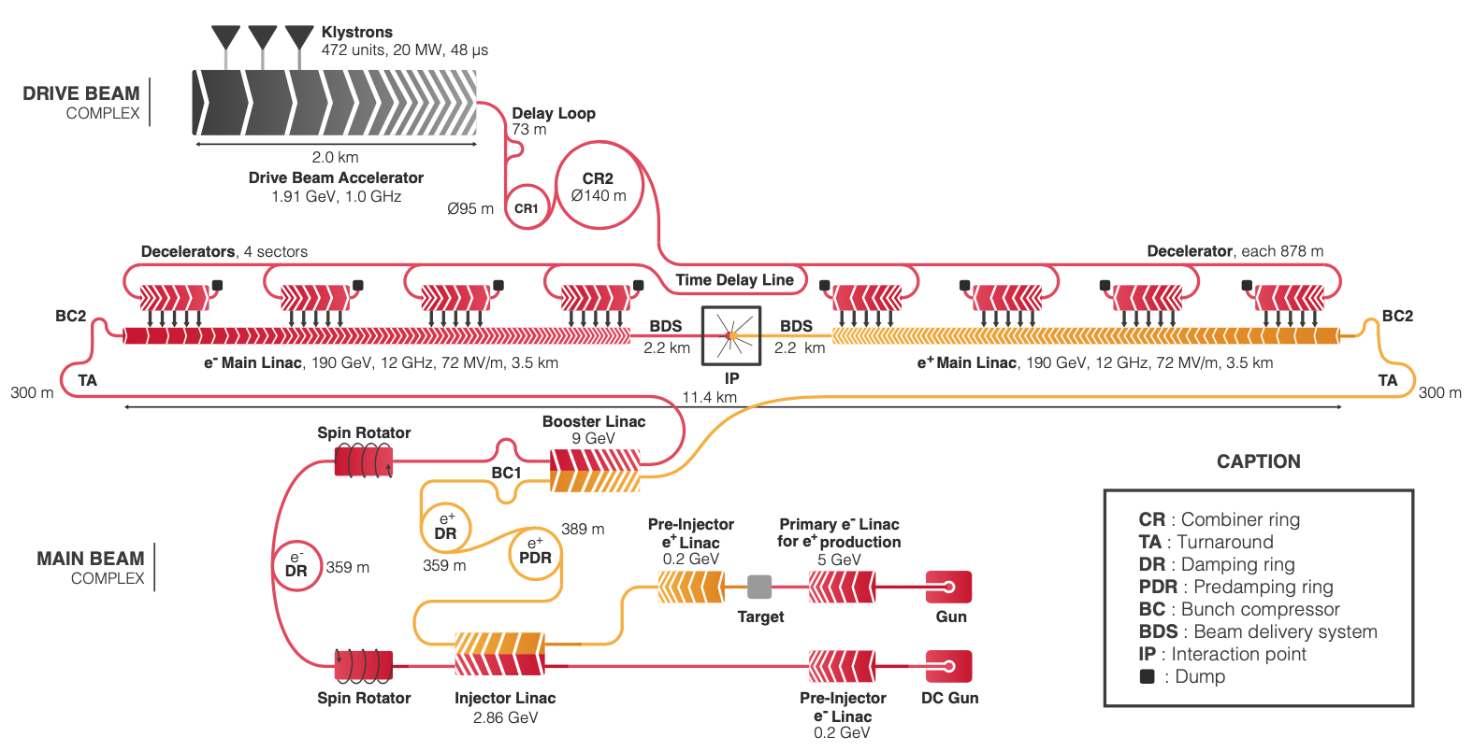
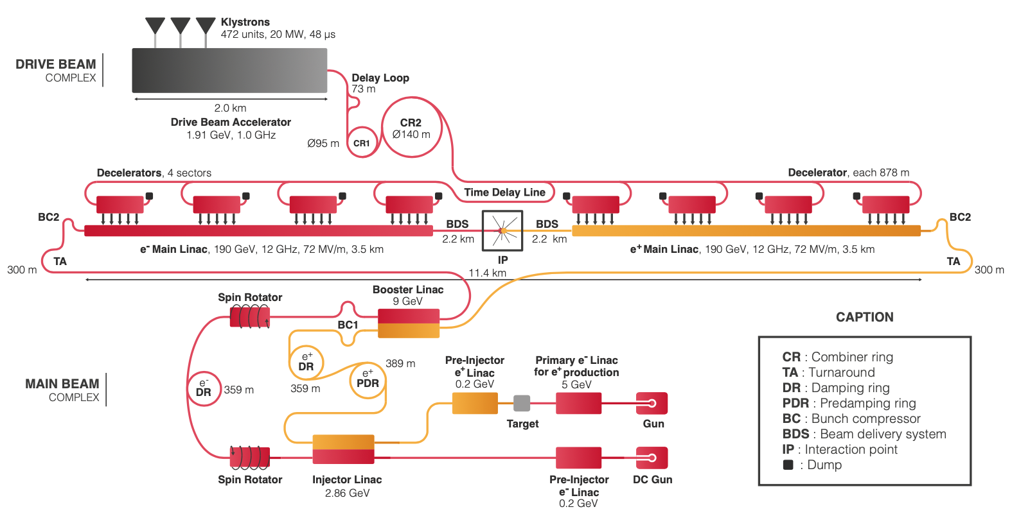
CLIC 380 GeV layout and power generation
Baseline electron polarisation ±80%

Slide 23
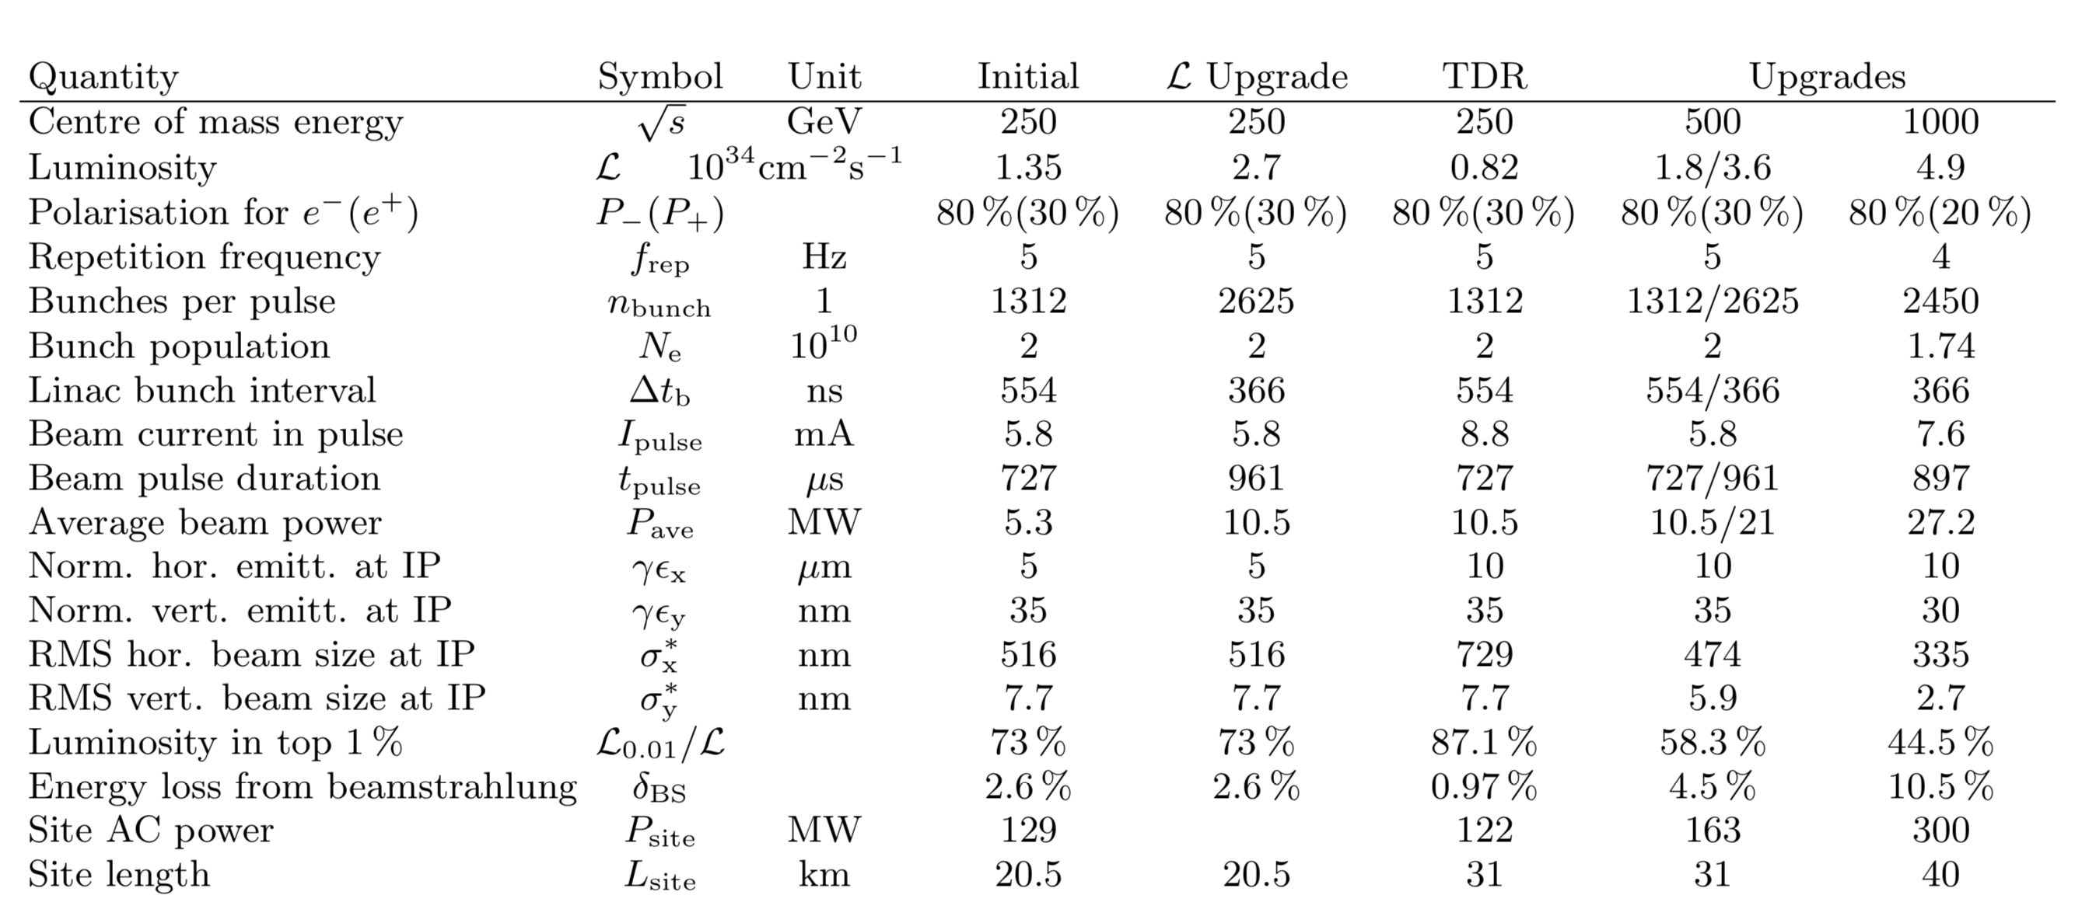
ILC Design Overview
Damping Ring
e- Source
Physics Detectors
e+ Main Linac
e+ Source
e- Main Linac
Luminosity upgrade to 10 Hz at 250 also considered

Slide 24
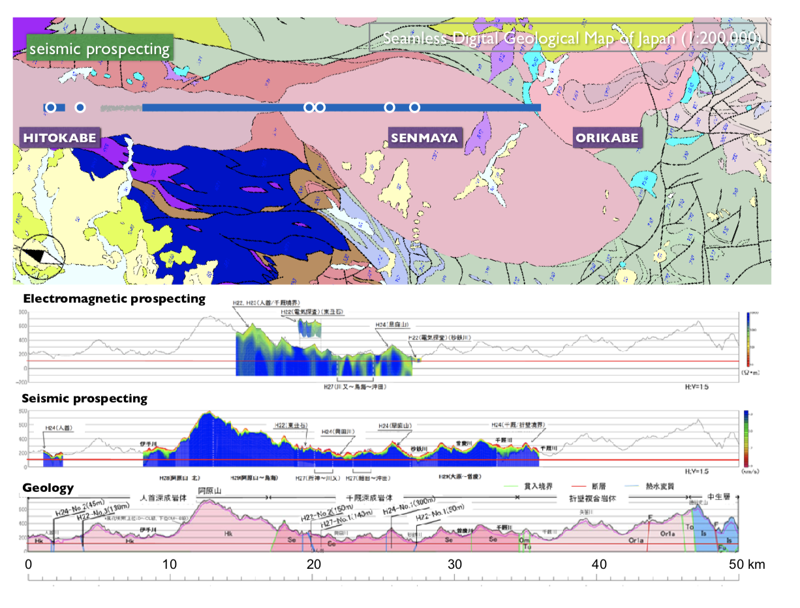
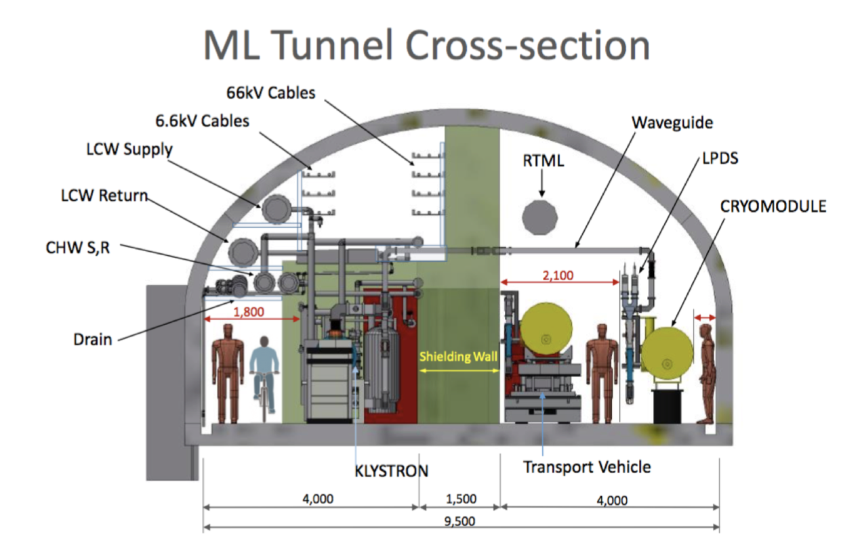
ILC in Japan
Extensive studies of civil engineering, local layout of accelerator and lab, general and specific infrastructure - for the Kitakami site

Slide 25
Processes toward realization of ILC
2018.12
2019.3
2020.5
2024-
Announcement
by Japanese government
Discussion among governments
Exchange of information
Start negotiations among governments
on international sharing
Agreement on governance,
operation, sharing of cost
and human resources
Strengthen US-Japan Discussion Group, cost reduction R&D,
governance discussion
Start construction of ILC
Full-scale negotiation among
governments – specification of
conditions and processes
Final agreement among governments
on construction
Government Level
MEXT
panel
Summarize
opinions of
relevant
ministries
Establish Discussion Group with
the European partners
Critical decision
process
MOU among research labs on start of
the preparation phase under approval by each government
Oct. 2019
Next Roadmap
by MEXT
SCJ committee on ILC
SCJ Master Plan
3/7
Physicists Level
LCB/ICFA mtgs. @ Tokyo
EPPSU submitted to CERN
ILC pre-lab
(4 years)
European Particle Physics Strategy Update
Establish KEK International WG
Produce draft for international sharing of
human and material resources
Draft proposal by researchers
on international cost sharing
Talks with other countries
Good enough design for the final approval of construction, resolution of remaining technical issues
＊ICFA: international organization of researchers consisting of directors of world’s major accelerator labs and representatives of researchers
＊ILC pre-lab: International research organization for the preparation of ILC based on agreements among world’s major accelerator labs such as KEK, CERN, FNAL, DESY etc.

Slide 26
ILC-250 construction
Update: 190510a

Slide 27
FCC integrated project cost estimate
Construction cost phase1 (FCC-ee) is 11,6 BCHF
5,4 BCHF for civil engineering (47%)
2,2 BCHF for technical infrastructure (19%)
4,0 BCHF accelerator and injector (34%)
Construction cost phase 2 (FCC-hh) is 17,0 BCHF.
13,6 BCHF accelerator and injector (57%)
  Major part for4,700 Nb₃Sn 16 T main dipole magnets, totalling 9,4 BCHF, targeting 2 MCHF/magnet.
CE and TI from FCC-ee re-used, 0,6 BCHF for adaptation
- 2,8 BCHF for additional TI, driven by cryogenics
(Cost FCC-hh stand alone would be 24,0 BCHF.)

