Slide 1
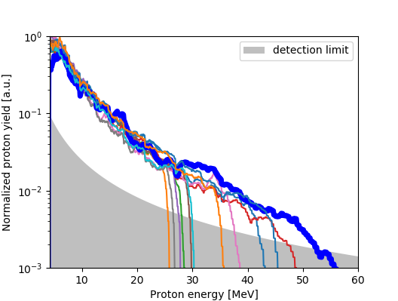
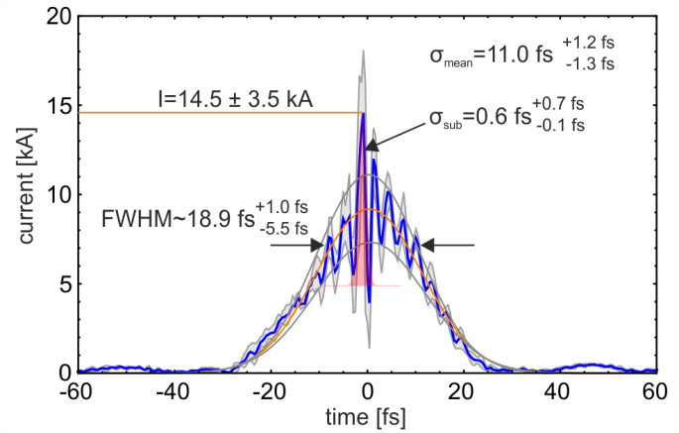
Prospects and Challenges of Laser Plasma Acceleration 2020 ff
Thoughts along the line of turning Novel Acceleration Concepts into
Novel Accelerators and their Applications based on present achievements
LWFA-PWFA hybrid
Bright Betatron radiation
Intense neutron pulses
>10 kA electron peak current
and fs-scale metrology
Predictive simulation
capability (onset)
Femto-scale metrology
Leading laser
infrastructure
>50 MeV protons @ 15J laser
energy, near Debris-free

Slide 2
Prospects and Challenges of Laser Plasma Acceleration 2020 ff
Thoughts along the line of turning Novel Acceleration Concepts into
Novel Accelerators and their Applications
Controlled beam quality (charge, energy, bandwidth, emittance,
pulse duration, slice properties)
Advanced metrology (on-target laser diagnostics, on-shot plasma
diagnostics, femto-scale diagnostics, beam
metrology, active feedback)
Application ready throughput (repetition rate, i.e. kHz for electrons and
photon sources, 1Hz for ions)
Laser and target technology development

Slide 3
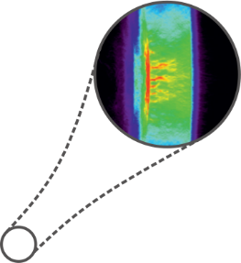
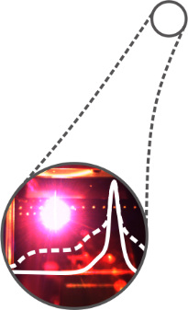
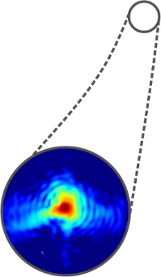
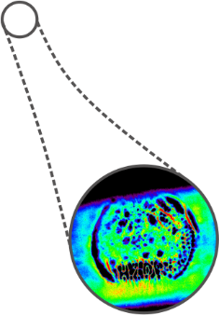
Energy transfer
and transport
Proton acceleration
Dose delivery

Slide 4
Prospects and Challenges of Laser Plasma Acceleration 2020 ff
Highlights …
Understand scaling of proton energies and assess appls of societal relevance
Measure and control e beam parameters relevant for FELs and other applications
Increase average power (rep.rate) of plasma accelerators for high throughput applications (feedback to industry)
Make use of current and upcoming facilities (ATHENA, EUPRAXIA, ELI)

Slide 5
ST4 – POF4
Novel Acceleration Concepts
-> Novel Accelerators and their Applications
Controlled beam quality (charge, energy, bandwidth, emittance, duration)
LWFA injection high Q (THz generation, Betatron, Hybrid, …)
LWFA injection high quality and phase space manipulation (FEL, incl. other structures)
Combination with RF technology
LWFA energy scaling (staging – for phase space control)
PWFA (incl. Hybrid) as quality booster
Ion energy scaling and controlled dose deposition (transport)
Average energy (repetition rate)
PWFA and Hybrid as concept study
LWFA depending on driver technology
Ions DPSSL and compatible contrast improvement
Ions targetry (Debris-free, fast exchange, …)

Slide 6
ST4 – POF4
Novel Acceleration Concepts
-> Novel Accelerators and their Applications
Controlled beam quality -> Improved measurement techniques
Beam parameters, slice properties, shape, high resolution, polarization…
Active feedback from these measurements
Plasma conditions time-resolved at variable densities
Including overdense at full energy (variable critical densities)
Laser parameters on target (full energy, full aperture, couplings, …)
Image guiding techniques for ion irradiation
Make explicit use of methods developed and future infrastructure
IVF femtoscale probing, matter forum
Athena
In line with EU projects (EuPRAXIA, HIBEF@XFEL, …)

